Slide 1
Pathology of the Central Nervous System

Slide 2
Pathology of the CNS
degenerative diseases
heterogenous group of diseases
proteinopaties
familiary incidence in some diseases
progressive course
selective pattern of neuronal loss (different anatomic distribution of degenerative changes)

Slide 3
Pathology of the CNS
degenerative diseases – classification
diseases affecting cerebral cortex
Alzheimer disease, Pick disease…
diseases affecting extrapyramidal system (basal ganglia and brain stem)
Parkinson disease, Huntington chorea…
spinocerebellar degenerations
amyotrophic lateral sclerosis, spinocerebellar ataxias, spinal muscular atrophy…

Slide 4
Pathology of the CNS
degenerative diseases – Alzheimer disease
A beta Amyloid-senile/neuritic plaques, amyloid vasculopathy
Tau protein – neurofibrilary tangles

Slide 5
Pathology of the CNS
degenerative diseases – Alzheimer disease
macroscopic examination
variable degree of cortical atrophy with widening of the cerebral sulci, most pronounced in the frontal, temporal and parietal lobes, compensatory ventricular enlargement, cerebellum and brain stem remain unchanged
microscopic changes
neurofibrillary tangles, senile (neuritic) plaques and amyloid angiopathy, Hirano bodies and
granulovacuolar degeneration

Slide 6
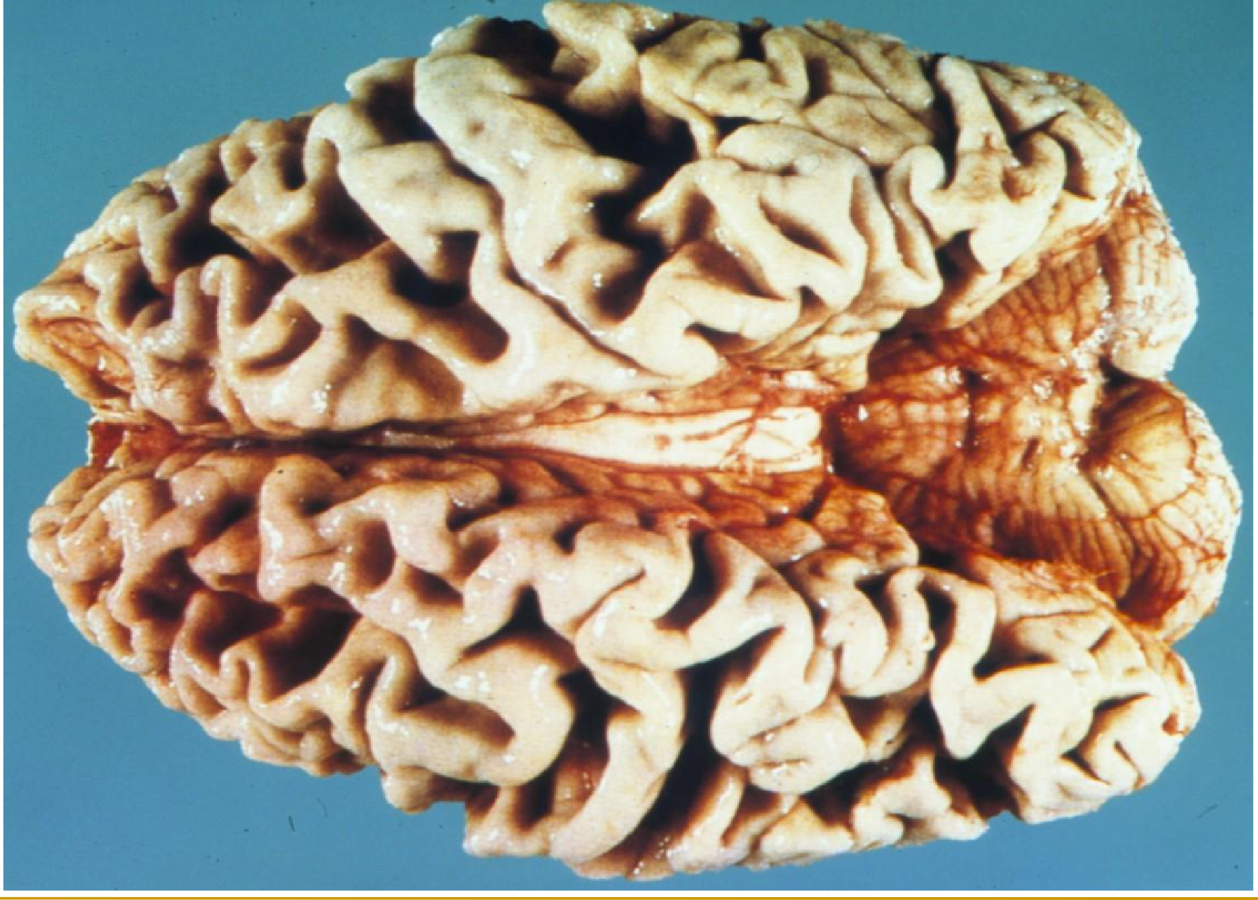
Alzheimer disease – cortical atrophy

Slide 7
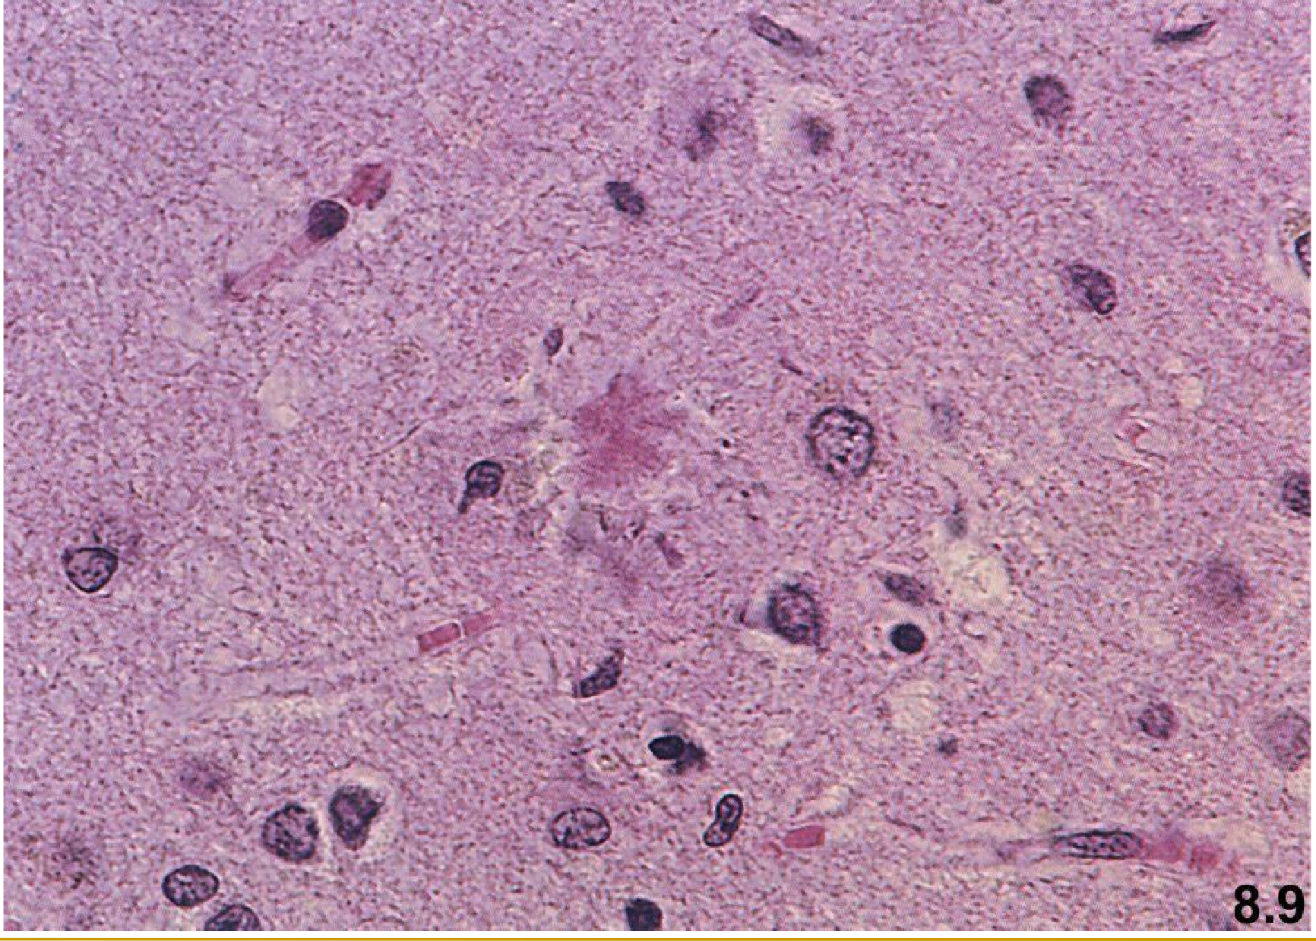
Alzheimer disease – senile plaques

Slide 8
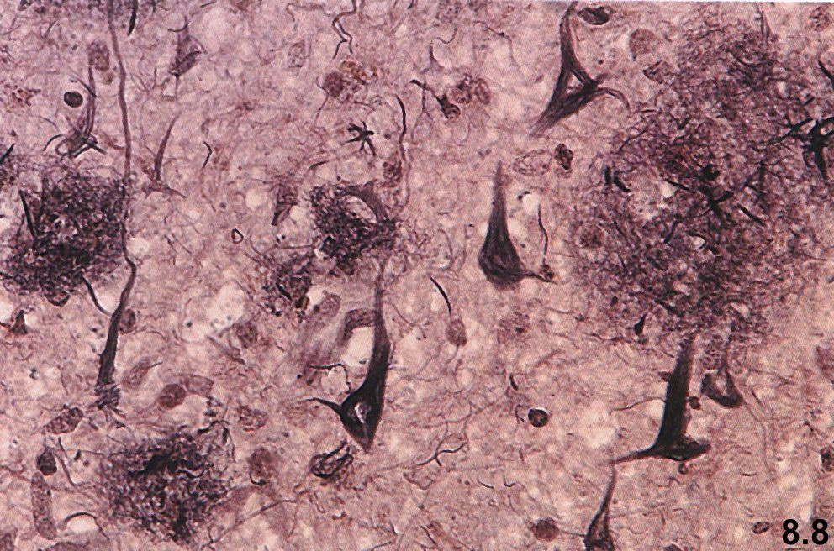
Alzheimer disease - senile plaques – silver stain

Slide 9
Pathology of the CNS
degenerative changes - Pick disease
FTLD associated with tau-protein accumulation
macroscopically
pronounced, frequently asymmetric atrophy of the frontal and temporal lobes with conspicious sparing of the posterior two thirds of the superior temporal gyrus
lobar atrophy, bilateral atrophy of the caudate nucleus and putamen
microscopic examination
neuronal loss is most severe in the outer three layers of the cortex, demyelinisation in the white matter, Pick bodies - round to oval weakly eosinophilic cytoplasmatic inclusions, Pick cells – swelling of surviving neurons (Hirano bodies and
granulovacuolar degeneration)

Slide 10
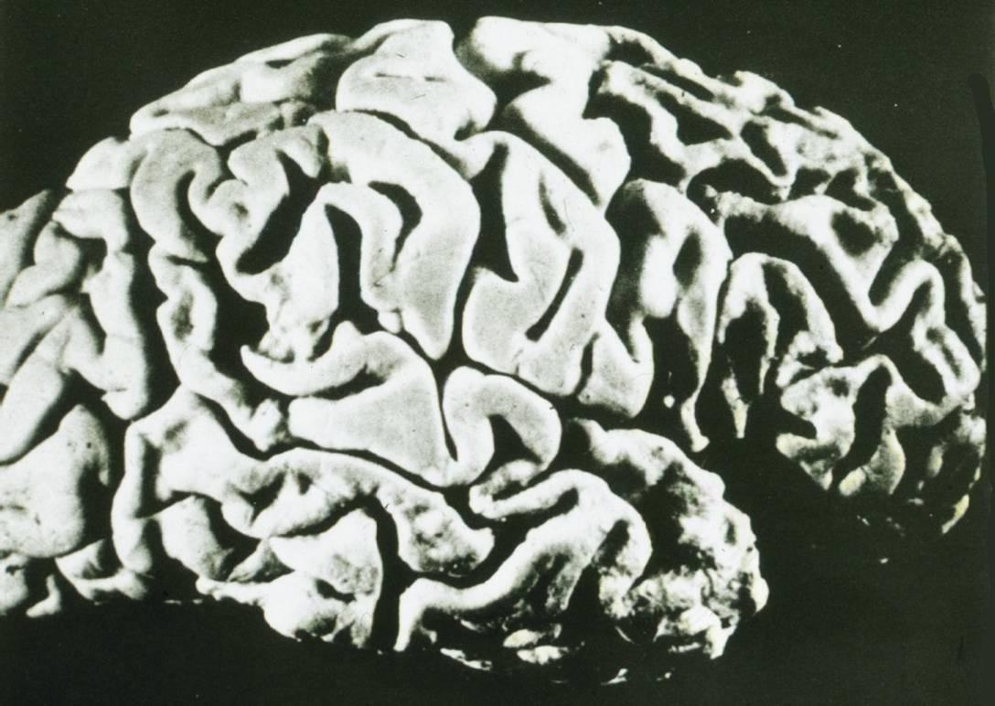
Pick disease – cortical atrophy, foremost of the frontal and temporal lobe

Slide 11
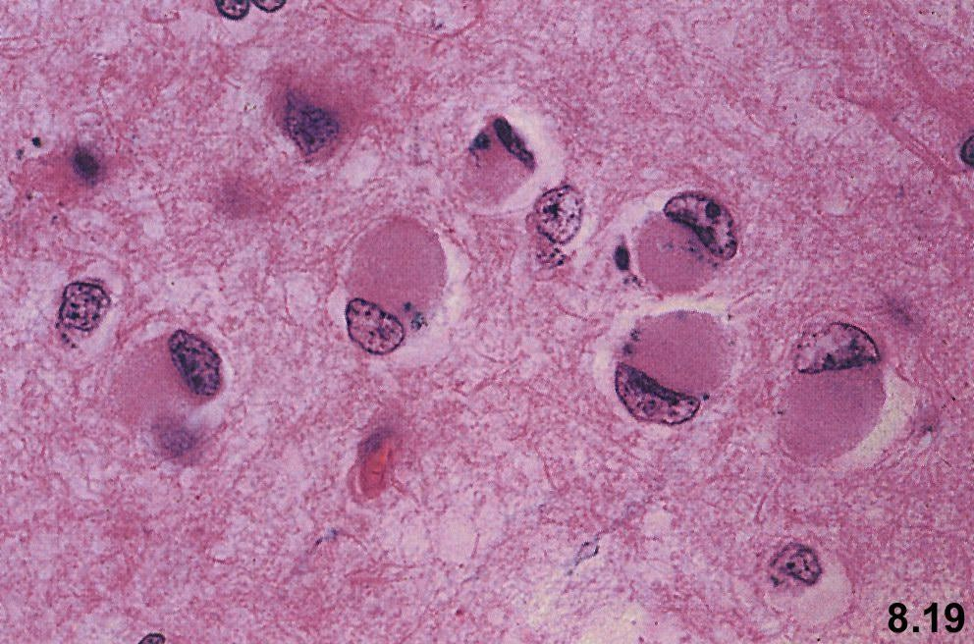
Pick disease – Pick cells

Slide 12
Pathology of the CNS
degenerative diseases – Huntington chorea
inheredited autosomal dominant disease
Trinucleotide repetitions CAG
progressive movement disorders and dementia
macroscopically
striking atrophy of the caudate nucleus and putamen, the weight of brain is decreased of about 30 %
microscopic examination
severe loss of striatal neurons, both the large and the small neurons are affected, but loss of the small neurons generally precedes, glial proliferation in the caudate nucleus and putamen.

Slide 13
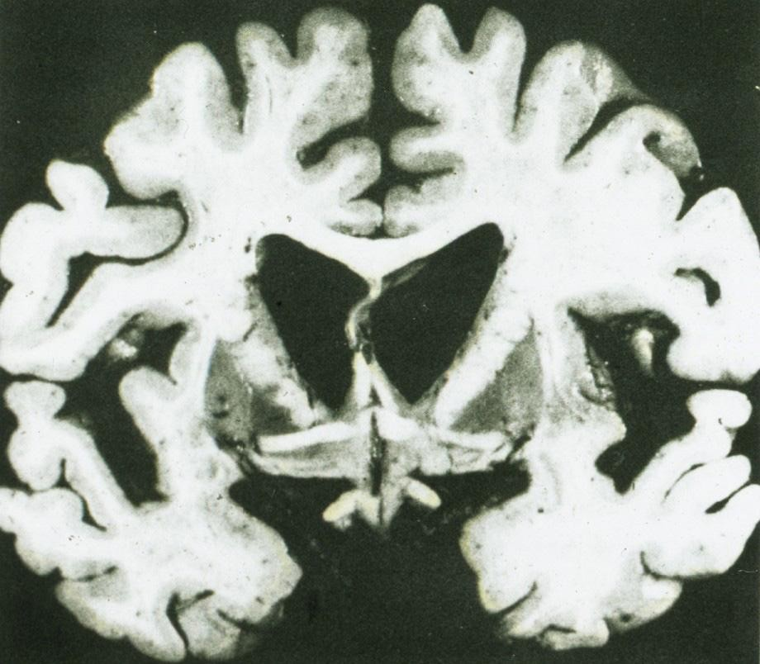
Huntington chorea – atrophy of the caudate nucleus

Slide 14
Pathology of the CNS
degenerative diseases – Parkinson disease
Alfa synuclein protein (lewy bodies)
macroscopically
Loss of pigmentation in substantia nigra
Microscopic changes
Loss of pigmented neurons in the substantia nigra
Proliferation of astrocytes
Lewy bodies – intraneuronal eosinophilic inclusions

Slide 15
Pathology of the CNS
degenerative diseases – Parkinson disease
Clinical features (TRAP)
Tremor
Rigidity
Akinesia/bradykinesia
Postural instability and shuffling gait

Slide 16
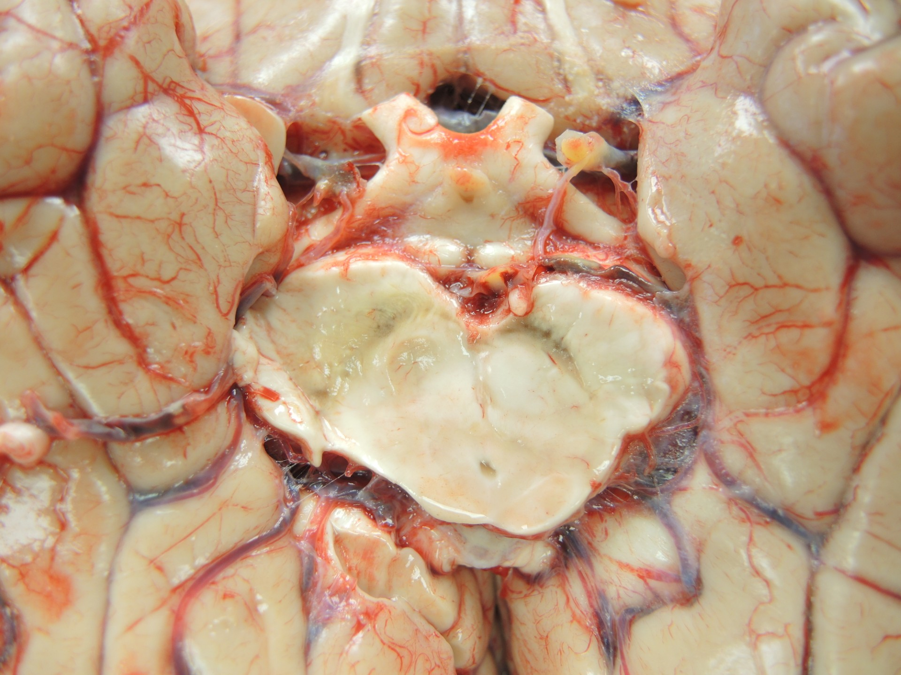
Parkinson disease – loss of pigmentation in substantia nigra

Slide 17
Parkinson disease – microscopically – Lewy bodies

Slide 18
Pathology of the CNS
degenerative disorders – Spongiform encephalopathy
Degenerative disease due to prion protein
Normal conformation PrP^{c} - alpha helix
Pathologic conformation PrP^{sc} – beta pleated sheet
Conversion: sporadic, inherited, transmitted
Intracellular vacuoles, brain atrophy

Slide 19
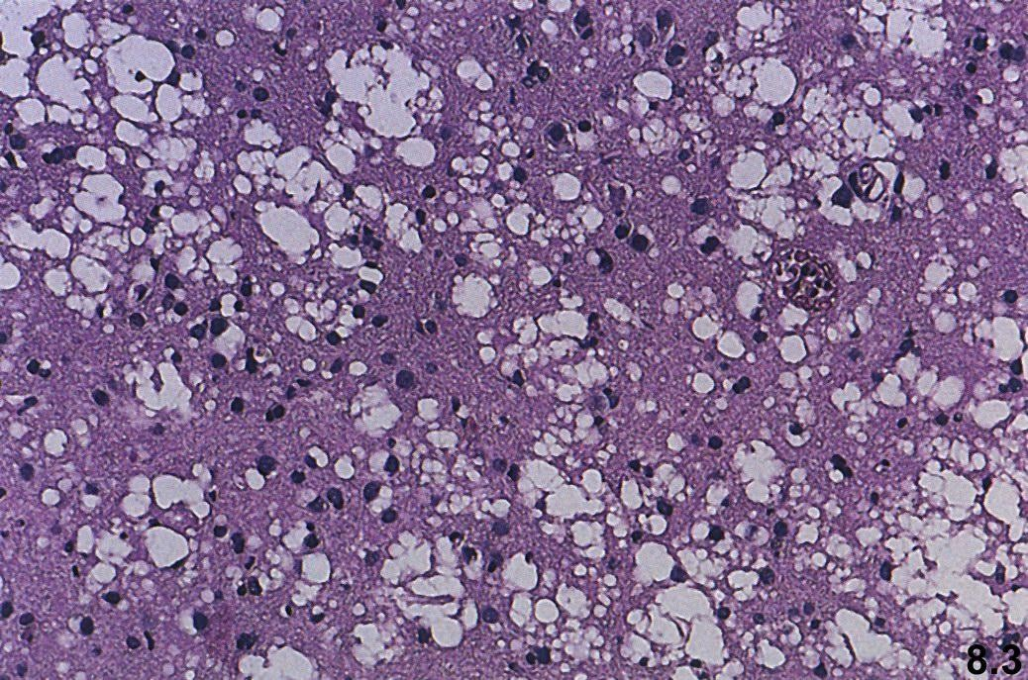
Spongiform encephalopathy – vacuolar degeneration of the neurons

Slide 20
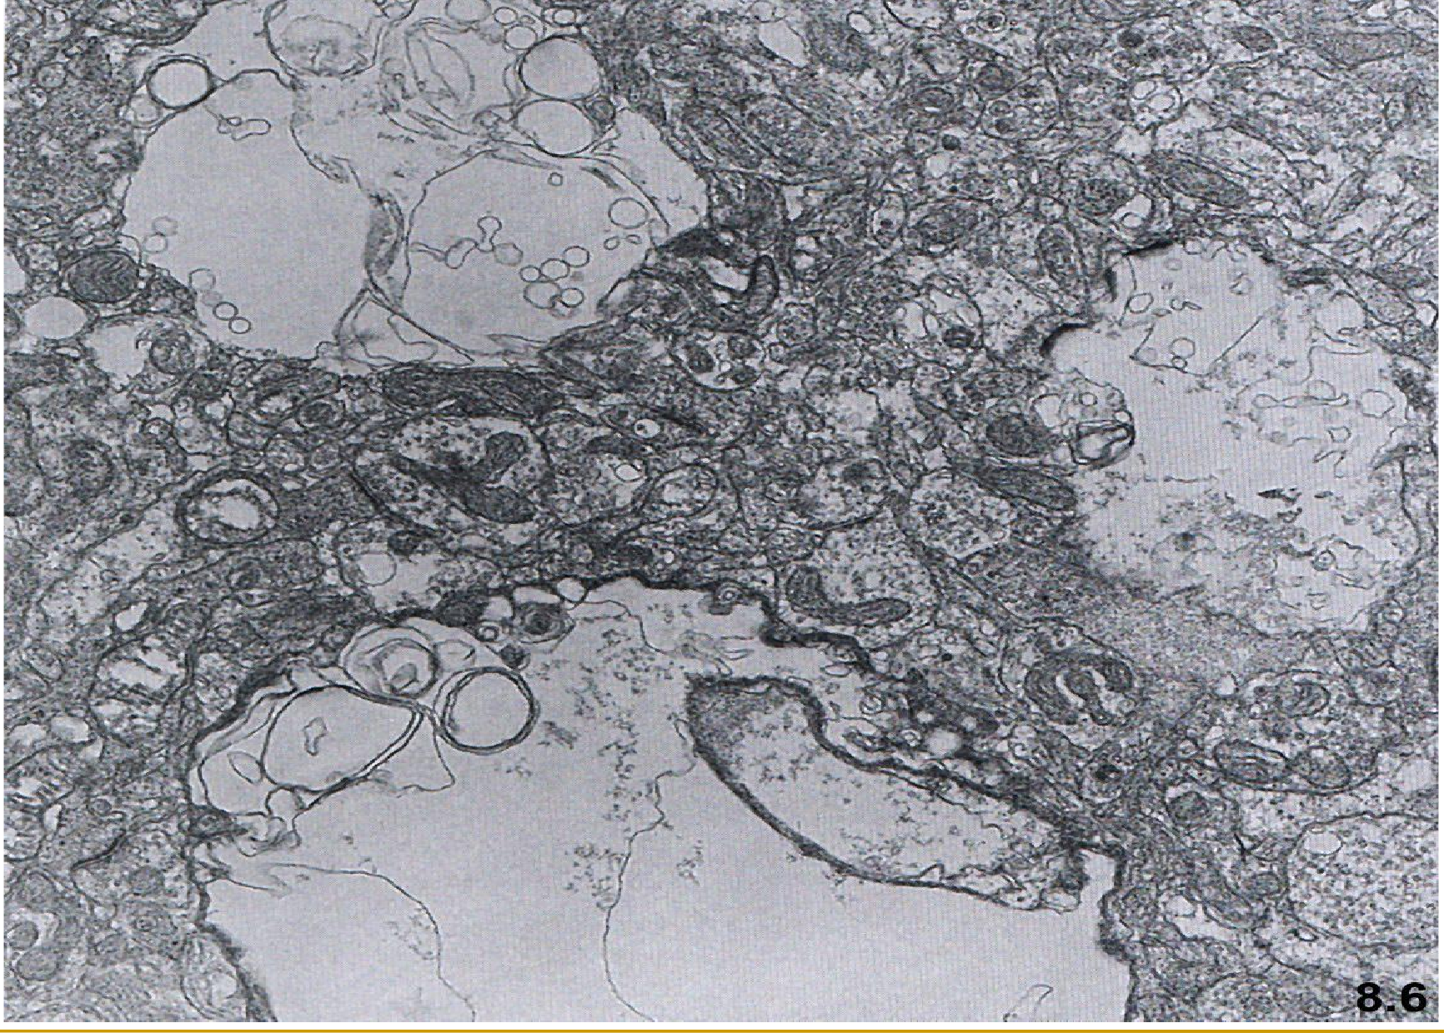
Spongiform encephalopathy – vacuolar degeneration of the neurons – EM

Slide 21
Pathology of the CNS
demyelinating disorders
Heterogenous group of diseases
Young adults
Slow, progressive
Destruction of myelin or oligodendrocytes
Axons are generally preserved

Slide 22
Pathology of the CNS
demyelinating disorders
Multiple sclerosis
PML
Acute disseminated encephalomyelitis
postinfectious encephalomyelitis
acute necrotizing hemorrhagic encephalomyelitis

Slide 23
Pathology of the CNS
demyelinating disorders – sclerosis multiplex
macro
Gray-appearing plaques in the white matter
micro
Active plaques (early) – reduction of myelin, perivascular inflammatory infiltration, phagocytosis (macrophages)
Inactive plaques – loss of oligodendroglia and myelin, astrocytosis

Slide 24
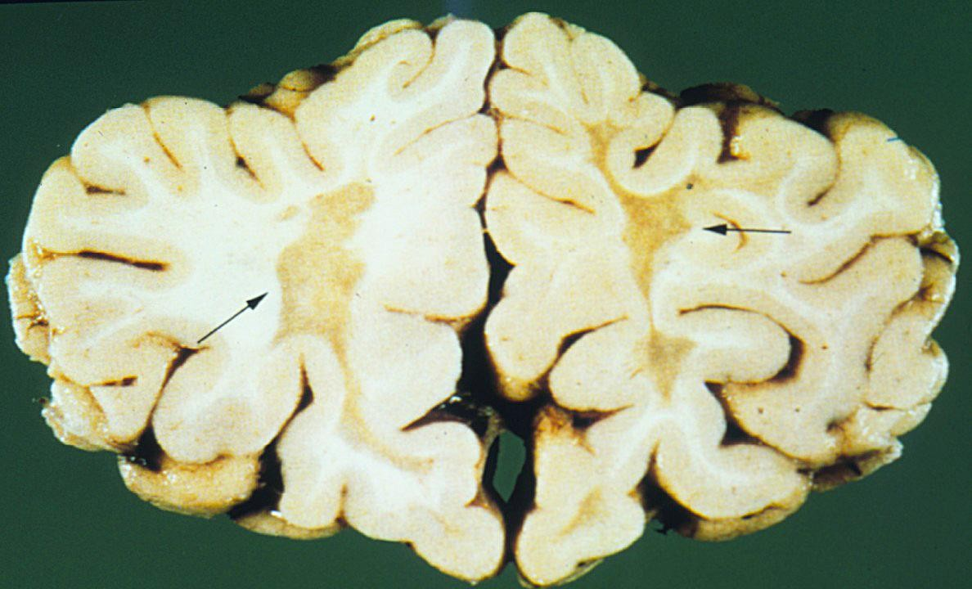
sclerosis multiplex – gray plaques

Slide 25
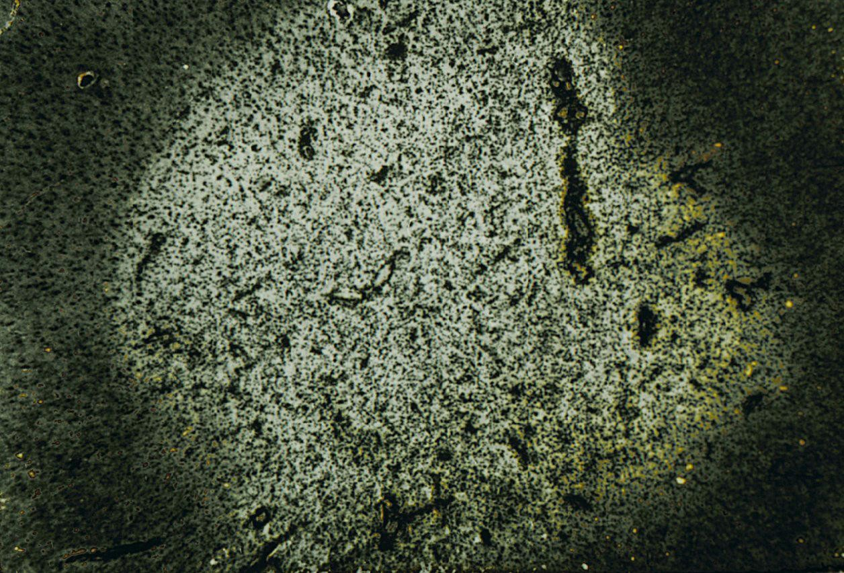
sclerosis multiplex – myelin stain – demyelinization (light focus)

Slide 26
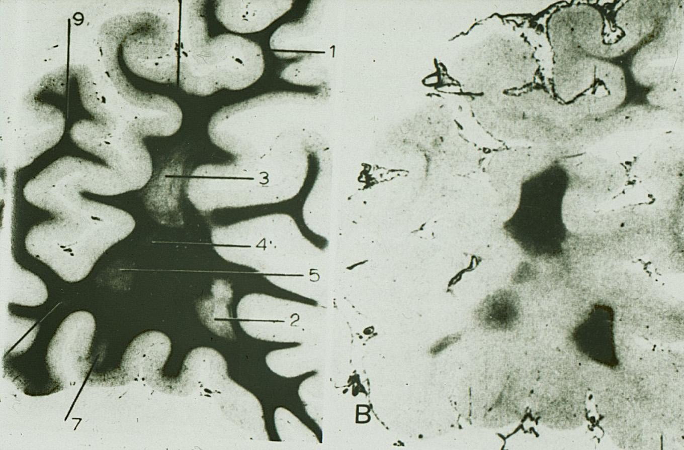
sclerosis multiplex – histotopogram – myelin stain

Slide 27
Pathology of the CNS
demyelinating disorders – acute disseminated encephalomyelitis
Autoimmune reaction to the white matter damaged by viruses or toxins
Brain edema
Perivenous pink-gray foci in the white matter
Micro
Demyelinization
Lymphocytes and plasma cells infiltration
Macrophages, erythrocytes

Slide 28
Pathology of the CNS
demyelinating disorders – acute disseminated encephalomyelitis
Postinfectious encephalomyelitis
Complication of measles, variolla, rubella, flu, pertussis, scarlatina,
parotitis
Usually 3-21 days after the onset
Or simultaneously (parainfectious encephalitis)
Postvaccinal encephalomyelitis
Rare complication
Rabies, variolla, typhus, paratyphus
3-20 days after vaccination
2O% lethality
Acute necrotizing hemorrhagic encephalomyelitis
Hyperacute anaphylactoid reaction
Multiple pericapillary hemorrhage, necrosis, perivascular demyelination

Slide 29
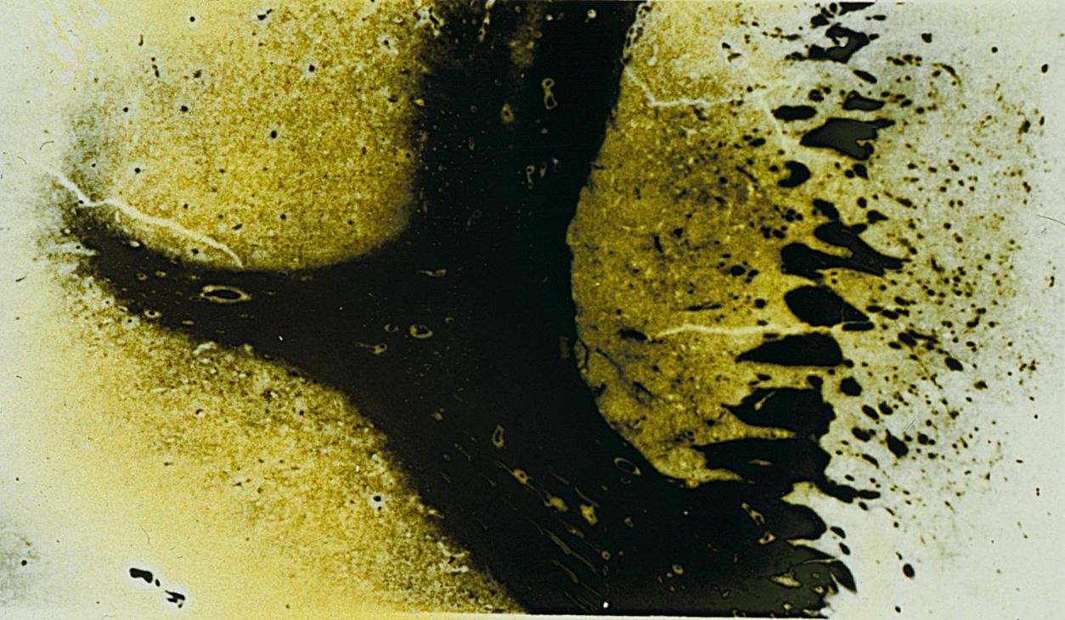
Acute disseminated encephalomyelitis – perivenous demyelination

Slide 30
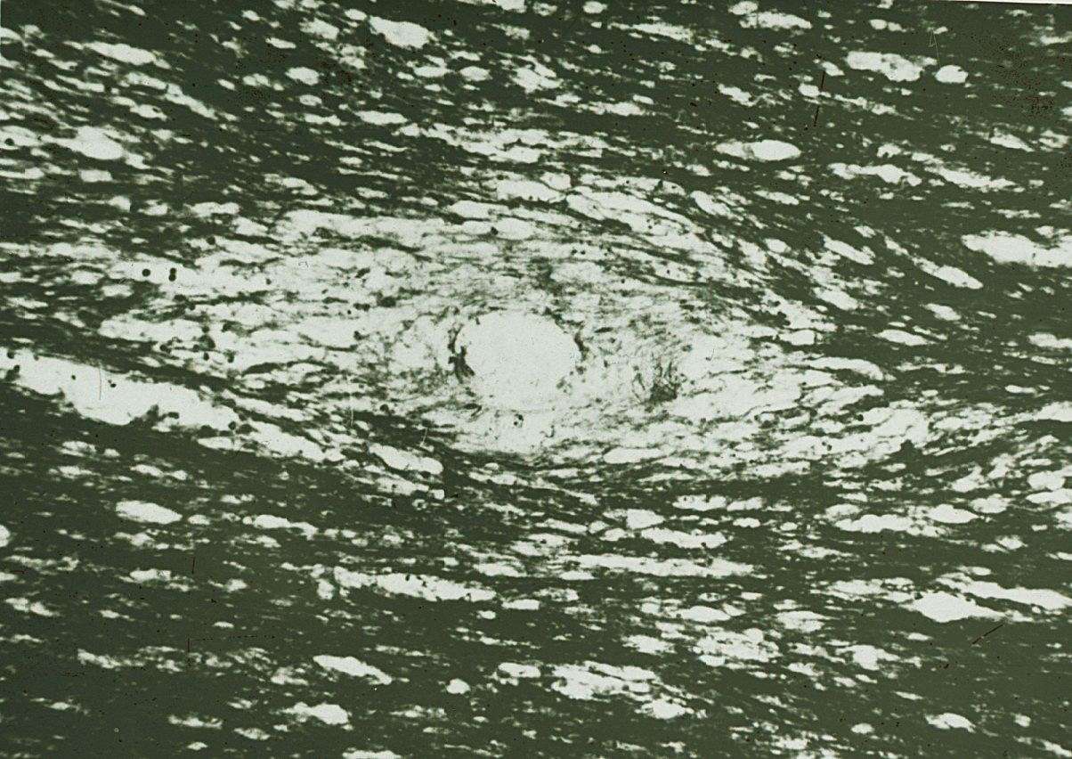
Acute disseminated encephalomyelitis – perivenous demyelination

Slide 31
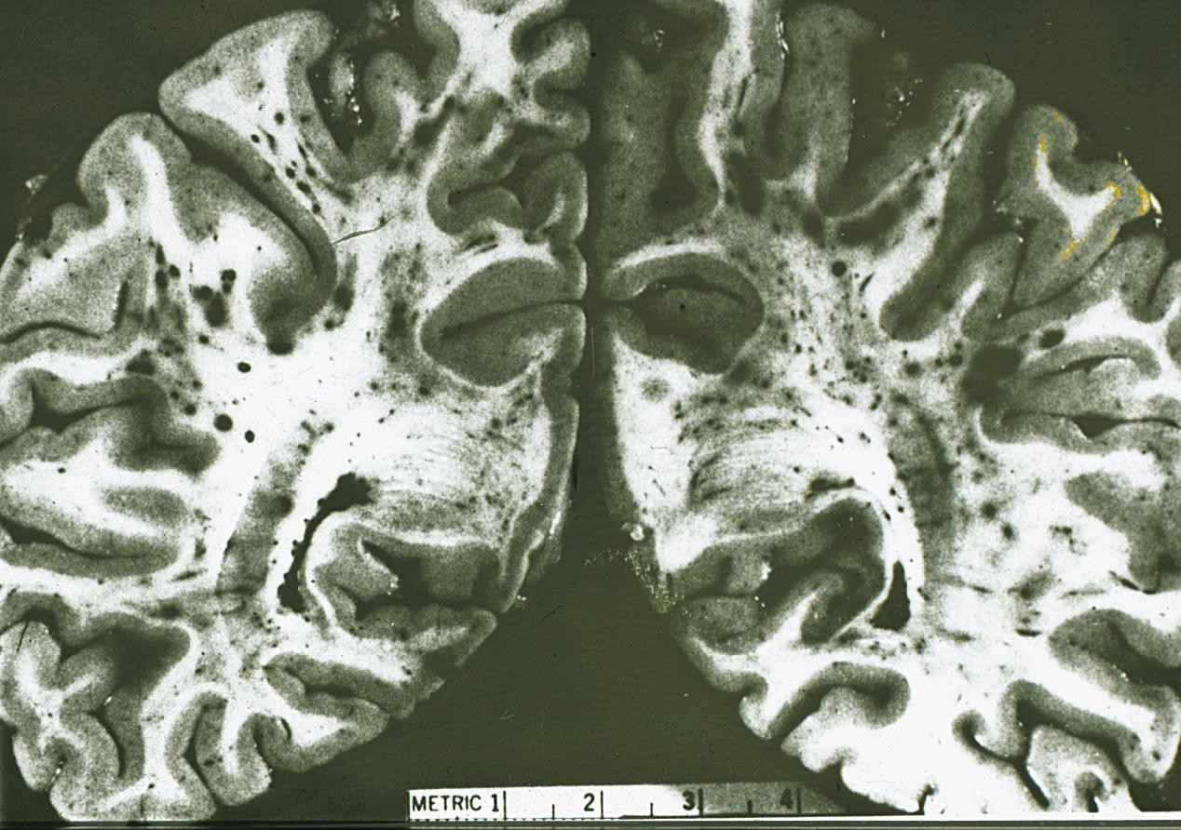
Acute disseminated encephalomyelitis – perivenous demyelination,
hemorrhage

Slide 32
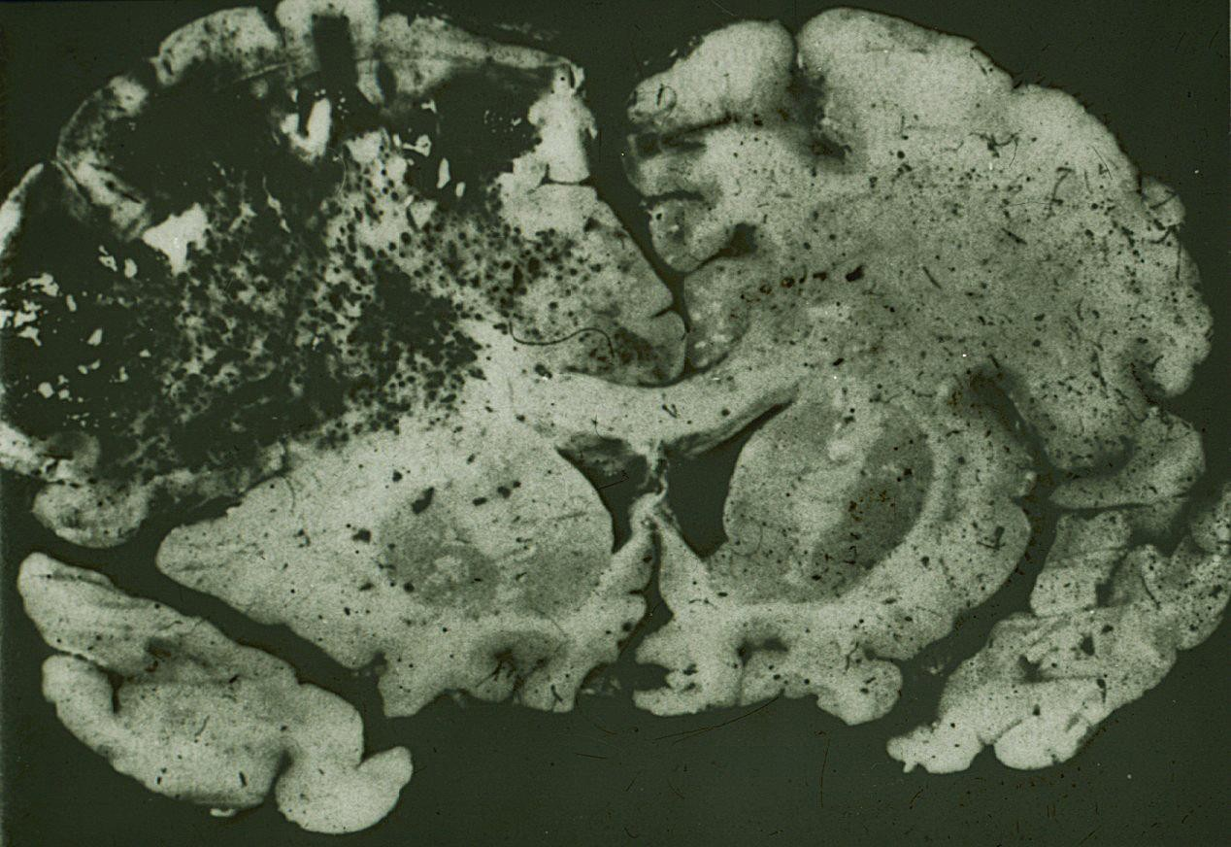
Parainfectious flu encephalomyelitis – asymmetric hemorrhage

Slide 33
Pathology of the CNS
demyelinating disorders – progressive multifocal leukoencephalopathy
JC virus (John Cunningham, polyomavirus) infection of oligodendrocytes (white matter)
Immunosuppresion (AIDS, leukemia, TBC)
Rapidly progressive neurologic signs (visual loss, weakness, dementia) leading to death

Slide 34
Pathology of the CNS
demyelinating disorders – progressive multifocal leukoencephalopathy
macro
Gray foci 3-5 mm in the white matter of the hemispheres and brain stem (similar to sclerosis multiplex)
micro
Regressive changes of oligodendrocytes with intranuclear inclusions
Perivascular demyelination
Astroglial proliferation

Slide 35
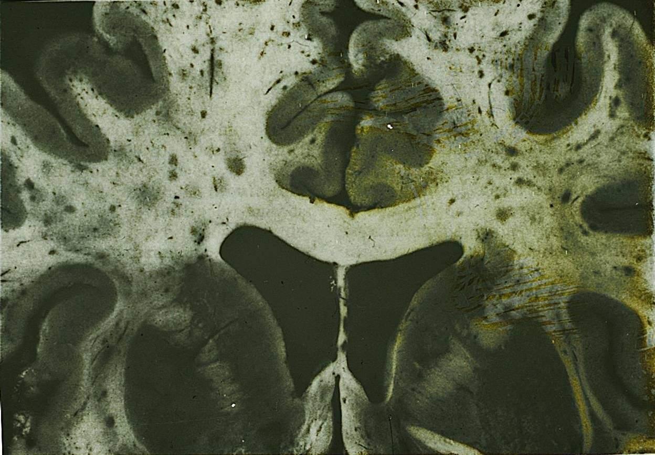
Progressive multifocal leukoencephalopathy - multiple foci of demyelination

Slide 36
Pathology of the CNS
brain tumors
Neuron derived tumors
Glial tumors
Tumors of the meninges
Other intracranial tumors
Metastatic tumors – 50 %

Slide 37
Pathology of the CNS
medulloblastoma
Malignant tumor derived from granular cells of cerebellum (nuroectoderm)
Usually arises in children
Small, rouind blue cells; Homer-Wright rosettes may be present
Poor prognosis
Tumor grows rapidly and spreads via CSF

Slide 38
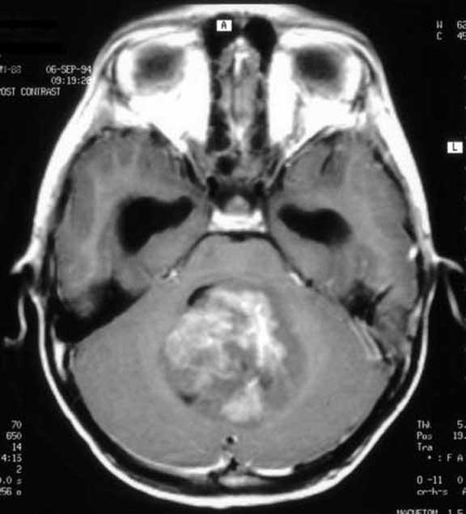
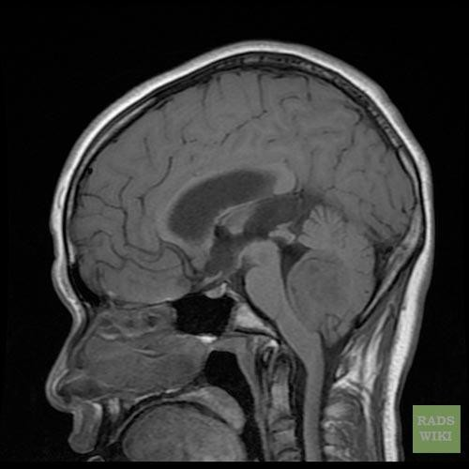
Medulloblastoma

Slide 39
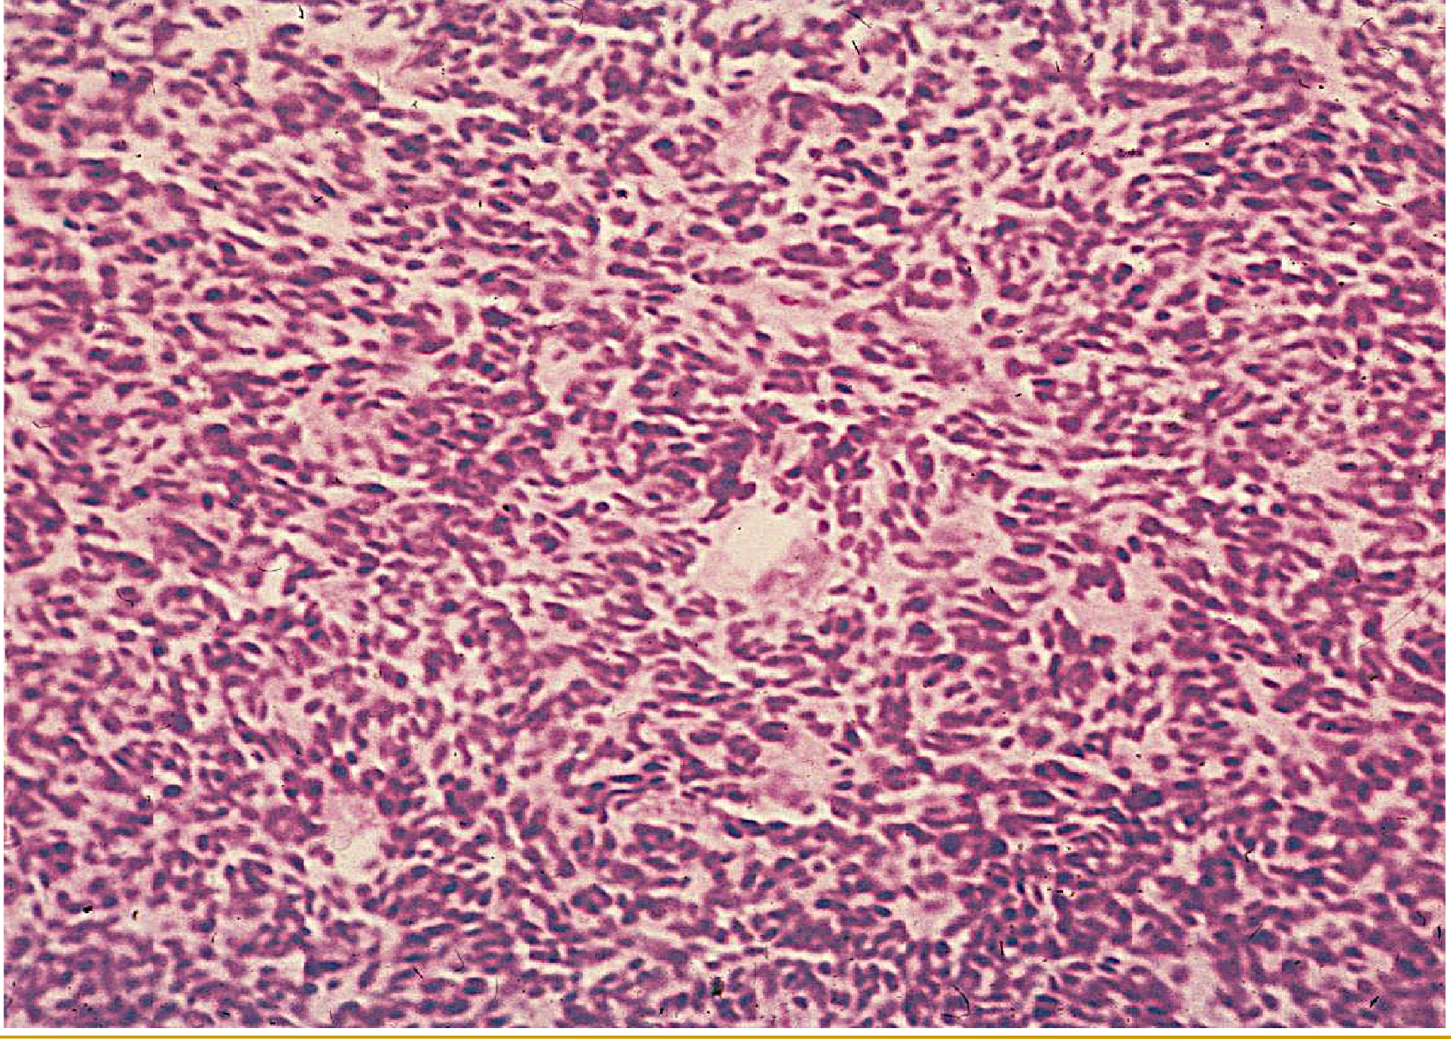
medulloblastoma – cerebellum, tumor made of small mitotically active cells

Slide 40
Pathology of the CNS
astrocytomas
Most common group of primary brain tumors
Pilocytic astrocytoma G1 - chlidren
Fibrillary astroctic neoplasms
Diffuse astrocytoma G2
Anaplastic astrocytoma G3
Glioblastoma multiforme G4

Slide 41
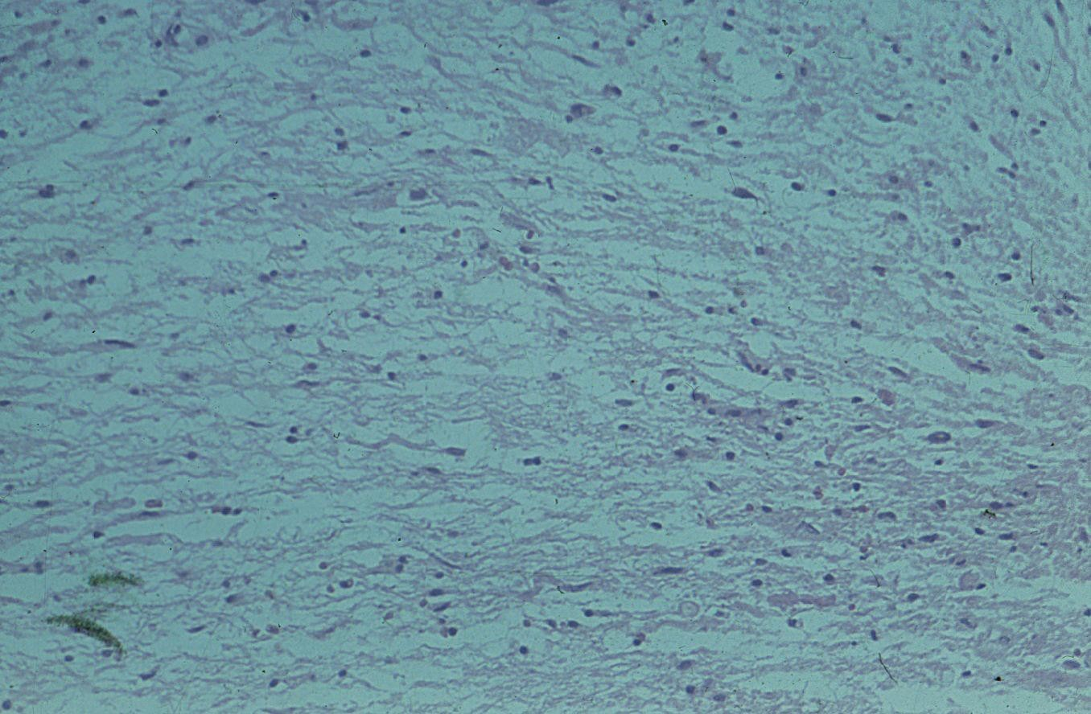
Pilocytic astrocytoma – spindle cells, hairlike processes

Slide 42
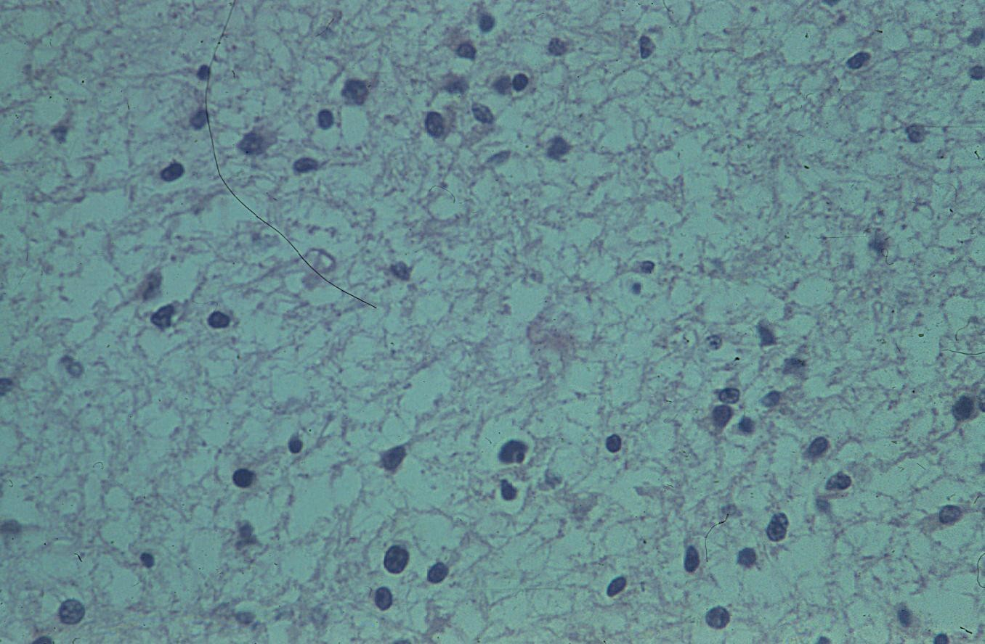
fibrillary astrocytoma

Slide 43
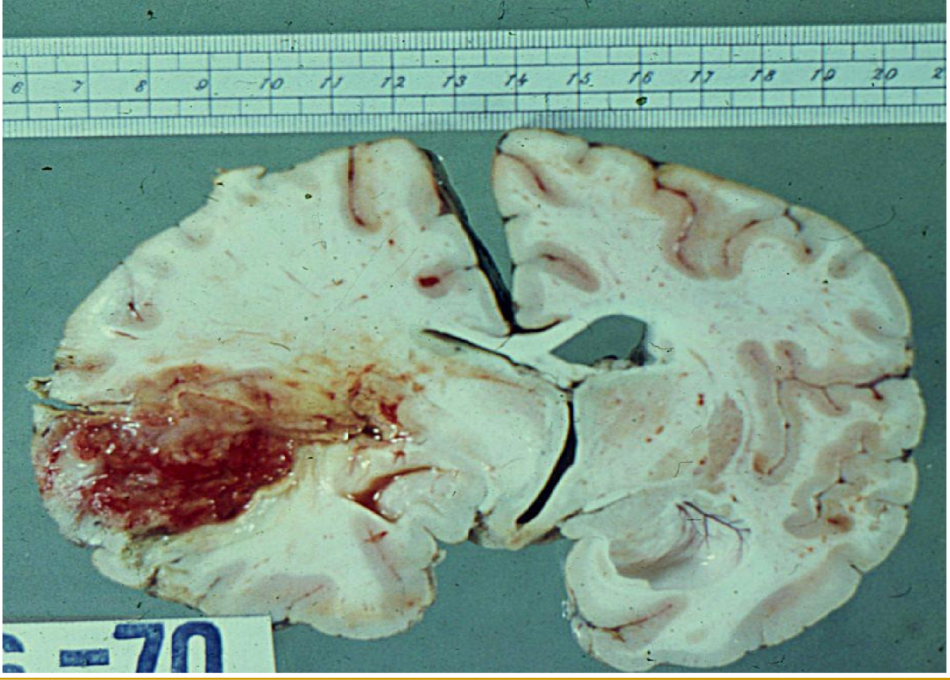
glioblastoma multiforme – gross view

Slide 44
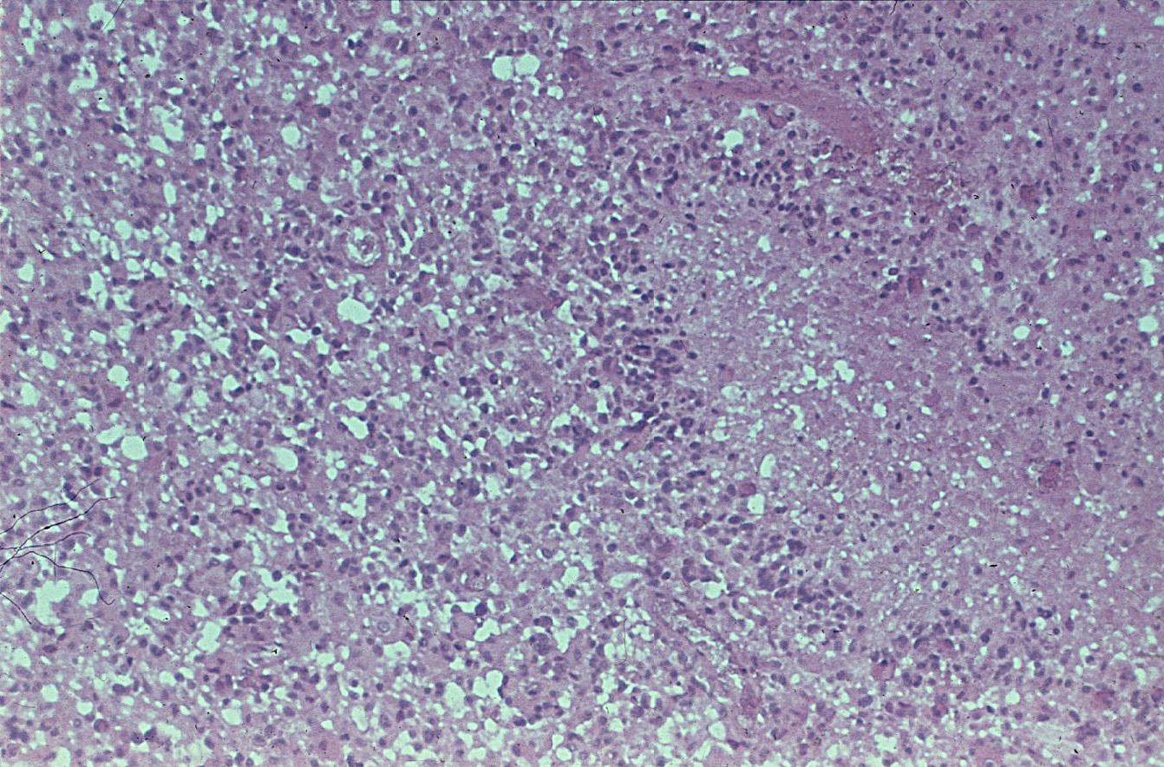
glioblastoma multiforme – microscopically – necrosis, pseudopalisading of the
nuclei

Slide 45
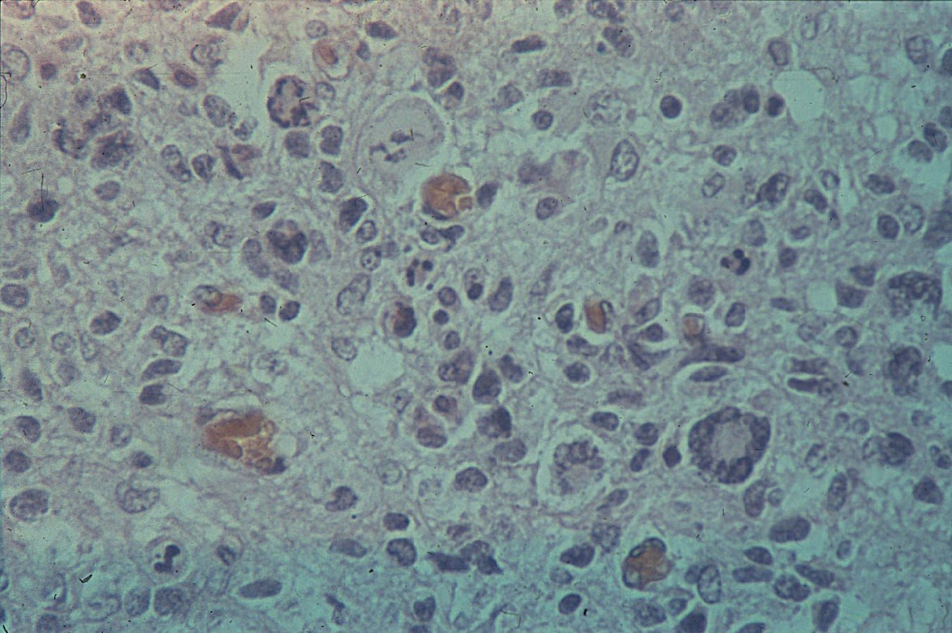
glioblastoma multiforme – microskopically – malignant astrocytes,
multinucleated cells, atypic mitosis

Slide 46
Pathology of the CNS
oligodendroglioma
Malignant tumor of oligodendrocytes
Calcified tumor in the white matter
Usually involves frontal lobe
May present with seizures
G2/G3(anaplastic)

Slide 47
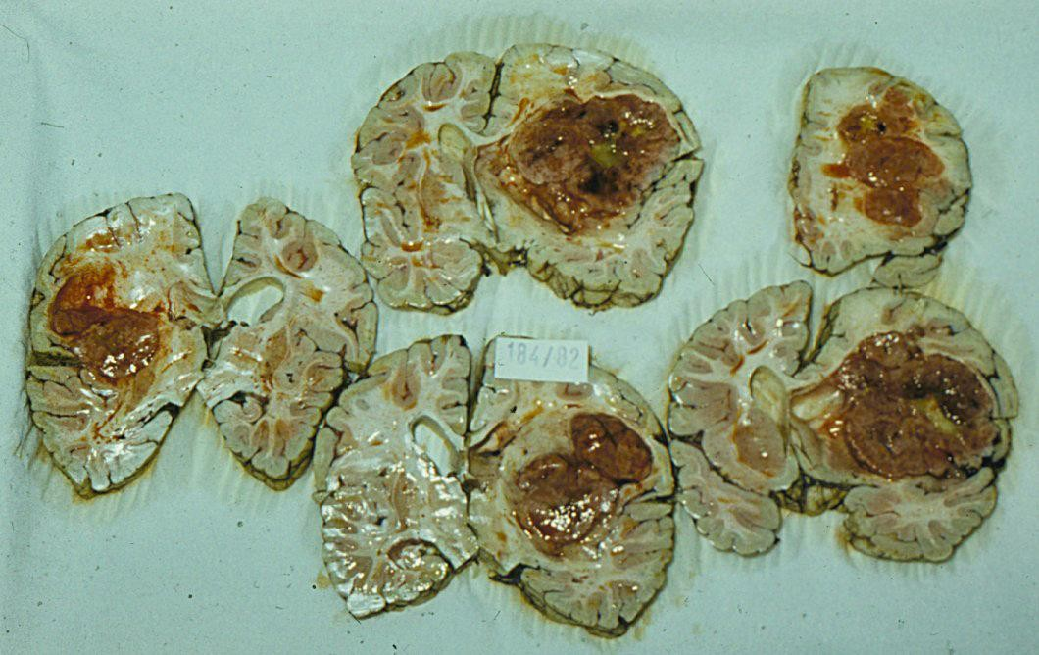
Oligodendroglioma - gross view

Slide 48
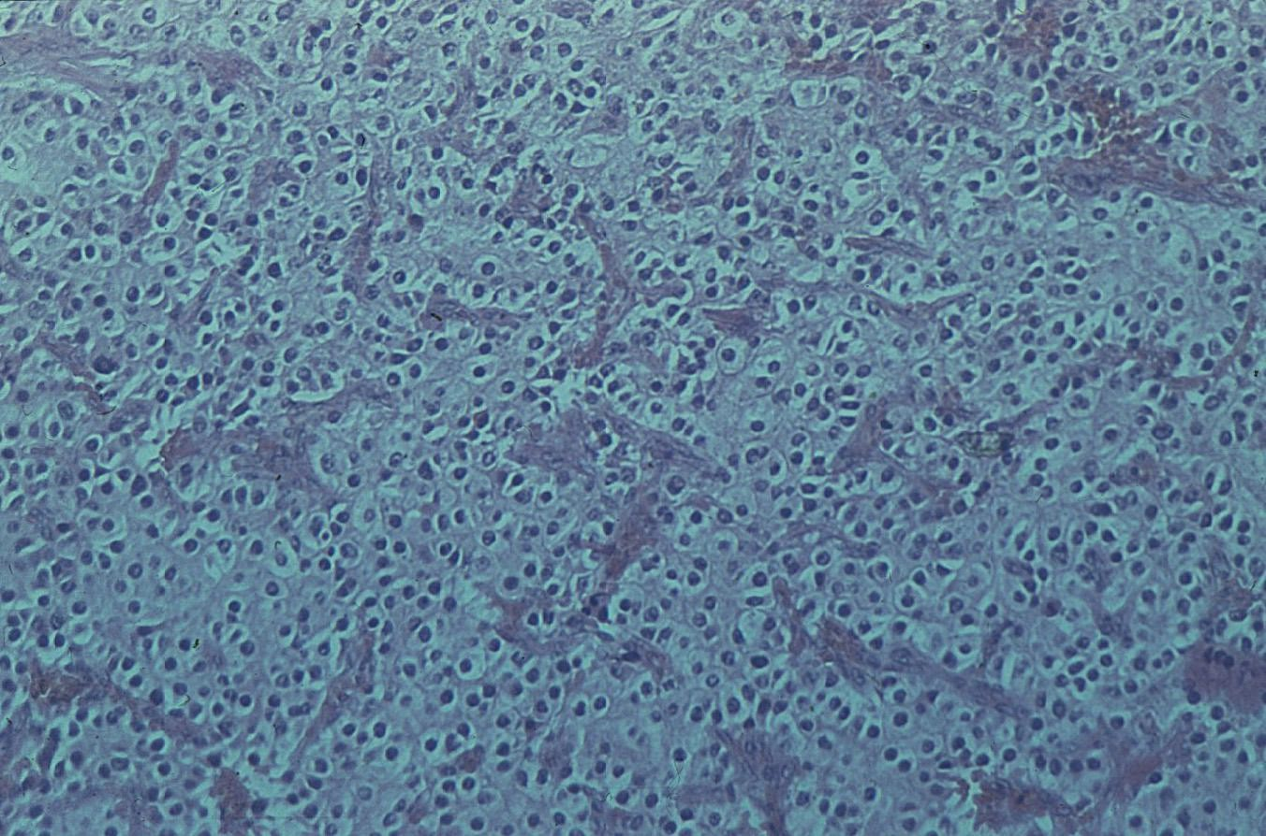
oligodendroglioma – histology – uniform clear cells, plentiful capillaries

Slide 49
Pathology of the CNS
ependymoma
Malignant tumor of ependymal cells
Usually seen in children
Most comonly arises in 4th ventricle
May present with hydrocefalus

Slide 50
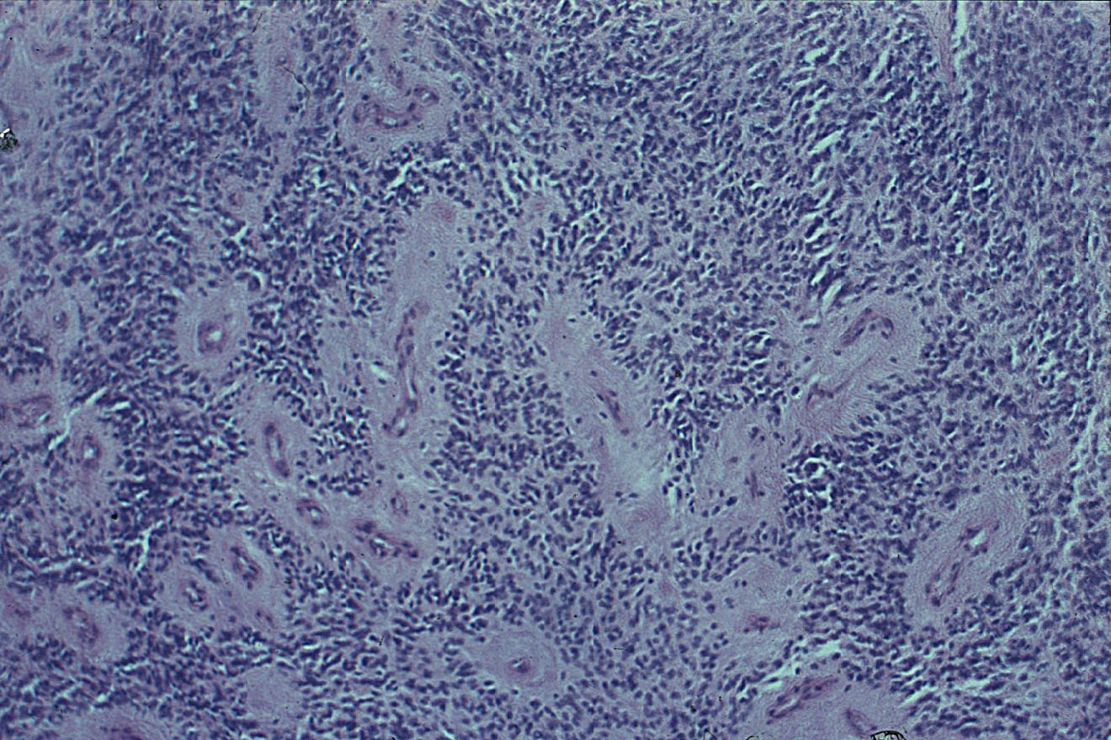
ependymoma – histology – pseudorosettes aound capillaries

Slide 51
Pathology of the CNS meningioma
Tumor of the meninges
G1-G3
Different morfological patterns, most common meningothelial and fibrous

Slide 52
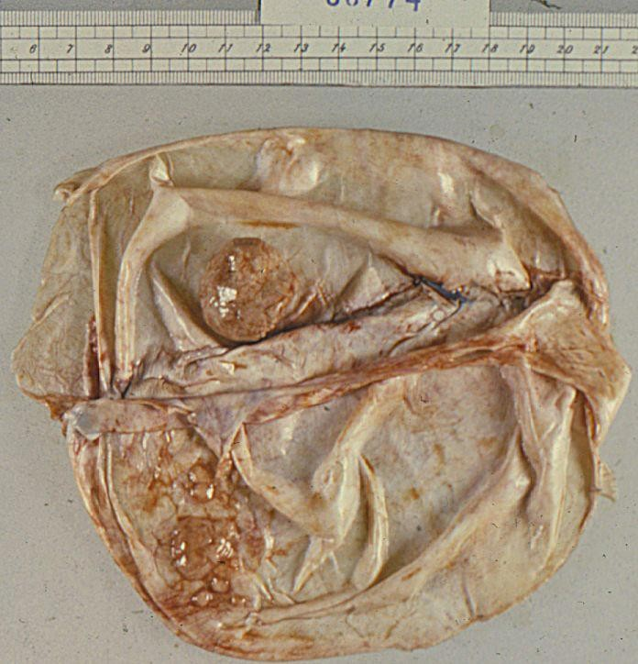
meningeoma – gross view

Slide 53
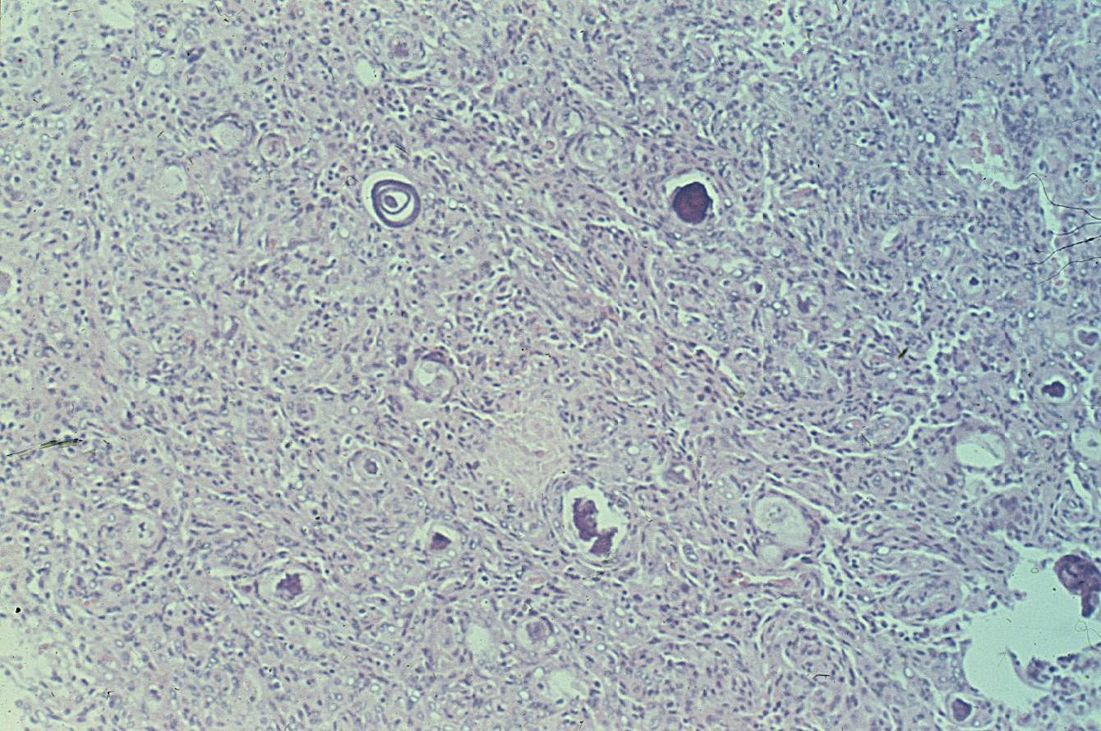
meningeoma – histology – whorled structures, calcifications

Slide 54
Pathology of the CNS
other intracranial tumors
Lymphoma
Germ cell neoplasms
Hemangioblastoma
Schwannoma of 8th cranial nerve

Slide 55
Pathology of the CNS
infections of the nervous system
Meningitis – inflammation of the meninges
leptomeningitis, epidural abscess, subdural abscess
Encephalitis
General term for brain inflammation regardless cause
or morphology

Slide 56
Pathology of the CNS
meningitis
purulent meningitis
etiology – Neisseria meningitidis, E.coli, group B streptococci, Haemophilus influenzae
gross – congested pia mater, variable amount of creamy exudate in the subarachnoid space, edematous brain tissue
histology – leptomeninges are congested, contain neutrophils and fibrin

Slide 57
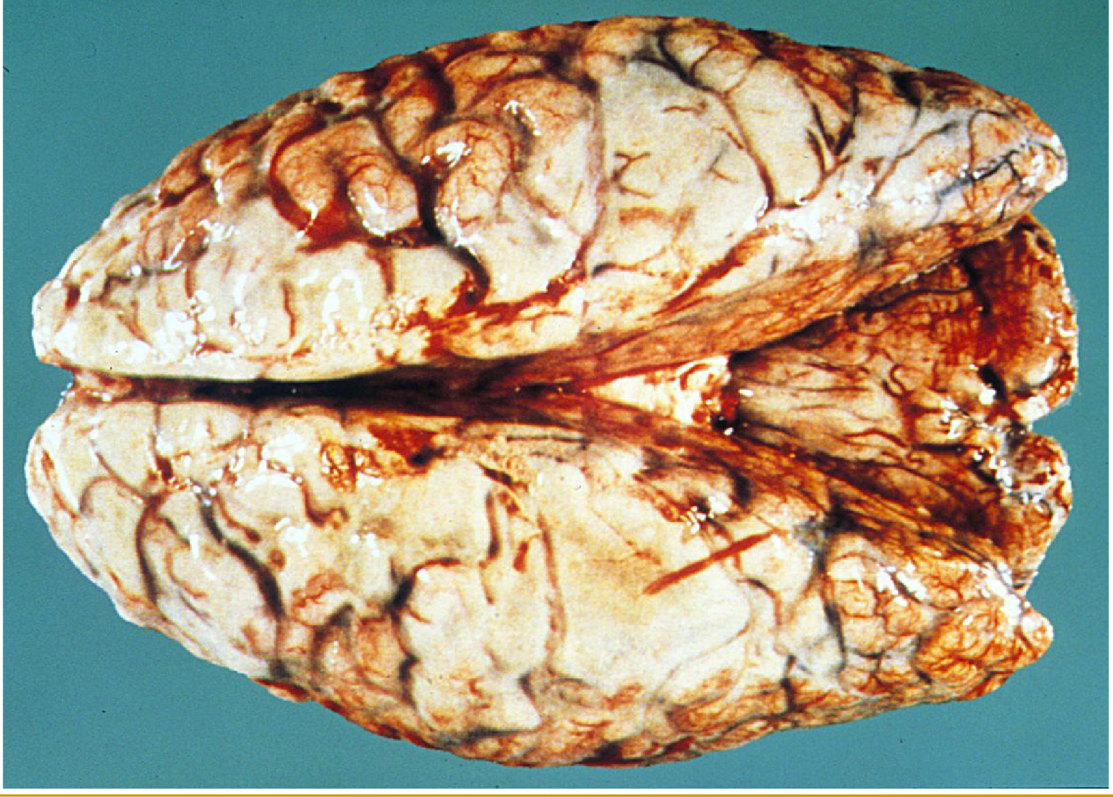
purulent meningitis – gross view

Slide 58
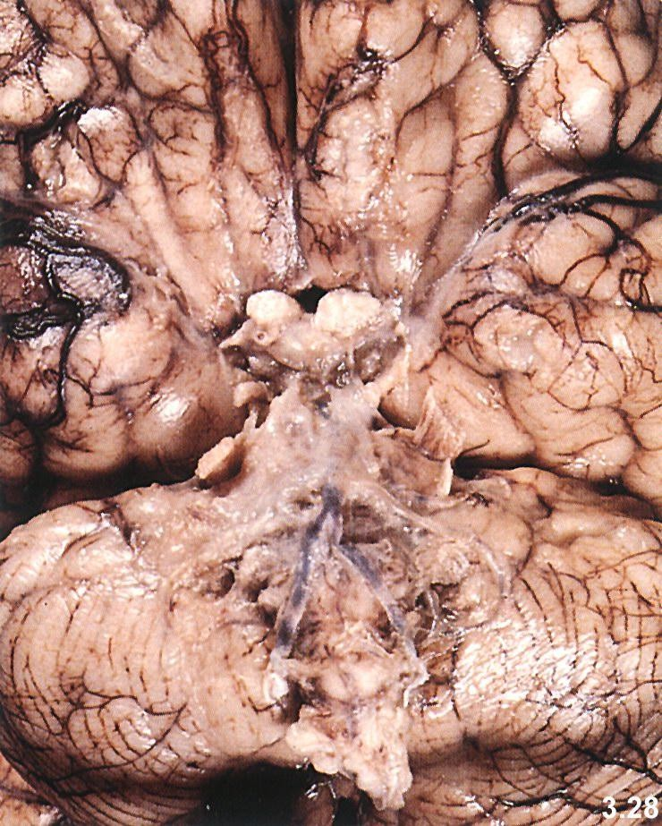
basilar meningitis – gross view

Slide 59
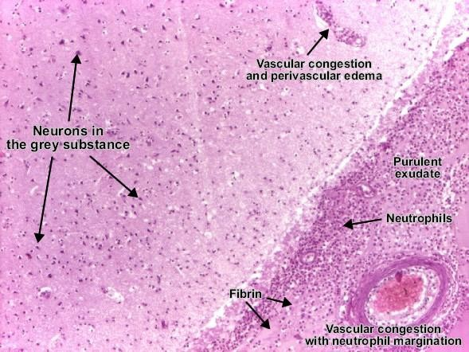
Purulent meningitis
Hnisavá meningitida

Slide 60
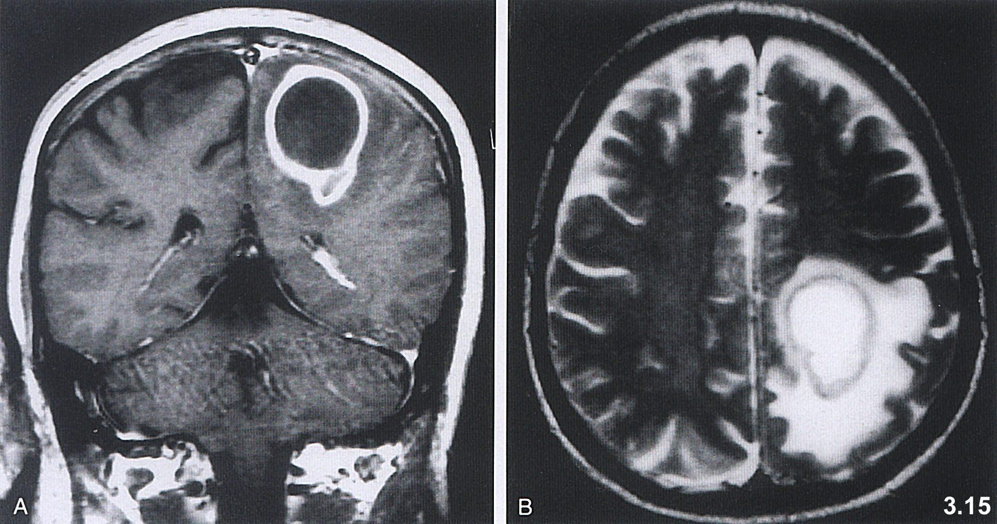
Brain abscess with perifocal edema

Slide 61
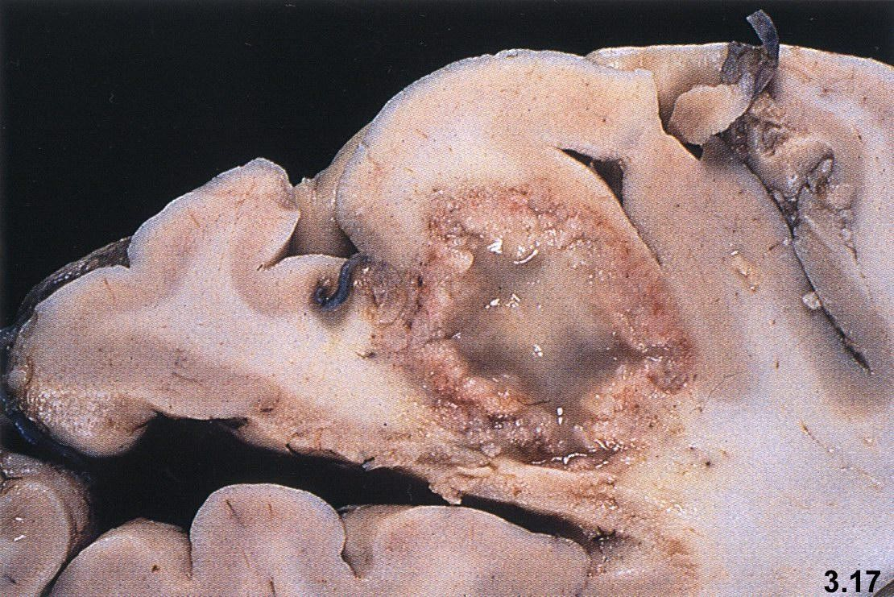
Brain abscess - gross view

Slide 62
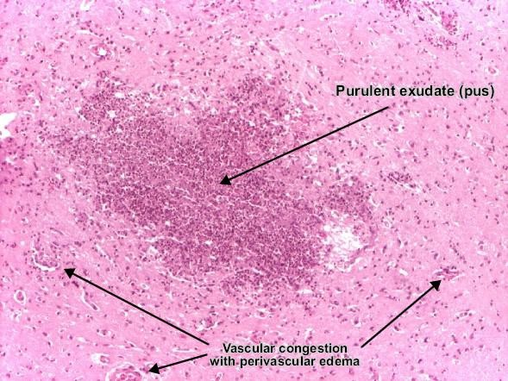
Brain abscess

Slide 63
Pathology of the CNS
encephalitis
Primary encephalitis
Caused by neurotropic viruses
secondary encephalitis
Complication of generalised infections

Slide 64
Pathology of the CNS
encephalitis
Inclusion body encephalitis
rabies, herpetic enceohalitis, poliomyelitis acuta anterior…
Encephalitis without inclusion bodies
Tick-borne encephalitis, HIV encephalitis, ...

Slide 65
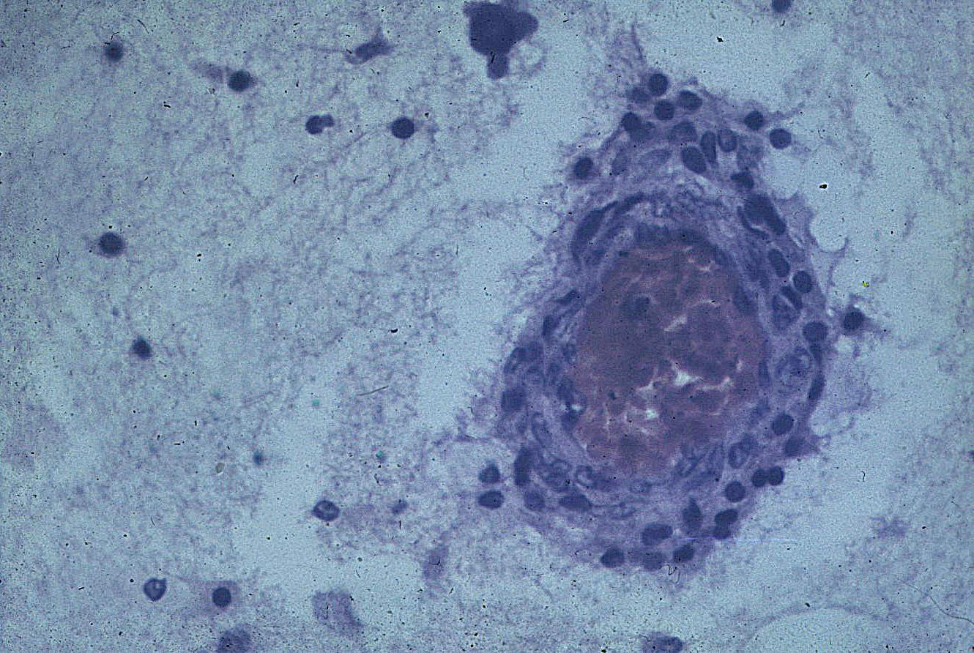
encephalitis – perivascular lymfocytic infiltrate

Slide 66
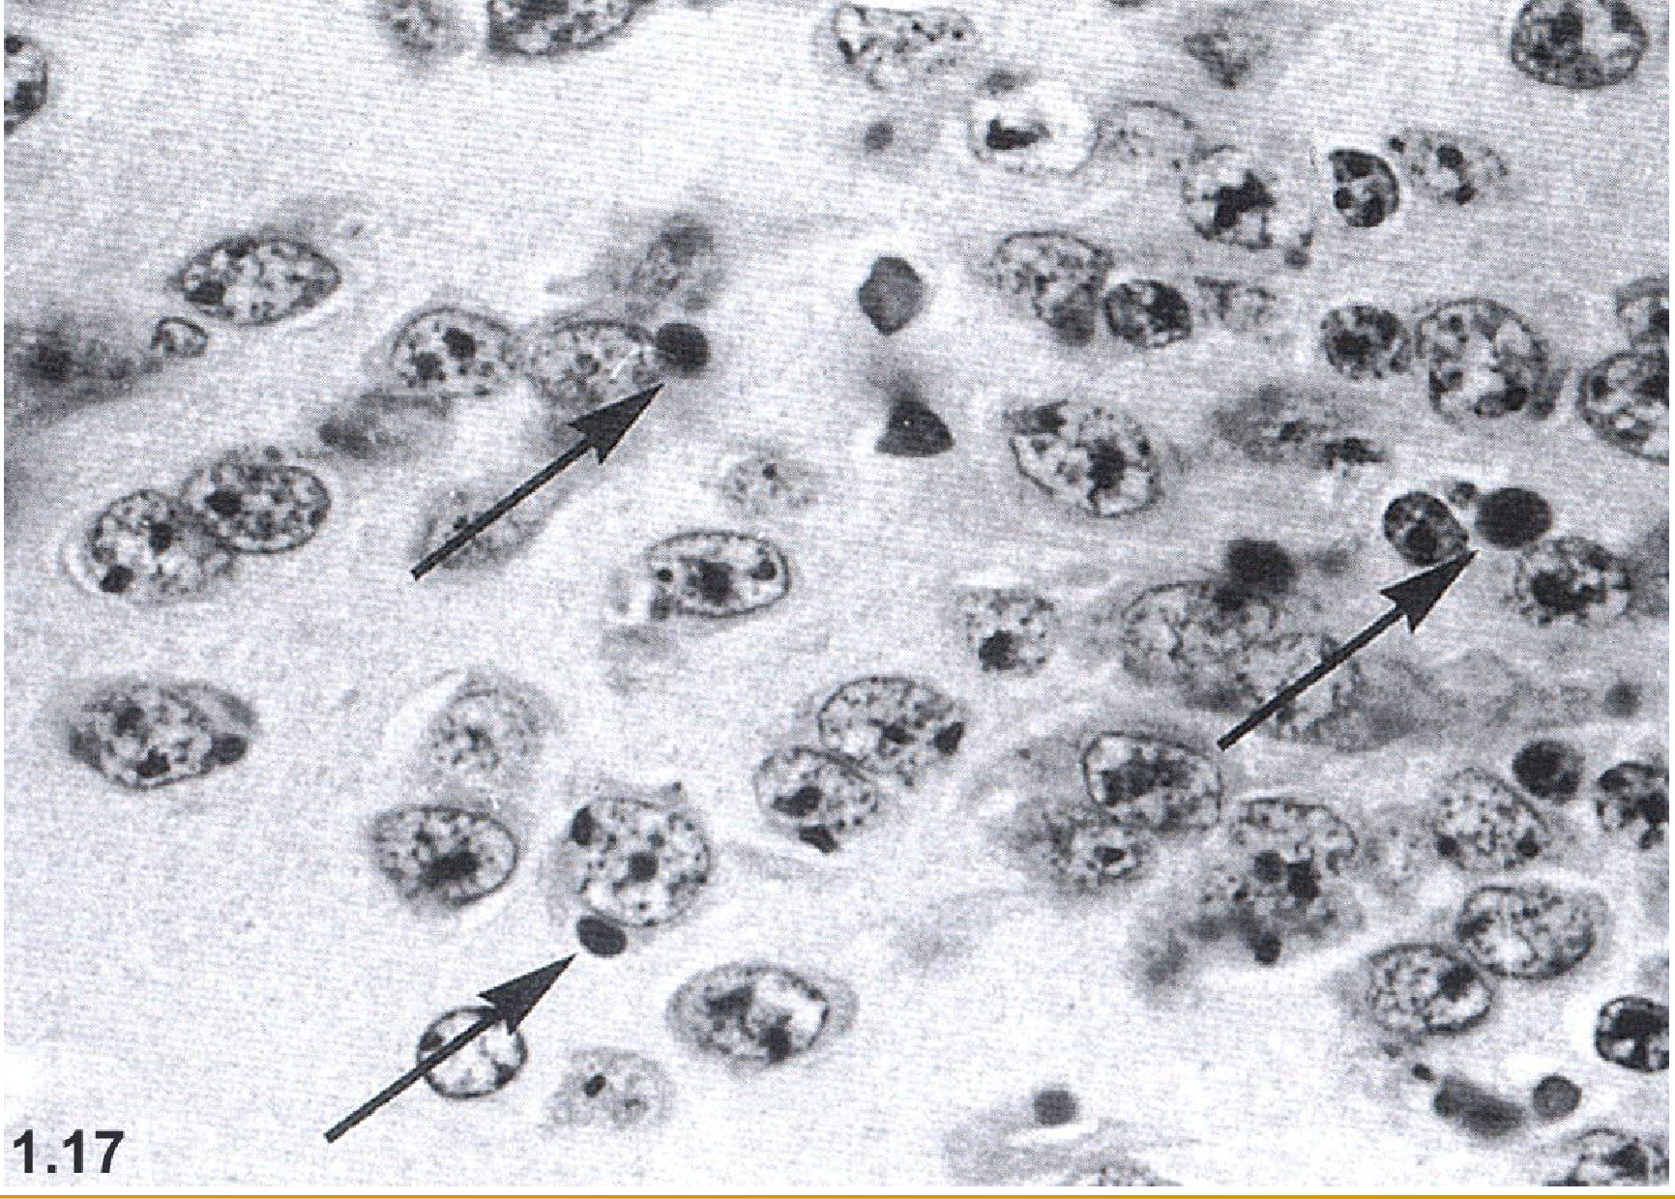
rabies – Negri bodies

Slide 67
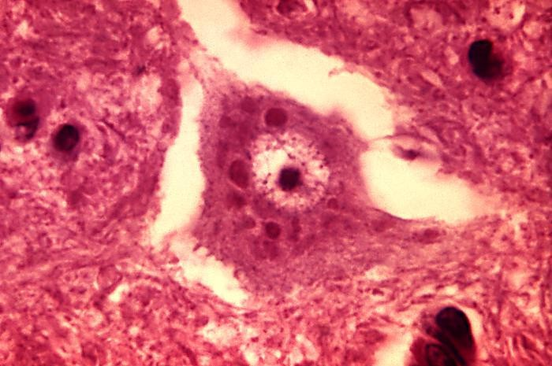
Rabies – Negriho bodies

Slide 68
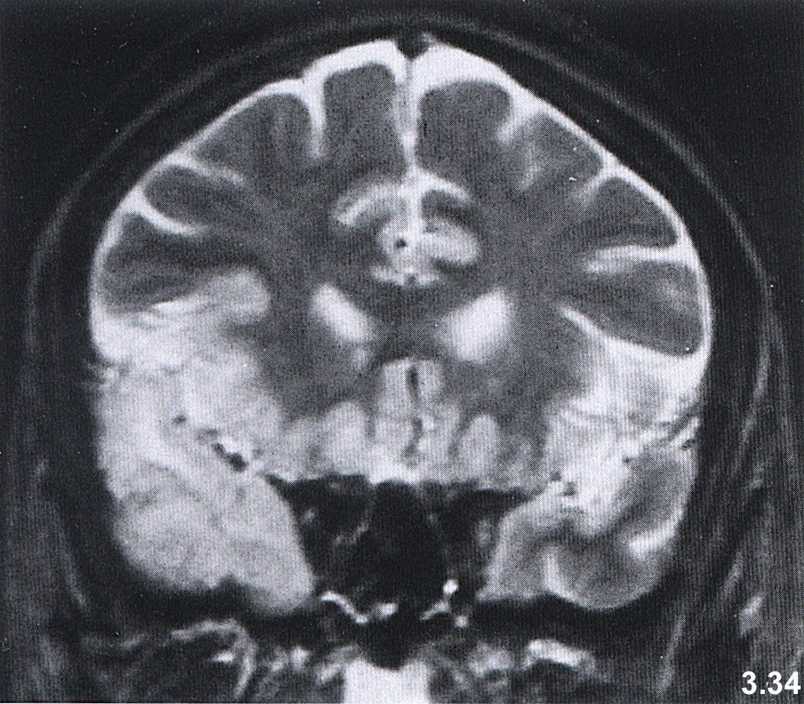
herpetic encephalitis – MRI

Slide 69
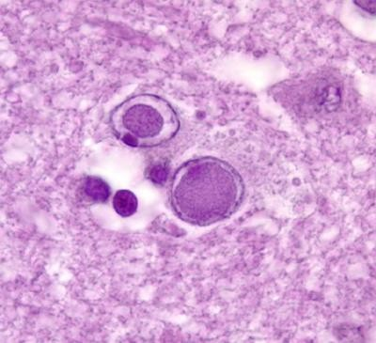
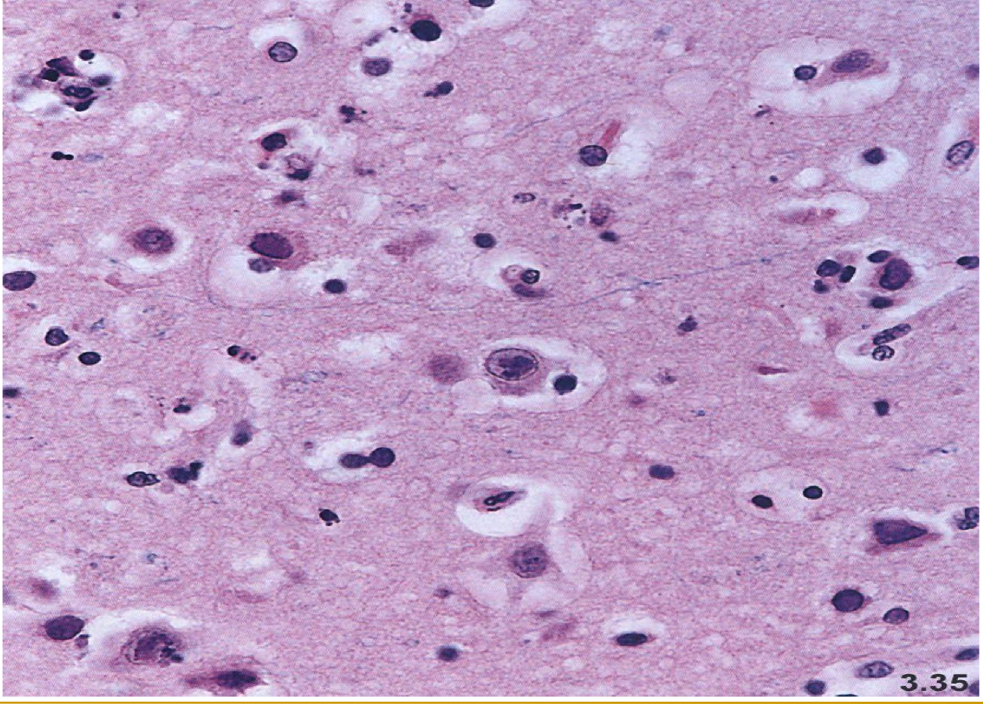
Herpetic encephalitis – intranuclear inclusions

Slide 70
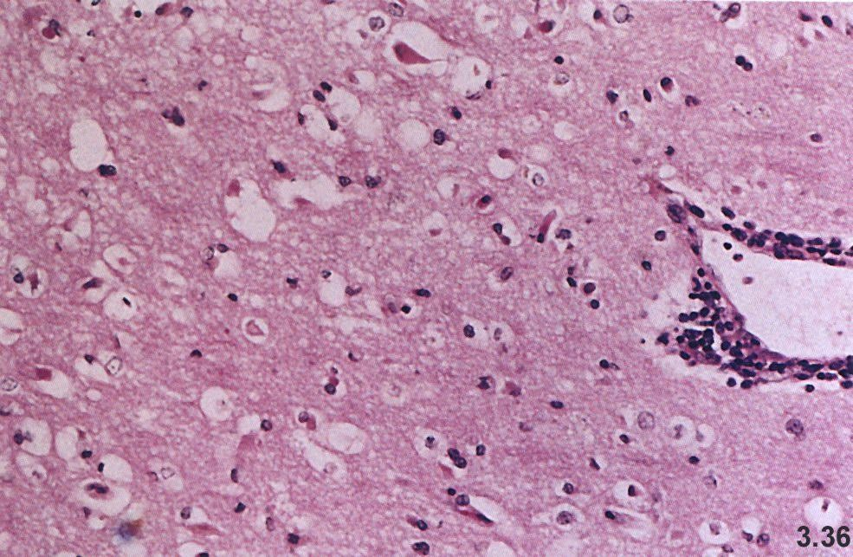
Herpetic encephalitis – necrotic neurons, edema, perivascular infiltrate

Slide 71
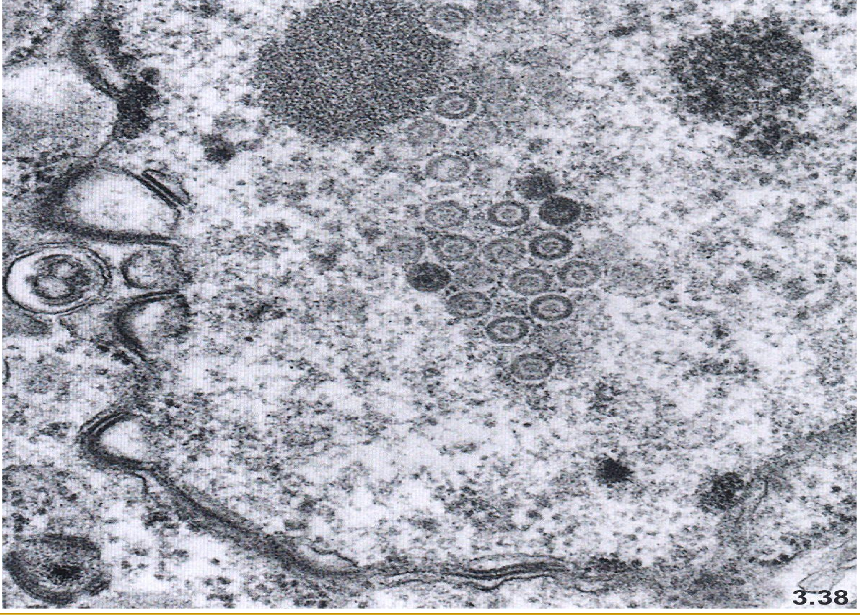
herpetic encephalitis – EM – intranuclear inclusion formed of virions

Slide 72
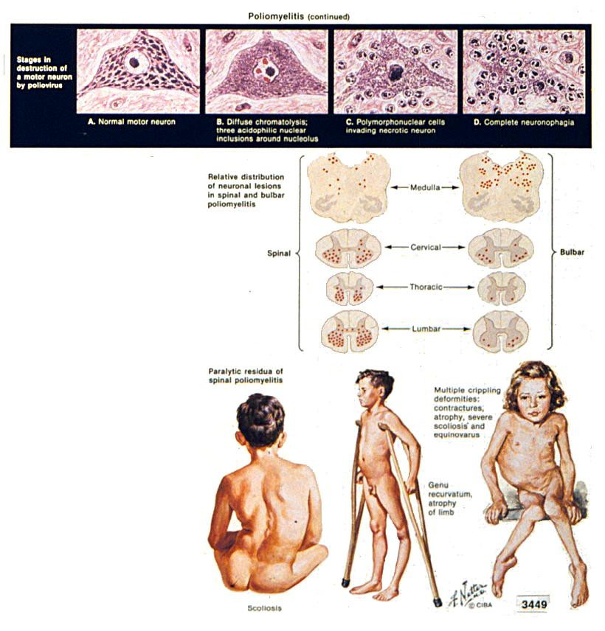
Poliomyelitis acuta anterior
1
2
3
4
1- 4 Motor neurons
1= normal
2= affected neuron with
intranuclear inclusions
3= necrosis of neurons
4= leukocytic infiltrate in site necrotic neron
5 late complications of poliomyelitis
of
5

Slide 73
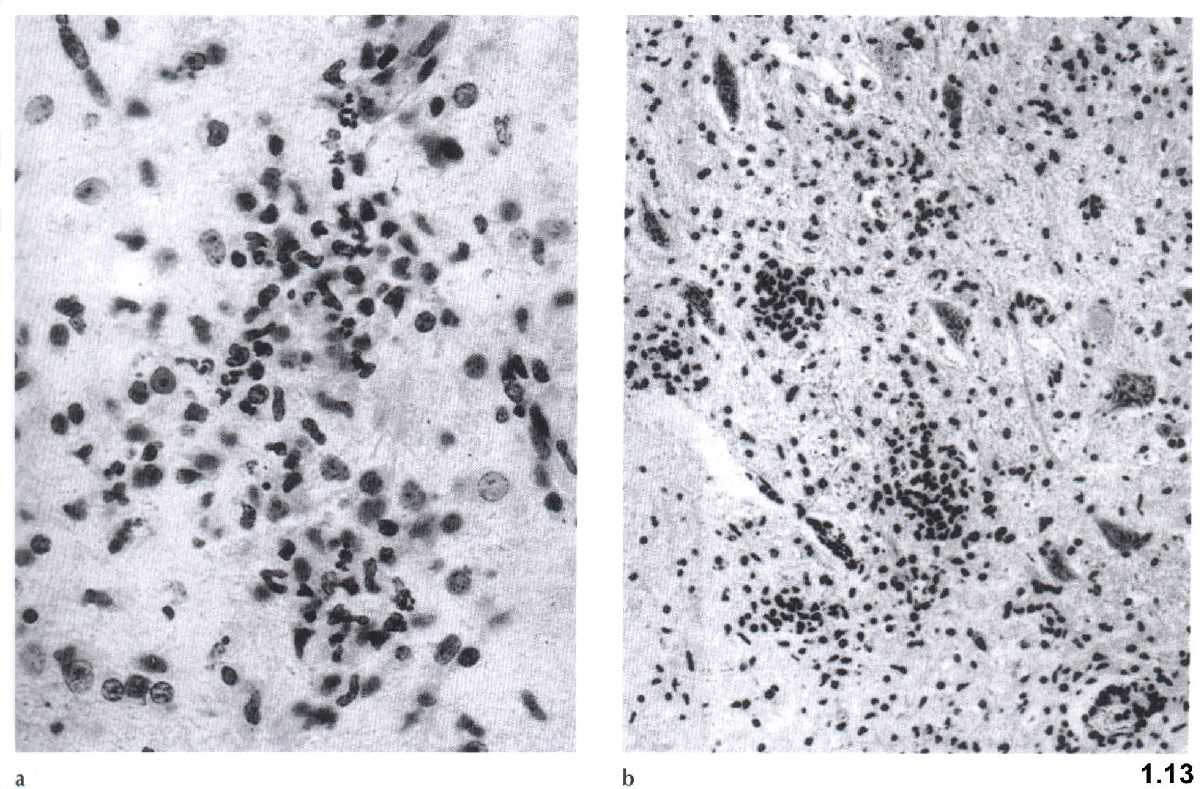
poliomyelitis – lymphocytic inflitrate of anterior spinal columns, necrosis of
neurons

Slide 74
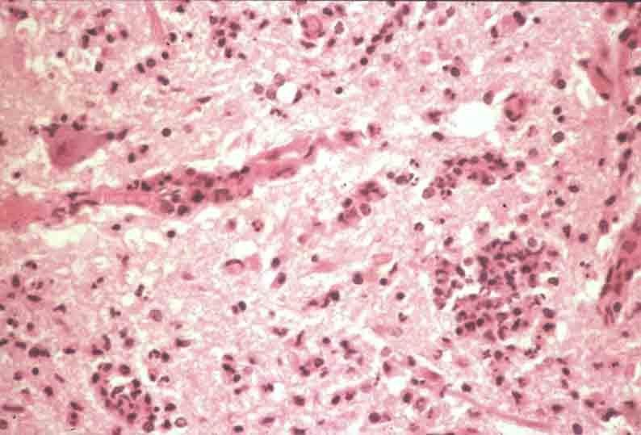
Poliomyelitis acuta anterior

Slide 75
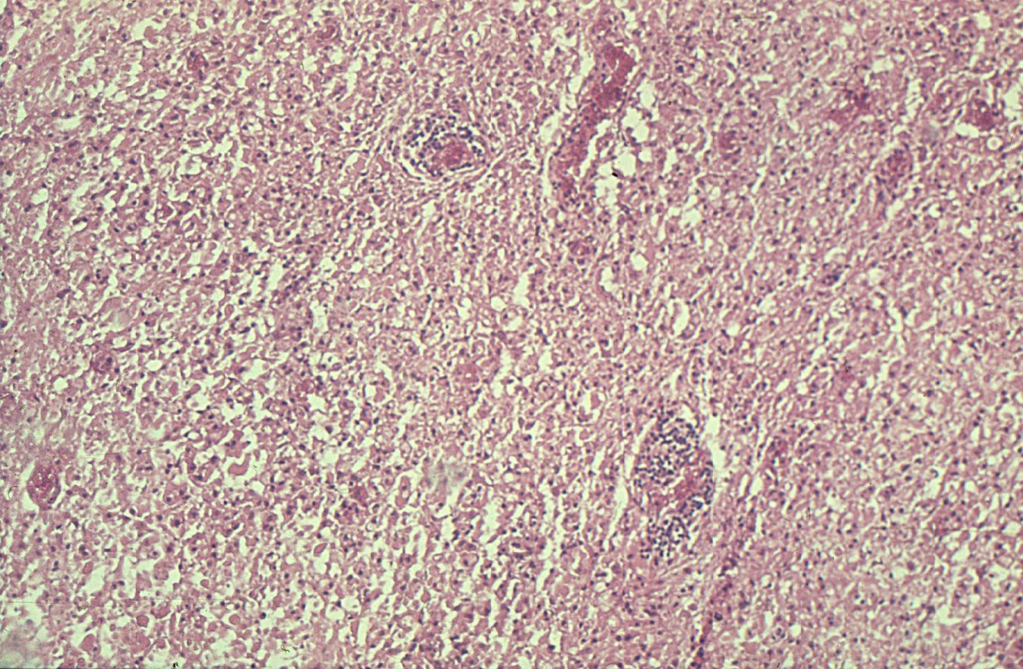
tick-borne encephalitis – edema, perivascular infiltrate

Slide 76
Pathology of the CNS
neurosyphilis
meningovascular form
Thickening of the meninges with miliary gummas, lymphoplasmocytic infiltrate, particularly at the base of brain, Heubner arteritis. On occasion process preferentially involves the spinal meninges
paralysis progresiva
In untreatud syphilis. Atrophy of the cortex, hemosiderine deposition (atrophia cerebri rubra), neuronal loss

Slide 77
Pathology of the CNS
záněty mozku – neurosyphilis
tabes dorsalis
Demyelinization of dorsal spinal columns
gumma
Nodular tumor like focus

Slide 78
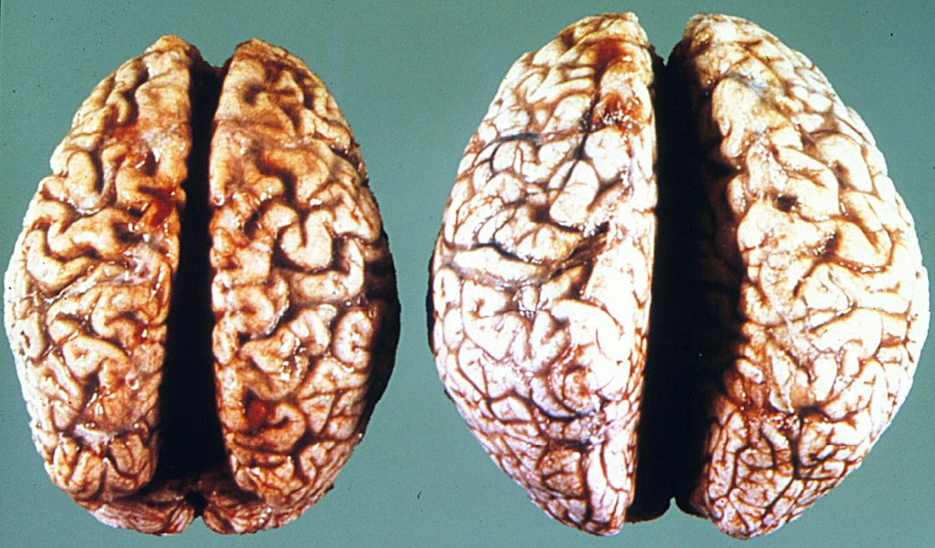
neurosyphilis – atrophia cerebri rubra

Slide 79
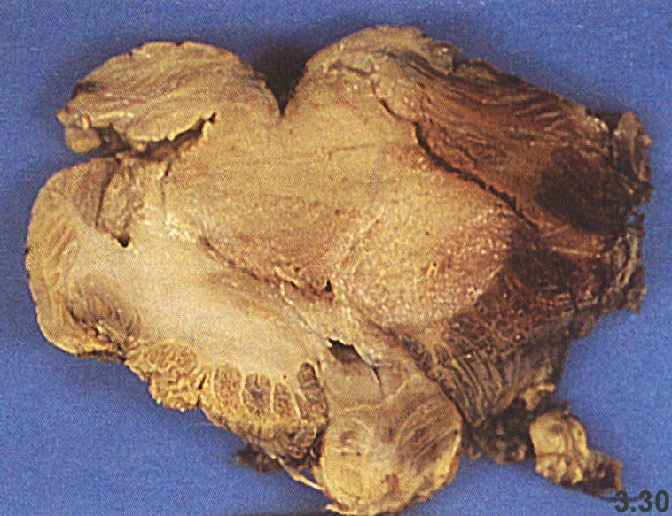
neurosyphilis – syphilitic gumma in the cerebellum

Slide 80
neurosyphilis – tabes dorsalis – atrophy of dorsal spinal columns

Slide 81
neurosyphilis – silver stain

