Slide 1
Pathology of the Skeletal Muscle

Slide 2
Examination methods
■
Clinical examination – neurologic examination, EMG
Muscle biopsy – conventional, quantitative analysis, histochemical examination, immunohistochemistry, Western blotting
Molecular genetics
■
■

Slide 3
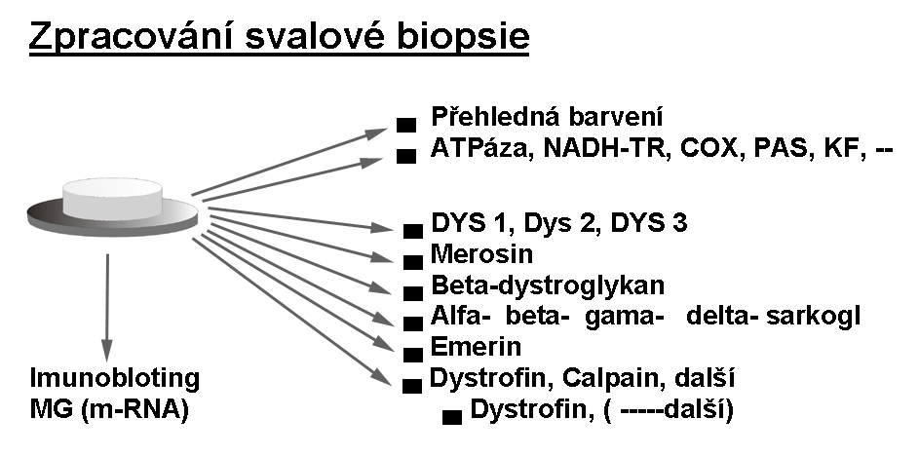

Slide 4
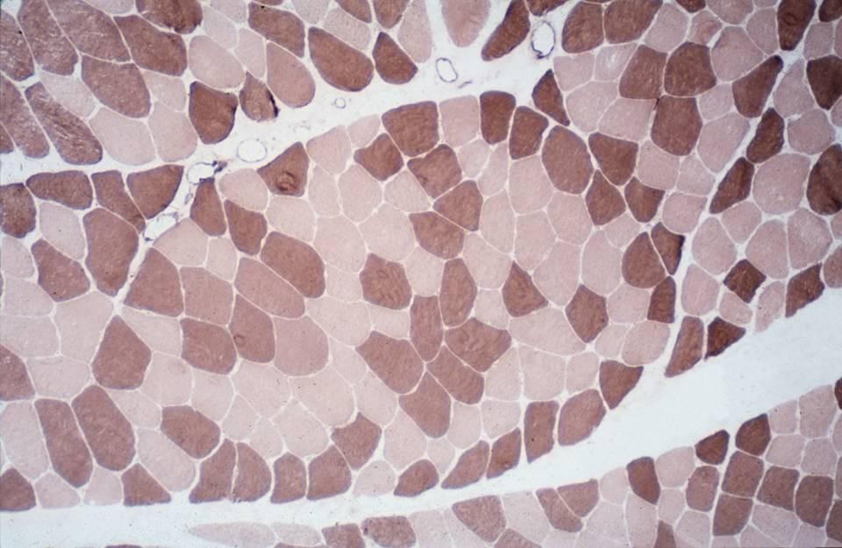
2
1
Type 1 and type 2 muscle fibers – myosin ATPase

Slide 5
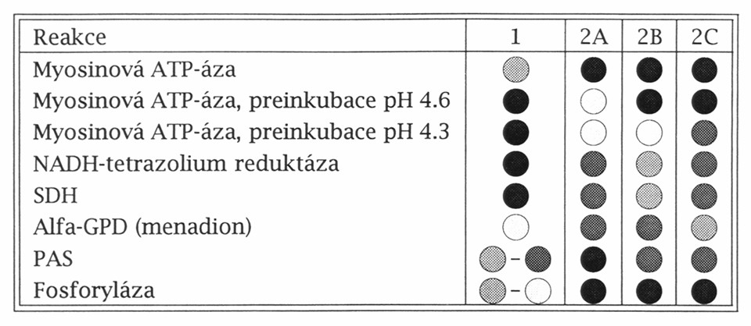

Slide 6
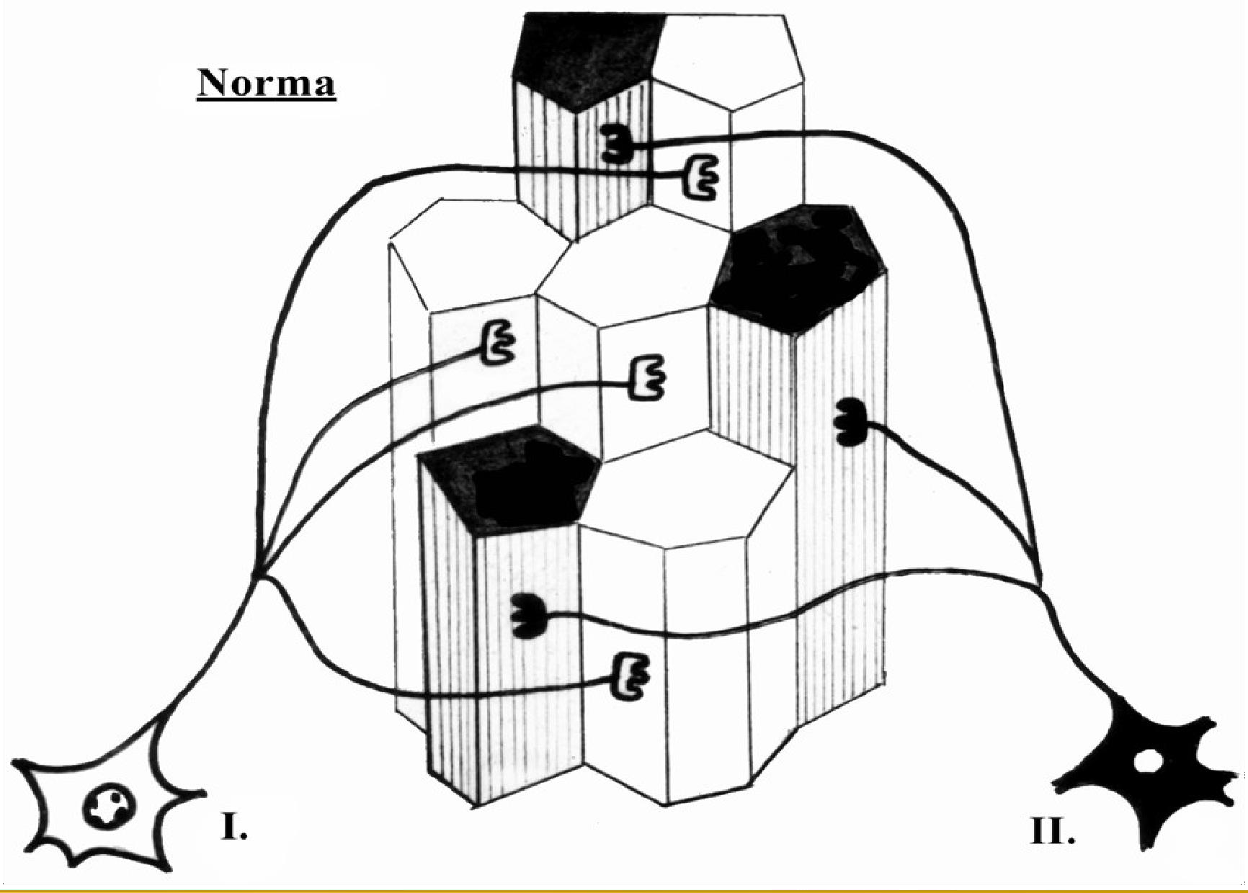

Slide 7
Pathology of the Skeletal Muscle
Neurogenic lesions – defects of inervation Disorders of the neuromuscular junction Primary myopathies
■
■
■
❑ Muscular dystrophy
Structural congenital myopathy
Myositis
❑
❑
■
Secondary muscular disorders

Slide 8
Neurogenic lesions
Nuclear leasions (ALS, SMA)
Diseases of the spinal nerve (Discopathy, extramedullary tumors)
Involvement of the peripheral nerves (polyneuritis)
Disorders of supraspinal muscle tone control (cerebral palsy)
■
■
■
■

Slide 9
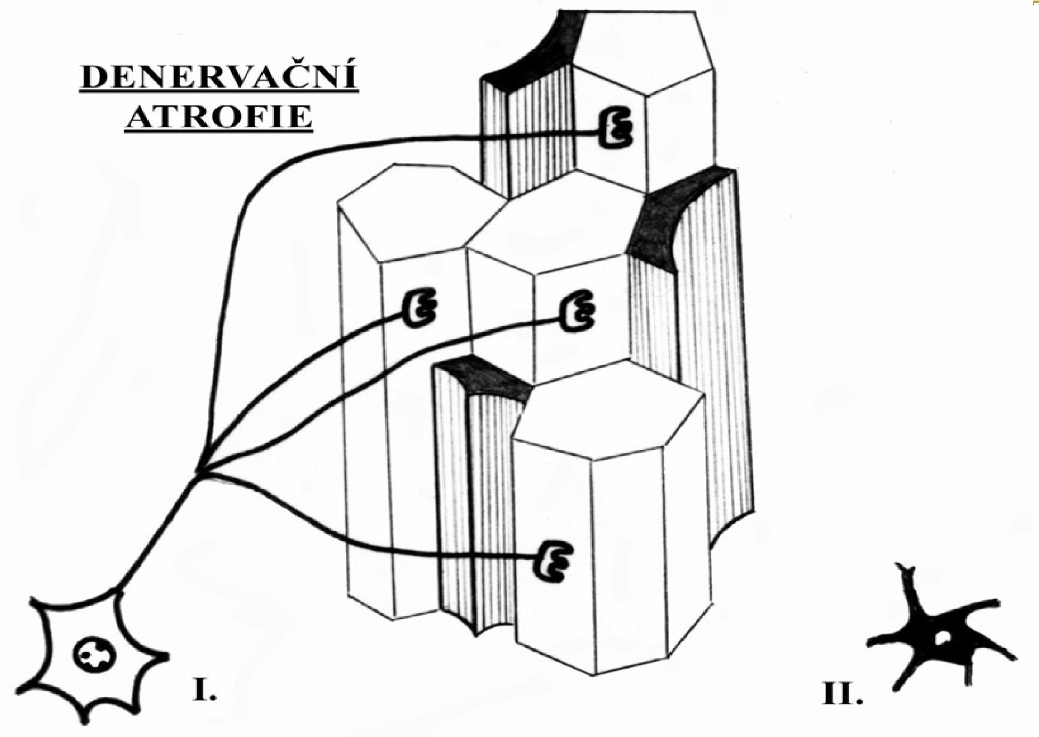
Denervation atrophy

Slide 10
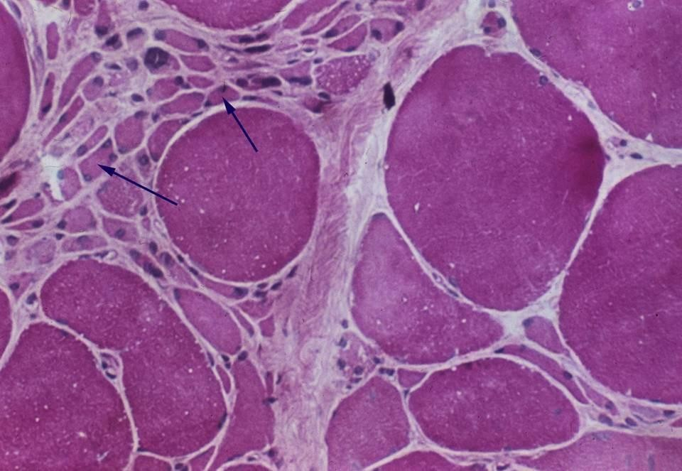
Atrophy of the muscle fibers

Slide 11
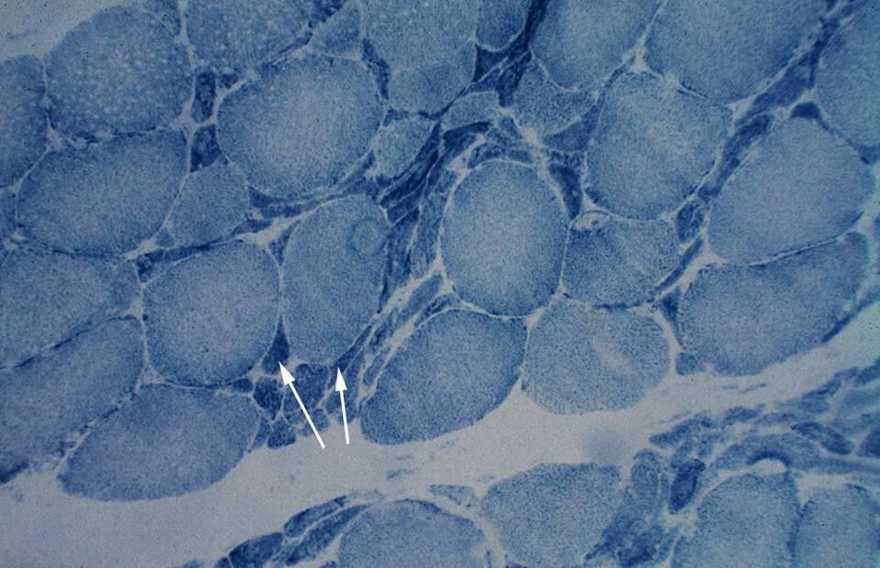
Atrophy of the muscle fibers - SDH

Slide 12
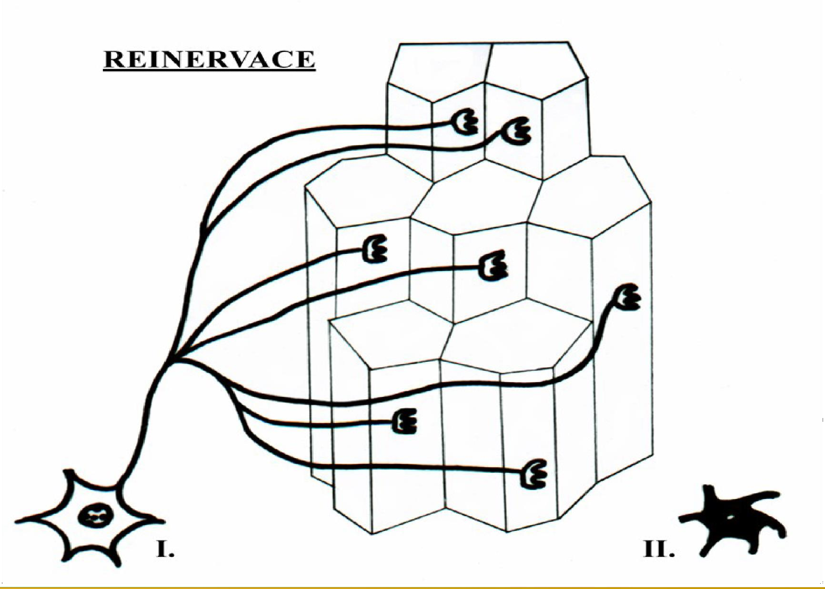
Reinervation

Slide 13
Neurogenic lesions
nuclear leasions
■
Amyotrophic lateral sclerosis (motor neuron disease)
Spinal atrophy
■
❑ Infantile (Werdnig-Hoffmann) Intermedate
Juvenile (Kugelberg-Welander)
❑
❑

Slide 14
Diseases of the Neuromuscular Junction
myasthenia gravis
Autoantibodies against postsynaptic Ach receptors at the NMJ
Muscle weakness that worsens with use and improves with rest
Classically involves eyes – ptosis, double vision
Symptoms improve with anticholinesterase agents
Associated with thymic hyperplasia or thymoma
■
■
■
■
■

Slide 15
Myogenic leasions
Heterogenous group of diseases
Nuclear changes – inner nuclei, multiplication of nuclei
Variation of fiber diameter Splitting of the fibers
Endomysial and perimysial fibrosis Focal/diffuse regresive sarcoplasmatic changes
■
■
■
■
■
■

Slide 16
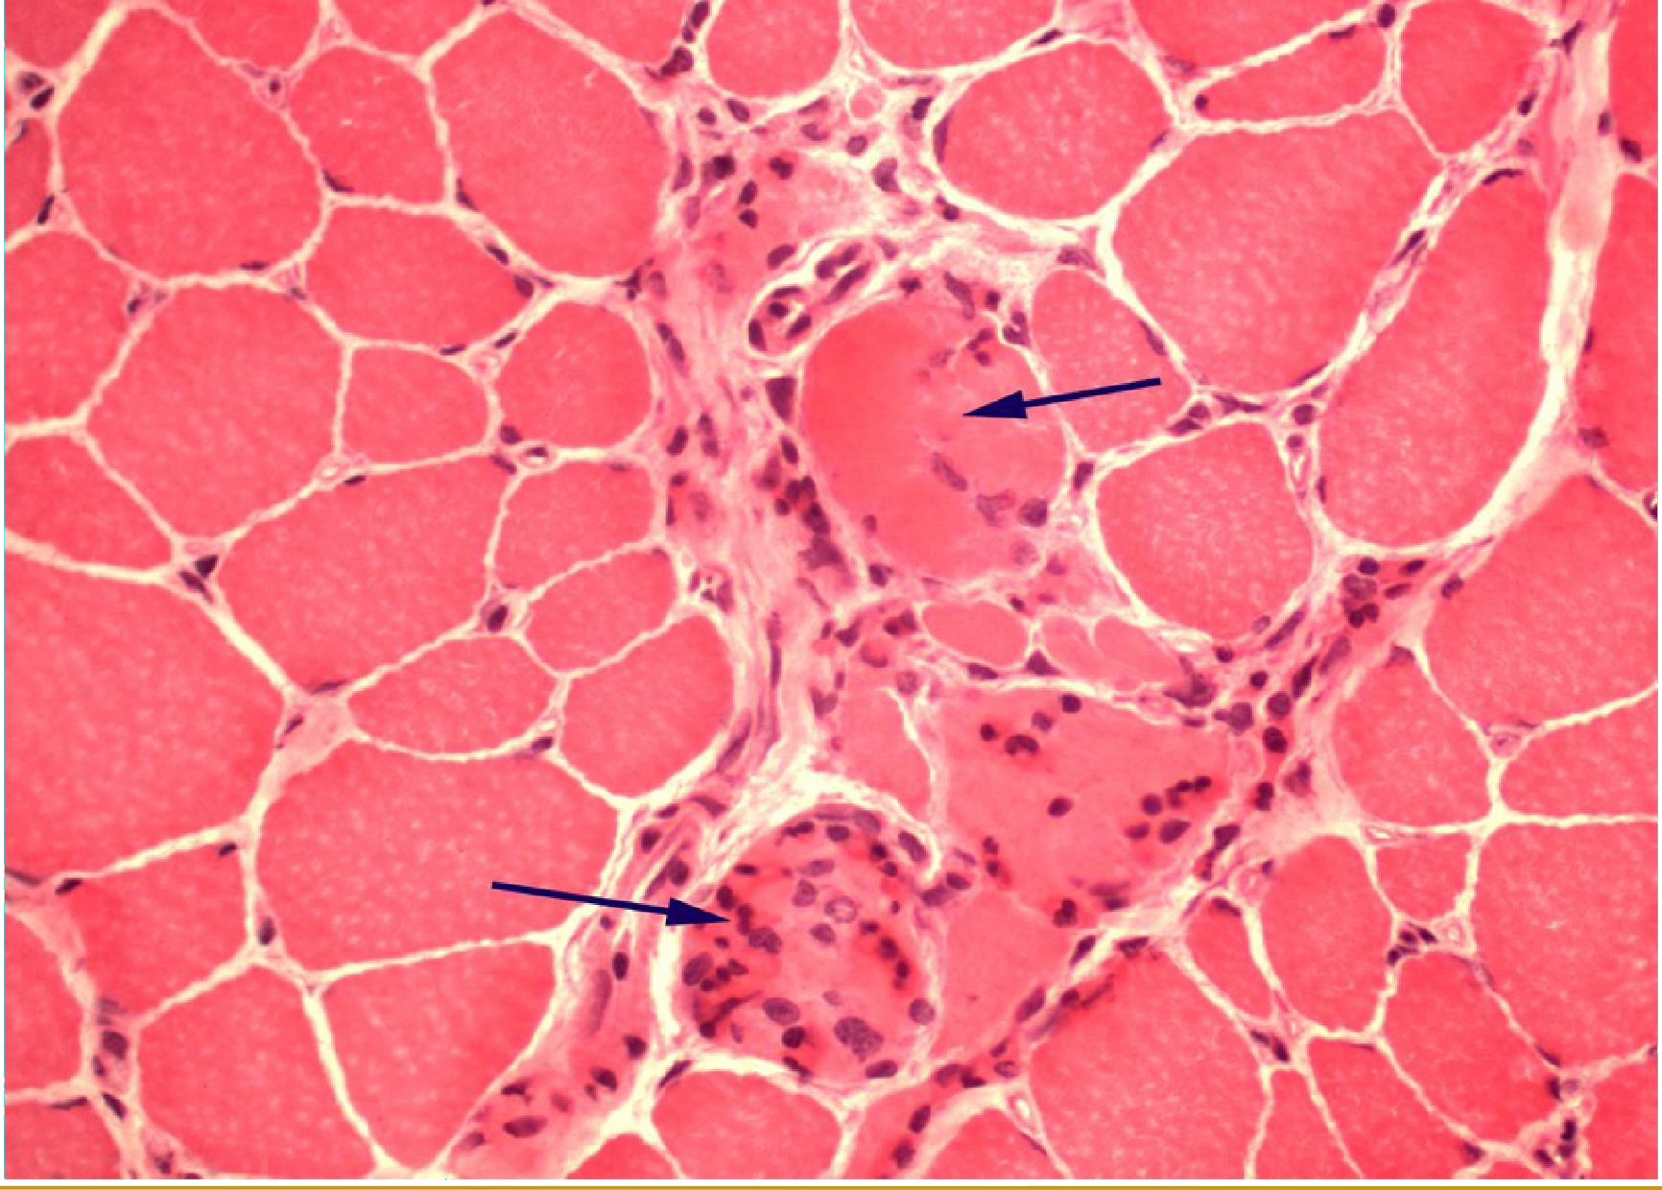
Regresive changes of muscle fibers - necrosis

Slide 17
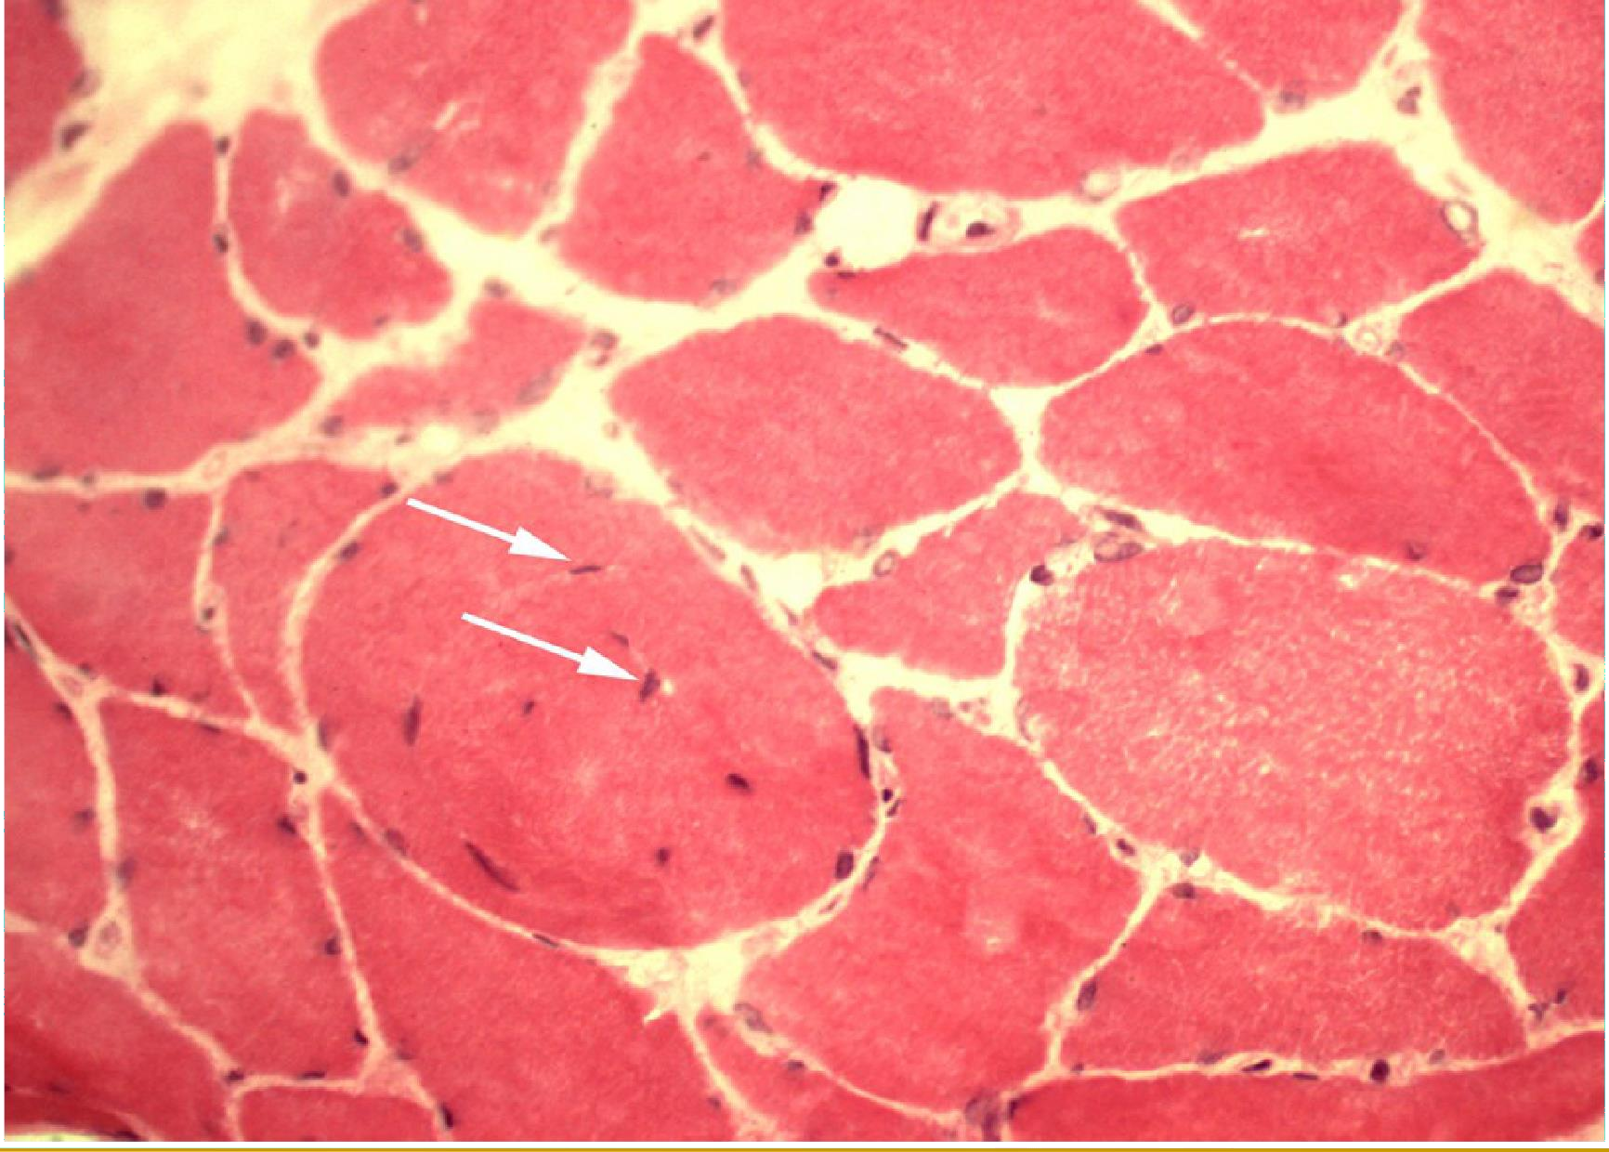
Inner nuclei

Slide 18
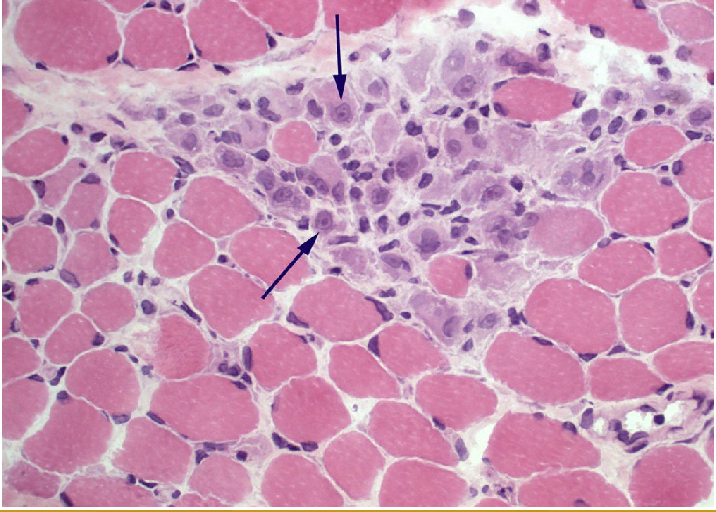
Regeneration of muscle fibers (basophylic cytoplasm, nucleoli)

Slide 19
Myogenic leasions
muscular dystrophy
■
Duchen / Becker muscular dystrophy
❑ DMD onset within 1-3 years of life, BMD slower onset milder symptoms
Proximal mucle weakness, calf pseudohypertrophy
X-linked disease
Deletion / mutation in dystrophin gene
❑
❑
❑

Slide 21
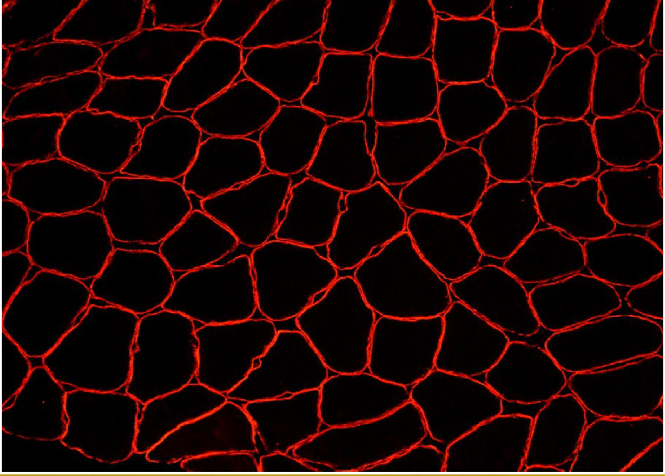
dystrophin – normal finding

Slide 22
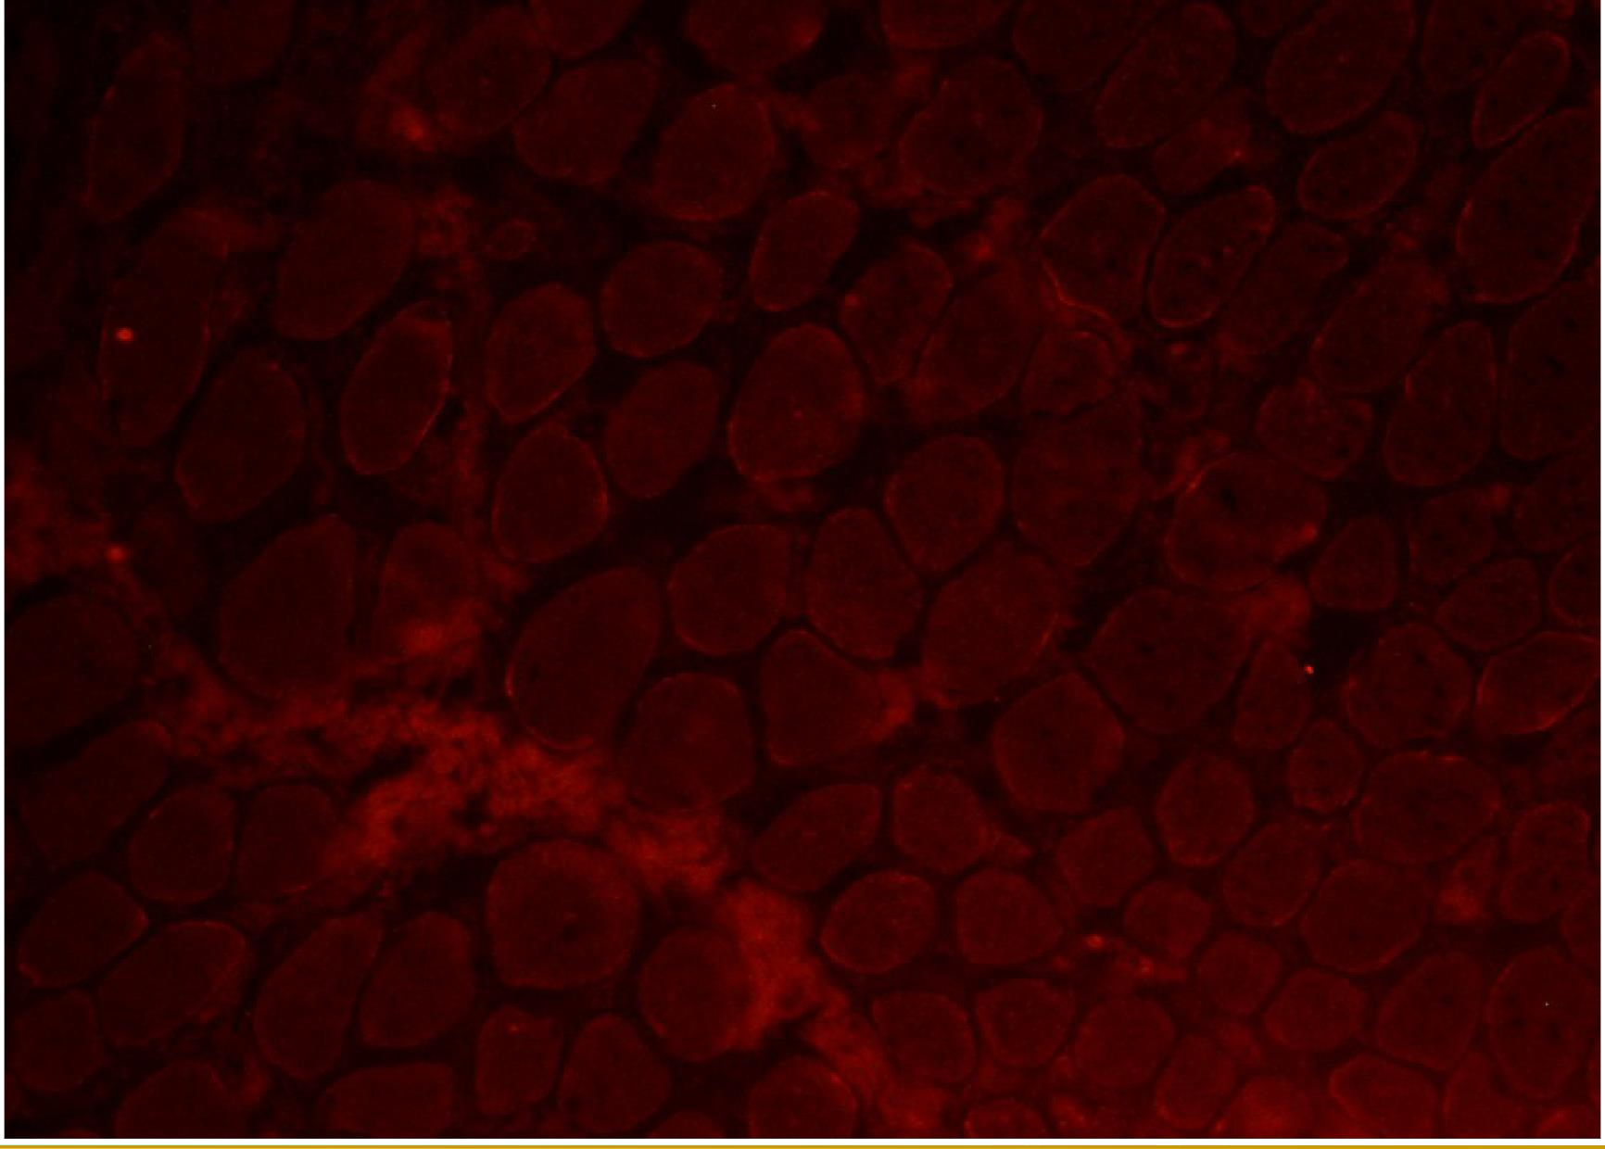
dystrophin – DMD

Slide 23
Myogenic leasions
congenital structural myopathies
Defined by characteristic histopathologic findings Central core disease
Multicore disease Centronuclear myopathy
…
■
■
■
■
■

Slide 24
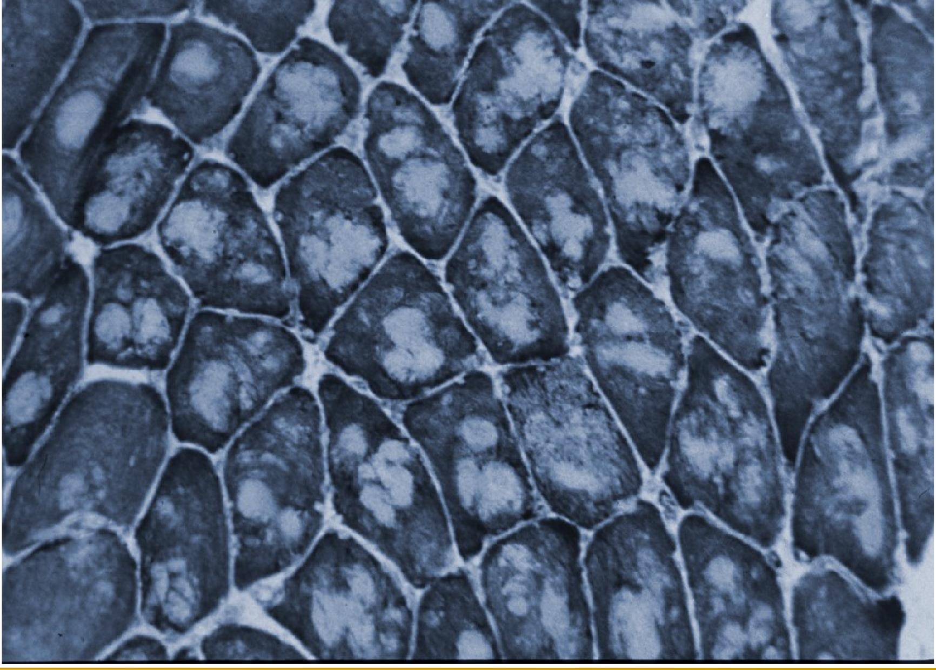
central core disease

Slide 25
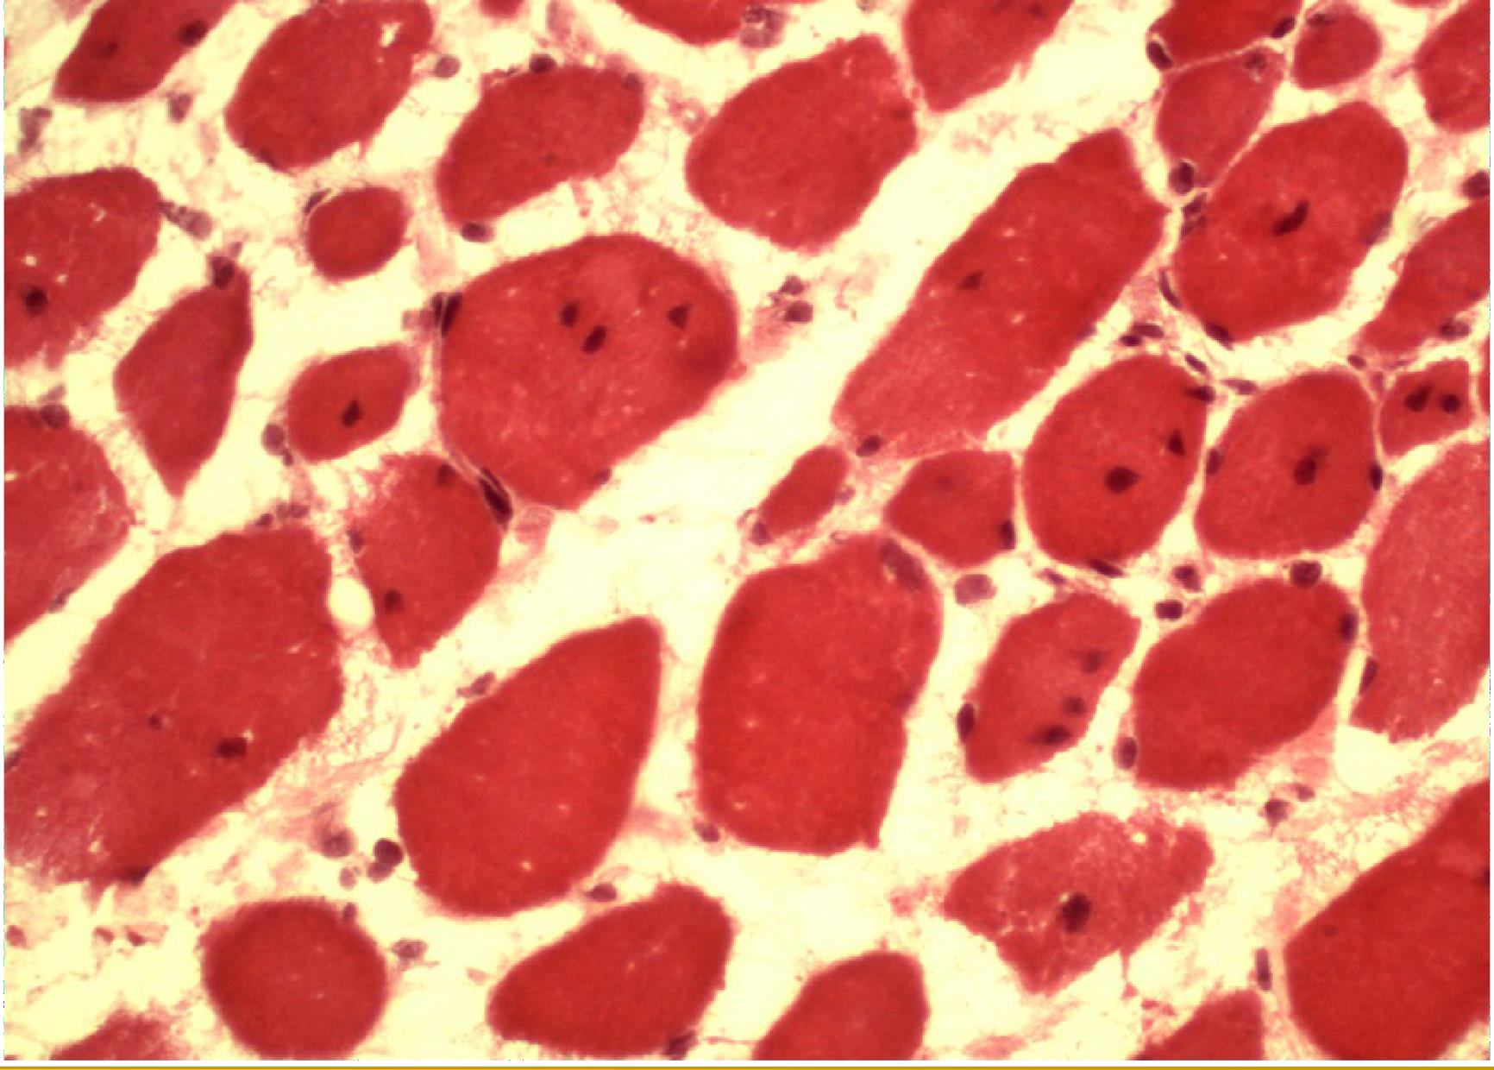
Centronuclear myopathy

Slide 26
Myogenic leasions
metabolic myopathies
■
Defects of metabolism of carbohydrates (glycogenosis) and lipids (lipidosis)

Slide 27
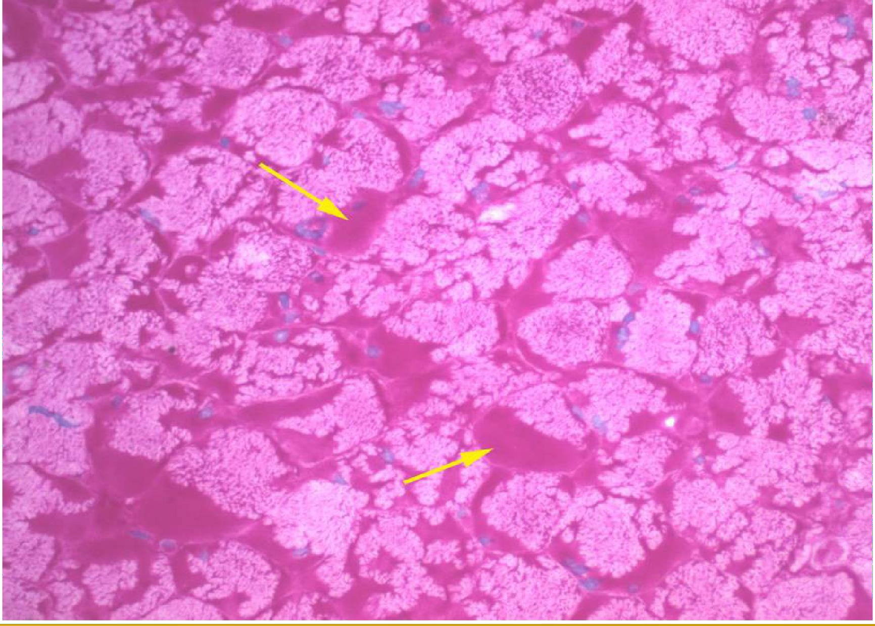
glycogenosis – PAS positive material

Slide 28
Inflammatory myopathies
Dermatomyositis Polymyositis
■
■

Slide 29
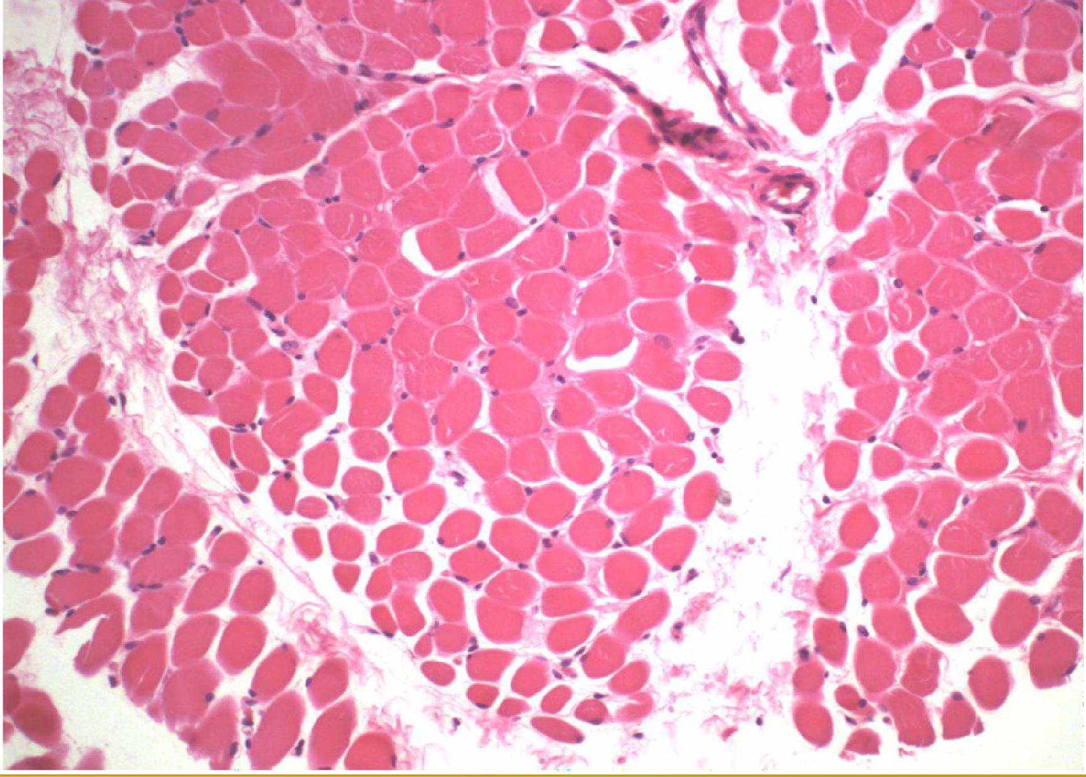
inflammatory myopathy – dermatomyositis – perifascicular atrophy

Slide 30
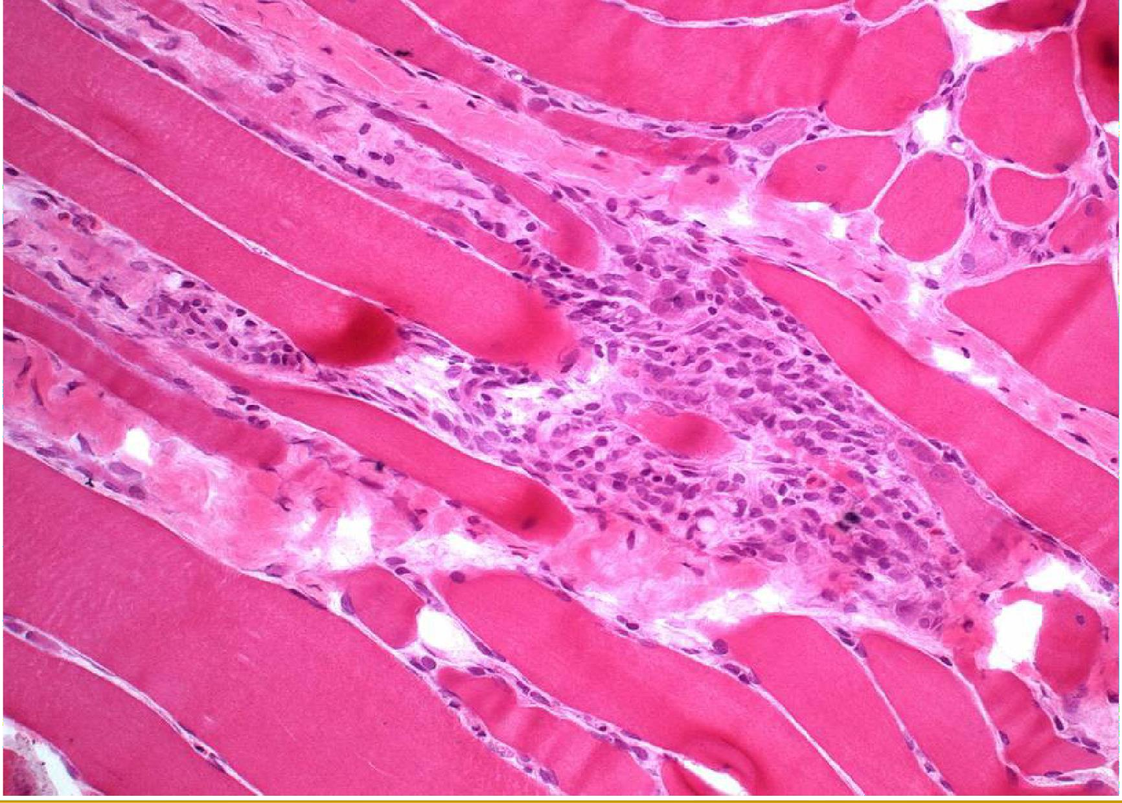
Inflammatory myopathy – lymphocytic inflammatory infiltrate

Slide 31
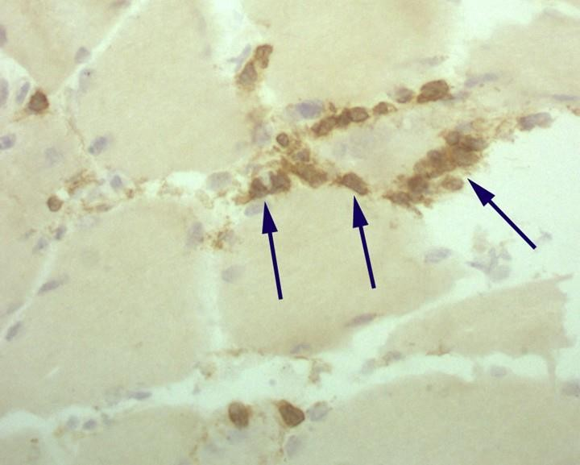
Inflammatory myopathy – lymphocytic inflammatory infiltrate (CD8+)

Slide 32
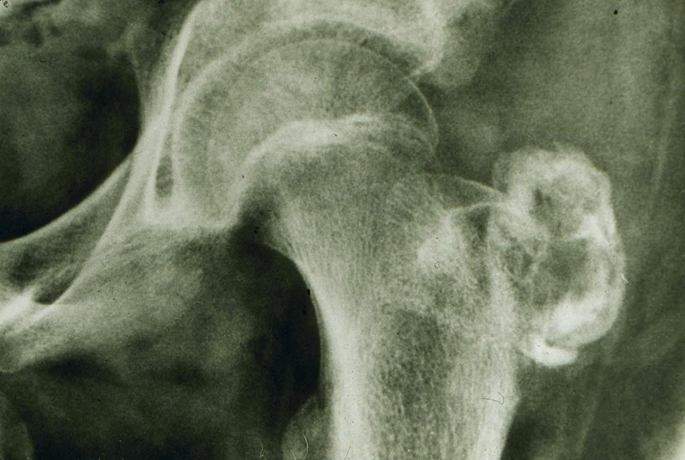
myositis ossificans – peritrochanteric calcification

Slide 33
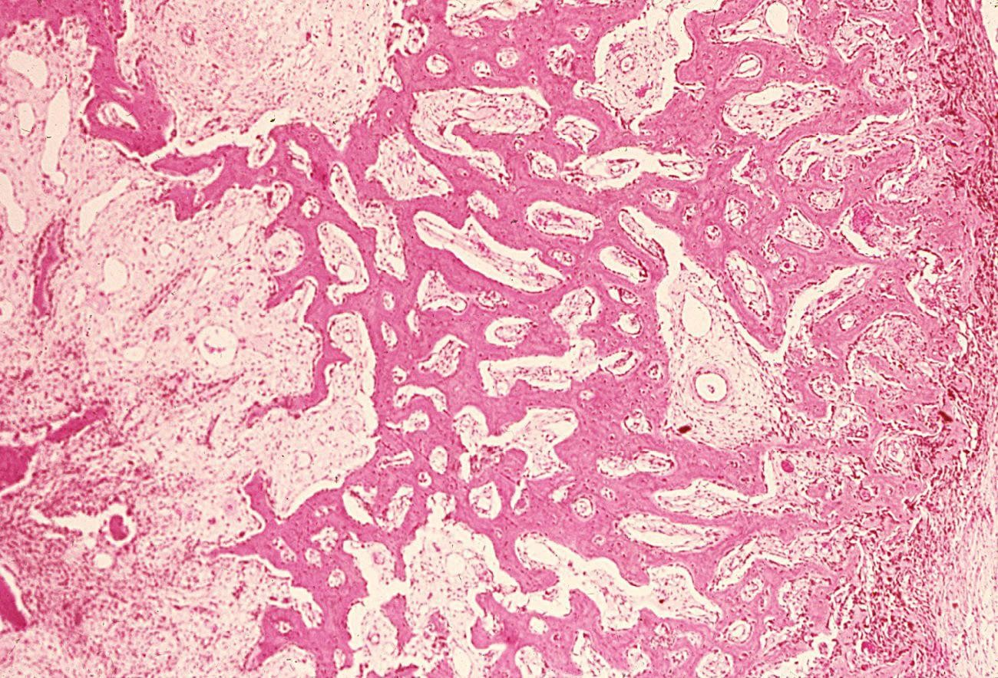
myositis ossificans – proliferation of fibrous tissue, formation of
lamelar bone

Slide 34
Pathology of the Bones

Slide 35
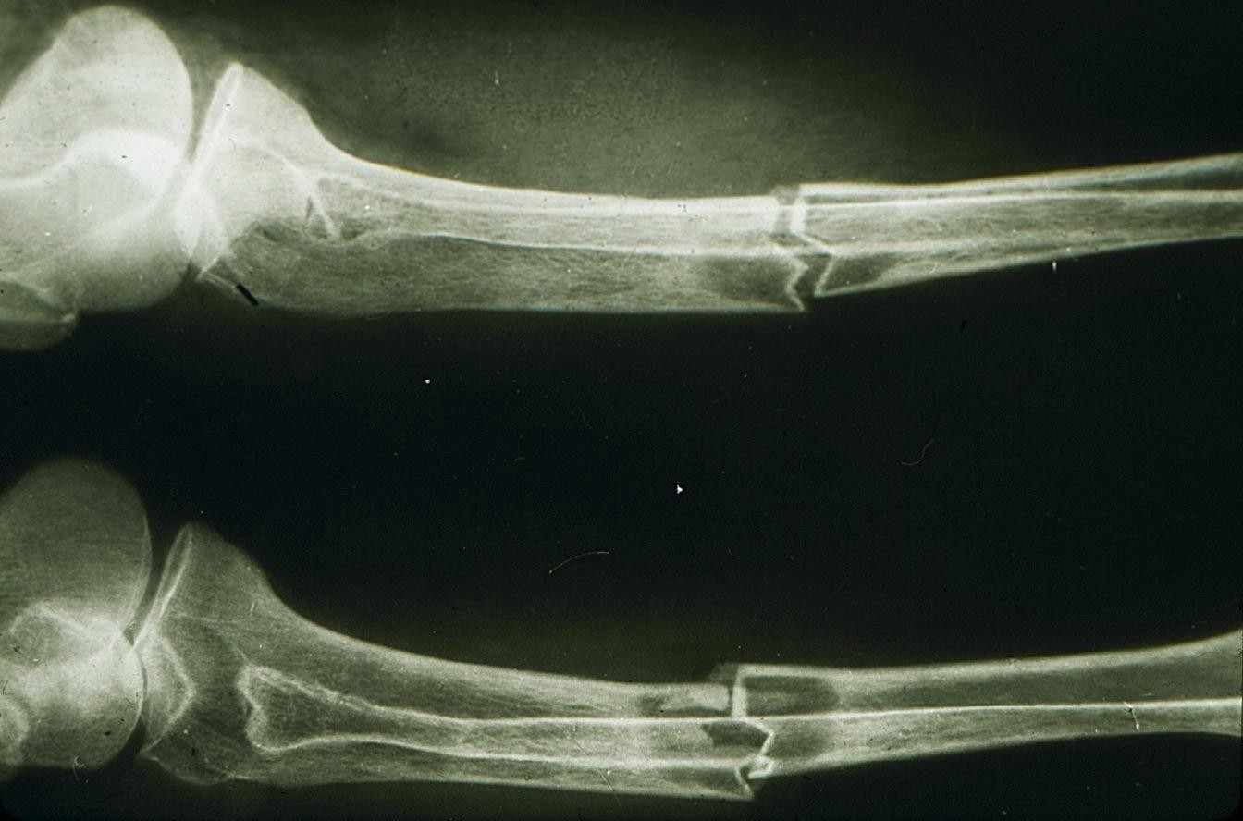
hyperparathyreoidism – decalcification, pathologic fracture

Slide 36
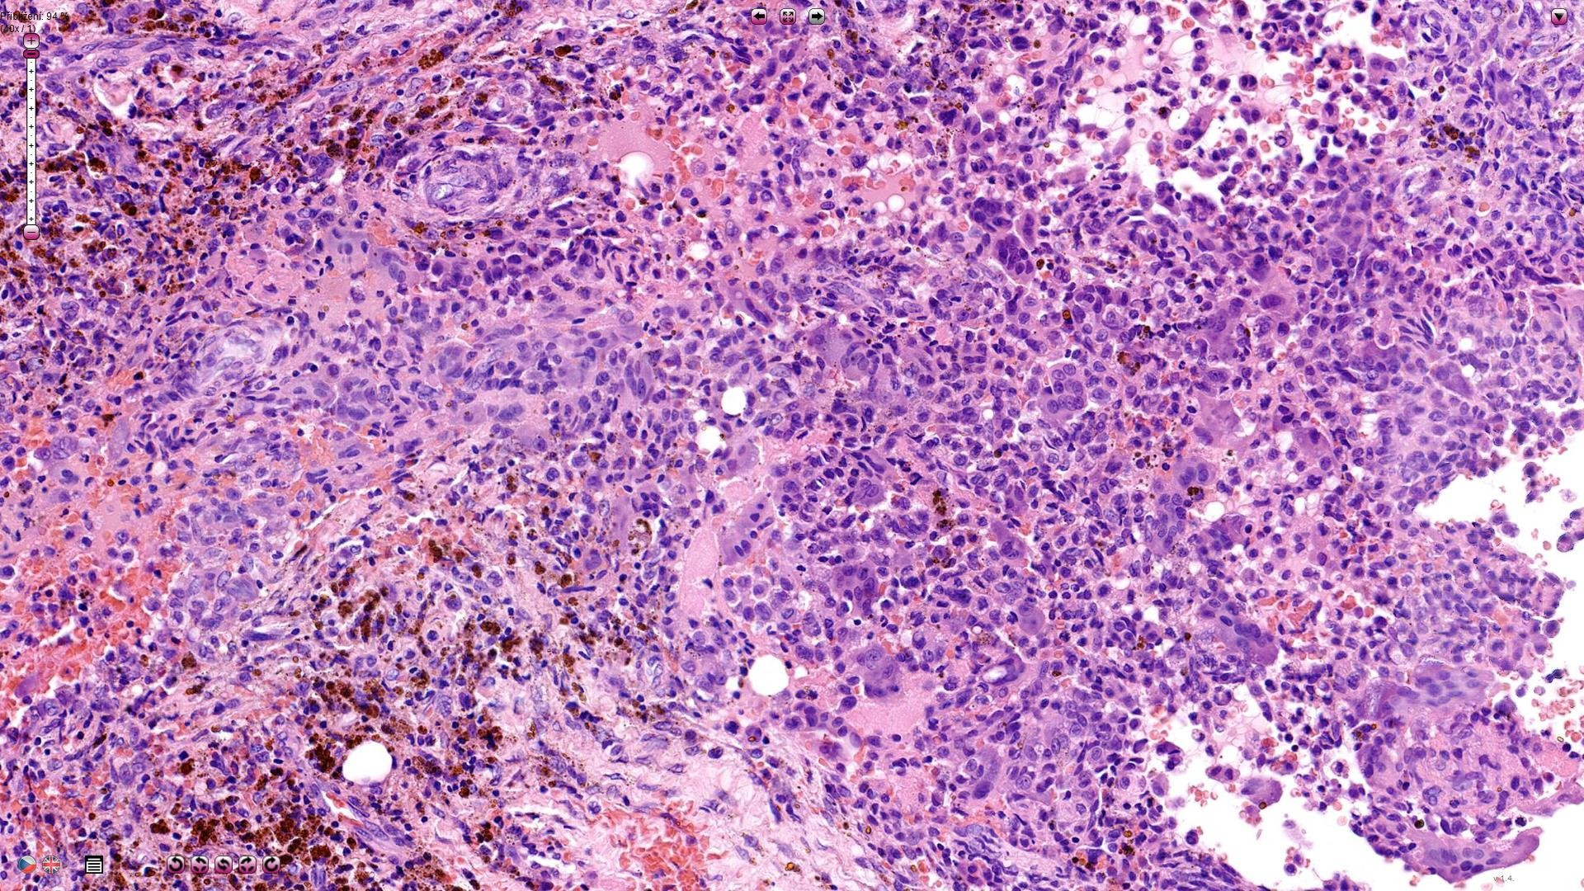
Cystic fibrous osteodystrophy – multinucleated cells - osteoclasts

Slide 37
Bone tumors
osteosarcoma
Hihg grade malignancy Peak incidence in teenagers
Usually starts in medullar spaces of metaphysis, infiltrates the cortex
Hihg grade pleiomorphic cells producing osteoid
■
■
■
■

Slide 38
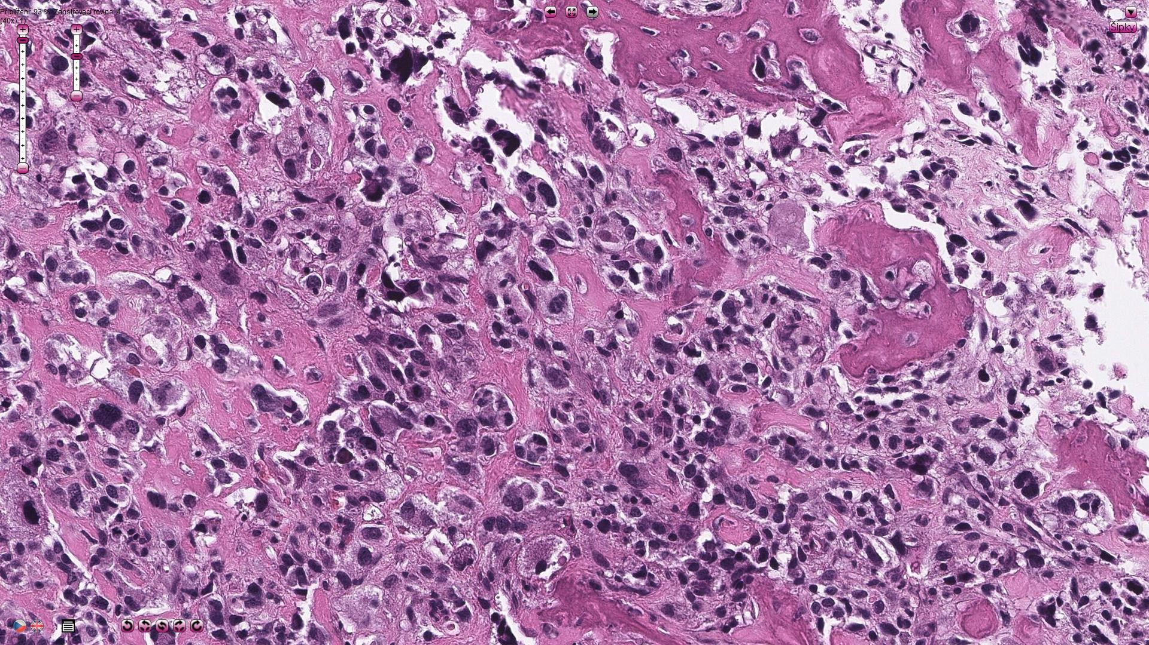
osteosarcoma – tumorous osteoid, sarcomatous spindle cells

Slide 39
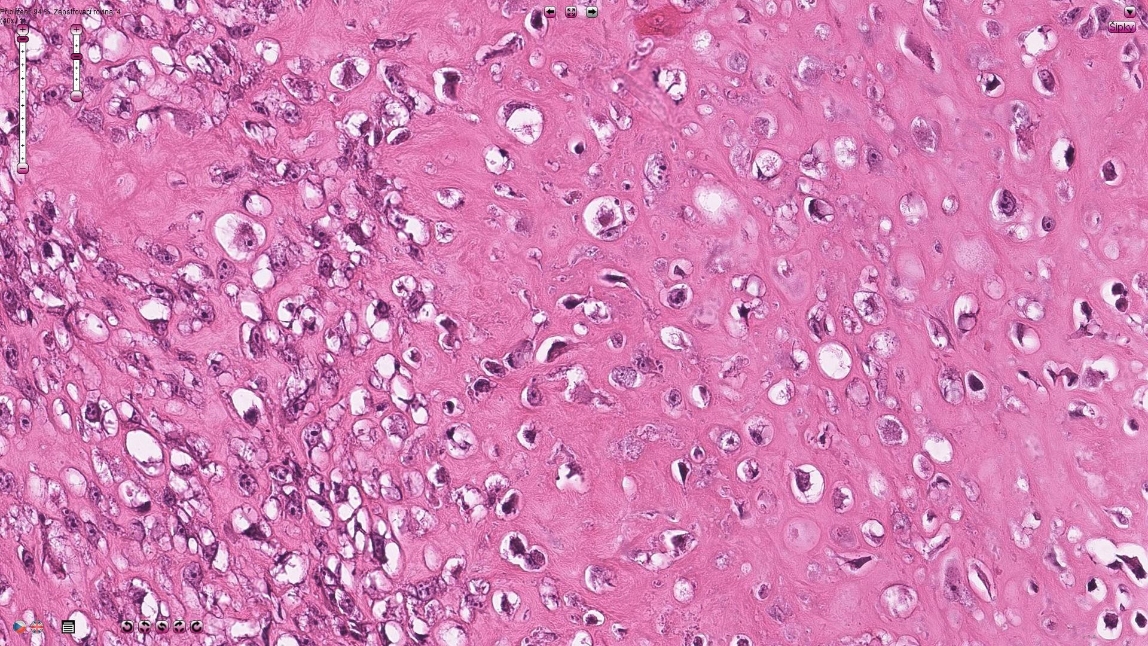
osteosacoma – trabeculae of tumorous osteoid

Slide 40
Bone tumors
Osteochondroma
- Most common benign bone tumor
- surface of metaphysis of long/flat bones
- Exophytic lesion on the surface composed of mature bone and cartilagineous cap

Slide 41
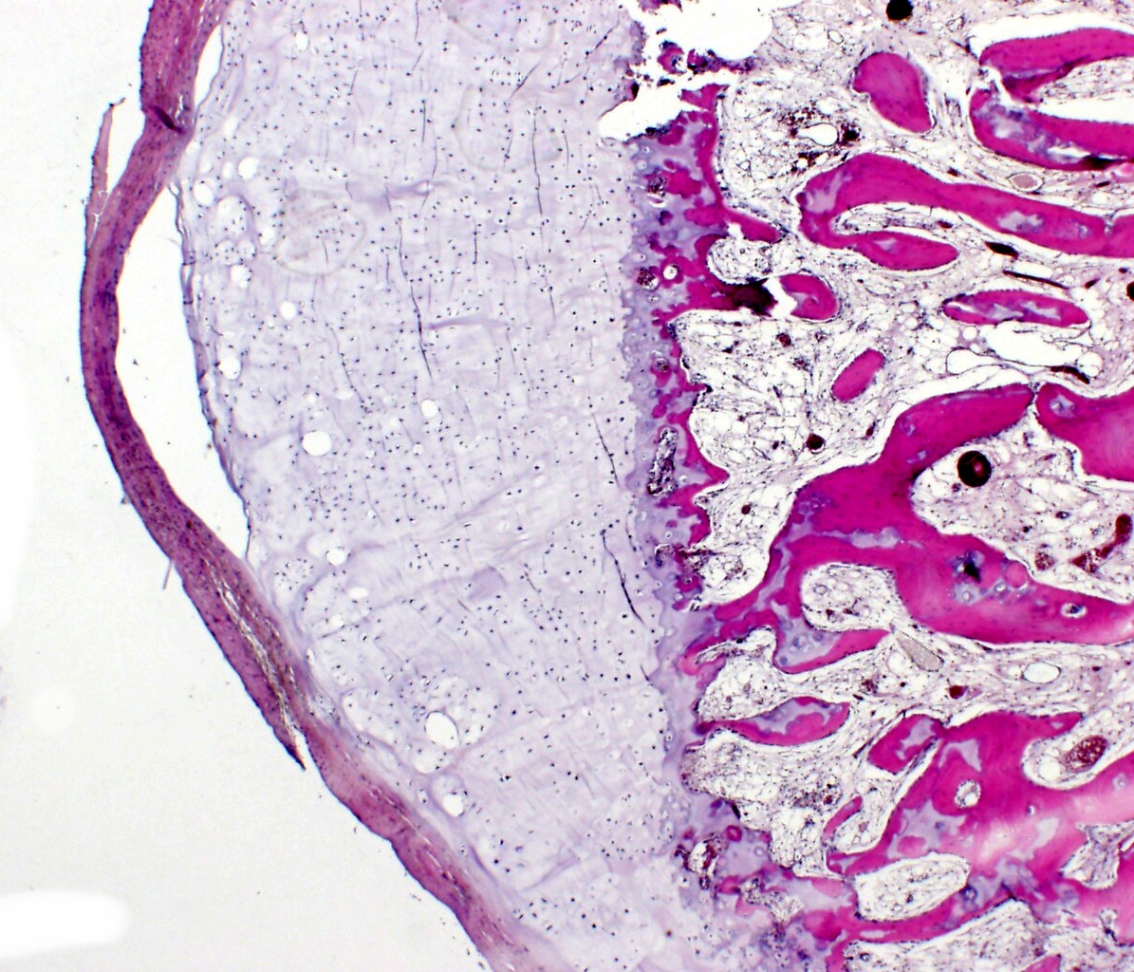

Slide 42
Bone tumors
Giant cell tumor of the bone
- Locally aggressive tumor, very rarely malignant
Epiphysis and metaphysis of skeletally mature individuals
Composed of mononuclear (neoplastic) cells with admixture of macrophages and numerous osteoclasts

Slide 43
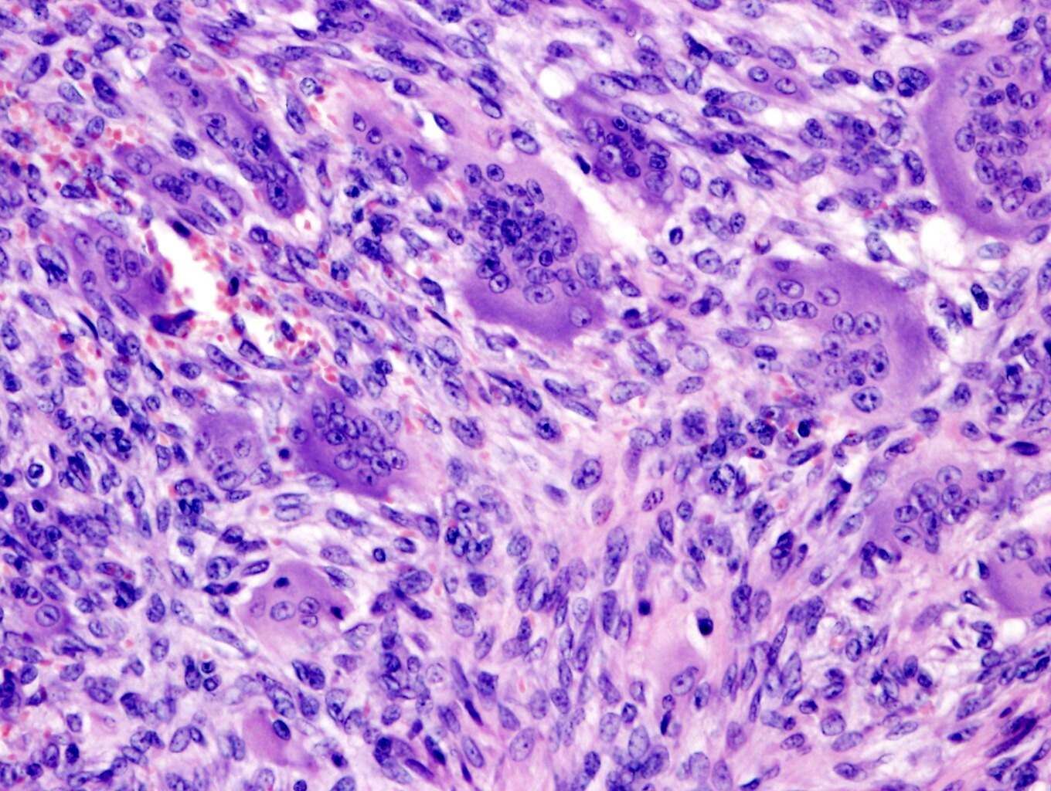

Slide 44
Bone tumors
chondrosarcoma
Several forms – classic, juxtacortical, …
Older than 20 years (pelvic bones, femur, shoulder)
Histology: more or less differencciated chondrous tissue with lacunar cells
■
■
■

Slide 45
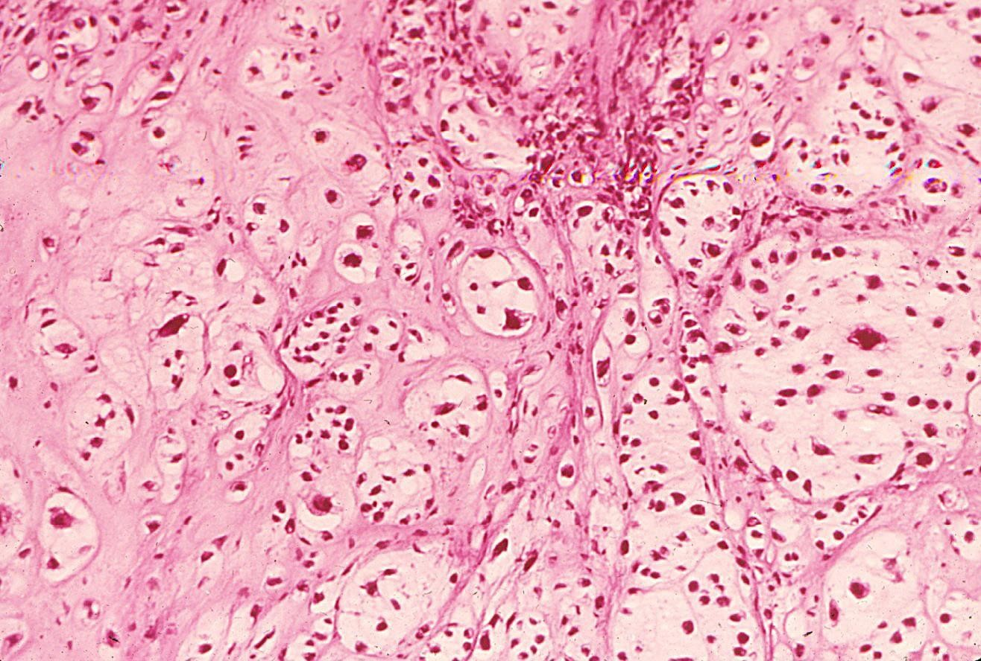
chondrosarcoma – irregular foci of neoplastic chondrous tissue

Slide 46
Bone tumors
multiple myeloma
Tumor of bone medulla
Multifocal destructive bone lesions
Clonal proliferation of plasma cells
■
■
■

Slide 47
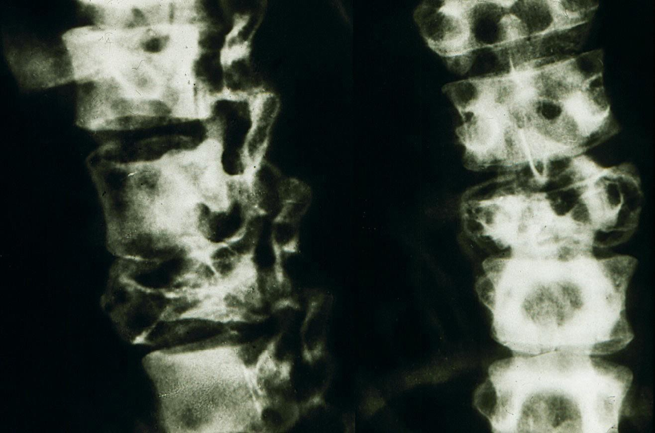
multiple myeloma – osteolytic foci in the spine

Slide 48
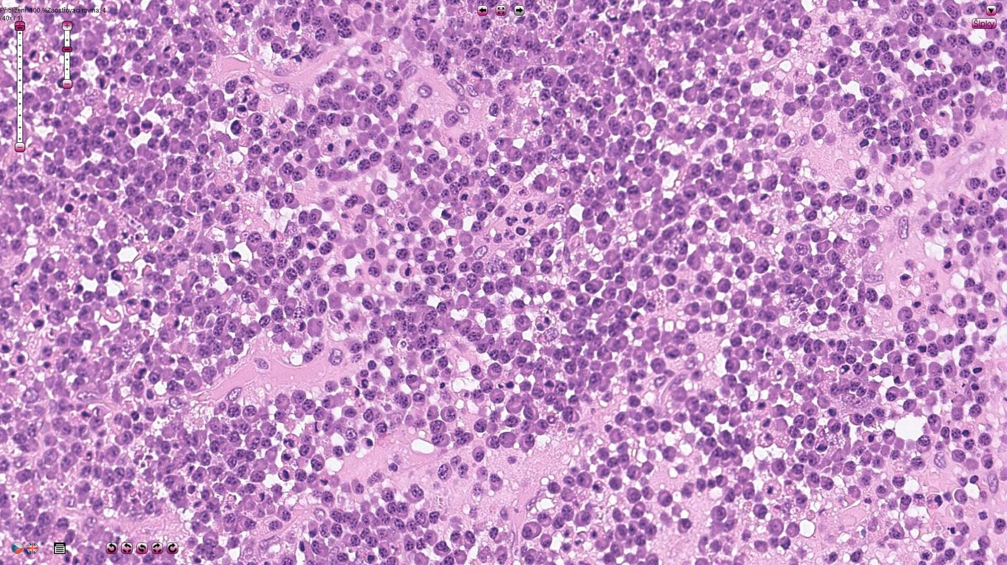
multiple myeloma

Slide 49
Bone tumors
Ewing sarcoma
Tumor of bone in and young adults children
Soft, pink osteolytic foci in diaphyses
a metaphyses of the long bones (12% extraskeletal)
Histology: solid foci of uniform small round cells
Fusion in EWSR gene

Slide 50
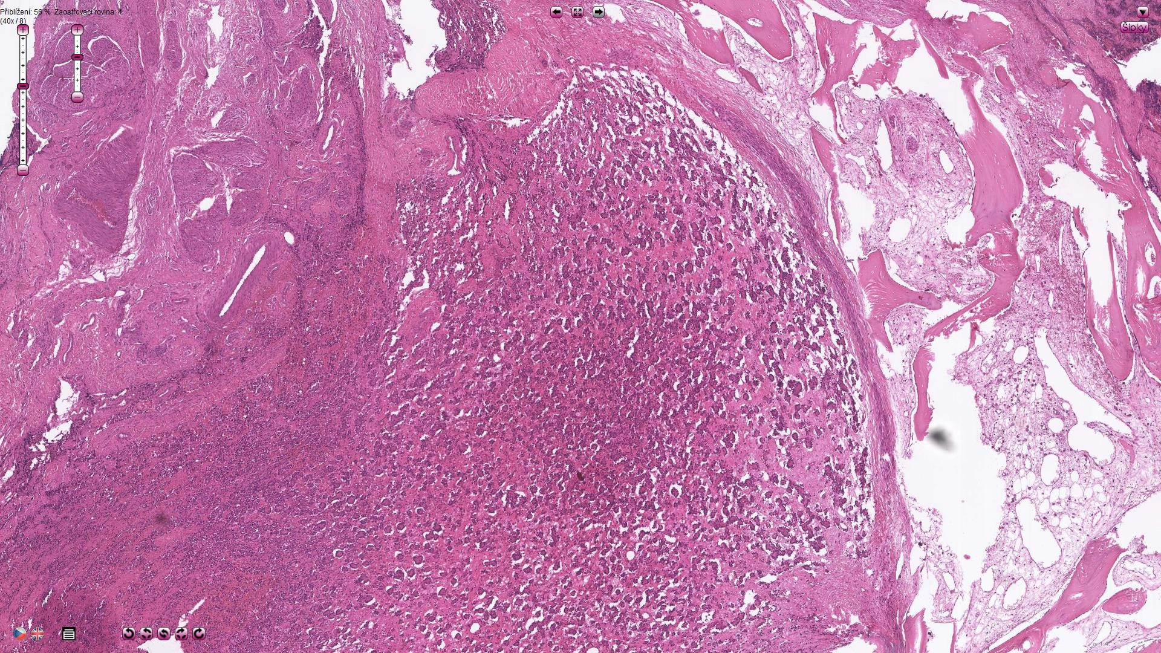
Ewing sarcoma

Slide 51
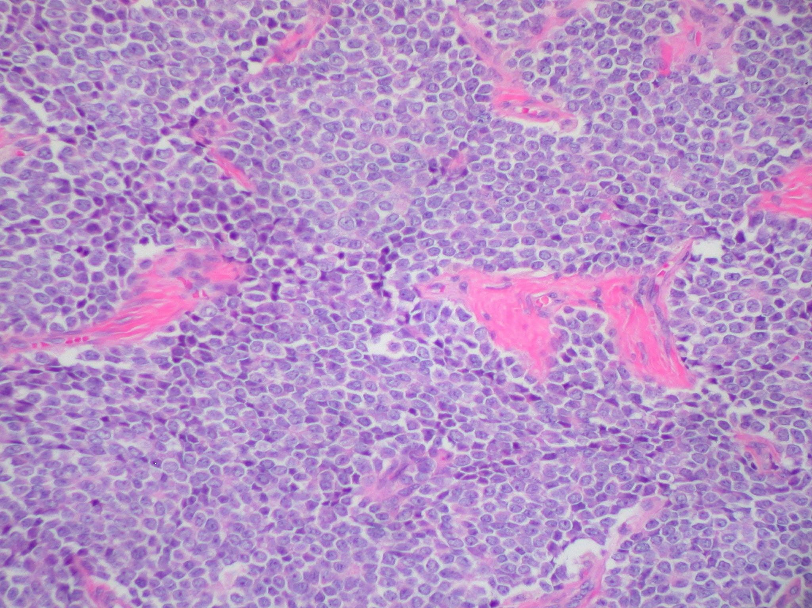
Ewing sarcoma – uniform population of neoplastic cells

