Slide 1
Pathophysiology of gastrointestinal tract pt. 1, upper GIT
Jaromír Gumulec

Slide 2
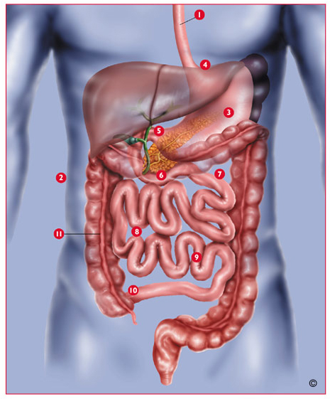
The GIT
1- esophagus
2- peritoneal cavity
3- stomach (1.5l)
4- gastroesophageal junction
5- pylorus
6- small intestine (4.5 – 6m)
    7- duodenum
    8- jejunum
    9- ileum
10- ileocoecal valve
11- large intestine
    ascendent
    transversal
    descendent colon
    rectum + anus

Slide 3
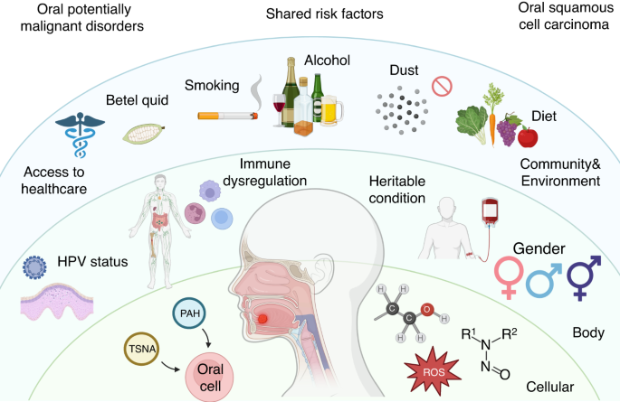
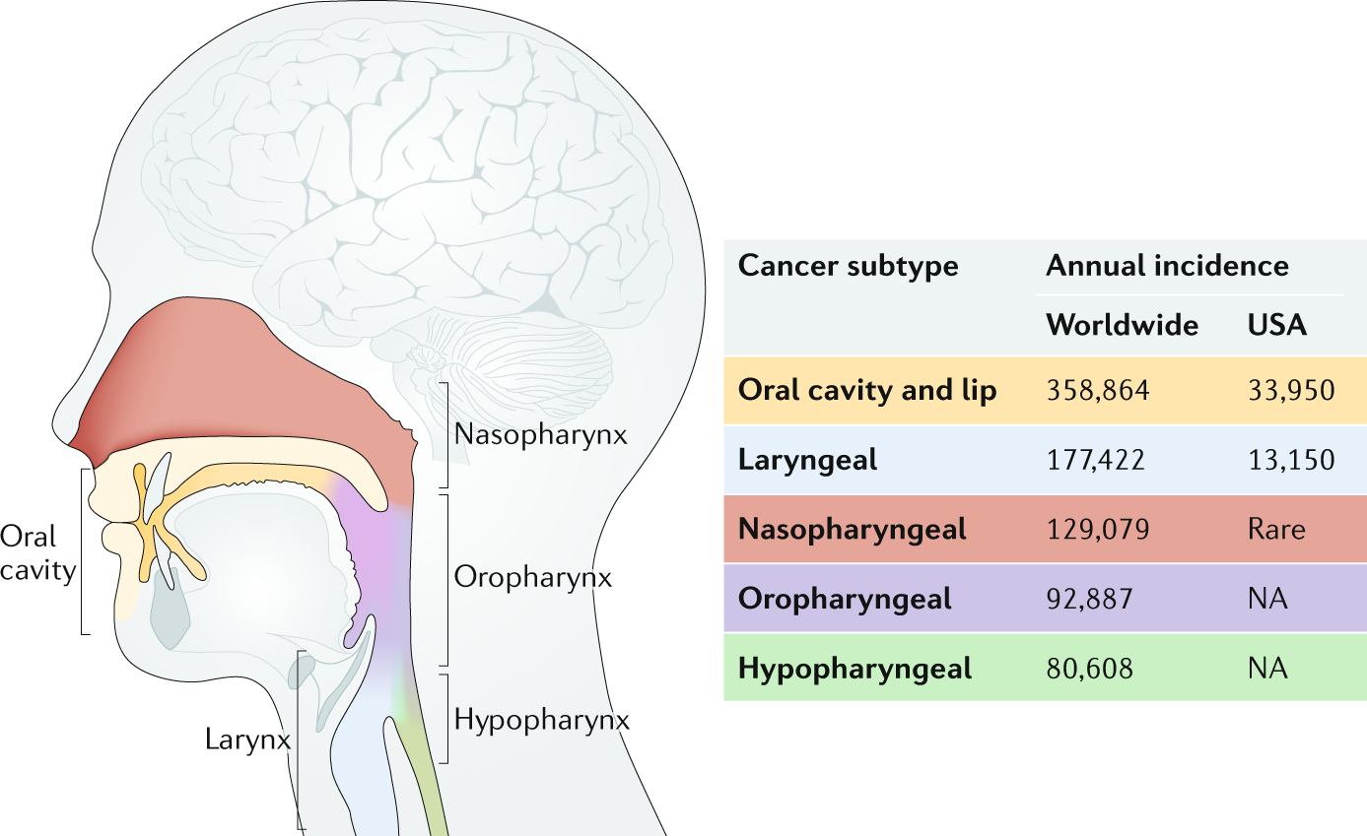
Head and neck squamous cell cancer
Etiology: tombacco, alcohol, HPV, UV light, poor oral hygiene, exposure environmental polutants

Slide 4
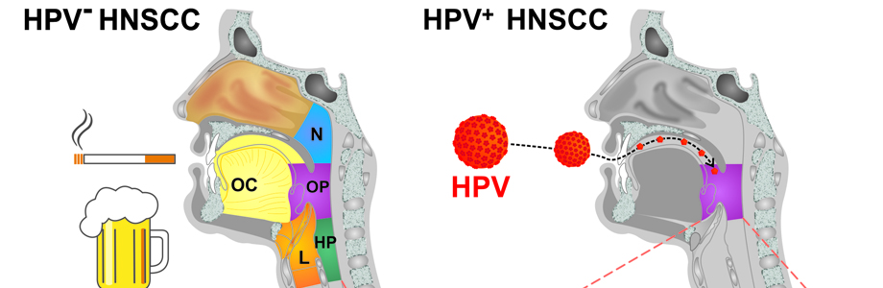
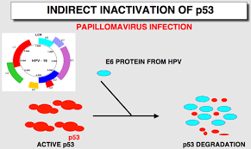
Head and neck squamous cell cancer
Pathogenesis:
  Initiation: Exposure to carcinogens or oncogenic viruses (e.g., HPV) leads to genetic alterations (mutations, deletions, amplifications)
  Promotion: Proliferation of initiated cells driven by continued exposure of carcinogens.
  Progression: additional genetic alterations, leading to invasive carcinoma.
Molecular Alterations:
  TP53 mutations: Commonly observed in HNSCC, associated with resistance to apoptosis and poor prognosis.
  HPV infection: Integration of HPV DNA into host genome, leading to overexpression of viral oncoproteins (e.g., E6, E7), inactivation of tumor suppressor genes (e.g., p53, Rb), and promotion of cellular proliferation.
  EGFR (epidermal growth factor receptor) overexpression: Associated with tumor proliferation, angiogenesis, and resistance to therapy

Slide 5
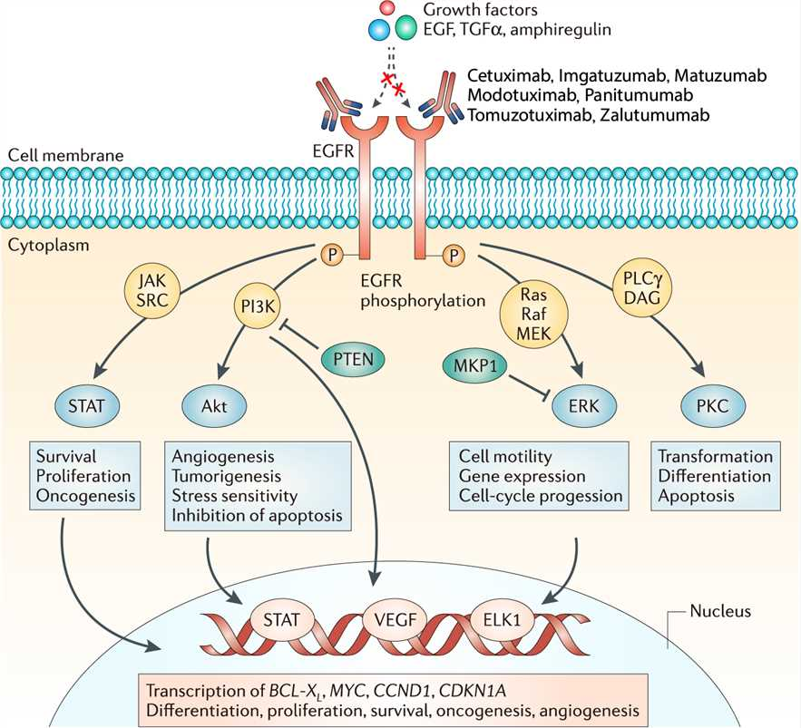
EGFR in head and necjsquamous cell cancer
Impact on Tumor Behavior:
  Proliferation: EGFR signaling stimulates cell proliferation and tumor growth.
  Survival: Enhances cell survival by inhibiting apoptosis Invasion and Metastasis:
Clinical Implications:
  Prognostic Marker: Higher EGFR expression associated with poorer prognosis
  Therapeutic Target: EGFR inhibitors (e.g., cetuximab) used in targeted therapy
  Resistance Mechanisms: Development of resistance to EGFR inhibitors through HER2, MET or mutations in EGFR itself.

Slide 6
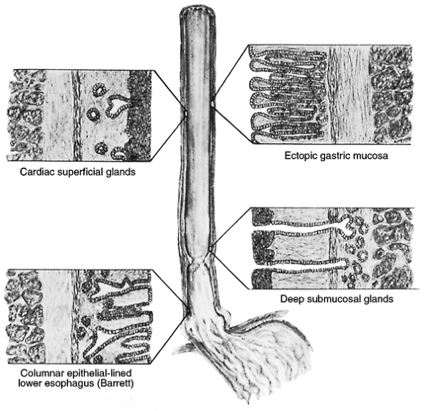
Esophagus - anatomy
Upper sphincter (cricopharyngeal muscle)
Upper 2/3 – skeletal muscle, squamous epithelium
Lower 1/3 – smooth muscle
Lower sphincter (LES)
Cylindrical epithelium in the terminal part

Slide 7
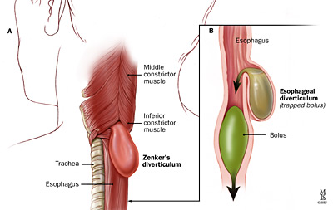
Esophageal diverticula
Weakness in the esophageal wall leading to outpouching formation
true diverticula (traction) – include muscular layer
pseudodiverticula – only mucous layer
Localization
  Zenker's Diverticulum: Located in the posterior hypopharyngeal wall, just above the upper esophageal sphincter.
  Epiphrenic Diverticulum: Arises in the distal esophagus, typically just above the lower esophageal sphincter.
Factors contributing to the development:
Zenker's Diverticulum: Dysfunction of the cricopharyngeal muscle (upper esophageal sphincter dysfunction) leads to increased pressure in the hypopharynx during swallowing, causing mucosal herniation.
Epiphrenic Diverticulum: Associated with esophageal motility disorders such as achalasia or diffuse esophageal spasm, leading to increased intraluminal pressures in the distal esophagus.
pseudodiverticulum
true diverticulum

Slide 8
Esophageal diverticula
Factors contributing to the development:
  Increased intraesophageal pressure
  Dysfunction of the esophageal sphincters
  Structural abnormalities
  Motor disorders (e.g., achalasia)
Pathophysiology:
  Result of mediastinal or periesophageal inflammation or fibrosis
  Traction on the esophageal wall leads to outpouching
Clinical features and complications:
  Often asymptomatic
  Dysphagia if large enough to obstruct the esophageal lumen
  Diverticulitis: Inflammation or infection of diverticula, usually resulting from fecal stasis and microperforation of diverticular wall.
pseudodiverticulum
true diverticulum

Slide 9
Dysphagia
Difficulty swallowing, a common symptom in esophageal diverticula
Mechanisms:
  Mechanical obstruction caused by the diverticulum
  Functional impairment due to associated motility disorders
Functional
  Inflammation in gastroesophageal reflux
  Sclerodermia
  Neuropathy (e.g. in diabetes)
  Amyotrophic lateral sclerosis
  Achalasia
Obstructive
  Tumours
  Strictures
  Peptic ulcers

Slide 10
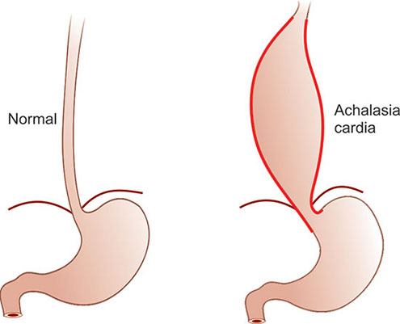
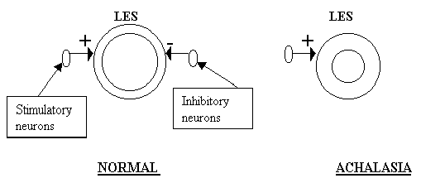
Esophageal achalasia
The lower sphincter is incapable of relaxation
This leads into esophageal dilatation and loss of peristaltic movements
The primary cause is the disorder of myenteric plexus (plexus Auerbachi), which produces NO
NO acts as a neurotransmitter, leading to relaxation of the LES
Most often, it is caused by autoimune destruction
Complications: Esophageal dilation, aspiration pneumonia.

Slide 11
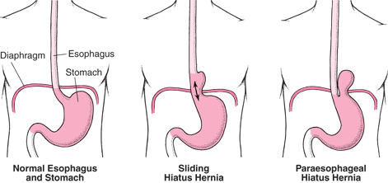
Hiatal hernias
Weakness in Diaphragmatic Structures:
  phrenoesophageal ligament and muscular diaphragmatic crura, allowing the stomach to herniate through the esophageal hiatus.
Increased Intra-abdominal Pressure: (obesity, pregnancy, chronic cough, or heavy lifting)
Aging: Age-related changes in connective tissue
paraesophageal
  Part of stomach‘s fundus is squeezed into thoracic cavity paralelly with esophagus
  This can lead into its incarceration or strangulation with necrosis (life-threatening)
  Mostly, it manifests by pain and vomiting
sliding
  Lower esophageal sphincter and upper part of stomach slides into thoracic cavity
  Low external pressure in the thoracic cavity leads into the loss of function of LES and gastroesophageal reflux

Slide 12
Hiatal hernias – risk factors, complications
Wide hiatus
Obesity
High intraabdominal pressure
Gravidity
Complications:
Gastroesophageal Reflux Disease
Esophagitis: Barrett's esophagus
Bleeding

Slide 13
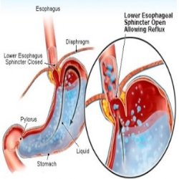
Gastroesophageal reflux disease (GERD)
Retrograde movement of gastric juice = Loss of anti-reflux barrier
Pathophysiology:
Incompetent lower esophageal sphincter (LES) allowing retrograde flow of gastric contents.
Impaired esophageal clearance mechanisms.
Factors contributing to LES dysfunction:
    Hiatal hernia
    Obesity
    Smoking
    Certain medications (e.g., anticholinergics, calcium channel blockers)

Slide 14
GERD – symptoms and complications
Clinical Features:
  Heartburn: Retrosternal burning sensation, often exacerbated by lying down or after meals.
  Regurgitation: Sour or bitter taste in the mouth due to refluxed gastric contents.
  Dysphagia: Sensation of difficulty swallowing, especially in severe cases.
Complications:
  Esophagitis: Inflammation of the esophageal mucosa.
  Barrett's esophagus: Metaplastic change in the esophageal epithelium, predisposing to esophageal adenocarcinoma.

Slide 15
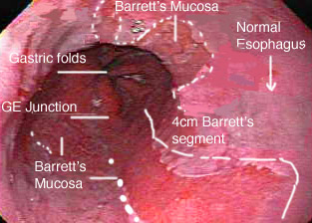
Barrett‘s esophagus
metaplastic change in the esophageal epithelium, where normal squamous epithelium is replaced by columnar epithelium containing goblet cells.
Causes
GERD
Hiathal hernia
Genetic factors
Lifestyle (obesity, smoking), age, male gender, NSAID overuse

Slide 16
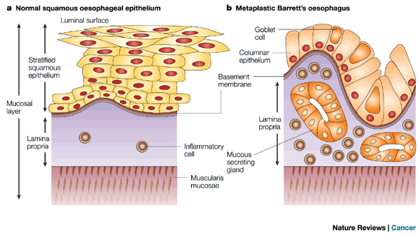
Barrett‘s esophagus
Mechanism
Activation of signaling pathways involved in epithelial cell differentiation and proliferation
Wnt/β-catenin, Notch, and Hedgehog signaling, contributes to the development and maintenance of metaplasia.
Complications:
Esophageal Adenocarcinoma (EAC)
(not Esophageal Squamous Cell Carcinoma!)
Dysplasia:
Gastroesophageal Reflux Disease (GERD)

Slide 17
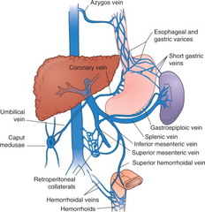
Esophageal varices
Definition: dilated, tortuous veins located in the submucosa of the esophagus, typically as a result of portal hypertension.
Pathophysiology
Portal hypertension from liver cirrhosis.
Collateral vessels form, causing varices.
Varices prone to rupture, leading to bleeding.
Causes of Portal Hypertension:
Liver Cirrhosis: Main cause.
Portal Vein Thrombosis.
Budd-Chiari Syndrome (hepatic venous outflow obstruction).

Slide 18
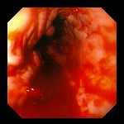
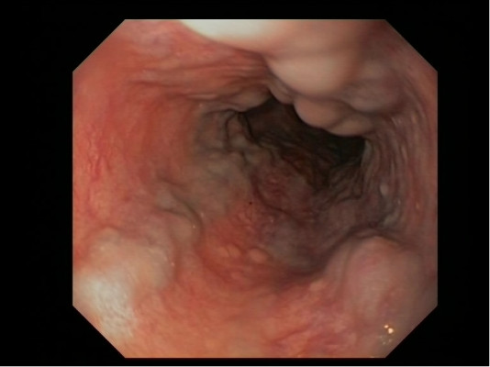
Esophageal varices - complications
Esophageal varices
Diagnosis:
Upper endoscopy.
Imaging: Doppler ultrasound, CT, MRI.
Liver function tests.
Complications:
Variceal hemorrhage.
Hypovolemic shock.
Hepatic encephalopathy.
Bleeding

Slide 19
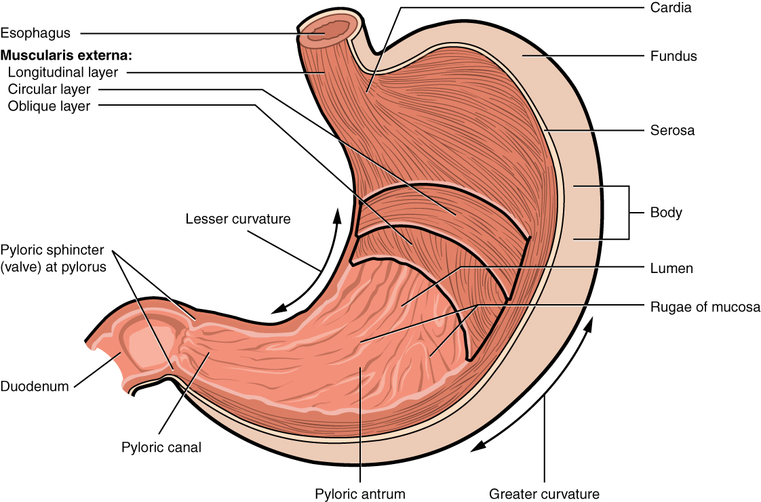
Stomach physiology
Motor functions of the stomach
  storage
  mixing and propulsion
  emptying
Secretions
  parietal cells - HCl, intrinsic factor
  chief cells – enzymes (pepsinogen, gastric lipase)
  surface cells - mucous, sodium bicarbonate

Slide 20
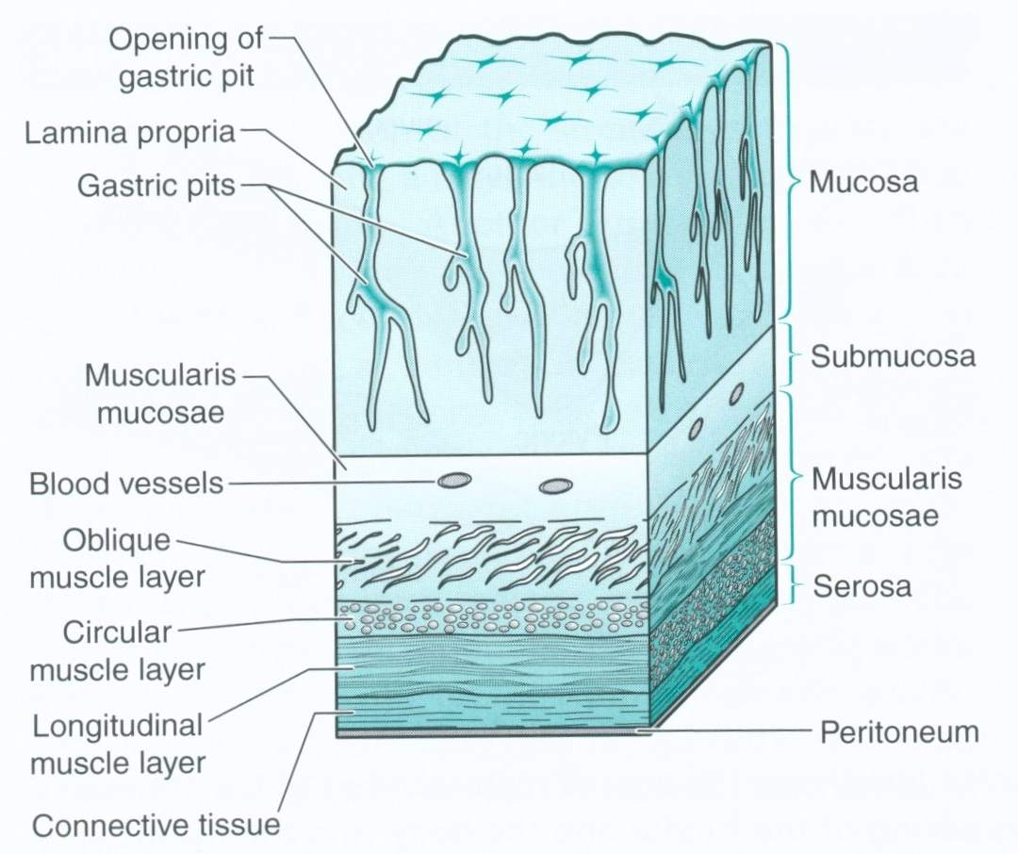
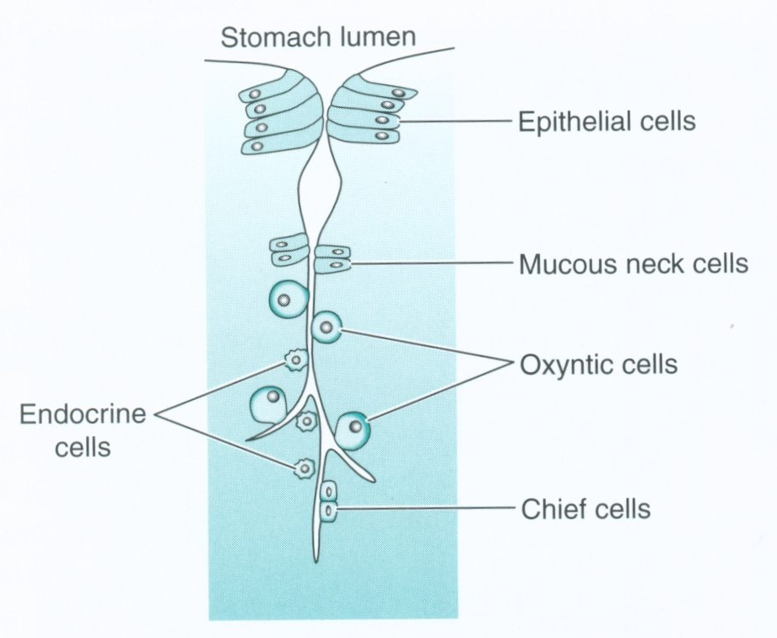

Slide 21
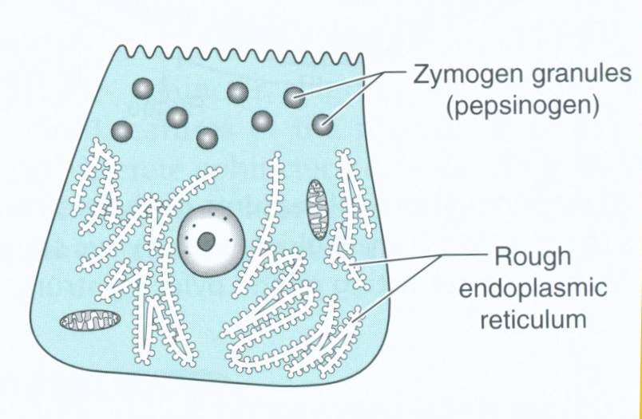
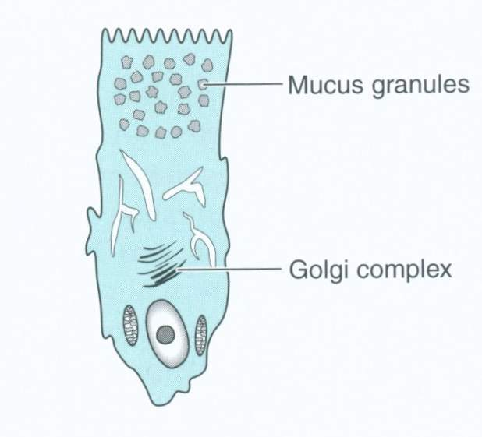
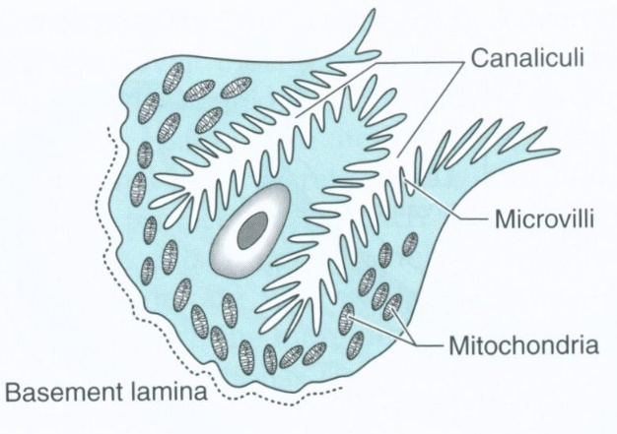
Chief cell
Mucous neck cell
Parietal cell
Secretion of Hydrochloric Acid (HCl):
  Activated by histamine, gastrin, and acetylcholine.
  Lowers pH of gastric contents for optimal enzymatic activity and antimicrobial defense.
Secretion of Intrinsic Factor:
  Essential for absorption of vitamin B12 in the ileum.
  Deficiency leads to pernicious anemia.
Secretion of Pepsinogen:
  Inactive precursor of pepsin, a proteolytic enzyme.
  Activated to pepsin by low pH in the stomach.
Contribution to Protein Digestion:
  Breaks down dietary proteins into peptides and amino acids.
Production of Mucus and bicarbonate: Forms protective layer over gastric mucosa.
Prevents self-digestion by gastric acid and pepsin.
Facilitates smooth passage of food through stomach.

Slide 22
Other cell types
Enterochromaffin-like (ECL) Cells:
  Secretion of Histamine:
    Acts as a paracrine signaling molecule to stimulate parietal cells.
    Potentiates secretion of HCl in response to gastrin and acetylcholine.
G Cells (Gastric Cells):
  Secretion of Gastrin:
    Stimulates acid secretion by parietal cells.
    Promotes gastric motility and emptying.
    Regulated by luminal pH and presence of food in stomach.
D Cells:
  Secretion of Somatostatin:
    Inhibits acid secretion by parietal cells.
    Acts as a negative feedback regulator of gastric acid secretion.

Slide 23
Phases of gastric secretion regulation
Phase | Trigger | Mechanism | Contribution to Secretion
Cephalic Phase | Smell, taste, sight, thought of food | Vagus nerve (ACh) stimulates parietal cells, G cells | ~30% of total secretion
Gastric Phase | Food enters stomach (distension, peptides, pH change) | Gastrin (G cells), vagus nerve (ACh), histamine (ECL cells) | ~60% of total secretion
Intestinal Phase | Chyme enters duodenum | Enterogastric reflex (inhibitory), secretin, CCK, GIP | ~10% of secretion, mainly inhibitory

Slide 24
Neural Regulation of Gastric Secretion
Vagus nerve (parasympathetic system) plays a major role:
  Stimulates parietal cells (HCl secretion).
  Stimulates G cells (gastrin release).
  Stimulates chief cells (pepsinogen release).
  Increases mucus production.
Local enteric nervous system (ENS):
  Controls peristalsis, secretion, and feedback inhibition.
Neurotransmitters Involved
Neurotransmitter | Effect
Acetylcholine (ACh) | Stimulates parietal cells, G cells, and ECL cells (histamine release)
Gastrin-releasing peptide (GRP) | Stimulates G cells (gastrin release)
VIP (Vasoactive Intestinal Peptide) | Inhibits gastric secretion, stimulates bicarbonate secretion
Somatostatin (from D cells) | Inhibits gastrin, parietal cells, and histamine release

Slide 25
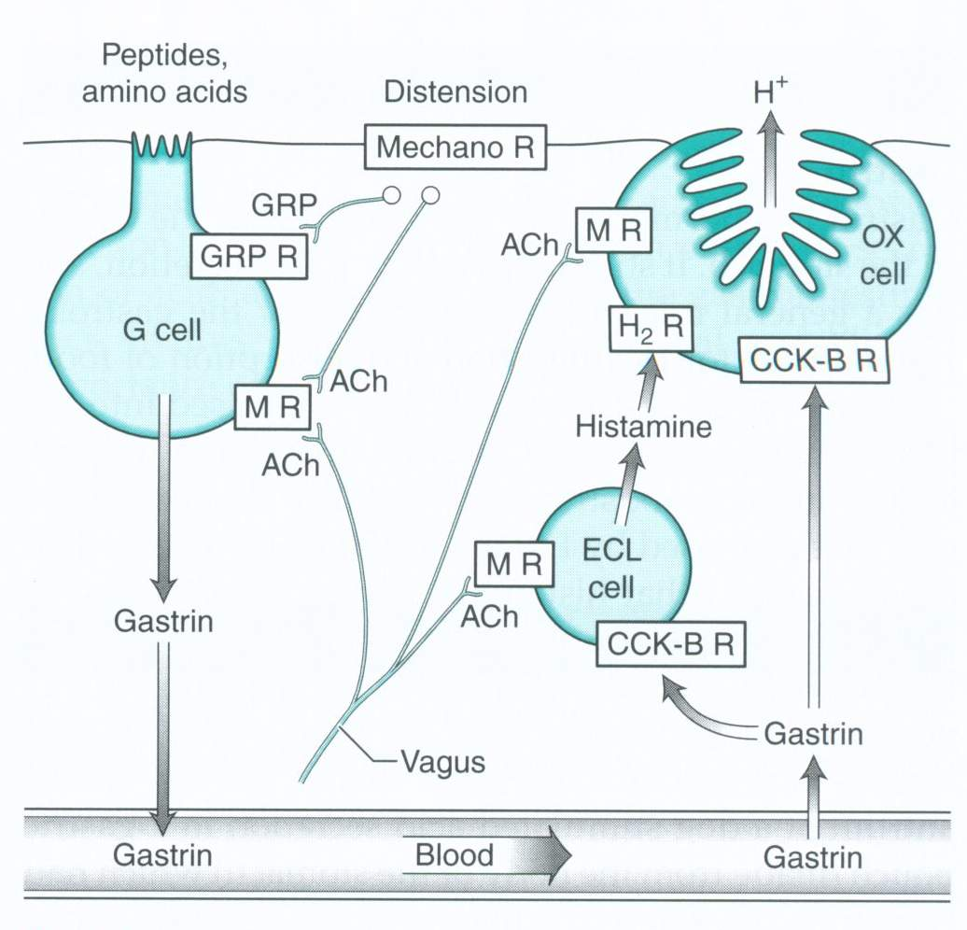
Hormonal Regulation of Gastric Secretion
Gastrin (Key Stimulatory Hormone):
Secreted by: G cells (in the antrum of the stomach).
Stimulus:
  Presence of peptides/amino acids in the stomach.
  Gastric distension.
  Vagal stimulation (via GRP).
Effects:
  Stimulates parietal cells → ↑ HCl secretion.
  Stimulates chief cells → ↑ pepsinogen secretion.
  Stimulates ECL cells → ↑ histamine, which further stimulates acid secretion.
  Enhances gastric motility.
Histamine (Paracrine Regulation)
Secreted by: Enterochromaffin-like (ECL) cells.
  Stimulus: Gastrin and vagal stimulation.
  Effect: Binds H₂ receptors on parietal cells → potentiates acid secretion.
  Clinical relevance: H₂ blockers (e.g., ranitidine) reduce acid secretion

Slide 26
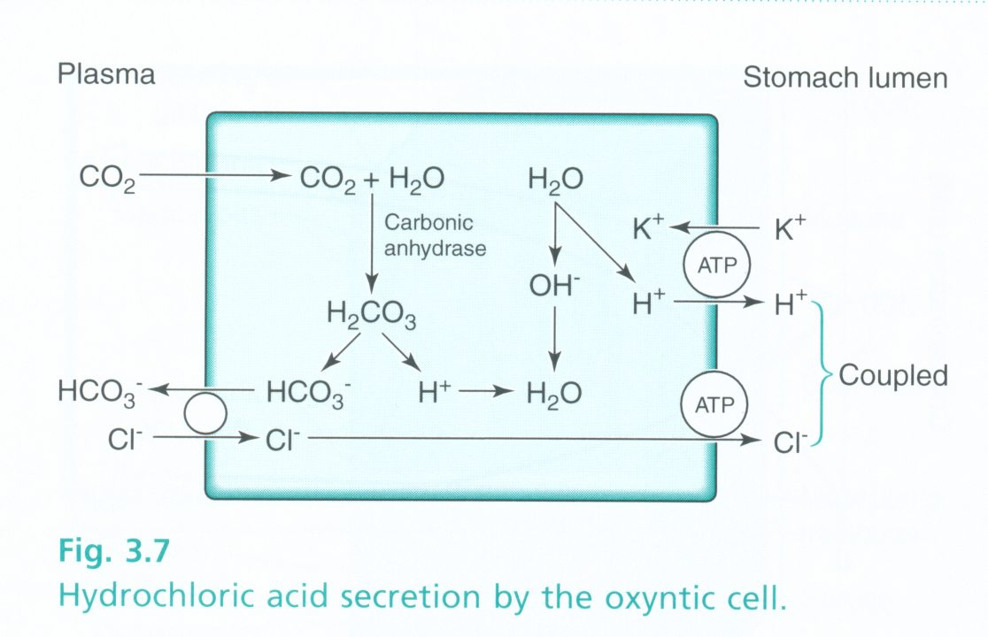
Hydrochloric acid secretion in parietal cells
Stimulation: Triggered by various stimuli including histamine, gastrin, and acetylcholine.
Activation of H+/K+ ATPase Pump:
  Proton pump located on the apical membrane of parietal cells.
  Exchanges cytoplasmic K+ for luminal H+ ions, generating an electrochemical gradient.
Secretion of HCl:
  H+ ions are actively pumped into the stomach lumen.
  Cl- ions follow passively via anion channels, forming HCl.
Acidification of Gastric Contents:
  Lowers pH to around 1-2, creating an acidic environment optimal for digestion and microbial defense.
Notes:
Chloridové ionty jsou aktivně transportovány z cytoplazmy do kanalikulu a sodné ionty jsou aktivně transportovány z kanalikulu do bb. Toto vytváří negativní potenciál v kanalikulu, který zapříčiňuje difuzi draselných a malého množství sodných iontů zpět do kanalikulu.
Voda disociuje v buňce a hydrogenový iont je aktivně transportován do kanalikulu HK ATP-ázou.
Voda prochází pasivní difuzí do kanalikulu, takže v kanalikulu máme roztok HCl s malou příměsí KCl a stopami NaCl.
Oxid uhličitý reaguje za katalýzy karboanhydrázy s hydroxylem a opouští bb.

Slide 27
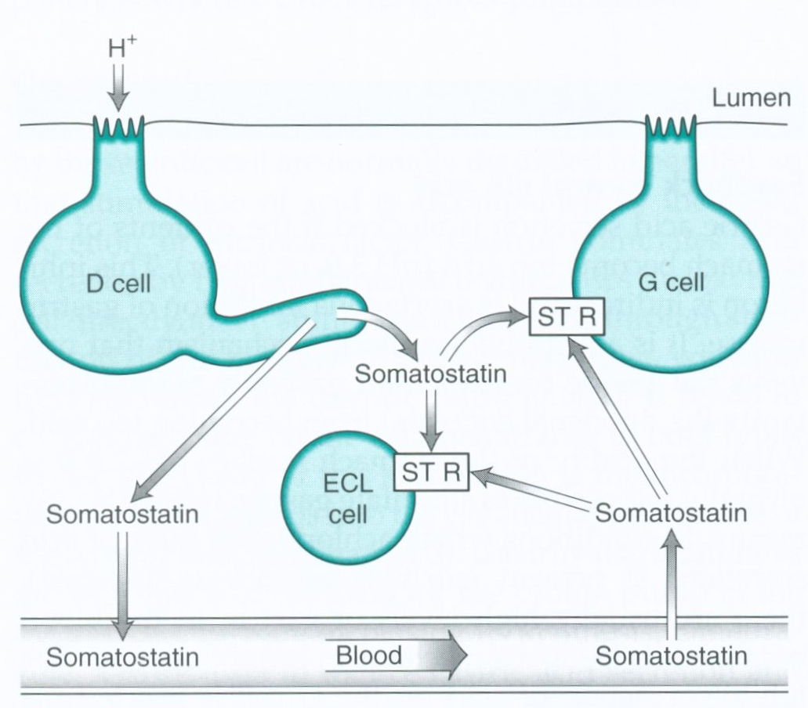
Somatostatin : Negative Regulation of HCl
    key inhibitory regulator of gastric acid secretion
    Released by D cells in response to low luminal pH and inhibits acid secretion by parietal cells.
  Feedback loop helps maintain gastric pH balance and prevent excessive acid production.
  Release Stimuli:
    Low pH (acidic conditions, pH <3 in stomach) → Direct stimulation of D cells.
    Secretin (from S cells in duodenum) → Enhances somatostatin release.
    CCK (from I cells in duodenum) → Also promotes somatostatin release.
    Vagal stimulation (ACh, via M3 receptors) inhibits somatostatin (during the cephalic and gastric phases).

Slide 28
Pathology
Pathophysiology:
  Peptic Ulcer Disease (PUD): Erosion of gastric or duodenal mucosa due to imbalance between protective factors (mucus, bicarbonate) and damaging factors (acid, pepsin).
  Gastritis: Inflammation of gastric mucosa, often due to infection (Helicobacter pylori), NSAID use, or alcohol abuse.
  Gastric Cancer: Malignant tumor arising from gastric epithelium, often associated with chronic gastritis, H. pylori infection, or genetic predisposition.
  Zollinger-Ellison syndrome
  Gastroparesis
Common Symptoms:
  Dyspepsia: Epigastric discomfort, bloating, early satiety.
  Hematemesis: Vomiting of blood, indicative of gastrointestinal bleeding.
  Melena: Dark, tarry stools due to digested blood.
  Nausea, vomiting, weight loss.
Notes:
Dobře definována jedině histologicky, ostatní definice závisí na úhlu pohledu – klinická gastritida, endoskopická, rentgenologická atd.

Slide 29
Gastritis
Inflammation of the gastric mucosa, characterized by mucosal injury and infiltration of inflammatory cells.
Acute Gastritis:
  Sudden onset, often due to irritants such as NSAIDs, alcohol, or infectious agents (e.g., H. pylori).
Chronic Gastritis:
  Persistent inflammation, typically associated with H. pylori infection, autoimmune conditions (e.g., autoimmune gastritis), or long-term use of NSAIDs.
Etiology:
  Helicobacter pylori (H. pylori) infection: Most common cause of chronic gastritis, implicated in peptic ulcer disease and gastric cancer.
  NSAID Use: Direct mucosal injury leading to erosions and inflammation.
  Alcohol: Disruption of mucosal barrier and stimulation of acid secretion.
  Autoimmune Disorders: Antibodies target gastric mucosal cells, leading to chronic inflammation (e.g., autoimmune gastritis).
  Severe inless

Slide 30
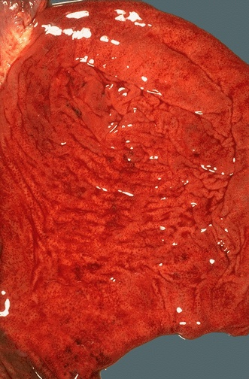
Acute Gastritis mechnaism
Etiology:
  Helicobacter pylori (H. pylori) infection: Most common cause of chronic gastritis, implicated in peptic ulcer disease and gastric cancer.
  NSAID Use: Inhibtion of prostaglandins, Direct mucosal injury leading to erosions and inflammation.
  Alcohol: Disruption of mucosal barrier and stimulation of acid secretion.
  Severe inless
Disruption of mucosal barrier → acid-induced injury → inflammation.
Symptoms: Epigastric pain, nausea, vomiting, GI bleeding (if severe).

Slide 31
Gastritis mechnaism
Activation:
  H. pylori: Release of virulence factors (e.g., cytotoxin-associated gene A, CagA) causing mucosal damage.
  NSAIDs/Alcohol: Direct injury to gastric mucosa, disrupting barrier function.
Inflammatory Response:
  Recruitment of immune cells (neutrophils, lymphocytes) to the gastric mucosa.
  Release of pro-inflammatory cytokines (e.g., interleukin-1β, tumor necrosis factor-α).
Mucosal Damage:
  Disruption of epithelial integrity, erosion of gastric mucosa.
  Activation of inflammatory pathways, amplifying tissue injury.
Consequences:
  Chronic Inflammation: Persistence of inflammatory
  Ulcer Formation
  Carcinogenesis: Chronic inflammation-associated

Slide 32
Gastritis mechnaism
Type A (Autoimmune metaplastic atrophic gastritis):
  Pathophysiology: Autoantibodies against parietal cells & intrinsic factor → achlorhydria, pernicious anemia (B12 deficiency).
  Associations: Increased risk of gastric cancer.
Type B (H. pylori-associated gastritis):
  Pathophysiology: H. pylori colonizes antrum → inflammation, increased gastrin → increased acid secretion → risk of peptic ulcer disease.
  Associations: Can progress to MALT lymphoma, gastric adenocarcinoma.

Slide 33
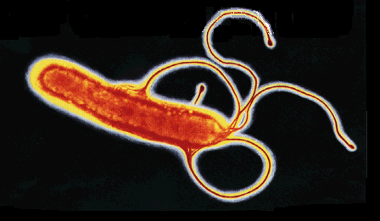
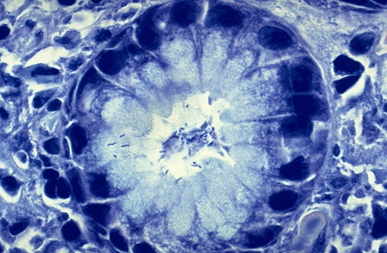
H Pylori
Gram-negative, spiral-shaped, microaerophilic bacterium
Resides in the gastric mucosa, primarily in the antrum of the stomach
50-60% of the global population infected, but only some develop clinical disease
Adherence
Colonization
Inflammatory Response

Slide 34
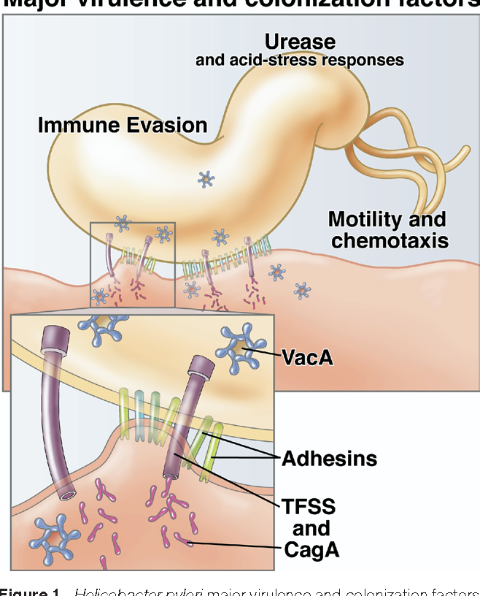
Helicobacter pylori
Urease Production:
  H. pylori converts urea to NH3+CO2, buffering gastric acid.
Movement:
  Flagella enable motility, facilitating penetration of mucus layer.
Adhesins:
  BabA, SabA, AlpA/B: Bind to gastric epithelial cells, facilitating colonization.
Cytotoxin-Associated Gene A (CagA):
  Injected via Type IV Secretion System (T4SS).
  Phosphorylated CagA alters host cell signaling, contributing to gastric carcinogenesis.
Vacuolating Cytotoxin A (VacA):
  Forms pores, causing vacuolation and cellular damage.
  Induces apoptosis and modulates immune response.
Gamma-Glutamyl Transpeptidase (GGT):
  Generates reactive oxygen species, promoting oxidative stress.
  Impairs host immune response and mucosal integrity.
Outer Inflammatory Protein A (OipA):
  Induces inflammation and enhances adherence.

Slide 35
H Pylori
Induction of Chronic Inflammation
H. pylori triggers an immune response, but evades clearance.
Inflammation leads to:
  Chronic gastritis (lymphocyte infiltration, epithelial damage).
  Increased gastrin secretion → acid hypersecretion (→ duodenal ulcers).
  Metaplasia & dysplasia → potential progression to gastric adenocarcinoma.
Diagnostic Tests:
  Stool antigen test (detects H. pylori antigens).
  Endoscopic biopsy with histology or urease test.
  Urea breath test (detects CO₂ from urease activity).

Slide 36
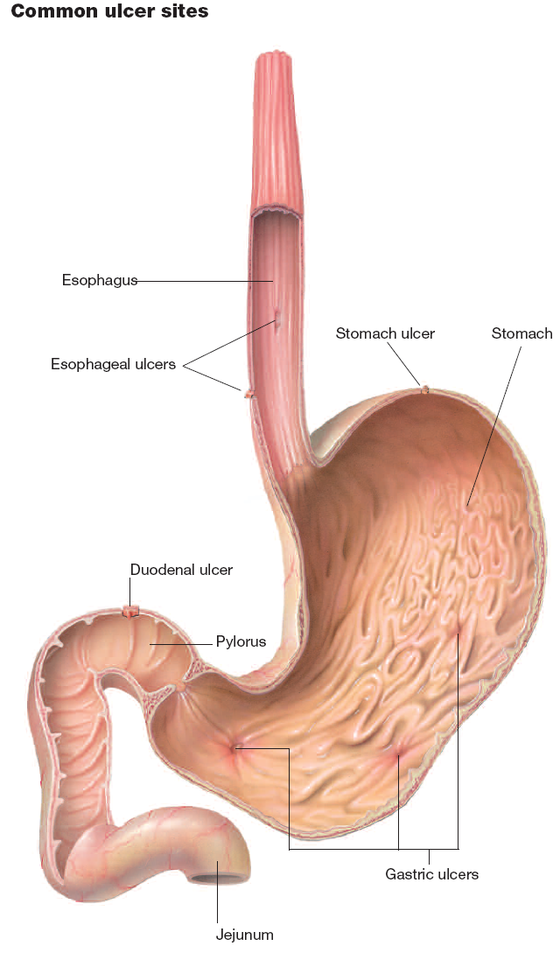
Peptic ulcer
Mucosal defect reaching deeper than muscularis mucosae layer, localized in areas exposed to acid-pepsin secretions.
Causes:
  Helicobacter pylori (H. pylori) infection
  NSAIDs Disrupt mucosal integrity, inhibit prostaglandin synthesis, increasing susceptibility to injury.
  Excessive alcohol consumption, smoking, stress, and genetic predisposition.
Most Common Locations:
  Gastric ulcers → Lesser curvature of the stomach (near the antrum).
  Duodenal ulcers → First part of the duodenum.

Slide 37
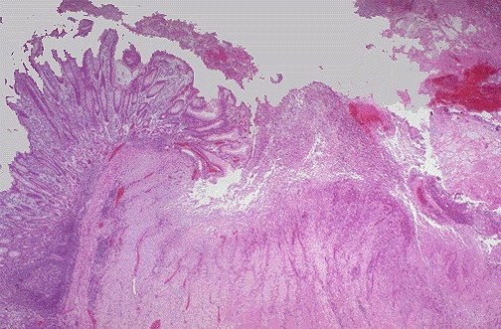
Pathological anatomy
Diagnosis:
Upper Endoscopy: Direct visualization of ulcers, biopsy for H. pylori testing and histological examination.
H. pylori Testing: Serology, urea breath test, stool antigen test.
Imaging Studies: Upper GI series, CT scan, MRI, to assess ulcer size and complications.

Slide 38
Stomach vs. Duodenal Ulcers Differences
Feature | Gastric Ulcers (Stomach) | Duodenal Ulcers
Location | Lesser curvature of the stomach (antrum) | First portion of the duodenum
Primary Cause | ↓ Mucosal protection (weakened barrier) | ↑ Acid secretion
H. pylori association | ~70% of cases | >90% of cases
Gastrin levels | Normal or decreased | Increased (due to reduced acid inhibition)
Gastric acid secretion | Normal or low (mucosal damage is primary issue) | ↑ Increased (H. pylori affects inhibitory feedback)
Pain Pattern | Worsens with food (acid secretion directly irritates ulcer) | Improves with food (bicarbonate-rich secretions neutralize acid), worsens 2-3 hours later or at night
Cancer Risk | Higher (gastric adenocarcinoma risk) | Lower risk of malignancy
Complications | Bleeding (gastric artery erosion), perforation, gastric outlet obstruction | Perforation (into pancreas), bleeding (gastroduodenal artery erosion)

Slide 39
Complications of peptic ulcer
Complications:
  Bleeding: Major complication, requires urgent medical attention and may necessitate endoscopic hemostasis or surgery.
  Perforation: Ulcer penetration through the gastric wall, leading to peritonitis and requiring emergency surgery.
  Gastric Outlet Obstruction: Scar tissue formation or edema may obstruct gastric emptying, requiring endoscopic dilation or surgical intervention.

Slide 40
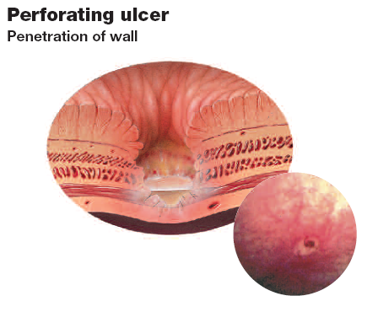
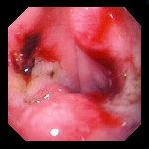
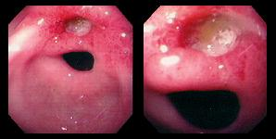
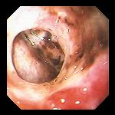
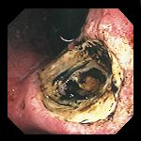
bleeding
Perforation

Slide 41
Treatment
  Eradication of H. pylori: Antibiotics (e.g., clarithromycin, amoxicillin) with proton pump inhibitors (PPIs).
  Acid Suppression: PPIs or H2-receptor antagonists to reduce acid secretion and promote ulcer healing.
  NSAID Use: Discontinue or reduce dosage, consider alternative medications or gastroprotective agents.
  Lifestyle Modifications: Smoking cessation, moderation of alcohol intake, stress management.

Slide 42
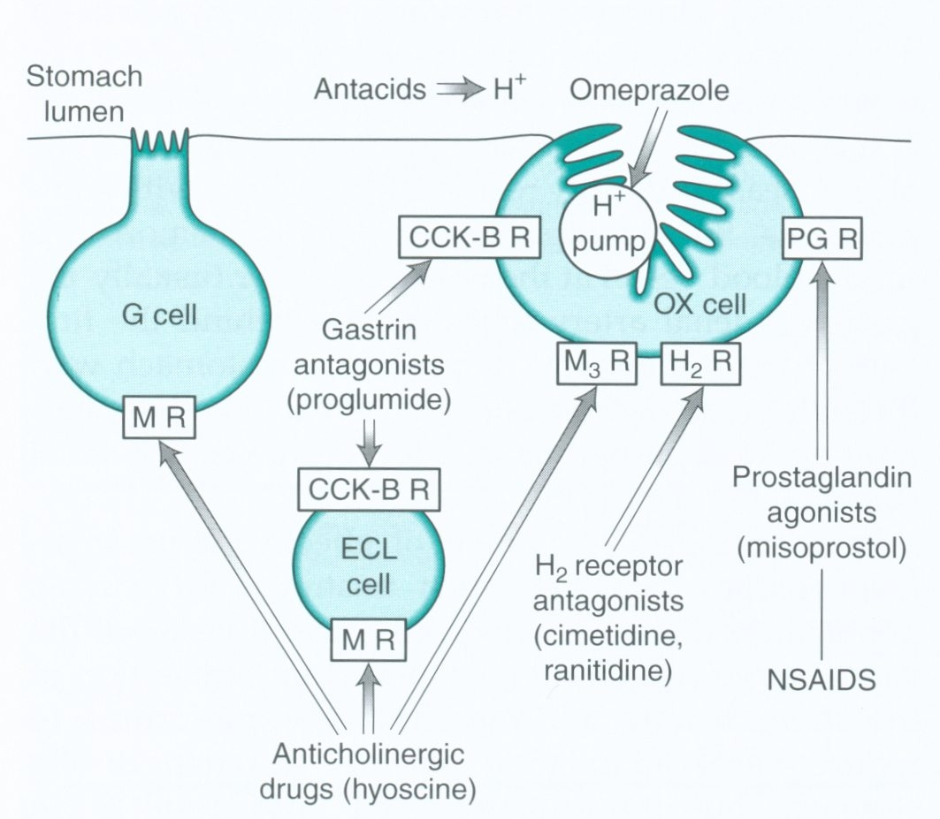
Treatment
Histamine Receptor Antagonists (H2 Blockers):
  Examples: Ranitidine, Cimetidine, Famotidine.
  Mechanism: Block histamine receptors (H2 receptors) on parietal cells, reducing gastric acid secretion.
Proton Pump Inhibitors (PPIs):
  Examples: Omeprazole, Esomeprazole, Lansoprazole.
  Mechanism: Irreversibly inhibit the H+/K+ ATPase pump on parietal cells, preventing acid secretion.
Antacids:
  Examples: Aluminum hydroxide, Magnesium hydroxide, Calcium carbonate.
  Mechanism: Neutralize gastric acid, providing rapid but short-term relief from ulcer symptoms.
  Result: Temporary reduction in acidity and symptomatic relief, but not effective for long-term ulcer management.

Slide 43
Stomach vs duodenal ulcers
 | Gastric | Duodenum
Causes | H. pylori infection. NSAID use. Excessive alcohol consumption. Smoking. | H. pylori infection NSAID use. Hypersecretory states (e.g., Zollinger-Ellison syndrome).
Clinical presentation | Epigastric pain worsened by meals. Nausea and vomiting. Hematemesis or melena. | Epigastric pain relieved by meals (hunger pain). Nighttime awakening due to pain. Hematemesis or melena

Slide 44
Gastric Cancer
Types:
  Adenocarcinoma (most common).
  MALT lymphoma (associated with H. pylori).
Risk Factors:
  H. pylori (chronic inflammation → atrophic gastritis → metaplasia → dysplasia).
  Diet: High salt, smoked foods, nitrosamines.
  Chronic gastritis (autoimmune or H. pylori-related).
  Genetic syndromes (e.g., Lynch syndrome).
Clinical Features:
  Weight loss, early satiety, epigastric pain.
  Acanthosis nigricans (paraneoplastic sign).
  Virchow’s node (supraclavicular),

Slide 45
Gastroparesis
Definition: Delayed gastric emptying without mechanical obstruction.
Causes:
  Diabetes mellitus (autonomic neuropathy).
  Vagal nerve damage (post-surgical, idiopathic).
  Medications (e.g., opioids, anticholinergics).
Symptoms:
  Nausea, bloating, early satiety, vomiting undigested food.
Diagnosis:
  Gastric emptying scintigraphy.
Treatment:
  Dietary modifications, prokinetic agents (metoclopramide, erythromycin).

Slide 46
Zollinger-Ellison Syndrome
Pathophysiology:
  Gastrin-secreting tumor (gastrinoma) → excessive acid production.
  Leads to multiple peptic ulcers, diarrhea, acid-related complications.
Diagnosis:
  Elevated serum gastrin levels.
  Secretin stimulation test (gastrin remains elevated).
Treatment:
  High-dose proton pump inhibitors (PPIs).
  Surgical removal if localized.

