Slide 1
Blood pressure measurement
The system pressure values are, for technical reasons, dependent on:
Measuring method used
  Non-invasive methods:
    auscultatory
    oscillometry
    ultrasound – very little used
    photopletysmography
  Invasive methods
    indirect – Swan-Ganz´s catheter
    direct – catheter with a pressure sensor at the end
Methodology
  Clinical measurement – in ambulance - practitioner
  Home measurement
  24hour ambulatory blood pressure monitoring

Slide 2
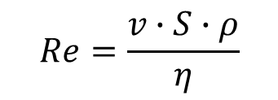
Laminar / turbulent flow, Korotkoff sounds
$$Re=\frac{v∙S∙ρ}{η}$$
laminar flow Re < 2000
turbulent flow Re > 3000
Reynolds number Re: predicts the transition from laminar to turbulent flow
v: velocity of blood flow
S: area of vascular lumen (π.r²)
ρ: density of blood
η: viscosity of blood
cuff
a. brachialis
Re₂
r₁
r₂
v₁
v₂
Re₁
laminar flow
turbulent flow
closely behind narrowing of the artery:
S₁ < S₂ a v₁≈ v₂ → Re₁ < Re₂ → turbulent flow

Slide 3
Digital photoplethysmography
(volume-clamp method)
Continuously blood pressure measurement - „beat to beat“ – from digital artery
Profesor Jan Peňáz – Department of Physiology – Masaryk university in Brno - patent 1969
Disadvantage: can not be used in conditions with peripheral vasoconstriction (shock states, vasoneurosis, diabetic angiopathy)

Slide 4
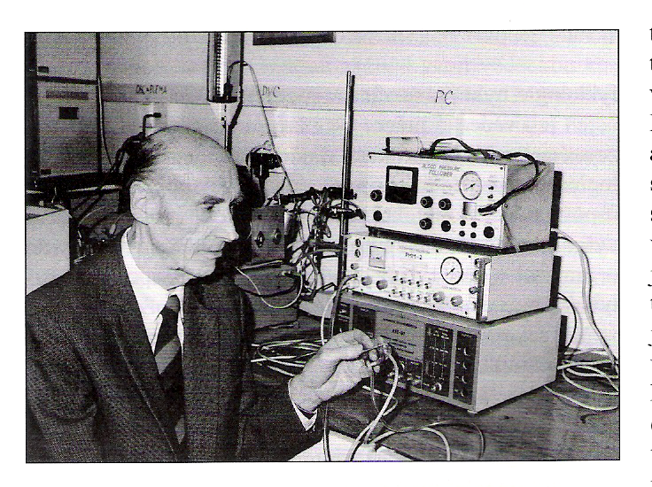

Slide 5
We need than pressure in the cuff corresponded to the pressure of the digital artery
(volume-clamp method or method of „lightway artery system“)
It is based on clamping the volume of finger arteries by fast changes of pressure in a special cuff equipped with a photoelectric plethysmograph to measure the vascular volume.
Method: photopletysmography
Recorded photoelectric plethysmogram
The new term: Transmural pressure = Pt (the pressure across the wall of the artery)
  BP, Pc (pressure in cuff), Pt
We estimated: BP=Pc if Pt=0
  photoplethysmogram registered the highest amplitude of oscilation --- we measure the MAP. This situation comming at the beginning of measurement, when the cuff is inflated
  step by step (5 mmHg) and Pc increase. In the moment of the highest amplitude is registered – feed-back loop started for obtained the constant volume of the finger. This feed-back control is based on record amount of the light from photocells

Slide 6
Penaz patent
He used the signal from the photocell to control the external cuff pressure and that to keep the finger volume unchanged. This has achieved that pressure in the cuff monitors blood pressure in the artery.

Slide 7
Peňáz method
photopletysmography (Recorded photoelectric plethysmogram)
(volume-clamp method – method of „lightway artery system“)
It is based on clamping the volume of finger arteries by fast changes of pressure in a special cuff equipped with a photoelectric plethysmograph to measure the vascular volume.
based on the fact- - we need than pressure in the cuff corresponds to the pressure in the digital artery
The new term: Transmural pressure – Pt (the pressure across the wall of the artery)
So, we know following parameters:
BP=Blood pressure inside of digital artery, Pc = pressure in cuff, Pt =transmural pressure
We estimated: BP = Pc it is mean, that Pt = 0 … photoplethysmogram registered the highest amplitude of oscilation --- we measure the MAP
This situation comming at the beginning of measurement, when the cuff is inflated step by step (5 mmHg) and Pc increase. In the moment of the highest amplitude is registered – feed-back loop started for obtained the constant volume of the finger. This feed-back control is based on record amount of the light from photocells

Slide 8
Peňáz patent (1969)
He used a photocell signal to control the outer cuff pressure so that the finger volume did not change

Slide 9
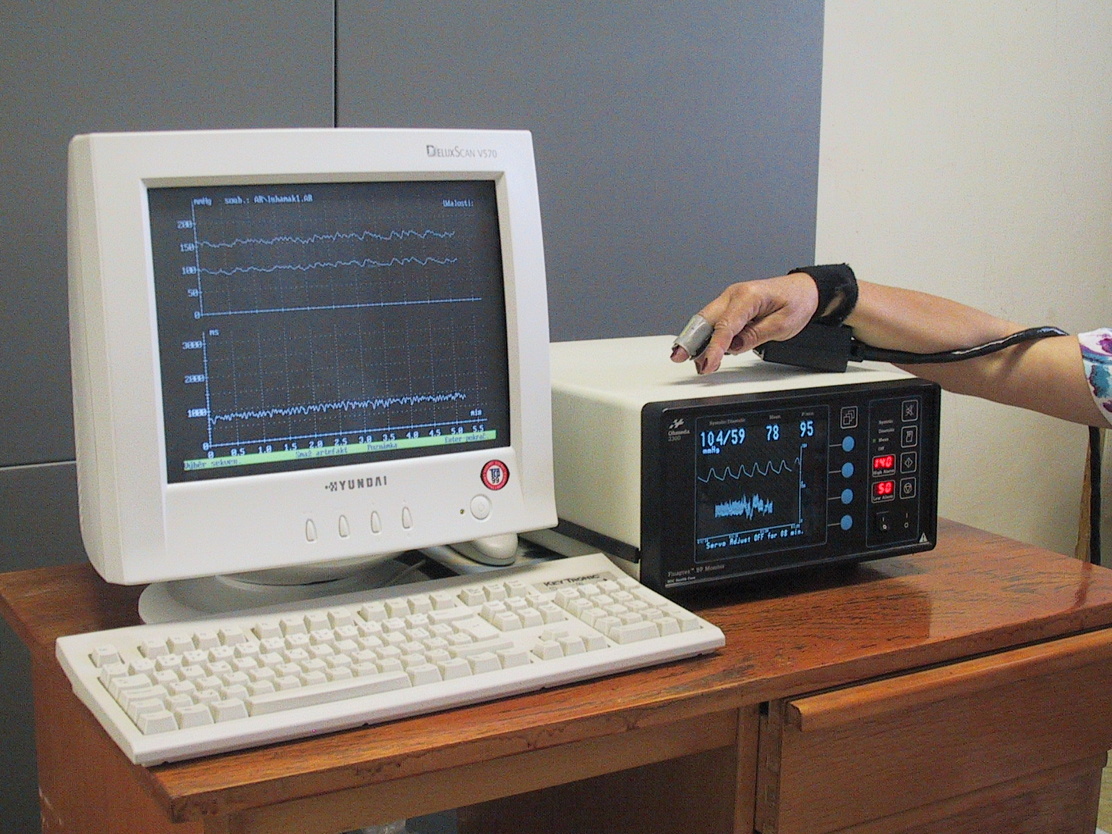
Finapres (Ohmeda, USA)

Slide 10
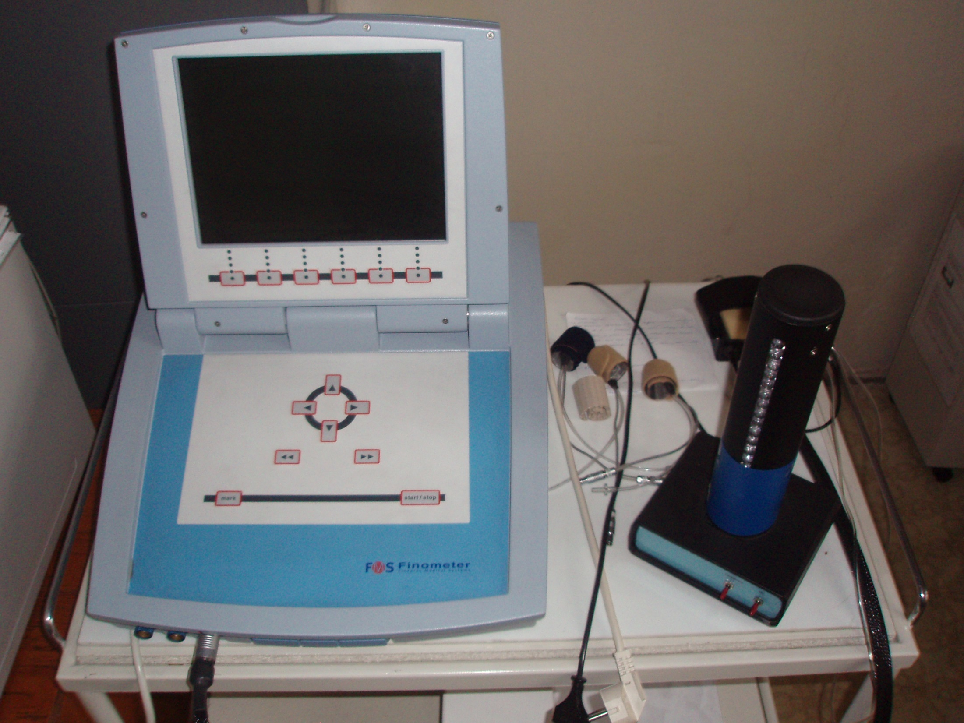

Slide 11
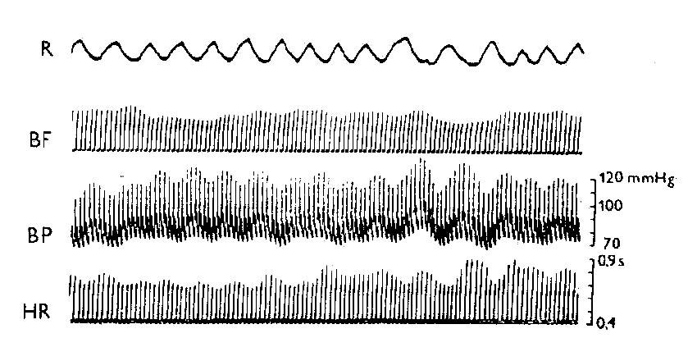
Record of breathing and waves in circulatory parameters
(Peňáz´s photoplethysmomanometr)

Slide 12
Continuously blood pressure measurement
Beat to beat record by Penaz method
BP is dynamic parameter
  variability of fluctuation of heart rate and blood pressure – regulation by baroreflex – cooperation both parts of autonomic nervous system (symphathetic and parasymphathetic part)
  Necessary component in clinical tests - head up table test (on inclined plane) and BP dysregulation in young subjects - dif.dg syncope
  BP regulation research - maneuvers – Valsalva etc. ... ..
  BP measurement in extreme situations: supersonic airplane pilots – overload condition, the cosmic program – weightlessness condition etc.

Slide 13
Invasive measurement of blood pressure
The most accurate measurement method of BP – but at great RISK:
- difficult accessibility, risk of infection diseases
Usage: BP monitoring in critical states (coronary units, intensive care units); in more complex therapeutic procedures
  Indirect - Swan-Ganze catheter - hollow tube, on the vessel side with a hole, the other side connected to the sensor - filled with physiological solution - transfer of pressure changes from the vessel's light towards the sensor – inaccurate
  Direct – special sensor – special microsensor on the vessel side - the blood pressure signal is transmitted from it
  up-to-date catheters - signal transmission via fiber optics
  Important for the diagnosis of all forms of pulmonary hypertension

Slide 14
Clinical statement
In keeping with a good practice is still auscultation method able to report reliable results
We must rely on white-coat hypertension versus masked hypertension in some patients
There is always higher BP in the case of BP measurement by physician and lower values measured by nurse or technician

Slide 15
„Home“ blood presure measurement
Advantage: measurement by patients, elimination of white-coat hypertension effect, measurement in long period
Disadvantage: technical problem, correct measurement by patient
Classic oscillometry method – cuff on the arm
  Attention on location of measurement on the wrist - in the vertical position - pressure above 15-20 mmHg higher than on the arm, even when in the heart position the SBP is higher by 2-3mmHg than on the arm
  Finger position cuff (non digital photoplethysmography) - Higher values of 4 mmHg than on the arm (another characteristic of the pulse curve in the finger artery)
  Values at home measurements are always lower than in the clinical setting – Hypertension society recommendation: BP higher than 135/85mmHg - are increased !

Slide 16
24 hour ambulatory blood pressure monitoring
Advantage: an overview of absolute values and variability in time-defined periods (! but still intermittent measurement!)
Oscillometric method
Information: SBP, DBP, pulse pressure, mean arterial pressure - profile of absolute values at monitored intervals; average and standard deviation for the period under review; % of the blood pressure parameters above the specified upper limit; calculation of different indexis; determination of variability of blood pressure fluctuation
The number of BP increases in more than 40% of all values in either on night – or day-time interval – dg: arterial hypertension
ABPM values are lower than clinical values - recommendations:
normal: below 135/85 daily and night under 120/70; 24 hour diameters 130/80 mmHg

Slide 17
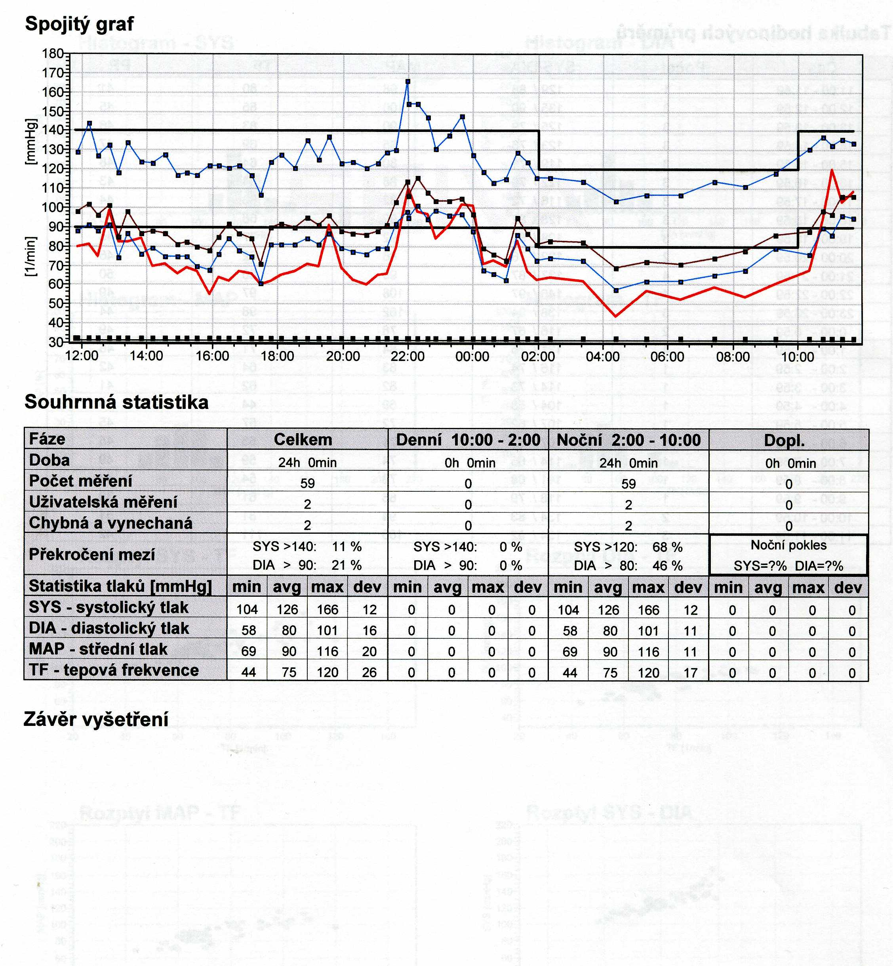

Slide 18
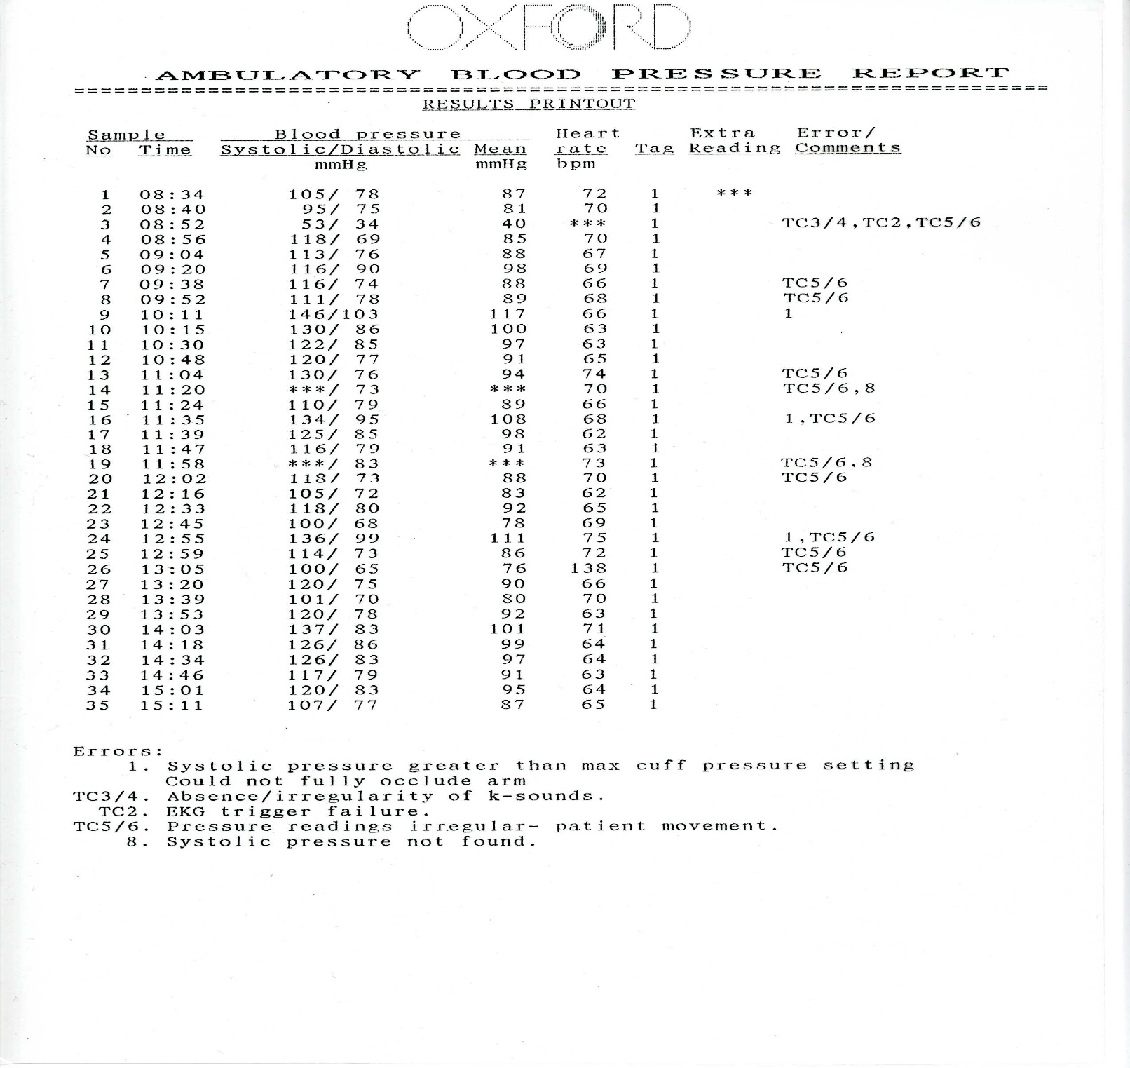

Slide 19
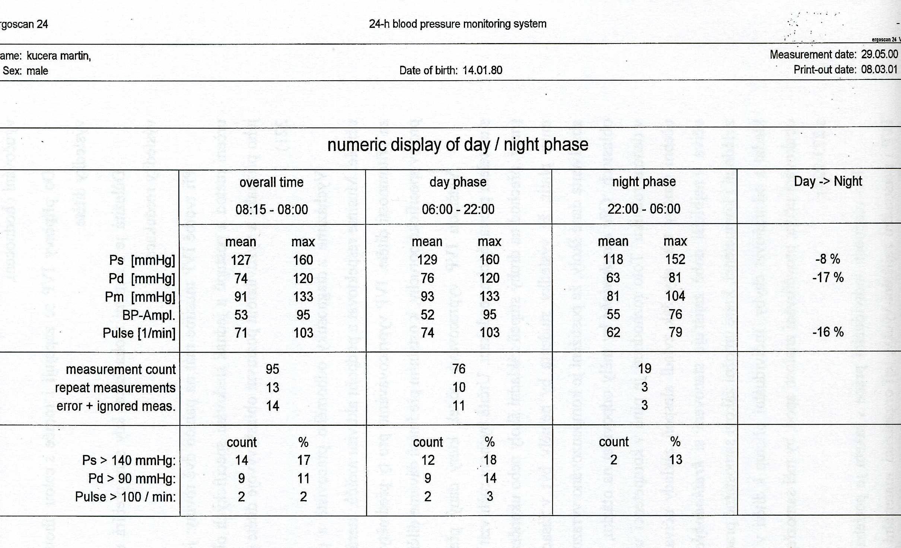

Slide 20
Specific features measurement
Pregnant women
  Physiological profile of pregnancy - decrease of BP with increase in cardiac output and large decrease of peripheral resistance = special hyperkinetic conditions - Korotkoff phenomena we auscultated even after deflation of the cuff - diastolic BP we estimated in IV phase of Korotkoff phenomena
  Elderly people with atherosclerosis - poor compressibility of the artery wall by a compression cuff - we need to inflate more - so we measure falsely higher SBP values - pseudohypertension
  Obese persons – using the right size of the cuff !!!!! using a standard cuff – overstocking of SBP
  Dynamic physical exercise - auscultation method may underestimate SBP by 15 mmHg, during recovery phase - overstatement of up to 30mmHg SBP; DBP less frequently but falsely low - better use for DBP measurement reading from phase IV of Korotkoff sounds

Slide 21
Actual blood pressure values are dependent on:
factors that are conditioned by the organism
on the measurement method
in which conditions the measurements are performed (methodology)
even on accuracy and reliability of instruments (technical page - necessary tests and calibration of pressure device / 1 year)
THIS MUST BE ALLOWED TO CONSIDER AT THE MEASUREMENT IN CLINICAL PRACTICE

Slide 22
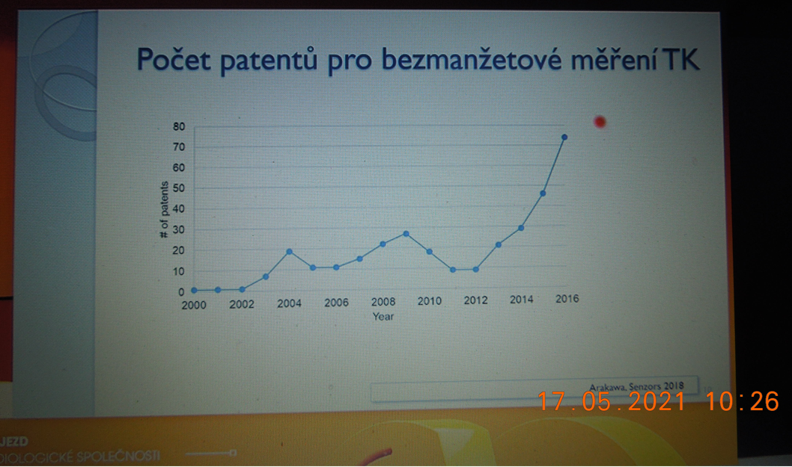
Measurement of BP without the use of cuff
Number of patents

Slide 23
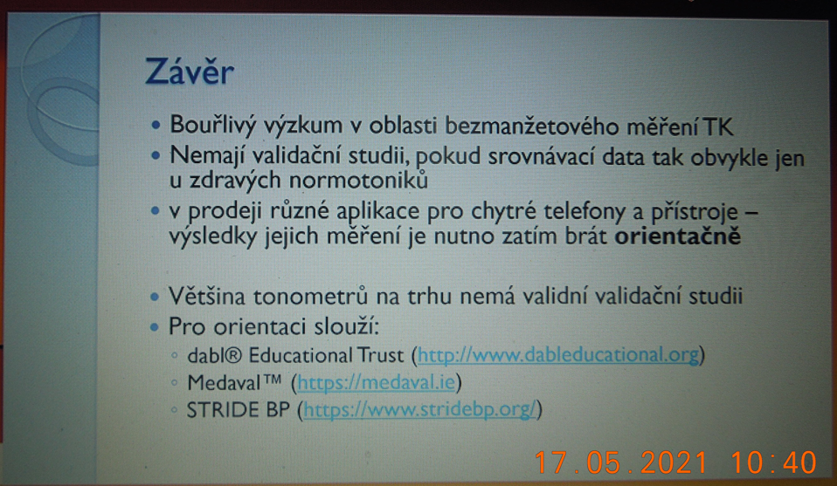
Conclusion:
You can see – a great researche on problematice in BP measurement without the cuff
BUT
do not have validation studies
measurements should only be taken as indicative

Slide 24
Regulation of blood pressure
Short - term regulation
- baroreflex
Middle - term regulation
- humorals regulation
sympathetic - catecholamines
RAAS (decrease perfusion pressure in kidney – secretion of renin)
ADH
Long – term regulation
- kidney regulation

Slide 25
BAROREFLEX
Sinoatrial node
Parasympathetic NS: prolongation of prepotencial of AP
Sympathetic: shortening of prepotencial of AP
IX.
NucleusTractusSolitarii
X.
arteries
veins

Slide 26
Baroreflex – in every day life:
Orthostatic and clinostatic reaction - changes in body position:
lying down - sitting - standing
Valsalva maneuvre - changes in BP during defecation

Slide 27
Resetting of baroreflex
During repeated raising of blood pressure - e.g. in chronic hypertension - the force of baroreflex reaction on systemic blood pressure is lower
??? Why???mechanical changes in baroreceptors – decrease sensitivity due to structure changes on the vessels wall OR dysfunction of endotelium OR down-regulation in the brain center due to their increasing frequency of stimulation
Resseting of baroreflex can regulate the changes in blood pressures, but the resseting is unable to go back on „normal“ level
Resetting is a partially reversible – during a short-term influence of raising blood pressure
Notice: in clinical practice:
  !start treatment of hypertension in time!

Slide 28
BAROREFLEX SENSITIVITY
A change of duration of pulse interval (in ms)
due to a change of systolic blood pressure by 1 mmHg
Laboratory methods:
- Phenylephrin aplication
- neck suction
- Valsalva manoever
Spontaneous methods:
in time-domain
- Sequence analysis
in frequency-domeain
- cross-spectral analysis

Slide 29
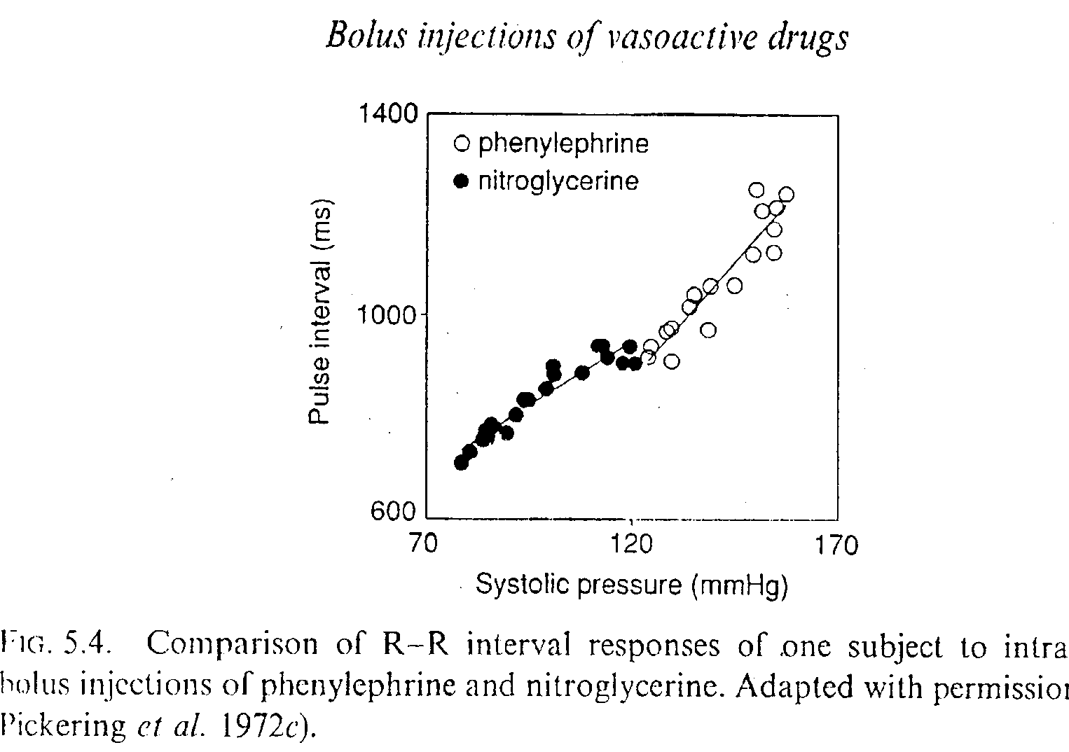
BAROREFLEX SENSITIVITY
- Phenylephrin aplication

Slide 30
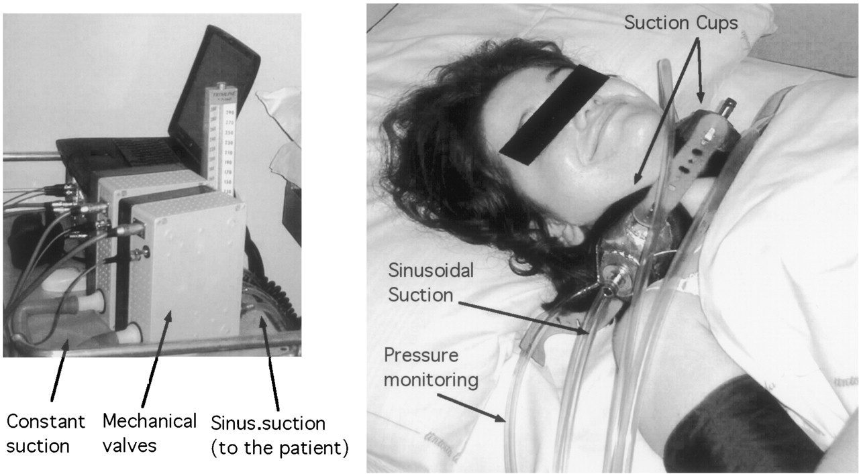

Furlan R et al. Circulation 2003;108:717-723
BAROREFLEX SENSITIVITY
- Neck suction

Slide 31
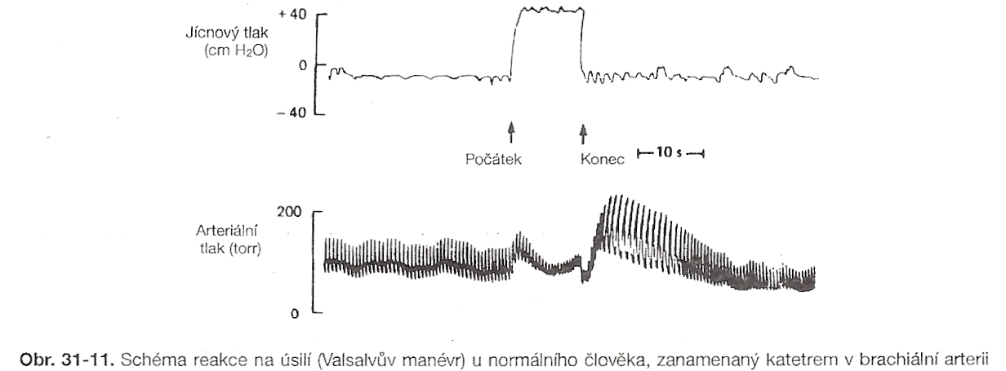

Slide 32
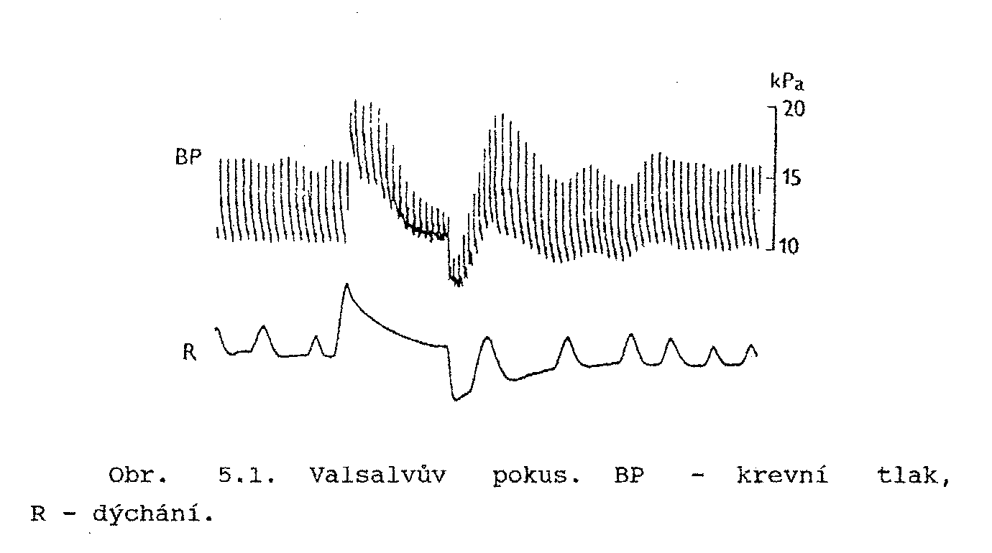
BAROREFLEX SENSITIVITY
- Valsalva manoever
(BP)VRSVPPMAP

Slide 33
Records of circulatory parameters
- Its variability

Slide 34
Variability of parameters
variability expresses their fluctuation around the average value at specified time intervals (or under different conditions)

Slide 35
Spectral analysis:
Carried out under standard conditions at various maneuvers (supine, standing); evaluated with 300 representative intervals RR / NN /
Another mathematical processing (Fourier transform) -length RR intervals are converted to cycles in Hz
The spectrum is divided into several components - low (LF: the sympathetic modulation) and high frequency (HF: vagal modulation)
People with reduced heart rate variability have a 5 times higher risk of death

Slide 36
original record of waves in circulatory parameters
(photoplethysmography by Peňáz)
Respiration
Blood flow
Blood pressure
Heart rate

Slide 37
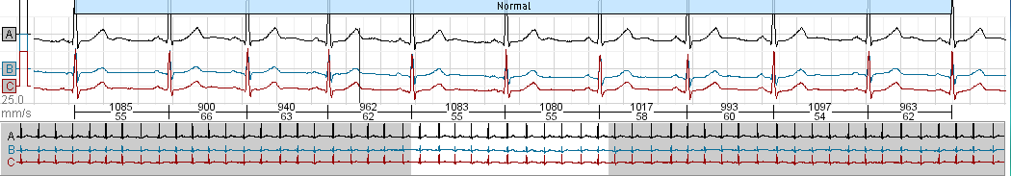
Variability of circulatory parameters
TIME - DOMAIN METHODS
Example: from Holter monitoring of ECG

Slide 38
Variability of circulatory parameters
TIME - DOMAIN METHODS
- statistical methods
Maximal value
SD
Variační
rozpětí
Range
SD
Minimal value

Slide 39
Variability of circulatory parameters
FREQUENCY - DOMAIN METHODS
- spectral analysis
perioda T
amplituda a
frekvence f = 1/T
T=50 s
0.5
0.5
a=0.5
+
T=10 s
f = 1/50 = 0.02 Hz
+
amplitude
0.2
a=0.2
+
T=3 s
f = 1/10 = 0.1 Hz
+
0.3
=
a=0.3
=
f = 1/3 = 0.33 Hz
f = 0,33 Hz
0.5
f = 0,02 Hz
0.2
0.3
f = 0,1 Hz
time (s)
0.02
0.1
0.33
frequency (Hz)
Spectrum – the same principle in light: white light – via glass prism - decomposes into individual components
- colors of the spectrum, like a rainbow

Slide 40
FREQUENCY - DOMAIN METHODS
- spectral analysis
angiotensin-reninový systém
změny průtoku kůži …
baroreflex
dýchání
MF
0,07-0,12
HF
>0,13
VLF
0,01-0,06
0
0,1
0,2
0,3
0,4
0,5
f [Hz]

Slide 41
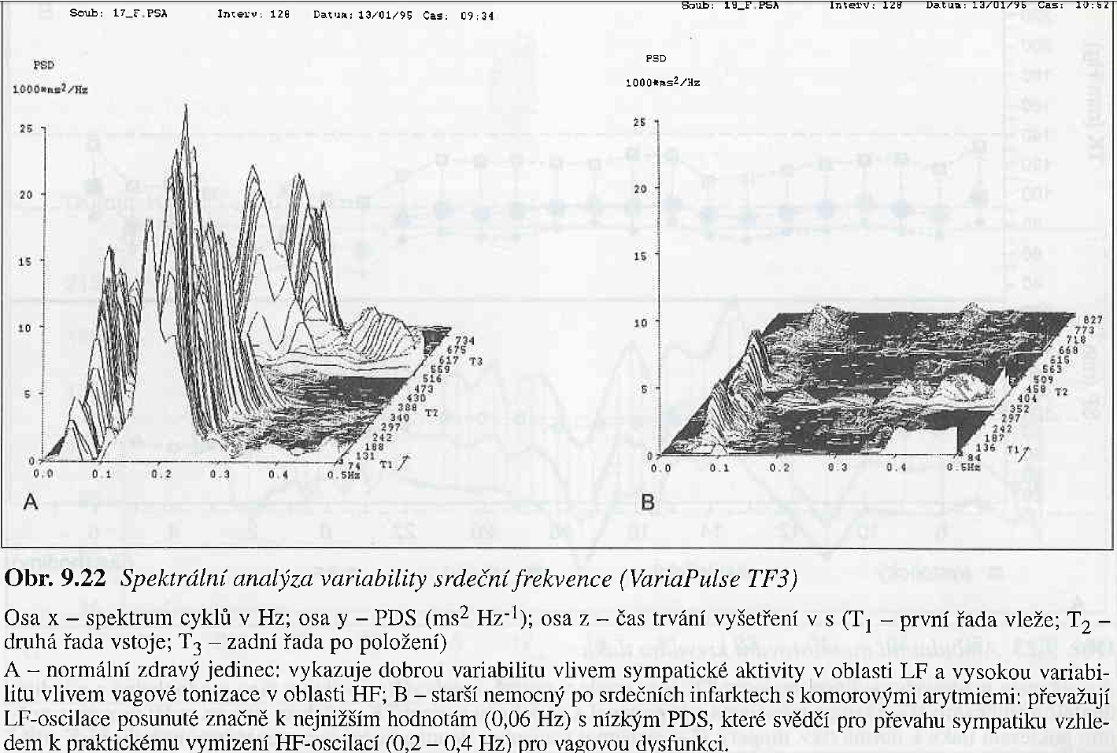

Slide 42
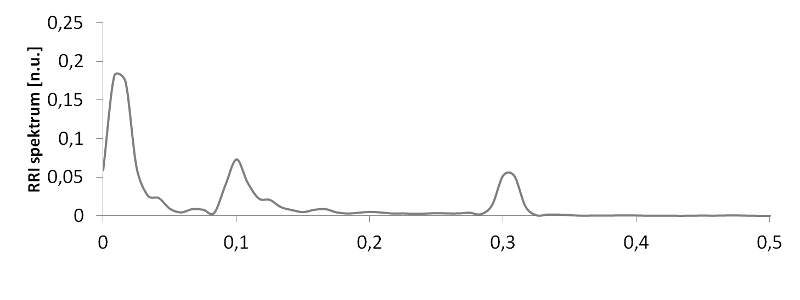
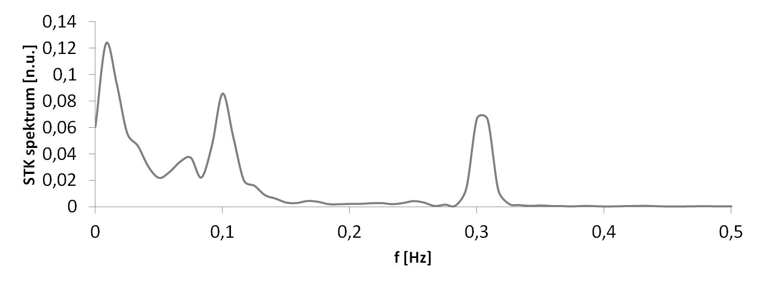
VARIABILITY of circulatory parameters
parasympathicus
sympathicus
Baroreflex
Respiratory sinus arrhythmia
Baroreflex
changes in intrathoracic pressure

