Slide 1
Aesthetics is a science about beauty.
Iti is connected with sensual perception.
Rules are changing during the time a there are differences in various regions. .

Slide 2
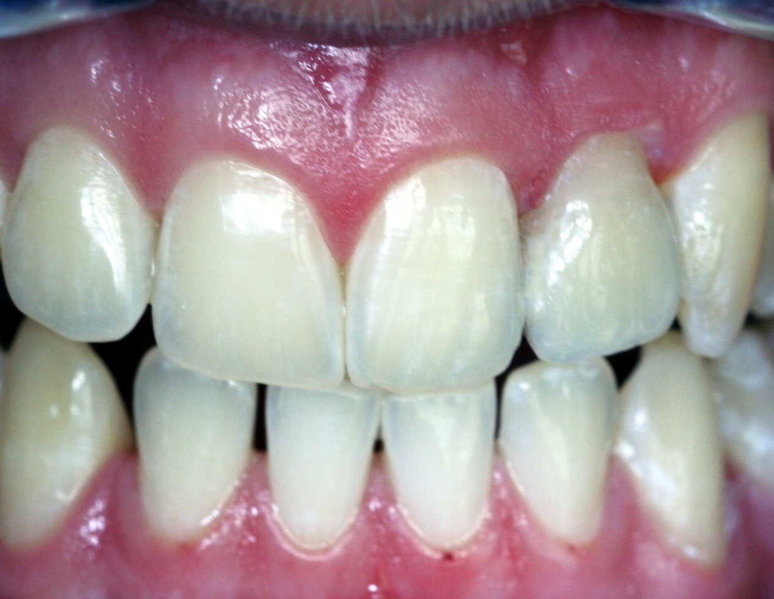
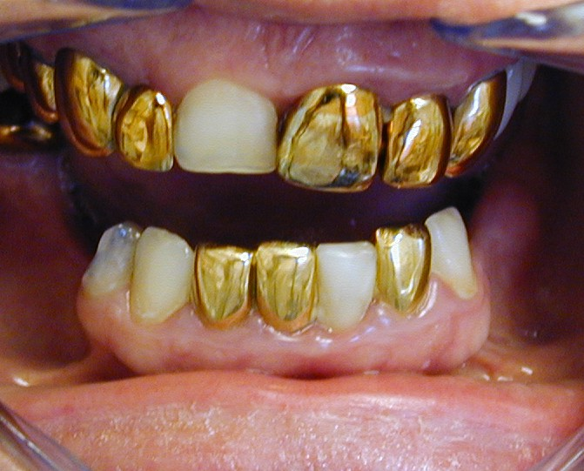
???
???

Slide 3
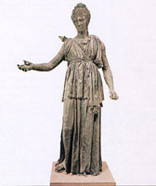
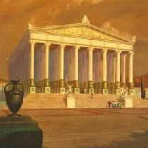

Slide 4
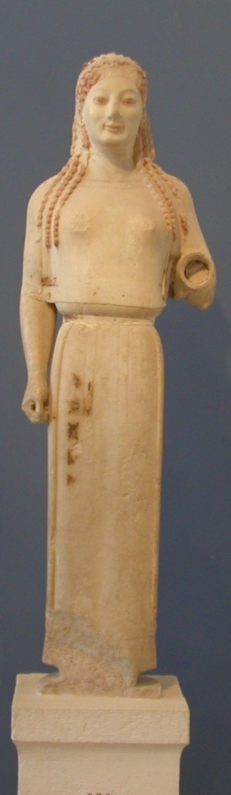
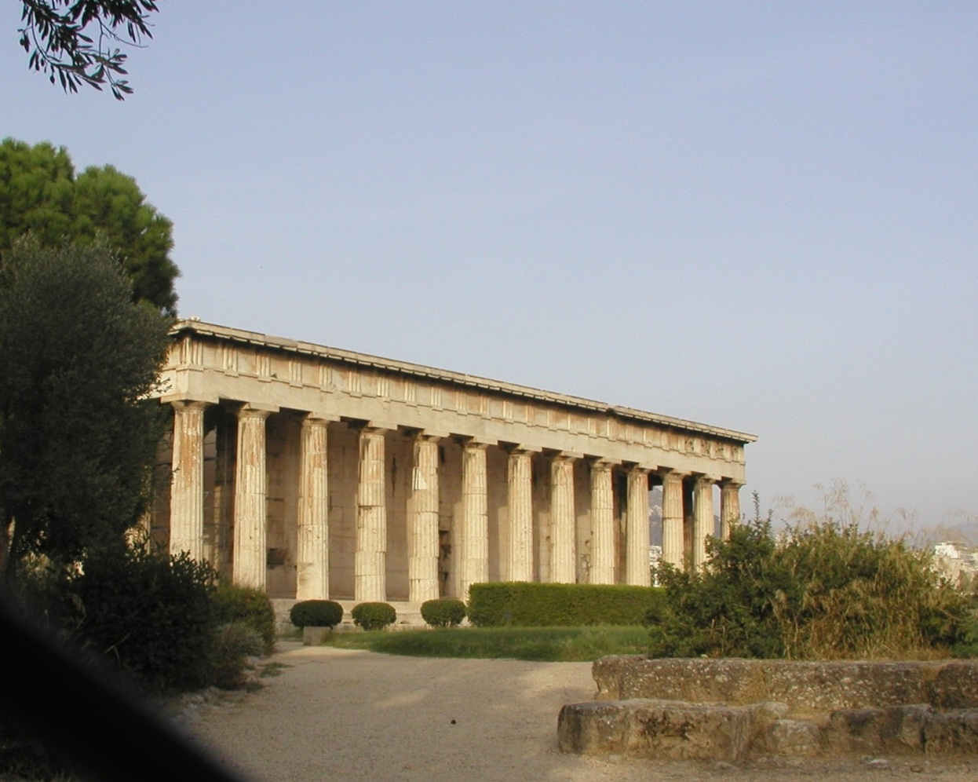
„Penta en arithmo“
(Pythagoras)
1/1,618 = 0,618
Golden cut

Slide 5
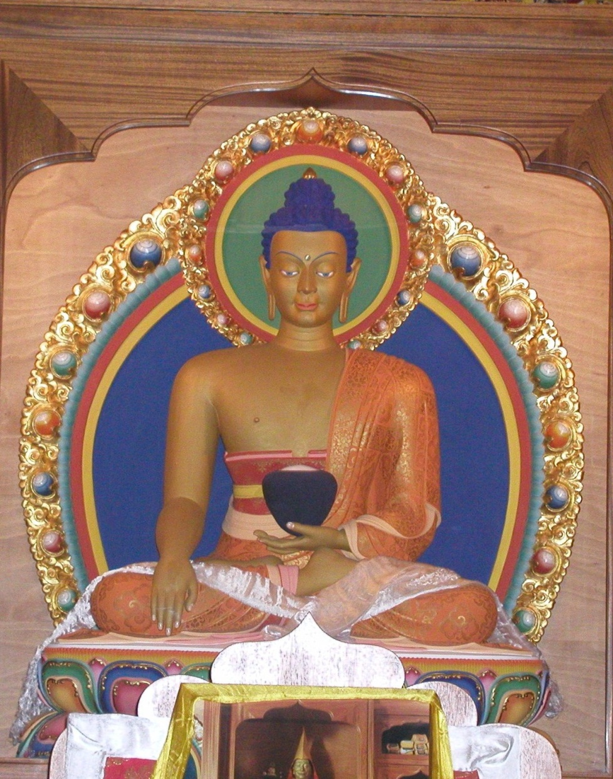
Perception of the object
Composition
Single items
Harmony
Symetry
Dominanca
Lines

Slide 6
Dentofacial harmony
Imaginary lines – stuctures must have harmonious relation to them
Teeth are in harmony with the face, they can attract our attention and distract it form other structures

Slide 7
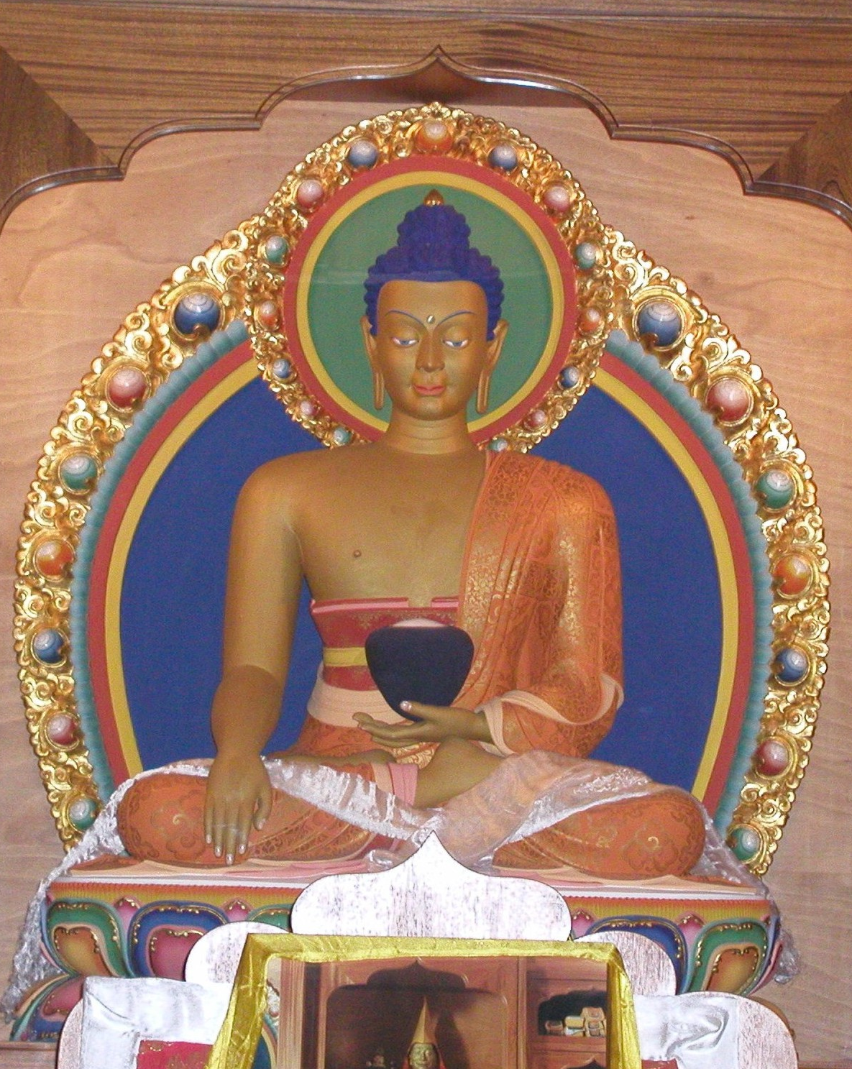
Horizontal
a vertical lines
axis

Slide 8
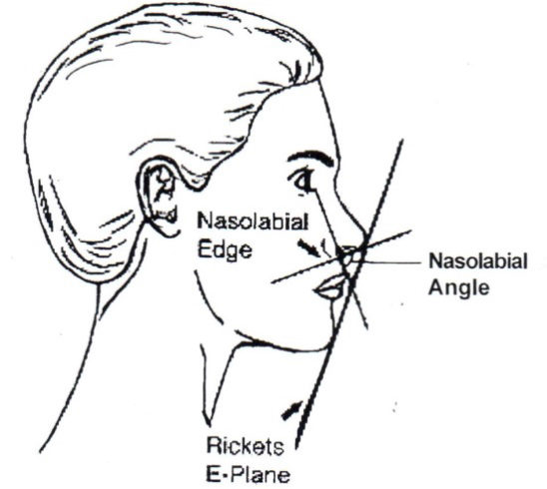
Profile:
Balance of lip, nose
and chip.
Nasolabial angle:
90° – 95 °men
100° - 106° women
Rickets line:
4 mm before upper
2 mm before lower lip

Slide 9
Line of smile
Connects incisal edges of upper frontal teeth and touches cusos of upper molars. Lower border is lower lip. Line of lower lip is parallel to line of smile.
Upper central incisors should be in touch with wett part of upper lip.

Slide 10
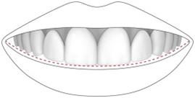
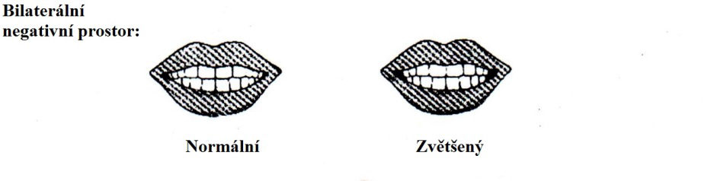
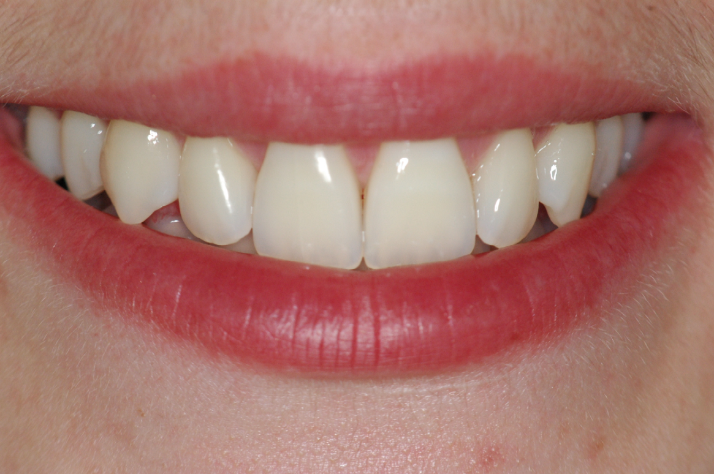
Line of smile
Bilateral negative space
Normal Enlarged

Slide 11
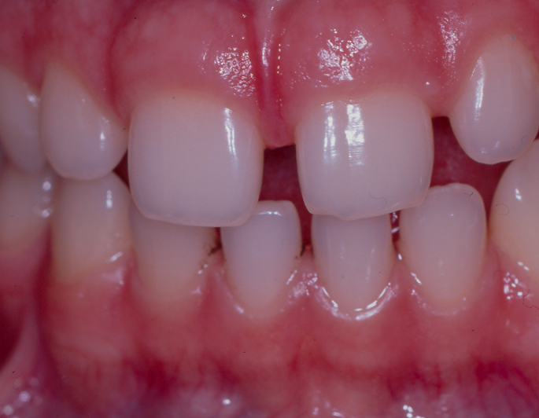
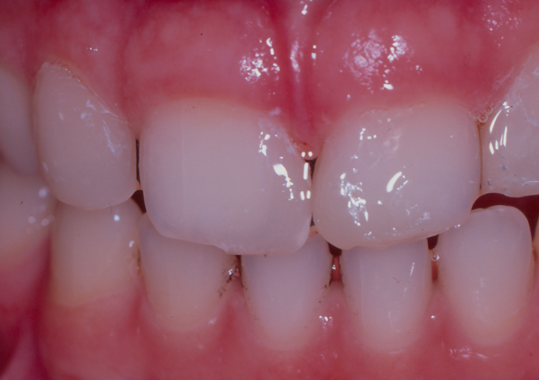
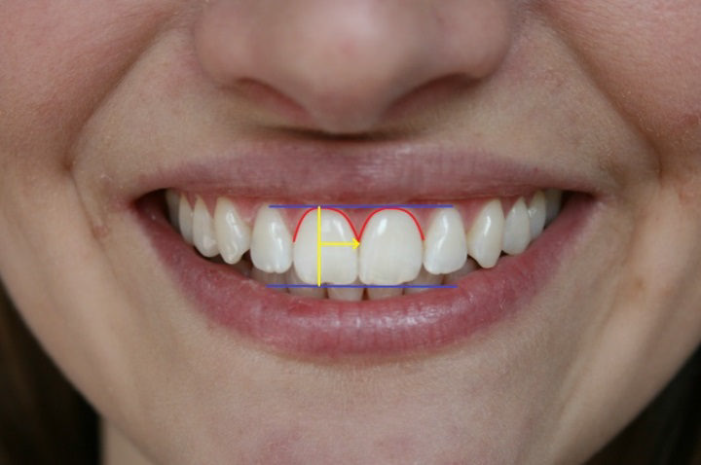

Slide 12
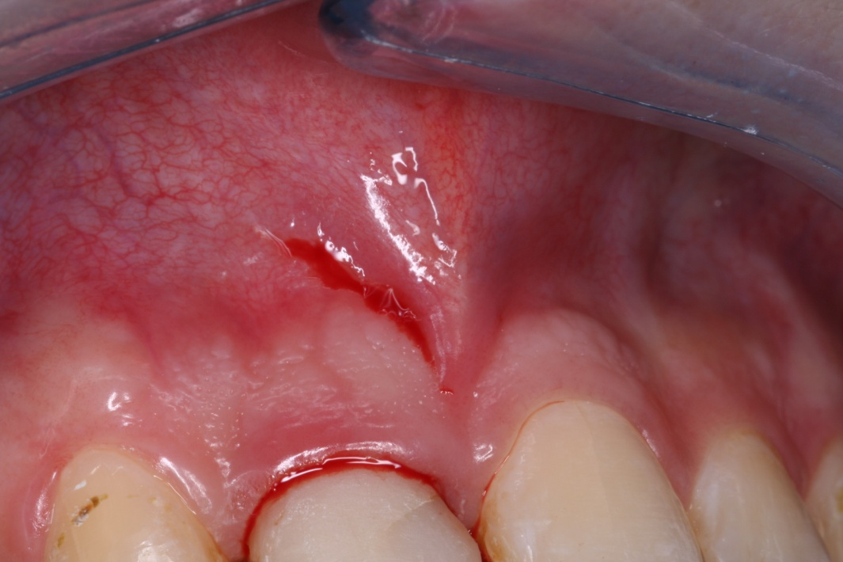
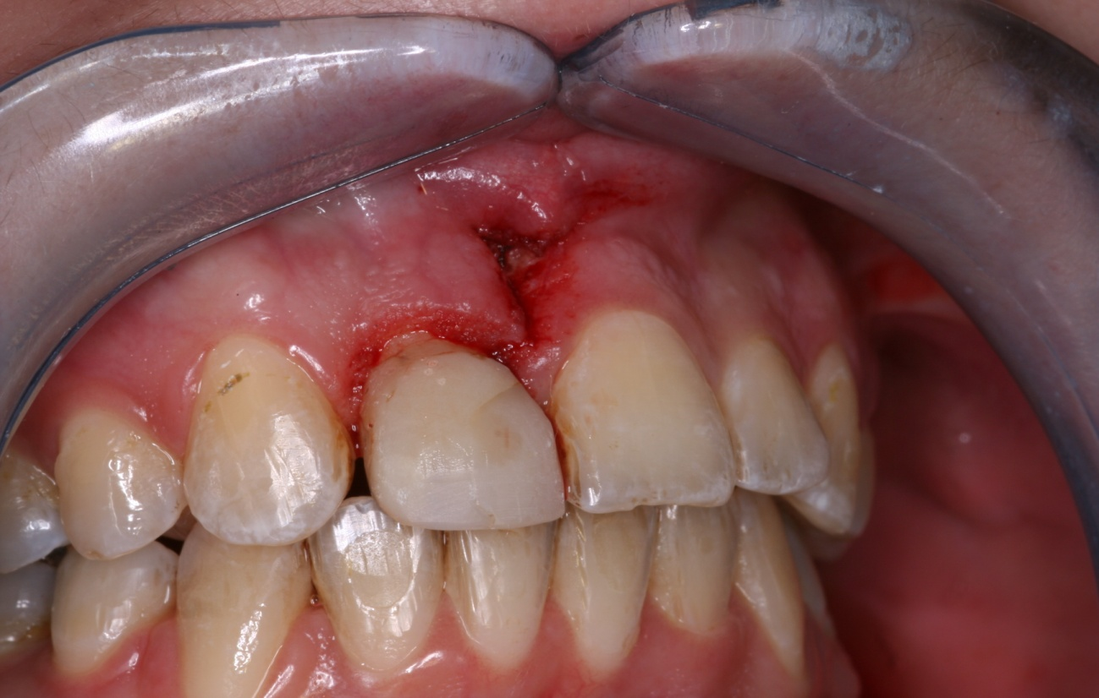
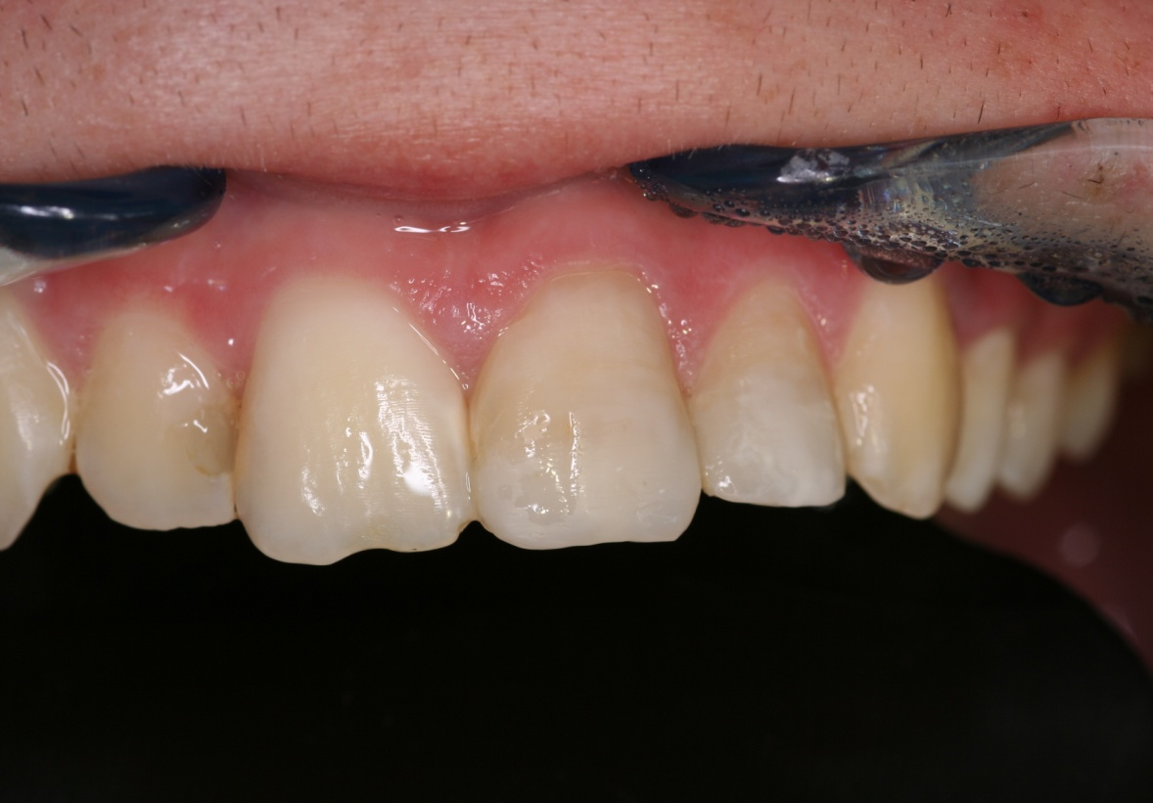
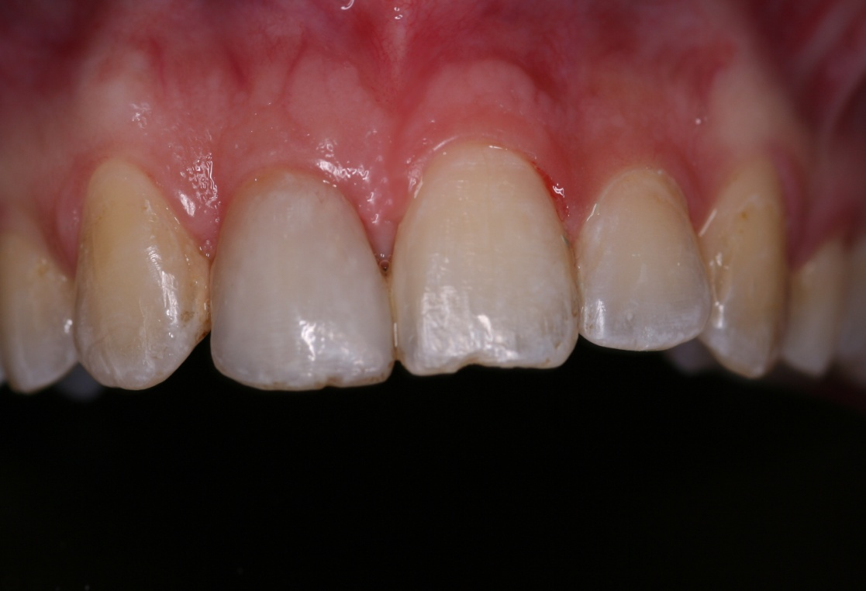

Slide 13
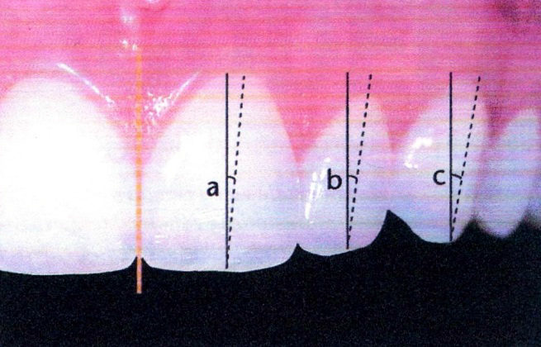
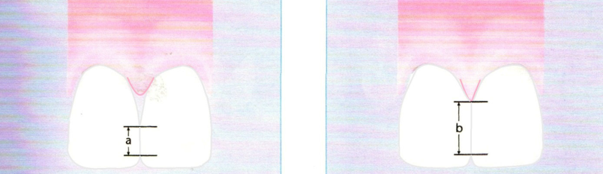
Dentál harmony
Inclination of long axis
Slight mesial inclination of long axis
Slight inclination vestibulary
Position of contact points:
They become smaller and move apically
(50:40:30)
Their elongation can optically widen teeth

Slide 14
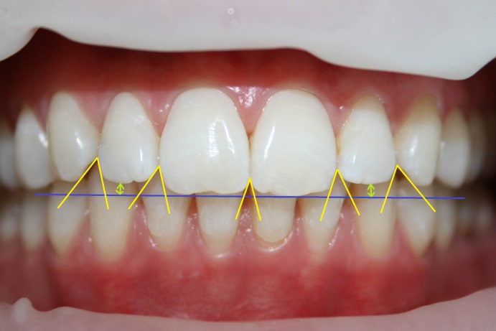
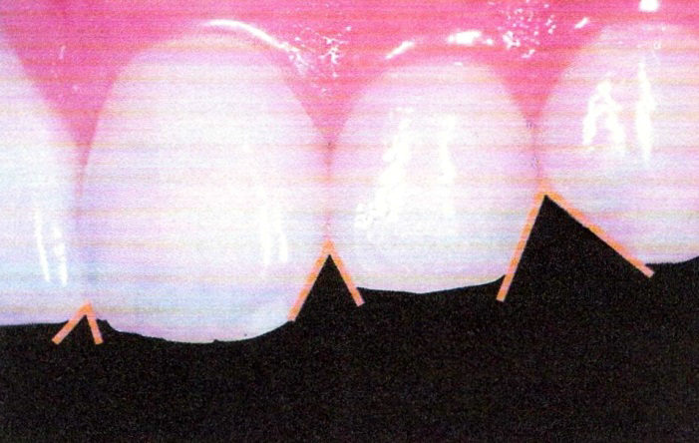
Dental harmony
Interincisal spaces become
smaller in distal direction
They become smaller in younger
individuals

Slide 15
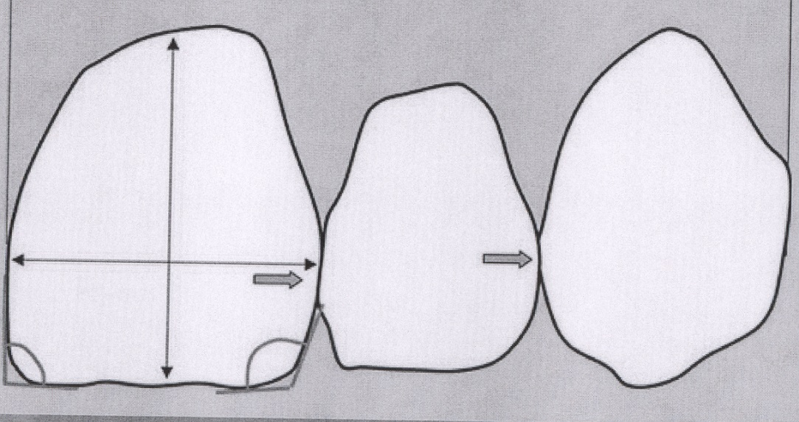
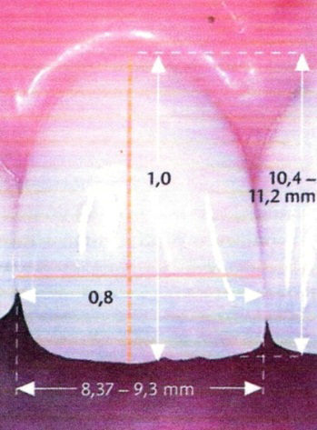
Relation between width and height
With of upper central incisor is
70 – 80% its height

Slide 16
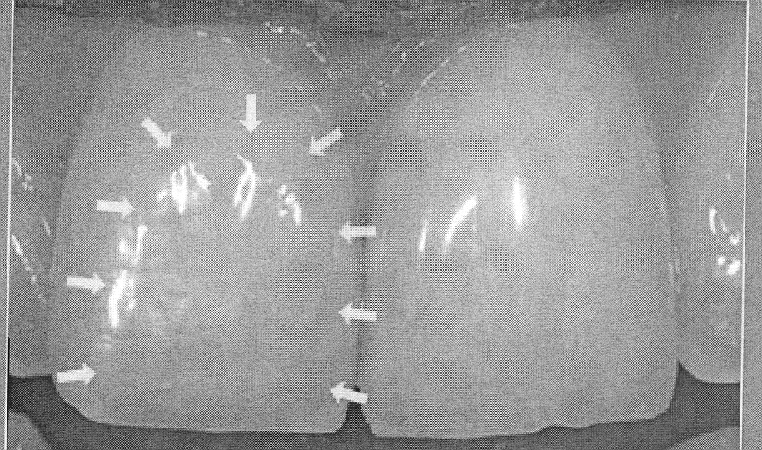
Optical width

Slide 17
Golden cut
width length
= 0,618
length width+length

Slide 18
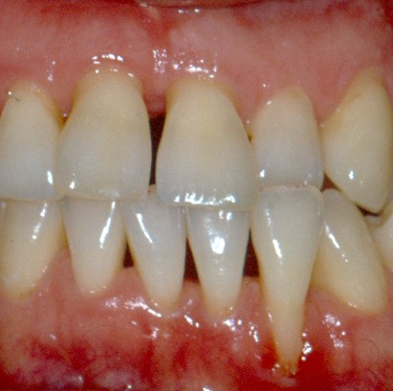
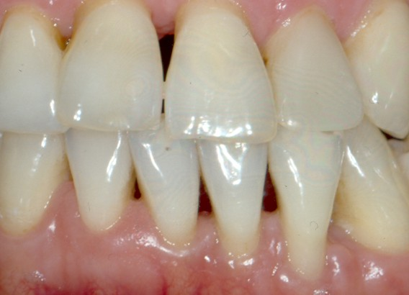
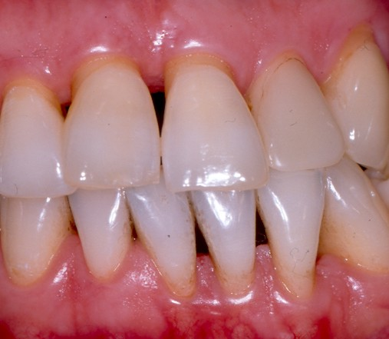
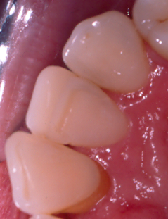
Roubalíková L. Méně obvyklý případ řešení obráceného skusu.
Prakt zub Lék;48: 117-120.

Slide 19
Shape of crown principally corresponds to shape of the face
Shape of the face:
angular, oval a triangular
Corresponding shapes of teeth

Slide 20
Front
Zygomatic line
Mandibular line

Slide 21


Harmony

Slide 22
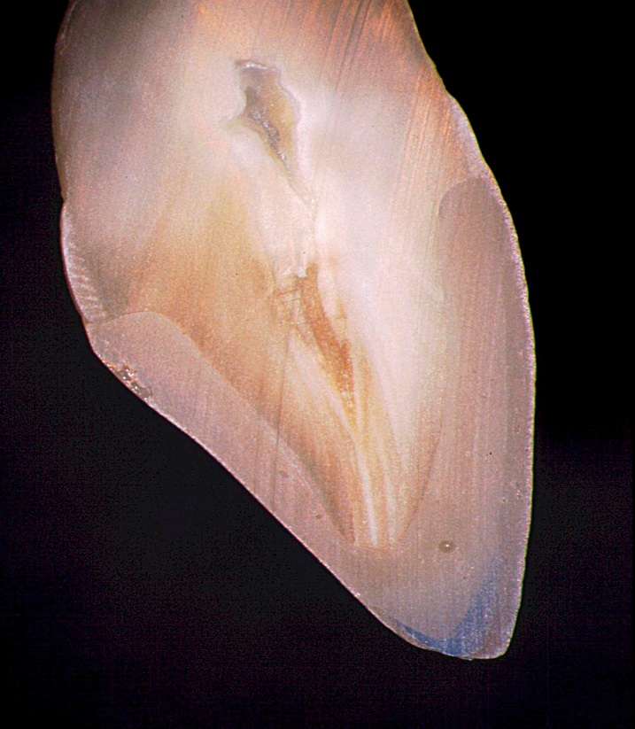

Curvature of the labial surface – for reflection of the light
Reflexe světla

Slide 23
Surface texture

Slide 24
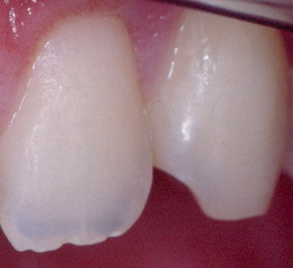
Harmony

Slide 25
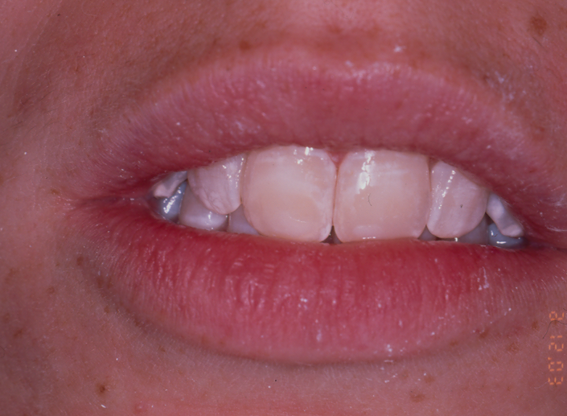
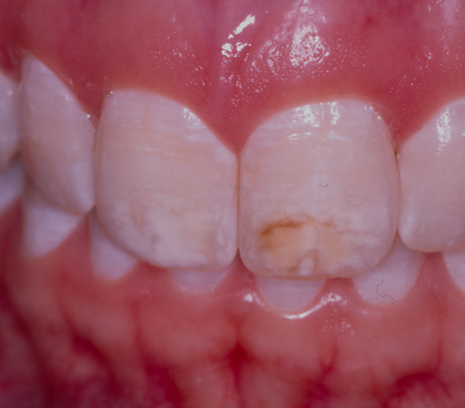

Slide 26
Basic terms -optic

Slide 27
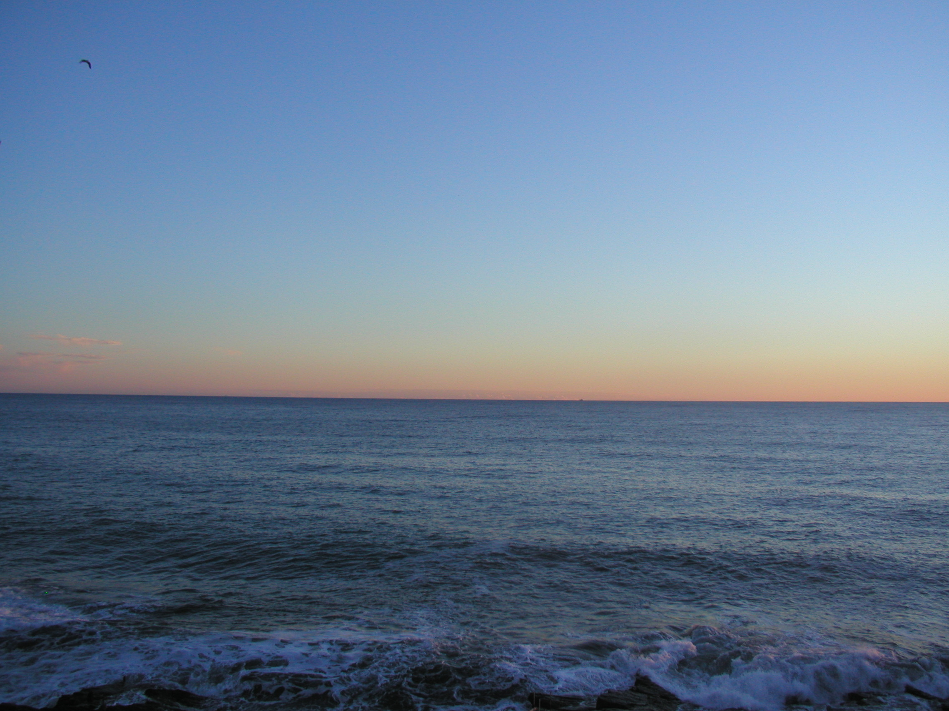
We can recognise depht of the colour because
of dispersion of ligth inside the air and water

Slide 28
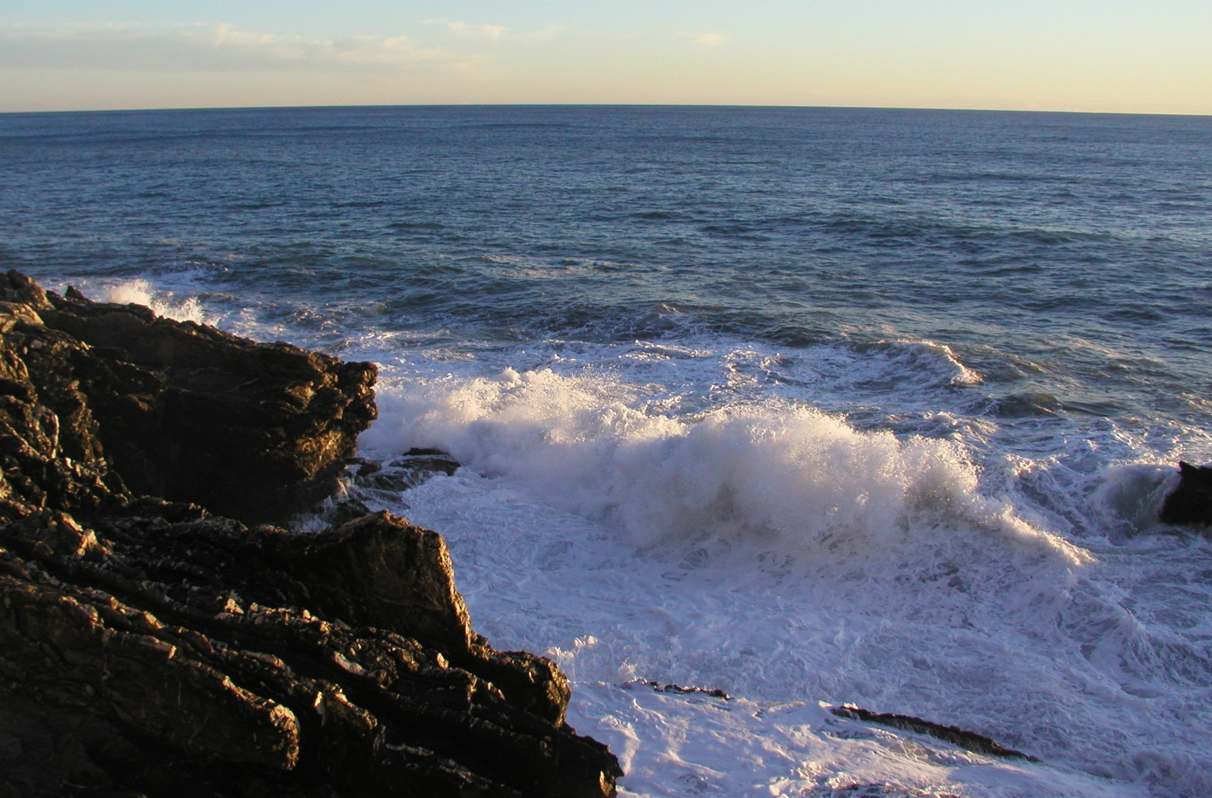

Slide 29
Světlo
Elektromagnetic undulation
Wave length
Amplitude
Quantum
Ray
- reflection
- deflection
Various velocity of the light in various environment
Relation of these velocities in twpo various environments
is index of refraction

Slide 30
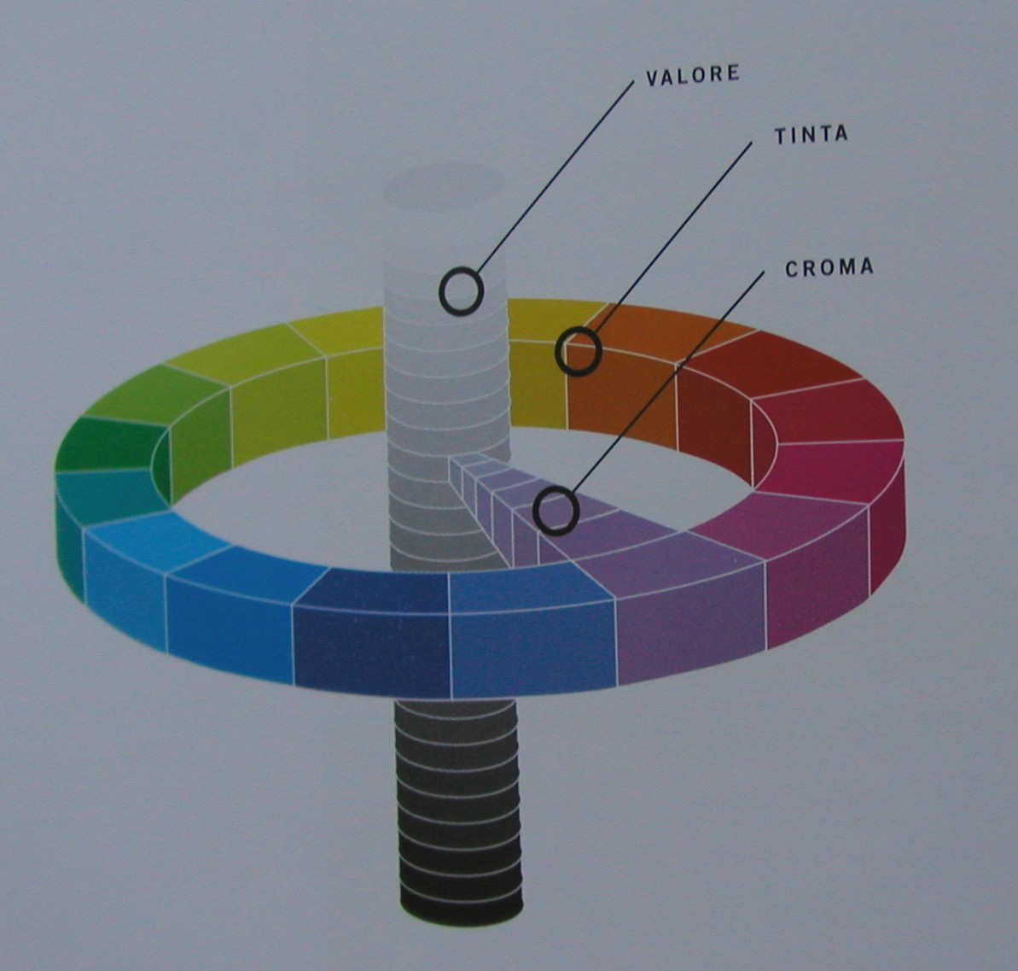
hue
chroma
3 Variables of colour
value
Chroma – colour.
Result of wavelength
Hue – result of amplitude
Value - cleanliness

Slide 31


Slide 32
Transparency
Translucency
Opacita
Opacity

Slide 33
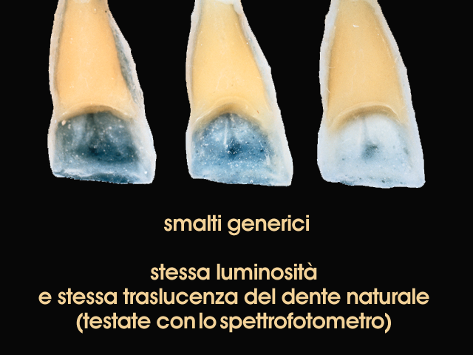
11
1 2 3
Enamel is translucent

Slide 34
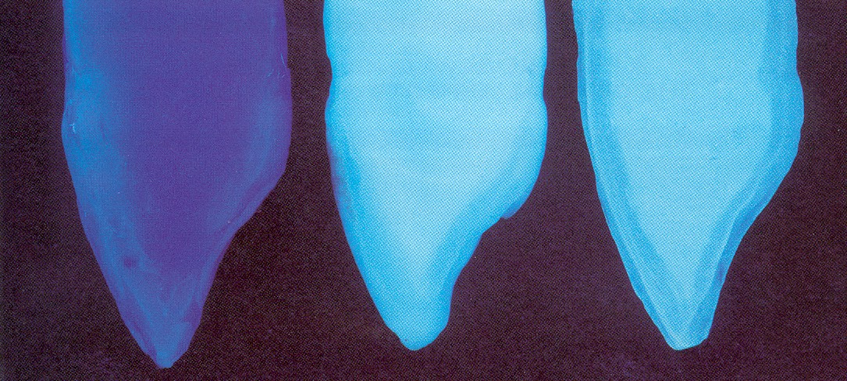
Fluorescence
The light is absosbed and irradiated back in very short time
10⁻¹² s.
Special, „live“ appearance od dentin

Slide 35
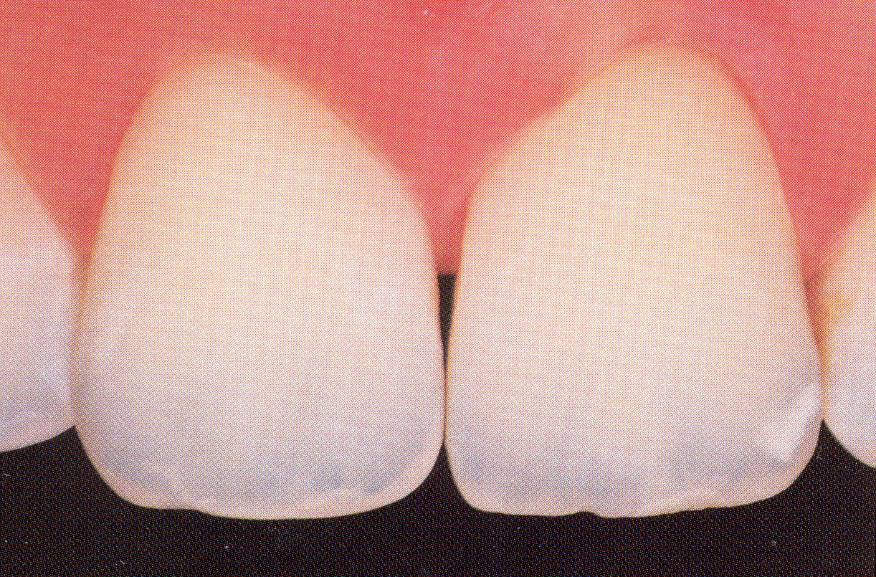
Opalescence
Special effect on incisal edge
Result of translucency of enamel

Slide 36
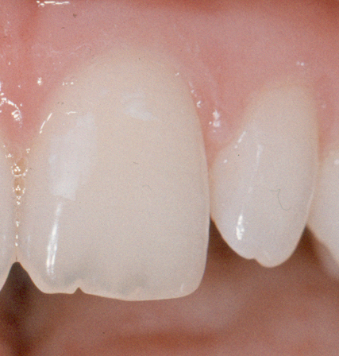
Mamelony
Opalescence
Halo efekt

Slide 37
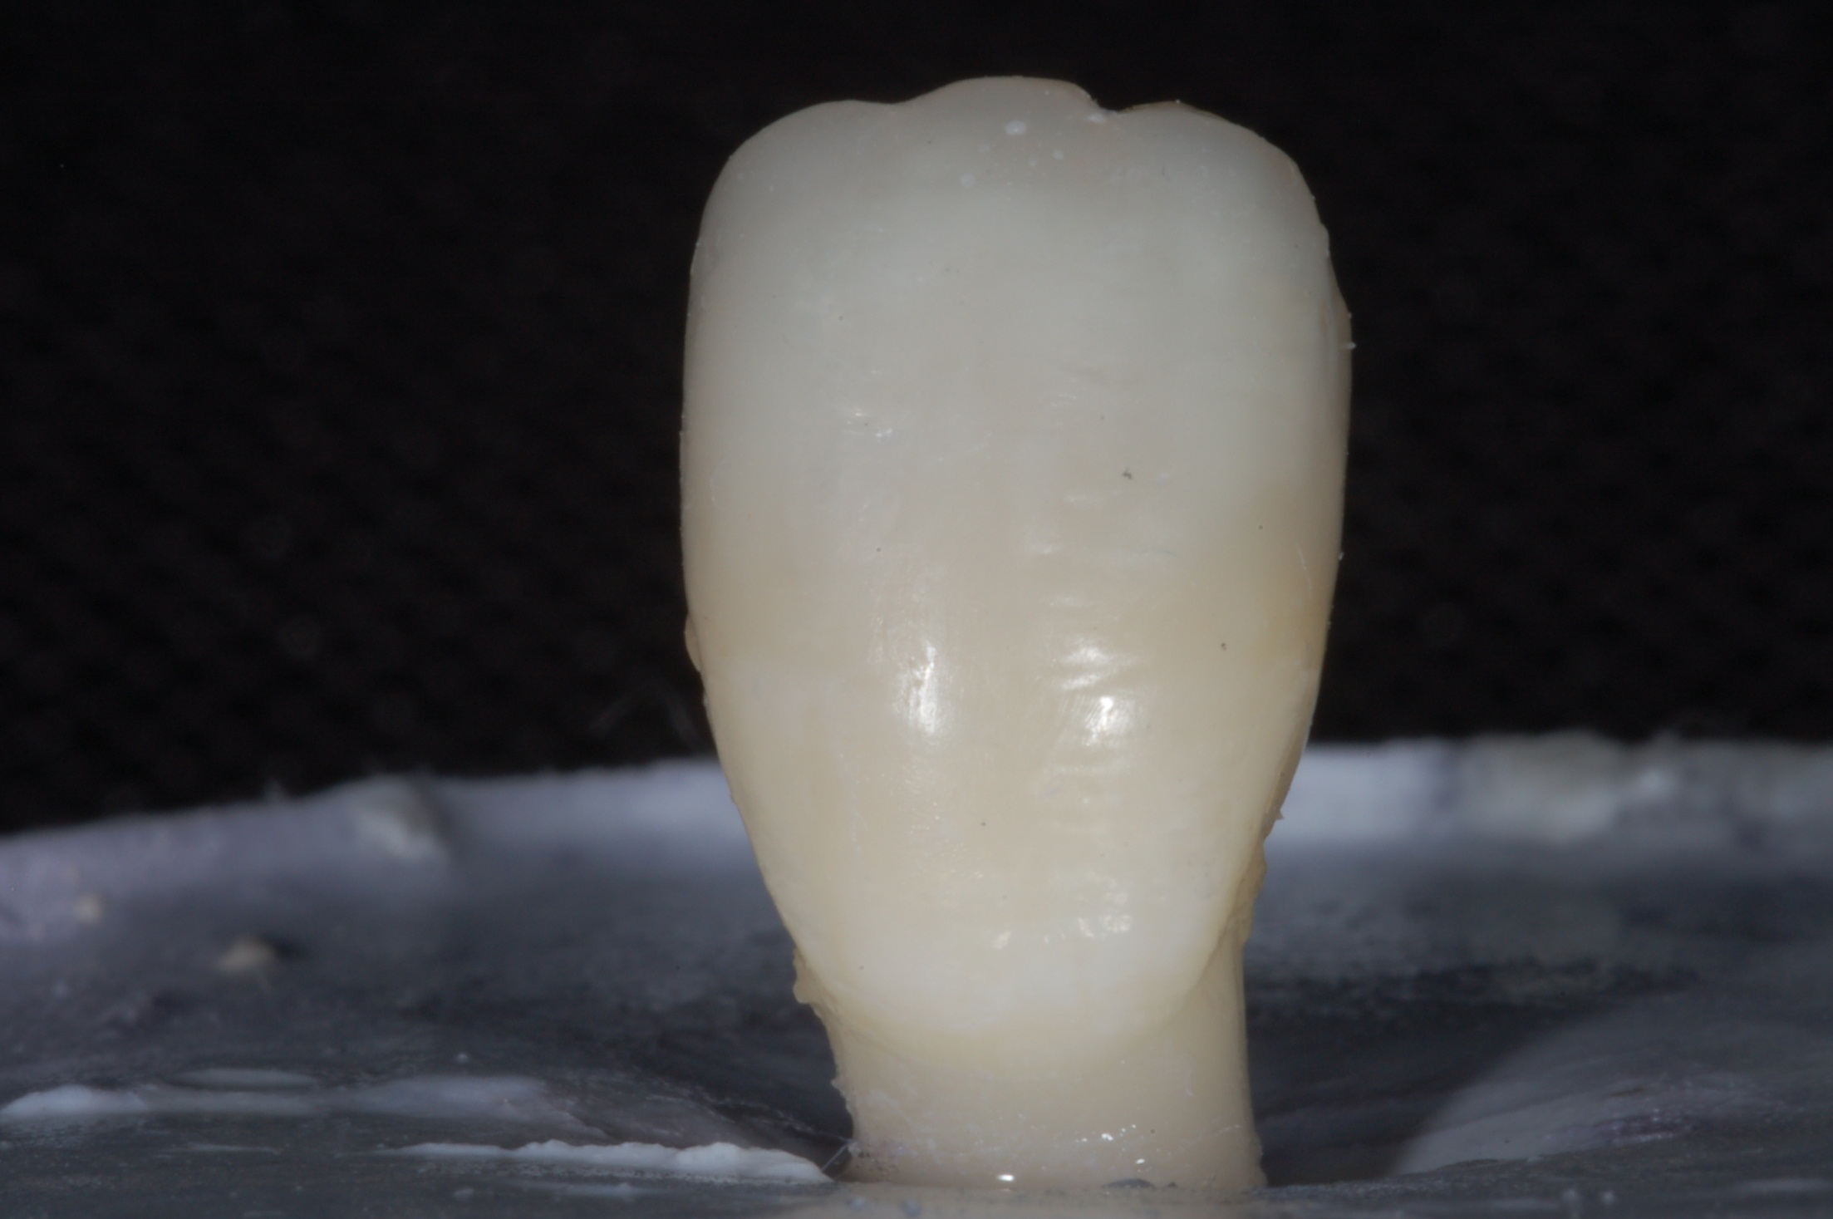

Slide 38
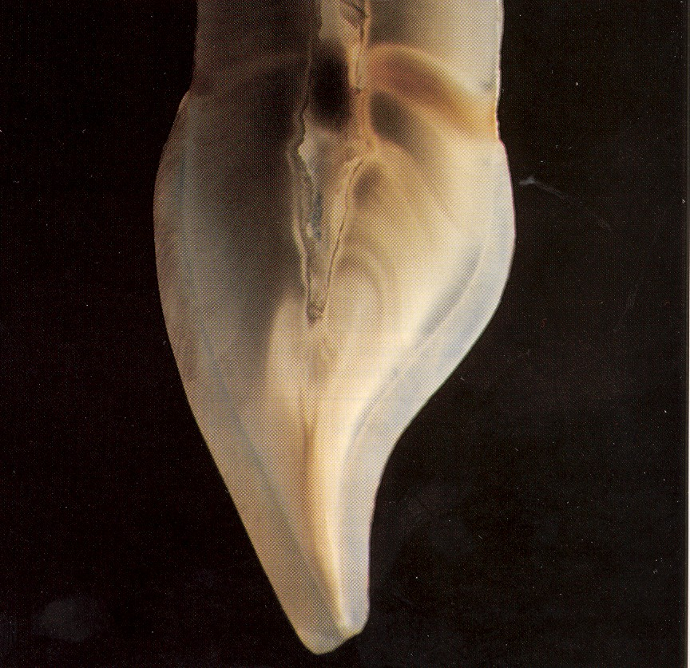
young

Slide 39
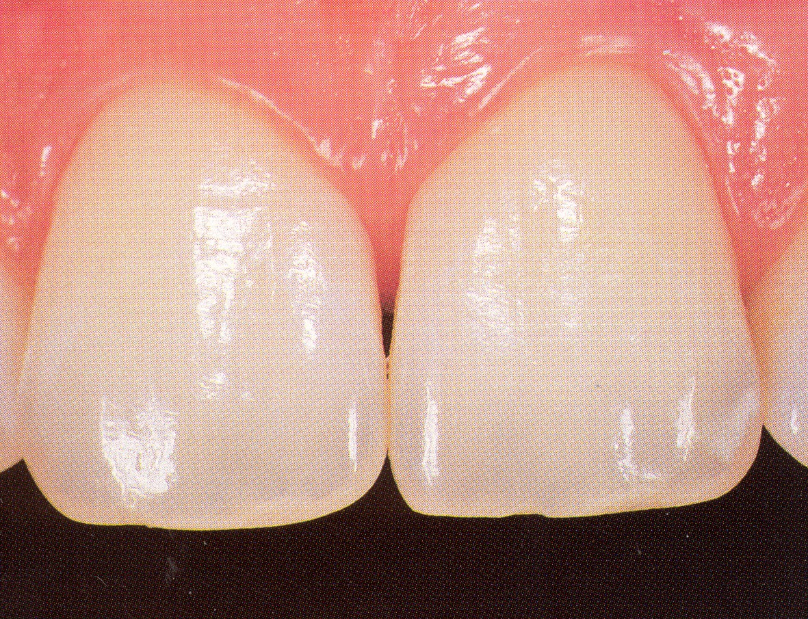
Midle age

Slide 40
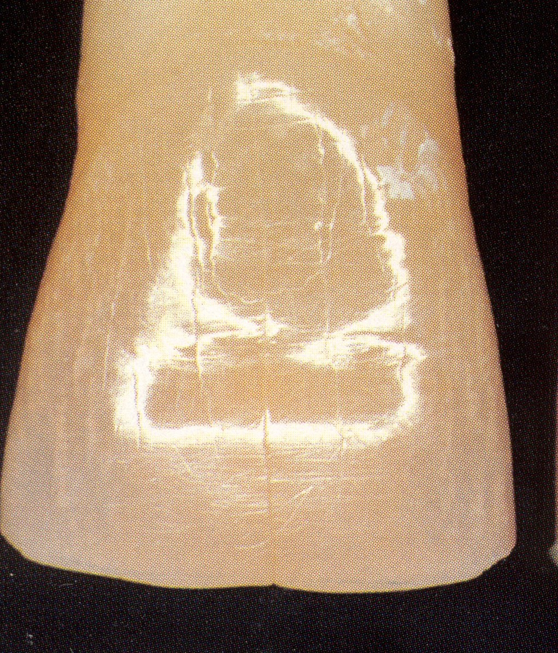
Old age

Slide 41
Optical reading of the crown

Slide 42
colour
Desaturation
Opalescency
Tvar mamelons
Halo efekt
Spots, special chracterizations

Slide 43
Chromatic scala of composite materials
Dentin shades
Enamel shades
Special effects

Slide 44
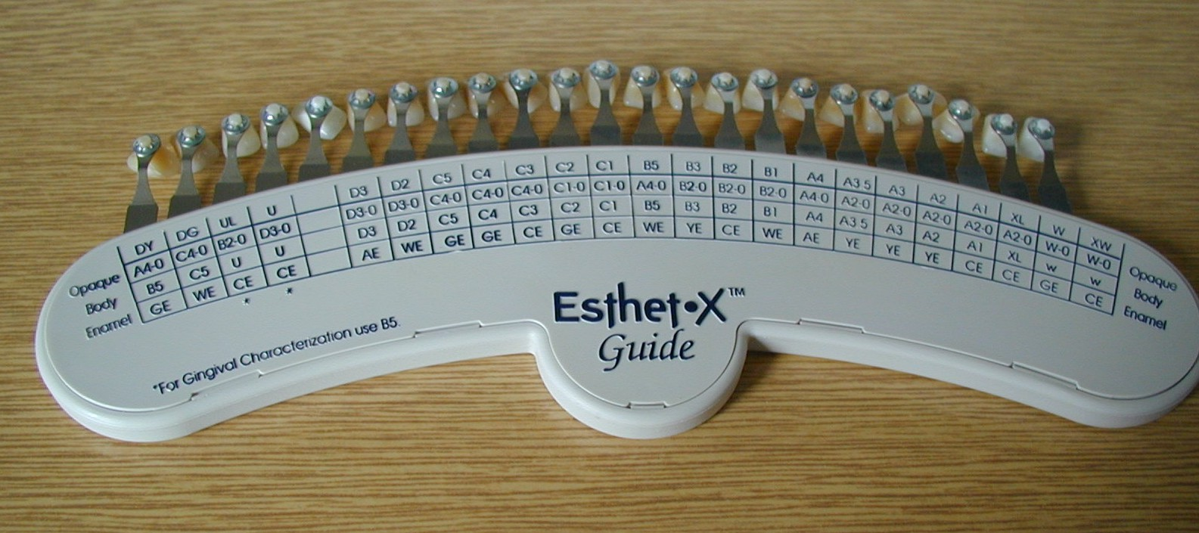
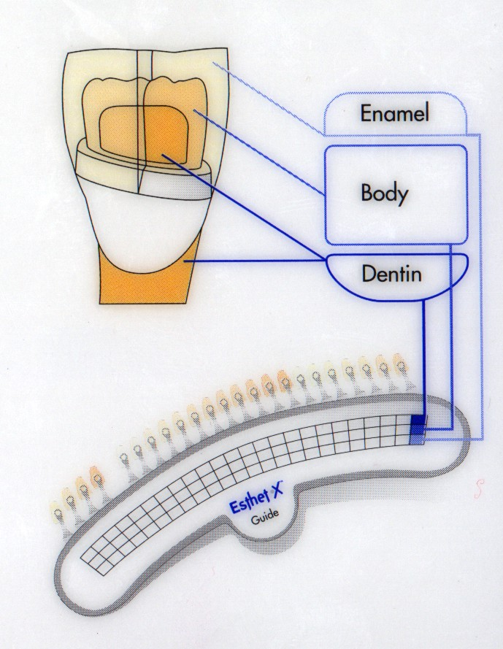

Slide 45
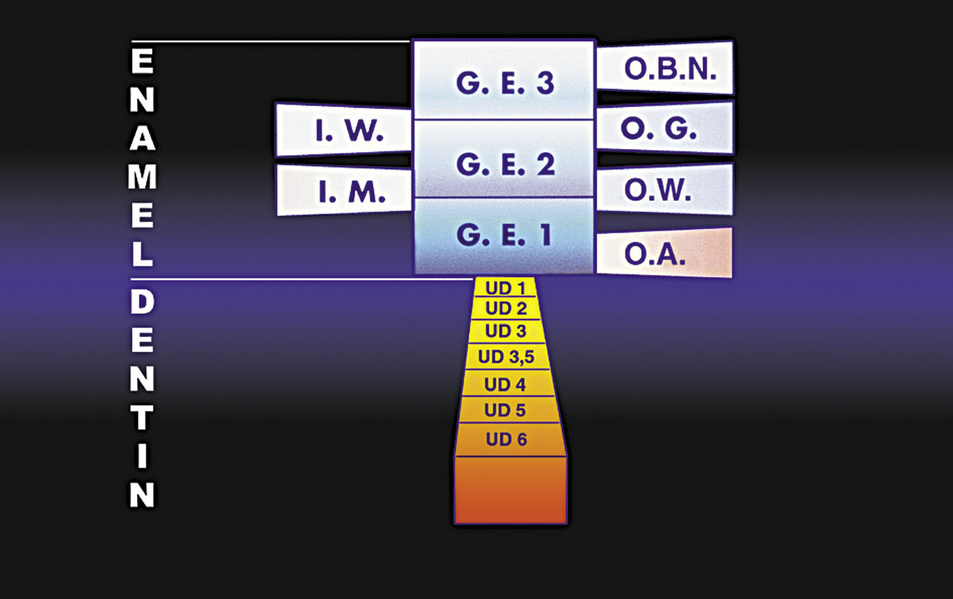

Slide 46
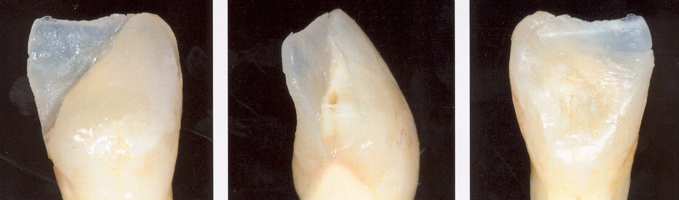
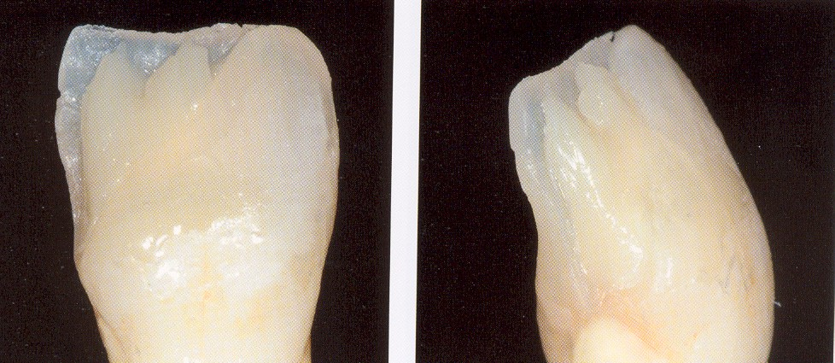


Slide 47



Slide 48


Slide 49


Slide 50
Shape
Stratification
Surface texture
Polishing

