Slide 1
Latin - a dead language?

Slide 2
History of Greek-Latin medical terminology
=
history of medicine

Slide 3
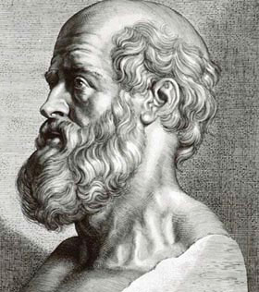
Hippocrates of Kos
460 – 370 B.C.
Corpus Hippocraticum (53 books)
Hippocratic oath

Slide 4
"Invia est in medicina via sine lingua Latina"

Slide 5
Latin alphabet
and pronunciation

Slide 6
Latin alphabet
24 letters
W and j are missing
I ↔ J: maior/major; ieiunum/jejunum x tinctura
Kinetosis; kyphosis/cyphosis; cystis
Y: syndesmosis
Z: zygomaticus

Slide 7
Pronunciation
1) Vowels:
a) Short
a – glandula (cup)
e – membrum (pen)
i (y) – minimus, lympha (finger)
o – fossa (top)
u – tarsus (put)
b) Long
a – sanus (car)
e – vena
i (y) – vita (dream)
o – novus (door)
u – purus (boom)
2) Diphthongs:
1) ae, oe - aequalis, lagoena – the same like long e
2) oē – eupnoe
3) eu - eutrophia

Slide 8
3) Consonants:
1) c:
a) /k/:
+ a, o, u – caput, costa, cubitus
Before a consonant - cranium
At the end of the word – lac
b) /c/:
Before e, i, ae, oe, y – cerebrum, circum, caecus, coeliakia, cystis

Slide 9
2) ch: chirurgia
3) j: jejunum (yes)
4) r: ruptura
5) s: /z/ - nasus, pulsus, morsus, mensis, plasma
6) di, ni: digitus, nicotinum
7) ti:
a) /ti/ - tibia
b)/ci/ - functio
c) /ti/: s, x + ti – ostium, mixtio

Slide 10
8) ex: /egz/ - exitus x extrauterinus
9) ngu: /ngv/ - sanguis
10) qv: /kv/ - aqua
11) ph: /f/ - phalanx
12) rh: /r/ - rhaphe
13) th: /t/ - thorax
14) su: /sv/ - suavis x superior

Slide 11
Lengths of syllables
Sēpsis post vulnus pūnctum in regiōne
abdōminālī

Slide 12
Read the terms:
Cancer duodeni
Dorsum linguae
Sanguis venosus
Deviatio septi nasi ad latus sinistrum
Post injectionem intravenosam
Pulvis adspersorius
Ostium venae cavae
Musculi recti, obliqui
Lobi et partes hypophysis
Oedemata membrorum inferiorum
Auxilium celere in traumate gravi
Asthma bronchiale

Slide 13
Parts of speech in Latin
9 parts of speech
Inflected x uniflected parts of speech
In medical terminology:
Nouns, adjectives, numerals, prepositions, verbs

Slide 14
Grammatical categories of nouns
1) Gender: 2) Number:
a) Masculines a) Singular
b) Feminines b) Plural
c) Neutrals
3) Case: 4) Declension:
1) Nominative 1) 1st declension
2) Genitive 2) 2nd declension
3) Dative 3) 3rd declension
4) Accusative 4) 4th declension
5) Vocative 5) 5th declension
6) Ablative

Slide 15
Cases in medical terminology
Nominative = subject
(e.g. fractura tibiae, lagoena aquae destillatae)
Genitive = a part of st./a relation to st.
(e.g. musculus dorsi, fractura tibiae)
Accusative - with some prepositions
(e.g. post operationem)
Ablative – wih some prepositions
(e.g. sine complicationibus)

Slide 16
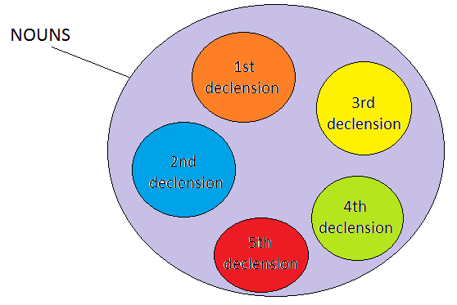
Declensions - nouns

Slide 17
Declensions - nouns
1st declension: ā-stems (venārum)
2nd declension: ō-stems (nervōrum)
3rd declension:
a) Consonant stems (dolorum)
b) i-stems: pelvium
4th declension: u-stems (ductuum)
5th declension: ē-stems (faciērum)

Slide 18
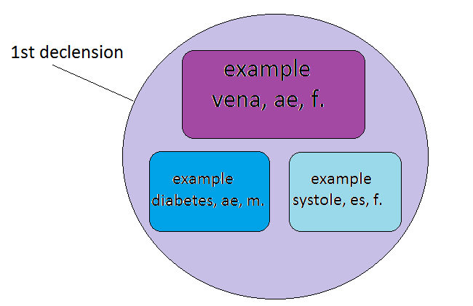
DECLENSIONS => EXAMPLES
Nom. sg. + gen. sg. + gender

Slide 19
5 declensions of nouns
x
3 declensions of adjectives
x
4 conjugations of verbs

