Slide 1
Hand Hygiene in Health Care
MUDr. Markéta Petrovová
Dpt. of occupational medicine LF MU Brno
2011

Slide 2
WHY??
WHO??

Slide 3

Health care-associated infections
affect hundreds of millions of patients worldwide
every year.
Infections
lead to more serious illness
prolong hospital stays
induce long-term disabilities
add high costs to patients and families
contribute to additional financial burden
on the health-care system
often result in tragic loss of life.

Slide 4
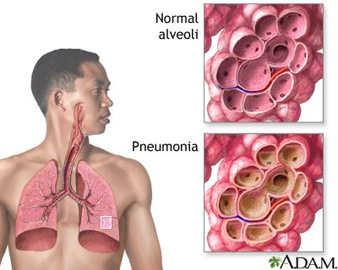
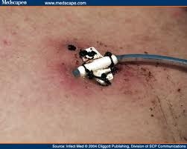
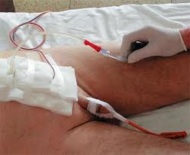
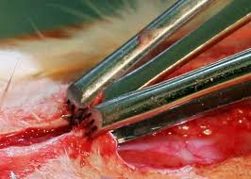
Type of HCAI
VAP = ventilator-associated pneumonia
CLA-BSI = central line-associated bloodstream infection
CR-UTI = catheter-related urinary tract infection
SSI = surgical site infection

Slide 5
Health care-associated infections
HCAI is a major problem for patient safety and its prevention must be a first priority for settings and institutions committed to making health care safer.
Hand hygiene is the primary measure to reduce
infections and the spread of antimicrobial resistance.
WHO: New global Guidelines on Hand
Hygiene in Health Care

Slide 6
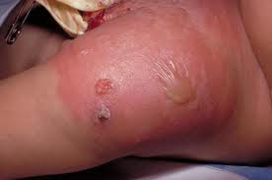
HCAI In developed countries
concerns 5–15% of hospitalized patients
can affect 9–37% of those admitted to intensive care units.
Prevalence rates of infection:
Europe: from 9 to 37% when assessed 12
USA: with trude mortality rates ranging from 12% to 80%.
Device-associated infections have a great economic impact; for example catheter-infection caused by methicillin-resistant Staphylococcus aureus (MRSA) may cost as much as US$ 38 000 per episode.

Slide 7
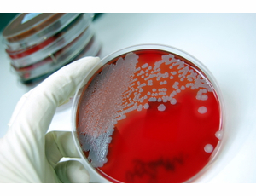
HCAI in developing countries
The risk for patients to develop surgical site infection (SSI), the most frequently type in developing countries, is significantly higher than in developed countries
e.g. 30.9% in a paediatric hospital in Nigeria
23% in general surgery in a hospital in the United Republic of Tanzania
19% in a maternity unit in Kenya

Slide 8






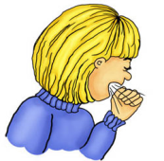
MODE OF Transmission
direct transmission (STD)
organism
non-direct transmission
source of infection
dirty hands
area/surface
subject
water
food
soil
insect …
susceptible
patient
droplets transmission (influenza)

Slide 9
Prevention of nosocomial infections
observance of hygienic rules
implementation of disinfection and sterilization
can reduce the presence of microorganisms
HAND HYGIENE
TOOLS DISINFECTION
AREAS AND SUBJECTS
DISINFECTION

Slide 10
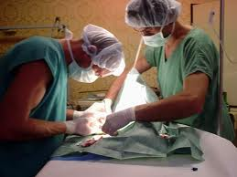
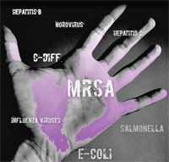
HAND Hygiene
Cost-effective method of preventing the spread of hospital infections
HANDS TRANSMITS UP TO 60% INFECTIONS

Slide 11
Indications for hand hygiene
A. Wash hands with soap and water when visibly dirty or visibly soiled with blood or other body fluids or after using the toilet.
B. If exposure to spore-forming pathogens is strongly suspected or proven (Clostridium difficile, hand washing with soap and water is the preferred means.
C. Use an alcohol-based handrub for routine hand antisepsis in all other clinical situations. If it is not obtainable, wash hands with soap and water.

Slide 12
HAND Hygiene – WHO??
personal – doctor, nurse …
patient
visitors
= all in hospital

Slide 13
Perform hand hygiene:
before and after touching the patient
before handling an invasive device for patient care, regardless of whether or not gloves are used
after contact with body fluids or excretions, mucous membranes, non-intact skin, or wound dressings
if moving from a contaminated body site to another body site during care of the same patient

Slide 14
Perform hand hygiene:
after contact with inanimate surfaces and objectes (including medical equipment) in the immediate vicinity of the patient after removing sterile or non-sterile gloves
before handling medication or preparing food perform hand hygiene using an alcohol-based handrub or wash hands with either plain or antimicrobial soap and water

Slide 15
Use of gloves
The use of gloves does not replace the need
for handhygiene (HR, HW)
Wear gloves when is possible contact with
blood or other potentially infectious materials,
mucous membranes or non-intact skin
Remove gloves after caring for a patient. Do not wear the same pair of gloves for the care of more than one patient
When wearing gloves, change or remove gloves during patient care if moving from a contaminated body site to either another body site within the same patient or the environment
The reuse of gloves is not recommended.

Slide 16
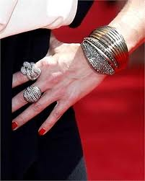
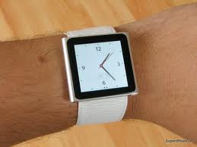
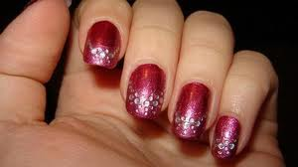
Other aspects of hand hygiene
Soap and alcohol-based handrub should not be used concomitantly.
Do not wear watch, rings and artificial fingernails when having direct contact with patients.
Keep natural nails short (less than 0.5 cm long)

Slide 17
My 5 Moments for Hand Hygiene
defines the key moments when health-care
workers should perform hand hygiene.
This approach recommends to clean their hands
before touching a patient,
before clean/aseptic procedures,
after body fluid exposure/risk,
after touching a patient, and
after touching patient surroundings.

Slide 18
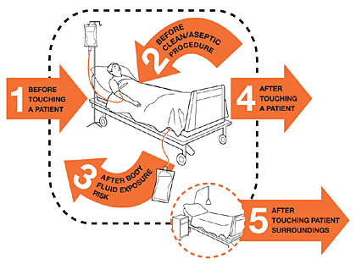

Slide 19
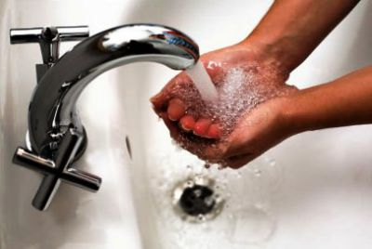

How to Handwash?
WASH HANDS WHEN VISIBLY SOILED!
OTHERWISE, USE HANDRUB
40 -60 sekund !!!

Slide 20
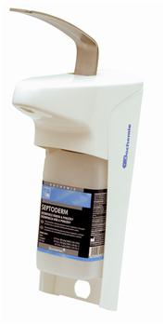
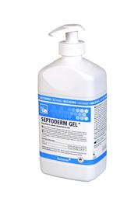
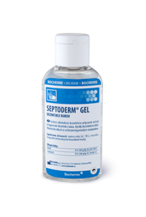
How to Handrub?
RUB HANDS FOR HAND HYGIENE!
WASH HANDS WHEN VISIBLY SOILED
40 -60 sekund !!!

Slide 21
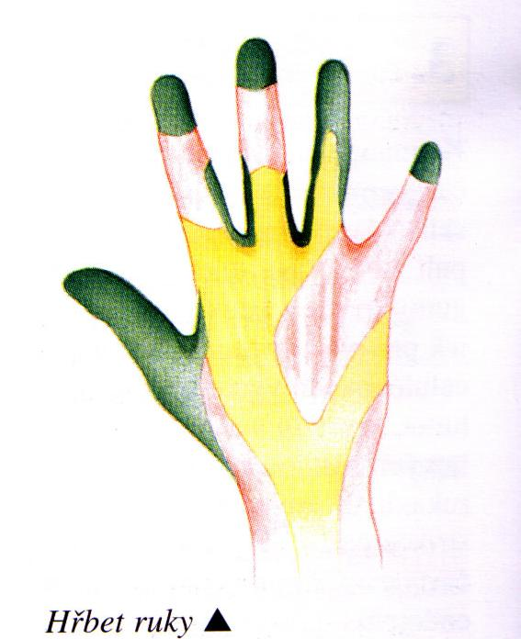
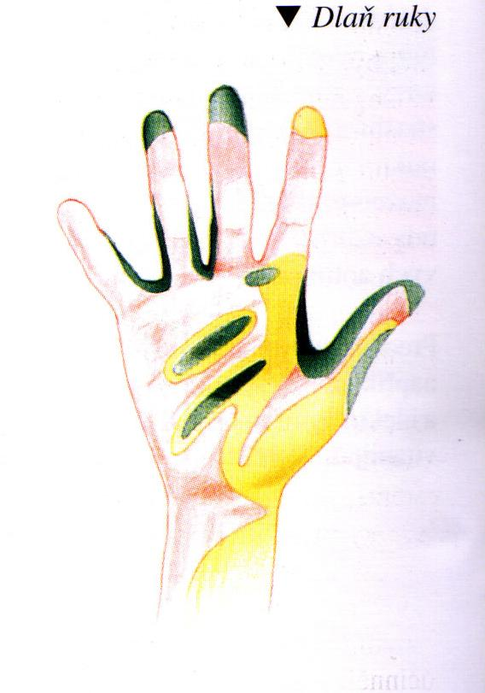
Often forgotten places
back of the hand
palm of the hand

Slide 22
THE END
“Clean Care is Safer Care”
is not a choice
but
a basic right.

Slide 23

Thank you for attention
followed by a practical demonstration of their own hands…

