Slide 1
General arthrology

Slide 2
Connections of bones
(juncturae ossium)
SYNARTHROSIS:
Bones are connected with some connective tissue
Articular surfaces are missing, mobility is minimal
Differentiation according to the type of connective tissue
2. DIARTHROSIS: articulatio synovialis
Joint connection with contact
ART. FIBROSA- SYNDESMOSIS
ART. CARTILAGINEA (SYNCHONDROSIS, SYMPHYSIS)
SYNOSTOSIS

Slide 3
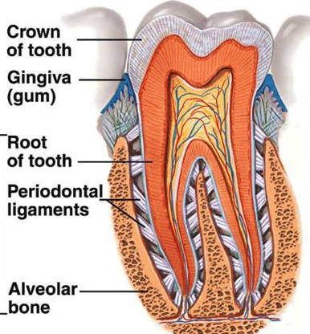
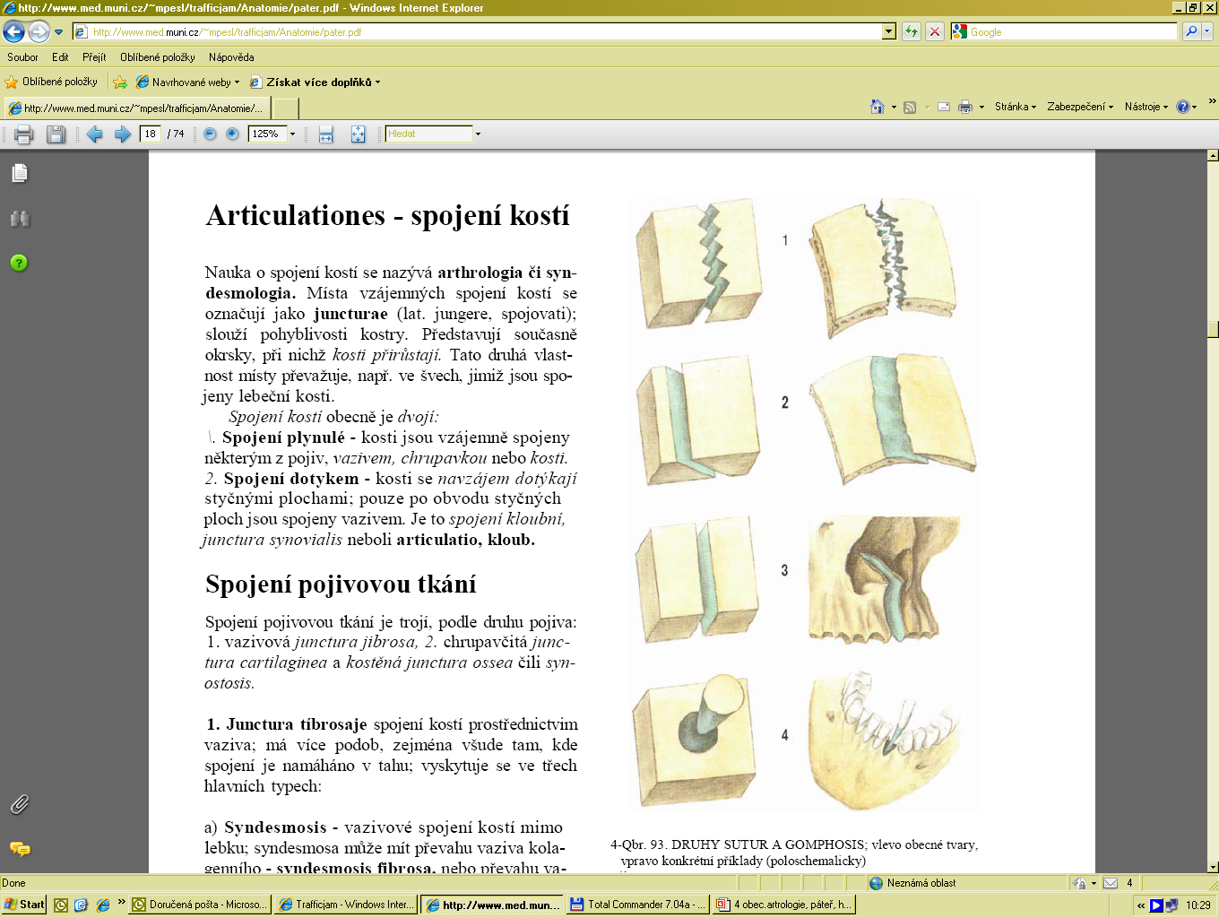
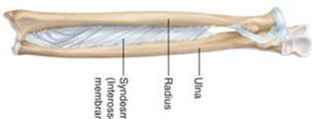
a) ART. FIBROSA- SYNDESMOSIS
Connection using fibrous tissue
wedging (gomphosis):
fixation of the tooth into dental alveolus in the jaw
suture (sutura):
connection of the skull plane bones
smooth- plana
serrated- serrata
squamous- squamosa
ligament (ligamentum):
band of collagenous connective tissue, it can have form of membrane
3

Slide 4
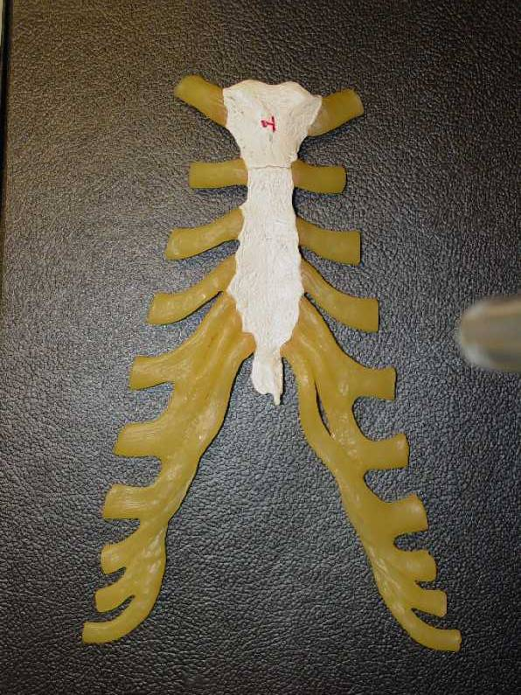
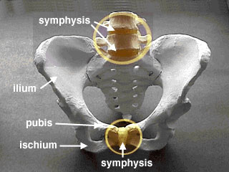
b) ART. CARTILAGINEA
SYNCHONDROSIS
Connection using hyaline cartilage
(between ribs and sternum,
between bones of base of the skull)
During development between epiphysis and diaphysis of long bones
SYMPHYSIS
- Connection using fibrous cartilage
(intervertebral disc, symphysis pubica)

Slide 5
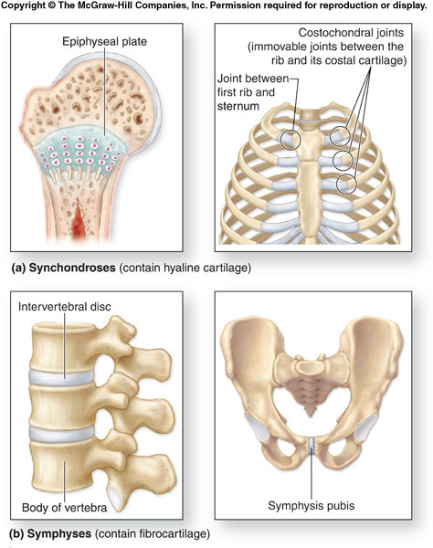
5

Slide 6
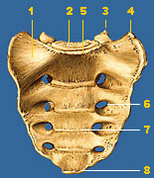
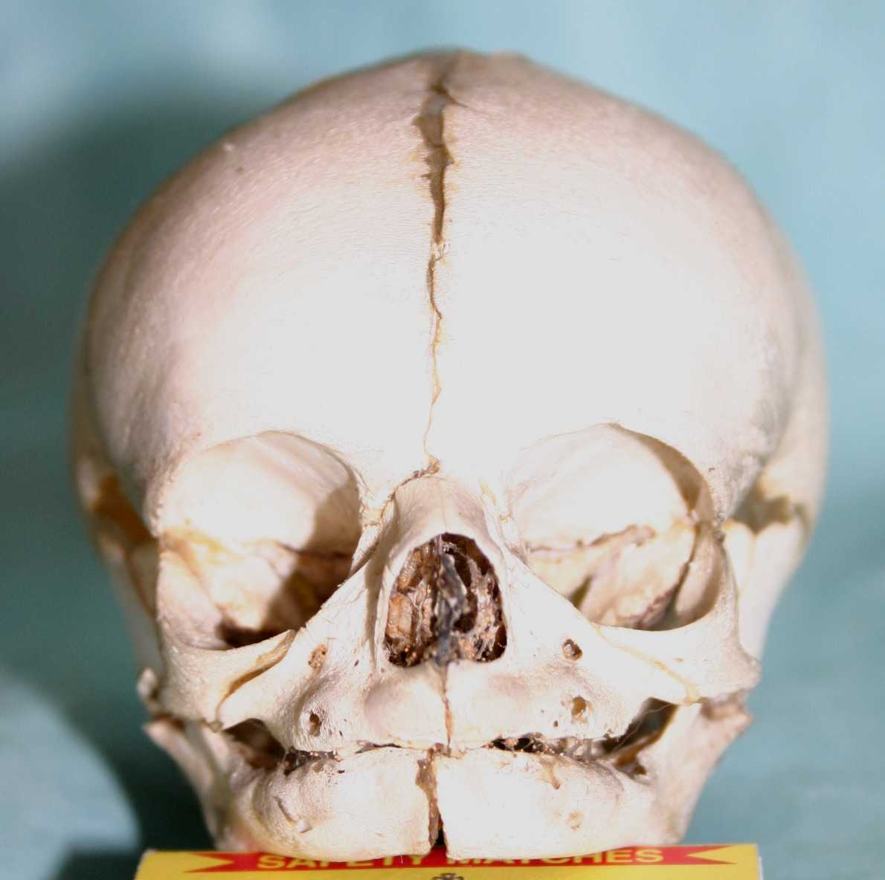
c) SYNOSTOSIS
Connection using bone tissue, originally independent bones grow together
For example sacral bone, coccygeal bone, bones of pelvis, some bones of skull

Slide 7
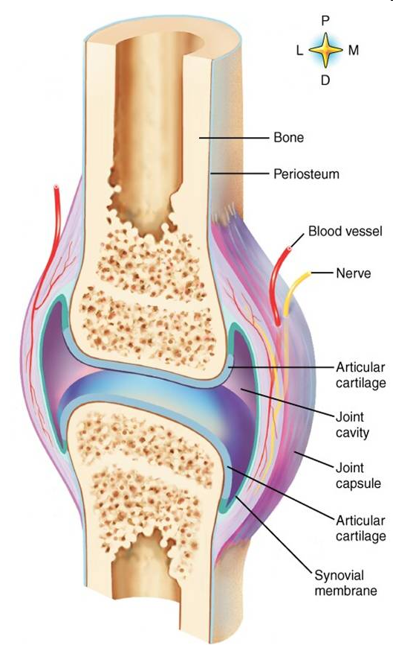
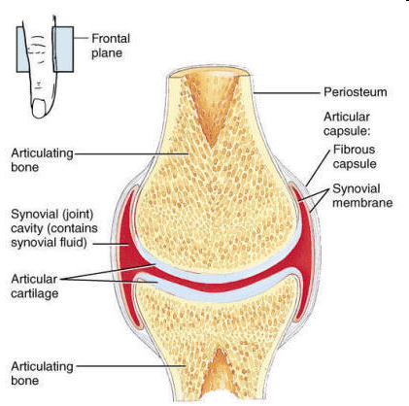
2. DIARTHROSIS
joint– articulatio, usually movable
Description of the joint
Articular surfaces - facies articulares
Articular cavity - cavitas articularis
Articular capsule - capsula articularis
Additional features

Slide 8
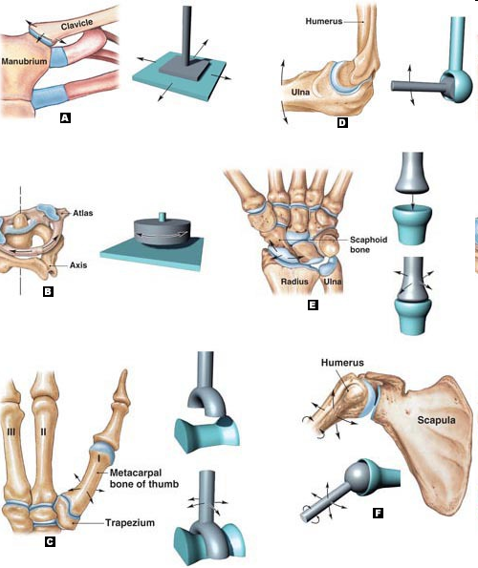
a) Articular surface(facies articularis):
-is covered by hyaline cartilage
has various shape, articular head(caput)- convex, articular fovea (fossa)- concave

Slide 9
b) Articular capsule(capsula articularis):
covering of the joint, has two layers
stratum fibrosum- external layer is created by fibrous connective tissue, is firming up the joint connection
- stratum synoviale- internal layer is created by thin fibrous tissue with vessels and nerves, forms folds - plicae synoviales, and villi- villi synoviales, produces synovial fluid - synovii (significance for joint movement and for nourishment of joint cartilages)
c) Articular cavity (cavum articulare):
- cavity (fissure) inside the joint between articular surfaces and articular capsule, its content is synovial fluid

Slide 10
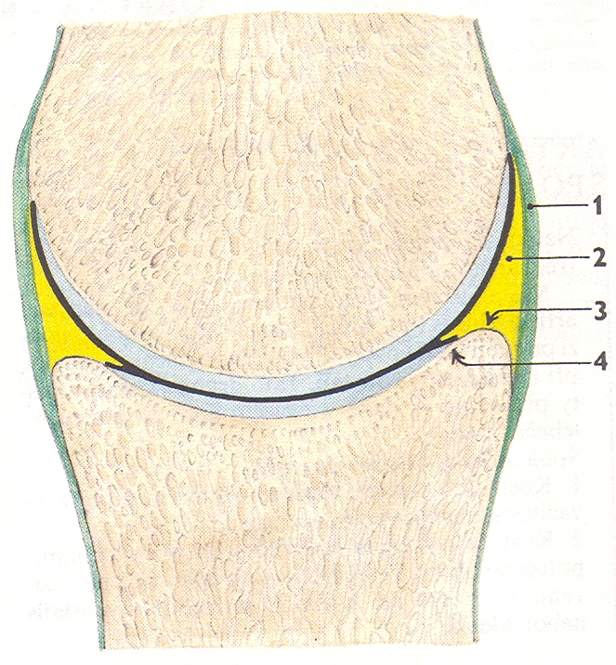

Slide 11
d) Additional features:
- only in some joints
- provide better function
Articular ligaments (ligamenta articularia):
- (intraarticular, extraarticular)
Cartilaginous plates (disci et menisci):
Fibrous cartilage, intraarticularly,
discus articularis- completely septates the articular cavity
- meniscus articularis- doesn´t separate the entire articular cavity
Articular labra (labra articularia):
- Bands of cartilaginou tissue, enlarge and deepen articular pit
Synovial bursae (bursae synoviales):
- Cavities of various size, are bordered by fibrous capsule and filled by synovia, in places, where muscles or tendons lies directly on bones

Slide 12
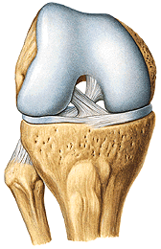
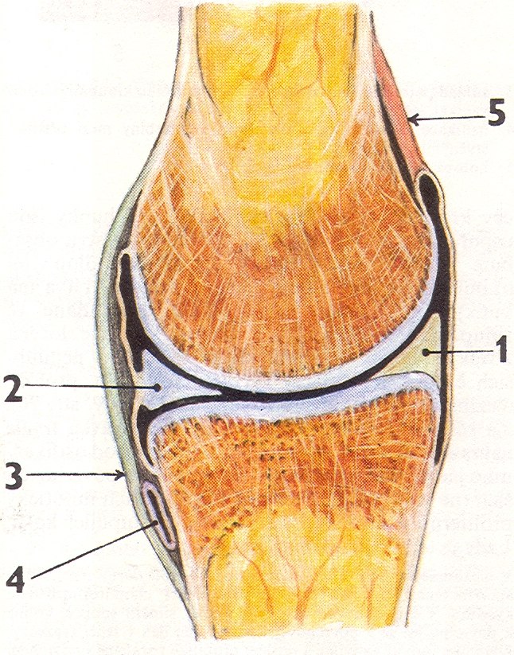
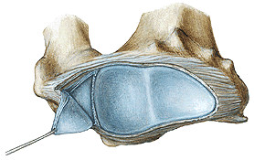
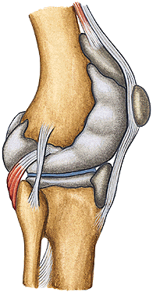
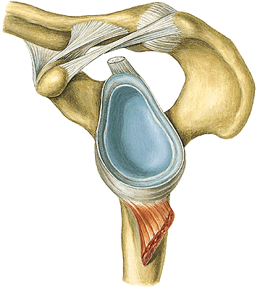

Slide 13
Types of joints

Slide 14
A. Classification of joints according to the shape of articular surfaces:
  joint with irregular surfaces - AMPHIARTROSIS
  flat joint - ART. PLANA
  Spherical joint (ball and socket)- ART. SPHAEROIDEA
    spherical free - ARTHRODIA
    spherical restricted - ENARTHROSIS
  cylindrical joint - ART. CYLINDROIDEA
    GINGLYMUS- axis of movement is perpendicular to the longitudinal axis of bone
    wheel joint - TROCHOIDEA- axis of movement is paralel to the longitudinal axis of bone
  elipsoidal joint - ART. ELLIPSOIDEA
  sellar joint- ART. SELLARIS
  trochlear (hinge) joint - ART. TROCHLEARIS

Slide 15
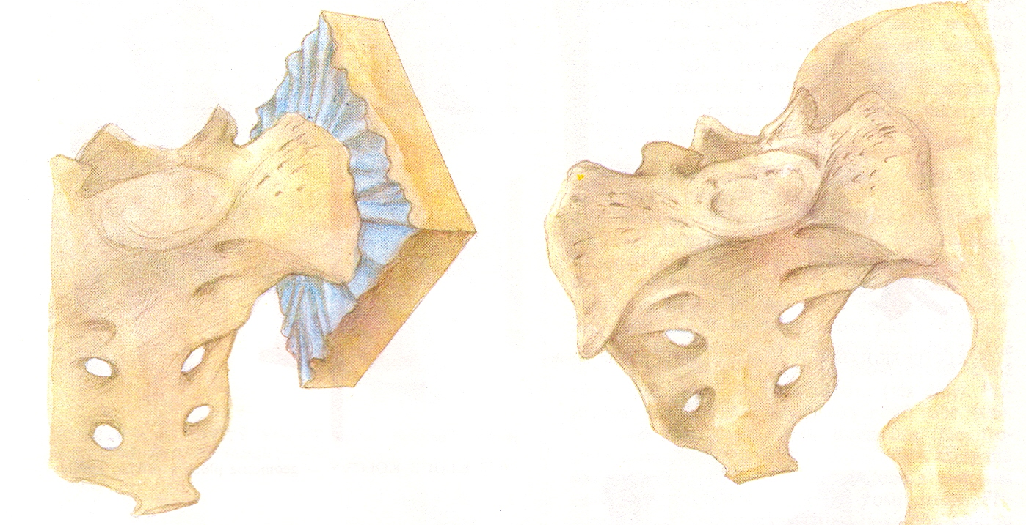
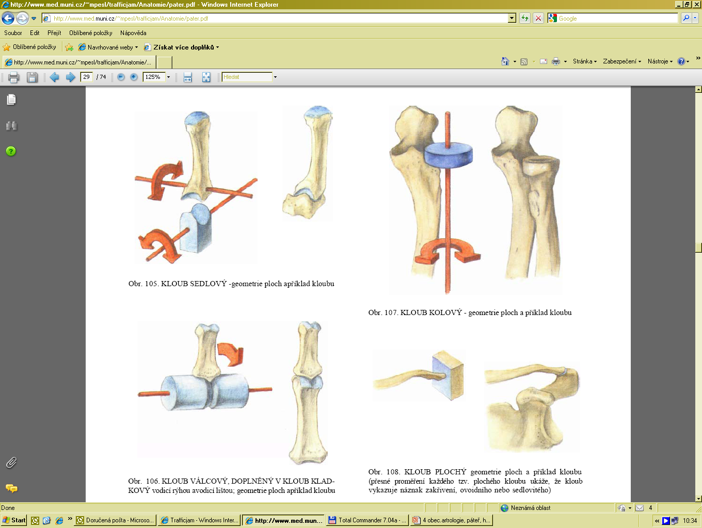
AMPHIARTROSIS
ART. PLANA

Slide 16
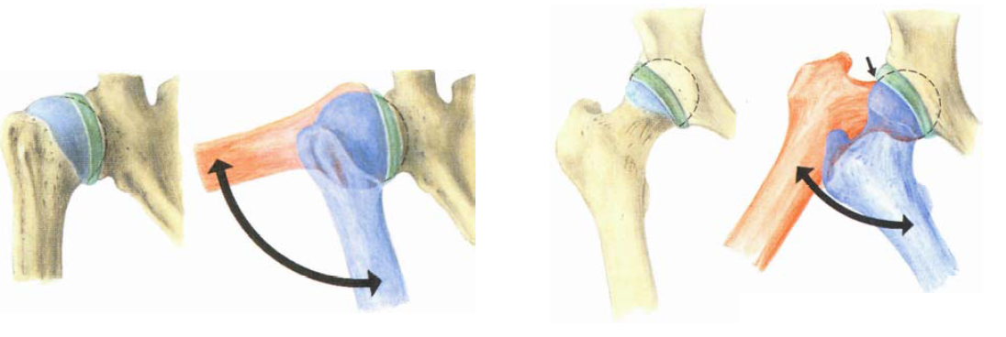
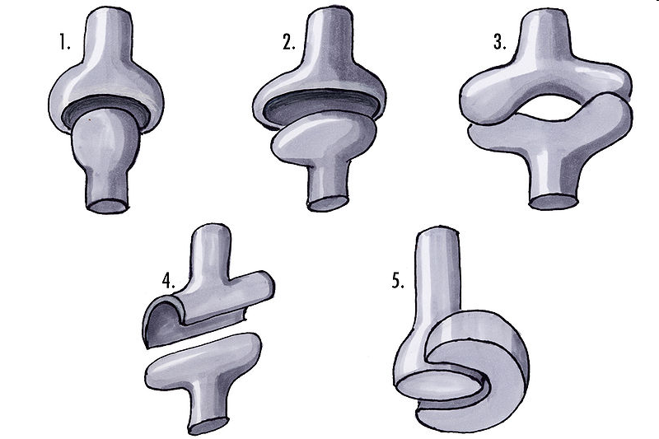
ART. SPHAEROIDAE
ARTHRODIA
ENARTHROSIS
ART. CILINDROIDAE:
TROCHOIDAE
GINGLIMUS

Slide 17
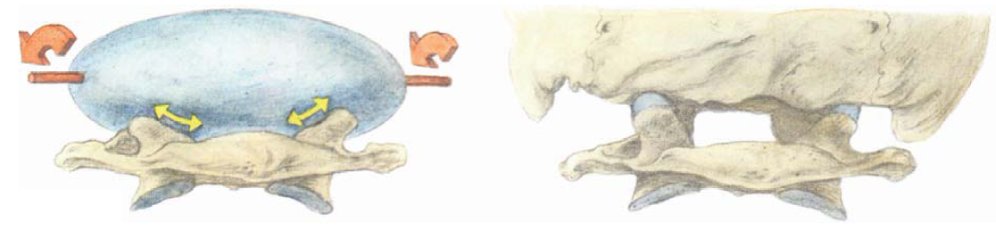
ART. ELLIPSOIDAE
ART. SELLARIS
ART. TROCHLEARIS

Slide 18
B. Classification of joints according to the level of movability and number of axis of movements:
Joints with minimal movements:
amphiartrosis
Joints with sliding movements:
articulatio plana
Joints with rotational movements:
Rotation is possible around one, two or thee axes
One-axis joints (art. Cylindroidea, art. trochlearis)
Two-axis joints (art. Ellipsoidea, art. sellaris)
Three-axis joint (art. sphaeroidea)

Slide 19
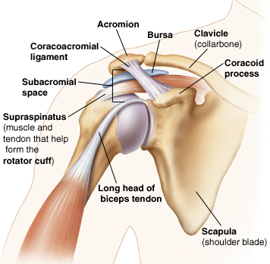
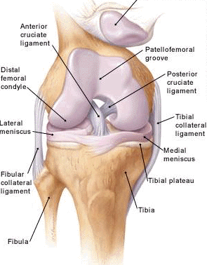
C. Classification of joints according to number of connecting bones
Simple joint - art. simplex- two bones are connecting
Composed joint - art. composita- more than two bones are connecting, or discus or meniskus is inserted into the joint

