Slide 1
FEATURES OF ACADEMIC WRITING IN ENGLISH

Slide 2
There are believed to be 8 main features of academic writing in English. Can you brainstorm what they could be?

Slide 3
8 features of academic writing in English:
Complexity
Formality
Precision
Objectivity
Explicitness
Accuracy
Hedging
Responsibility

Slide 4
1. COMPLEXITY
noun-based phrases and nominalizations instead of verbs
Many factors must be considered in explaining how fast the population has grown in the developing countries.
Many factors must be considered in explaining the rapid growth of population in the developing countries.
subordinate clauses
There are several factors which affect the climate of the Earth …

Slide 5
-ed/-ing participles – allow verbs to be used nominally or adjectively
The Egyptians regarded time as a succession of recurring phases.
It was only found to be occurring in a controlled and formalized context.
passives
The new computer system is being installed next month.
lexical complexity
The project was not funded enough.
The project was underfunded.

Slide 6
2. FORMALITY
Avoid the following when you write an academic article:
colloquial words and expressions:
Modern houses have many labour-saving things which help us save time.
It focused on a subject which a lot of scientists regarded as insignificant.
contracted forms: can’t, doesn’t, shouldn’t…
some phrasal verbs:
This will cut down the amount of drug required…
Dieters often feel that they should totally get rid of high-fat and high-sugar foods.

Slide 7
3. PRECISION
in academic writing you need to be precise when you use information, dates or figures.
A lot of people… 50 million people…
4. OBJECTIVITY
in general, avoid I, me, myself and you in academic writing.
I would call Wagner a subjective artist. What I mean is that his art had its source in his personality. Wagner was what might be called a subjective artist in that his art had its source in his personality.

Slide 8
5. EXPLICITNESS
make explicit the signposting of the organization of the ideas in the text by the use of connectives:
e.g., The computer has become smaller and cheaper and hence more available to a greater number of people.
acknowledge the sources of the ideas in the text:
McGreil (1977: 363-408) has shown that though Dubliners find the English more acceptable than the Northern Irish, Dubliners still seek a solution to the Northern problem within an all-Ireland state.

Slide 9
Discordant data have been published on the immunovirogical response in patients during HAART, but most authors, after adjustment for potential confounders including CD4 cell count and adherence, do not report any difference in terms of virological and immunological outcome (Figures 2 and 3). Fardet et al.[4] observed that the probability of a CD4 count increment of at least 100 cells/mm3 and the percentage of patients who achieved a viral load below 500 copies/mL were similar in women and men. Conversely, an observational trial conducted in the US reported different conclusions. Hunt et al.[10] showed that lower pre-therapy CD4 cell count, younger age, female sex and infrequent low-level viraemia (versus sustained undetectable viraemia) were all factors associated with increased CD4 cell count gains from month 3 to year 4. In contrast, in an Italian multicentre cohort study of 2460 HIV-infected persons during HAART, no sex differences were reported in terms of proportion of patients (66.2%) achieving viral suppression, exhibiting rebound after viral suppression or recovering CD4 cell counts from baseline.[11] The EuroSIDA cohort showed that virological and immunological response was not associated with sex, but an increased hazard of virological rebound in females was reported but not confirmed as an independent factor at adjusted analysis (crude HR 1.40, 95% CI 1.18–1.67).[12] Consistent with such data, two population-based cohort studies reported an increasing number of virological rebound among females and a lower number of female patients with undetectable HIV-RNA viral load at 1 year (46.7% versus 64.8%, P = 0.001).[13,14] Nevertheless, these findings were not confirmed at adjusted analysis. In a simplification-based study in patients enrolled in the French Hospital Database on HIV (FHDH), Abgrall et al.[15] observed that after month 12, male sex was associated with a lower risk of virological rebound, with no gender difference in the immunological outcome during the switching therapy. Furthermore, few data from structured interruption trials have been presented. In a multicentre prospective French trial, Hoen et al.[16] showed that female gender was an independent predictor of viral response (P = 0.02). However, it is noteworthy that two of the five women included in this trial were infected with a non-B viral subtype. In a longitudinal cohort study performed in Alabama, USA, on 71 patients, Bedimo et al.[17] showed that the female gender was independently associated with the nonvirological rebound status (P = 0.04). Finally, a recent study performed in Uganda and Zimbabwe on the viroimmunological outcome of _300 HIV-infected adults treated with triple nucleoside reverse transcriptase inhibitors (NRTIs), showed a 2.3-fold significantly higher virological response in women compared with men (P = 0.001). [18]

Slide 10
6. ACCURACY
be accurate in your use of vocabulary, choose the most appropriate word
e.g., finances
cash
currency The project has been cancelled
capital because of lack of __________. funds

Slide 11
7. HEDGING
An important feature of academic writing is the concept of cautious language, often called “hedging” or “vague language”.
e.g., The results of the study demonstrate…
The results of the study indicate…

Slide 12

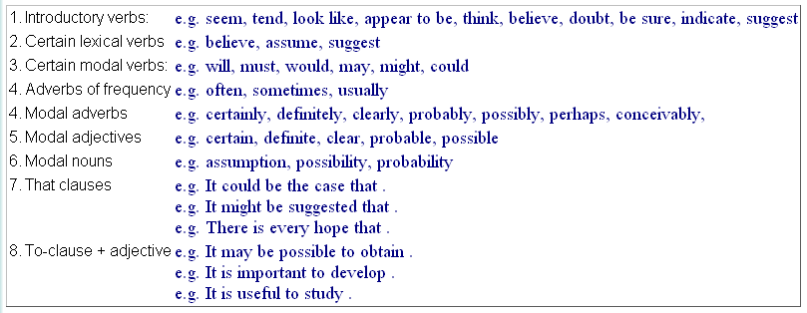

Slide 13
Hedging and certainty
Longitudinal studies have consistently showed that women have higher CD4 cell count and lower HIV-RNA levels at seroconversion and during the first course of HIV infection. In a few original articles, all from US cohorts, female patients have a significant delay in the initiation of a new antiretroviral treatment. [6–9] This difference could be due to the abovementioned lower zenith viral load and to the greater fear of drug effects on the fat body distribution compared with males. In European countries, this difference in the access to HAART has been reported but it never reached a statistical significance at adjusted analysis.[4,5] This geographical divergence may be due to the different national health policies between the USA and Europe. HIV-infected patients from Western European countries are usually cared for by a completely free-of-charge health public system without any user fees in terms of cost sharing for drugs, diagnostic and therapeutic procedures and hospitalization.
A possible outcome is…; it may be…; it is likely that…; It seems that…etc

Slide 14
8. RESPONSIBILITY
you are responsible for demonstrating an understanding of the source text, this is done by paraphrasing and summarizing.
e.g., Memory is the capacity for storing and retrieving information.
Memory is the facility for keeping and recovering data.

