Slide 1
Digestive system - 2
Pictures from MedAtlas version 3,0

Slide 2
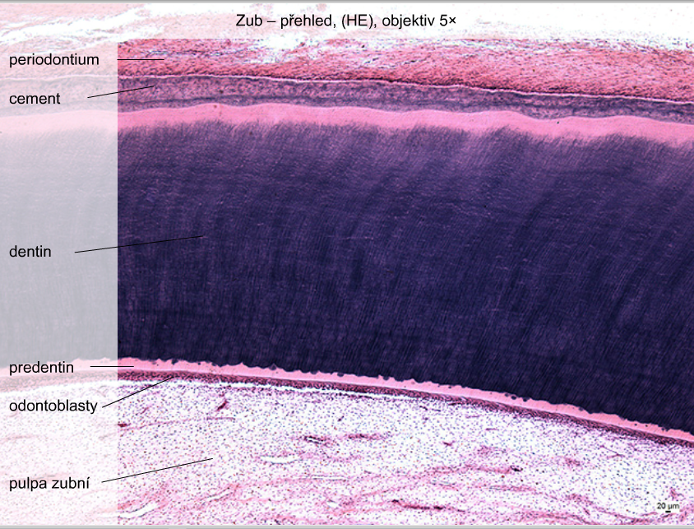
Tooth
dental pulp

Slide 3
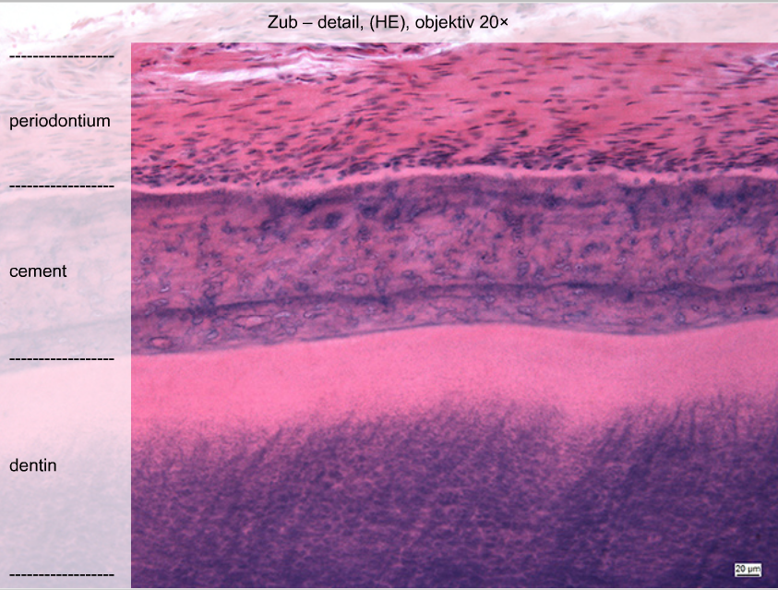
Tooth

Slide 4
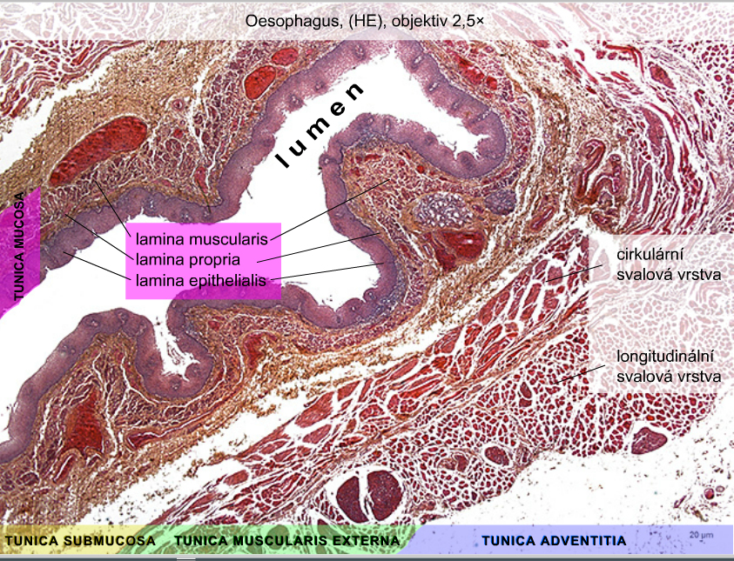
circular layer
longitudinal layer
of tunica muscularis
externa

Slide 5
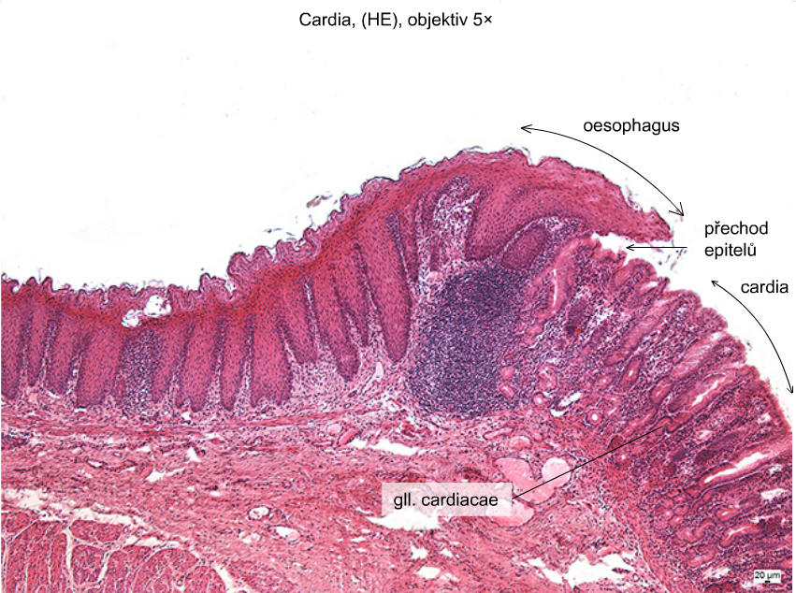
transition
of epithelia

Slide 6
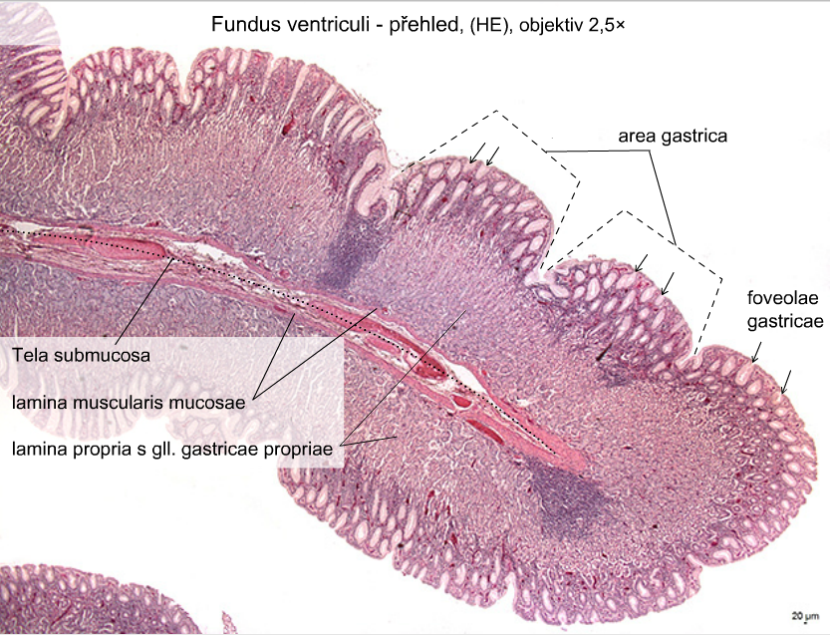

Slide 7
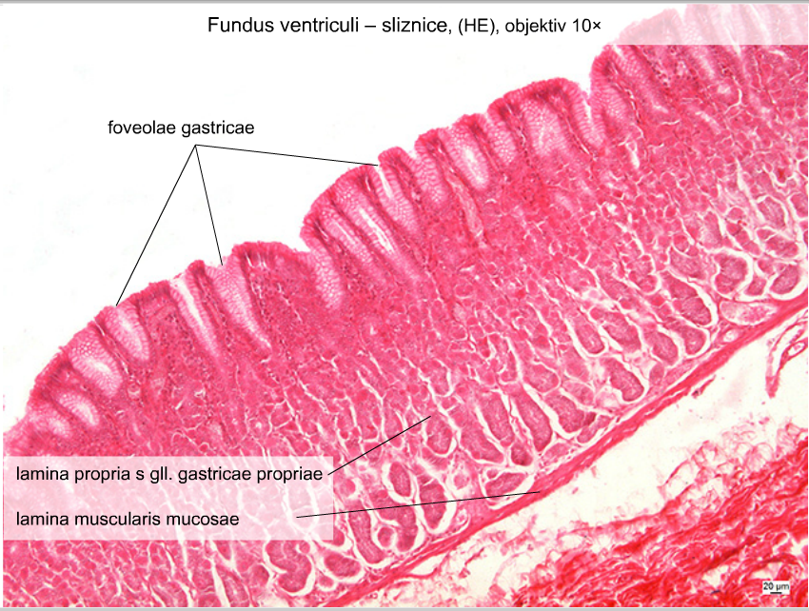

Slide 8
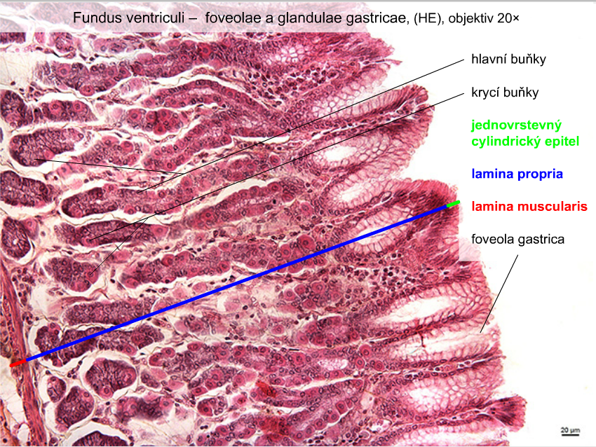
chief cells
parietal cells
simple coulumnar
epithelium
lamina propria
lamina muscularis

Slide 9
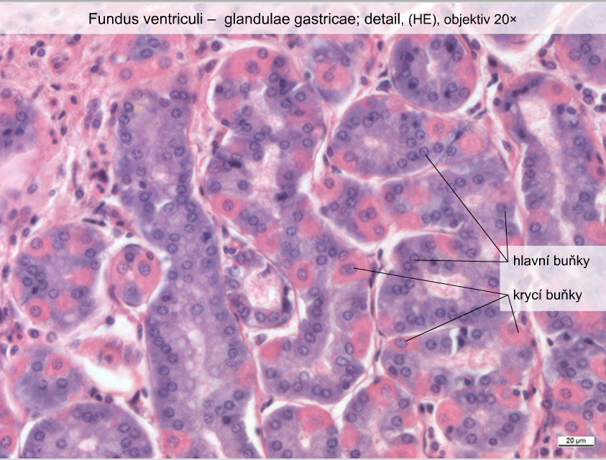
chief cells
parietal cells

Slide 10
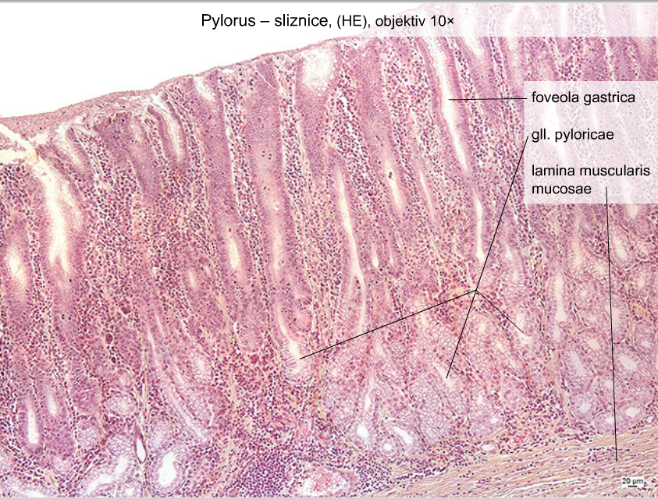
Pylorus - tunica mucosa

Slide 11
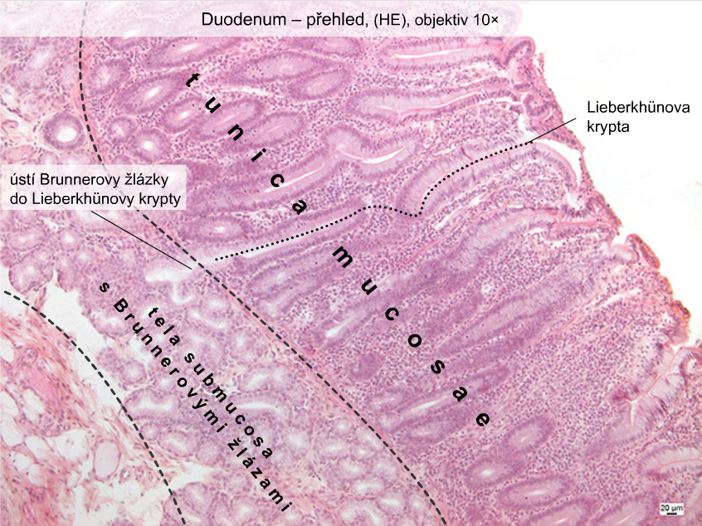
crypt
glands

Slide 12
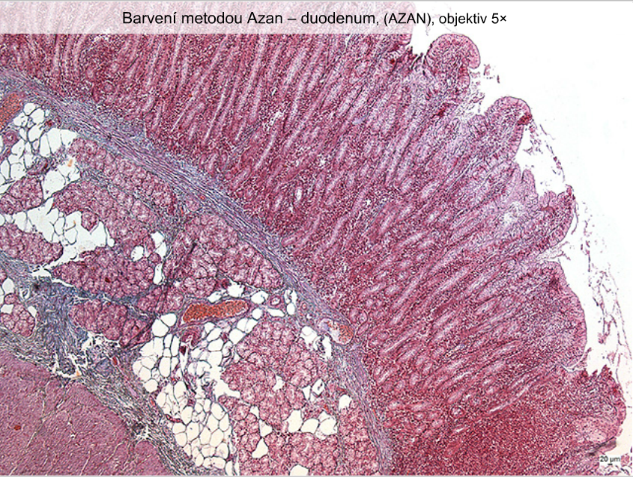
Duodenum – staining method: Azan

Slide 13
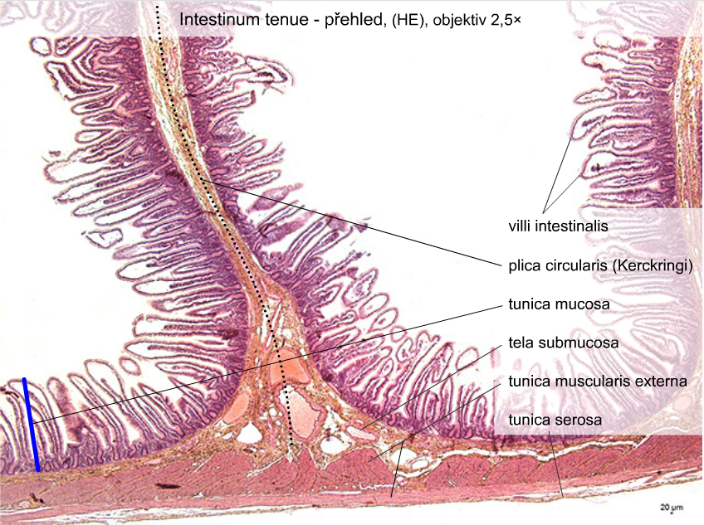

Slide 14
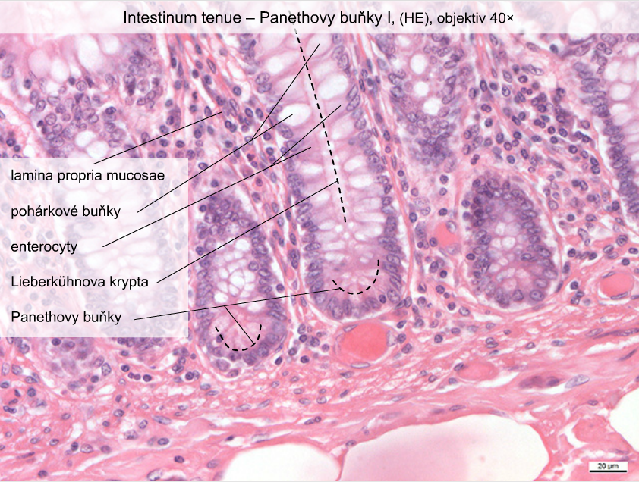
goblet cells

Slide 15
