Slide 1
Digestive system - 2
Pictures from MedAtlas version 3,0

Slide 2
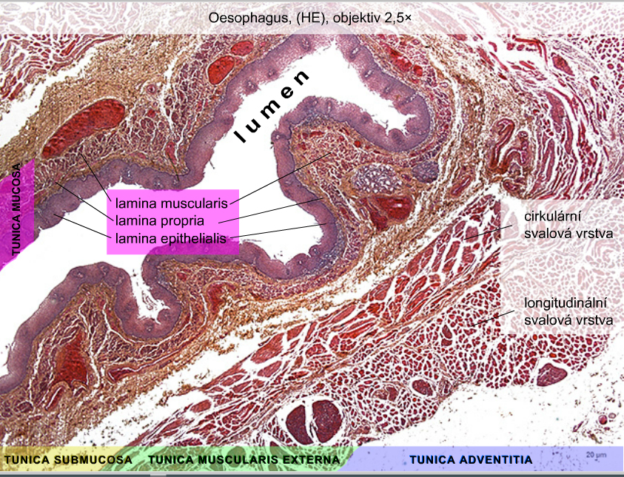
circular layer
longitudinal layer
of tunica muscularis
externa

Slide 3
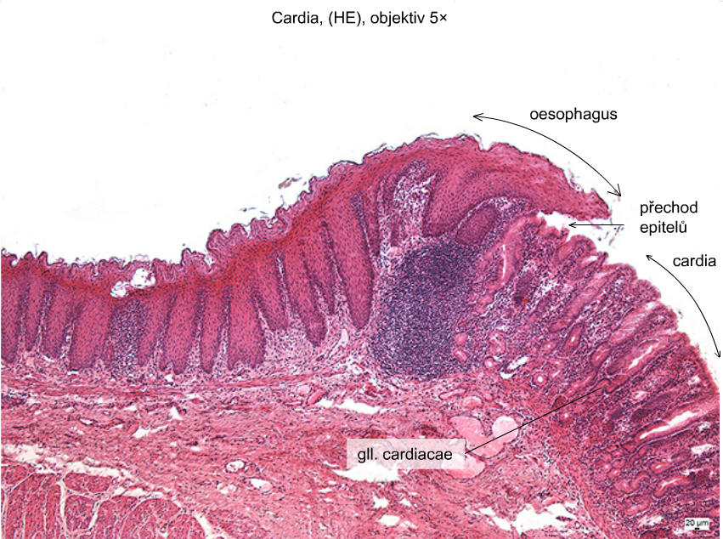
transition
of epithelia

Slide 4
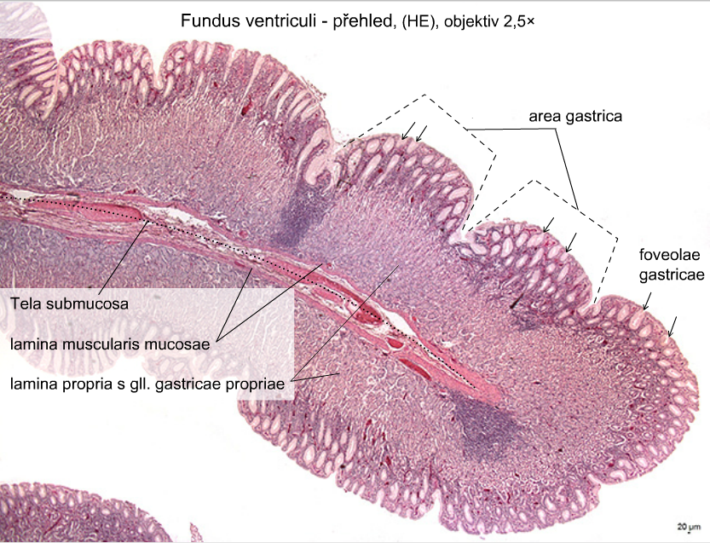

Slide 5
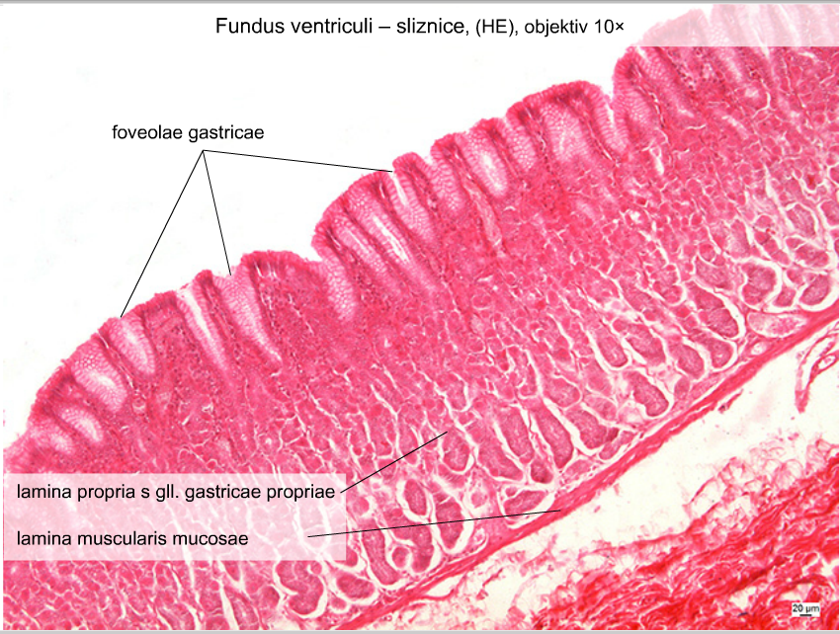

Slide 6
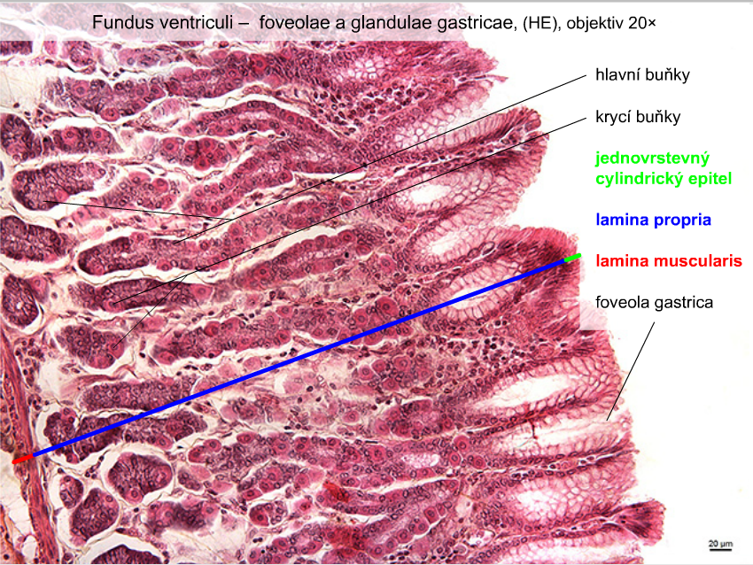
chief cells
parietal cells
simple coulumnar
epithelium
lamina propria
lamina muscularis

Slide 7
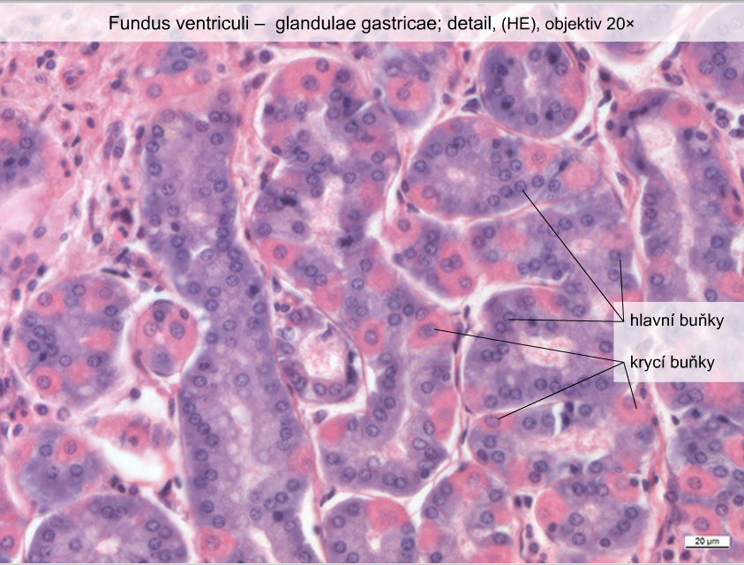
chief cells
parietal cells

Slide 8
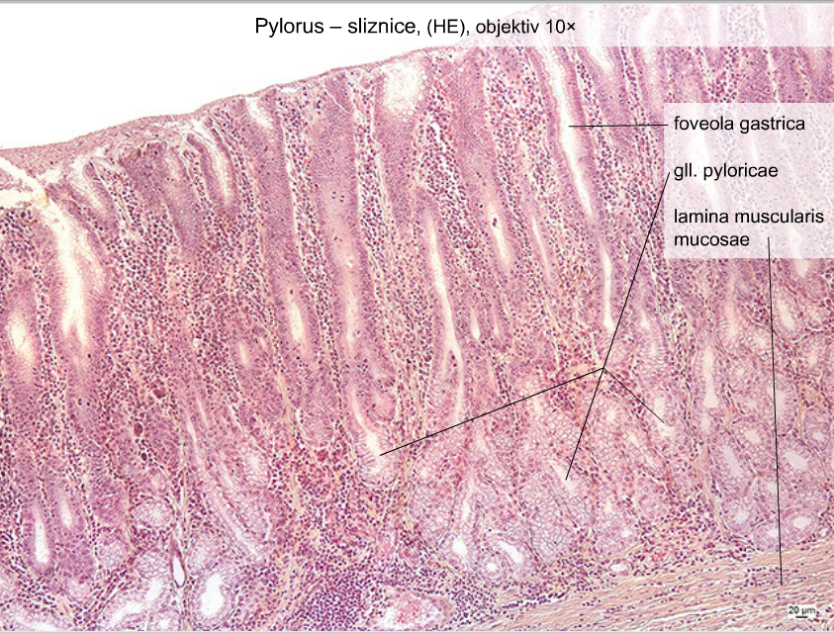
Pylorus - tunica mucosa

Slide 9
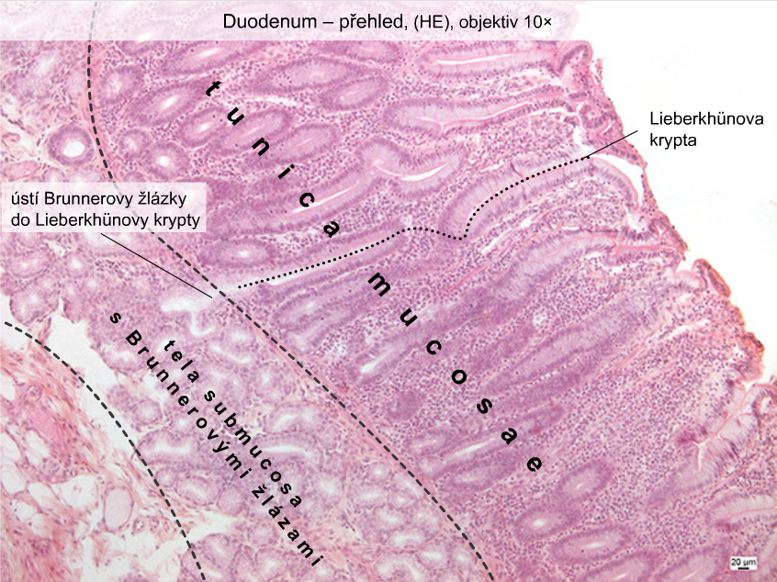
crypt
glands

Slide 10
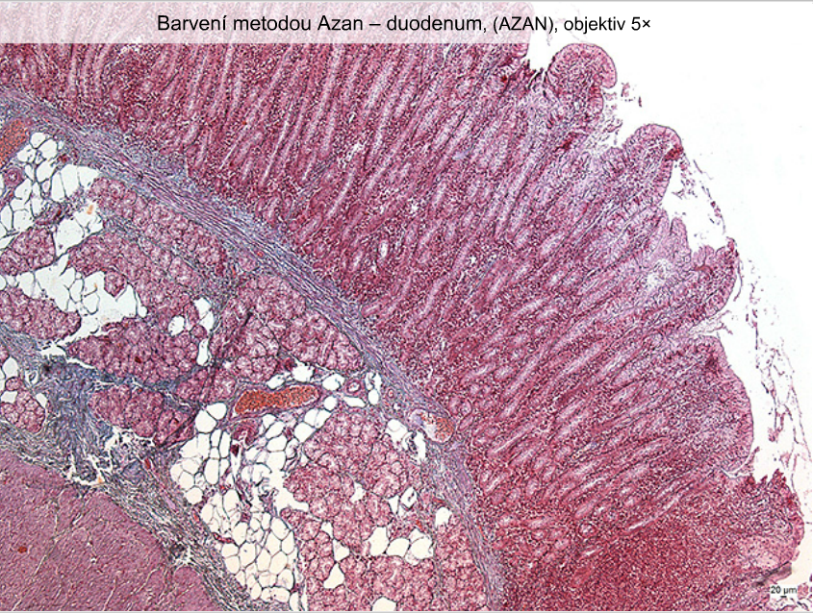
Duodenum – staining method: Azan

Slide 11
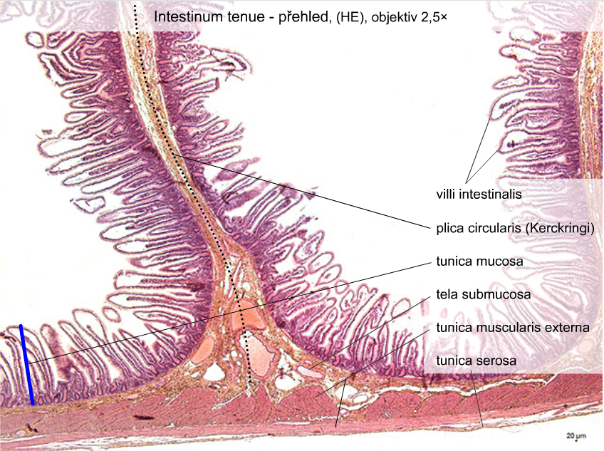

Slide 12
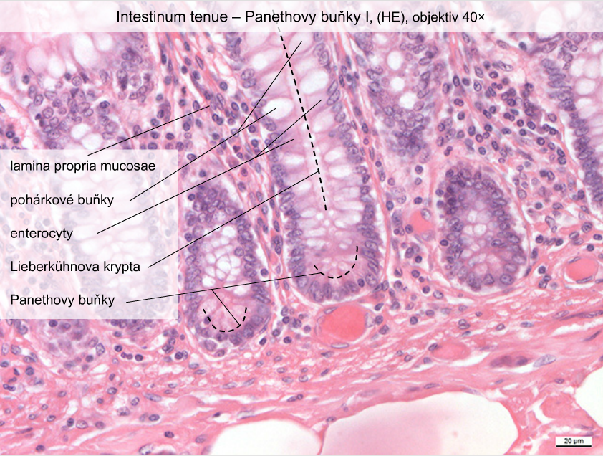
goblet cells

Slide 13
