Slide 1
Digestive system - 3
Pictures from MedAtlas version 3,0

Slide 2
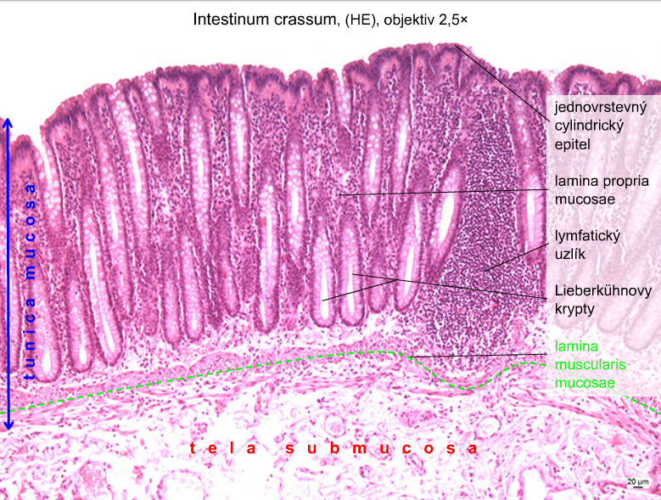
simple
columnar
epithelium
lymmph
nodule

Slide 3
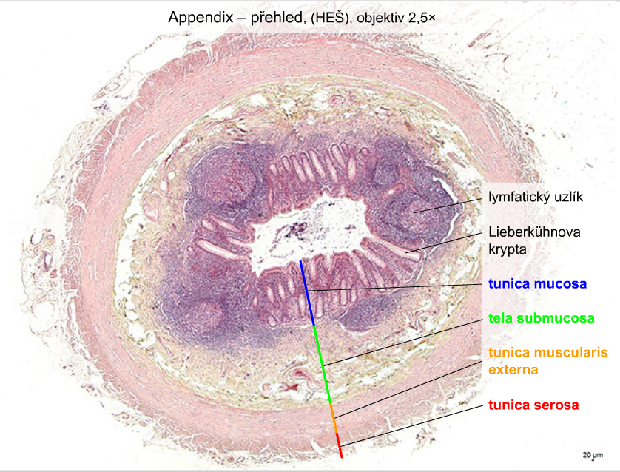
lymph nodule
crypt

Slide 4
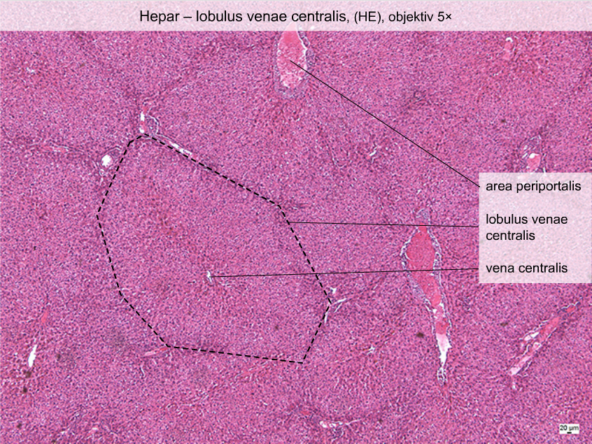

Slide 5
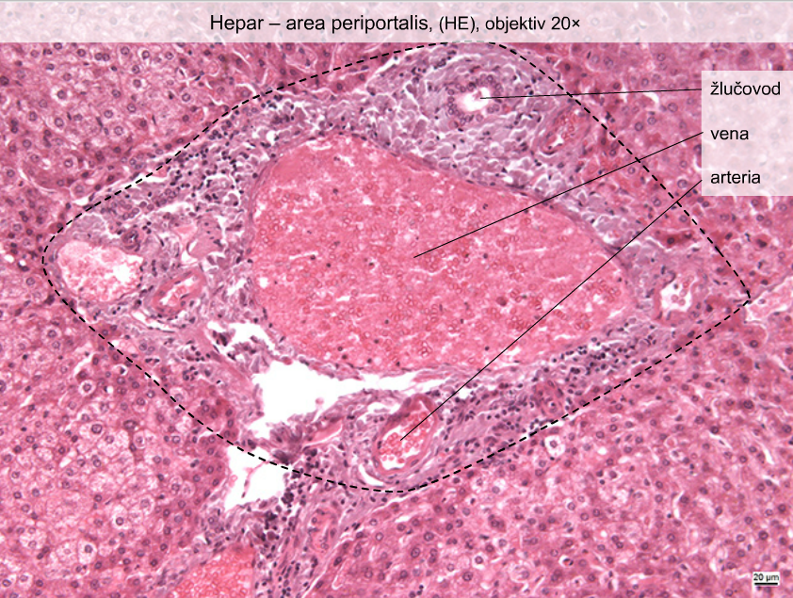
bileduct

Slide 6
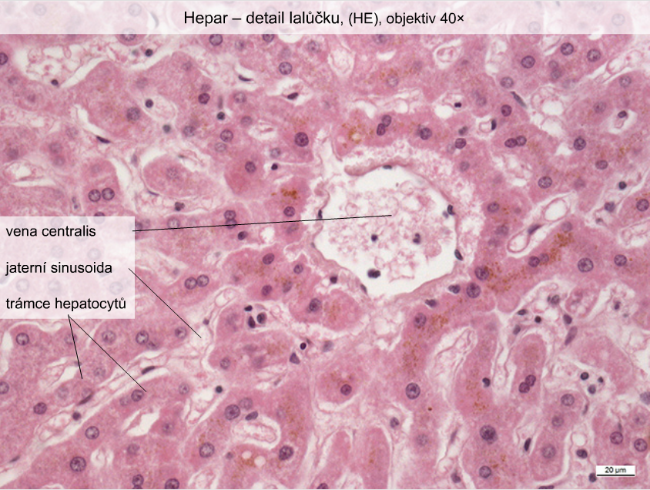
liver sinusoid
sheets of
hepatocytes

Slide 7
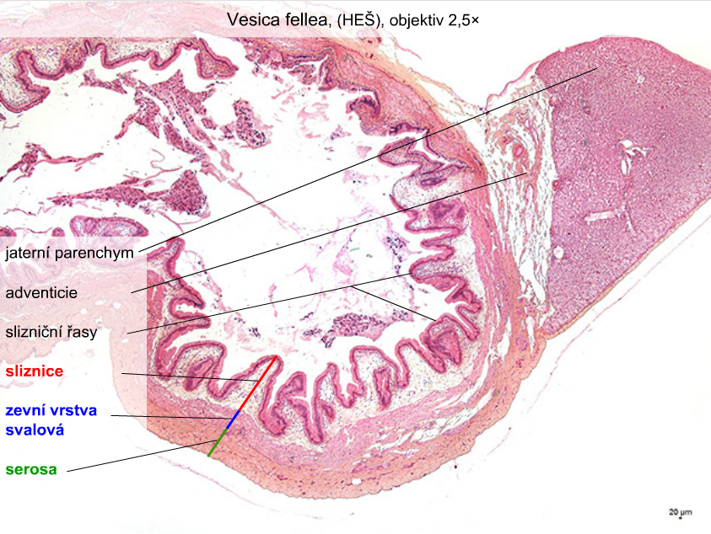
liver parenchyma
adventitia
mucosal folds
mucosa
outer muscle
layer

Slide 8
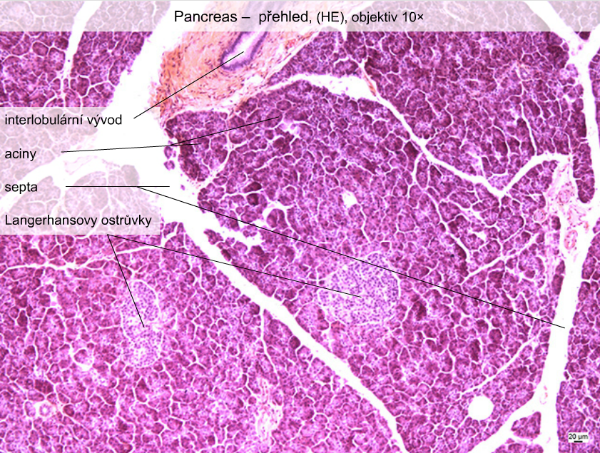
interlobular
duct
acini
islets of
Langerhans

Slide 9
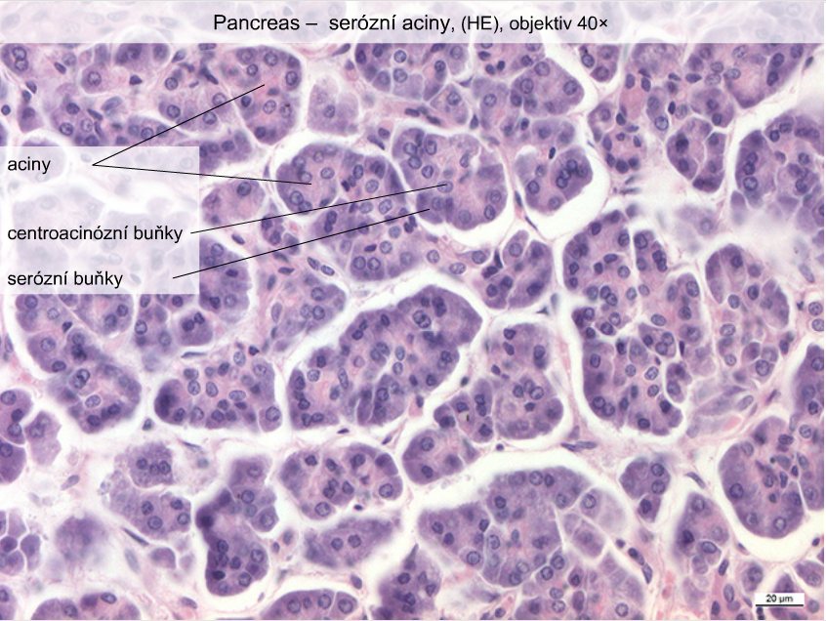
acini
centroacinar
cells
serous cells

Slide 10
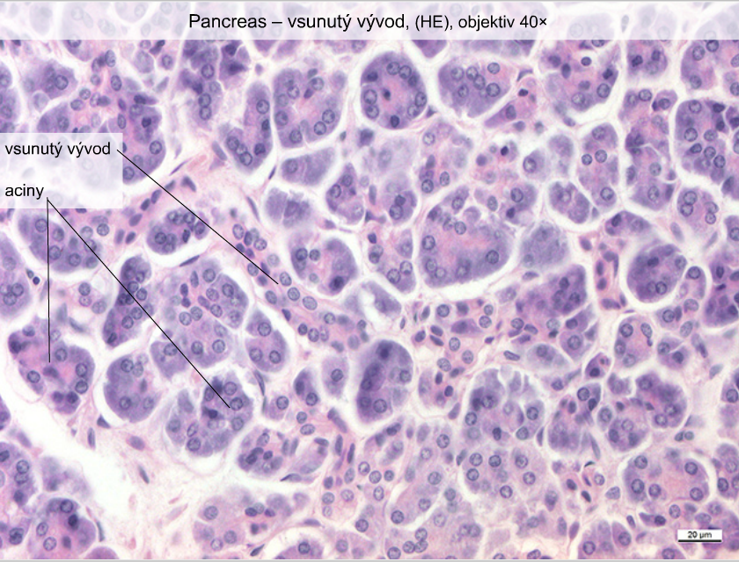
intercalated
duct
acini

Slide 11
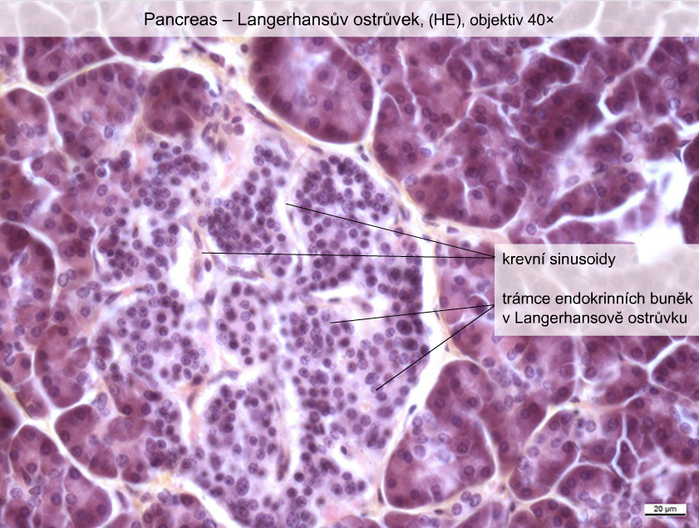
Pancreas – islet of Langerhans
blood
sinusoid
cords of
endocrine
cells

Slide 12
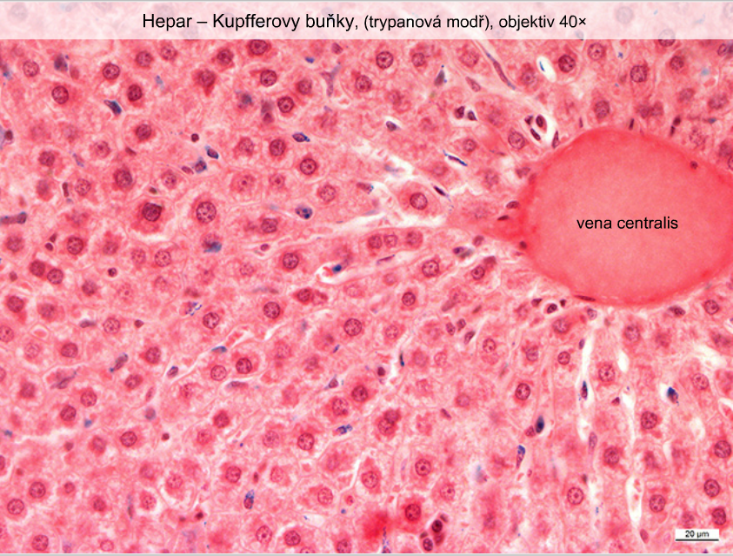
Hepar – Kupffer cells

