Slide 1
DIGESTIVE SYSTEM II.

Slide 2
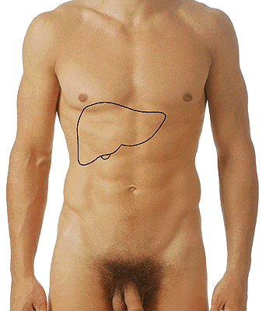
HEPAR

Slide 3
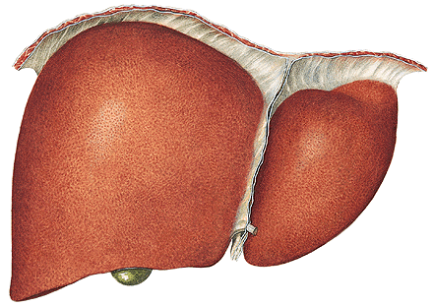
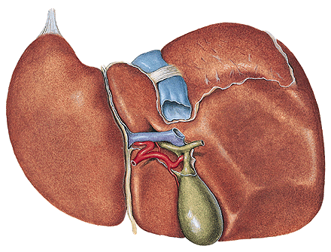
Facies diaphragmatica
- pars superior (area nuda)
- pars anterior
- lig. falciforme hepatis
- lobus dexter
- lobus sinister
Facies visceralis
Fissura ligamenti teretis
(lig. teres hepatis)
Fissura ligamenti venosi

Slide 4
Fossa vesicae biliaris
Sulcus venae cavae
Lobus dexter
sinister
caudatus
quadratus
Porta hepatis
- vena portae
- a. hepatica propria
- ductus hepaticus
communis
(portal triad)

Slide 5
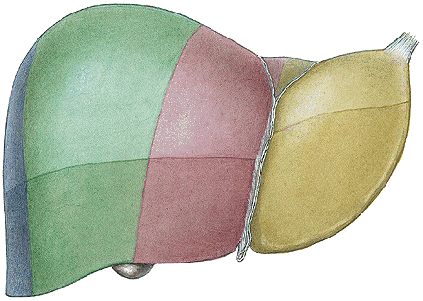
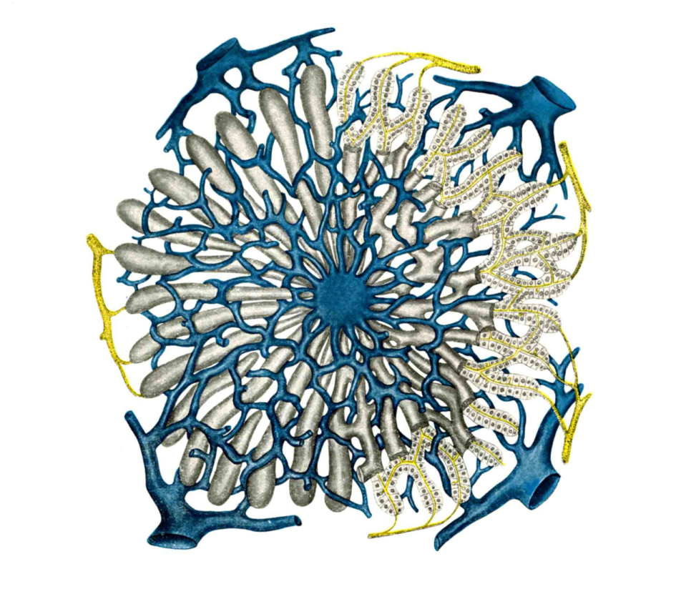

Slide 6
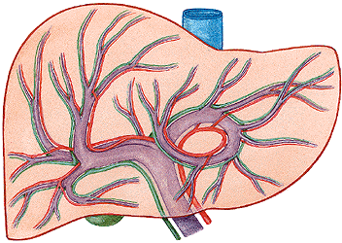
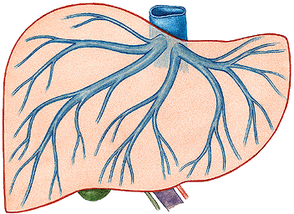
V. PORTAE
(v. mesenterica sup.
+ v. lienalis)
A. HEPATICA PROPRIA
- a. hepatica communis
→ RAMUS DEXTER ET SINISTER
→ VV. HEPATICAE

Slide 7
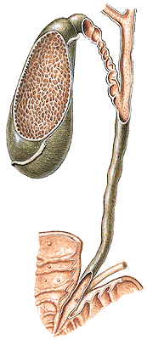
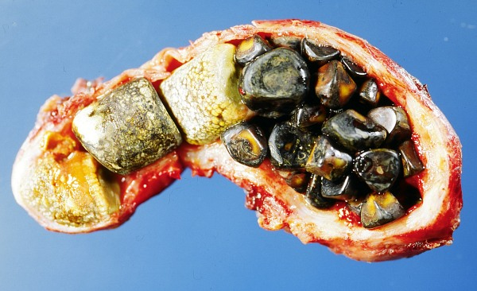
Intrahepatic ducts ductus hepaticus dexter
et sinister – ductus hepaticus communis
+ ductus cysticus = ductus choledochus
Ampulla hepatopancreatica
M. sphincter ampullae (Oddi)
Papilla duodeni major (Vater)
(Plica longitudinalis duodeni)
Vesica biliaris (fellea)
- fundus, corpus,
infundibulum, collum
- ductus cysticus
(plica spiralis)

Slide 8
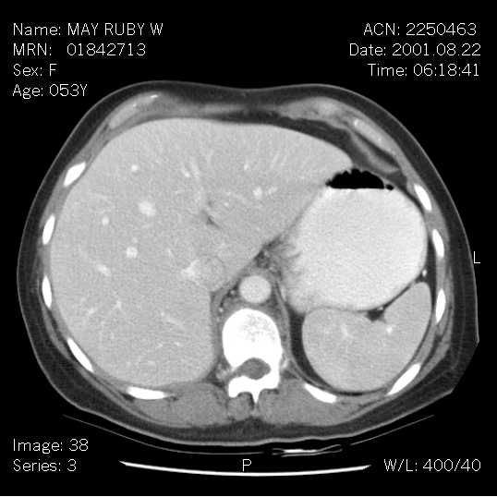

Slide 9
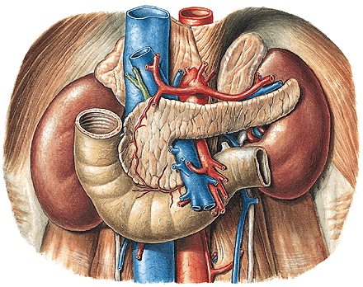
PANCREAS
Caput, corpus, cauda,
incisura pancreatis,
processus uncinatus
(a. et v. mesenterica sup.)

Slide 10
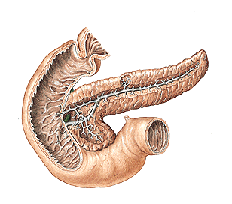
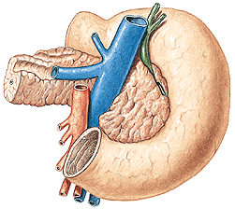
Exocrine pancreas: Endocrine pancreas:
ductus pancreaticus insulae pancreaticae
ductus pancreaticus accessorius (islets of Langerhans)
succus pancreaticus insulin, glucagon

Slide 11
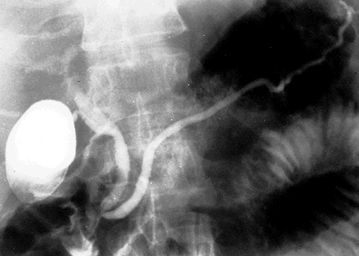
ERCP – endoscopic retrograde cholangio-pancreatography

Slide 12
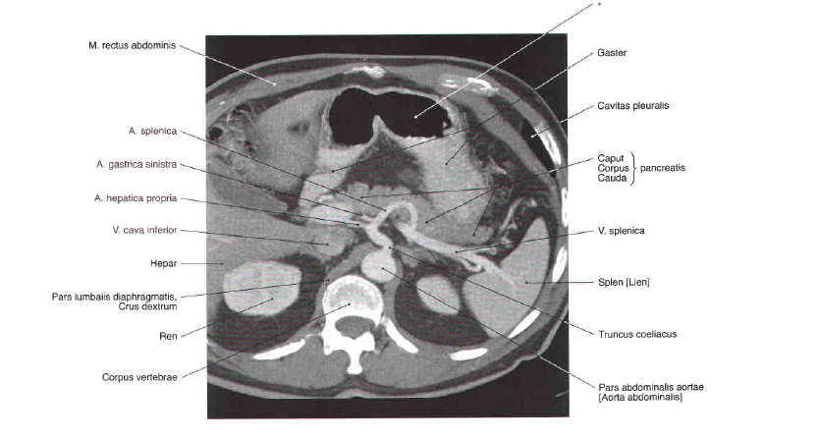

Slide 13
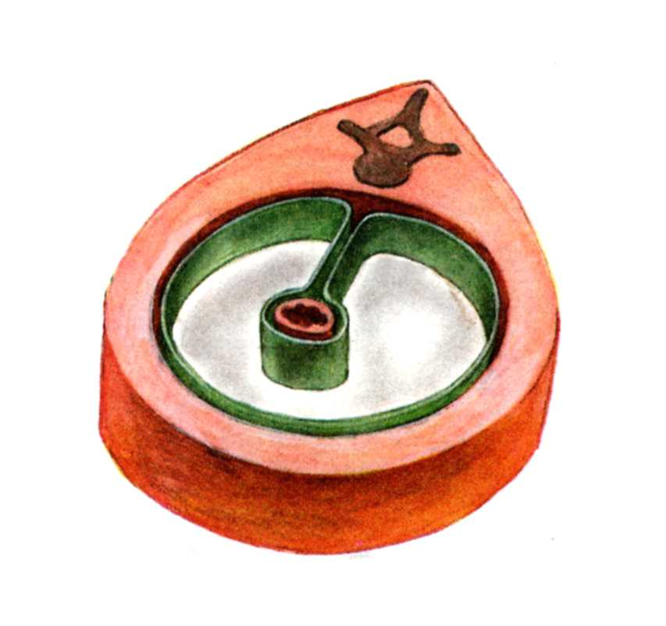
CAVITAS PERITONEALIS
PERITONEUM PARIETALE
PERITONEUM VISCERALE

Slide 14
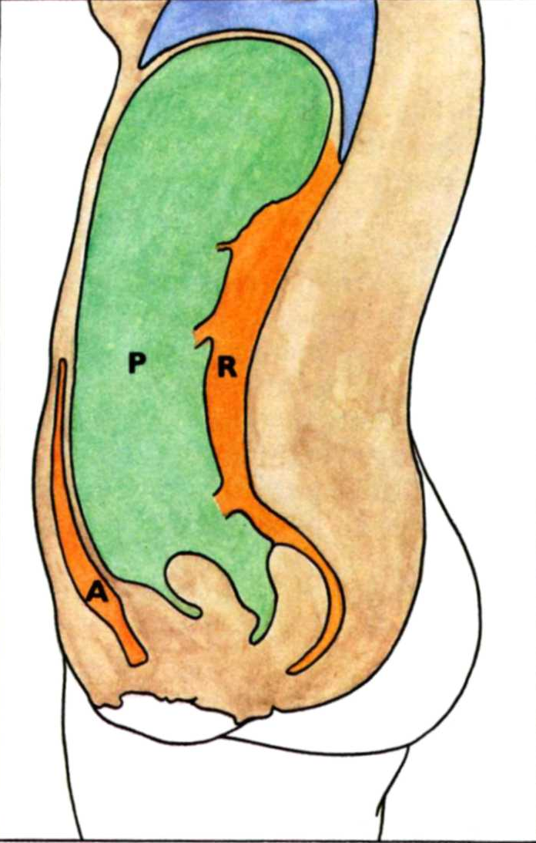
CAVITAS ABDOMINALIS
P – cavitas peritonealis
A – spatium preperitoneale
R – spatium retroperitoneale
S – spatium subperitoneale
(infraperitoneale)
ascites
S

Slide 15
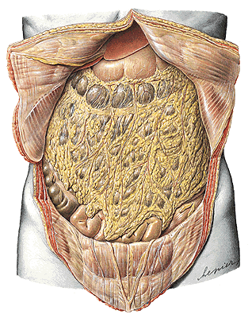
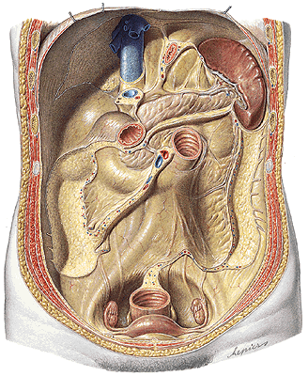
Cavitas peritonealis - pars supramesocolica, inframesocolica

Slide 16
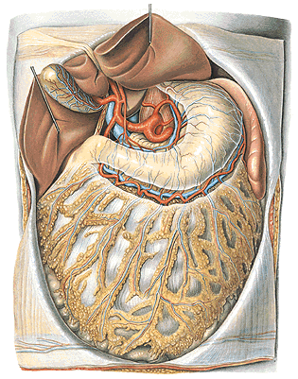
Pars supramesocolica
Truncus coeliacus

Slide 17
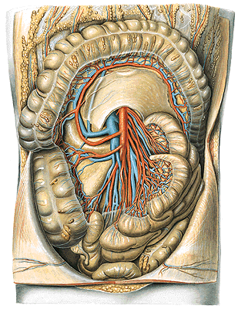
Pars inframesocolica
A. mesenterica superior

Slide 18
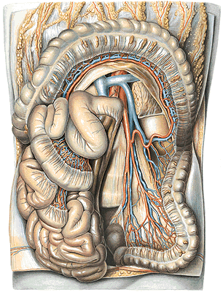
Pars inframesocolica
A. mesenterica inferior

Slide 19
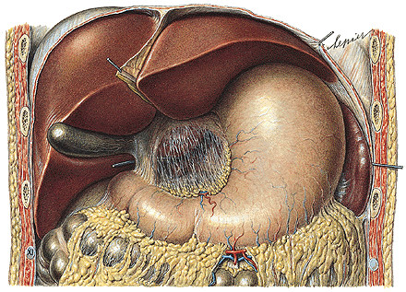
Omentum minus - lig. hepatogastricum
- lig. hepatoduodenale - a. hepatica propria
- v. portae
- ductus hepaticus
comm.
(d.choledochus)

Slide 20
Omentum majus
- lig. gastrocolicum

Slide 21
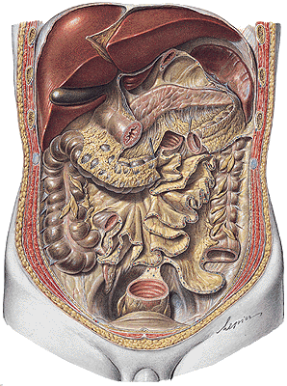
Lig. gastrosplenicum, phrenicosplenicum, splenorenale
Mesenterium – radix mesenterii
Mesocolon transversum, mesoappendix, mesocolon
sigmoideum, lig. phrenicocolicum

Slide 22
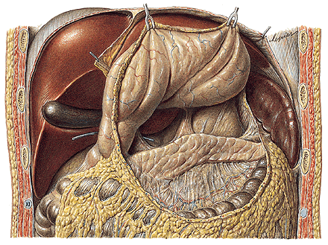
RECESSUS PERITONEI
Bursa omentalis
Internal hernias

Slide 23
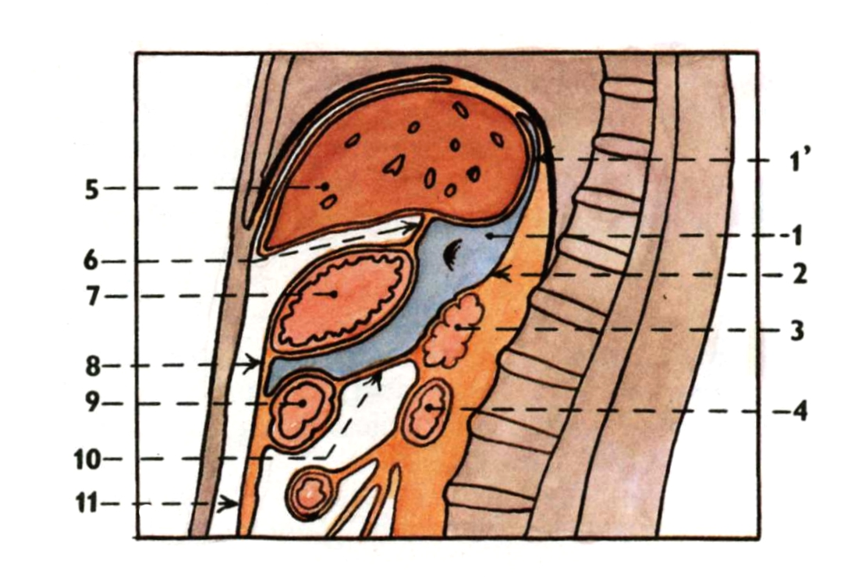
Bursa omentalis

Slide 24
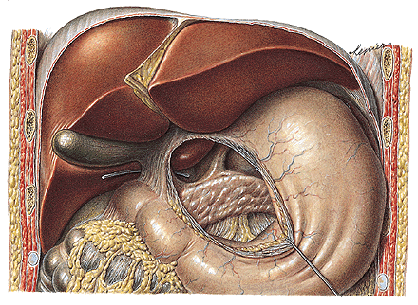
Foramen omentale/epiploicum (Winslow)
Recessus sup., splenicus, inf.

Slide 25
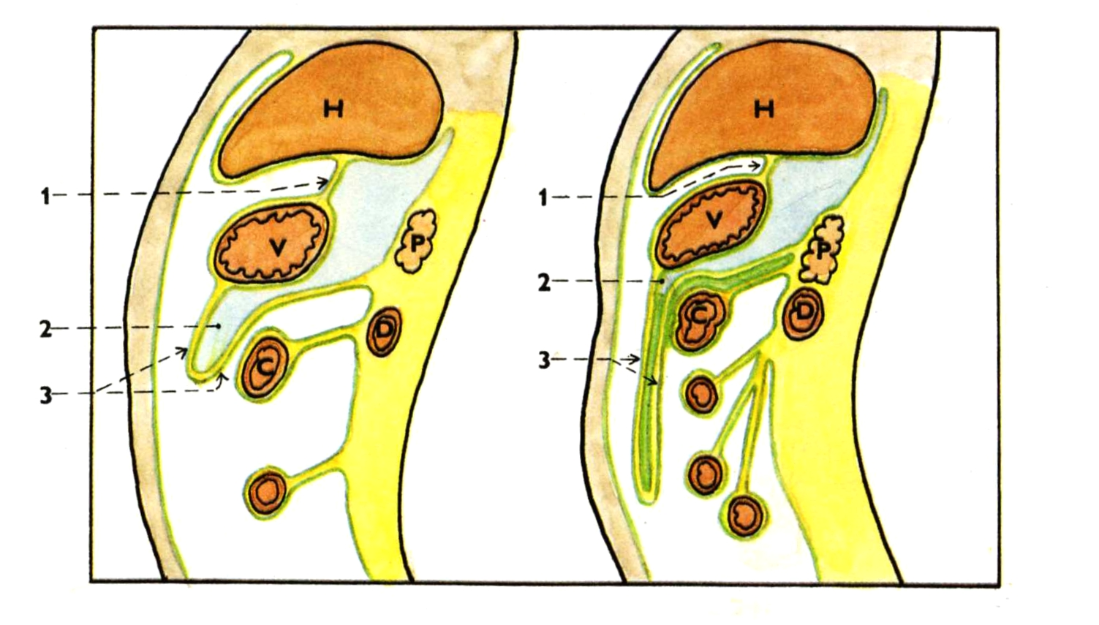
Recessus inferior bursae omentalis

Slide 26
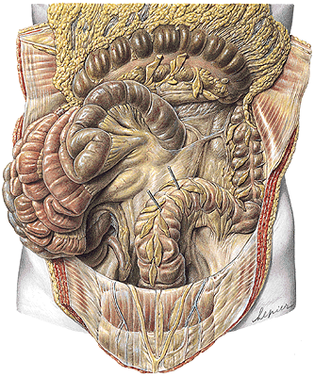
Recessus duodenalis
sup., inf., sinister,
retroduodenalis
Recessus ileocaecalis sup.
Recessus ileocaecalis inf.
Recessus intersigmoideus
Recessus paracolici

Slide 27
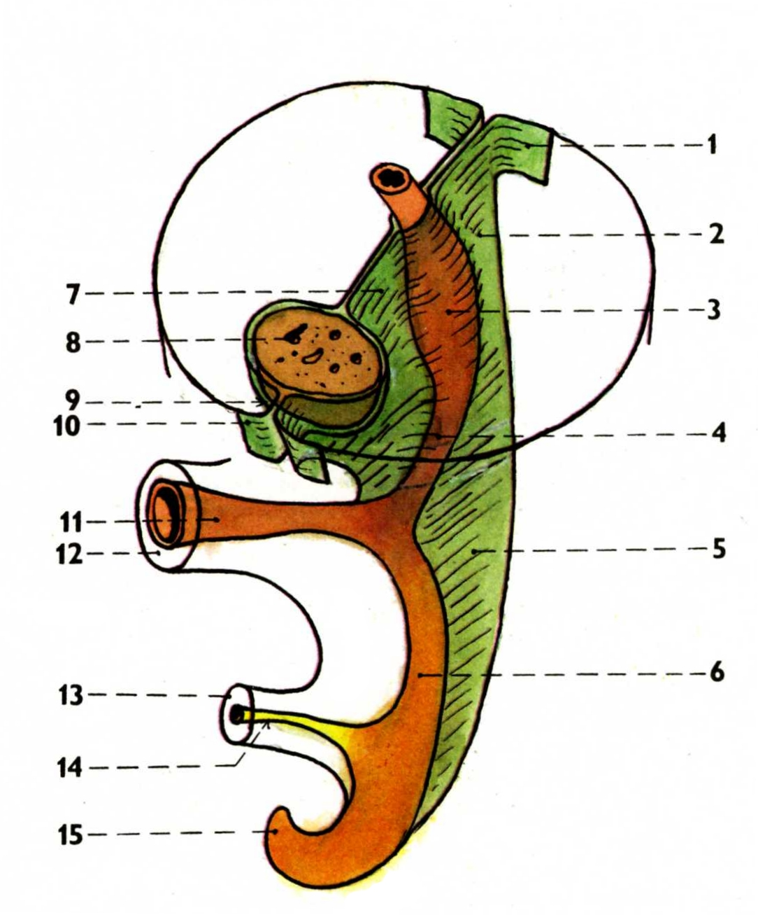
Development of the peritoneum
Mesenterium dorsale
Mesogastrium ventrale

Slide 28
Development of the peritoneum
peritoneum parietale
mesogastrium dorsale
anlage of the stomach
anlage of the duodenum
mesenterium
hindgut
mesogastrium ventrale
liver
mesogastrium ventrale
peritoneum parietale
ductus omphaloentericus
umbilicus
connecting stalk
allantois
hindgut

Slide 29
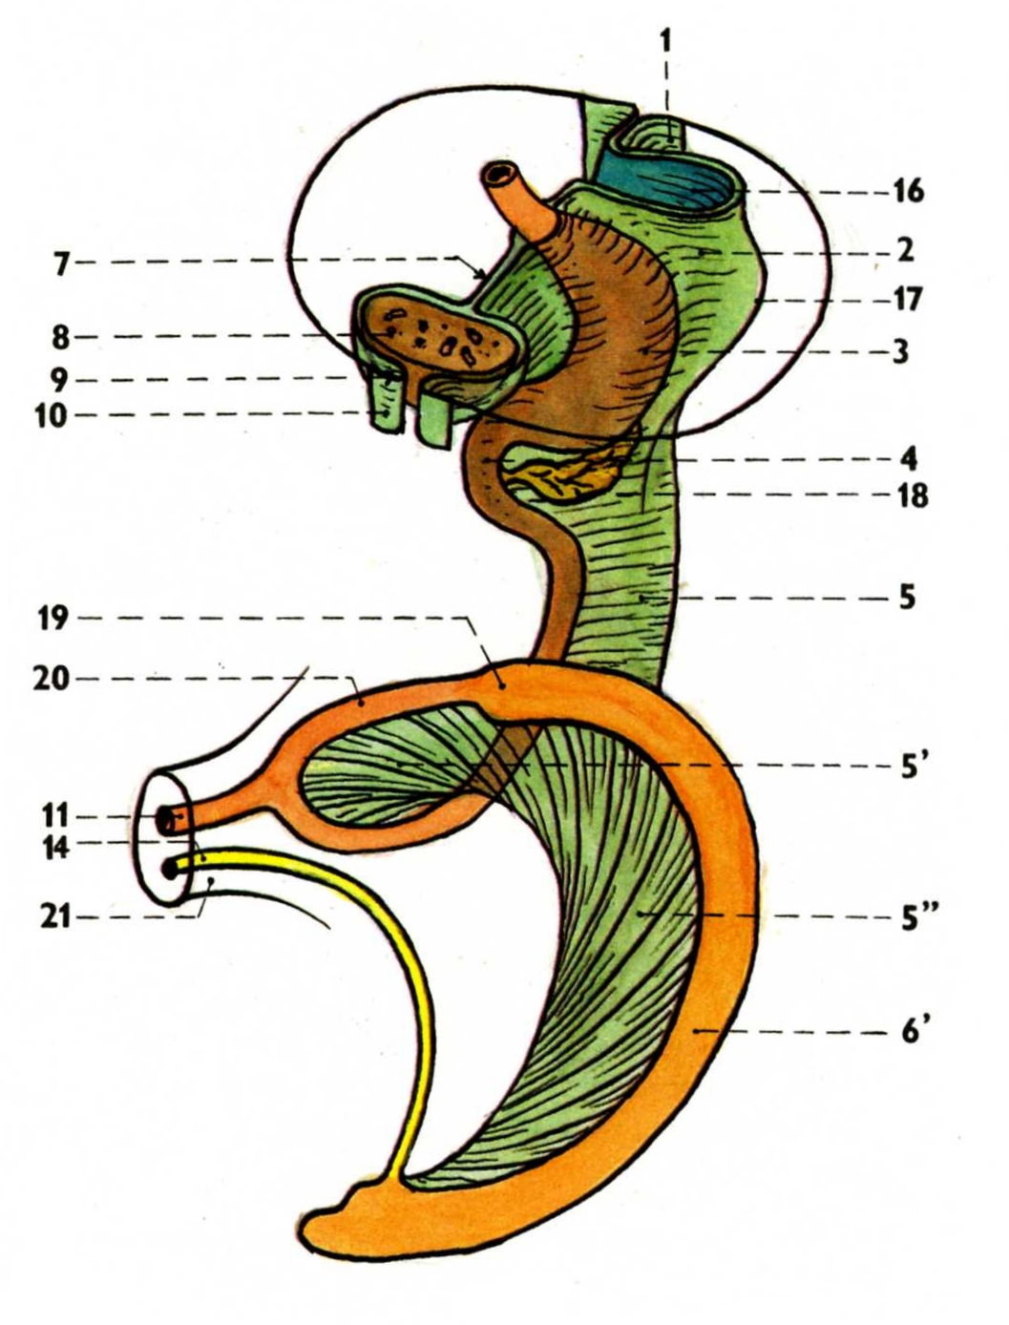
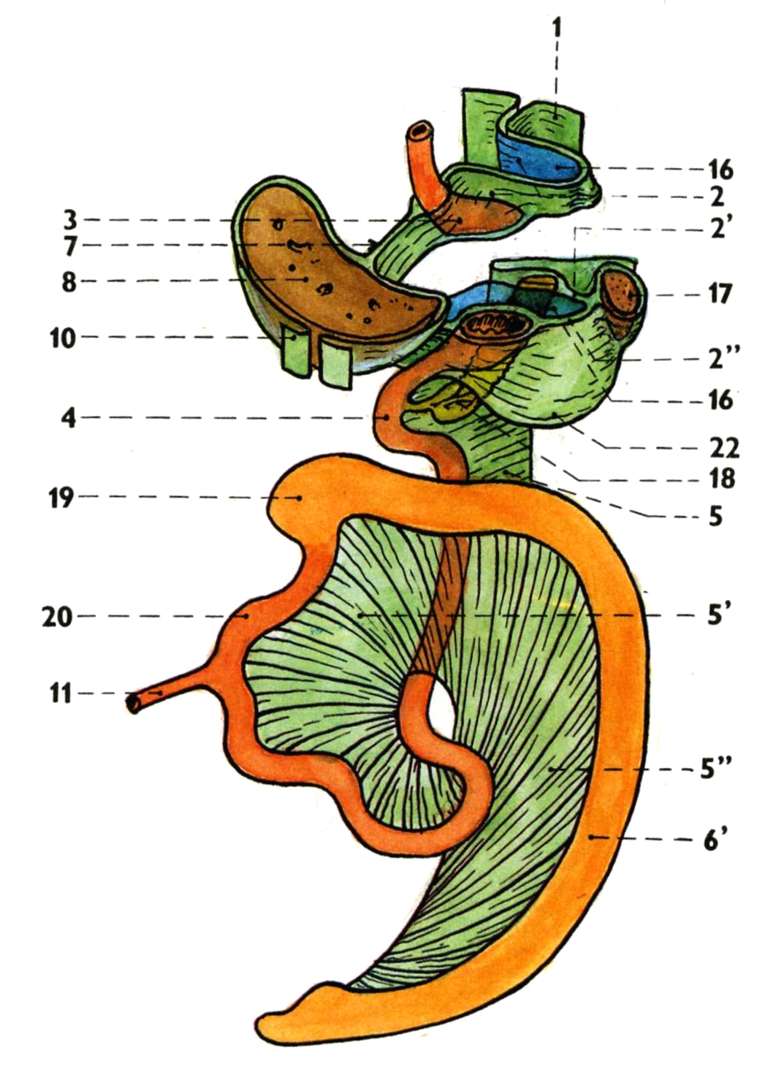
Development of the peritoneum

Slide 30
Development of the peritoneum
2’. lig. phrenicolienale
2’’. lig. gastrolienale
5’. mesenterium
5’’. mesocolon
6’. anlage of the large intestine
22. omentum majus

Slide 31
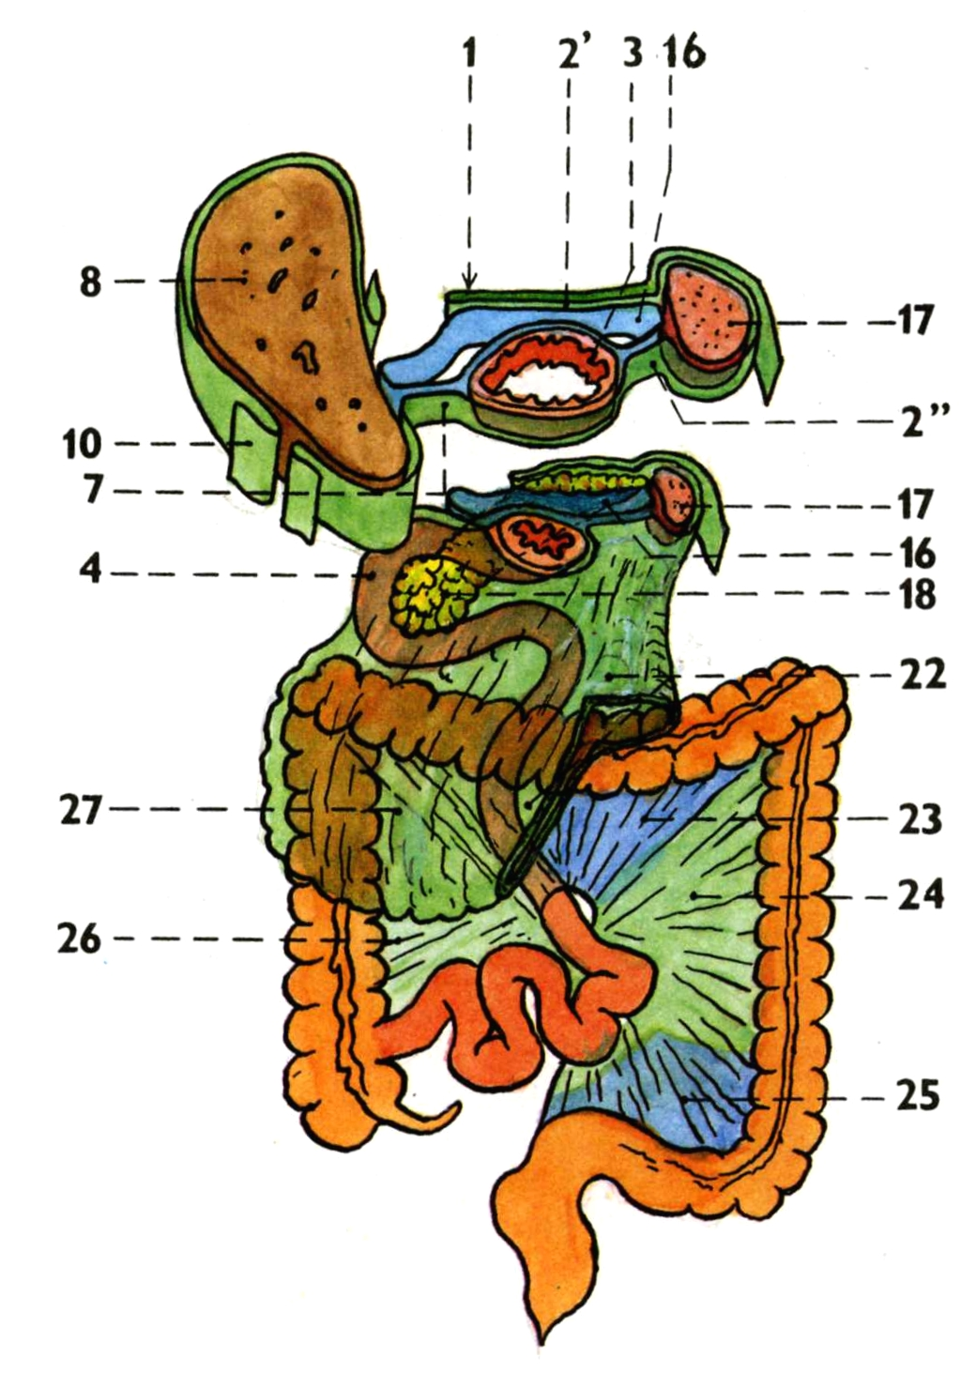
Development of the peritoneum
23. mesocolon transversum
24. mesentery of the colon
descendens
25. mesocolon sigmoideum
26. mesentery of the colon
ascendens
27. omentum majus

Slide 32
Illustrations 27-31 were copied from:
Čihák R: Anatomie 2 (Splanchnologia). Avicenum,
zdravotnické nakladatelství, Praha, 1988.
Remaining illustrations, photographs, and radiographs were
copied from:
Atlas der Anatomie des Menschen/Sobotta.
Putz,R., und Pabst,R. 20. Auflage. München:
Urban & Schwarzenberg, 1993

