Slide 1
RESPIRATORY SYSTEM

Slide 2
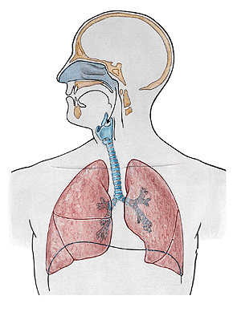

Slide 3
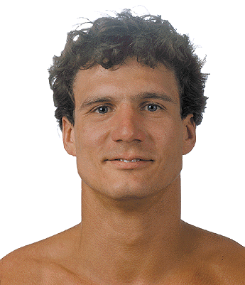
NASUS EXTERNUS
Radix nasi
Dorsum nasi
Apex nasi
Nares
Alae nasi

Slide 4
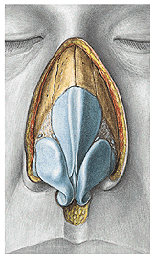
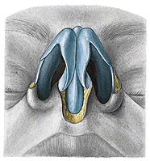
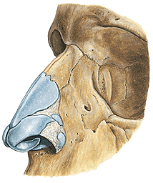
Cartilago nasi lateralis
Cartilago alaris major
- crus laterale
- crus mediale
Cartilagines alares minores
Cartilagines nasales accessoriae

Slide 5
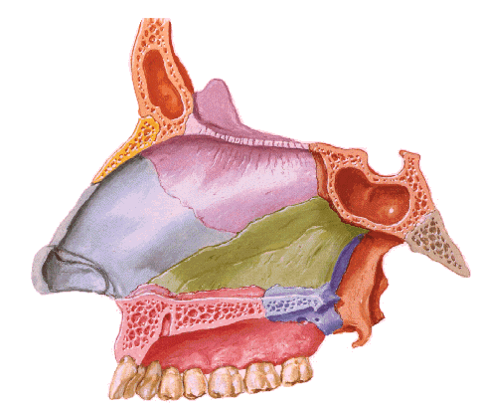
SEPTUM NASI
Cartilago alaris major – crus mediale
Cartilago septi nasi
Lamina perpendicularis ossis ethmoidalis
Vomer

Slide 6
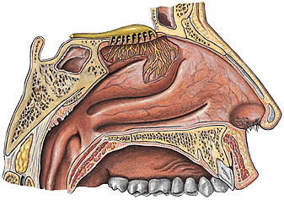
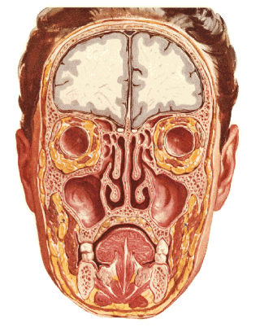
CAVITAS NASI
- vestibulum – limen, vibrisae
- cavitas nasi propria – meatus nasi sup., medius, inf.
meatus nasi communis, meatus nasopharyngeus, choanae

Slide 7
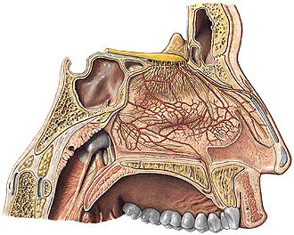
Septum nasi
- pars membranacea
- pars cartilaginea
- pars ossea

Slide 8
Superior wall: cartilago nasi lateralis, os nasale,
pars nasalis ossis frontalis, lamina cribrosa
ossis ethmoidalis, corpus ossis sphenoidalis
Inferior wall:
processus palatinus
maxillae, lamina
horizontalis ossis
palatini
canalis incisivus

Slide 9
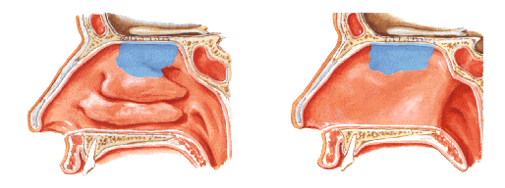
NASAL MUCOSA
Regio respiratoria
plexus cavernosi - epistaxis
Regio olfactoria

Slide 10
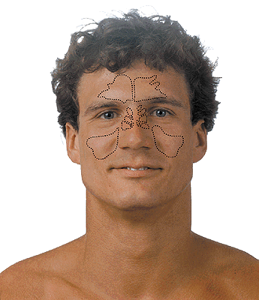
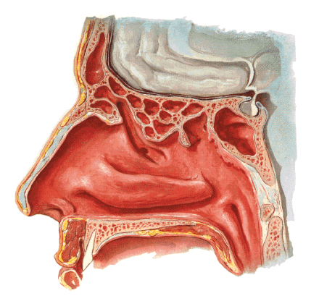
SINUS PARANASALES
Sinus maxillaris
Sinus frontalis
Sinus ethmoidales
Sinus sphenoidalis

Slide 11
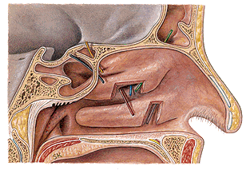
Meatus nasi inf. – ductus nasolacrimalis
Meatus nasi medius – sinus maxillaris, frontalis, cellulae
ethmoidales anteriores
Meatus nasi sup. – cellulae ethmoidales posteriores, sinus
sphenoidalis

Slide 12
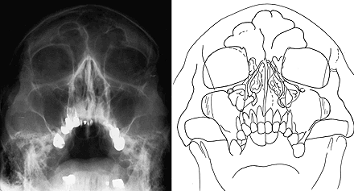

Slide 13
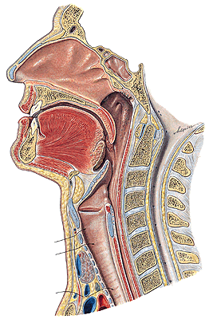
PHARYNX
Aditus laryngis

Slide 14
LARYNX
Prominentia laryngis

Slide 15
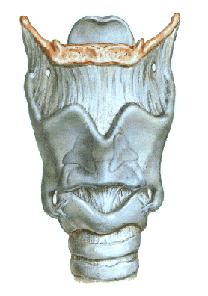
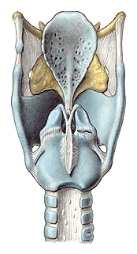
CARTILAGINES LARYNGIS:
Cartilago thyroidea
Cartilago cricoidea
Cartilago arytenoidea
Cartilago epiglotica
Cartilago corniculata
Cartilago cuneiformis

Slide 16
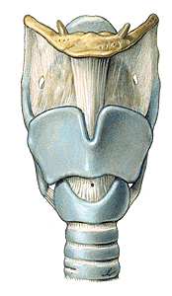
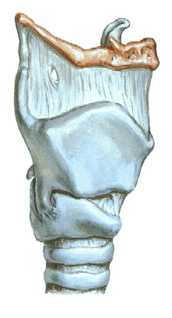
LARYNX
Membrana thyrohyoidea
Cartilago thyroidea
lamina dextra
lamina sinistra
cornua superiora
cornua inferiora
facies art. cricoidea

Slide 17
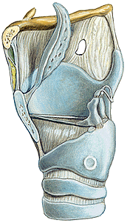
CARTILAGO CRICOIDEA
-arcus
-lamina
-facies articularis
arytenoidea
-facies articularis
thyroidea

Slide 18
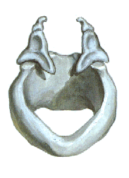
CARTILAGO ARYTENOIDEA
- apex
- basis
- facies art. cricoidea
- processus vocalis
- processus
muscularis

Slide 19
CARTILAGO EPIGLOTTICA
petiolus epiglottidis
lamina
CARTILAGO CORNICULATA
CARTILAGO CUNEIFORMIS

Slide 20
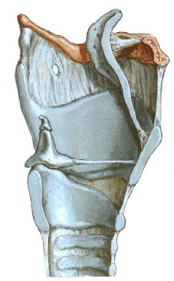

Slide 21
ARTICULATIO CRICOARYTENOIDEA
ARTICULATIO CRICOTHYROIDEA

Slide 22
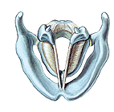
CONUS ELASTICUS
lig. cricothyroideum- coniotomy
lig. vocale – plica vocalis
Lig. cricotracheale

Slide 23
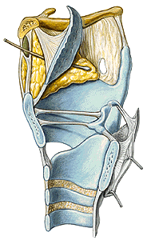
Lig thyroepiglotticum
Lig. hyoepiglotticum
Spatium preepiglotticum
MEMBRANA QUADRANGULARIS
lig. vestibulare – plica vestibularis
MEMBRANA FIBROELASTICA
LARYNGIS

Slide 24
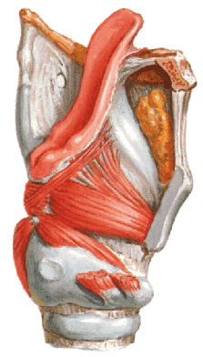
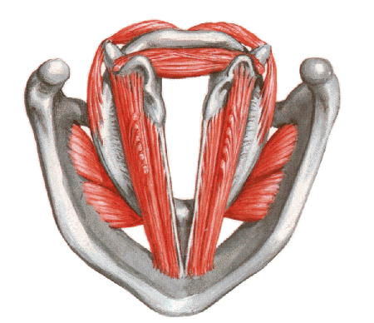
MUSCULI LARYNGIS
M. thyroarytenoideus
(thyroepiglotticus)
M. vocalis
Rima glottidis – pars intermembranacea
– pars intercartilaginea

Slide 25
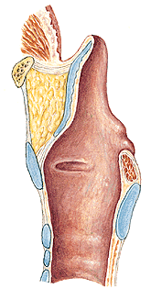
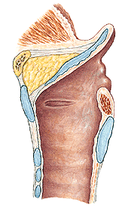

Slide 26
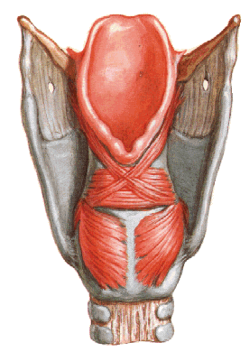
M. cricoarytenoideus post.
- respiration

Slide 27
M. cricoarytenoideus lateralis
M. arytenoideus transversus
M. arytenoideus obliquus (aryepiglotticus)

Slide 28
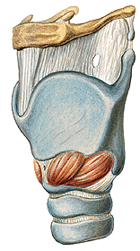
M. cricothyroideus

Slide 29
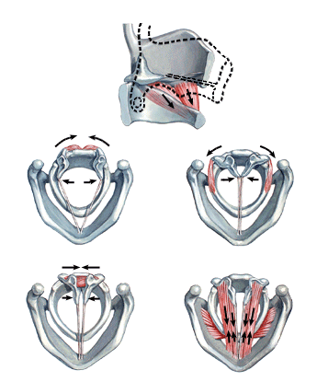
M. cricothyroideus
M. cricoarytenoideus
post.
M. cricoarytenoideus
lateralis
M. arytenoideus trans. et obliq.
M. thyroarytenoideus

Slide 30
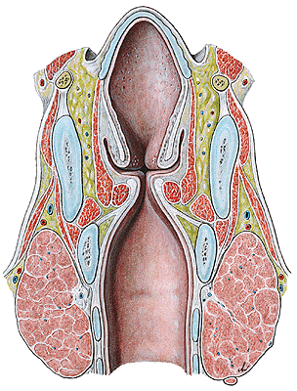
CAVITAS LARYNGIS
vestibulum laryngis
plicae vestibulares
rima vestibuli
plicae vocales
rima glottidis
-glottis
-ventriculus laryngis
cavitas infraglottica

Slide 31
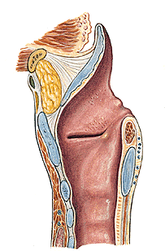
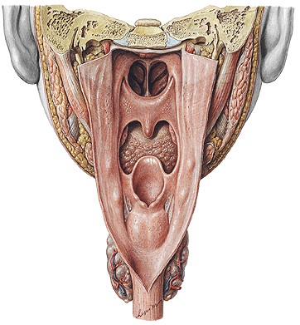
ADITUS LARYNGIS
-epiglottis, plicae aryepiglotticae (tuberculum cuneiforme
et corniculatum), plica interarytenoidea,incisura inter-
arytenoidea
plicae vestibulares
plicae vocales

Slide 32
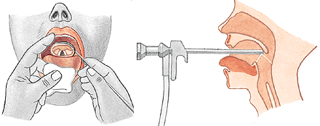
LARYNGOSCOPY
indirect
direct

Slide 33
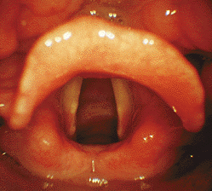
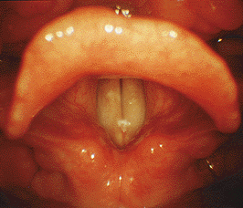
RESPIRATION
PHONATION

Slide 34
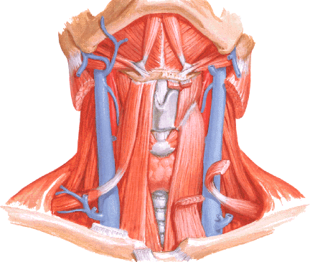
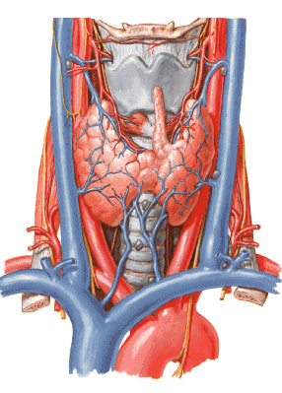

Slide 35
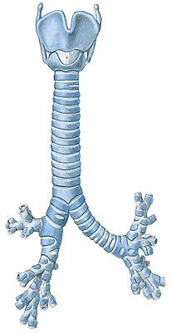
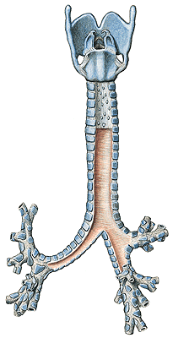
TRACHEA
pars cervicalis
pars thoracica
bifurcatio tracheae
- carina tracheae
15-20 cartilagines tracheales
ligg. anularia
paries membranaceus
(m. trachealis)

Slide 36
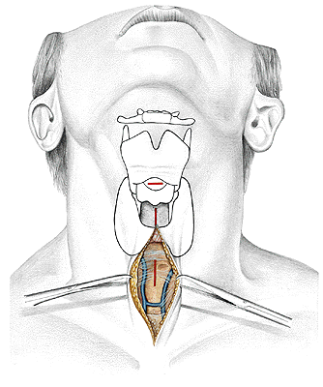
CONIOTOMIA (CRICOTHYROTOMIA)
TRACHEOTOMIA SUPERIOR
TRACHEOTOMIA INFERIOR

Slide 37
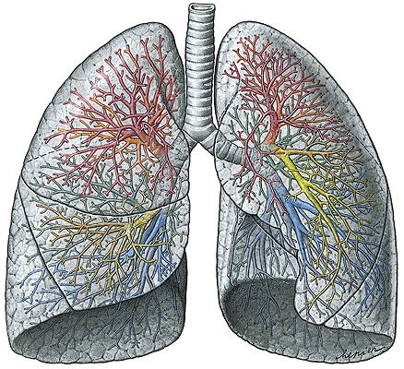
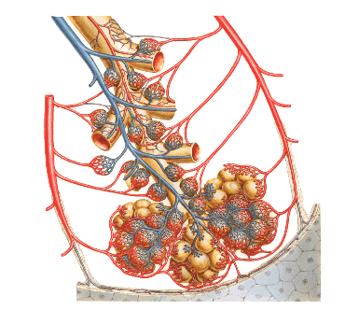
BRONCHI
- principales
- lobares
- segmentales
BRONCHIOLI
ALVEOLI
Arbor bronchialis

Slide 38
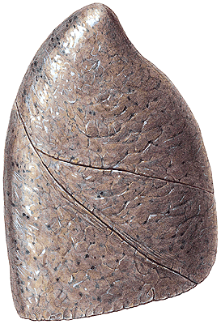
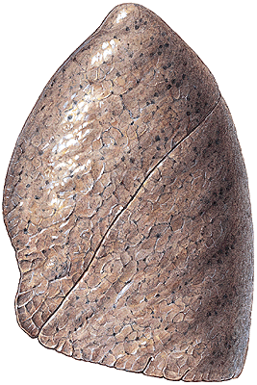
PULMO DEXTER
Lobus superior,
medius et inferior
Fissura obliqua
et horizontalis
Apex pulmonis
Basis pulmonis
(facies diaphragmatica)
Facies costalis
Facies mediastinalis
Margo anterior
inferior
posterior
PULMO SINISTER
Lobus superior et
inferior
Fissura obliqua
Incisura cardiaca
Lingula

Slide 39
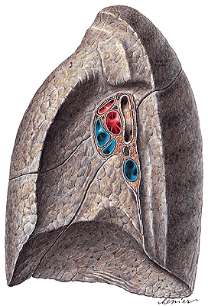
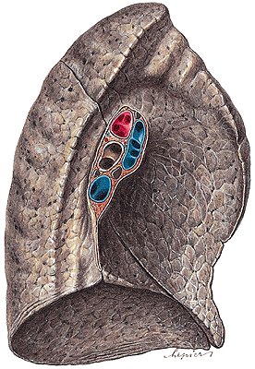
FACIES MEDIASTINALIS
hillum pulmonis
radix pulmonis
lig. pulmonale
impressio cardiaca

Slide 40
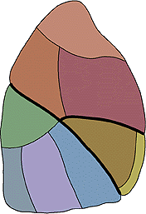
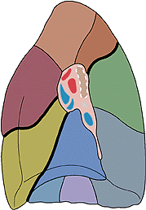
SEGMENTA BRONCHOPULMONALIA DEXTRA
s. apicale 4. s. laterale 6. s. apicale
s. posterius 5. s. mediale 7. s. basale mediale
s. anterius 8. s. basale anterius
9. s. basale laterale
10. s. basale posterius

Slide 41
SEGMENTA BRONCHOPULMONALIA SINISTRA
1+2. s. apicoposterius 6. s. apicale
3. s. anterius (7. s. basale mediale)
4. s. lingulare superius 8. s. basale anterius
5. s. lingulare inferius 9. s. basale laterale
10. s. basale posterius

Slide 42
PLEURA - visceralis
- parietalis - costalis
- diaphragmatica
- mediastinalis
Cavitas pleuralis
Cupula pleurae
Recessus pleurae:
r. costodiaphragmaticus
r. costomediastinalis
r. phrenicomediastinalis
Pneumothorax

Slide 43
Area interpleuralis sup. (thymica)
Area interpleuralis inf. (pericardiaca)

Slide 44
EXPIRATION
INSPIRATION

Slide 46
Illustrations and photographs were copied from:
Atlas der Anatomie des Menschen/Sobotta.
Putz,R., und Pabst,R. 20. Auflage. München:
Urban & Schwarzenberg, 1993
Netter: Interactive Atlas of Human Anatomy.
Windows Version 2.0

