Slide 2
List of X-rays
LOCOMOTOR SYSTÉM
Head – axial and lateral projection
Cervical part of the spine – axial and lateral projection
Thoracic part of the spine – axial and lateral projection
Lumbar part of the spine – axial and lateral projection
Shoulder joint – axial projection
Elbow joint – axial and lateral projection
Wrist + hand (child) – axial projection
Wrist + hand (adult) – axial projection
Pelvis – axial projection
Knee joint – axial and lateral projection
Foot – dorsoplantar and lateral projection
Chest – axial projection

Slide 3
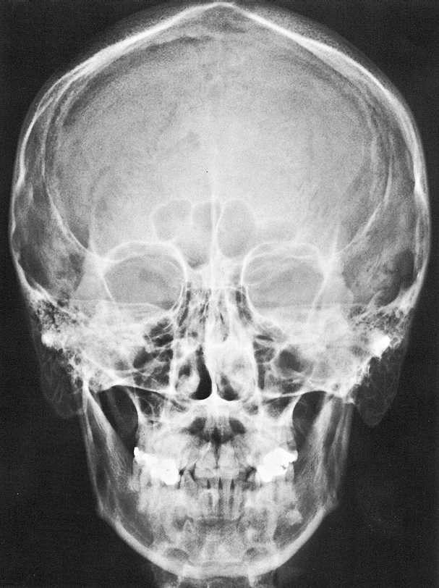
Head axial projection
sagittal suture
lambdoid suture
frontal sinus
roof of right orbit
cribriform plate
supraorbital margin
fronto-zygom. suture
superior orbital fissure
right orbit
zygomatic arch
ethmoidal air cells
superior border of petrous bone
nasal septum
maxillary sinus
inferior nasal concha
mastoid air cells
maxilla
nasal septum
mastoid process
nasal aperture
ramus of mandible
mandibular canal
angle of mandible
tooth

Slide 4
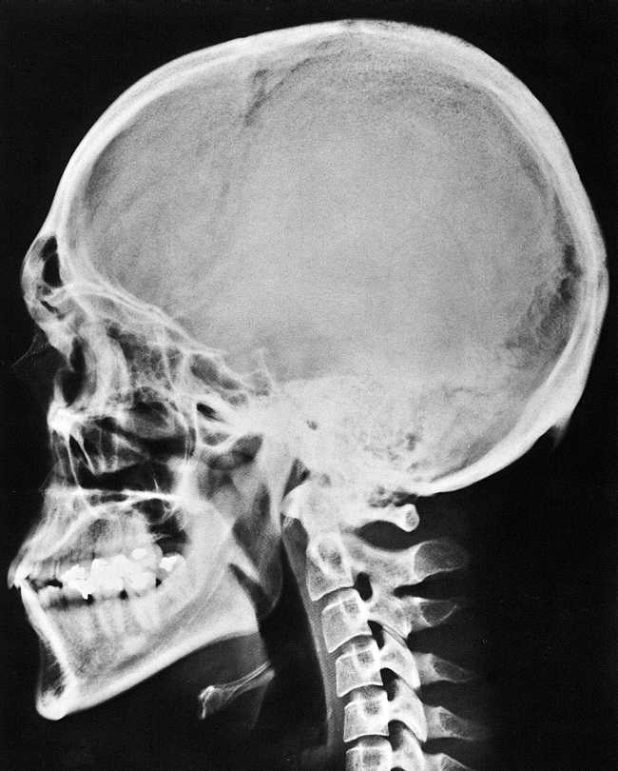
Head lateral projection
compact bone (lamina ext. et int.)
spongy bone (diploe)
coronal suture
lambdoid suture
frontal sinus
hypoglossal fossa
nasal bone
dorsum sellae
sphenoid sinus
petrosal bone
external/internal acoustic meatus
maxillary sinus
condylar process
ant. nasal spine
palatine process of maxilla
ramus of mandible
C2
angle of mandible
body of mandible
mandibular canal

Slide 5
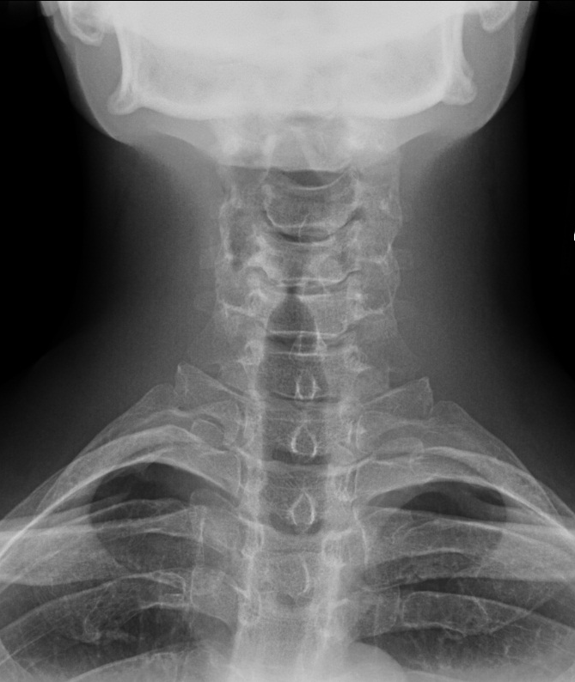
SPINE CERVICAL PART axial projection
mandible
disc space
transverse process
vertebral body
cervical vertebra
spinous process
clavicle
thoracic vertebra
1th rib

Slide 6
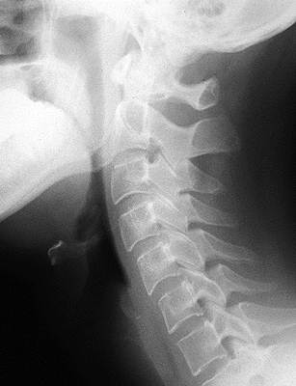
SPINE CERVICAL PART lateral projection
occiput
dens (C2)
C1
posterior arch of C1
Tuberculum posterius atlantis
C2
spinous processes
mandible
C3
C4
intervertebral joint
hyoid
C5
inf. articular process
C6
intervertebral disc spaces
sup.articular process
intervertebral foramen
C7

Slide 7
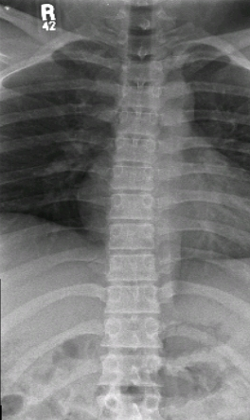
SPINE THORACIC PART axial projection
thoracic vertebral body
spinous process
pedicles
disc space
ribs
diaphragm
costovertebral joint

Slide 8
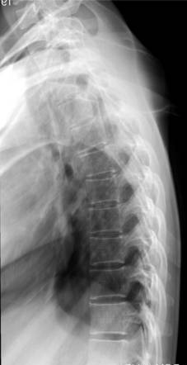
SPINE THORACIC PART lateral projection
ribs
thoracic vertebral body
intervertebral disc space

Slide 9
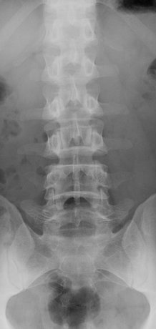
SPINE LUMBAR PART axial projection
last rib
L1
1th thoracic vertebra
L2
L3
pedicle
vertebral body
intervertebral space
L4
costal process
L5
spinous process
superior articular process
intervertebral joint
inferior articular process
sacrum

Slide 10
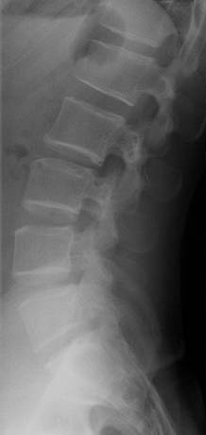
SPINE LUMBAR PART lateral projection
L1
intervertebral foramen
vertebral body
L2
pedicle
L3
spinous processes
disc space
L4
L5
sacrum

Slide 11
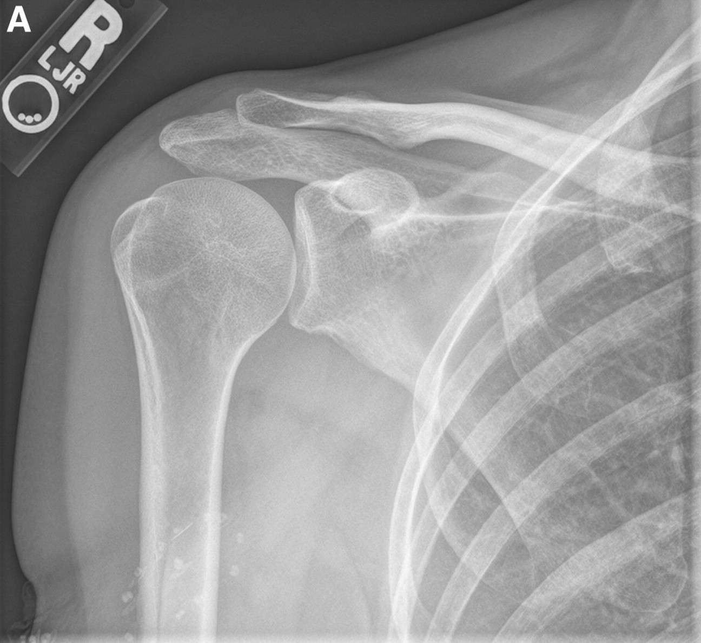
Shoulder joint axial projection
acromion
clavicle
anterior ribs
coracoid process
greater tubercle
lesser tubercle
glenoid cavity
posterior ribs
infraglenoid tubercle
scapula
humerus

Slide 12
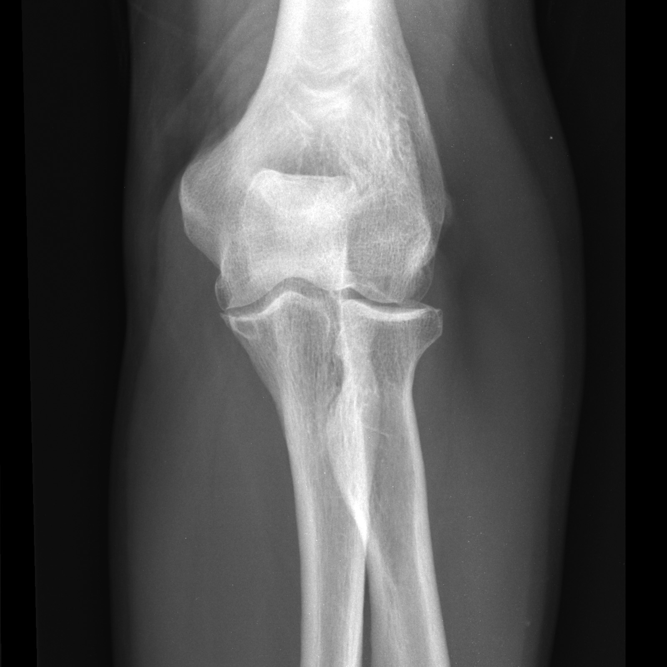
Elbow joint axial projection
humerus
olecranon fossa
medial epicondyl
olecranon process
lateral epicondyl
humeroulnar joint
humeroradial joint
coronoid process
radial head
neck of radius
proximal radioulnar joint
radial tubercle
ulna
radius

Slide 13
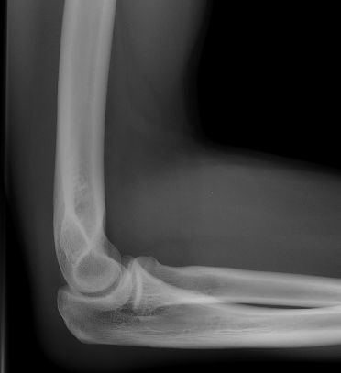
Elbow joint lateral projection
humerus
coronoid process
head (articular circumference)
trochlea
radius
olecranon
ulna

Slide 14
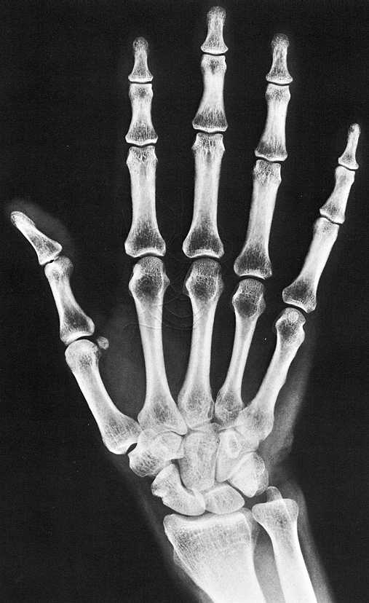
Hand and wrist adult
distal
middle
phalanges
proximal
trochlea
body
phalanges
base
sesamoid bone
head
metacarpals
body
2
3
4
1
5
base
hamatum (+hamulus)
trapezoideum
capitatum
carpals
trapezium
triquetrum+pisiforme
scaphoid
lunate
radius
ulna

Slide 15
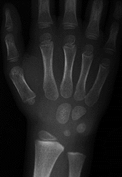
Hand and wrist child
4,5 years old child
(4 carpal bones are ossificated)

Slide 16
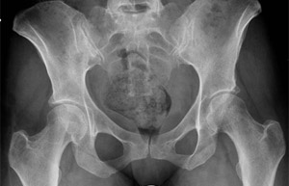
Pelvis axial projection
iliac crest
posterior superior iliac spine
sacral
anterior superior iliac spine
iliac fossa
sacral foramens
sacroiliac joint
posterior inferior iliac spine
coxal bone
arcuate line
acetabulum
symphysis
obturator foramen
ischial tuberosity
pubic bone
femur

Slide 17
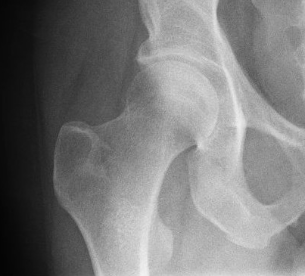
Hip joint axial projection
coxal bone
acetabulum
acetabular fossa
head
trochanter fossa
greater trochanter
neck
obturator foramen
intertrochanteric crest
lesser trochanter
femur

Slide 18
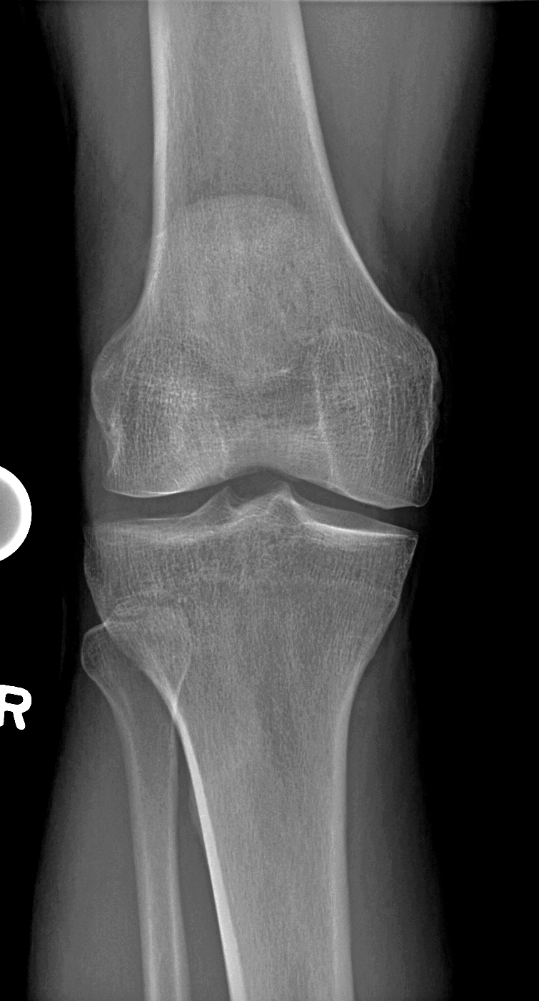
Knee joint axial projection
femur
patella
intercondylar fossa
lateral femoral condyle
medial femoral condyle
lateral intercondylar tubercle
medial intercondylar tubercle
lateral tibial condyle
medial tibial condyle
tibia
fibula

Slide 19
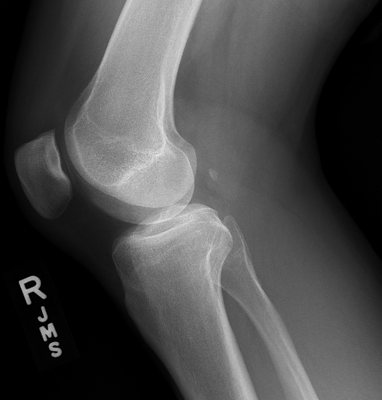
Knee joint lateral projection
femur
base
lateral condyle
patella
medial condyle
intercondylar eminence
apex
apex of head
head
tibial tuberosity
fibula
tibia

Slide 20
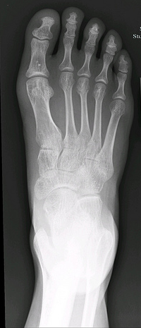
Foot dorsoplantar projection
phalanges
trochlea
body
sesamoid bones
base
metatarsals
head
1
body
2
3
base
4
1th
2nd
5
3rd
navicular
cuboid
tarsals
1th, 2nd, 3rd = cuneiforme bones
talus
calcaneus
tibia
fibula

Slide 21
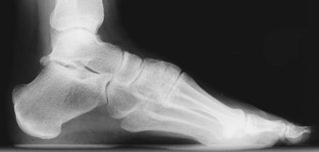
Foot lateral projection
tarsal
sinus tarsi
talus
navicular
metatarsal
cuneiformes: med., intermed., lat.
calcaneus
cuboid
phalanges

Slide 22
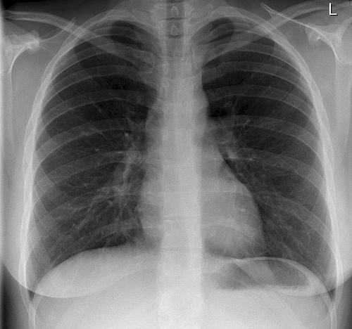
Chest sagittal projection
1st rib
clavicle
bronchial bifurcation
anterior ribs
aortic knob
thoracic spine and aorta
hilum
posterior ribs
heart
descending aorta
gastric air bubble
diaphragm
outline of female brest
liver
stomach

Slide 23
Splanchnology
Oesophagography
Gastrography
Cholecystography
Irigography
Intravenous urography
Ascending (retrograde) pyelography
Cystography
Hysterosalpingography

Slide 24
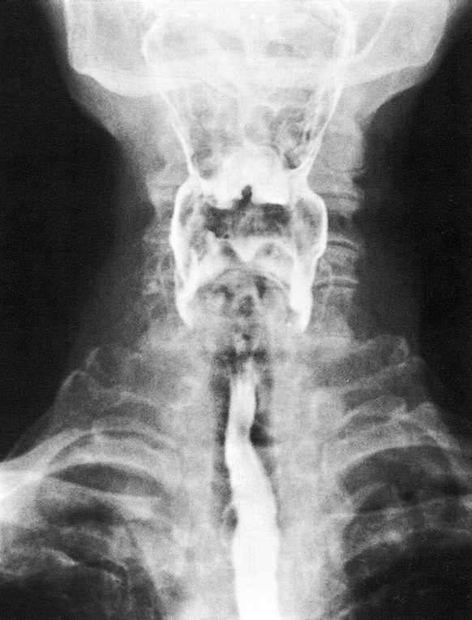
OESOPHAGOGRAPHY axial projection
Radiographic visualization of the esophagus using a swallowed radiopaque contrast medium.
recessus piriformis (pharynx)
oesophagus

Slide 25
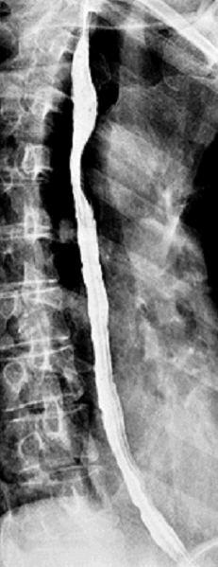
OESOPHAGOGRAPHY lateral projection
ribs
thoracic vertebrae
oesophagus
diaphragm

Slide 26
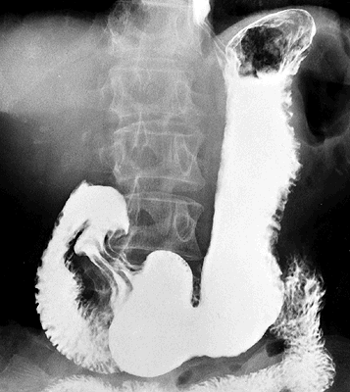
GASTROGRAPHY
Radiography of the stomach taken after administration of barium.
kardia
gastric air bubble
body
incisura angluaris
bulbus duodeni
gaster
pylorus
duodenum
intestinum tenue

Slide 27
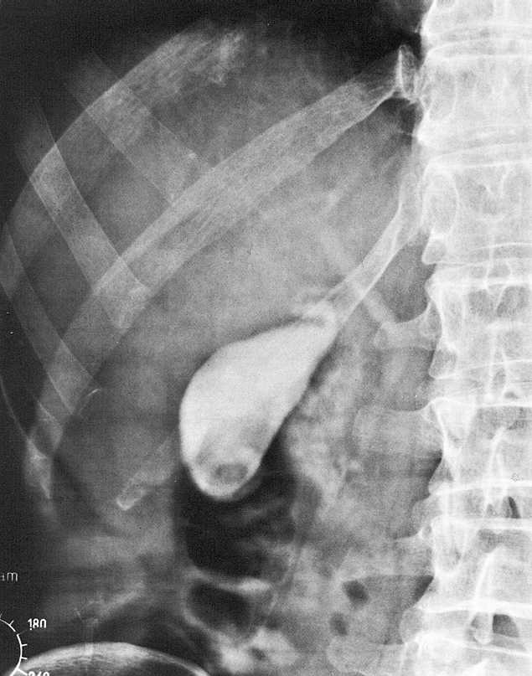
CHOLECYSTOGRAPHY
Visualize the gallbladder by administering a radiopaque contrast agent (by mouth) that is excreted by the liver. This excreted material will collect in the gallbladder, where reabsorption of water concentrates the excreted contrast.
thoracic vertebrae
Th 12
L1
vesica felea
L2
fundus
lumbar vertebrae
the last rib
air in intestinum
L3
os coxae

Slide 28
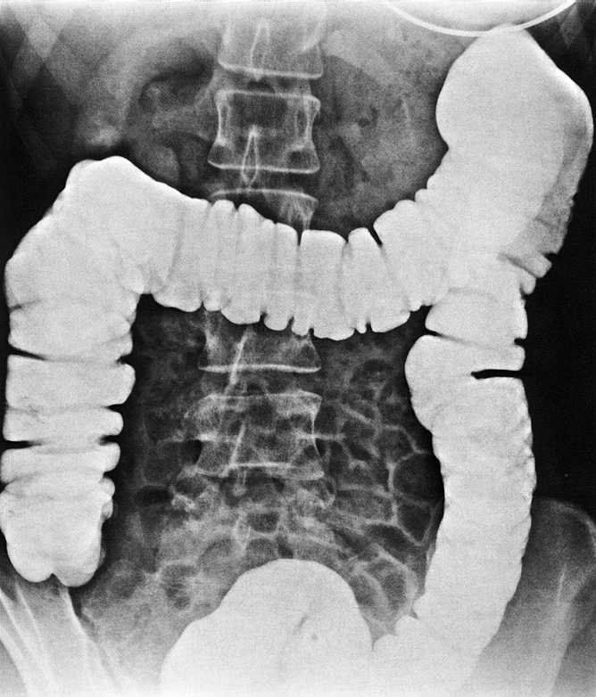
IRIGOGRAPHY
flexura colli sin.
Contrast X-ray method where the X-ray image is taken after filling the colon with contrast (barium) through the anus.
colon transversum
flexura colli dx.
intestinum crassum
colon ascendens
colon descendens
colon sigmoideum

Slide 29
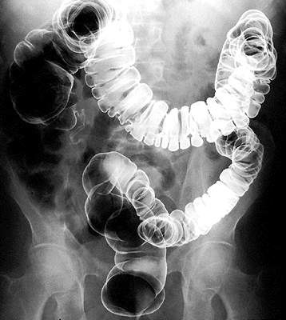
IRIGOGRAPHY – double contrast
Radiography of the colon taken after administration of barium, then air.

Slide 30
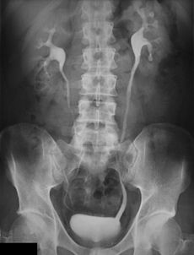
INTRAVENOUS UROGRAPHY
calices renales
pelvis renalis
ureter
X-ray of urinary tract following an injection of a iodine dye into a vein of arm.
vesica urinaria

Slide 31
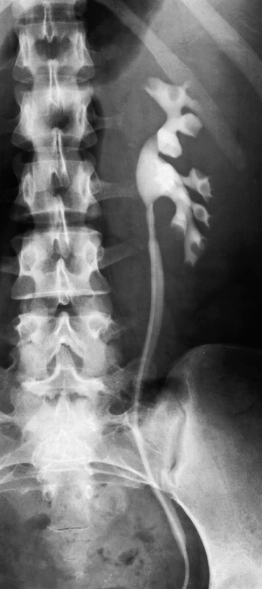
ASCENDING (RETROGRADE) PYELOGRAPHY
calices renales
Contrast medium has been introduced into the ureter and calyces via an ureteric catheter.
pelvis renalis
ureter
catheter

Slide 32
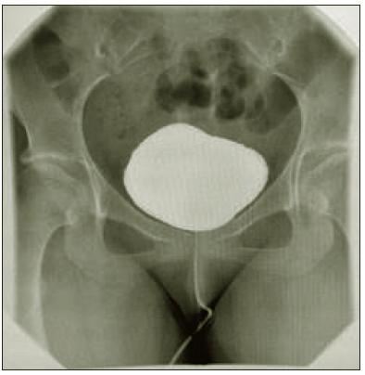
CYSTOGRAPHY
Contrast material is instilled in the bladder via urinary catheter
vesica urinaria
catheter in urethra

Slide 33
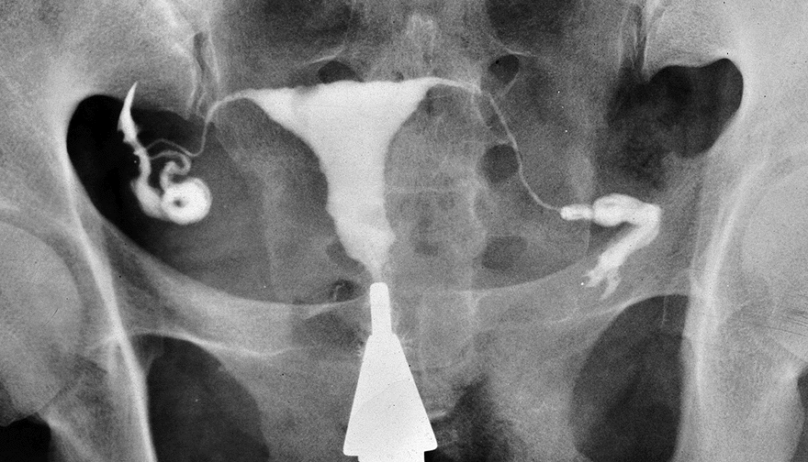
HSG (hysterosalpingography)
The uterus and fallopian tubes are filled with a water-soluble contrast material (iodine)
tuba uterina
uterus
free spill of contrast off from fallopian tube
cannula

