Slide 1
Čeština: 4. lekce
Czech language: 4th lesson
Communicative Competency: My family.
Grammar: What time is it?
Czech verbs (introduction).

Slide 2
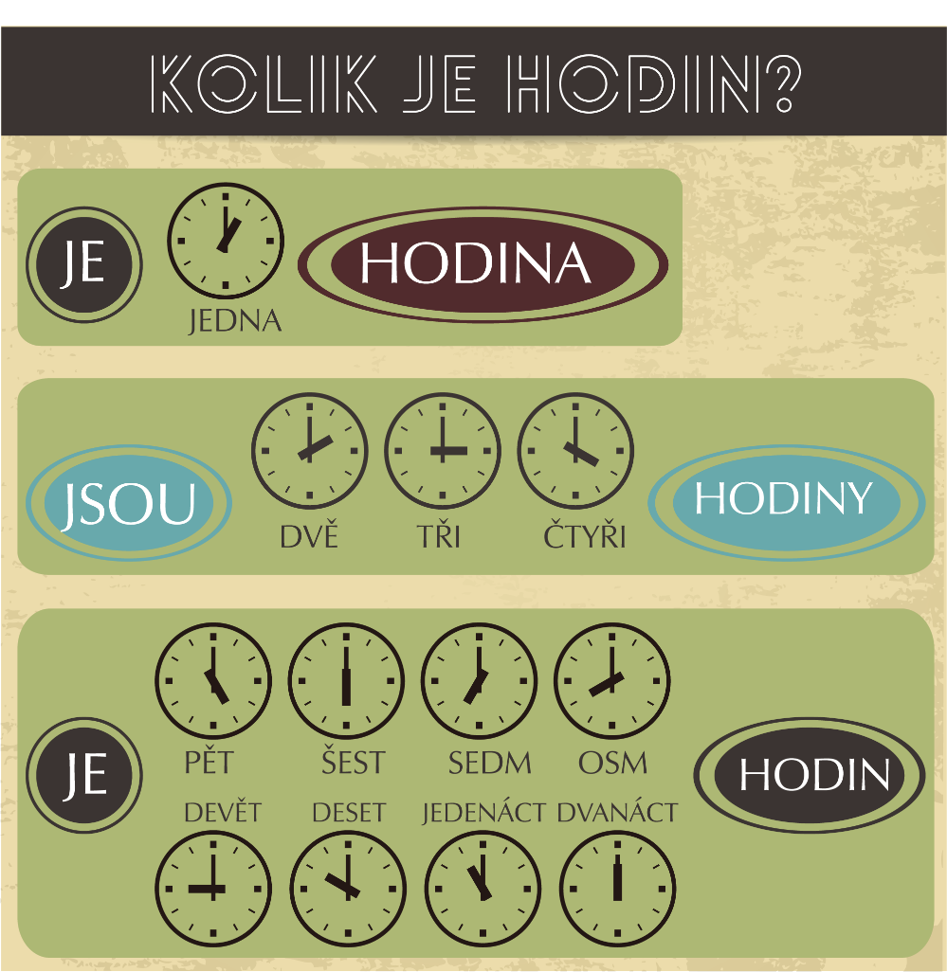
Kolik je hodin?

Slide 3
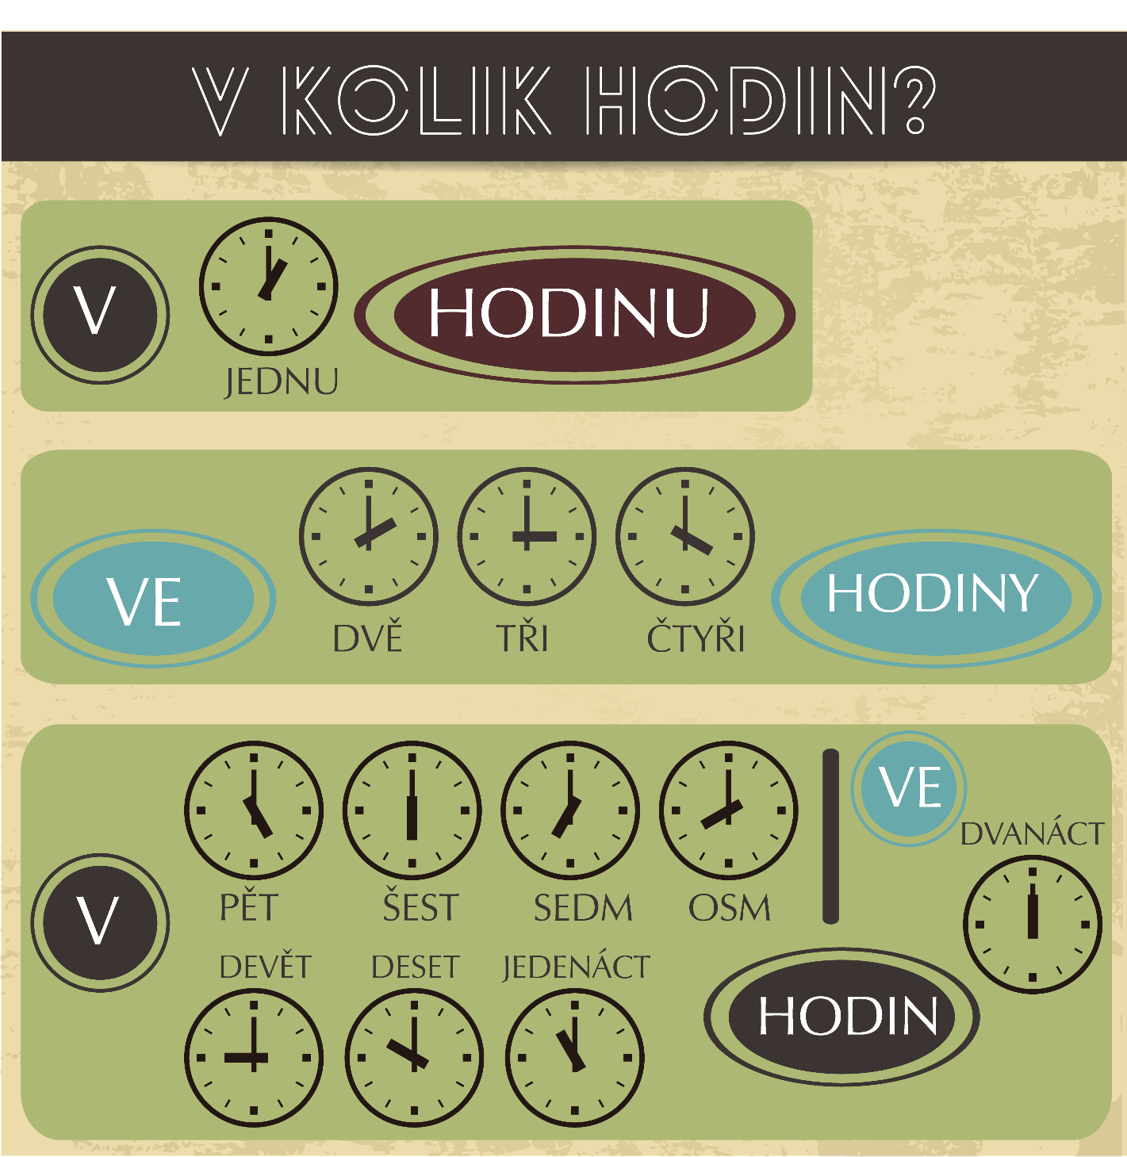
V kolik hodin?

Slide 4
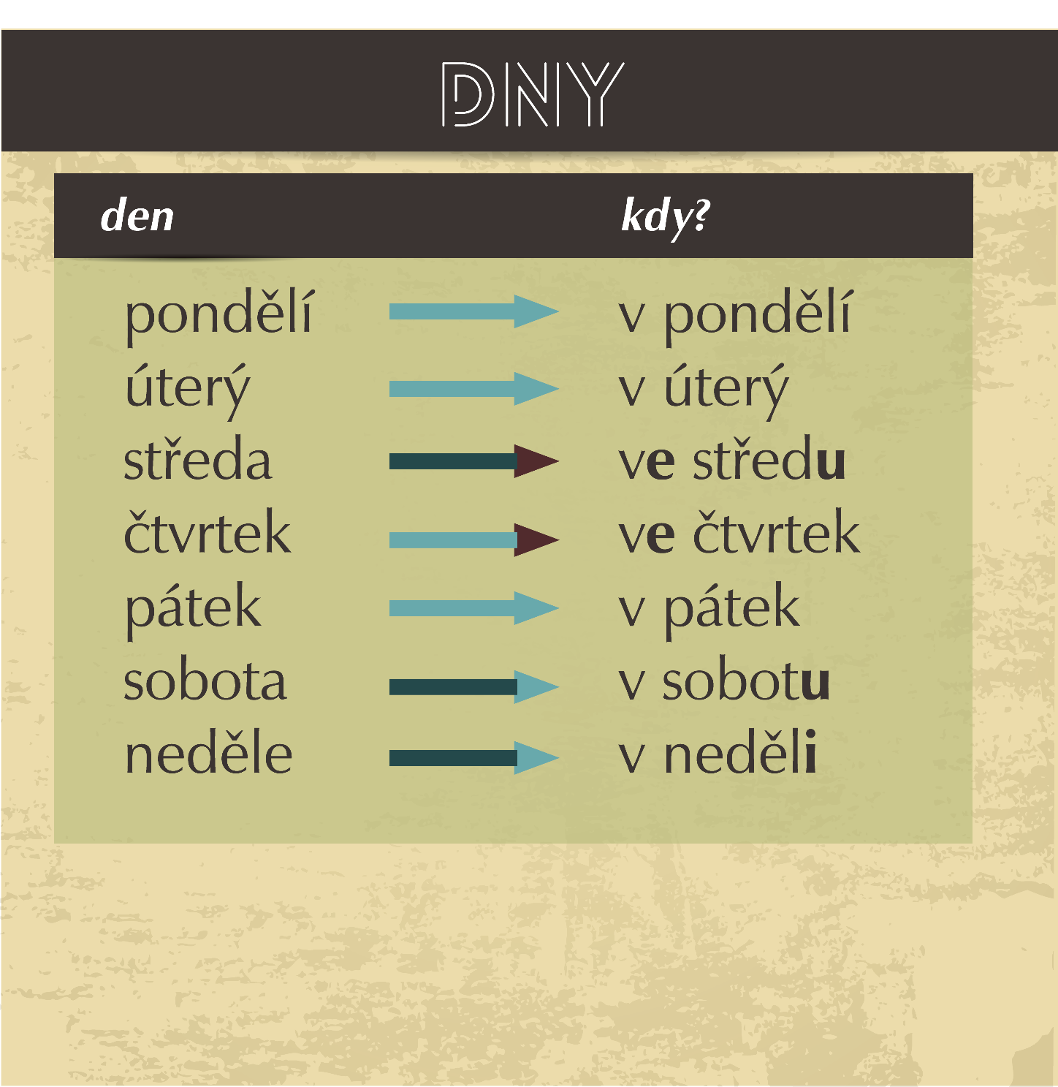
Jaký je den? — Kdy?

Slide 5
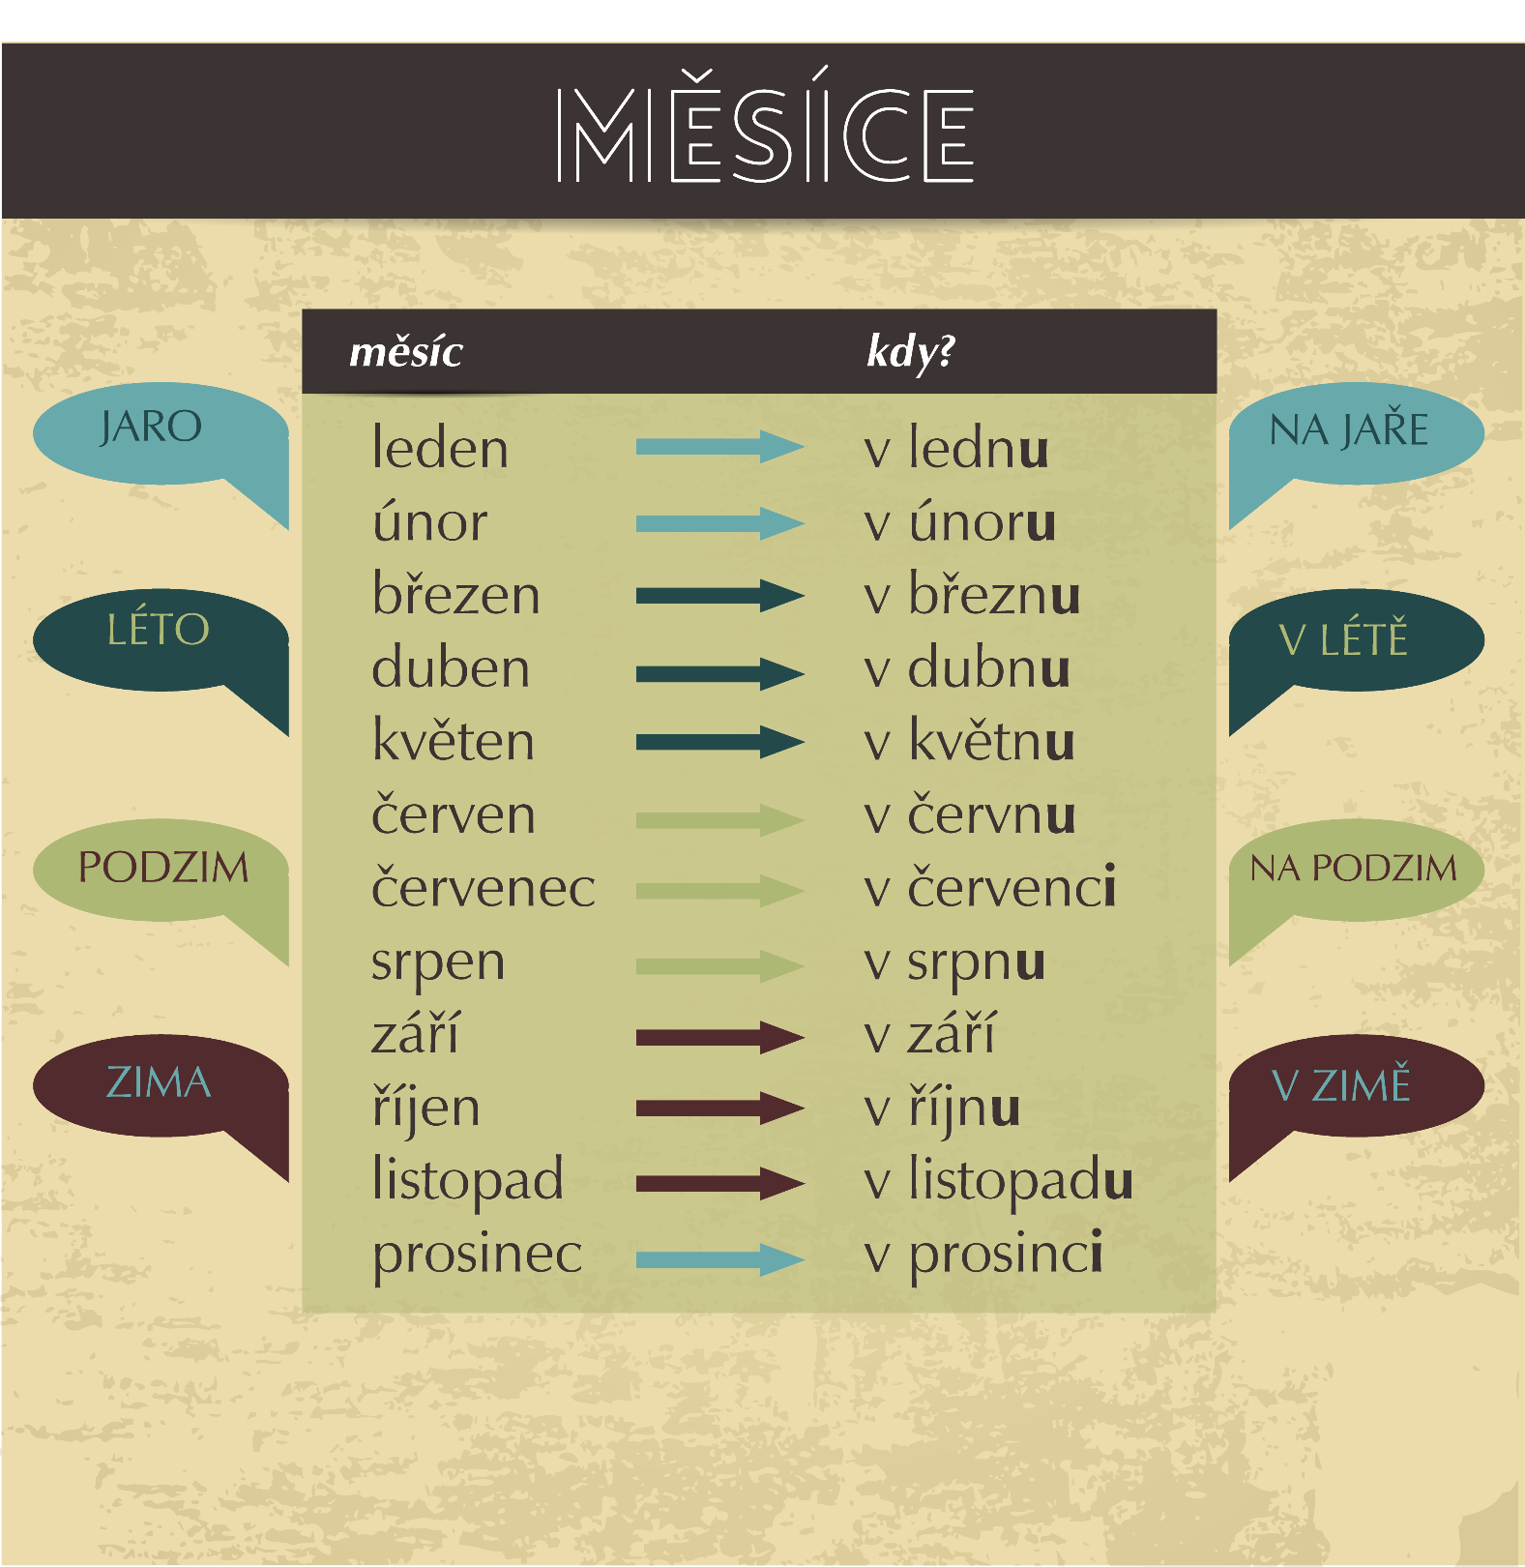
Jaký je měsíc?
— Kdy?

Slide 6
Homework
Review today's lesson.

