Slide 1
Lesson no. 3
Competence, Employment, Administration

Slide 2
Competence
What it takes to practice medical proffession

Slide 3
What is a medical profession
Regulated activities related to treatment of a patient
Administrative regulation for the sake of patient’s protection
Does not relate only to the physicians but almost any profession connected with medicine

Slide 4
Three requirements to practice medical profession
Health capacity
Both physical and mental
Professional competence
Education and Experience
Moral integrity (no criminal history)
Two levels of protection
Medical board or council (Ethical integrity)
State enforcement (Criminal liability)

Slide 5
Health capacity

Slide 6
Health capacity
Health capacity requirements are mainly in place to protect a healthcare professional
Incapacity to work at night
Temporarily incapacities
Pregnancy
Weight-lifting limits
Lack of vaccination

Slide 7
Health capacity for the sake of patient
Two possible approaches
State regulation (negative list)
Competence of employer (provider of medical care)

Slide 8
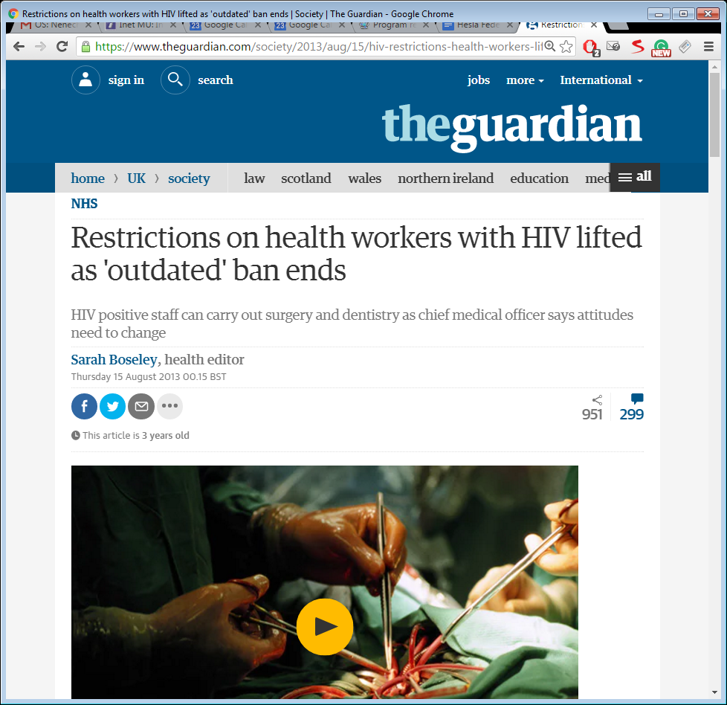

Slide 9
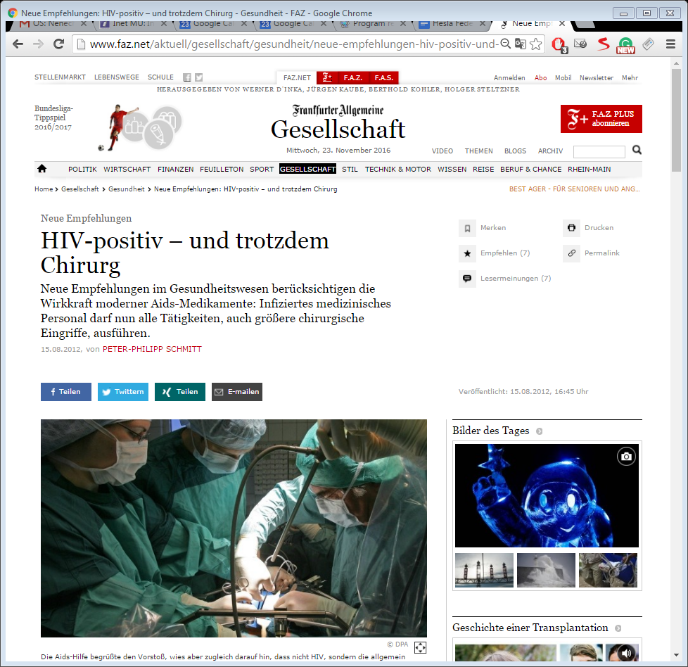

Slide 10
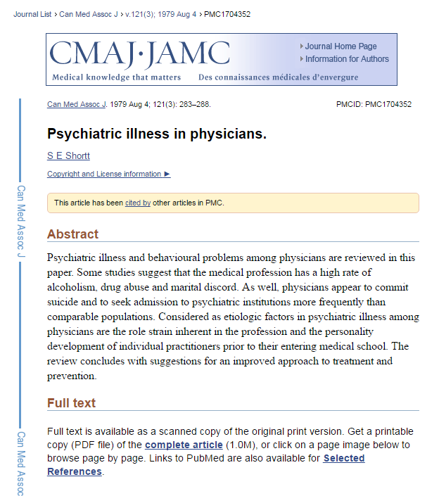
Mental capacity
Czech republic regulates dieseases which are incompatible with work in hospital
Schisopherenia
Dementia
Recidiving manic episodes or depression

Slide 11
Moral integrity

Slide 12
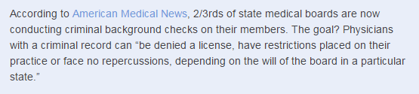
Criminal records
UK
certification from the Disclosure and Barring Service (DBS)
Employer has duty to check, GMC may decide but no automatic ban
USA
Czech republic
Automatic ban if there is inprisonment for more than year

Slide 13
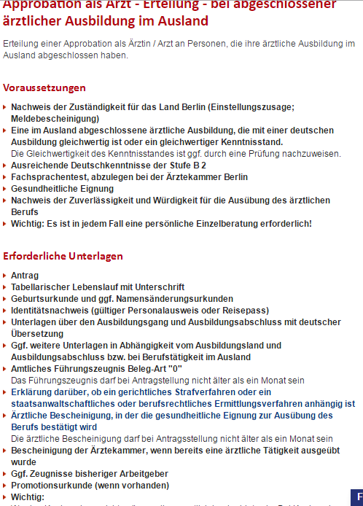

Slide 14
Professional Capacity

Slide 15
Professional capacity
To perform profession per se
Education
To perform specialized tasks
Practice

Slide 16
Recognition of professional qualification within the EU
Temporarily mobility
Establishment
Employment ?

Slide 17
Temporarily mobility
Maximum 6 months
Has to be reported

Slide 18


Slide 19
Basic medical Training IN EU
Admission to basic medical training shall be contingent upon possession of a diploma or certificate providing access, for the studies in question, to universities
Basic medical training shall comprise a total of at least six years of study or 5 500 hours of theoretical and practical training provided by, or under the supervision of, a university.

Slide 20
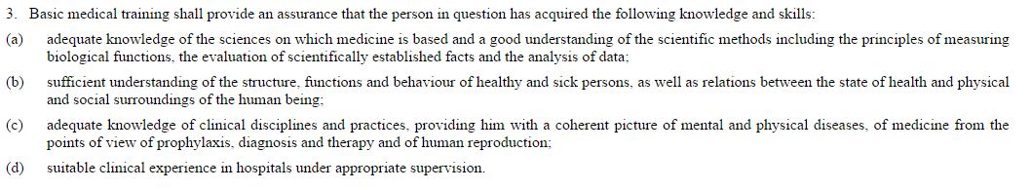

Slide 21
Specialist medical Training (EU)
Admission to specialist medical training shall be contingent upon completion and validation of six years of study
Specialist medical training shall comprise theoretical and practical training at a university or medical teaching hospital or, where appropriate, a medical careestablishment approved for that purpose by the competent authorities or bodies.
Training shall be given on a full-time basis at specific establishments which are recognised by the competent authorities. It shall entail participation in the full range of medical activities of the department where the training is given
http://eur-lex.europa.eu/legal-content/EN/TXT/HTML/?uri=CELEX:32005L0036&from=en

Slide 22
Administration

Slide 23
Method of regulation
Public law
Private law

Slide 24
Administration of Healthcare
Governmental level
Regional level
Autonomous organisations
Economic regulation (contractual)

Slide 25
Universal declaration of human rights
Everyone has the right to a standard of living adequate for the health and well-being of himself and of his family, including food, clothing, housing and medical care and necessary social services

Slide 26
Who is ultimately responsible?

Slide 27
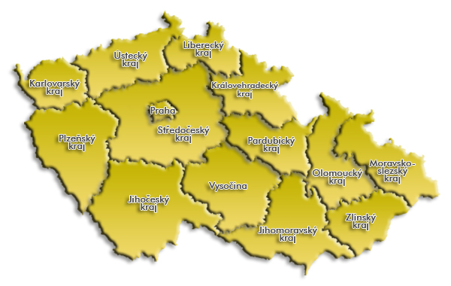
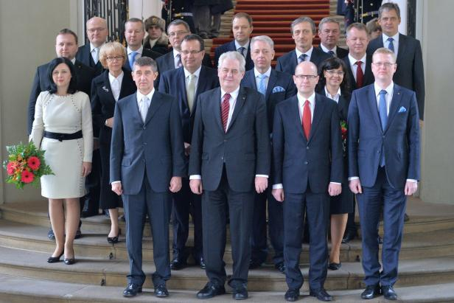
State vs Autonomy?

Slide 28
Central Authorities
Government
  Ministry of health
Institute for drug control
Statistical institute
Public health insurance companies

Slide 29
System of public insurance
Insurer
Healthcare provider
Chooses insurer (compulsory)
Receives healthcare from insurer’s network
Legal duty to create adequate network of Healthcare providers
Legal duty to provide Healthcare
Patient
Contractual relationship
+ imperative norms
Non-contractual relationship
Regulated exclusively by Public law
Contractual relationship, content strictly regulated

Slide 30
Ministry of Health services (typical)
Central administrative body
Does not provide healthcare, does not assess its quality
Resposible for integrity of a systém
Creates rules of the game

Slide 31
LOCAL RESPONSIBILITIES
Regions, Counties,
Cities and Municipalities
Healthcare providers
Healthcare workers

Slide 32
Professional authonomy

Slide 33
Medical boards and councils
Voluntary or compulsory membership
Supervise the quality of individual members (not the quality of institutions)
Provide education
Disciplinary competence

Slide 34
Supervision
Of a healthcare provider
Government/authority
Insurance company
Police
Of an individual physician
Healthcare provider
Medical Board
Police

Slide 35
ReQuirements of a healthcare provider
Personnel composition
Material equipment

Slide 36
Definition of appropriate healthace
Personnel competence
Quality
Hygiene and safety

Slide 37
Employment law

Slide 38
Employment law
Form of a contract
Voluntary relationship
Employee is a weaker party
Employment contract can deviate in favour of employee

Slide 39
Collective bargaining (Unions)
Can change the contents of a contract
As little as three workers can form a union
Exist on different levels
  Country
  Sector specific
  Ocupation specific

Slide 40
Time in the labor law
Working time
Period during which the worker is working, at the employer's disposal and carrying out his activity or duties
Night time
Period of not less than seven hours which must include, in anycase, the period between midnight and 5.00
Overtime work
On-call shift
Rest period
Any period which is not working time

Slide 41
Maximum weekly working time
Limited by means of
Laws, regulations or administrative provisions or by collective agreements
Normally 40 hours
Three-shift and uninterrupted working mode - 37.5 hours a week
Two-shift work mode - 38.75 hours per week
Average working time for each seven-day period, including overtime, should not exceed 48 hours
Shorter has to be negotiated

Slide 42
Breaks & rest Periods
Every worker is entitled to a rest break
If working day is longer than six hours
Based on the agreement or collective agreements
Every worker is entitled to a minimum daily rest period of 11 consecutive hours per 24-hour period
Every worker is entitled to a minimum uninterrupted rest period of 24 hours plus the 11 hours' daily rest per each seven-day period

Slide 43
Entering into employment
Always in writing
Trial period
Non-discrimination clauses

Slide 44
Termination of Employment
Emoployer can terminate under defined reasons
Employee can terminate in notice period
Usually two months
Objective not subjective reasons

Slide 45
Thank you for your attention

