Slide 1

SENSORY ORGANS
Organ of vision,
organ of balance and hearing
and accessory organs

Slide 2
Organ of vision
Eyeball (bulbus oculi)
- anterior segment of eye
- posterior segment of eye
Eyelid (palpebra)
Tear gland (gl. lacrimalis)

Slide 3
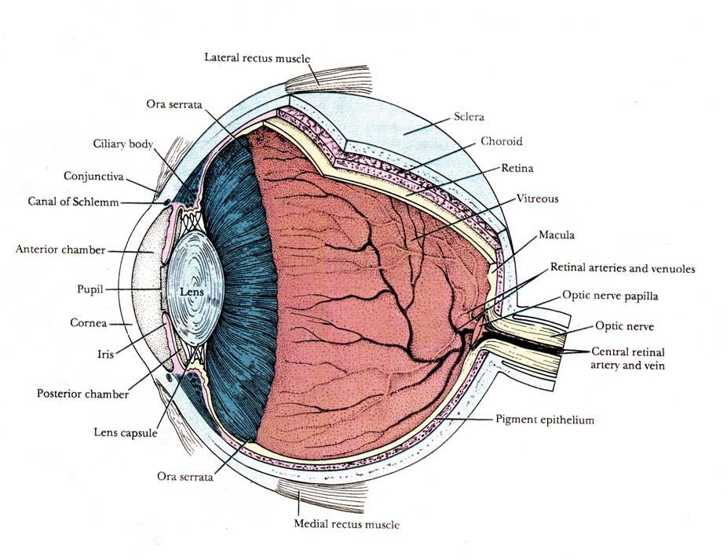
Anterior segment Posterior segment

Slide 4
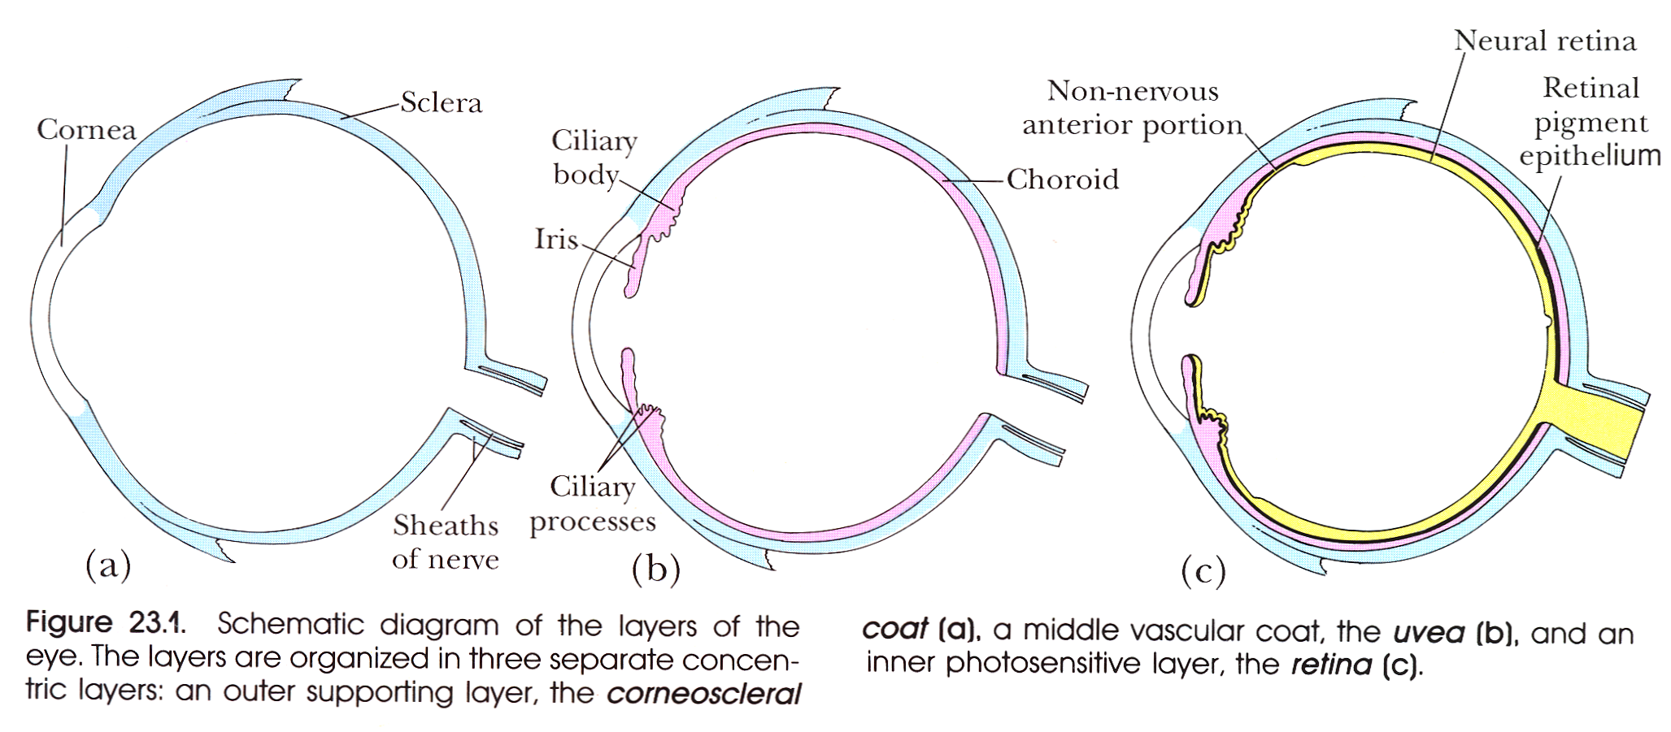
The wall of eyeball
Tunica externa
(fibrosa)
Tunica media
(vasculosa)
Tunica interna
(nervosa)
anterior cornea iris pars caeca
segment corpus ciliare retinae
posterior sclera choroidea pars optica
segment retinae

Slide 5
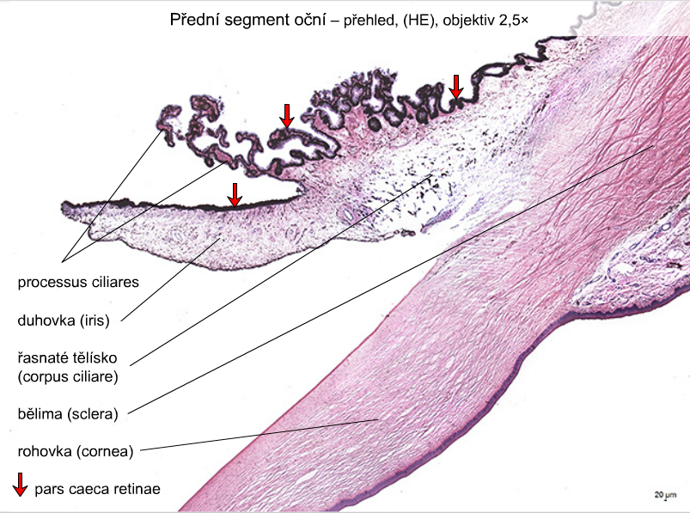
Anterior segment of eye

Slide 6
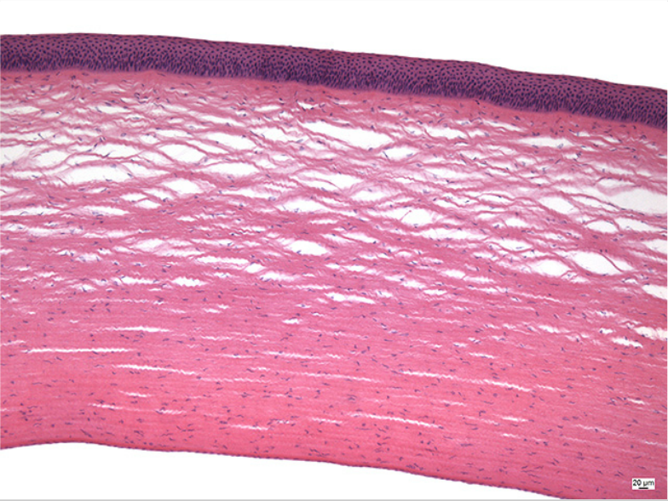
Anterior segment of eye – cornea
anterior epithelium
Bowman‘s membrane
substantia propria cornae
Descemet‘s membrane
posterior epithelium

Slide 7
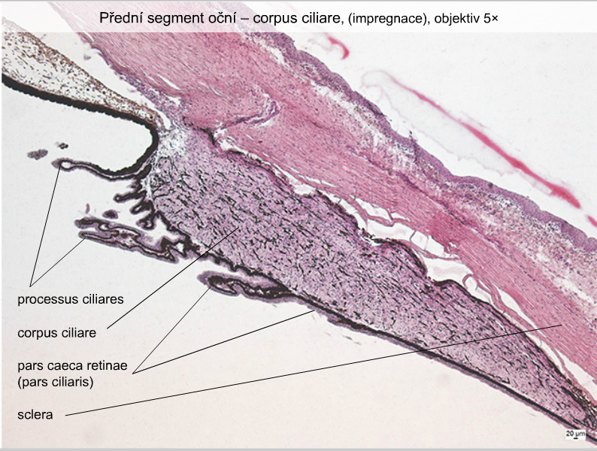
Anterior segment of eye – corpus ciliare

Slide 8
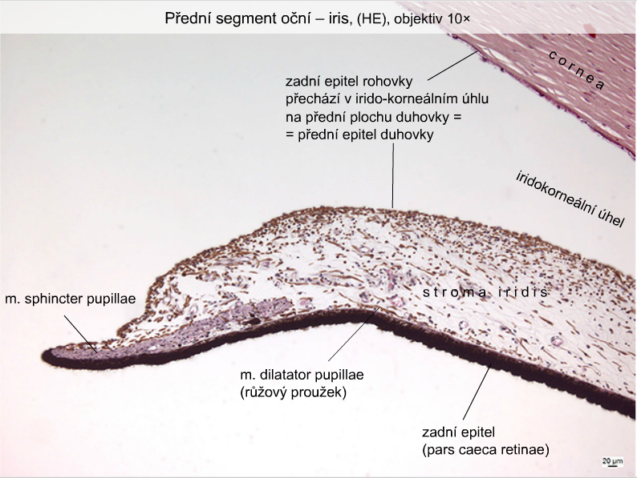
Anterior segment of eye – iris
dorsal corneal epithelium
continues
to ventral surface of iris as ventral epithelium of iris
iridocorneal angel
stroma iridis
[pink strip]
dorsal epithelium

Slide 9
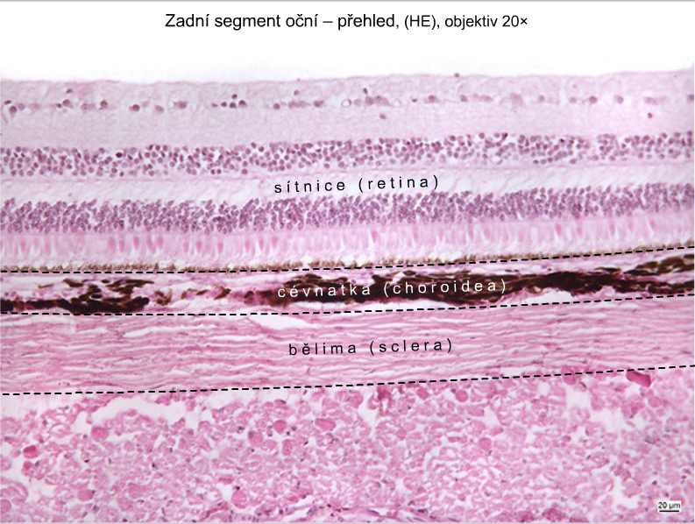
Dorsal segment of eye

Slide 10
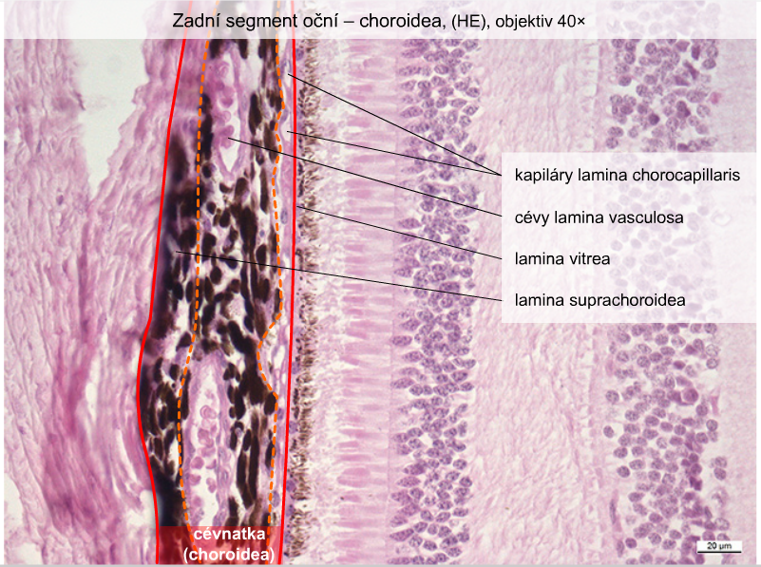
Posterior segment of eye – choroidea
Lamina chorocapillaris
- with capillaries
Lamina vasculosa
- with vessels
Lamina vitrea
Lamina suprachoroidea

Slide 11
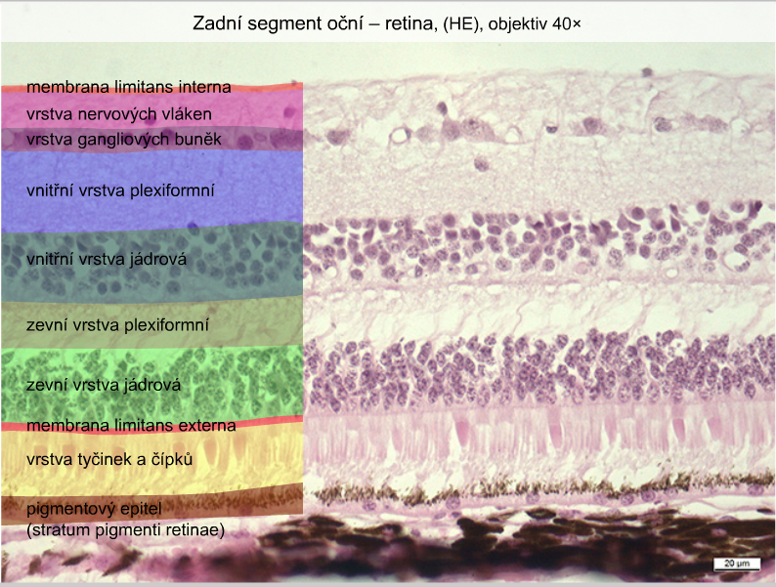
Posterior segment of eye – retina
membrana limitans interna
layer of nerve fibers
layer of ganglionic cells
inner plexiform layer
inner granular layer
outer plexiform layer
outer granular layer
membrana limitans externa
layer of rods and cones
pigmented epithelium
(stratum pigmenti retinae)

Slide 12
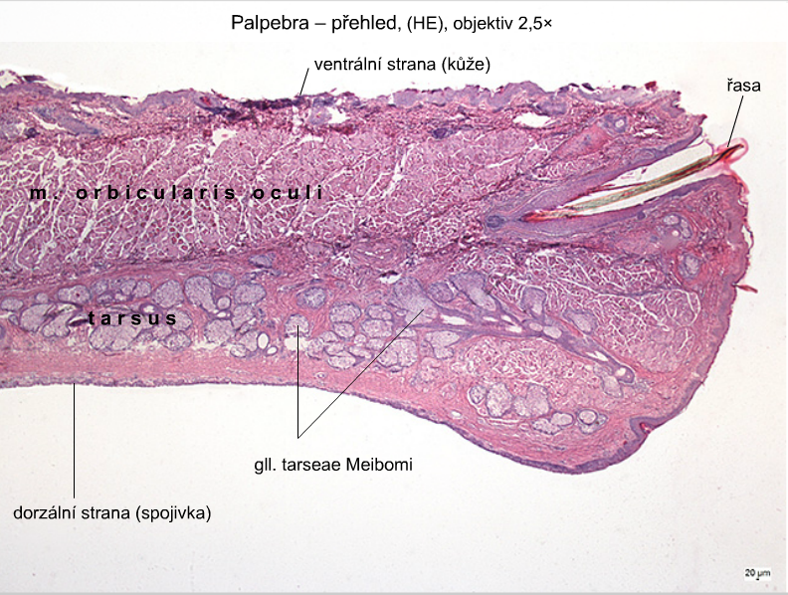
Palpebra
ventral side (skin)
eyelid
dorsal side (conjunctiva)

Slide 13
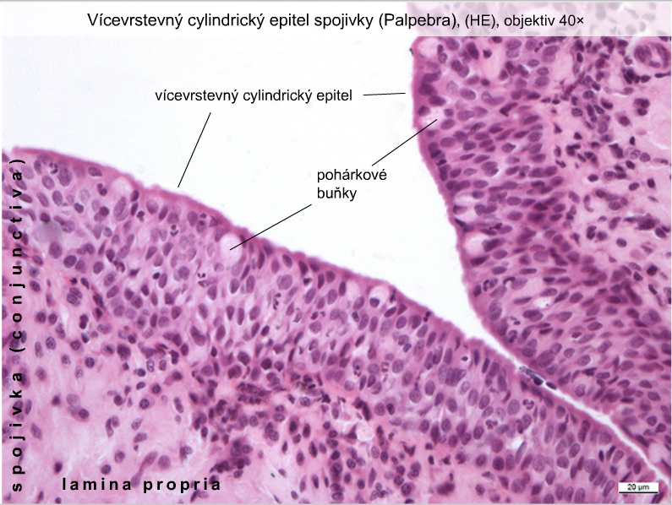
Palpebra – conjunctival side
pseudostratified columnar epithelium
goblet cells

Slide 14
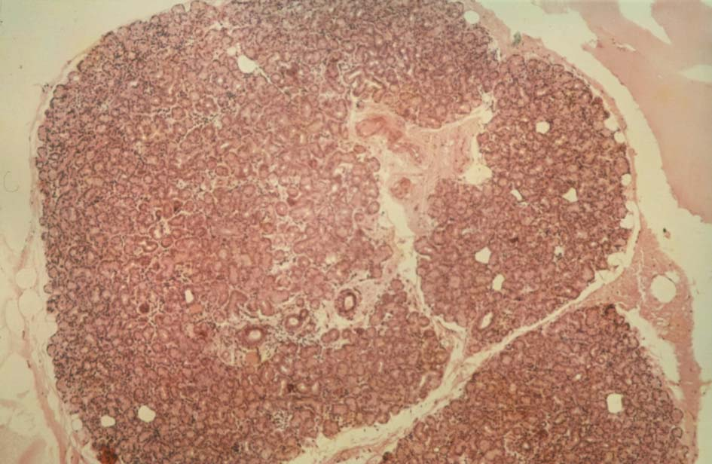
Gl. lacrimalis

Slide 15
Organ of balance and hearing
Outer ear auricle (auricula)
auditory meatus (meatus acusticus ext.)
ear drum (membrana tympani)
Middle ear tympanic cavity (cavum tympani)
Inner ear sacculus – macula sacculi
utriculus – macula utriculi
ductus semicirculares – cristae
ampullares
ductus cochlearis – organon Corti

Slide 16
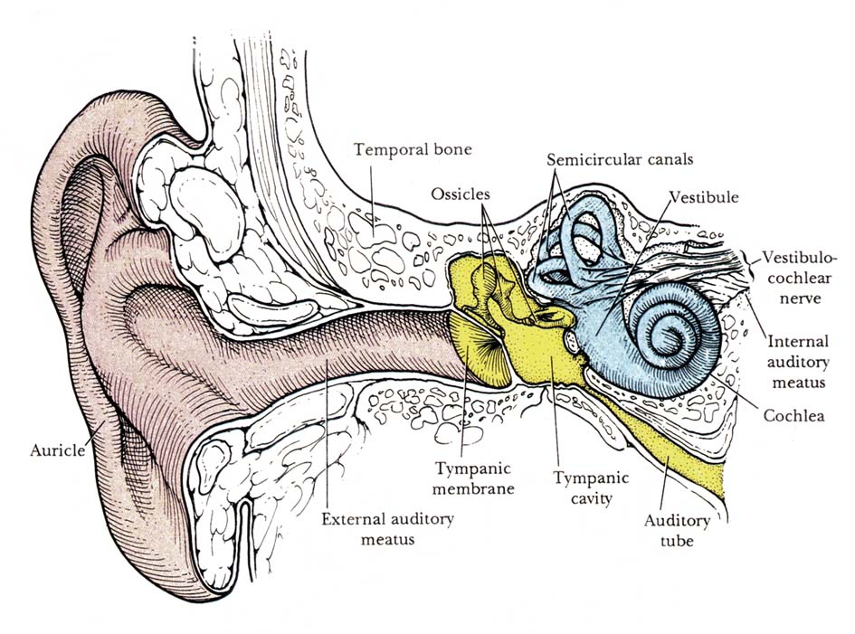

Slide 17
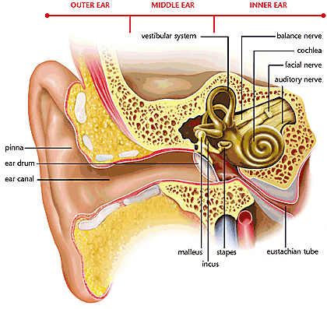
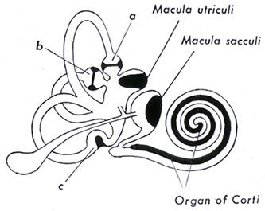
Inner ear
(in pyramid of ossis petrosum ossis temporalis)
Bony labyrinth
vestibulum
canales semicirculares
cochlea
perilymphatic
space
spatium
perilymphaceum
Membranous labyrinth
pars statica (1, 2)
pars akustica (3)
sacculus utriculus saccus endolymphaticus
ductus semicirculares
ductus cochlearis
endolymph

Slide 18
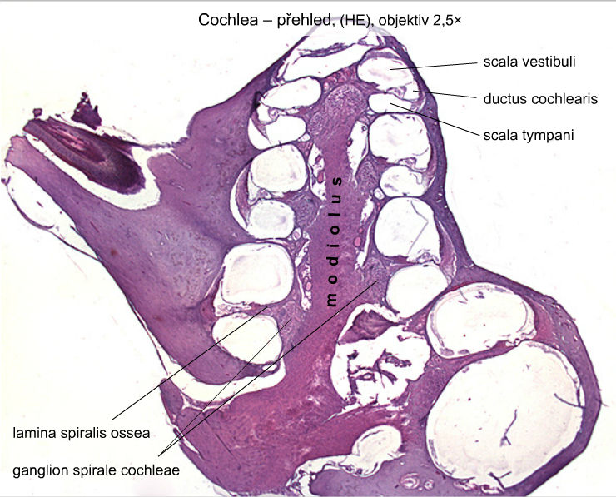

Slide 19
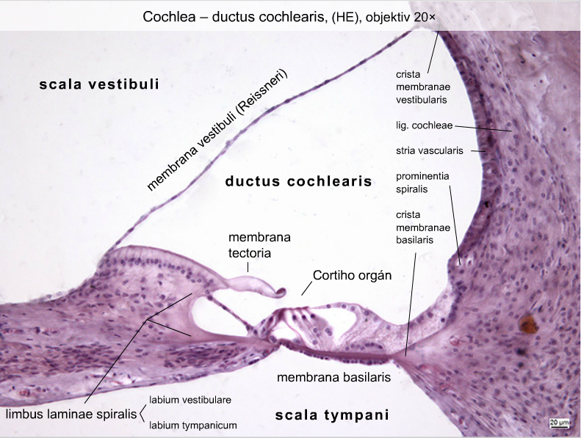
organ of Corti

Slide 20
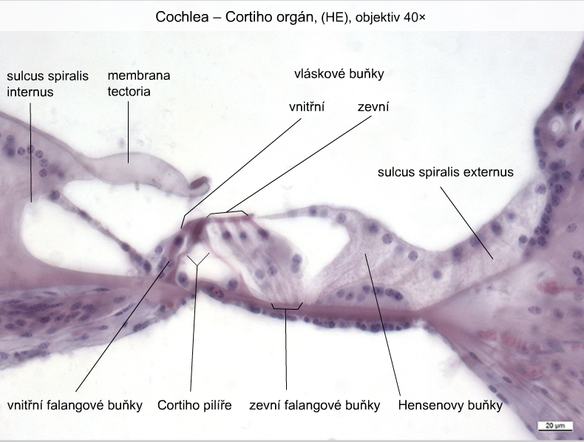
Cochlea – organ of Corti
hair cells
inner outer
inner phalangeal columnes outer phalangeal cells
cells of Corti cells of Hensen

Slide 21
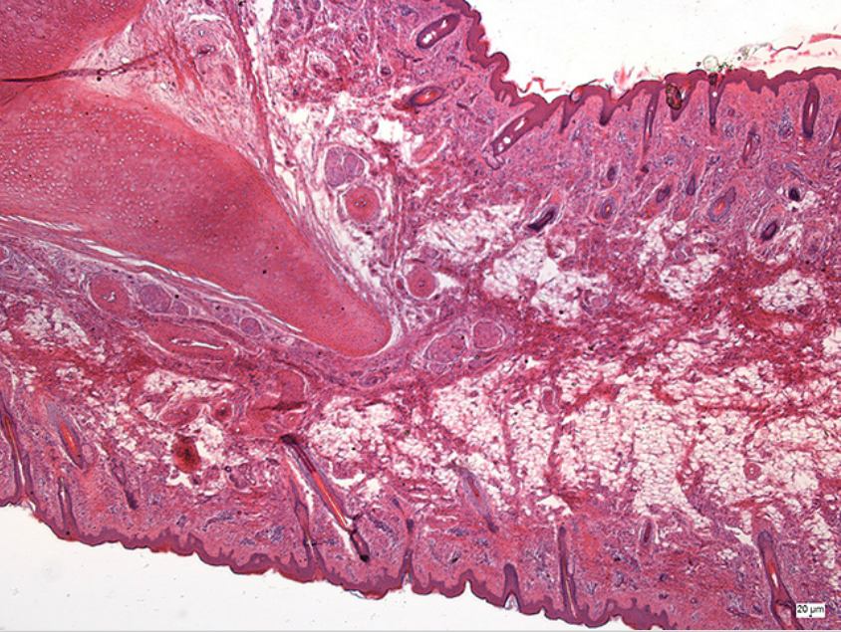
Auricle (auricula)
Elastic cartilage
Ear lobule

Slide 22

SENSORY ORGANS
Slides:
88. Anterior segment of the eye
89. Posterior segment of the eye
90. Fasciculus opticus
91. Palpebra
92. Gl. lacrimalis
93. Ductus cochlearis
94. Auricula

Slide 23
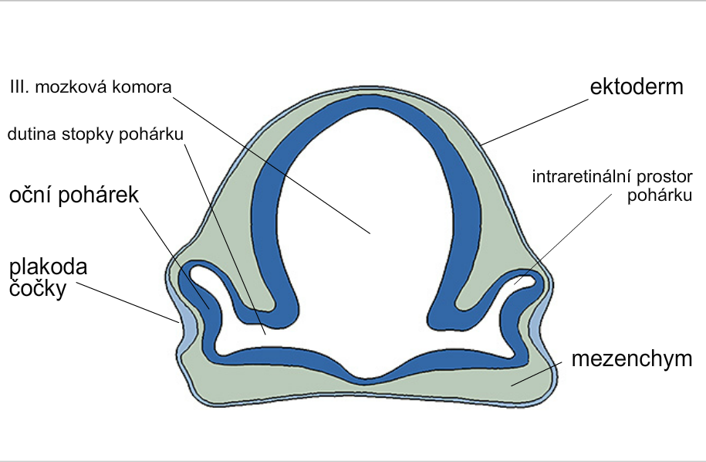
Development of eye
3rd brain ventricle
ectoderm
stalk of optic cup
intraretinal space
of optic cup
optic cup
lens
placode
diencephalon
mesenchyme

Slide 24
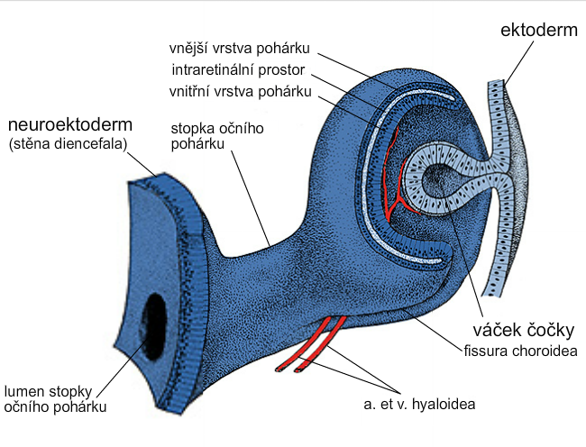
Development of optic cup and lens
ectoderm
outer layer of cup
intraretinal space
inner layer of cup
neuroectoderm
(wall of diencepalon)
stalk of optic cup
lens vesicle
lumen of stalk
of optic cup

Slide 25
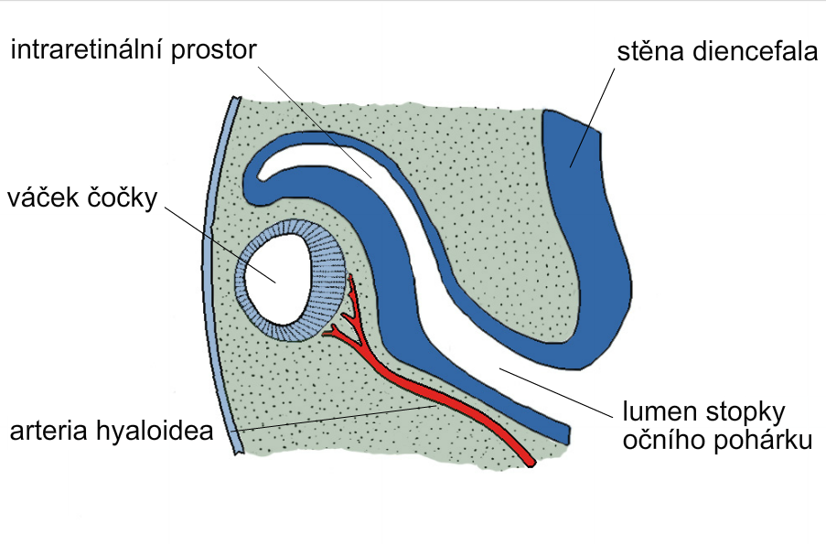
intraretinal space diencephalon wall
lens vesicle
lumen of stalk
of optic cup

Slide 26
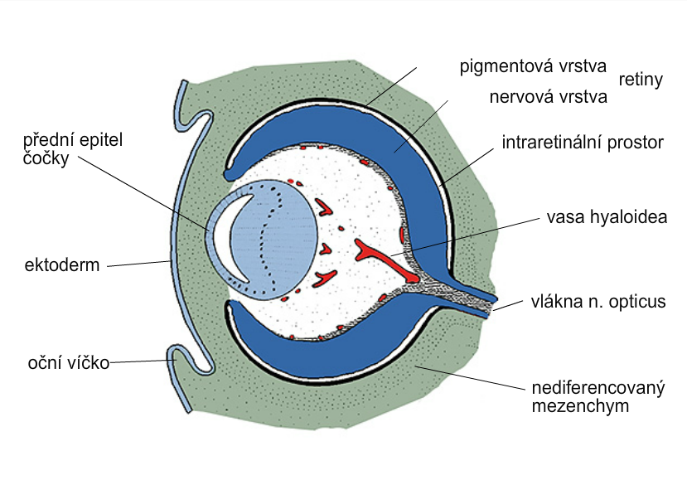
pigmented layer of retina
nervous layer of retina
anterior epithelium
of lens
intraretinal space
ectoderm
eyelid
mesenchyme

Slide 27
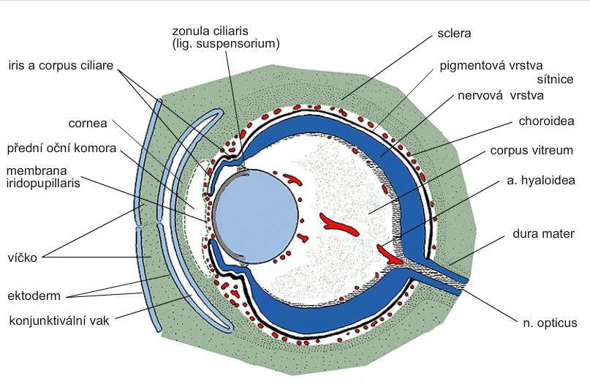
+
retinal pigmented layer
retinal nervous layer
camera oculi ant.
eyelid
ectoderm
conjunctival sac
mesenchyme

Slide 28
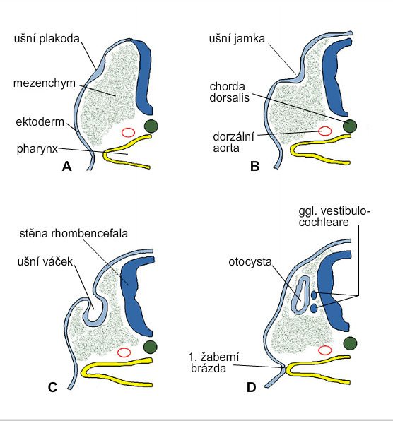
Development of inner ear
otic placode
otic pit
mesenchyme
ectoderm
dorsal aorta
wall of rhombencephalon
otic pit
otocyst
the 1st
ectodermal
cleft

Slide 29
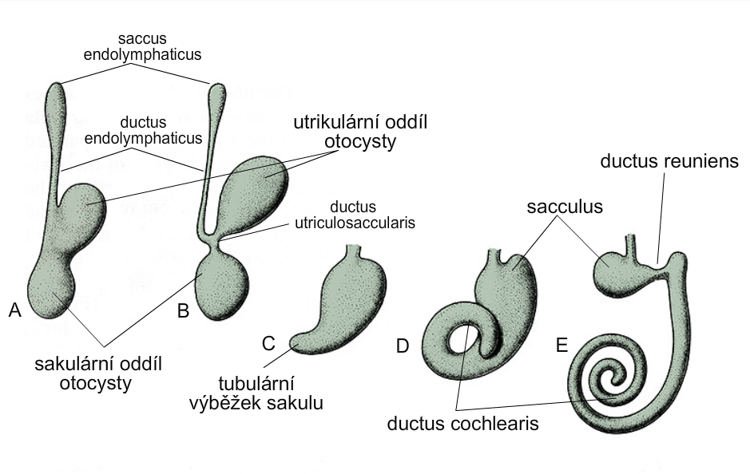
Development of membranous labyrinth
utricular part
of otocyst
saccular part
of otocyst
tubular process
of sacculus

Slide 30
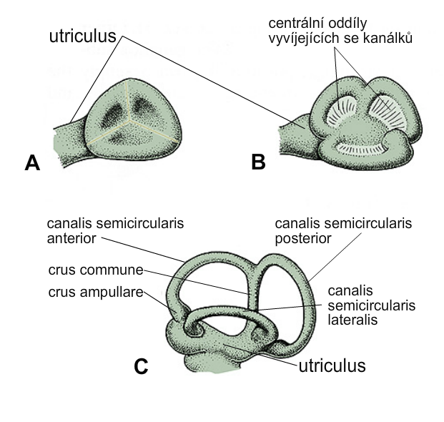
Development of semicircular canals
*central regions of developing
semicircular canals
*these regions
perforate later

Slide 31
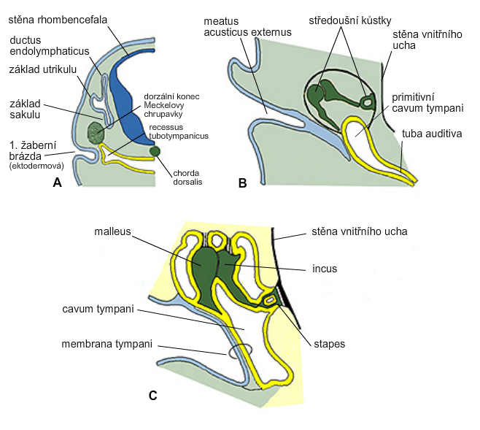
Development of middle ear
middle ear
ossicles
rhombencephalon
wall of inner ear
utriculus
sacculus
Meckel‘s
cartilage
primitive
cavum tympani
1st ectodermal
cleft
wall of inner ear

Slide 32
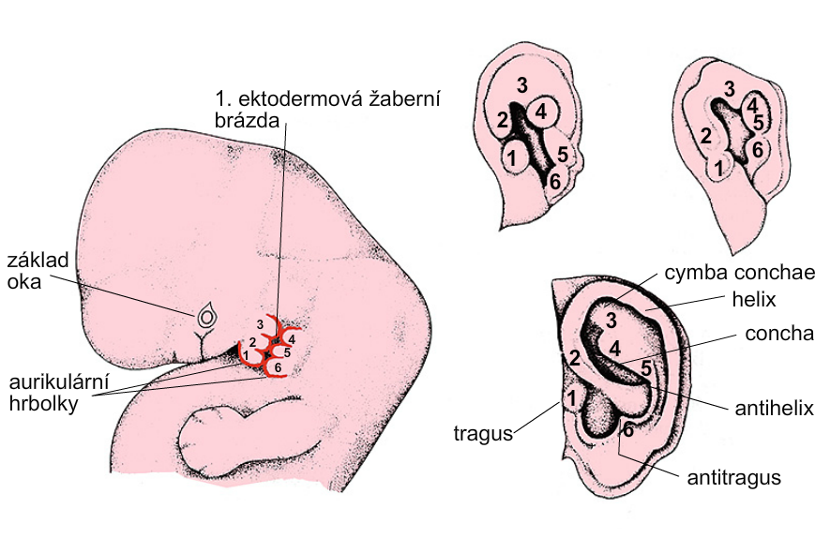
Development of external ear
the 1st ectodermal cleft
basis
of eye
auricular
tubercles

