Slide 1

DIGESTIVE SYSTEM 3
Big salivary glands parotid gland
submandibular gl.
sublingual gl.
Liver
Gallbladder
Pancreas

Slide 2
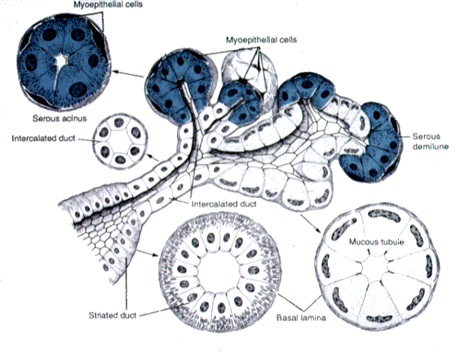
Salivary glands - schema
Glandular parenchyma
  secretory portion
    serous acini
    mucous tubules
    mixed /serous demilunes of Gianuzzi/
    + myopethelial cells
  duct system
    intercalated ducts
    intralobular /striated/ ducts
    interlobular and interlobar ducts
    main excretory duct

Slide 3
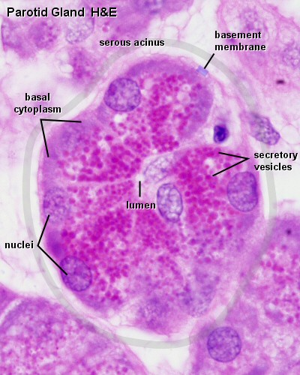
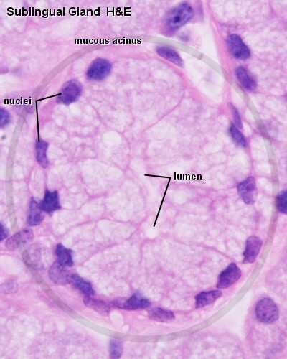
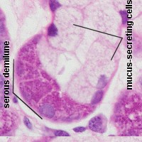
Secretory portion of salivary glands
serous acini
mucous tubules
mixed(serous
demilunes of
Gianuzzi)

Slide 4
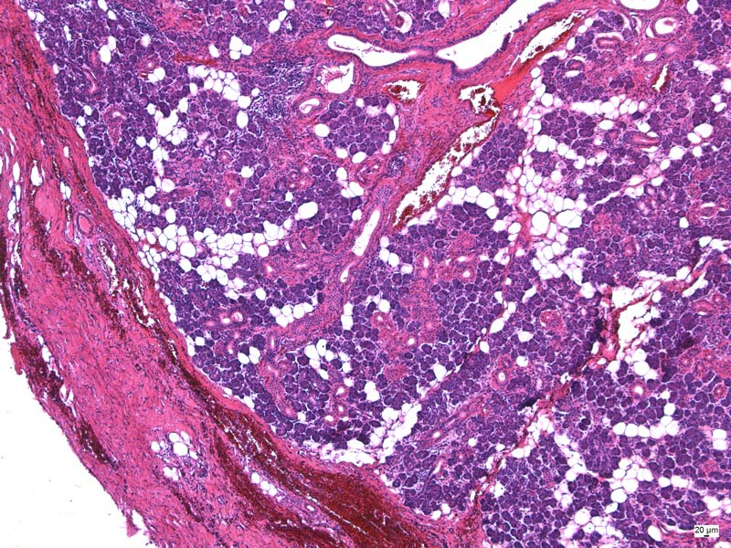
Parotid gland
Branched acinar serous gl.
ducts – intercaleted,striated, interlobular, excretory ducts
Adipose tissue

Slide 5
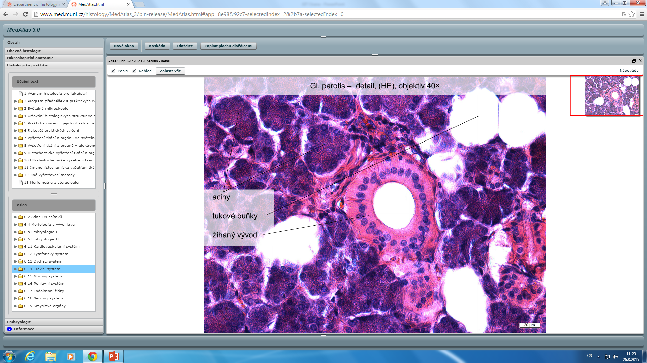
serous acini
adipose cell
striated duct

Slide 6
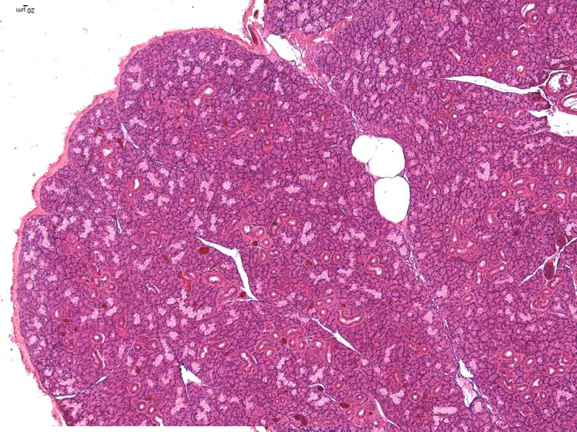
Submandibular gland
Branched tubuloacinar mixed gl.

Slide 7
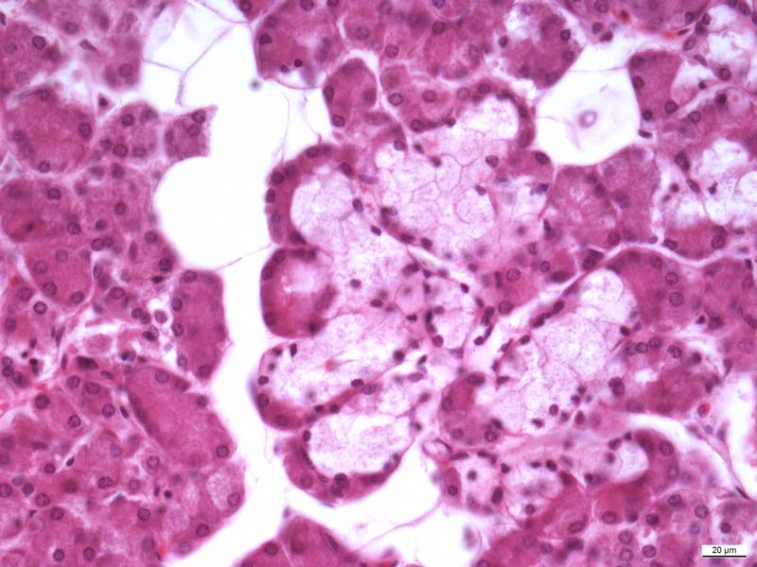
Submandibular gland
Serous demilune
Mucous tubules
Serous acines

Slide 8
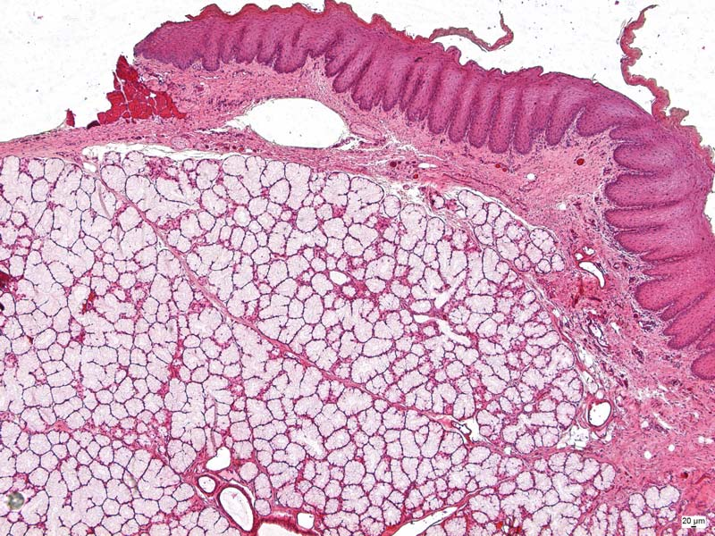
Sublingual gland
Branched tubuloacinar mixed gl.

Slide 9
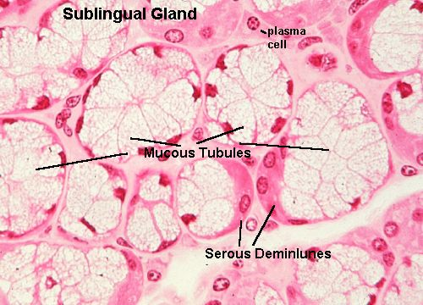

Slide 10
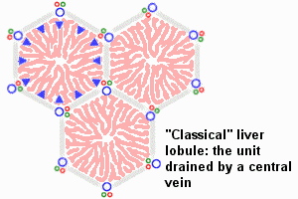
Liver = hepar

Slide 11
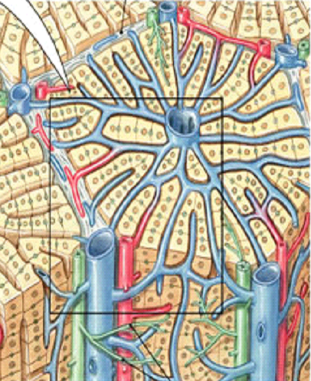
Classic liver lobule
1 – 2 mm
Shape – polygonal ( polyhedral )
Central vein
Hepatocytes in interconnected plates
Liver sinusoids
Bile canaliculus
2D cross section 3D

Slide 12
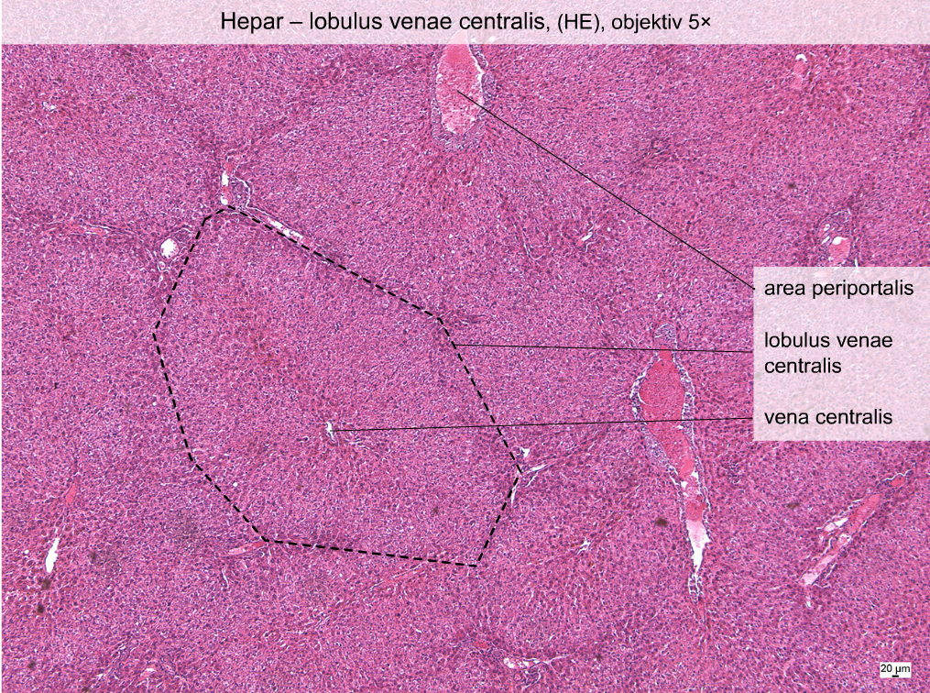
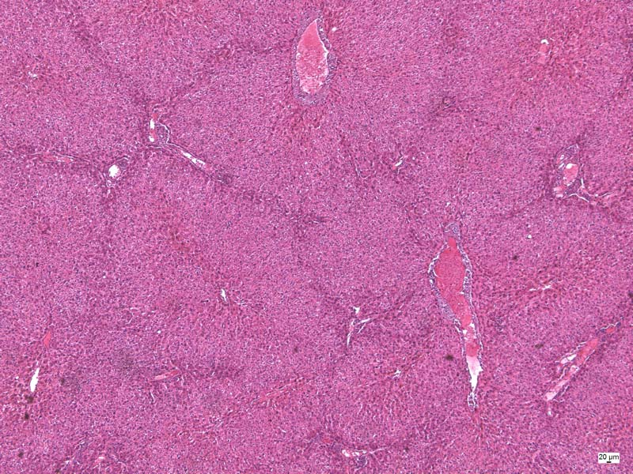
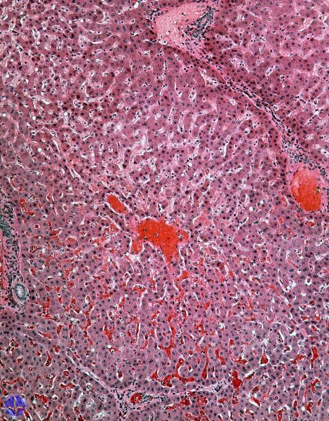
Portal space
Classic liver lobule
Central vein

Slide 13
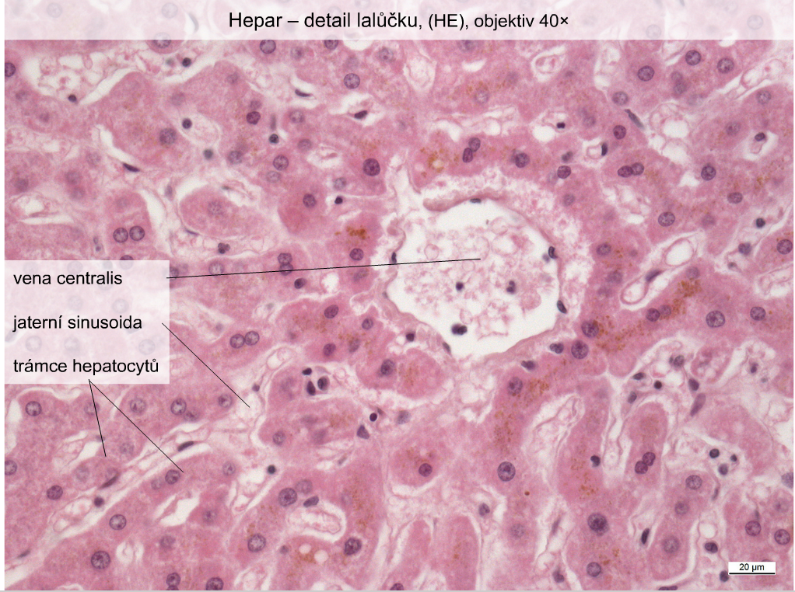
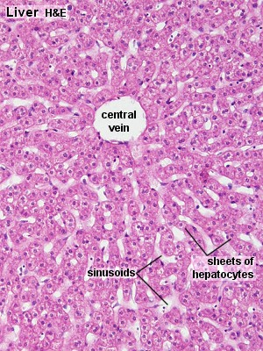
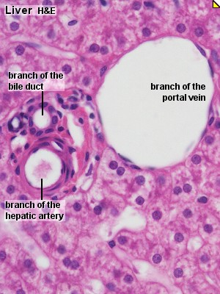
Central vein
Liver sinusoid
Liver plates
trias hepatis /Glissonova triáda/

Slide 14
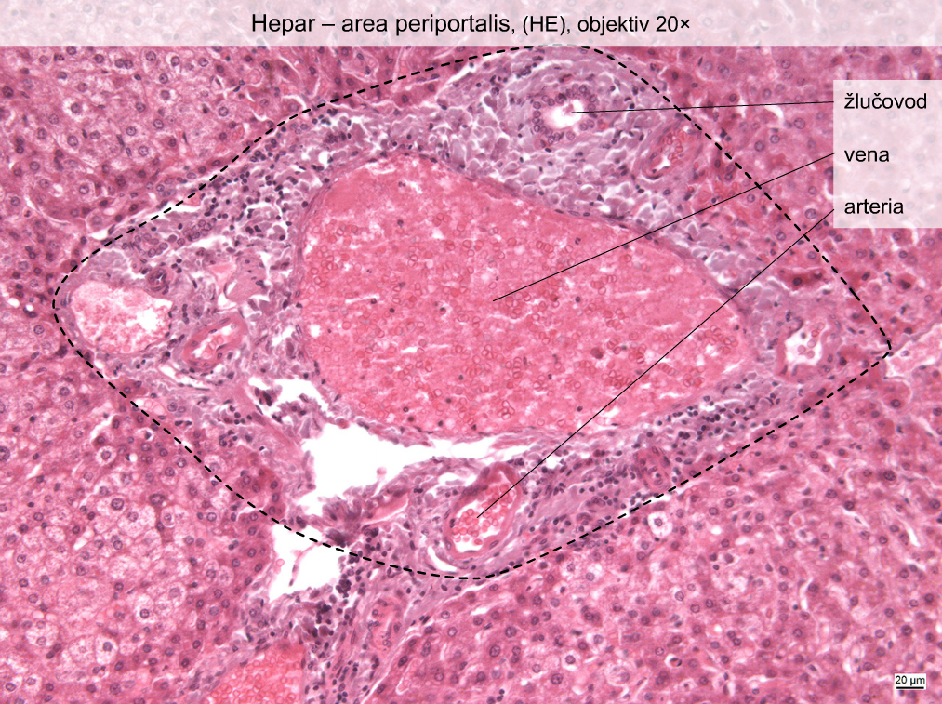
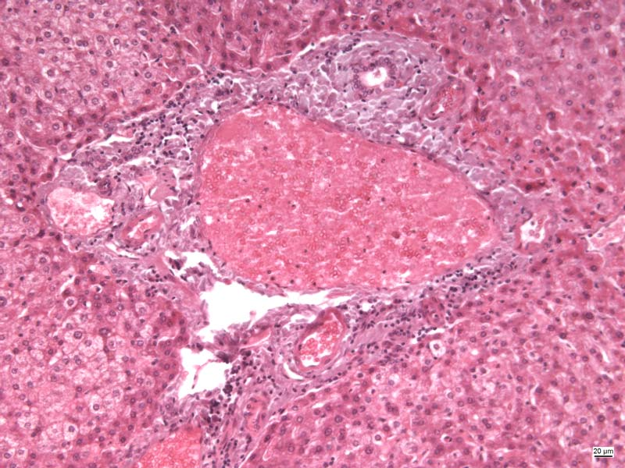
Játra – portální triáda
Bile duct
Portal vein
Hepatic artery

Slide 16
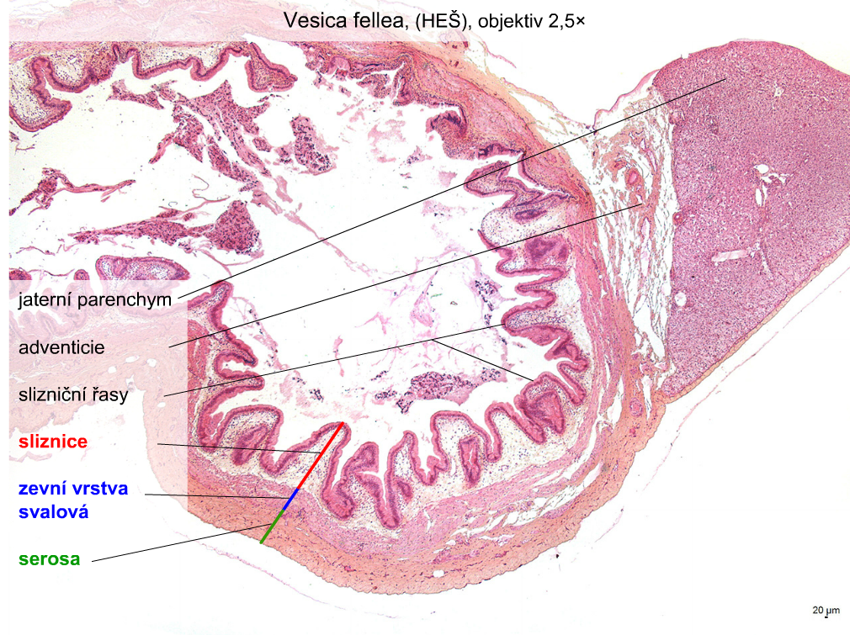
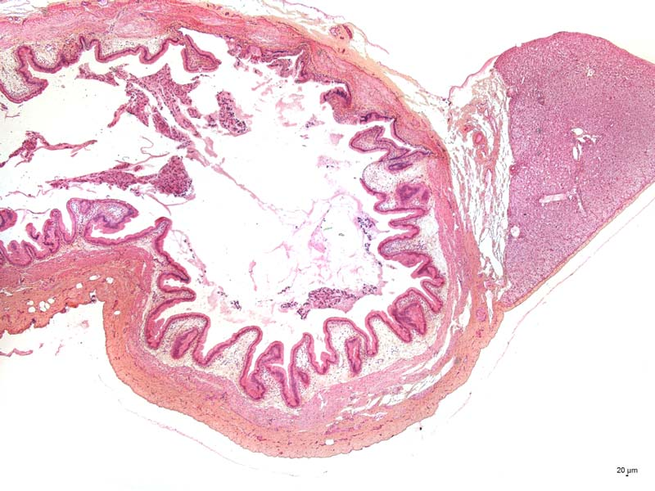
Žlučník /vesica fellea/
Liver parenchyme
Adventitia
Folds of mucosa
Mucous coat
T. muscularis externa
Serous layer

Slide 17
Gallbladder with mucus

Slide 18
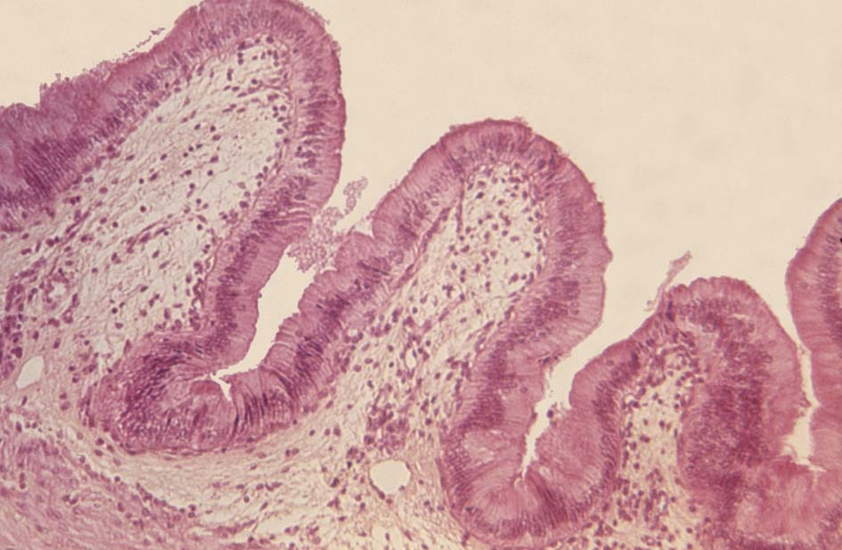
Vesica fellea – slizniční řasy
Pancreas - HE, 10x
simple columnar epithelium
Interlobular duct
Serous
acinus
Septum
Islets of Langerhans
lamina propria mucosae

Slide 19
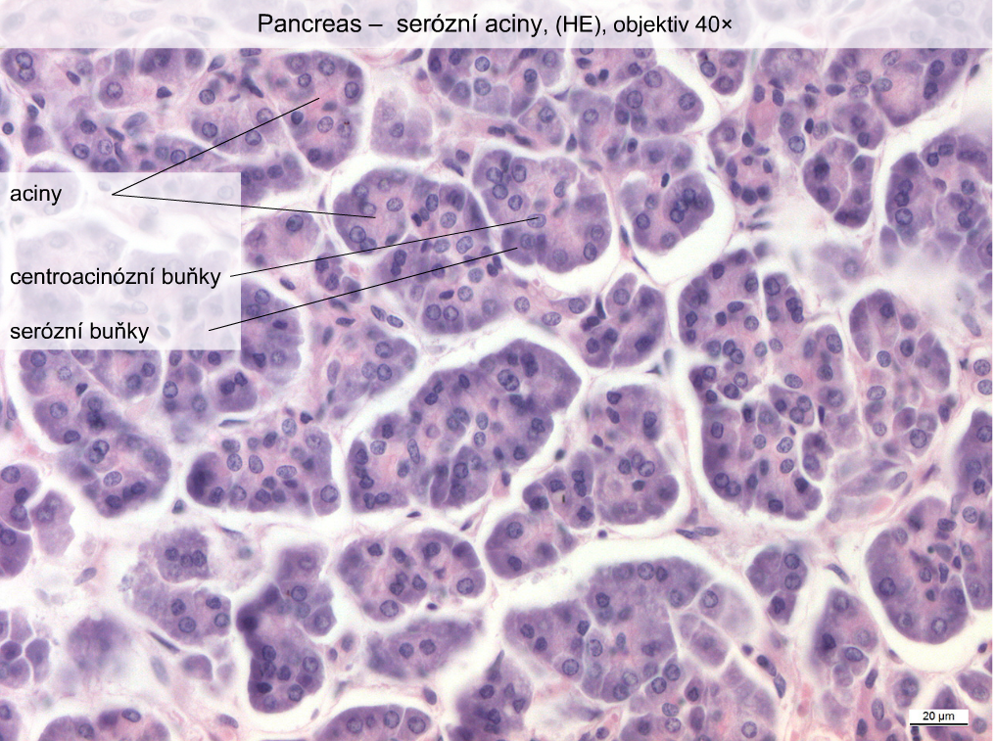
Pancreas – serous acinus, HE , 10x
Acinus
Centroacinar cells
Acinar cells

Slide 20
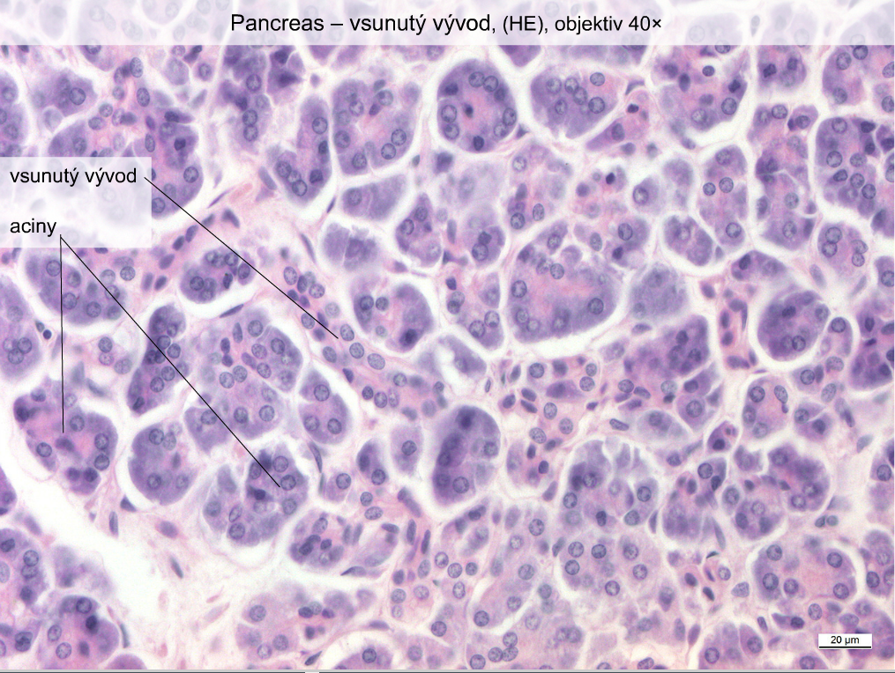
Pancreas, He, 10x
Intercalated
duct
Acinar cells

Slide 21
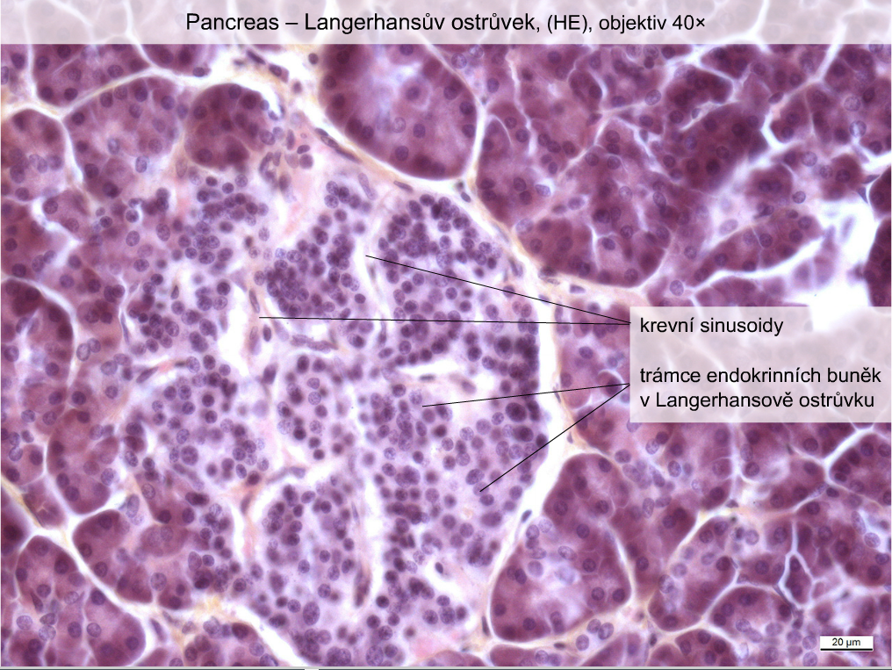
Pancreas, HE, 40x
sinusoids
Islets of Langerhans

Slide 22


3.
Digestive system - III
Slides:
8. Glandula parotis (HE)
9. Glandula submandibularis(HE)
10. Glandula sublingualis
20. Hepar(HE)
21. Hepar (AZAN)
22. Vesica fellea (HE)
23. Pancreas (HE)
Atlas EM:
Bile canaliculi (10)

Slide 23
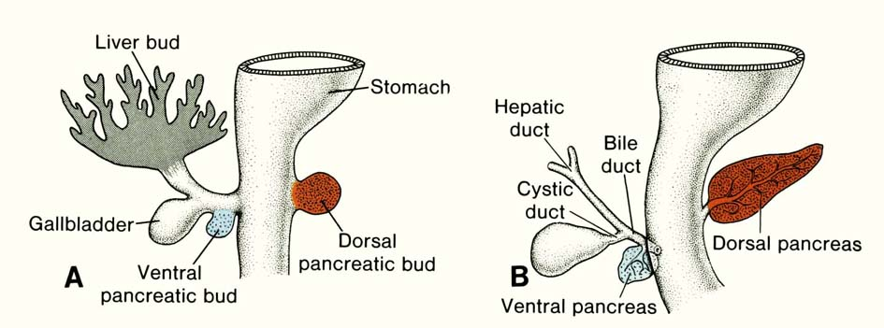
duoednal loop
is formed

Slide 24
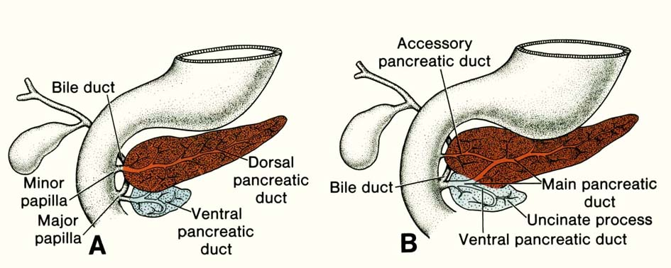
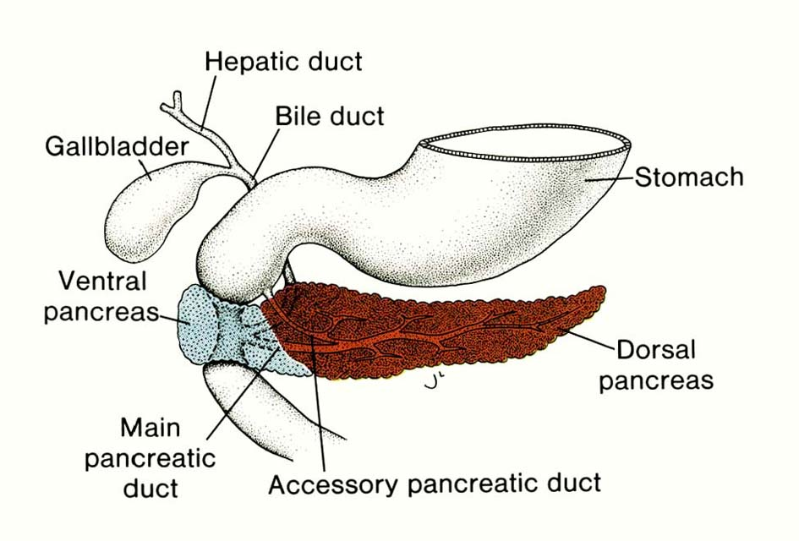
liver

Slide 25
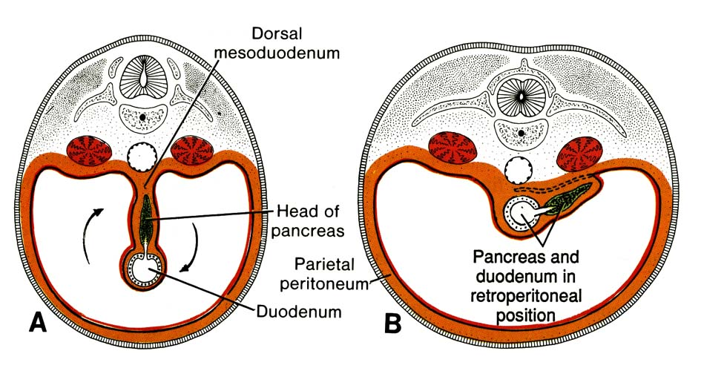
Pancreas – passes into dorsal mesoduodenum and mesogastrium by proliferation of endoderm of duodenal loop;
During rotation of stomach and duodenum – duodenum + pancreas are situated retroperitoneally

Slide 26
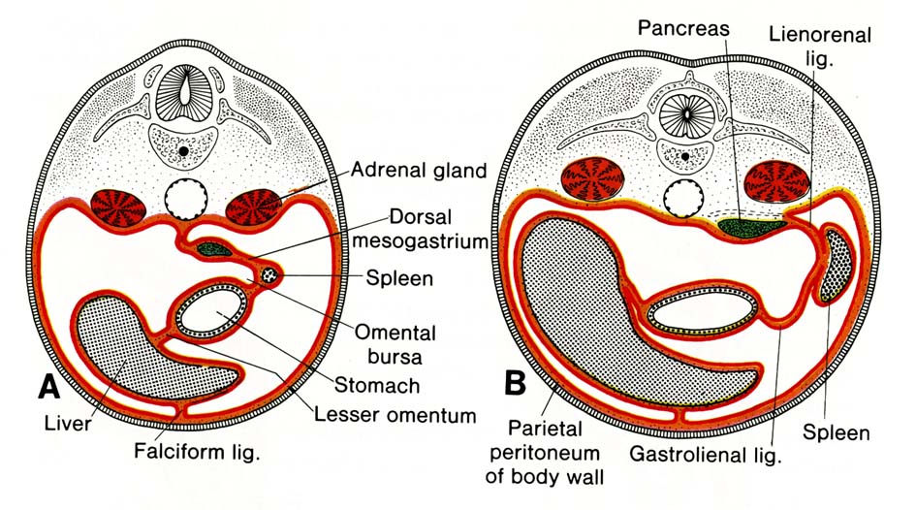
Lien – arises by proliferation of mesoderm cells in dorsal mesogastrium, which is
transformed into lig. gastrolienalis a lig. lienorenalis
Spleen is intraperitoneal organ, its surface coveres mesothelium.

Slide 27
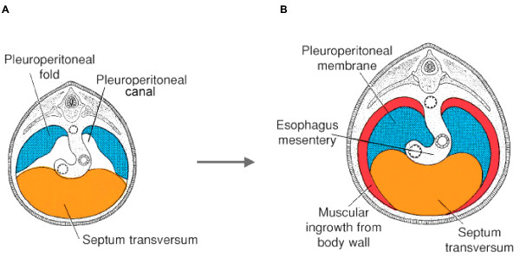
Development of diaphragm
W eek 5 month 4
The diaphragm originates from:
septum transversum (mesoderm mass),
plicae pleuroperitoneales,
mesooesophageum dorsale,
dorzolateral wall of the body tělní.

