Slide 1

Digestive system 1
Oral cavity:
Lips
Tongue
Palate – soft
- hard
Tooth

Slide 2
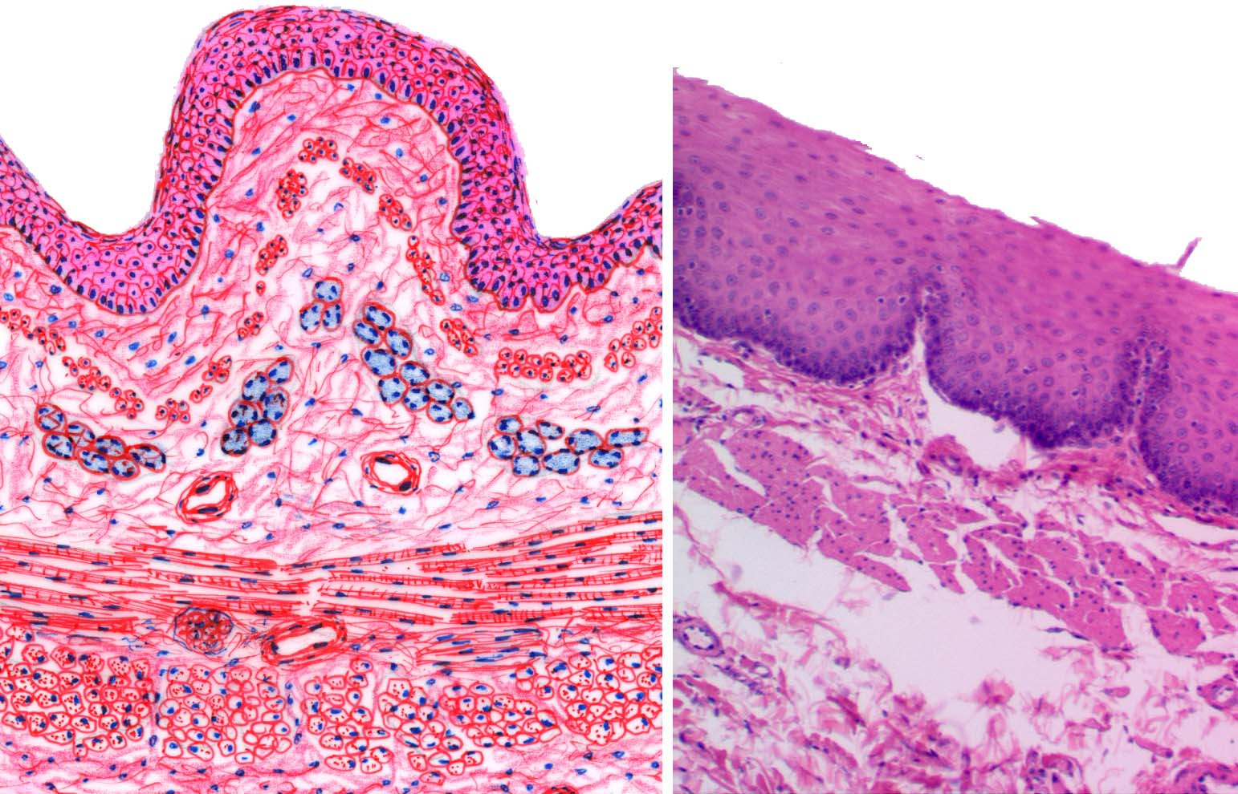
Common structure of the wall of GIT tube
The mucosa
  epithelial linning
  lamina propria
  /loose connect. tissue/
  the muscularis mucosae
The submucosa
/loose connect. tissue + Meissner´s nerve plexus/
The muscularis
  circular
    myenteric nerve plexus
  Longitudinal smooth muscle
The serose or adventitia
/loose connect. tissue -/+mesothelium/

Slide 3
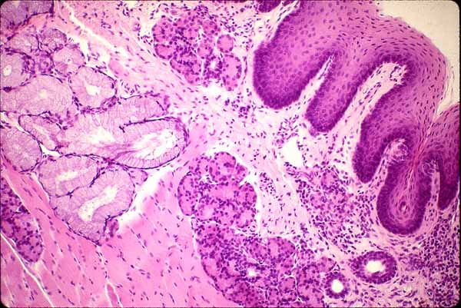
The oral cavity
(the mucosa)
The epithelium
Nonkeratinized
stratified squamous ep.
vrstevnatý
Lamina propria
loose connective tissue
The muscularis mucosae
is missing!!!
Lam. propria → the submucosa (loose connect. tissue) / periost / muscle

Slide 4
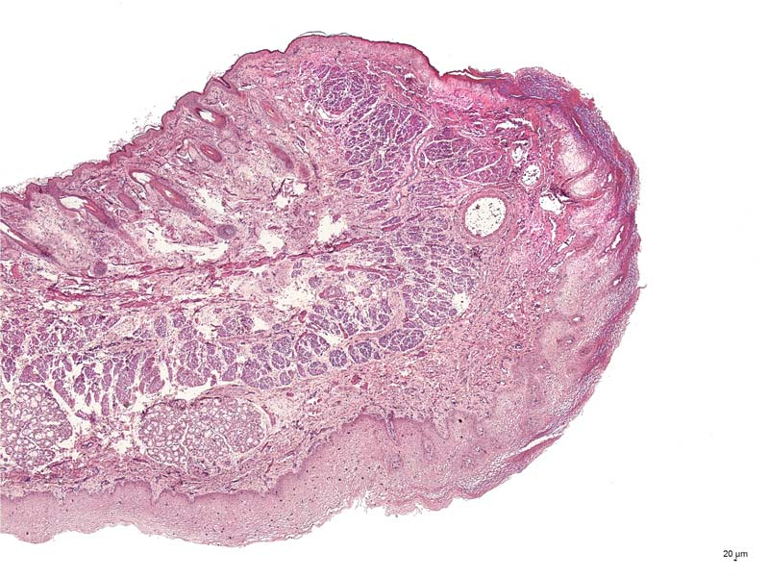
Labium oris
External surface - skin
hair follicles
Transitional
zone (vermilion)
m. orbicularis oris
gll.labiales
Mucous membrane

Slide 5
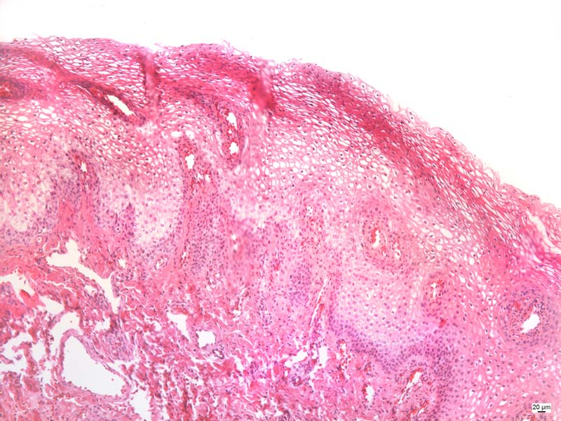
Lips labia
eleidin
The epithelium is somewhat thicker than in other parts of the facial skin. C.t. papilla extend deep into the epithelium and are heavily vascularized. It is the proximity of these vessels to the surface of the epithelium which gives the prolabium it's red appearance.

Slide 6
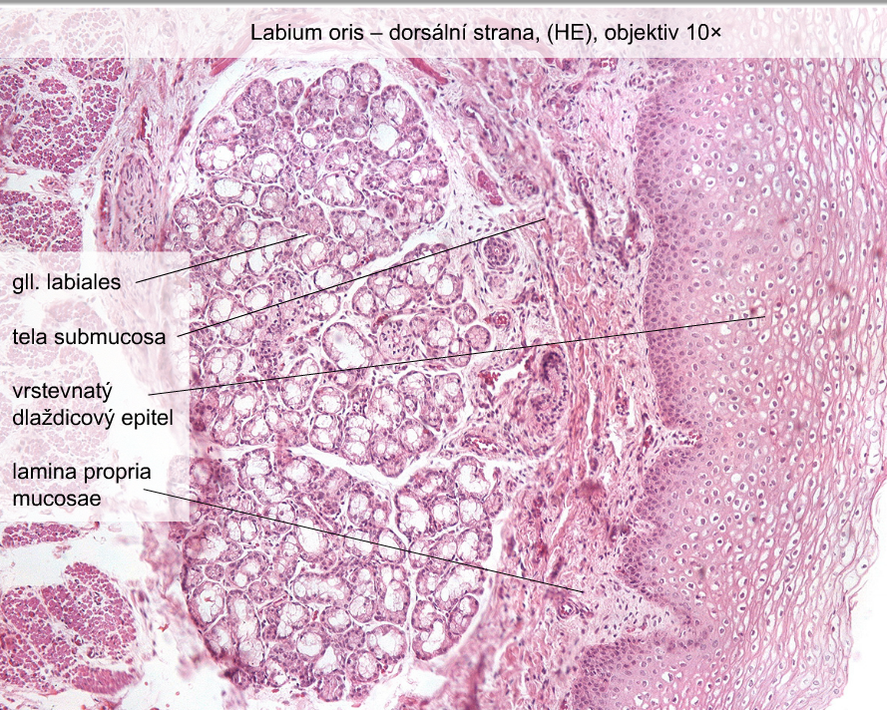
inner surface
the
stratified squamous
epithelium

Slide 7
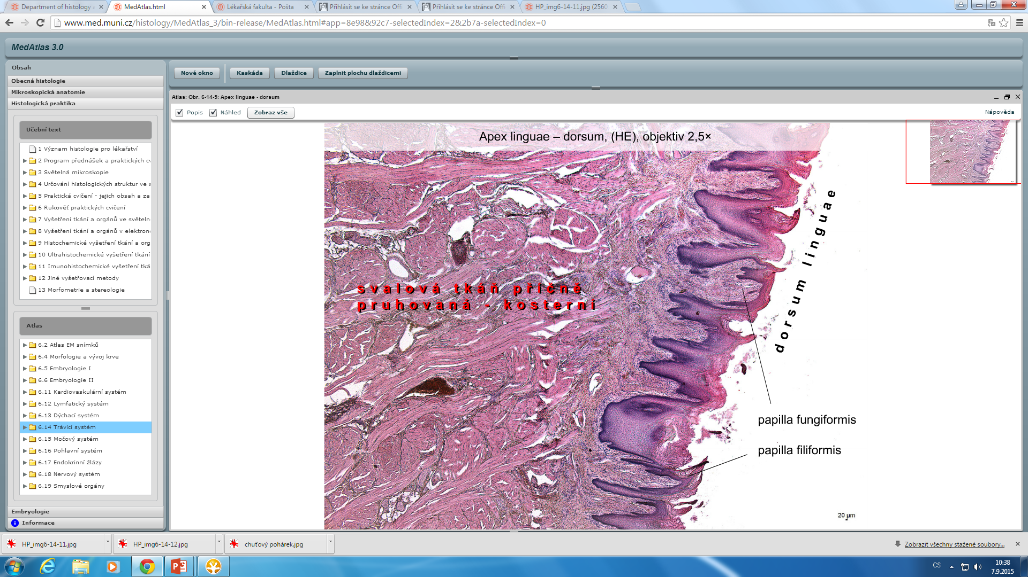
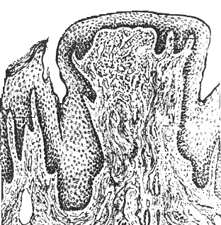
Tongue
- dorsal surface
  The mucosa – filiform, fungiform, circumvallatae, foliatae pap.
  (the submucosa is missing! )
  aponeurosis linguae
inferior surface (mylohyoidea)
  The mucosa – without papillae
  the submucosa!
papillae = elevations of the oral epithelium
and lamina propria
slizničního vaziva krytý epitelem jazyka

Slide 8
Apex linguae
dorsum linguae
facies mylohyoidea
gl. apicis linguae - Blandini

Slide 9
skeletal muscle

Slide 10
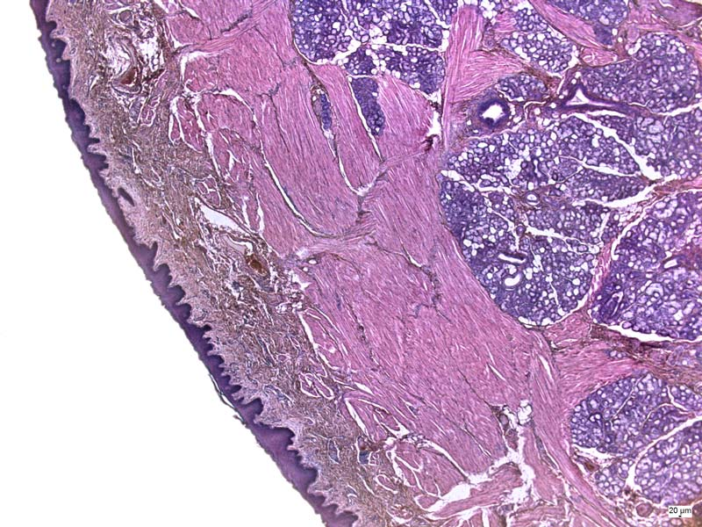
Apex linguae
facies mylohyoidea
gl. apicis linguae - Blandini

Slide 11
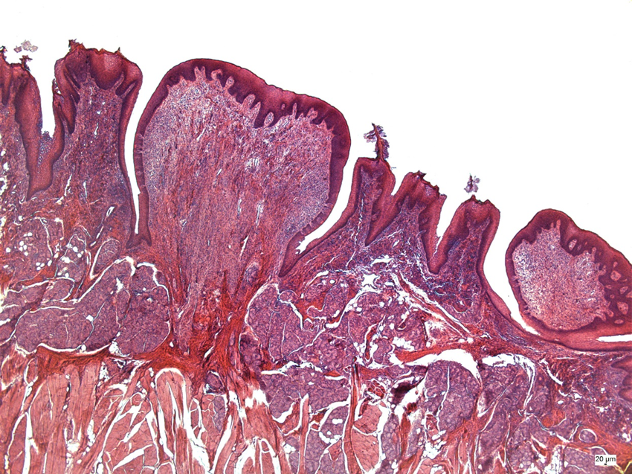
Circumvallatea Papillae
The epithelial linning – strat.squam.ep.
+ taste buds
Lamina propria
– loose connect. tissue
+Serous (von Ebner) glands- drain into deep grooves

Slide 12
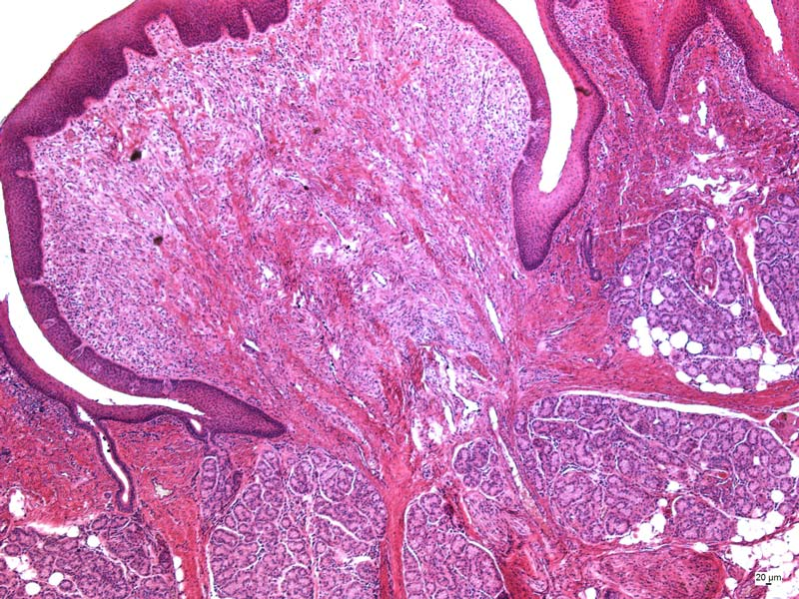
Circumvallate papilla (HE)
Taste bud
groove
Gland duct
gll. gustatoriae (Ebneri)

Slide 13
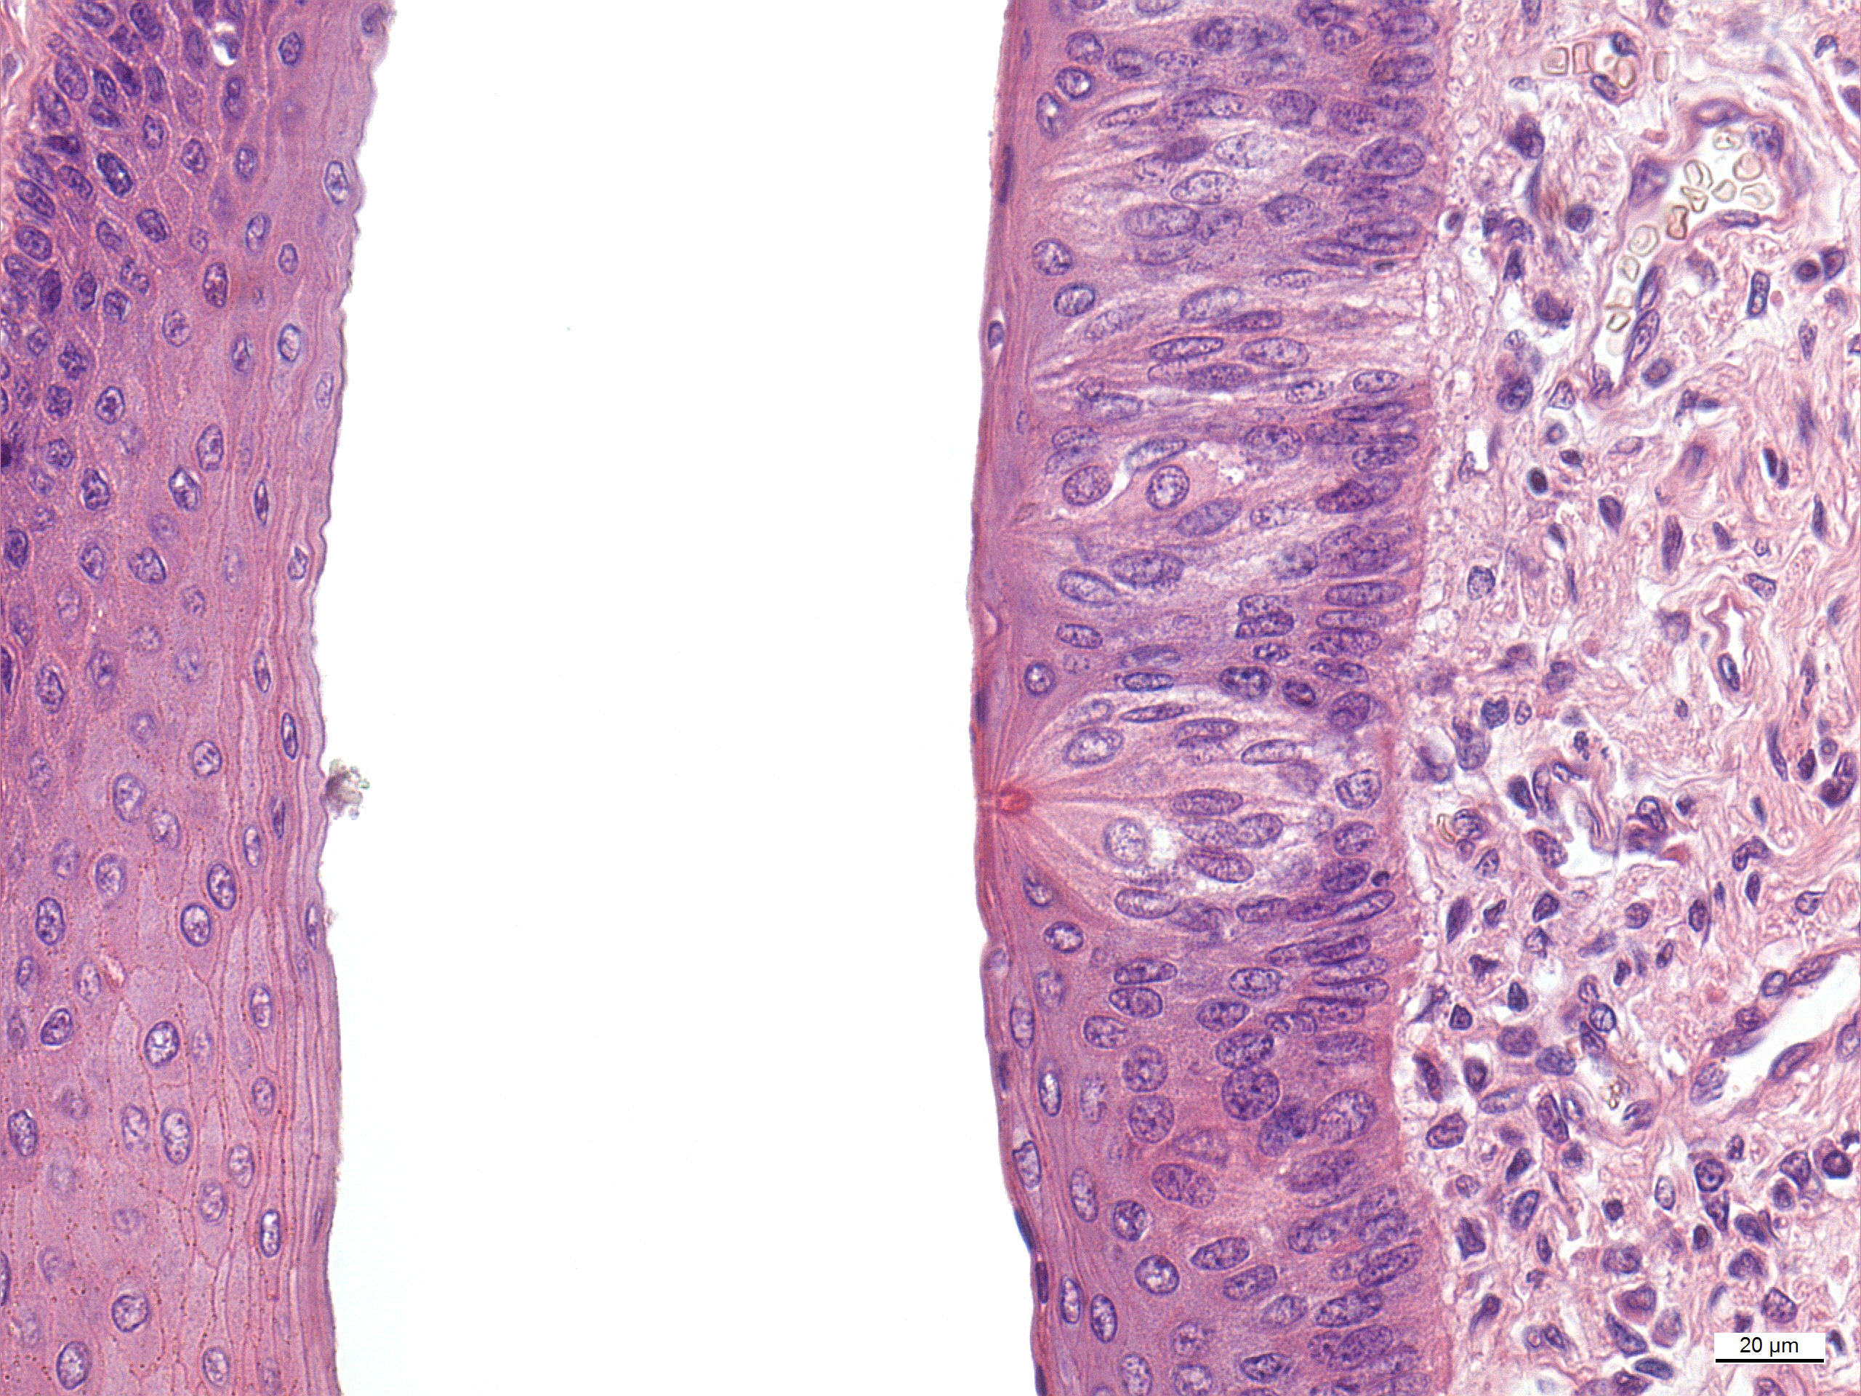
Taste bud
Circular groove

Slide 14
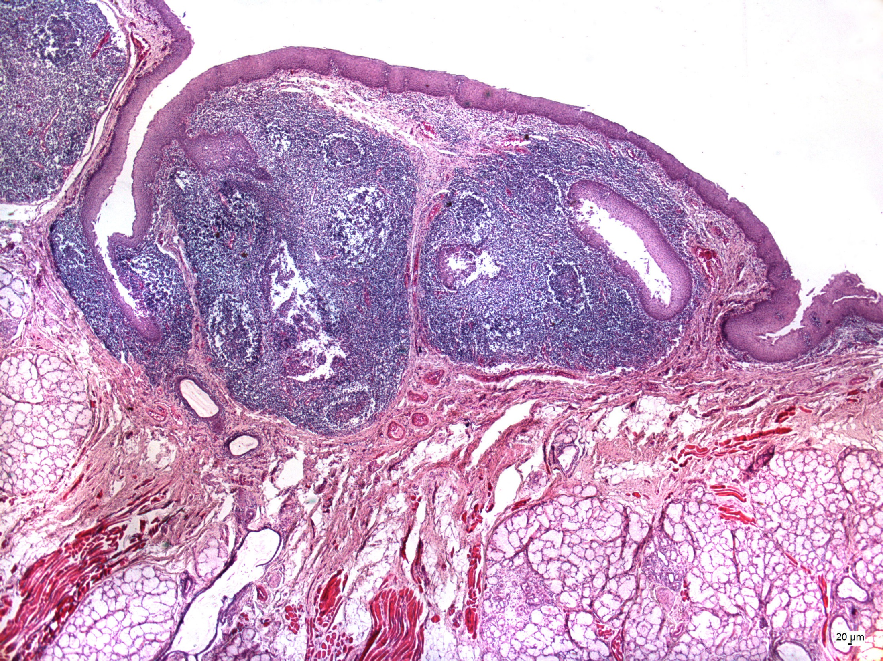
crypt
The lingual tonsil
Lymphoid nodule
Stratified squam.ep
Mucous (Weber´s) gland

Slide 15
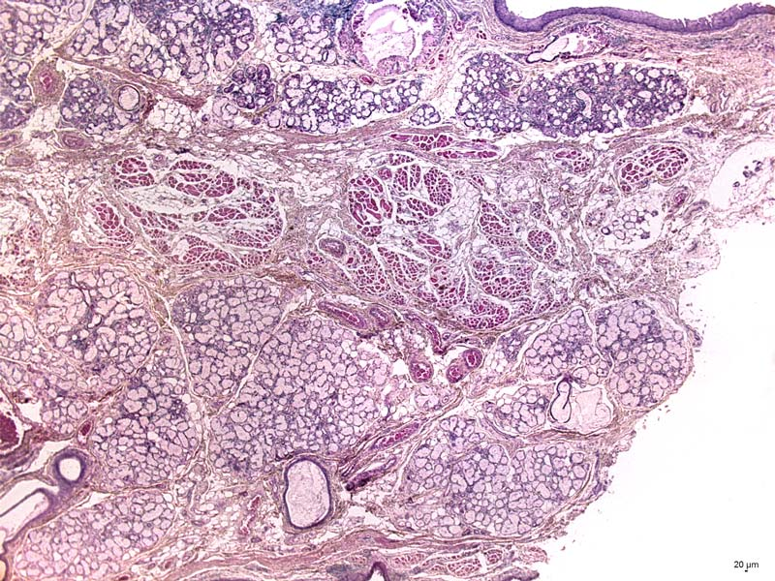
Soft palate
Nasal surface
Mixed gl. - gll.nasales
aponeurosis palatina-
Skeletal muscle+connect. tissue
Mucous glands - gll. palatinae,
Oral surface

Slide 16
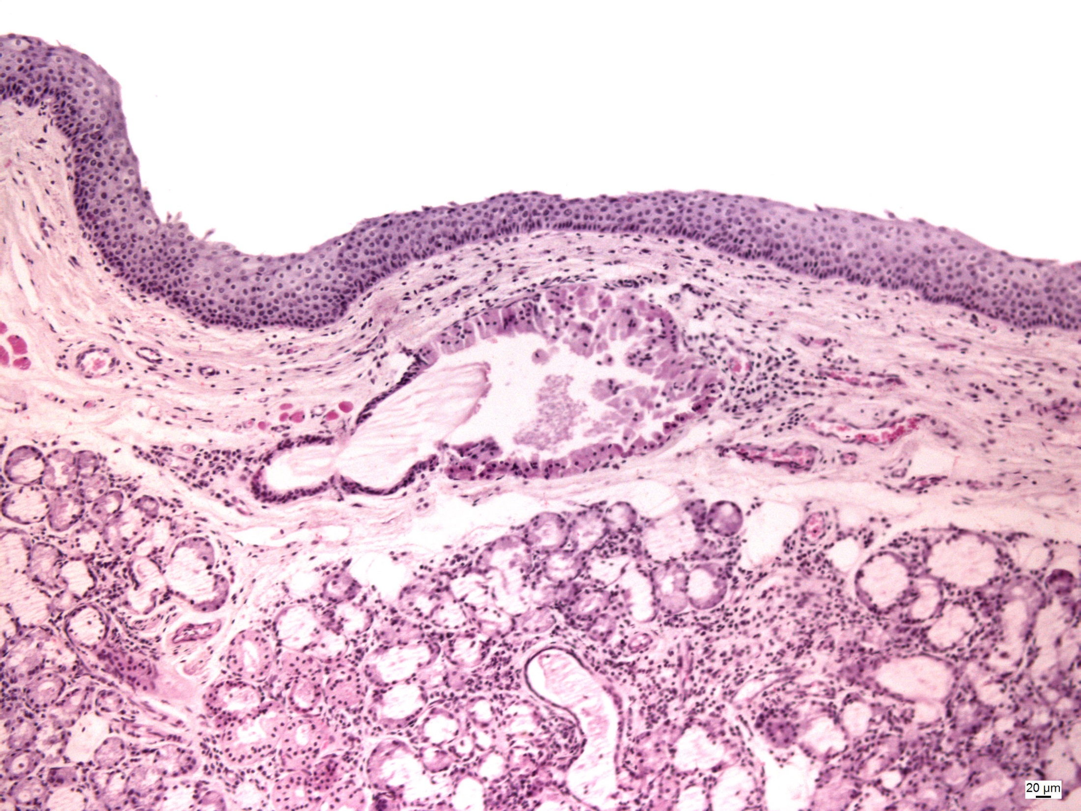
Nasal surface
-ciliated pseudostratif. columnar ep.(metaplasia)
gll. nasales (mixed gl.)
stratified squam. ep.
duct

Slide 17
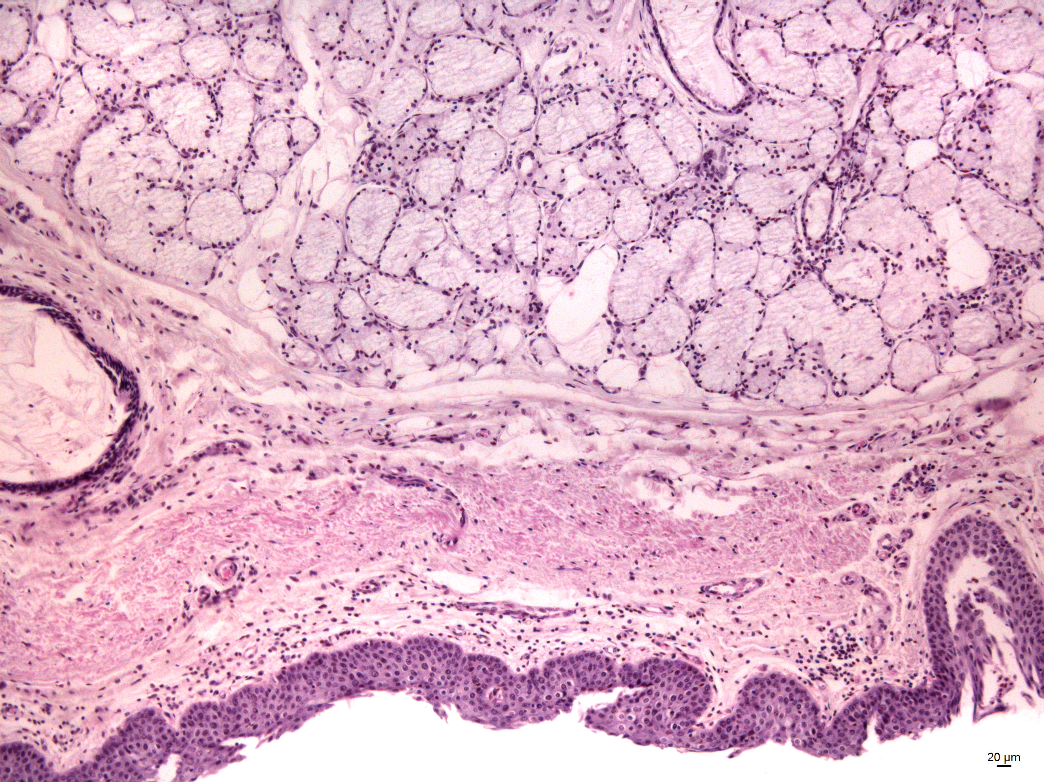
Oral surface
-stratified squamous epithelium
-gll. palatinae (MUCOUS gl.))
vývod

Slide 18
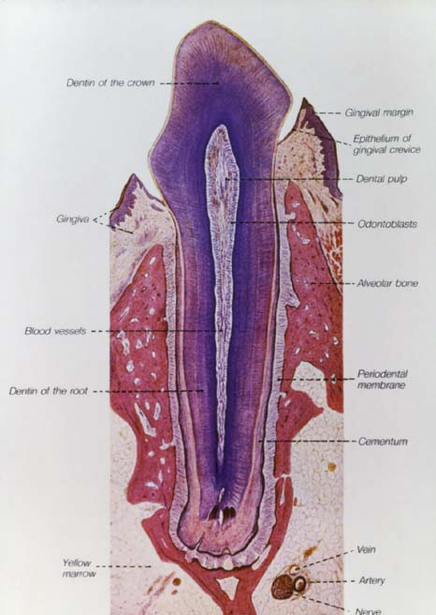
Tooth
(dens)
Deciduous
(baby) teeth- 20
Permanent teeth
– 28-32
Anatomy
Corona dentis (crown)
Collum (neck)
Radix (root)
Cavum et canalis radicis dentis (pulp cavity)
Pulpa dentis
Apex radicis dentis
+ foramen apicis radicis dentis
(apical foramen)
Alveoli
Periodontal ligament (membrane)
dense connective tissue fibers
radix (root)

Slide 19
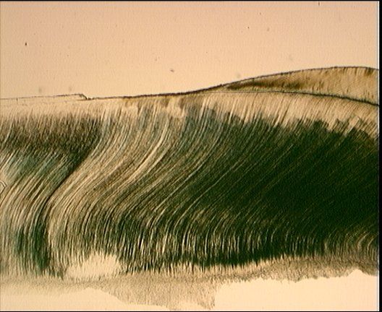
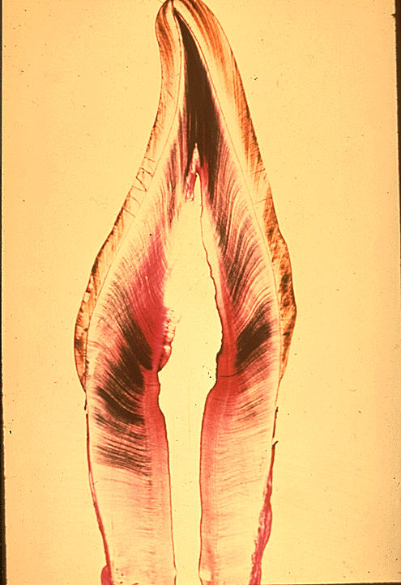
Tooth
ROOT ---------------------------------------------------CROWN
cementum enamel!!!!
dentin
dentinal tubules with odontoblast processes(Tomes´fibers)

Slide 20
Tooth – (HE) 5x
odontoblasts

Slide 21
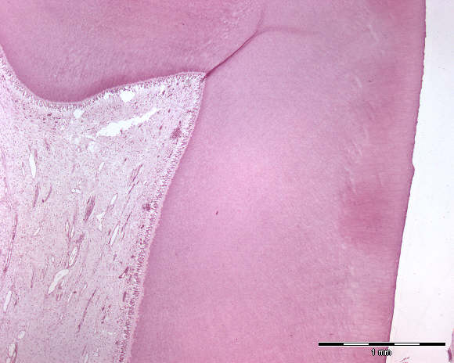
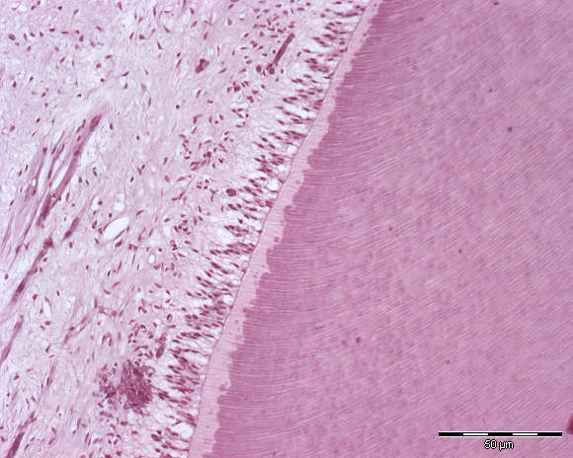
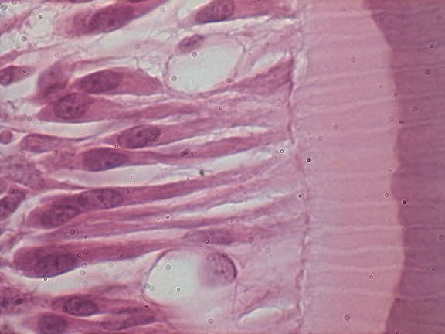
Enamel is missing!!!
predentin – unmineralized dentin
with nerve fibers
pulpa s odontoblasty
Dentinal tubules with odontoblast processes(Tomes´ fibers)

Slide 22
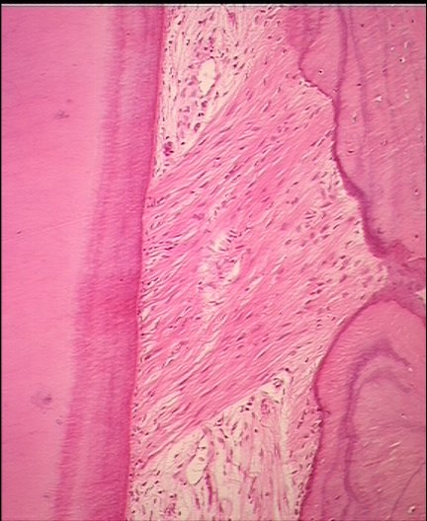
K
O
S
T
D
E
N
T
I
N
P
E
R
I
D
O
N
T
I
U
M
C
E
M
E
N
T
Periodontal ligament – dense connective tissue
Alevolar bone – woven bone
Gingiva connective tissue papillae+stratif.squamous ep.
Epithelial attachment of Gottlieb

Slide 23
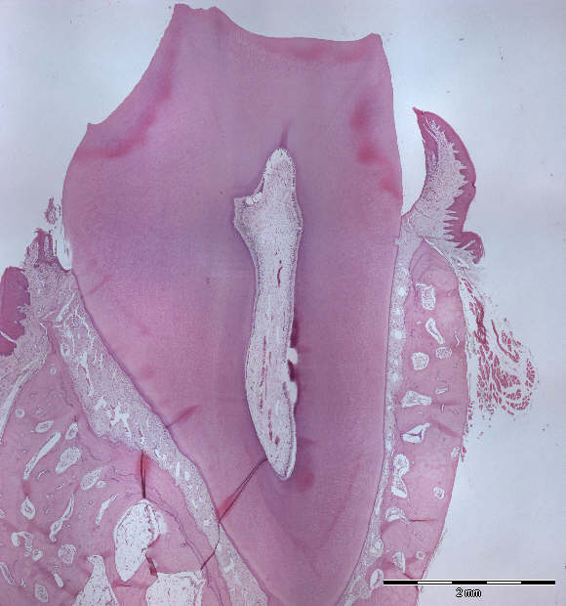
Sulcus gingivalis
Gingiva libera
Gingiva affixa
Epithelial attachment of Gottlieb
= epith. of gingiva is bound to the tooth enamel
GINGIVA
- Stratified squamous epith.
- Connective tissue papillae
NO!!! Tunica submucosa

Slide 24

1.
Digestive system – I
Slides :
1. Labium oris (HE)
2. Apex linguae (HE)
3. Papilla circumvallata(HE)
4. Tonsilla lingualis (HE)
5. Palatum molle(HE)
7. Tooth (HE)

Slide 25
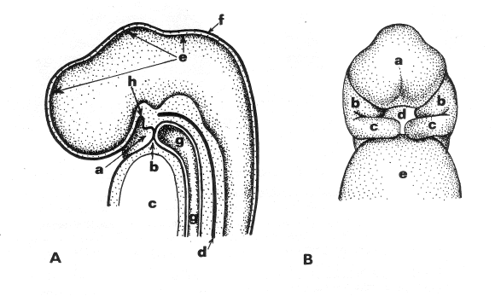
Development of the face, stomodeum and cervical region – embryo, day 24
body
ectoderm
proc.
frontonasalis
Rathke‘s
pouch
brain
proc. maxillaris
proc. mandibularis
stomodeum
stomodeum
pharyngeal
membrane
cardiac
bulge
perikardiac
cavity
A – sagital section
forgut chorda
dorsalis
B – frontal view

Slide 26
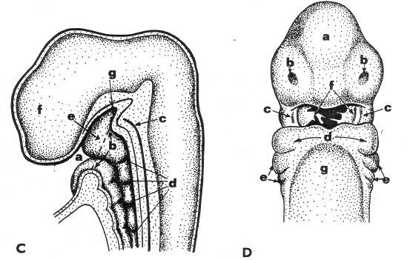
Development of the face, stomodeum and cervical region – embryo, day 28
proc. nasalis
med. + lat.
pharyngeal membrane (perforated)
proc.
frontalis
Rathke‘s
pouch
nasal
placode
proc. maxillaris
proc. mandibularis
chorda
dorsalis
1st– 4th
endodermal
pouch
2nd and 3rd
branchial arch
pharynx

Slide 27
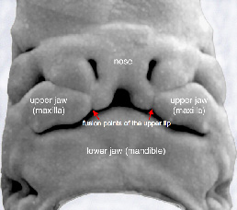
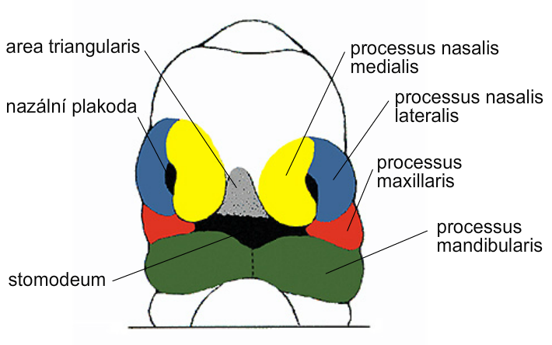
Development of the face – embryo , end of week 5
nasal placode

Slide 28
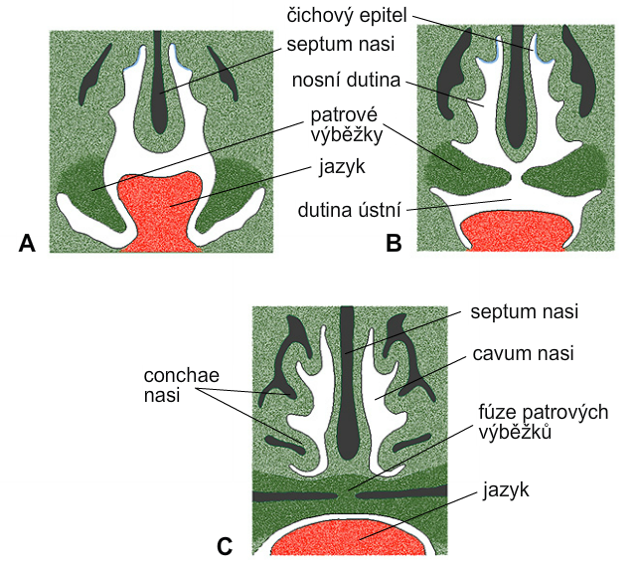
Development of palate – embryo, A – week 7, B – week 8, C – week 10
sensory epithelium
septum nasi
nasal cavity
palatine processes
tongue
oral cavity
palatine processes
fusion
tongue

Slide 29
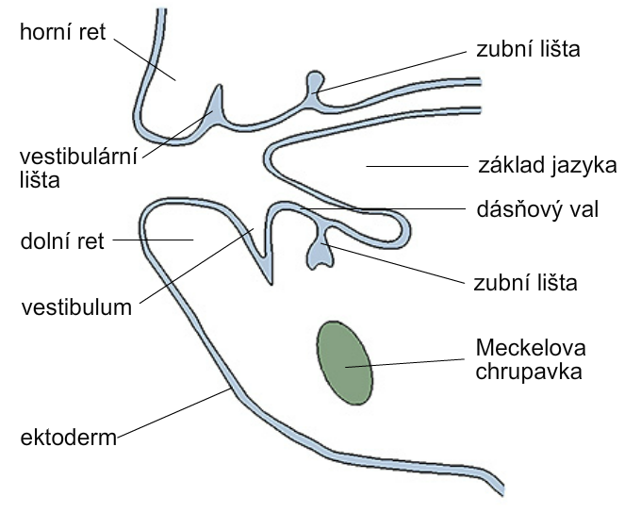
Development of the oral cavity – embryo, week 6
upper lip
dental lamina
+ tooth bud
vestibular
band
base of tongue
lower lip
dental lamina
+ tooth cap
cartilago
Meckeli
ectoderm

Slide 30
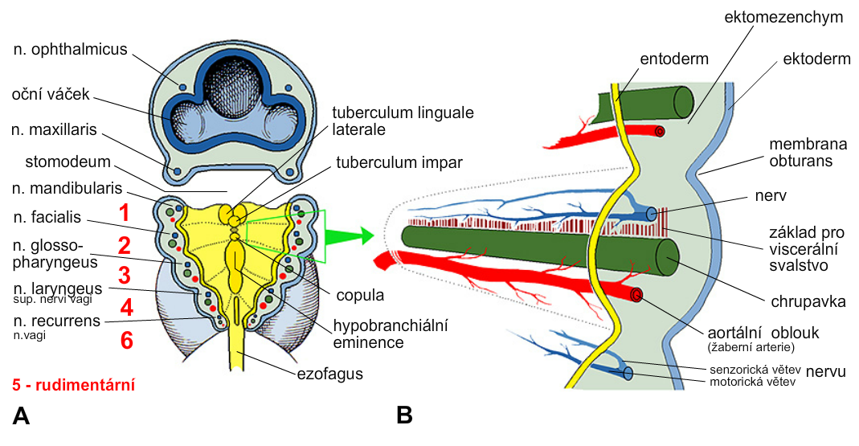
Development of pharyngeal (branchial) apparatus – embryo, week 6
ectomesenchyme
endoderm
ectoderm
nerve
base of
visceral
muscles
cartilage
eminencia
  hypobranchialis
aortic arch
(branchial artery)
oesophagus
sensitive and motor
branches of nerve
pharyngeal (branchial) arches

Slide 31
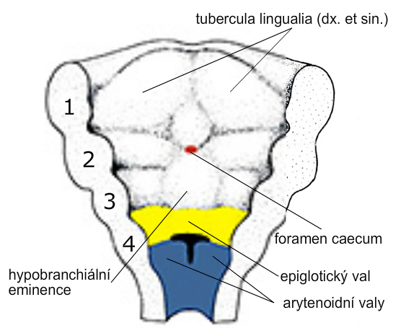
Development of tongue
sulcus terminalis
laryngotracheal diverticle (developoment of respiratory system)
thyroid gland
eminencia
  hypobranchialis
epiglotic swelling
arytenoid swelling

Slide 32
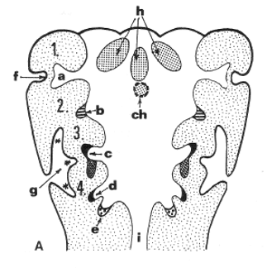
ECTODERMAL CLEFTS and ENDODERMAL POUCHES – embryo, week 5
pharyngeal
arches 1-4
1. membrana obturans
⇨ membrana tympani
meatus acusticus ext.
(cleft 1)
cavum tympani, tuba
auditiva (Eustachii)
sinus (fossa) tonsillaris
gl. parathyreoidea inf.
thymus
gl. parathyreoidea sup.
ultimobranchial corpuscle
sinus cervicalis
(clefts 2, 3, 4)

Slide 33
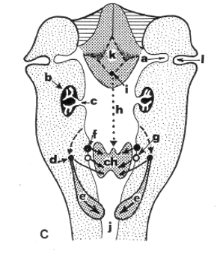
Descensus of thyroid gland and thymus with gll. parathyreoideae inf. – embryo, week 6
tongue (k),
foramen caecum (i),
ductus thyreoglossus (h),
gl. thyreoidea(ch),
thymus (e),
gll. parathyreoideae inf. (d),
gll. parathyreoideae sup.(f),
ultimobranchial corpuscle (g)

Slide 34
Embryology
Development of the tooth

Slide 35
Development of the oral cavity – embryo, week 6
upper lip
dental lamina
+ tooth bud
vestibular
band
base of tongue
lower lip
dental lamina
+ tooth cap
cartilago
Meckeli
ectoderm

Slide 36
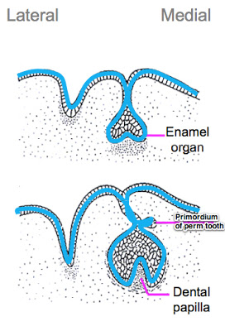
labium vestibulum dentogingival lamina
primary
dental lamina
organ
of enamel
permanent tooth
deciduous tooth
dental papilla

Slide 37
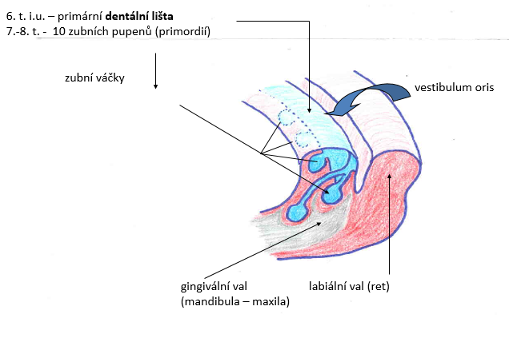
dentogingival
lamina
Week 6 – primary dental lamina
Week 7-8 – 10 tooth buds (primordia)
deciduous dentition
permanent dentition
mandibula or maxilla labial lamina

Slide 38
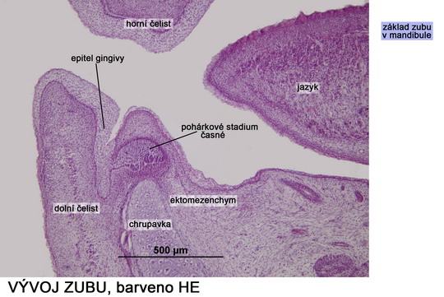

Slide 39
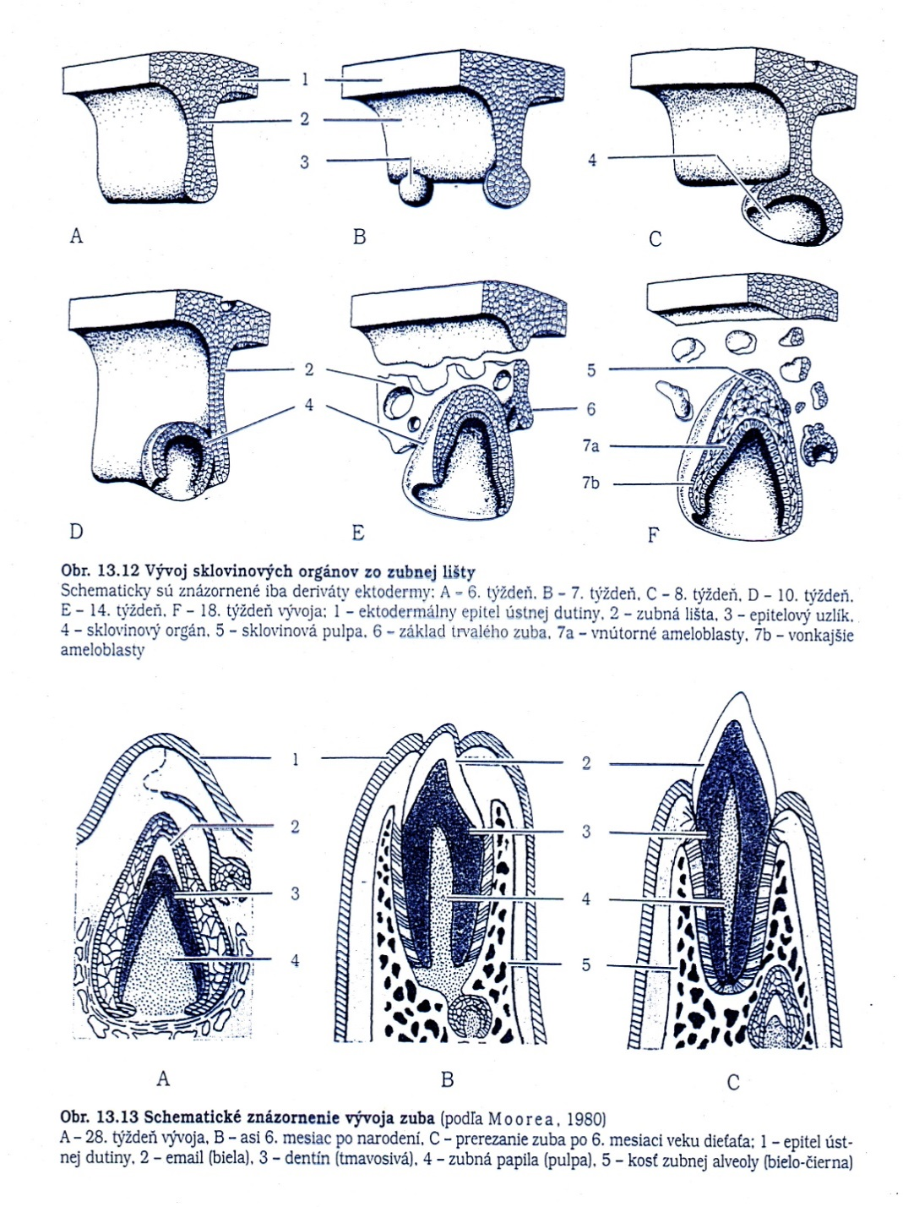
Developmental stages of tooth
1
2
primary dental lamina
stage of dental bud (primordium)
stage of dental cap
stage of dental bell
stage of apposition
stage of eruption
3
4
5

