Slide 1
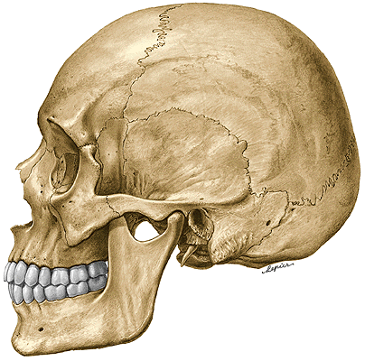
SKULL (cranium)
Neurocranium - the container for the brain and sensory organs
II. Splanchnocranium (viscerocranium=facial skeleton) - contains the initial portions of the digestive and respiratory tracts and substructure for the face

Slide 2
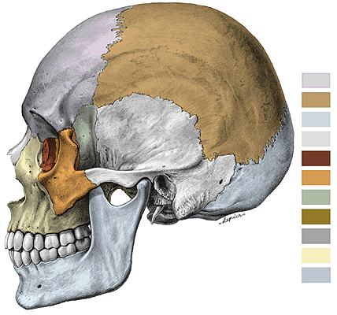
Skull (cranium)
Neurocranium consists of:
Calva (vault=brain case) and basis cranii
os frontale (frontal bone)
ossa parietalia (parietal bones)
os occipitale (occipital bone)
os sphenoidale (sphenoid bone)
ossa temporalia (temporal bones)
os ethmoidale (ethmoid bone)

Slide 3
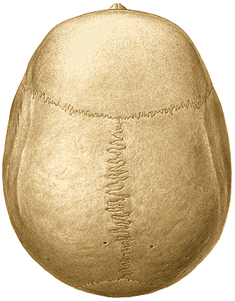

Slide 4
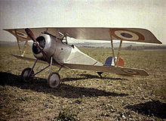
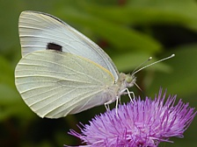
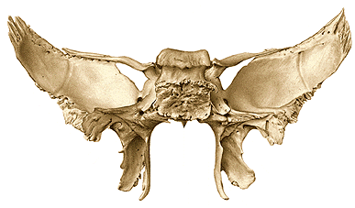
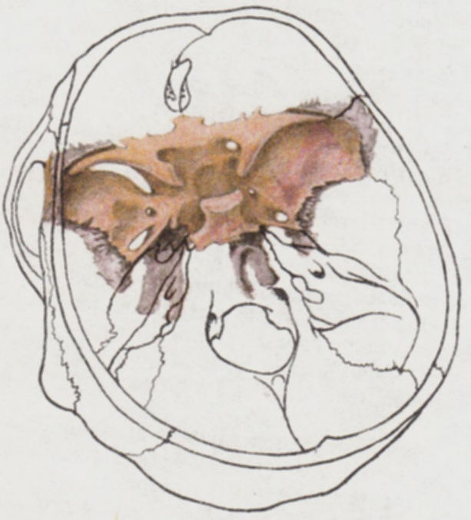
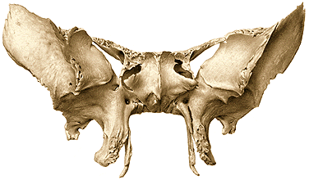
Os sphenoidale (Sphenoid bone)
1. Corpus (Body)
2. Alae minores (Lesser wings)
3. Alae majores (Greater wings)
4. Processus pterygoidei (Pterygoid processes)
D
V
Notes:
4

Slide 5
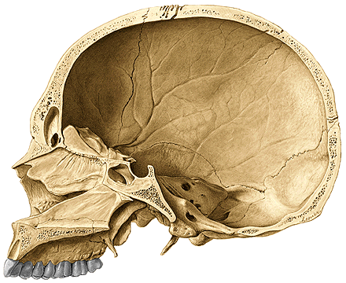
1. Corpus ossis sphenoidalis – ventral and caudal wall
sinus sphenoidalis (sphenoid sinus)
apertura sinus sphenoidalis (opening of sphenoidal sinus)
septum sinuum sphenoidalium (septum of sphenoid sinus)
crista sphenoidalis (sphenoid crest)
rostrum sphenoidale (sphenoid rostrum)

Slide 6

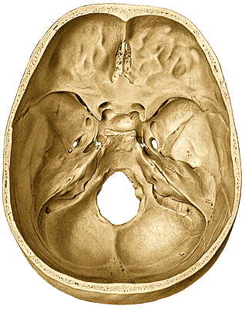
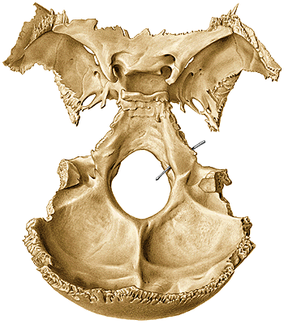
1. Corpus ossis sphenoidalis – upper and dorsal wall
fossa hypophysialis (hypophysial fossa)
sella turcica (turkish saddle)
dorsum sellae
processus clinoidei posteriores
(posterior clinoid processes)
sulcus caroticus (carotid groove)
lingula sphenoidalis (lingula of
the sphenoid bone)
synchondrosis /synostosis/
sphenooccipitalis

Slide 7
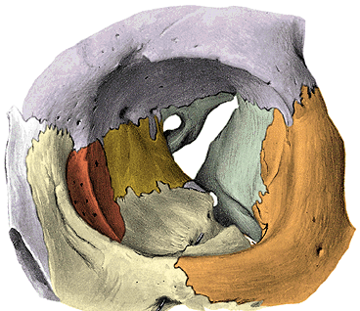
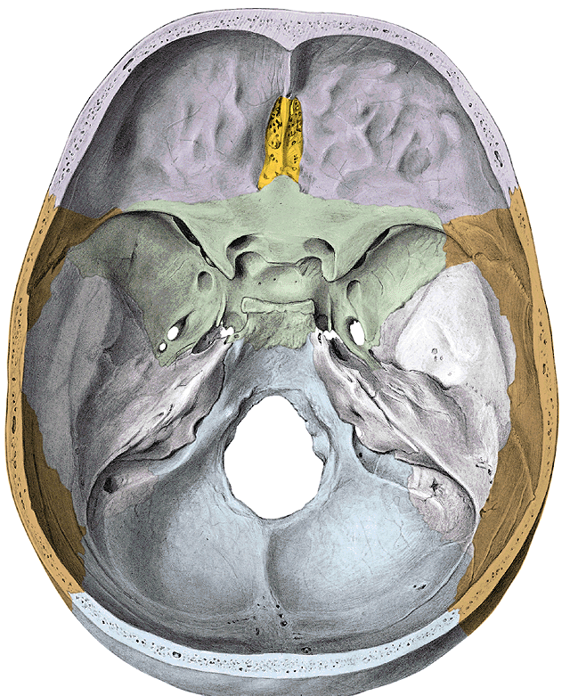
2. Alae minores ossis sphenoidalis (lesser wings)
processus clinoidei anteriores (anterior clinoid process)
(fissura orbitalis superior)
canalis opticus (optic canal)
sulcus praechiasmaticus (prechiasmatic groove)
Notes:
7

Slide 8
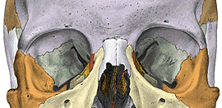
3. Alae majores ossis sphenoidalis (greater wings)
Facies cerebralis, orbitalis, temporalis, infratemporalis, maxillaris
(sphenomaxillaris)

Slide 9
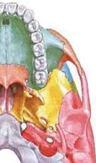
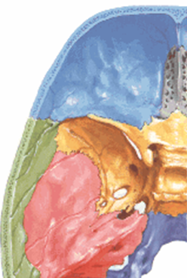
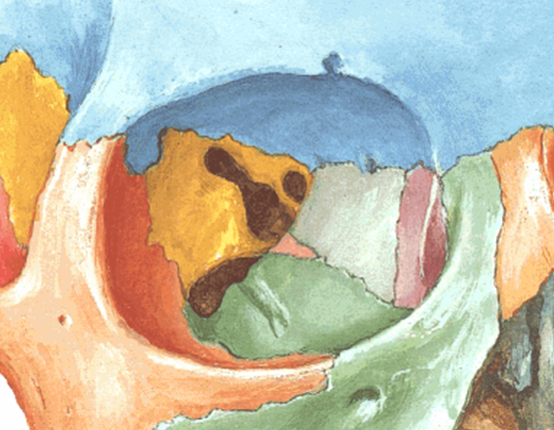
Facies cerebralis
(Cerebral surface)
Facies infratemporalis
Facies orbitalis
Foramen rotundum
Foramen ovale
Foramen spinosum
Fissura sphenopetrosa
Foramen lacerum
(fibrocartilago basilaris)
Fissura orbitalis superior
Fissura orbitalis inferior
Foramen ovale
Foramen spinosum
Spina ossis sphenoidalis
Crista infratemporalis

Slide 10
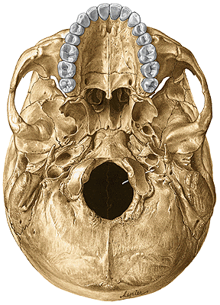
4. Processus pterygoidei
lamina lateralis processus pterygoidei
lamina medialis processus pterygoidei
hamulus pterygoideus
fossa scaphoidea
fossa pterygoidea
incisura pterygoidea (pterygoid notch)
canalis pterygoideus

Slide 11
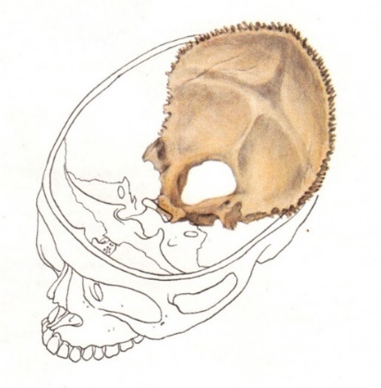
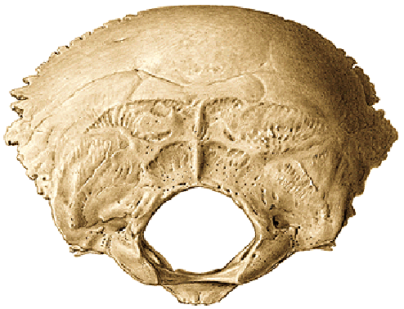
Os occipitale (occipital bone)
1. partes laterales
2. pars basilaris
3. squama occipitalis
1. partes laterales
condyli occipitales
canalis nervi hypoglossi (hypoglossal canal)
fossa condylaris with canalis condylaris
incisura jugularis (jugular notch)
2. pars basilaris
synchondrosis (synostosis) sphenooccipitalis
clivus
tuberculum pharyngeum
fissura petrooccipitalis
foramen magnum

Slide 12
3. Squama occipitalis
external surface:
protuberantia occipitalis externa
crista occipitalis externa
linea nuchae suprema (highest nuchal line)
linea nuchae superior
linea nuchae inferior
planum nuchale (nuchal area - surface)

Slide 13
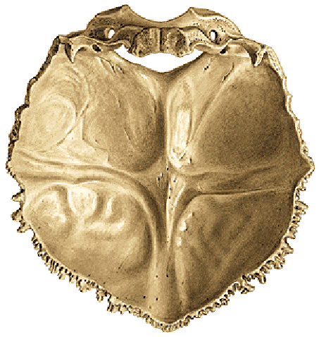
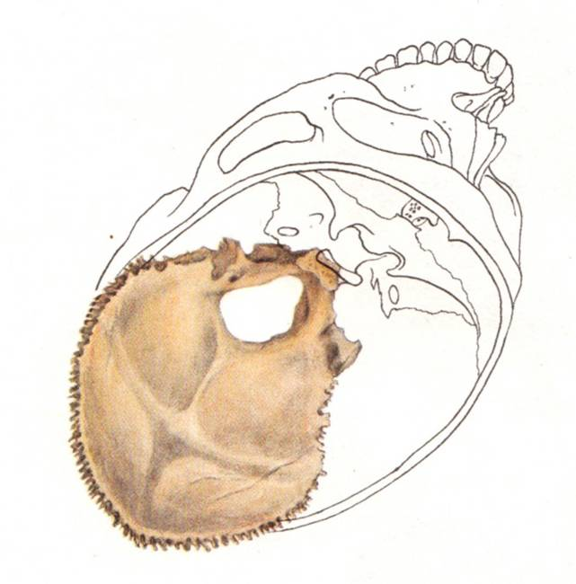
Endocranial surface of squama occipitalis:
protuberantia occipitalis interna
crista occipitalis interna
eminentia cruciformis (cruciate eminence)
sulcus sinus sagittalis superioris
(groove for superior sagittal sinus)
sulcus sinus transversi
sulcus sinus sigmoidei
fossae cerebrales
fossae cerebellares

Slide 14
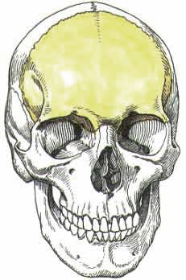
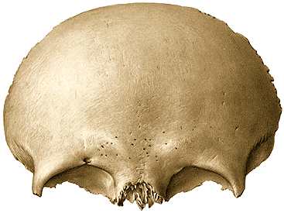
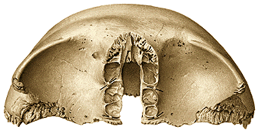
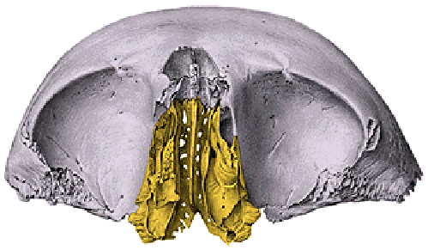
Os frontale
1. squama ossis frontalis
2. partes orbitales
3. pars nasalis
Ad 1. Squama ossis frontalis
External surface:
sutura coronalis
tuber frontale
glabella
arcus superciliaris (superciliar arch)
margo supraorbitalis
incisura frontalis et supraorbitalis (frontal notch......)
processus zygomaticus
linea temporalis superior (superior temporal line)

Slide 15
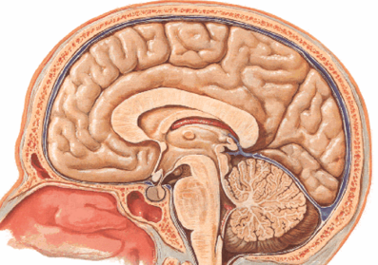
Internal surface of squama frontalis:
crista frontalis
sulcus sinus sagittalis superioris
impressiones digitatae/gyrorum
juga cerebralia
foramen caecum
sulci arteriosi
sinus frontalis
septum sinuum frontalium
apertura sinuum frontalium (aperture of frontal sinus)

Slide 16
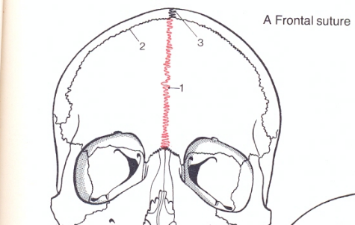
Ad 2. partes orbitales
fossa glandulae lacrimalis
spina trochlearis or fovea trochlearis
foramen ethmoidale anterius et posterius
Ad 3. pars nasalis
incisura ethmoidalis
Variation – sutura metopica

Slide 17
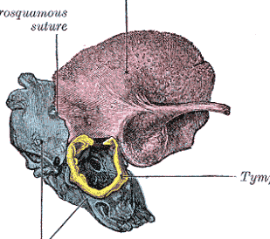
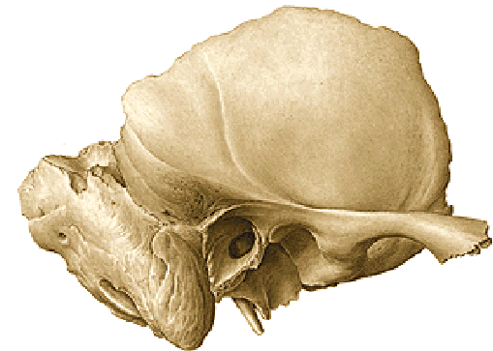
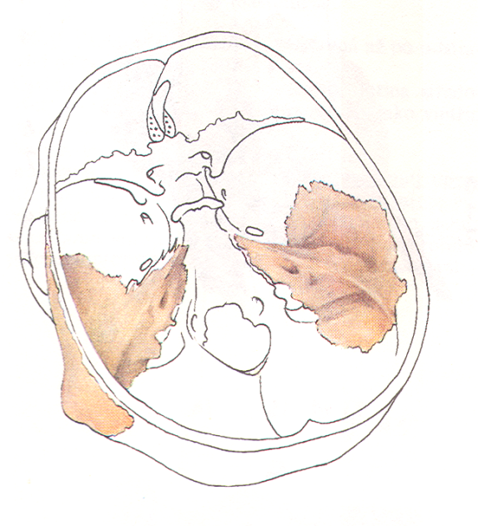
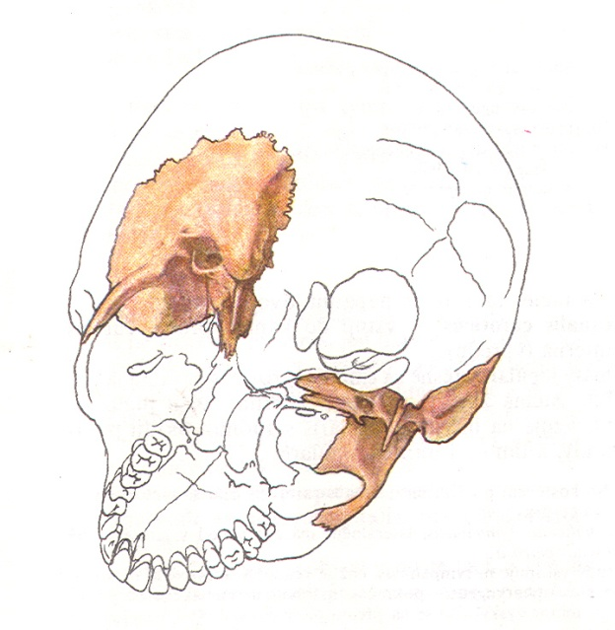
Os temporale (Temporal bone)
1. pars squamosa (squamous part)
2. pars petrosa – pyramis (pyramid)
3. pars mastoidea (mastoid part)
4. pars tympanica (tympanic part)
5. processus styloideus (styloid process)

Slide 18
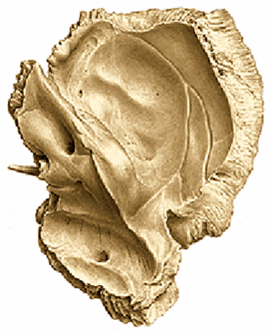
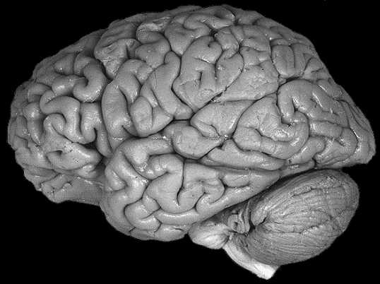
1. Pars squamosa
External surface:
processus zygomaticus
linea temporalis inferior
crista supramastoidea
spina suprameatum
fossa mandibularis
tuberculum articulare
Internal surface:
sulci arteriosi (grooves for arteries)
juga cerebralia
impressiones gyrorum/digitatae

Slide 19
2. Pars petrosa – pyramis (Petrous part – pyramid)
Apex pyramidis, facies anterior, posterior, inferior, ventrobasalis
Foramen lacerum
1. Facies anterior - cerebralis (anterior – cerebral surface)
eminentia arcuata
tegmen tympani
sulcus and hiatus canalis nervi petrosi majoris (groove
and hiatus of canal for greater petrosal nerve)
sulcus and hiatus nervi petrosi minoris (groove and hiatus
for lesser petrosal nerve)
impressio trigemini
apertura interna canalis carotici
canalis musculotubarius
margo superior - crista pyramidis
sulcus sinus petrosi superioris (groove for superior petrosal sinus)

Slide 20
2. facies posterior pyramidis (posterior surface of pyramid)
sulcus sinus petrosi inferioris (groove for inferior petrosal sinus)
porus acusticus internus
(opening of the internal acoustic porus)
meatus acusticus internus
fundus meatus acustici interni
area nervi facialis – introitus (entrance)
to the facial canal
apertura externa aquaeductus vestibuli
(the external opening of the vestibular aqueduct)
incisura jugularis - foramen jugulare
(jugular notch – jugular foramen)
sulcus sinus sigmoidei (groove for sigmoid sinus)

Slide 21
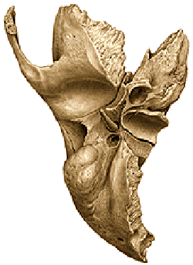
3. facies inferior pyramidis
apertura externa canalis carotici (external aperture of the carotid canal)
fossa jugularis (jugular fossa)

Slide 22
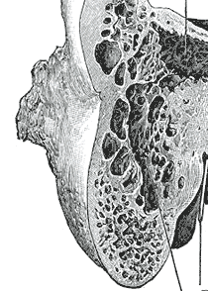
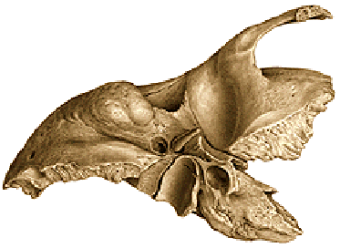
3. pars mastoidea
processus mastoideus (mastoid process)
sulcus sinus sigmoidei (groove for sigmoid sinus)
foramen mastoideum
incisura mastoidea (mastoid notch)
sulcus arteriae occipitalis (groove for the occipital artery)

Slide 23
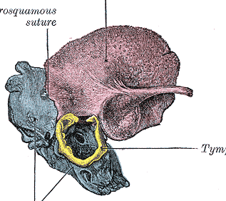
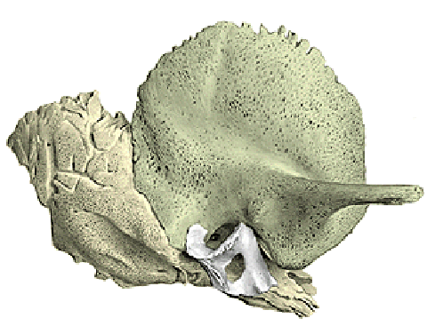
4. pars tympanica
porus acusticus externus (external acoustic porus)
meatus acusticus externus (external acoustic meatus)
fissura tympanomastoidea (tympanomastoid fissure)
fissura petrotympanica (petrotympanic fissure)
sulcus tympanicus (tympanic groove)
incisura tympanica (tympanic notch)
5. processus styloideus
foramen stylomastoideum

Slide 24
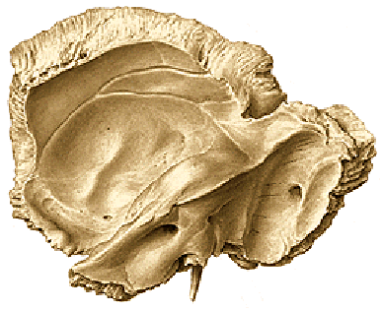
Canals of temporal bone
1. canalis caroticus
1a canaliculi caroticotympanici
2. canalis nervi facialis
3. canalis musculotubarius
4. canaliculus chordae tympani
5. canaliculus tympanicus
6. canaliculus cochleae
7. canaliculus vestibuli
8. canaliculus mastoideus
1
Canalis nervi facialis
3
2

Slide 25
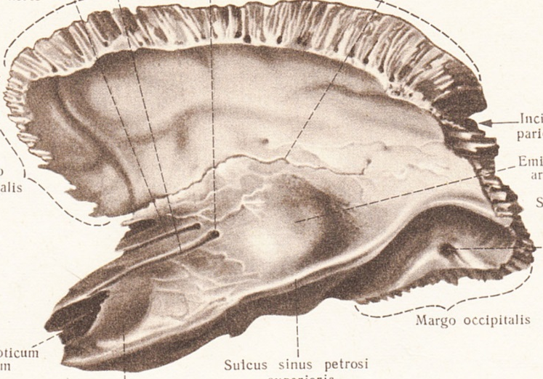
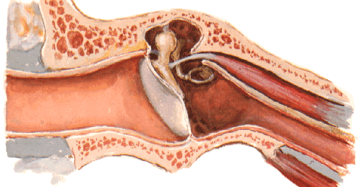
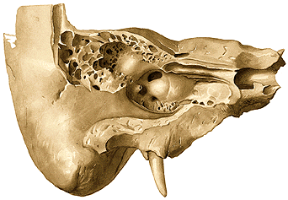
Canalis musculotubarius
consists of:
semicanalis musculi tensoris tympani
semicanalis tubae auditivae (semicanal
of auditory tube)

Slide 26
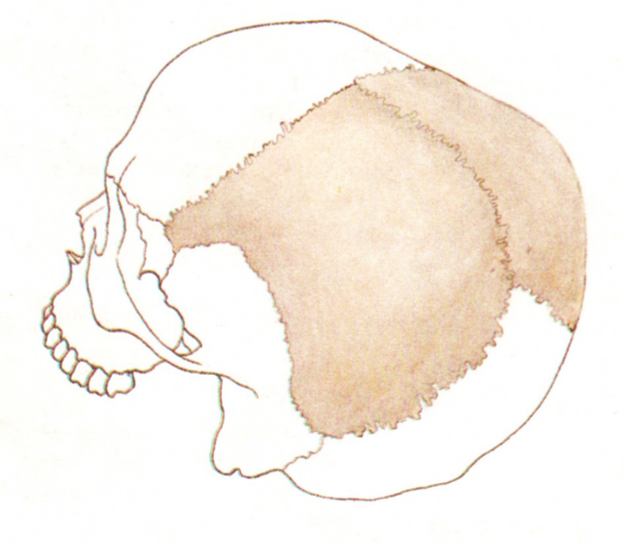
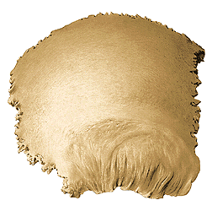
Ossa parietalia
sutura coronalis
sutura sagittalis
sutura lambdoidea
suturae squamosae
External surface:
tuber parietale (parietal eminence)
linea temporalis superior
linea temporalis inferior
foramina parietalia

Slide 27
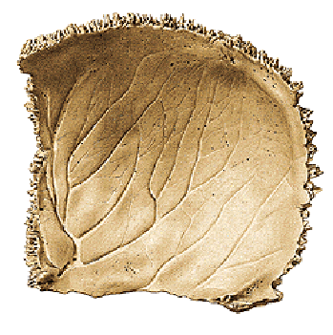
angulus frontalis, sphenoidalis, occipitalis, mastoideus
Internal surface:
sulci arteriae meningeae mediae
sulcus sinus sagittalis superioris
foveolae granulares

Slide 28
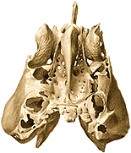
Os ethmoidale (Ethmoid bone)
1. Lamina cribrosa (Cribriform plate)
2. Lamina perpendicularis (Perpendicular plate)
3. Labyrinthus ethmoidalis (Labyrinth of ethmoid bone)
1. Lamina cribrosa ossis ethmoidalis (Cribriform plate of ethmoid bone)
2. Lamina perpendicularis (Perpendicular plate of ethmoid bone) - crista galli

Slide 29
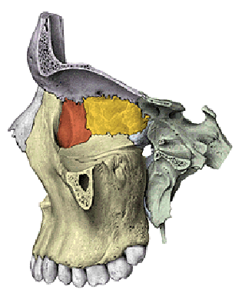
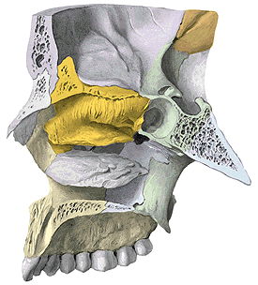
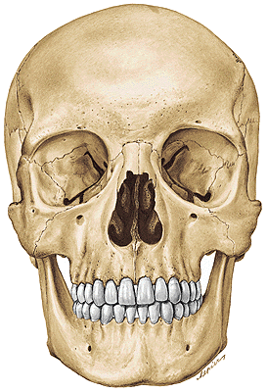
3. Labyrinthus ethmoidalis (Labyrinth of ethmoidal bone)
Cellulae ethmoidales (anterior and posterior)
Lamina orbitalis
Foramen ethmoidale anterius et posterius
(Anterior and posterior ethmoidal foramen)
Concha nasalis superior at media
(Superior and medial nasal conchae) (turbinate bones)
Processus uncinatus (Uncinate process)
Bulla ethmoidalis

Slide 30
Used pictures come from:
Čihák, R. (1987): Anatomie 1. Avicenum, Zdravotnické
nakladatelství.
Putz, R. (2008):
Atlas of Human Anatomy Sobotta. Elsevier Books.
Keith L. Moore, Arthur F. Dalley (2005):
Clinically Oriented Anatomy. Williams and Wilkins.
Platzer, W., Kahle, W., Leonhardt H. (1992):
Locomotor system. Georg Thieme Verlag, Stuttgart,
New York, 4th edition.

