Slide 1
Celebrity Injuries
Latin Tutorium 10.11.2017

Slide 2
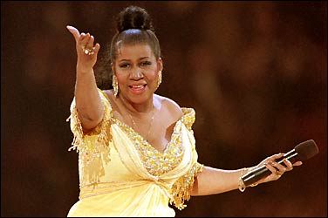
Aretha Franklin Breaks Toe over Jimmy Choos
The 69 year-old Queen of Soul broke her toe tripping over her Jimmy Choo shoes, according to People magazine. Franklin’s tour bus stopped at Community North Hospital in Indianapolis, where X-rays revealed a fracture in her left big toe. According to her rep, Franklin said: „It hurt like heck for a minute, but seemed to subside. I’m so grateful it wasn’t my right piano [pedal] foot.“

Slide 3
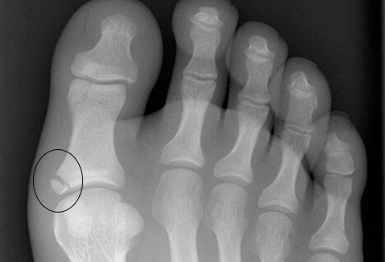
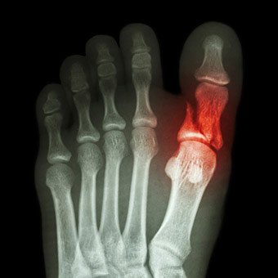
a fracture in her left big toe – fractura halucis sinistri/pedis sinistri
A survey conducted by the American Podiatric Medical Association showed some 42% of women admitted they’d wear a shoe they liked even if it gave them discomfort; 73% admitted already having a shoe-related foot issue

Slide 4
Avicii Hospitalized, to Undergo Gall Bladder Surgery
“Wake Me Up” superstar DJ Avicii is waking up in a Miami hospital.
Avicii (born Tim Bergling) had to make a last minute cancellation of a Miami concert when he developed severe abdominal pain. He was taken to the hospital where he was diagnosed as having a “blocked gallbladder.” Although he was discharged from the hospital, the pain returned and he was re-hospitalized.

Slide 5
Gall Bladder Surgery – Therapia chirurgica vesicae felleae
Abdominal Pain – Dolor abdominalis/abdominis
The most common cause of acute pancreatitis is the presence of gallstones that cause inflammation in the pancreas as they pass through the common bile duct. Heavy alcohol use is also a common cause. Acute pancreatitis can occur within hours or as long as 2 days after consuming alcohol.

Slide 7
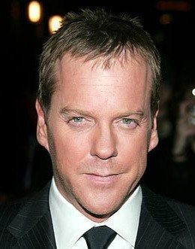
“24″ Production Stopped- Kiefer Sutherland Undergoes Surgery
Production on the hit Fox series 24 has stopped because its star, Kiefer Sutherland, will undergo minor surgery. The procedure is said to be “related to a ruptured cyst near his kidney.” The rupture had occurred earlier in the week while he was working on the set, however production was able to continue without him until Friday.

Slide 8
ruptured cyst near his kidney – ruptura cystis (is/eos, f.) prope renem
A cyst is a closed pocket or pouch of tissue that can form anywhere in the body. Cysts can be filled with air or fluid although kidney cysts usually contain fluid. They can vary greatly in size, from barely visible to as large as the kidney itself. The simple kidney cyst is different from the cysts that develop when a person has polycystic kidney disease, which is a genetic disease. Although its cause is not fully understood, the simple cyst is not an inherited condition. Simple kidney cysts become more common as people age. Nearly 30 percent of people over the age of 70 have at least one simple kidney cyst.

Slide 9
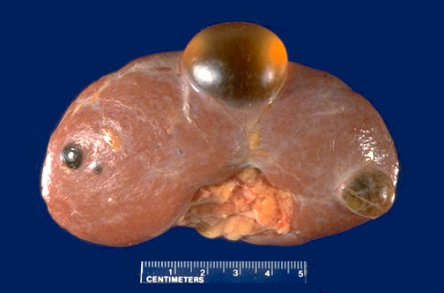
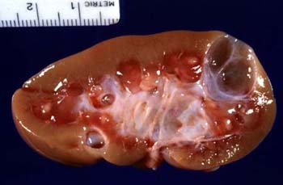

Slide 10
More Medical Woes for Zsa Zsa
In July 2010, we reported that actress Zsa Zsa Gabor was hospitalized after a hip fracture. A month later, she was rehospitalized with blood clots in her legs that had to be removed. Since that time she has been back and forth to the hospital, several times in critical condition. Reports began yesterday that Zsa Zsa was readmitted Sunday to Ronald Regan UCLA Medical Center to have her leg amputated because of the growing threat of gangrene. Later in the day, her publicist John Blanchette told People magazine that the 93-year-old actress an amputation has been postponed. “Over the next two days, the doctors are treating her with powerful antibiotics in the hope that they will affect the deep lesion on her lower leg. Her health is still precarious, however, and he added that the lesion is now very deep, and 12 inches long. If the antibiotics don’t work, doctors will have to amputate. She will lose the lower half of her leg below the knee.”

Slide 11
After a hip fracture – post fracturam coxae
With blood clots in her legs – cum blattis (blatta, ae f.) in cruribus
Because of the threat of gangrene – propter periculum gangraenae
the deep lesion on her lower leg – laesio profunda cruris
Gangrene (gangraena, ae f.) is the death of tissue in part of the body. Gangrene happens when a body part loses its blood supply. This may happen from injury, an infection, or other causes. You have a higher risk for gangrene if you have: A serious injury, Blood vessel disease (such as arteriosclerosis, also called hardening of the arteries, in your arms or legs), Diabetes, Suppressed immune system (for example, from HIV or chemotherapy), Surgery

Slide 12
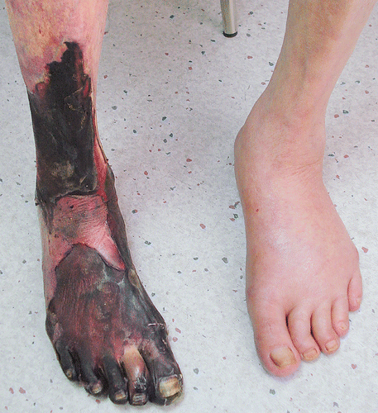
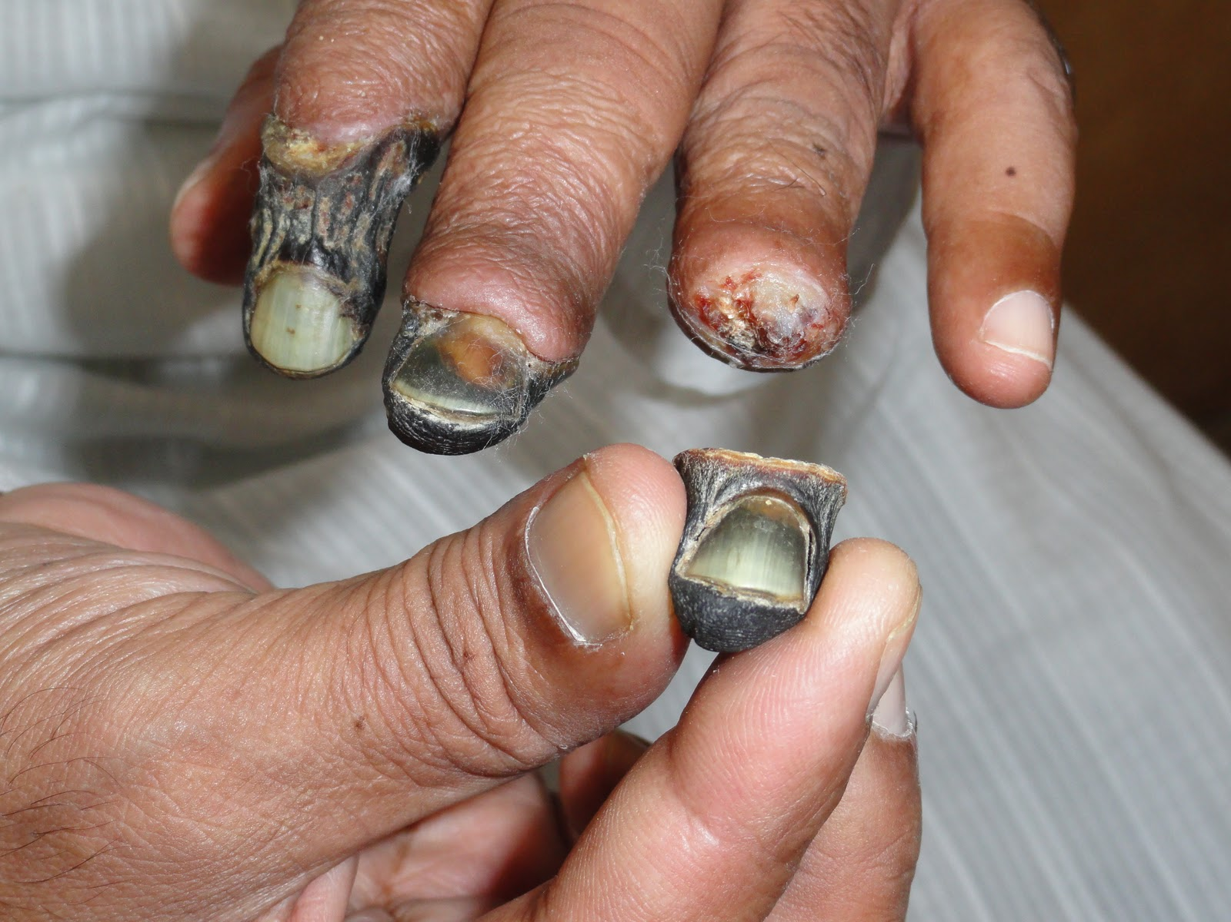

Slide 13
Brittany Murphy’s manner and cause of death
According to the Los Angeles County coroner, Brittany Murphy suffered an accidental death from pneumonia complicated by iron-deficiency anemia but also “multiple drug intoxication,” or toxic polypharmacy.

Slide 14
Death from pneumonia - mors proper pneumoniam (pneumonia, ae f.)
Pneumonia is an infection in one or both of the lungs. Many small germs, such as bacteria, viruses, and fungi, can cause pneumonia. The infection causes your lungs’ air sacs, called alveoli, to become inflamed. The air sacs may fill up with fluid or pus, causing symptoms such as a cough (with phlegm), fever, chills, and trouble breathing. Pneumonia can be a complication of upper respiratory infections, such as colds or flu, because the mucus in the airways is an excellent growth medium for germs.

Slide 15
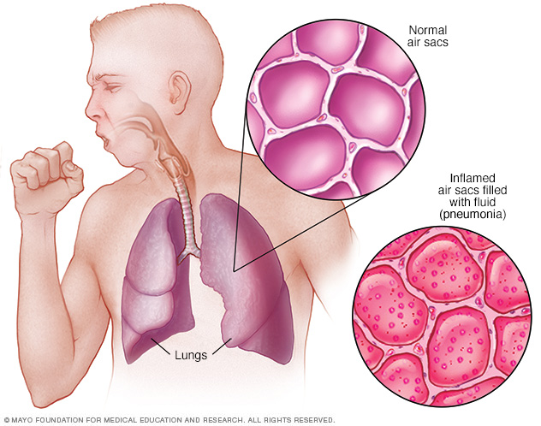
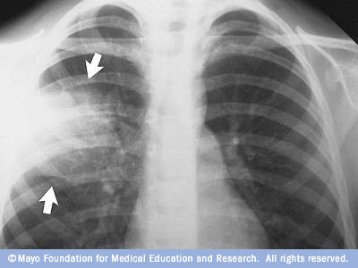

Slide 16
Harrison Ford Recuperating From Pelvic Fracture After Plane Crash
Harrison Ford is an accomplished pilot. He’s flown helicopters, fixed-wing aircraft as well as the Millennium Falcon.
On March 5, 2015, Ford was flying a vintage WWII airplane, when he was forced to make an emergency landing on the Penmar Golf Course in Venice, California. He did not lose consciousness, but did sustain some serious injuries. Ford suffered a laceration to his head and broke an ankle and his pelvis in the crash landing.
Just last June, Ford broke his leg while filming Star Wars: Episode 7 – The Force Awakens. Filming had to be delayed as he underwent surgery to repair the fracture.

Slide 17
A laceration to his head – laceratio capitis
broke an ankle and his pelvis = fracture of an ankle and pelvis – fractura tali (talus, i m.) et pelvis (pelvis, pelvis f.)
Broke his leg = fractura cruris

Slide 18
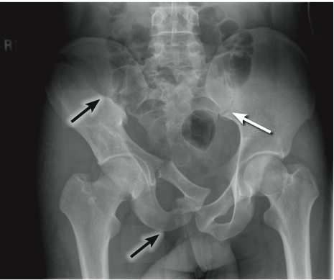

Slide 19
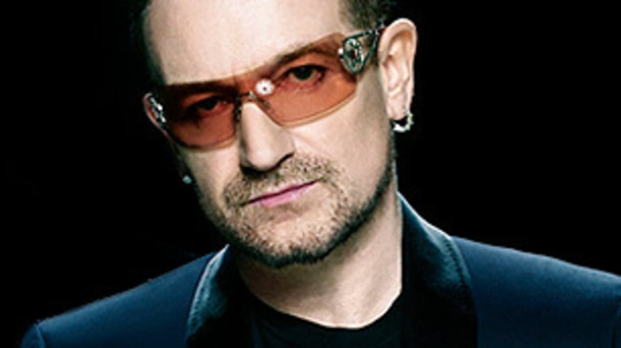
U2 cancels tours due to Bono’s back surgery
U2 frontman Bono underwent emergency back surgery due to an injury during a rehearsal. Today we learned the extent of those injuries when the group announced that they would be postponing their tour to North America. The press release cites “severe compression of the sciatic nerve” and “a serious tear in the ligament and a herniated disc.” Doctors expect the recovery to take at least “six to eight weeks.”

Slide 20
Back surgery – therapia surgica dorsi
compression of the sciatic nerve – compressio nervi sciatici
tear in the ligament and a herniated disc – laesio ligamenti et prolapsus disci intervertebralis
The intervertebral discs consist of a thick outer layer of cartilage, the annulus, which surrounds a jelly-like center called the nucleus. A disc is called herniated when the nucleus seeps out and encroaches on the nerves coming out of the space between the vertebrae. Although a herniated or ruptured disc can occur by a single severe trauma, more commonly it occurs as discs get worn over time, causing them to become less springy, and flatter, and to develop small cracks.

Slide 21
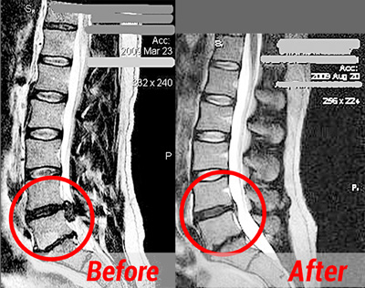
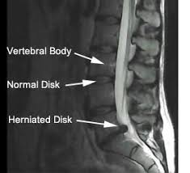

Slide 22
Canadian X Games Skier Sarah Burke in Coma After Brain Injury
Canadian Freestyle skier Sarah Burke has been pushing the envelope for 10 years. This time she may have pushed a little too far. The four-time Winter X Games winner was injured Tuesday during a training run on the superpipe in Park City, Utah. The injury put the 29 year old into a coma. Peter Judge of the Canadian Freestyle team told Toronto’s Globe and Mail newspaper: „She landed a trick down in the bottom end of the pipe and kind of bounced from her feet to her head… It wasn ’t anything that looked like a catastrophic fall, so I’m a bit mystified.“ Burke underwent surgery to repair a torn vertebral artery, which had caused bleeding into her brain.

Slide 23
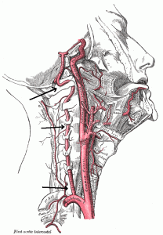
a torn vertebral artery – laesio arteriae vertebralis
had caused bleeding into her brain = cause of the bleeding into her brain – causa haemorrhagiae (haemorrhagia, ae f.) in cerebrum (direction)
The vertebral arteries are a pair of arteries that supply blood to the back of the brain. This part of the brain contains structures that are crucial for keeping a person alive. For instance, the brainstem controls breathing and swallowing, among other things. Parts of the brain help with vision (occipital lobes) and movement coordination (cerebellum) are also located in the back of the brain.

Slide 24
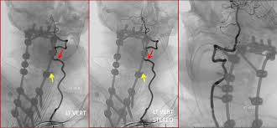
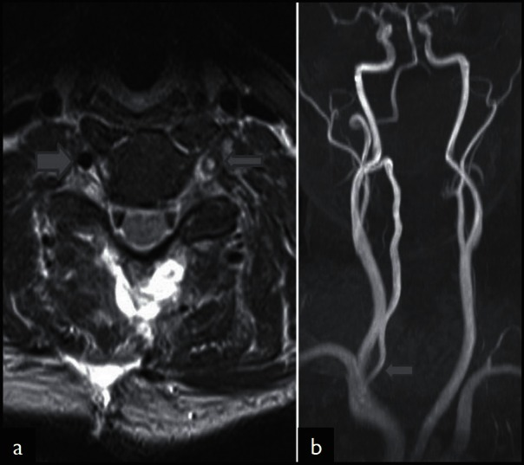

Slide 25
Michael Jackson’s Fiery Pepsi Commercial
You have no doubt seen the new footage of Michael Jackson’s 1984 Pepsi commercial in which the pyrotechnics go off too early, causing Jackson’s hair to ignite in flames. It is reported that Michael sustained second and third degree burns to his scalp and face. Many have stated that this was a watershed moment in Michael’s life, as this was when he was first given prescription pain killers to deal with the pain of the burns.

Slide 26
second and third degree burns to his scalp and face – combustiones calvae et faciei gr. II. et gr. III.
pain of the burns – dolor propter combustiones
First degree burns involve only the upper epidermis. It looks like a sunburn- the skin is pink and swollen and may be painful for a few days. Treatment consists of cool compresses and over the counter pain medications.
Second degree burns (also called partial thickness burns) damage the epidermis and the layer beneathit (the dermis). Second degree burns are pink or red,swollen, and painful, and they develop blisters that may ooze aclear fluid.
Third-degree burns (also called full thickness burns) usually are notpainful because the nerves have been destroyed. All layers of the skin are involved and the skin becomesleathery and may be white, black, or bright red. The burned areadoes not blanch when touched, and hairs can easily be pulled fromtheir roots without pain.

Slide 27
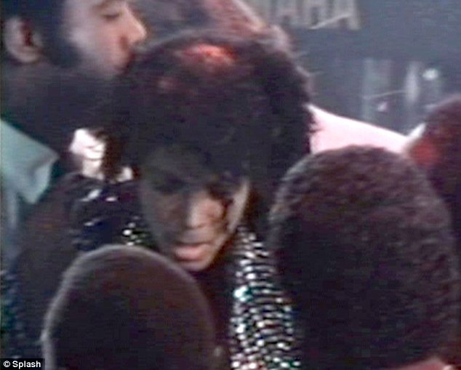
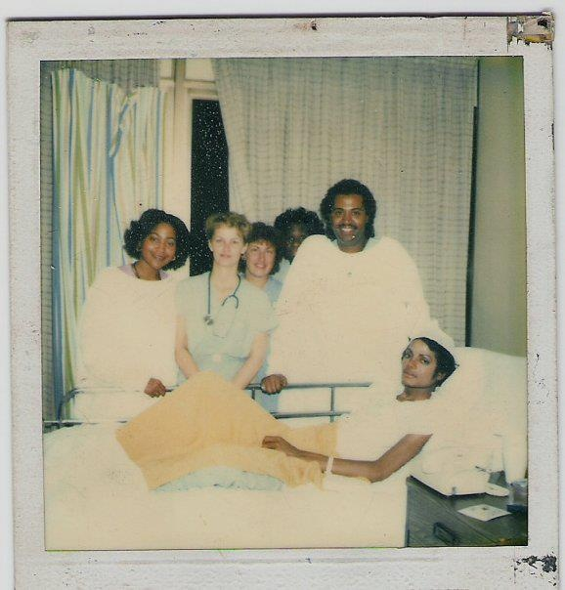

Slide 28
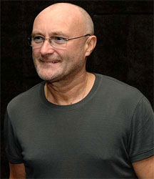
Phil Collins Unable to Play Drums After Surgery
Phil Collins, 58, is currently unable to play the drums. The Genesis drummer and front man, also known for his solo career, underwent surgery in April to repair a dislocated neck vertebrae. Since the surgery, the singer still has numbness in his hands and is unable to hold drumsticks.

Slide 29
a dislocated neck vertebrae – luxatio vertebrarum cervicalium
The spine of the neck consists of 7 cervical vertebrae (CI – VII) – the bony structures that supports the head and protect the spinal cord that passes through them. Between the vertebrae are cushions made of cartilage, called the intervertebral discs, which keep the spine flexible and act as shock absorbers. Strong fibrous tissue, called ligaments and bony protrusions of the vertebrae called facets further stabilize the spine. The spinal nerves pass through a second space, called foramen, between the vertebrae on each side of the spine, out to the neck and upper body.
A cervical vertebral dislocation refers to the displacement of one neck vertebrae in relationship to the ones above and/or below it. Disruption of the surrounding ligaments, either by trauma or degeneration of the discs, allow the vertebrae to move their positions. If the shift is slight, it is called a subluxation. If a greater shift occurs, it is called a dislocation. The most common place for cervical dislocation is between C5 and C6. Vertebral shift can cause pressure on the nerves coming through the foramen, leading to symptoms of pain, numbness, or weakness in the shoulder, arm, wrist or hand. This is called cervical radiculopathy.

Slide 30
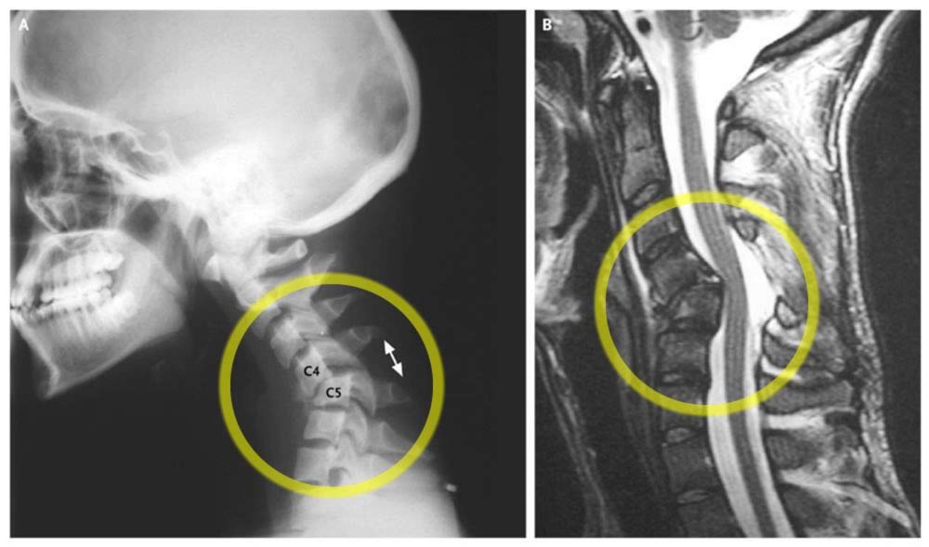

Slide 31
Jimmy Kimmel’s Newborn Son Undergoes Heart Surgery
Many saw a very different side of funny man Jimmy Kimmel last night. He tearfully recounted the scary situation he and wife Molly McNearney recently faced after the birth of their baby on April 21st. At three hours old, an observant nurse noticed that little William “Billy” Kimmel had a heart murmur, and also seemed “a bit purple.” An x-ray and heart ultrasound revealed that Billy had a heart condition where his pulmonary valve was closed and he had a large “hole in his heart.” He was ultimately diagnosed with a condition called Tetralogy of Fallot with pulmonary atresia. He was transferred to Childrens’ Hospital Los Angeles where he underwent a three hour surgery to open up the pulmonary valve. “He opened up the valve and the operation was a success. It was the longest three hours of my life,” said Kimmel.

Slide 32
pulmonary valve was closed and he had a large “hole in his heart.” – valva pulmonalis clausa et foramen cordis / in corde
with pulmonary atresia – cum atresia pulmonali
Surgery of the pulmonary valve – therapia surgica valvae pulmonalis
Congenital heart defects are problems with the heart’s structure that are present at birth. These defects can involve: The interior walls of the heart, The valves inside the heart, The arteries and veins that carry blood to the heart or the body
Congenital heart defects change the normal flow of blood through the heart. There are many types of congenital heart defects. They range from simple defects with no symptoms to complex defects with severe, life-threatening symptoms.

Slide 33
