Slide 1
Drowning
Hanging
Injuries in the nature
Lukáš Dadák

Slide 2
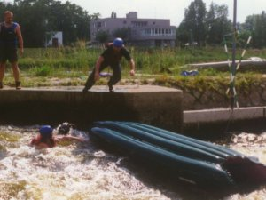
Drowning
= Near-drowning means a person almost died from not being able to breathe (suffocating) under water
disaster in the lung = H2O
Why:
jump to flat water
fall to wildwater
  haed trauma / C spine
Inability to swim or panic while swimming
alcohol
CHILDREN AREN'T
WATERPROOF
small children unattended around bathtubs and pools

Slide 3
How it works:
After initial breath holding, when the victim's airway lies below the liquid's surface, an involuntary period of laryngospasm is triggered by the presence of liquid in the oropharynx or larynx. At this time, the victim is unable to breathe in air, causing oxygen depletion and carbon dioxide retention. As the oxygen tension in blood drops further, laryngospasm releases, and the victim gasps, hyperventilates, possibly aspirating variable amounts of liquid. This leads to further hypoxemia.

Slide 4
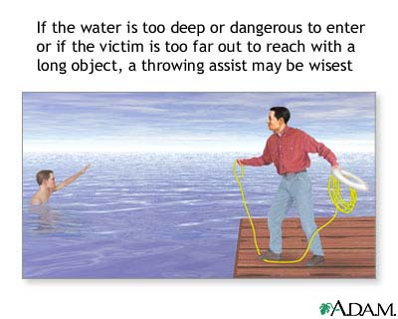
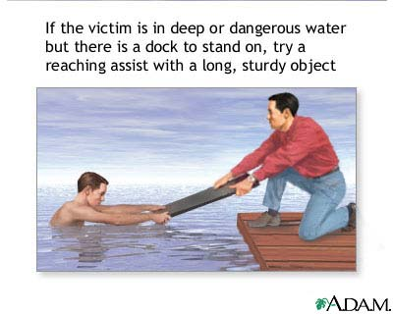
First Aid
Safely - Out of water
People who have fallen through ice may not be able to grasp objects within their reach or hold on while being pulled to safety.

Slide 5
First aid:
Do not place yourself in danger. Do NOT get into the water or go out onto ice unless your are absolutely sure it is safe.
(start the breathing while still in the water)
Move victim to dry land - give CPR if needed.
Assume neck or spine injury
Keep the person calm and still. Seek medical help immediately.
Remove any cold, wet clothes from the person and cover with something warm, if possible. = prevent hypothermia.

Slide 6
DO NOT
DO NOT go into rough or turbulent water that may endanger you.
The Heimlich maneuver is NOT part of the routine CPR
Do not go home
All near-drowning victims should be checked by a doctor. Even though victims may revive quickly at the scene, lung complications are common.

Slide 7
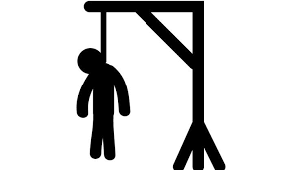
Hanging Injuries and Strangulation
Neck is vulnerable
to life-threatening injuries:
  airway
  spinal cord (fall from a distance greater
  than the height of the victim) fatal
  major vessels (cerebral hypoxia)
  Complete (body hangs off the ground and the entire weight of the victim is suspended at the neck)
  incomplete
Notes:
Hanging is a form of strangulation that involves suspension by the neck. Hangings can be classified as either complete or incomplete. When the whole body hangs off the ground and the entire weight of the victim is suspended at the neck, the hanging is said to be complete. Incomplete hangings imply that some part of the body is touching the ground and that the weight of the victim is not fully supported by the neck. Hangings may also be classified by intent (eg, homicidal, suicidal, autoerotic, accidental).

Slide 8
First aid
call for help
Release strangulation lane
lay back on the ground
BLS if no signs of death
call for EMS
EMS transport
Transport with immobilization of the cervical spine

Slide 9
Injuries in the nature
Crashes, backfilling with soil
Hypothermia
lightning accident
bite
insect bites

Slide 10
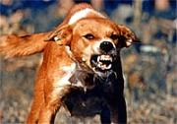
Bites
completely washed out
the wound with soap
(prevention of rabies)
disinfection
stop bleeding, arrange medical treatment, if possible, we get from the owner of the dog vaccination certificate, which pass EMS
Police will ensure the dog

Slide 11
Rabies
Viral deadly disease,
transmited by saliva of an mammal -
fox, cat, badger, roe, bats and raccoons bites
Prevention:
instruct (children)
announce a forester / municipal office
after direct of contact between seek medical treatment (preventive vaccine given in 5 doses over 28 days).
animal should be examined by vet

Slide 12
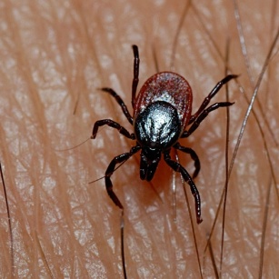
Tick bites
minor injury.
may transmit bacteria / viruses (Lyme disease or encephalitis)
Prevention:
Control your skin after return from nature
I.A.:
Remove the tick promptly and carefully.
Use tweezers to grasp the tick near its head or mouth and pull gently to remove the whole tick without crushing it.
Wash your hands with soap and water.
Disinfect area around the tick bite (Iod).
applying petroleum jelly, fingernail polish, rubbing alcohol or a hot match — aren't recommended.

Slide 13
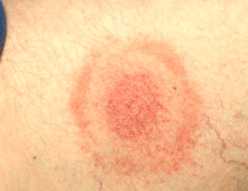
Tick bites
Viral:
flu-like signs and symptoms:
Fever, chills, fatigue,
body aches
headache .
Lyme:
Redness after
3 days

Slide 14
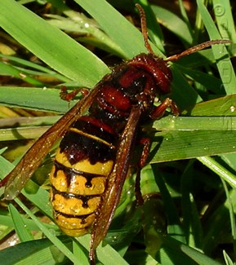
Insect bites
redness
swelling
pain
Itching
I.A:
Move to a safe area to avoid more bites or stings.
If needed, remove the stinger.
Wash the area with soap and water (Iod disinfection).
Apply a cool compress.

Slide 15
Insect in Czech
Mosquito
Bee
Wasp and Hornet
- late summer and autumn contamination of sting with bacteria
- Skin infections (phlegmone, fever, pain)
.. seek medical help (antibiotics p.os.)

Slide 16
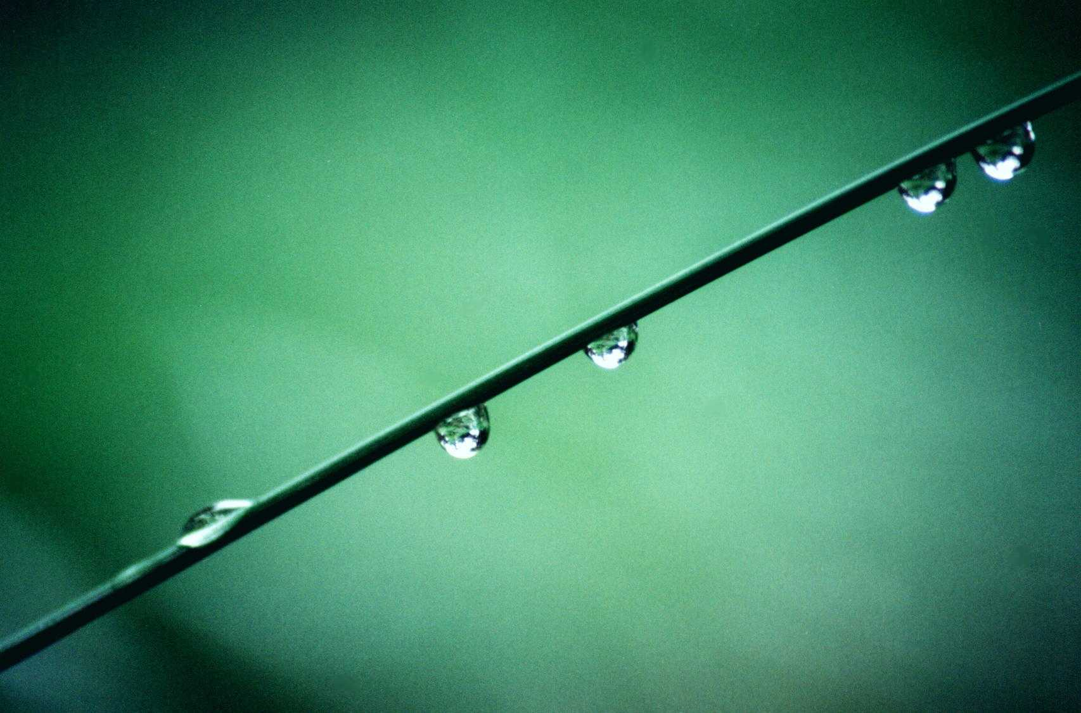
Storm
Risk:
lightning accident
hypothermia
Procedure:
leave the ridge, beyond the plains, peaks, lonely trees, water surfaces
Ideal Refuge:
Building a lightning rod, unprotected building (close the doors, windows, appliances, stoves)
Valley pit, woods (2 m from the branches, between the lower trees)

Slide 17
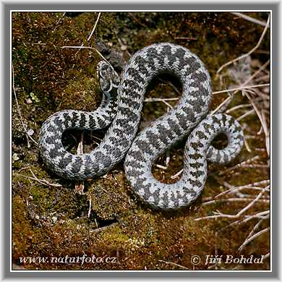
Zmije obecná, Vipera berus
Basic dyeing and coloring of the strip may be different. Vipers are brown, grayish, blackish. Males can be bright coloration;
white background with black or anthracite black distinctive stripe.

Slide 18
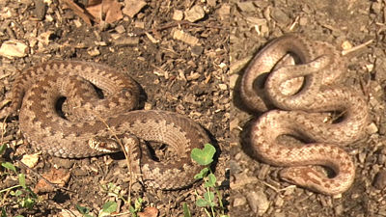
Who is who
Vipera Grass snake

Slide 19
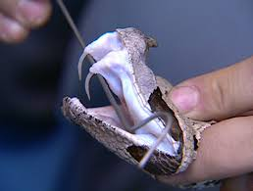
Signs
vision disorders
Nausea / vomiting
1 or 2 stab wounds accompanied by severe pain and swelling
Difficulty breathing or arrest
symptoms of shock

Slide 20
First Aid
Remain calm and move beyond the snake's striking distance.
Remove jewelry and tight clothing before you start to swell.
Position yourself, if possible, so that the bite is at or below the level of your heart.
Clean the wound, but don't flush it with water. Cover it with a clean, dry dressing.
Caution
Don't use a tourniquet or apply ice.
Don't cut the wound or attempt to remove the venom.
Don't drink caffeine or alcohol, which could speed the rate at which your body absorbs venom.
Don't try to capture the snake. Try to remember its color and shape so that you can describe it, which will help in your treatment.

Slide 21
