Slide 1
ANATOMY III
MUDr. Ivana Hradilová Svíženská, Ph.D.

Slide 2
 | Lectures | Seminars
1. | Anatomy of the nervous system, Spinal nerve Structure of the spinal cord | Gross anatomy and structure of the spinal cord
2. | Structure of the brain stem | Gross anatomy and structure of the brain stem
3. | Structure of the cerebellum and diencephalon | Gross anatomy and structure of the cerebellum and diencephalon
4. | Structure of the telencephalon | Gross anatomy and structure of the telencephalon
5. | Meninges, ventricles and vascular system of the CNS Cranial nerves 1 | Meninges, ventricles and vascular system of the CNS Cranial nerves 1
6. | Cranial nerves 2, Cervical plexus Intercostal nerves, Dorsal rami | Cranial nerves 2, Cervical plexus Intercostal nerves, Dorsal rami
7. | Autonomic nervous system | Autonomic nervous system
8. | Visual system | Visual system
9. | Regional anatomy of the head and neck | Demonstration of topographical regions (head and neck)
10. | Dissection course (head, neck)
11. | Auditory system | Auditory system
12. | Regional anatomy of the body (except limbs) | Demonstration of the topographical regions (except limbs)
13. | Regional anatomy of the body (except limbs) | Demonstration of the topographical regions (except limbs)
14. | RTG anatomy | RTG anatomy
15. | Spare lectures

Slide 3
Recommended literature:
Liebgott, Bernard. The anatomical basis of dentistry.
3rd ed. Mosby, ISBN 0-323-06807-3
Dubový, Petr. Gross anatomy and structure of the
human nervous system. Part I. Surface anatomy and
structural arrangement of the central nervous system.
3rd ed. Brno: Masarykova univerzita, 2016. 92 s. ISBN 978-80-210-6125-5
Dubový, Petr. Instructions for anatomical dissection course.
3rd ed. Brno: Masaryk University, 2013. 71 s. ISBN 9788021062023
Stingl, J. et al. Regional anatomy.
1st ed. Galén-Karolinum, 2012. 123s. ISBN 9788072628797
Atlas of Anatomy

Slide 4
Equipment:
lab coat
dressing forceps
gloves

Slide 5
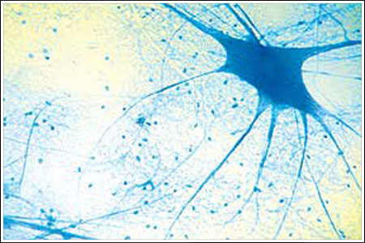
Nervous system
Notes:
5

Slide 6
Nervous system
■ is a complex, sophisticated system that regulates and coordinates activities of the body
■ regulates the body's responses to internal and external stimuli
■ has three main functions, sensory input, integration of data and motor output
■ is composed of excitable nerve cells
■ conducts nerve impulses
■ is divided into two categories: the central nervous system- CNS and the peripheral nervous system - PNS
■ the basic structural and functional unit - neuron
■ cells providing support and protection for neurons – glial cells
Notes:
6

Slide 7
Basic function of NS
Sensor
CNS
Effector
Notes:
7

Slide 8
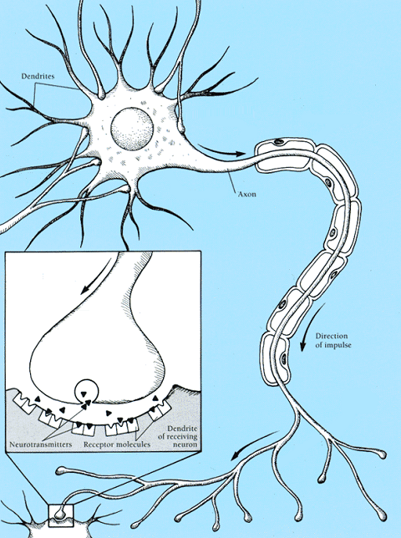
Neuron
■ receives stimuli
■ transforms stimuli to nerve impulses
■ conducts nerve impulses
■ processes information
■ transmits the electro-chemical signal across a synapse
Notes:
8

Slide 9
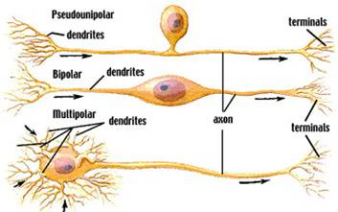
TYPES OF NEURONS

Slide 10
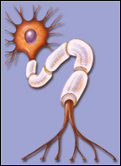
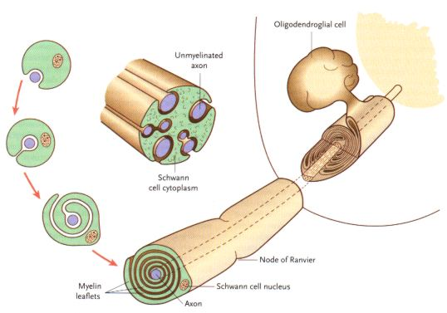
Myelinization – node of Ranvier, internodal segment
Saltatory conduction
oligodendroglia
unmyelinated axon
Schwann cell
Ranvier node
Schwann cell nucleus
axon
Notes:
10

Slide 11
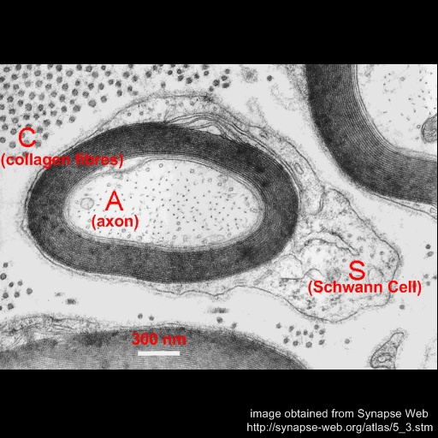
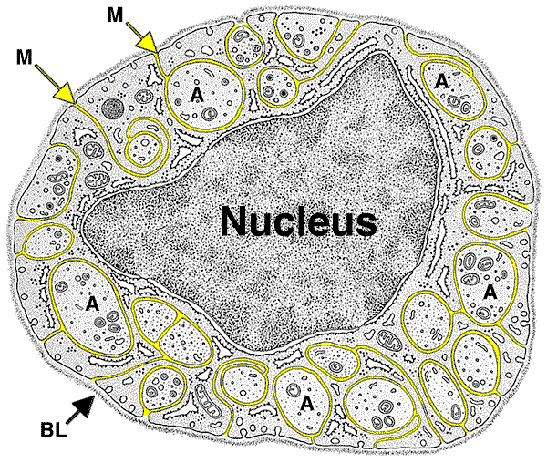

Slide 12
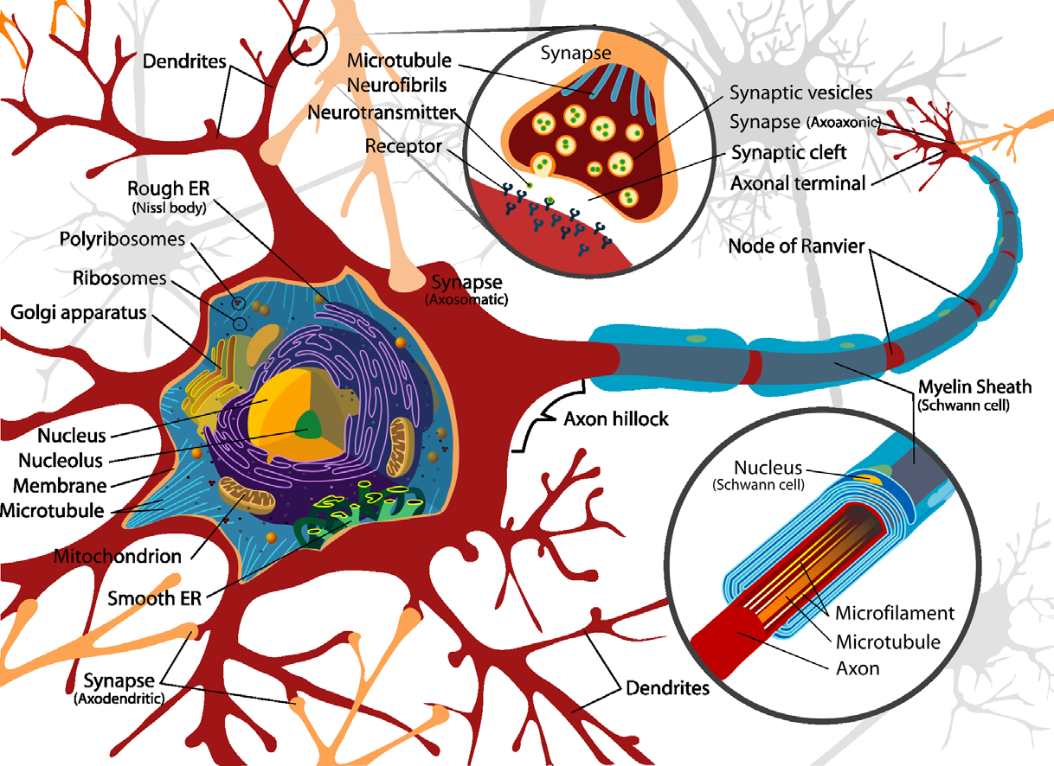
Synapse

Slide 13
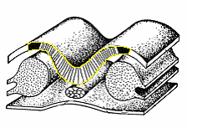
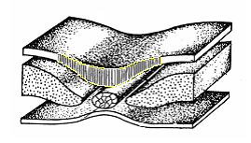
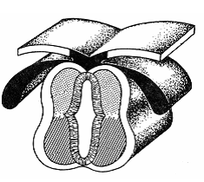
Development of NS
■ from ectoderm (under influence of the notochord) arises the neural:
plate
groove
3.w i.u.
tube + neural crest
Notes:
13

Slide 14
Parts derived from the neural tube
brain
spinal cord
Parts derived from the neural crest
cranial nerve ganglia
dorsal root ganglia and autonomic ganglia medulla of the suprarenal gland
some bones, cartilages and connective tissue of the head
pigment cells
Notes:
14

Slide 15
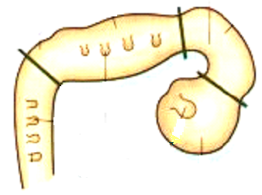
Cerebral vesicles from the rostral part of the neural tube
3. rhombencephalon (hindbrain)
2. mesencephalon (midbrain)
1. prosencephalon (forebrain)
3.
2.
1.
Spinal cord medulla spinalis
Notes:
15

Slide 16
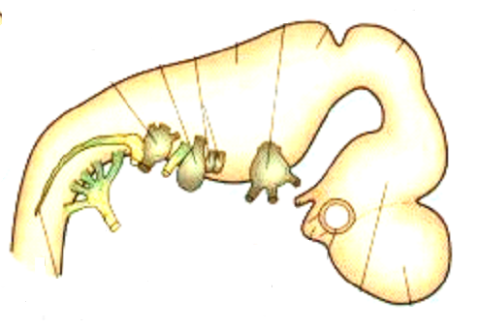
Secondary vesicles
3.
2.
rostral
1.
myelencephalon medulla oblongata metencephalon pons, cerebellum
mesencephalon midbrain
diencephalon diencephalon telencephalon telencephalon
3.
2.
1.
Notes:
16

Slide 17
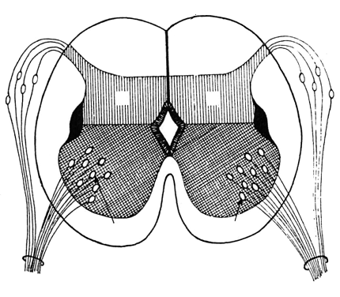
dorsal root
DRG
A
A
B
B
ventral root
Spinal nerve
skin
muscle
sulcus limitans
Notes:
17

Slide 18
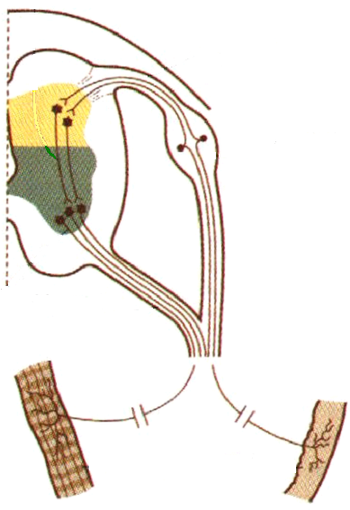
Interneuron
Muscle
Skin
Notes:
18

Slide 19
SENSOR
EFFECTOR
Surface of the body Extero- receptors
Skeletal muscles
CNS
Organs of motions Proprio- receptors
Efferent
Afferent
Smooth muscles + myocardium
Viscera Intero- receptors
PNS
Glands
Senses
Notes:
19

Slide 20
Functional types of axons
SENSOR
EFFECTOR
Somato + branchio- motor (SM) (BM)
Extero- receptors
Proprio- receptors
Somato- sensory (SS)
Skeletal muscles
CNS
Intero- receptors
Viscero- sensory (VS)
Smooth muscles and myocardium
Viscero- motor (VM)
Senses
Sensory (S)
Glands
Notes:
20

Slide 21
PNS
Cranial nerves III. - XII. (I.- XII.)
pass through the skull base
Spinal nerves - 31 pairs
pass through the intervertebral foramina
Notes:
21

Slide 22
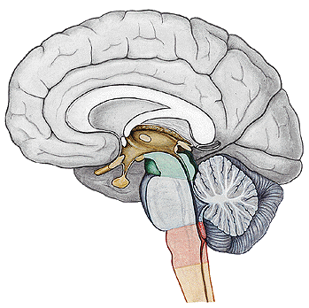
CNS
I. Brain
■ medulla oblongata
■ pons
■ mesencephalon
■ cerebellum
■ diencephalon
■ telencephalon
II. Spinal cord
Notes:
22

Slide 23
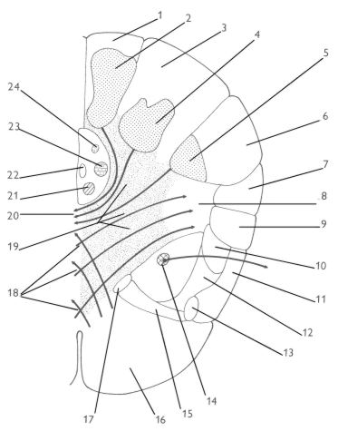
Structure of the CNS
Gray matter - nuclei White matter – nerve tracts: - tractus - fasciculus (lemniscus)
Notes:
23

Slide 24
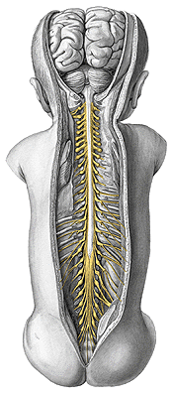
Spinal cord
■ transmission of neural signals between the brain and the periphery
■ contains neural circuits that can control numerous reflexes and central pattern generators independently on the cortex
Notes:
24

Slide 25
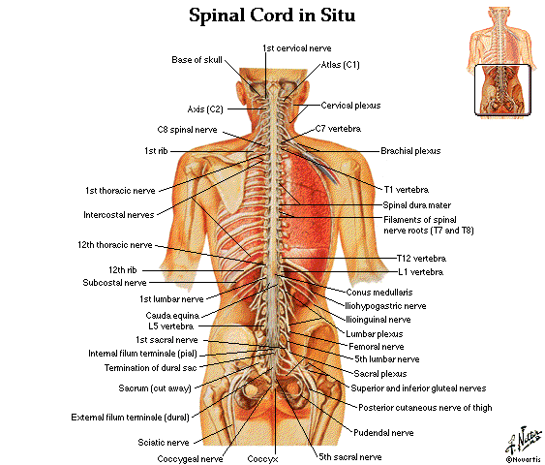
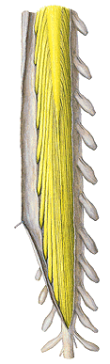
MEDULLA
SPINALIS

Slide 26
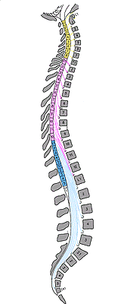
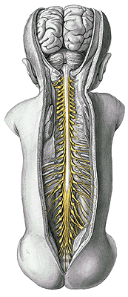
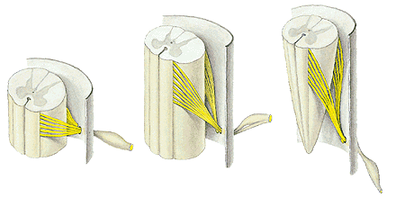
Cauda equina
Fila radicularia

Slide 27
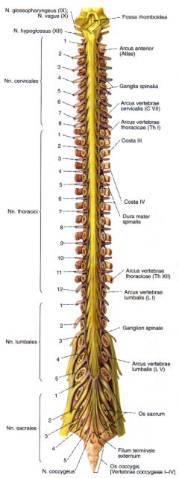
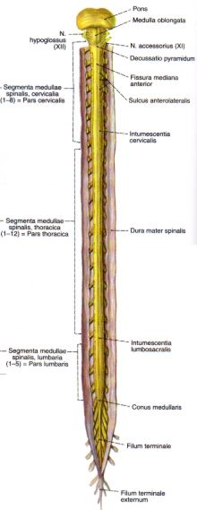
Intumescentia cervicalis
C5 – T1 segments
C4 – T1 vertebrae
Intumescentia lumbalis
L2 – S1 segments
T9 – T12 vertebrae

Slide 28
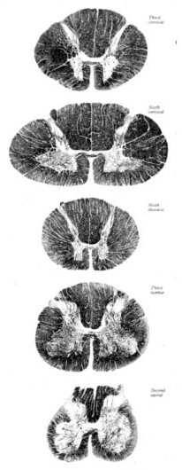
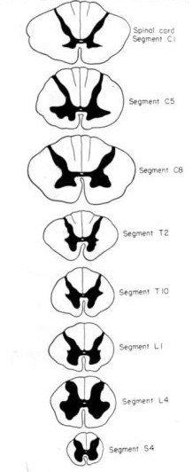
Segment C1
Segment C5
Segment C5
Segment C8
Segment C8
Segment Th2
Segment Th2
Segment Th10
Segment L4
Segment L1
Segment L4
Segment S4
Segment S4
Notes:
Left – real stained magnified cross section through some segments of the spinal cord
Right – diagrams of cross sections through the segments of the spinal sord

Slide 29
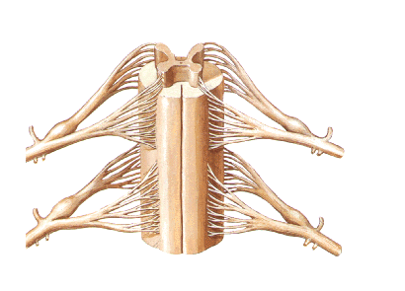
SUBSTANTIA GRISEA – cornu anterius (columna anterior),
cornu posterius (columna posterior), cornu laterale (columna
lateralis), substantia intermedia, canalis centralis

Slide 30
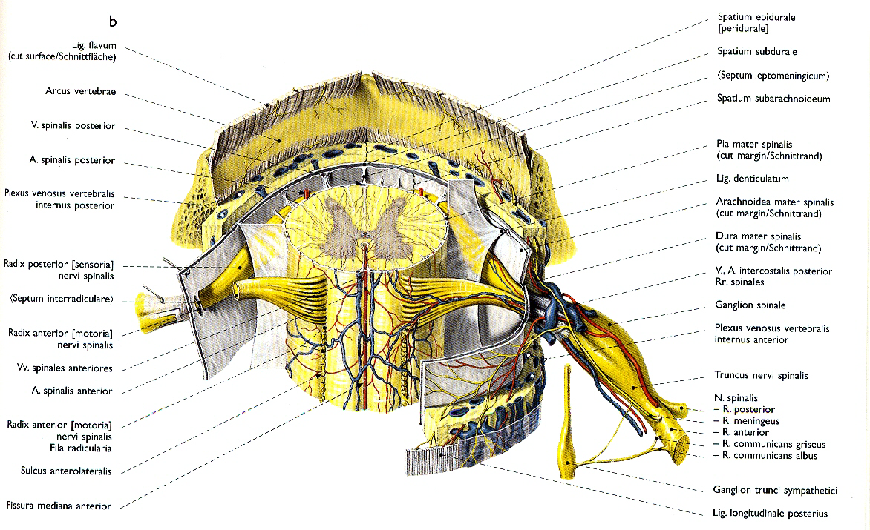
SUBSTANTIA ALBA – funiculus anterior, lateralis, posterior
fissura mediana ant., sulcus medianus post., septum medianum
posterius, sulcus anterolateralis, posterolateralis

Slide 31
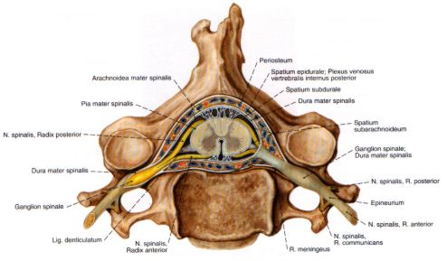

Slide 32

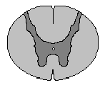
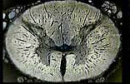
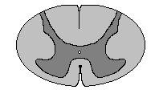
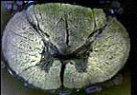
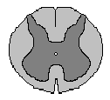
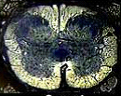
Dorsal horn
Ventral horn
p. cervicalis
p. thoracica
p. sacralis

Slide 33

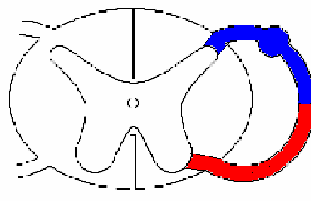
Dorsal root
extero + proprio + intero- receptors
Spinal nerve
skeletal + smooth muscles + glands
Ventral root
Notes:
33

Slide 34
Functional zones of the spinal cord
Extero+ proprio - receptors
GSA
Intero - receptors
Alar plate
GVA
Sulcus limitans
Basal plate
GVE
GSE
Smooth muscles, glands
Skeletal muscles
Notes:
34

Slide 35
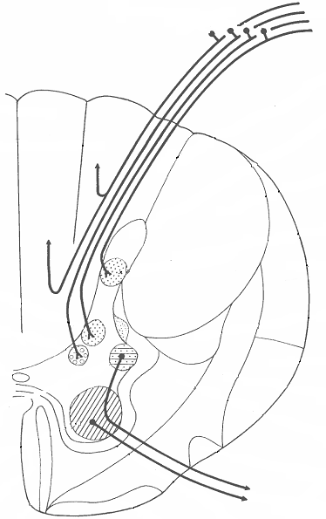
Gray matter
DORSAL HORN – afferent neurons
SUBST. INTERMEDIA (lateral horn) motoneurons of the ANS
VENTRAL HORN - motoneurons
FR
CC
White matter
Th1- L2
Funiculus post. (fasc. gracilis et cuneatus)
Funiculus ant.
Funiculus lat.
F. anterolateralis
Notes:
35

Slide 36
Functional zones in the spinal cord
GSA
GVE zone
GVA
T1 - L2 - preganglionic sympathetic neurons
below L2 - preganglionic parasympathetic neurons
GVE
GSE
Notes:
36
Upozornit na nové barvení
VM – musí být zelená – parasympatikus či žlutá – sympatikus (zahraniční literatura)
sympatikus – jádro v rozsahu Th1-L2 Pod L2= parasympatikus
Měl by tady být i FLM (obsahuje vlákna jdoucí z Ve jader, spojené se spinálními motoneurony a s neurony hlavových nervů).
Silně myelinizované aferentní axony SG jsou lokalizovány v zadních kořenech mediálně. Vedou inf. o diskriminačním kožním čití a propriorecepci. Po vstupu vydávají ascendentní a descendentní kolaterály. Ascendentní tvoří f. gracilis et cuneatus.
Laterálně jdou málo myelinizované a nemyelinizované aferentní axony, které vedou převážně nociceptivní informace a informace o teple a chladu. Tyto axony vstupují do tr. dorsolateralis (Lissaueri), kde se také dělí na ascendentní a descendentní větve a končí na neuronech zadnícho rohu míšního.
Sestupné dráhy = řízení motoriky
Tr. co-sp
Tr. re, ru, ve, te-spinalis

Slide 37
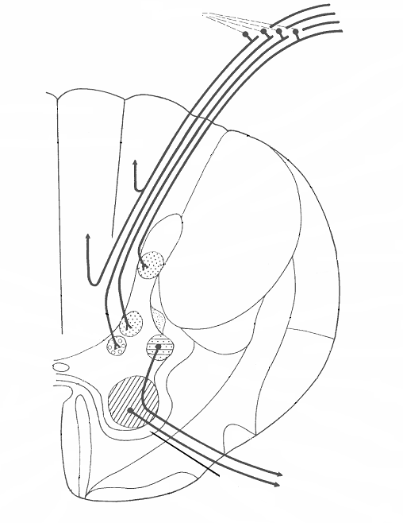
tr. co-sp lat
tr. ru-sp
Multipolar cells
Ncl. intermedio-lat.
tr. re-sp
α, γ
tr. ol-sp
Ncll. motorii
tr. te-sp
tr. ve-sp
Ventral root
tr. co-sp ant
Notes:
37

Slide 38
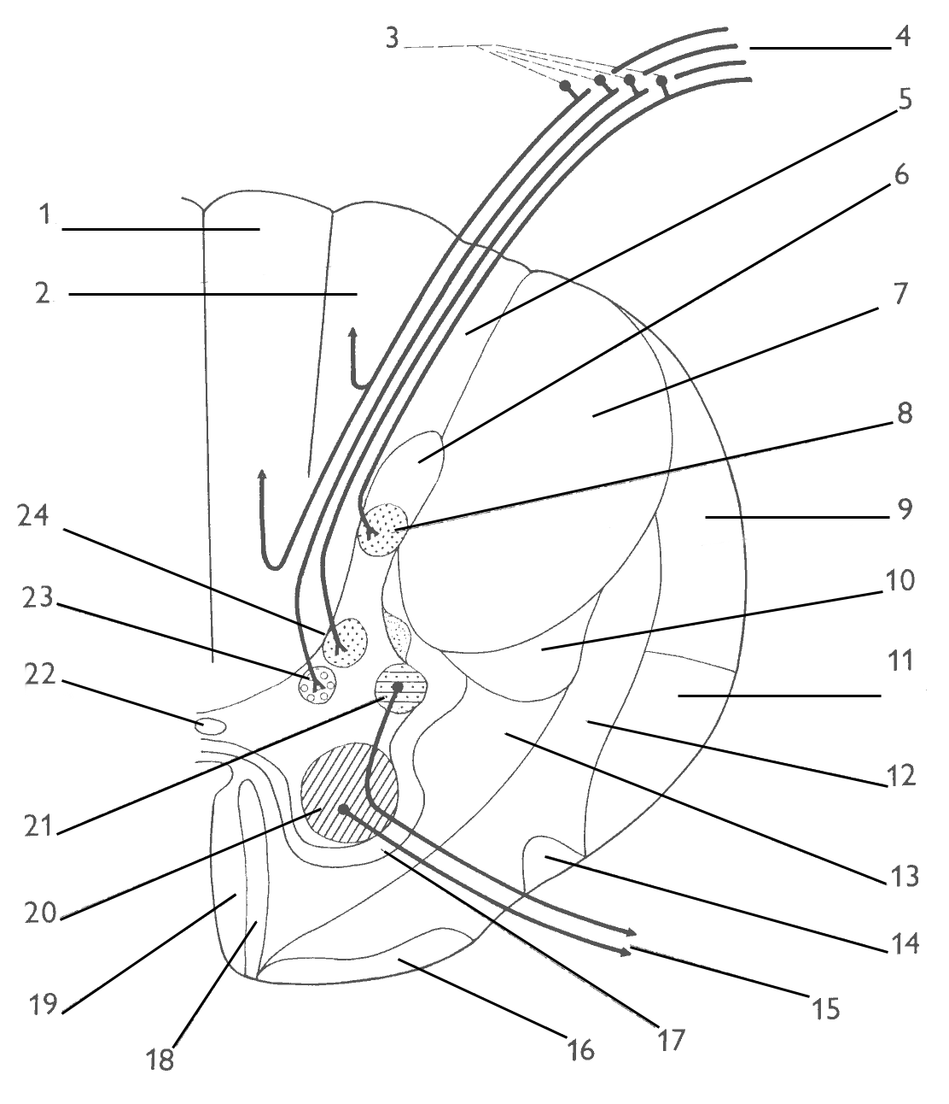
Pseudounipol. neurons of the DRG
Radix dorsalis
Ncl. posteromarginalis +
Subst. gelatinosa Rolandi
Tr. spino-
bulbaris
Fasc. gracilis
Fasc. cuneatus
Ncl. proprius
Ncl. thoracicus
(Stilling-Clark.)
Tr. spinocerebellaris post.
Ncl. intermediomedialis
Tr. spinocerebellaris ant.
Tr. spino-thalamicus,
-reticularis, -tectalis
Tr. spino-olivaris

Slide 39
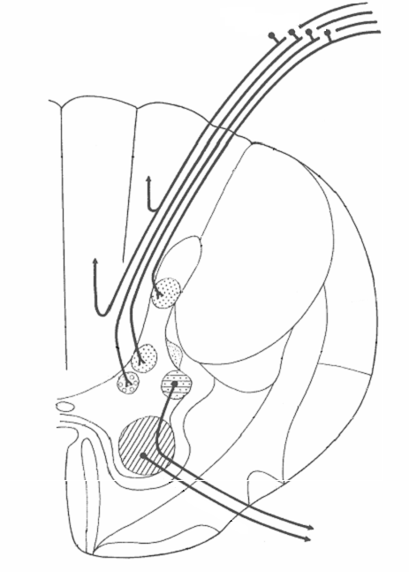
GSA
dorsal root
GVA
GVE
GSE
tr. sp-bulb
ncl apicalis subst gel Rolandi
tr. co-sp lat
ncl proprius
ncl thoracicus
tr. sp-cer ant, post
tr. ru-sp
ncl intermed-med
tr. sp-th, tec, ret
ncl intermedio-lat
tr. sp-sp
tr. re-sp
ncll motorii
tr. te-sp
tr. ol-sp
tr. co-sp ant
tr. ve-sp
ventral root
Notes:
39
Ncl. apicalis interneurony propojující segmenty míšní ascendentně a descendentně
Subst. gelatinosa Rolandi- vrstva šedé hmoty tvořena nakupením drobných interneuronů. Významným způsobem ovlivňují aferentní informace vstupující do míchy.
Ncl. proprius – končí zde aferentní axony přenášející informaci o hrubé kožní citlivosti, teple a chladu.
Ncl. thoracicus – končí zde aferentní axony převádějící proprioceptivní informace z DK a kaudální části trupu
Ncl. intermediomedialis – končí zde aferentní axony převádějící informace z viscerálních orgánů (mechanické, teplo, bolest) Odtud do FR nebo na ncl. intermediolateralis
Ncl. intermediolateralis – neurony vydávají pregangliová sympatická vlákna probíhající ve ventrálních kořenech spinálních nervů
Ncl. motorii – obsahují alfa a gama motoneurony. Jsou somatotopicky uspořádány
FR – soubor neuronů, interneuronů a jejich spojení. V míše omezený rozsah

Slide 40
Illustrations and photographs were copied from:
Atlas der Anatomie des Menschen/Sobotta.
Putz,R., und Pabst,R. 20. Auflage. München:
Urban & Schwarzenberg, 1993)

