Slide 1
SMYSLY

Slide 2
FYZIOLOGIE VIDĚNÍ

Slide 3
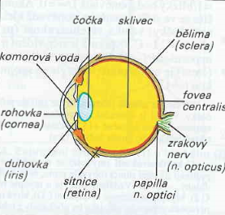
Zrak – nejdůležitější smysl,
u člověka 80% informací přicházejících z vnějšího prostředí
pro zpracování v CNS je získáno prostřednictvím zraku
CNS zpracovává odlišné druhy zrakové informace současně
(simultánně) a okamžitě pomocí paralelních subsystémů
zrakové dráhy – na rozdíl od akustické informace, která je
zpracovávána postupně (sukcesivně)
Oko: optické (rohovka, komorová tekutina, čočka, sklivec)
a nervové elementy (sítnice)
Vyměňuje se každých 60 min
Nitrooční tlak 15-16 mmHg
Glaukom-zelený zákal
poškození sítnice
m.ciliaris – pod kontrolou parasympatiku
První světlolomná plocha
Ochranná funkce
Jako clona fotoaparátu

Slide 4
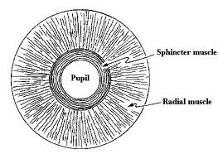
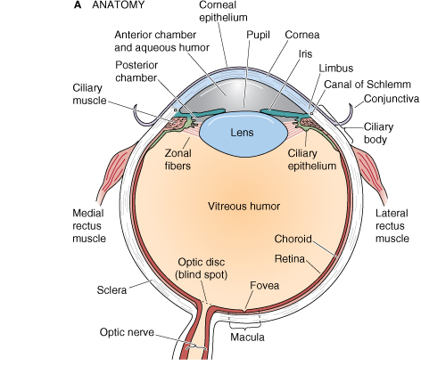
Pupilární reflex (zúžení a rozšíření zornice)
-neuronální dráha začínající v sítnici – n.opticus
-oddělení do pretektální oblasti k jádrům
okohybných nervů- Edinger-Westphalovo jádro
-jako vlákna ANS –končí: m.sphinkter-m.dilatator pupilae
Notes:
The eye is a fluid-filled sphere enclosed by three layers of tissue (Figure 11.1). Most of the outer layer is composed of a tough white fibrous tissue, the sclera. At the front of the eye, however, this opaque outer layer is transformed into the cornea, a specialized transparent tissue that permits light rays to enter the eye. The middle layer of tissue includes three distinct but continuous structures: the iris, the ciliary body, and the choroid. The iris is the colored portion of the eye that can be seen through the cornea. It contains two sets of muscles with opposing actions, which allow the size of the pupil (the opening in its center) to be adjusted under neural control. The ciliary body is a ring of tissue that encircles the lens and includes a muscular component that is important for adjusting the refractive power of the lens, and a vascular component (the so-called ciliary processes) that produces the fluid that fills the front of the eye. The choroid is composed of a rich capillary bed that serves as the main source of blood supply for the photoreceptors of the retina. Only the innermost layer of the eye, the retina, contains neurons that are sensitive to light and are capable of transmitting visual signals to central targets.
En route to the retina, light passes through the cornea, the lens, and two distinct fluid environments. The anterior chamber, the space between the lens and the cornea, is filled with aqueous humor, a clear, watery liquid that supplies nutrients to these structures as well as to the lens. Aqueous humor is produced by the ciliary processes in the posterior chamber (the region between the lens and the iris) and flows into the anterior chamber through the pupil. A specialized meshwork of cells that lies at the junction of the iris and the cornea is responsible for its uptake. Under normal conditions, the rates of aqueous humor production and uptake are in equilibrium, ensuring a constant intraocular pressure. Abnormally high levels of intraocular pressure, which occur in glaucoma, can reduce the blood supply to the eye and eventually damage retinal neurons.
The space between the back of the lens and the surface of the retina is filled with a thick, gelatinous substance called the vitreous humor, which accounts for about 80% of the volume of the eye. In addition to maintaining the shape of the eye, the vitreous humor contains phagocytic cells that remove blood and other debris that might otherwise interfere with light transmission. The housekeeping abilities of the vitreous humor are limited, however, as a large number of middle-aged and elderly individuals with vitreal “floaters” will attest. Floaters are collections of debris too large for phagocytic consumption that therefore remain to cast annoying shadows on the retina; they typically arise when the aging vitreous membrane pulls away from the overly long eyeball of myopic individuals.

Slide 5
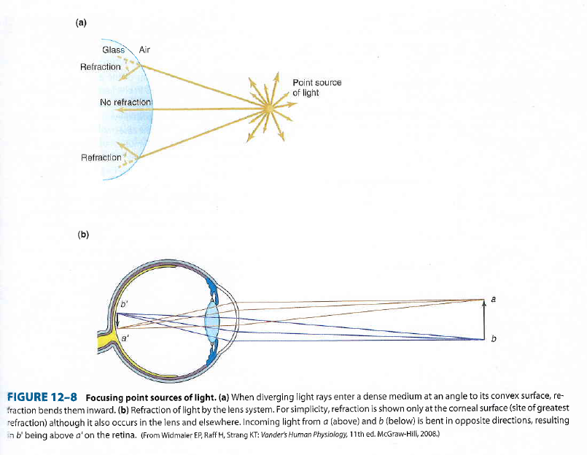

Slide 6
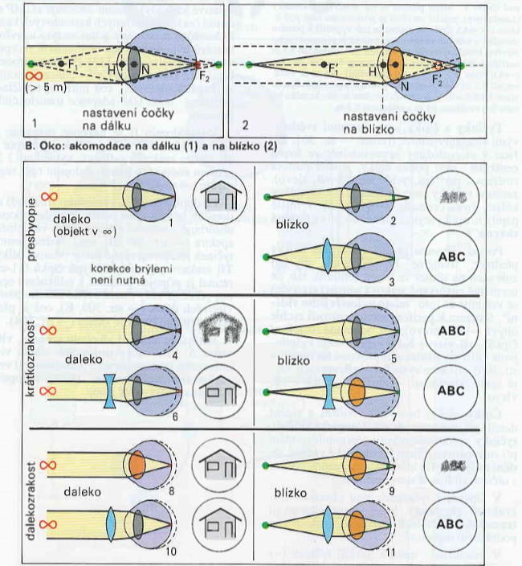
myopie

Slide 7
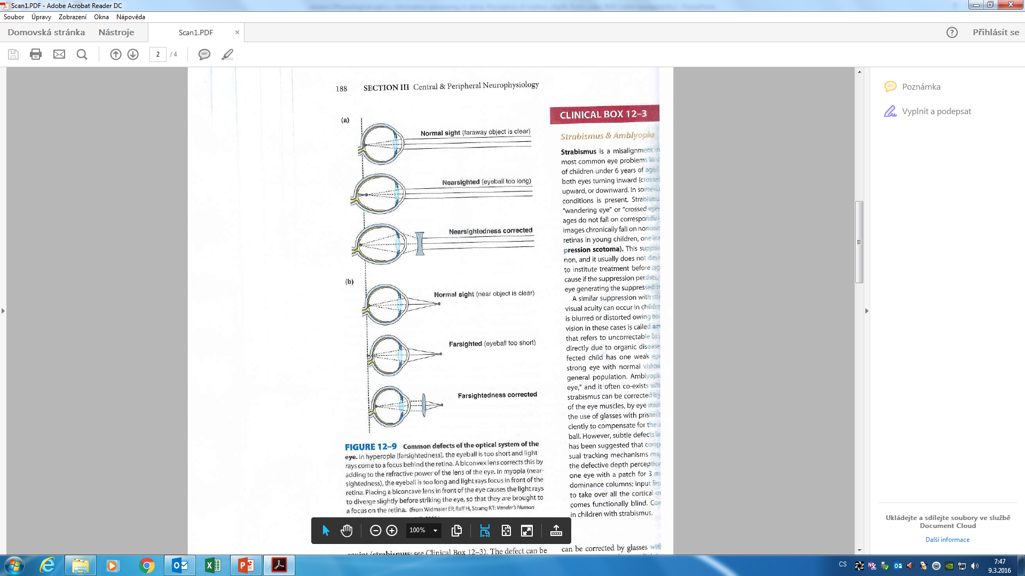

Slide 8
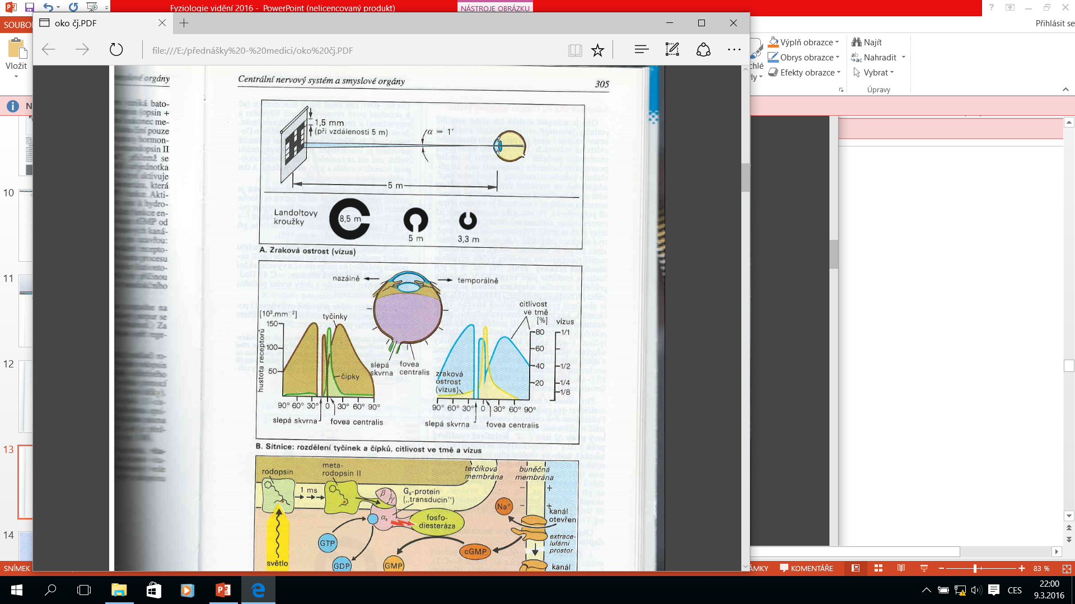

Slide 9
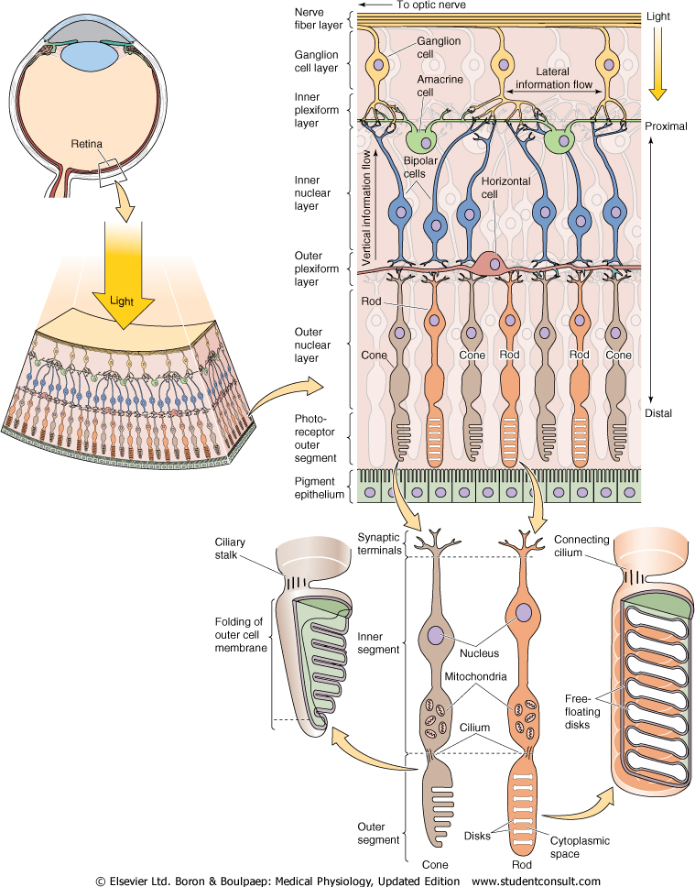
Světločivné elementy: tyčinky a čípky
v
v
Obsahují zrakové pigmenty, které se působením světla chemicky rozkládají.
Základ: sloučenina bílkovin opsinu a retinenu (derivát vit.A), působením světla pigment bledne, ruší se vazba mezi opsinem a retinenem. Rozpad pigmentu=nervový vzruch=akční potenciál
v gangliových buňkách sítnice. Působením vit.A se vazba obnovuje. Nedostatek vit.A- šeroslepost (nyktalopie)
Notes:
Photopigments contain same retinal, just different forms of opsin
Outer segments of cones consist of folded, stacked membrane containing other photopigments (opsins) but in lower concentration than rods therefore less sensitive to light.
As with rods, the inner segment synthesizes photopigments and inserts them into membrane of vesicles which move from inner to outer segment.
However, in cones the vesicles are inserted into membrane folds of outer segment

Slide 11
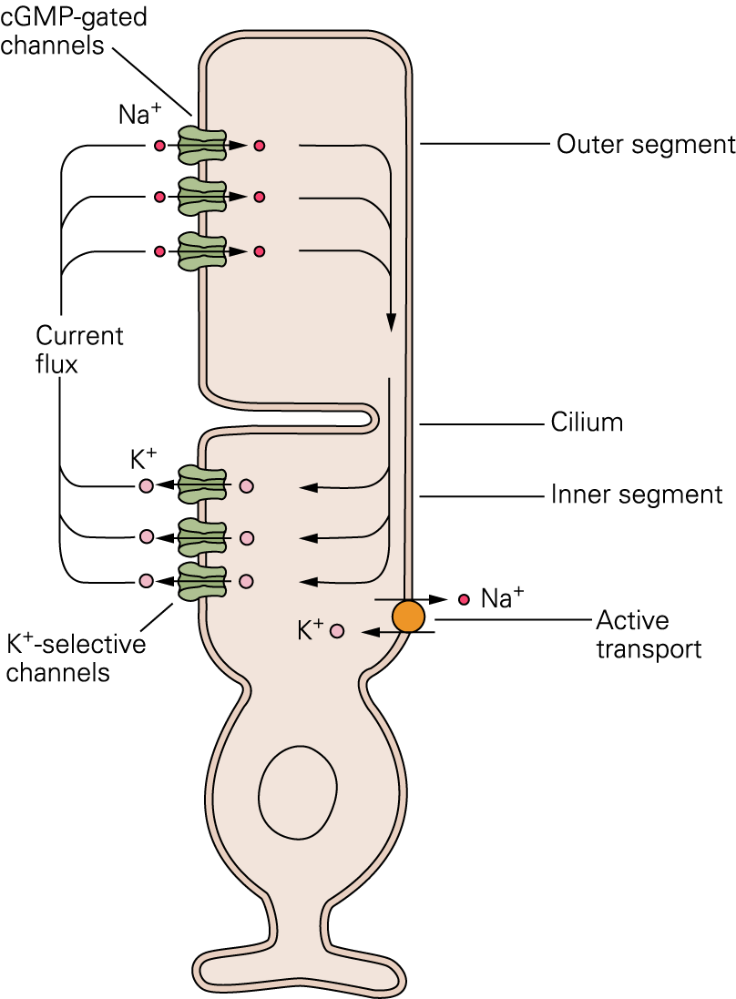
Phototransduction: Dark current
Partially active guanylyl cyclase keeps cytoplasmic [cGMP] high in the dark
Outer segment contains cGMP-gated cation channels
  Influx of Na⁺ and Ca²⁺
Inner segment contains non-gated K⁺ selective channels
  K⁺ efflux
Resting, or dark V_{m} is -40 mV
concentration gradients maintained by Na⁺/K⁺ pump
Notes:
Guanylyl cyclase synthesizes cGMP from GTP
Outer segment membrane has cation channels which remain open in the dark whereas inner segment has K+ channels that are not regulated by light.
Na+ (90%) and Ca++(10%) enter through cation channels in outer segment and K+ leaves inner segment, resulting in hyperpolarization (resting membrane potential of rods is ~ – 40 mV ) and ionic current called dark current.
Na-K pump removes Na+ from inner segment and Na-Ca exchanger removes Ca++ from outer segment to maintain concentration gradients.

Slide 12
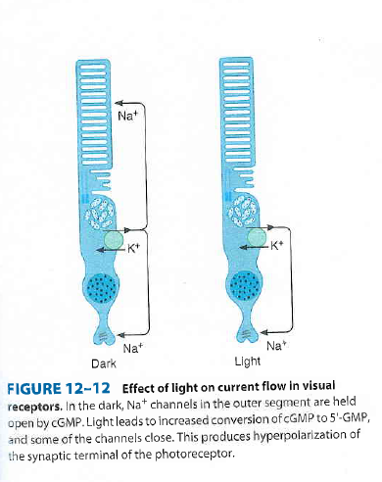
Ve tmě jsou sodíkové kanály drženy otevřené působením cGMP,
Proud teče od vnitřního segmentu k zevnímu
světlo kanály uzavírá – hyperpolarizace synaptických zakončení

Slide 13
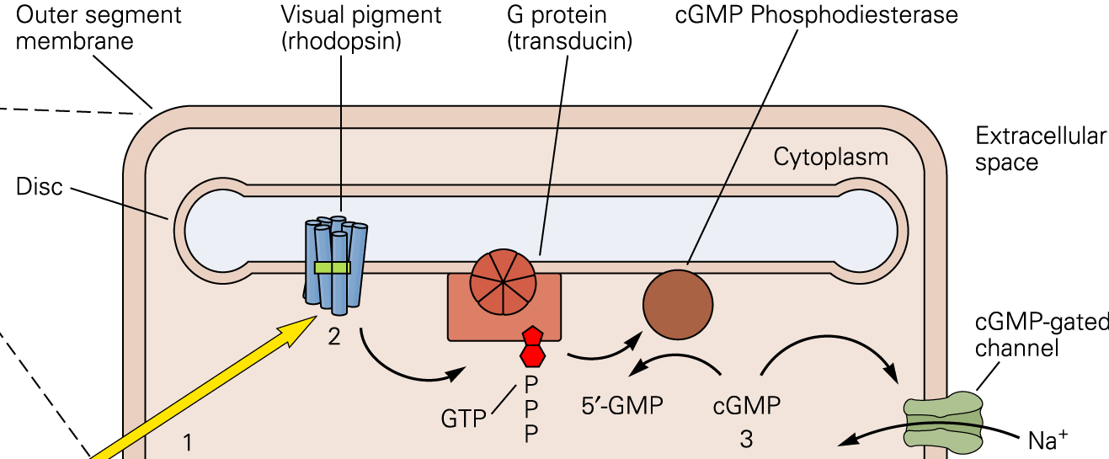
Phototransduction: mechanism
Opsin + retinen1
Zrakový pigment v tyčinkách
=rhodopsin,
Jeho opsin=skotopsin
Ve tmě je retinen1 v rhodopsinu
Ve formě 11cis- světlo přemění
Na all-trans izomer
light
Absorption of a photon isomerizes retinal fosfodiesteráza katalyzuje cGMP-5 GMP, uzávěr cGMPkanálů-hyperpolarizace-snížené uvolňování synapt.mediátoru-odpověď bipolárních buněk
  Converts opsin to metarhodopsin II
Metarodophsin II activates the G-protein transducin
  Activates cGMP phosphodiesterase (PDE)
PDE hydrolyzes cGMP to GMP
  Decreased [cGMP] closes cGMP gated cation channels
  Photoreceptor hyperpolarizes, less glutamate released
Notes:
transducin exchanges GDP for GTP
activated transducin (G protein) → activates cGMP phosphodiesterase → hydrolyzes cGMP to GMP (5’-guanylate monophosphate)→ ↓ [cGMP]i → closes cGMP-gated cation channels → hyperpolarization → ↓ neurotransmitter release
all-trans retinal separates from opsin (bleaching)
converts to retinol
translocates to the pigment epithelium where it is converted back to 11-cis retinal
returns to the outer segment and recombines with opsin
recycling process takes several minutes

Slide 14
RETINA
Its organized on layers
Visual receptors+4types of neurons.
Many different synaptic transmitters
Pigment epithelium
Absorps light rays, prevention the reflection of rays back through the retina
  Contains melanin to absorbs excess light
  Stores Vitamin A
Photoreceptors
  Transduce light energy into electrical energy
  Rods and cones
Ganglion cells
  Output cells of retina project via optic nerve
  Bipolar cells – 12 different types occur
  Horizontal cells
  Amacrine cells - 29types have been described
  The neural elements of retina are bound together by glial cells – Muller cells
Inner segments
Boron, Boulpaep, Medical Physiology, 2003
Notes:
Despite its peripheral location, the retina or neural portion of the eye, is actually part of the central nervous system.
There are five types of neurons in the retina: photoreceptors, bipolar cells, ganglion cells, horizontal cells, and amacrine cells.
Absorption of light by the photopigment in the outer segment of the photoreceptors initiates a cascade of events that changes the membrane potential of the receptor, and therefore the amount of neurotransmitter released by the photoreceptor synapses onto the cells they contact.
At first glance, the spatial arrangement of retinal layers seems counterintuitive, since light rays must pass through the non-light-sensitive elements of the retina (and retinal vasculature!) before reaching the outer segments of the photoreceptors, where photons are absorbed. The reason for this curious feature of retinal organization lies in the special relationship that exists between the outer segments of the photoreceptors and the pigment epithelium. The outer segments contain membranous disks that house the light-sensitive photopigment and other proteins involved in the transduction process. These disks are formed near the inner segment of the photoreceptor and move toward the tip of the outer segment, where they are shed. The pigment epithelium plays an essential role in removing the expended receptor disks; this is no small task, since all the disks in the outer segments are replaced every 12 days. In addition, the pigment epithelium contains the biochemical machinery that is required to regenerate photopigment molecules after they have been exposed to light. It is presumably the demands of the photoreceptor disk life cycle and photopigment recycling that explain why rods and cones are found in the outermost rather than the innermost layer of the retina. Disruptions in the normal relationships between pigment epithelium and retinal photoreceptors such as those that occur in retinitis pigmentosa have severe consequences for vision

Slide 15
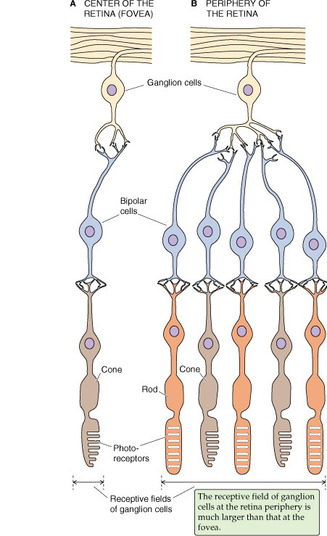
Periphery of retina
High degree of convergence → large receptive field
High sensitivity to light, low spatial resolution
Fovea
Low convergence → small receptive fields
Lower sensitivity to light, high resolution (visual acuity)
light
Electrical signal
Notes:
At the periphery of the retina there is convergence of synaptic input from many photoreceptors onto bipolar and ganglion cells, reducing spatial resolution because receptive fields are larger, but increasing sensitivity because more photoreceptors collect light
Outside fovea density of cones drops and density of rods rises; there are no photoreceptors at optic disc where ganglion cell axons leave retina (blind spot).
Fovea is region 300-700 μm in diameter located in center of retina and contains the highest density of cones
Over most of retina, light must travel through several layers to reach photoreceptors; at fovea layers of neurons are shifted aside, reducing distortion due to light scatter
Most photoreceptors in fovea synapse on only one bipolar cell which in turn synapses on only one ganglion cell, resulting in smallest receptive fields and greatest resolution

Slide 16
Neural circuits of retinal receptive fields
surround
centre
surround
Ganglion cell receptive field
P
P
P
_
_
B
B
H
H
On-center bipolar and ganglion cells
Off-center bipolar and ganglion cells
G
G
Notes:
On center bipolar cells hyperpolarized by glutamate
Off center bipolar cells depolarized by glutamate
Center photoreceptors always synapse onto bipolar cells of each type, on center and off center
Surround photoreceptors synapse on horizontal cells which mediate signals via lateral inhibitory connections

Slide 17
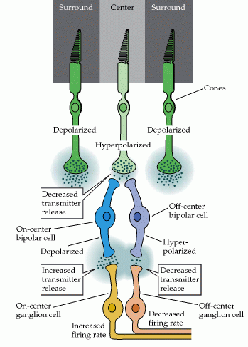
Neural Circuits of Retinal
Receptive Fields
light
Light stimulus on center:
↓ glu release from central photoreceptor
  ↓ inhibition of on-center bipolar cell → depolarization
    ↑ NT release → on-center ganglion cell excited
  less glu available to excite off-centre bipolar cell → hyperpolarization
    ↓NT release→ off-center ganglion cell inhibited
Notes:
On center bipolar cells hyperpolarized by glutamate

Slide 18
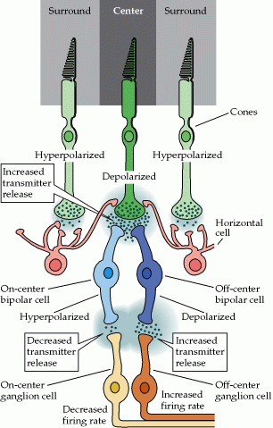
Neural Circuits of Retinal
Receptive Fields
light
light
Light stimulus on surround:
↓ glu release from surround photoreceptor
  ↓ excitation of horizontal cells → ↓ inhibitory NT released
    ↓ inhibition of central photoreceptor → ↑ glu released
    ↑ glu hyperpolarizes on-center bipolar cell and depolarizes off-center bipolar cell
    On-center ganglion cell inhibited, off-center ganglion cell excited

Slide 19
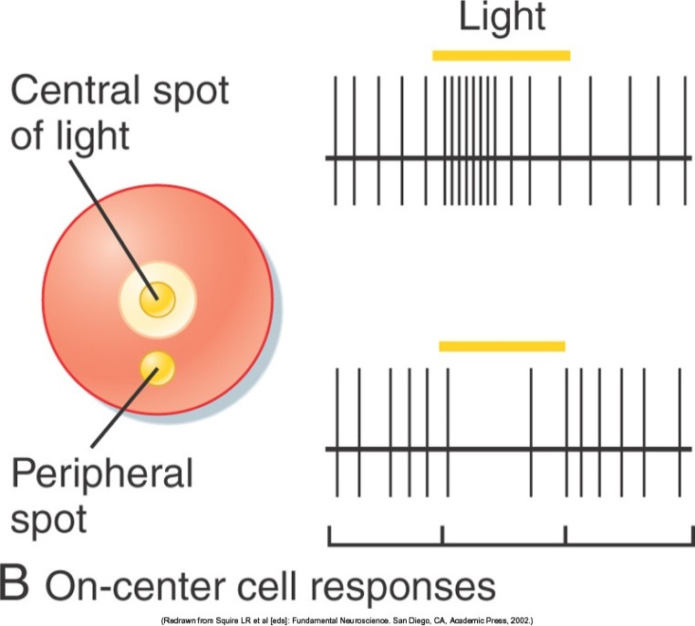
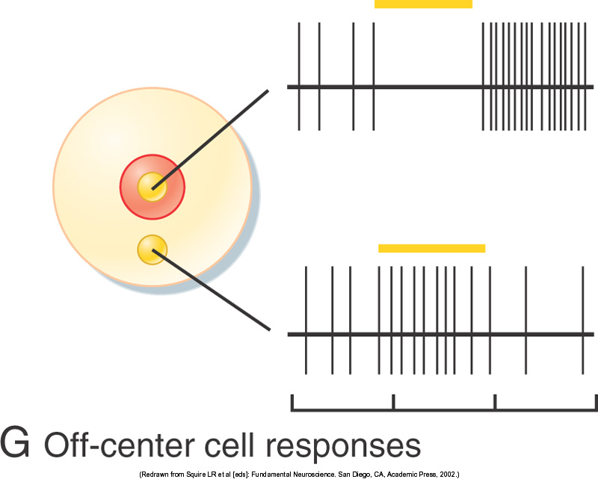
Receptive fields
On-center/off-surround
  Light shines on center of ganglion cell receptive field → ganglion cell increases AP firing
  Light on surround region → decreased AP firing
Off-center/on-surround
  Light on center → decreased AP firing
  Light on surround → increased AP firing
B&L Figure 8-8
Notes:
Always have a tonic release of AP, but their frequency is mediated by center/surround receptive fields

Slide 20
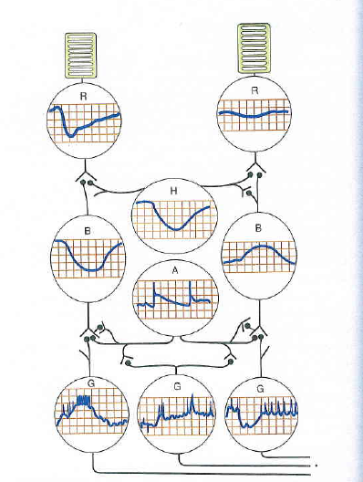
Tyčinky a čípky reagují na světlo hyperpolarizací
Horizontální buňky - hyperpolarizací
Bipolární buňky hyperpolarizací nebo depolarizací
Amakrinní – depolarizační potenciály a hroty
typu generátorového potenciálu sloužící pro vznik
AP v gangliových buňkách

Slide 21
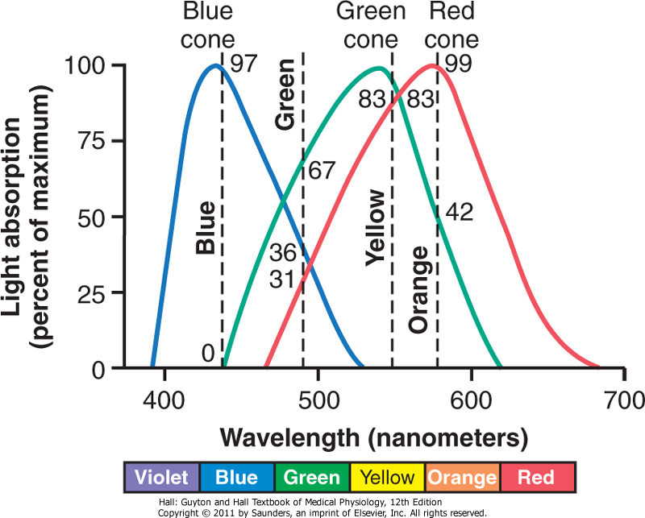
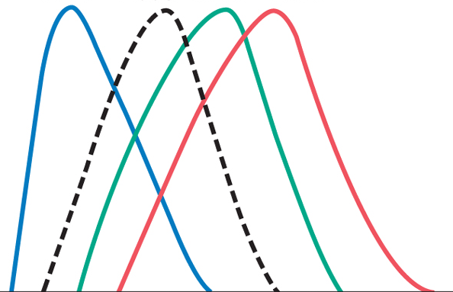
Colour Vision
Vnímání barev je dáno poměrem frekvence vzruchů ve 3
Systémech čípků
3 types of cones, each contain photopigment with different absorption spectra
  420 nm – blue
  530 nm – green
  560 nm - red
Colour interpreted by ratio of cone stimulation
  Orange (580nm) light stimulates:
    Blue cone – 0%
    Green cone – 42%
    Red cone – 99%
  0:42:99 ratio of cone stimulation interpreted by brain as orange
Rod
Guyton Figure 50-8
Notes:
Cones actually respond to violet, yellow-green, and yellow-red but called blue green red by convention
Rod peak wavelength at 500nm
Red green colour blindness: red or green cones missing, therefore cannot distinguish red from green because the colour spectra overlap.

Slide 22
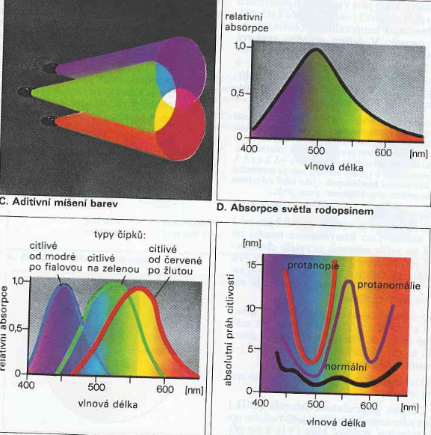

Slide 23
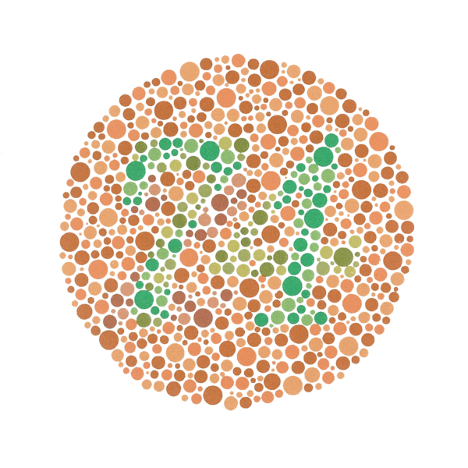
Notes:
The spots are arranged so that a normal vision person sees a 74, whereas a red-green colour blind person sees a 21

Slide 24
Binokulární vidění
Okohybné svaly –společná jednotka
Funkce obou očí – kyklopské oko
Fixujeme-li předmět a jiný je blíže – heteronymní diplopie (vidíme jej zkříženě a dvojitě)
Fixujeme-li předmět a jiný je dále – homonymní diplopie

Slide 25
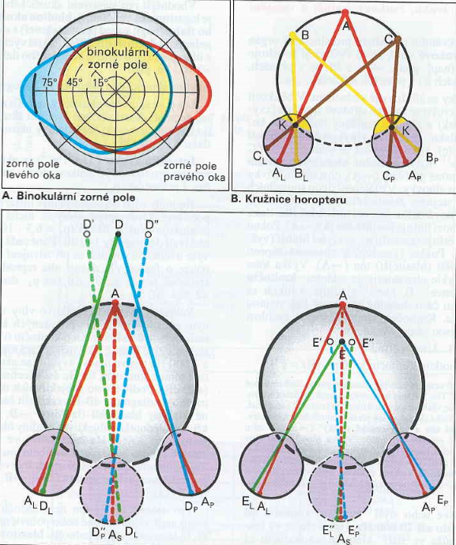

Slide 26
Hloubkové vidění - stereoskopické
Vzniká transformací trojrozměrného prostoru na dvojrozměrný v receptorech sítnice
Teorie vysvětluje toto vidění projekcí předmětů na tzv.korespondující a nekorespondující body sítnice
Korespondující – to jsou ta místa kam je promítán obraz bodu fixovaného foveou – tyto body definují horopter (množina všech bodů v prostoru, jejichž obraz dopadá na korespondující místa
Geometrická aproximace – horopterová kružnice
Fúze (splynutí obrázků obou očí v jeden prostorový)

Slide 27
SLUCH

Slide 28
Spánková kost
Bubínková dutina
Kladívko
kovadlinka
Třmínek – překrývá foramen ovale
m. tensor tympani
Bubínek – přechod mezi vnějším a středním uchem
(funkčně patří ke střednímu uchu)
Foramen rotundum

Slide 29
Střední ucho – zabezpečuje převod akustických signálů vzduchem
Vnitřní ucho – místo receptorů
Scala vestibuli
Membrana vestibularis
membrána tectoria
Vláskové buňky
foramen rotundum
Eustachova trubice
20 000Hz 1 500
Eust.tr.-vyrovnání vzdušného tlaku ve středouší s vnějším barometrickým, normálně je uzavřená

Slide 30
Struktura vláskové buňky
Laterálním pohybem vlásků se dráždí receptor
– receptorový potenciál

Slide 31
Kostěné a blanité struktury vnitřního ucha
vestibulum
Pro rovnovážný smysl sluchový i rovnovážný

Slide 32
perilymfa
endolymfa
Scala tympani scala media
Scala media
Membrana
tectoria
Intenzita zvuku se kóduje jako amplituda
receptorového potenciálu, v dostředivých vláknech
Jako frekvence AP; vyjádření v decibelech
Výška tónu s frekvencí (počtem vln/čas)
vnitřní vnější
vláskové buňky

Slide 36
ČICH

Slide 37
Tractus olfaktorius
Sekundární čichové neurony
Chemoreceptory
čichové sliznice
Drážděny látkami, které
se rozpustí v nosovém hlenu,
plocha 5 cm²
Fylogeneticky nejstarší smysl
Henningova klasifikace pachů:
Květinový, ovocný, živicový,
Kořenitý, hnilobný, spáleninový
Citlivý smysl
(metylmerkaptan=česnek-400pg/1 l vzduchu)
receptory se rychle adaptují
Hypoosmie –anosmie -hyperosmie
Bulbus olfaktorius
Řasinky čichových receptorů-primární senzorické neurony
Poznámka: nervová zakončení vláken n.trigeminus – čpavek, mentol, chlor-spouští se reflexní odpovědi na dráždivé látky – zastavení dýchání, kýchání, slzení

Slide 38
CHUŤ

Slide 39
Chuťové pohárky a chuťové chemoreceptory
drážděny chuťovými látkami rozpuštěnými ve slinách
Chuťové receptory v pohárkách na sliznici jazyka,
epiglottis, patře a faryngu
Vejcovitý tvar, 50-60mikrom, 40 vlastních chuťových
Receptorů=vláskové buňky přečnívající do ústní dutiny
Aferentní vlákna přiléhají na spodinu chuťové buňky
(50 vláken na 1 pohárek)
Základní chutě: sladká (hrot jazyka)-slaná (zadní okraje)
-kyselá (přední okraje)-hořká (kořen jazyka)
Návrh na 5.typ: umami

Slide 40
Chuťové dráhy
Z předních 2/3 jazyka
–chorda tympani – nervus trigeminus
Ze zadní části – nervus glossopharyngeus
Ncl.tractus solitarius v prodl.míše
Receptory jsou také adaptabilní,
Nízká rozlišovací schopnost mezi dvěma látkami
Neustále se obnovují
Hypogeuzia (pokles chuťové aktivity)
Ageuzia - hypergeuzia
Tractus solitarius
n.facialis
Chorda tympani
n.trigeminus
n.glossophar.

