Slide 1
1. hypovolemia/shock
2. pulmonary embolism
3. acute myocardial infarction
Ivan Čundrle, Pavel Suk, Jan Hruda
ARK, FNUSA
2016

Slide 2
Shock in general

Slide 3
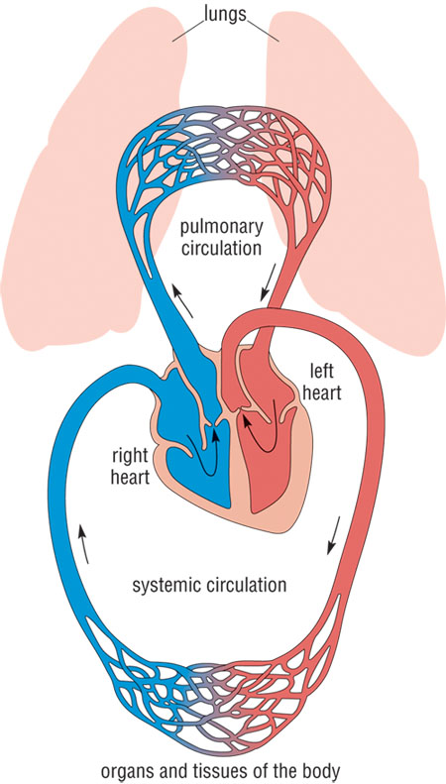
Shock
Circulatory failure – supply ≠ demand
1. cardiogenic – pump
2. obstructive – obstruction
3. hypovolemic – filling
4. distributive - shunts
2.
1.
3.
4.

Slide 4
Phases of Shock
Compensation
Decompensation
Refractory
Inflammatory cascade induction and organ damage - „secondary-hit model“
Organ damage further increases inflammatory cascade induction – vicious circle
Each type of shock differs at the beginning, however during the late phase all types of shock look similar (like distributive shock)

Slide 5
Pathophysiology
The main problem is cell hypoxia
Stress response
  catecholamines, RAAS, cortisol, glucagon
Systemic inflammatory response
  Imunity, inflamatory mediators
  Localy OK, but generalized response is harmful

Slide 6
Pathophysiology
1. Macrocirculation
  „blood flow centralization“
  rarely „warm shock“
2. Microcirculation
  Endothelium damage
  Increased vascular leakage, leucocytes adherence
  Main role in shock
3. Coagulation
  Intravascular coagulation
4. Metabolism
  Increased gluconeogenesis, proteolysis
  Lactate acidosis

Slide 7
MODS
1. Circulation
  Vasoplegia, cardiomyopathy
2. Lungs
  ARDS
3. Kidney
  AKI
4. Coagulation
  DIC
5. CNS
  Altered consciousness
6. GIT
  Loss of barrier function

Slide 8
Signs/Symptoms
Nonspecific
Variable
Unreliable
Hypotension, tachycardia:
  SBP < 90 mmHg
  MAP < 60 mm Hg
  Tf > 100/min
  Cave compensatory shock/BB
Oliguria:
  diuresis < 0,5 ml/kg/hr for 1 – 6hrs
Tachypnea
  > 30 breaths/min, dyspnea
Skin:
  Wet, cold
  CRT(> 2 s)
Mental state:
  Confusion
  Iritation
  coma

Slide 9
Diagnostics
1. Basic Lab
  BC, coagulation (Q/INR, aPTT, fib)
  ions, gly
  urea, kreatin
  CRP (sepsis?)
2. ABG
  Ventilation/oxygenation
  Lac, SvO2, ScvO2

Slide 10
ABG
Lac
ScvO2
Product of anaerobic glycolysis
Non-toxic, serves also as a fuel
normal < 2 mmol/l
Mortality predictor
Early sign
O₂ER = (SaO₂ – SvO₂) / SaO₂, normaly 25%
normal SvO₂ is 75%
SvO₂ < 70% = O₂supply impairment

Slide 11
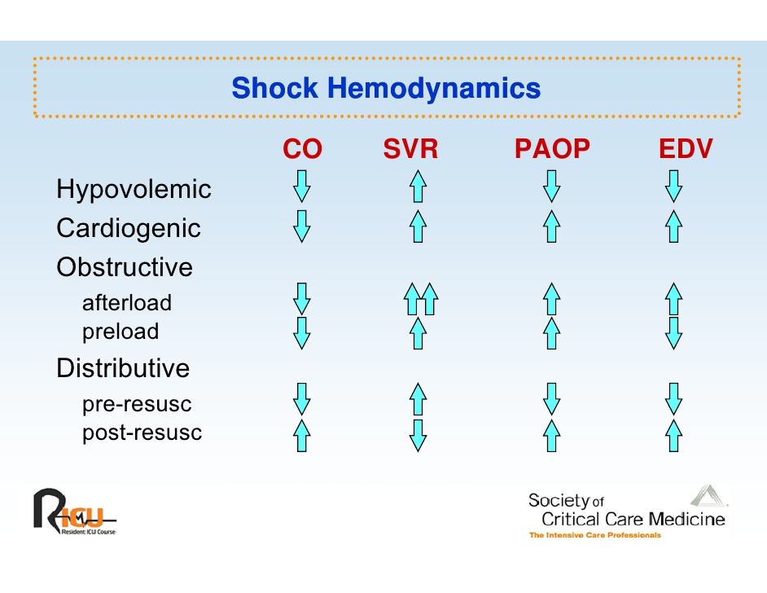
Extended Hemodynamics

Slide 12
Initial resuscitation
Preload optimization – increasing CO, fluids „volume challenge“, PLR
Persistent hypotension – catechols (norepinephrine)
If CO does not rise with fluids, add inotropes (dobutamin)
Lowering of inadequately high afterload (hypertension crisis)

Slide 13
Causal treatment
1. Cardiogenic shock:
  SCG - PCI
  Arrhythmia treatment (AV block III., VT)
2. Hypovolemic shock:
  fluids
  hemotherapy
  damage control surgery/damage control resuscitation
3. Obstructive shock:
  thrombolysis
  Pericardial effusion evacuation

Slide 14
1. Hypovolemic Shock

Slide 15
Most common Causes of Hypovolemia
Bleeding
Loss of fluids (sweating, vomiting, diarrhea, ....) inadequate intake
Burns
3rd space losses
  Ileus
anafylaxis, sepsis (relativ hypovolemia)

Slide 16
Treatment
Initial resuscitation
Causal treatment
Goal is to restore organ perfusion, O2 supply
Early initiation
Secondary goal: restoration of O2 transportation capacity (ERY...)

Slide 17
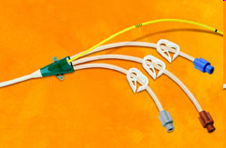

Venous access
2-3 thick peripheral cannulas
Central venous access is secondary (good for catecholamine, not fluids)
Exception: thick central lines (Edwars AVA 9F)

Slide 18
Arterial Catheter
Continuous blood pressure monitoration
accurate
PPV
Repeated blood draws

Slide 19
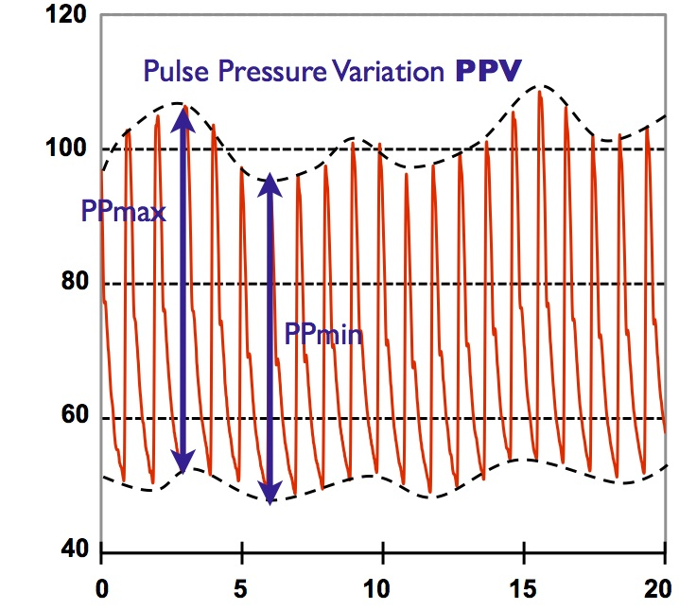
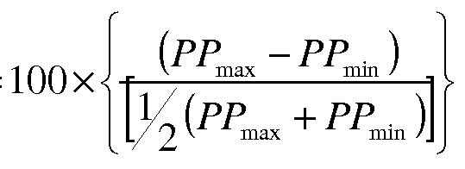
SPV / PPV

Slide 20
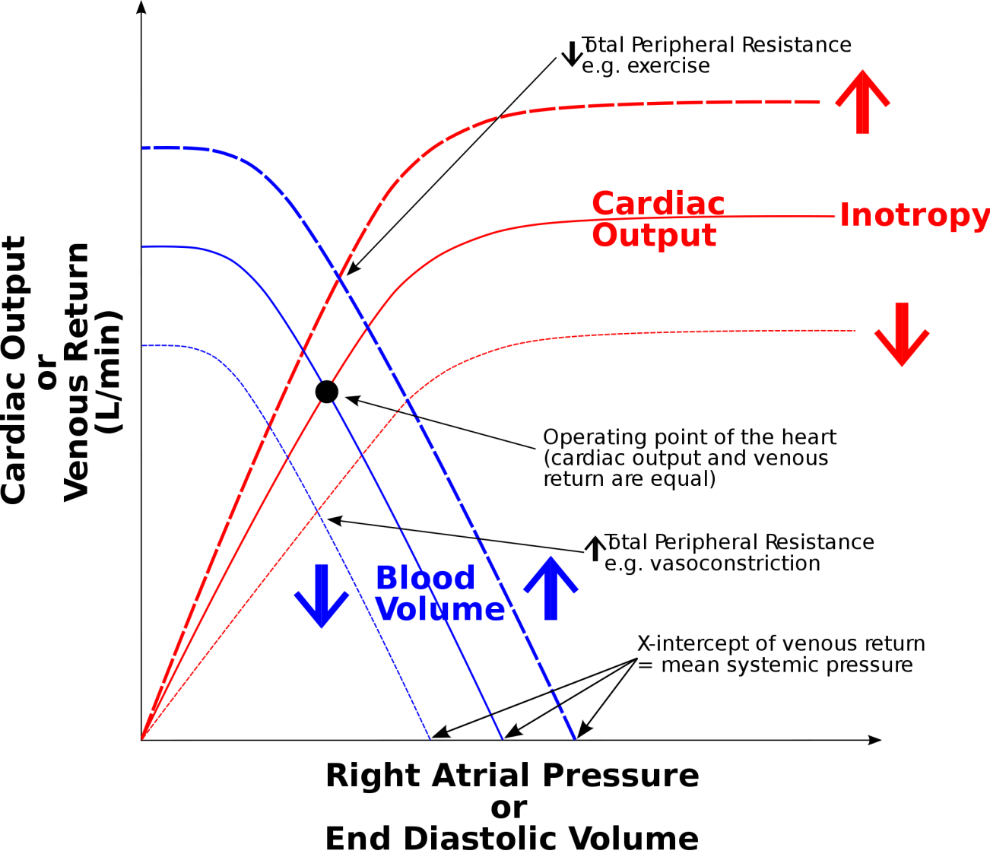
SPV / PPV

Slide 21
Witch fluid to use?
Ions Na⁺ and K⁺ - ICT/ECT distribution
Oncotic pressure plasma/ECT distribution
ECT 20%
ICT 40%
4%

Slide 22
Glucose
Inadequate
Absolute water deficit
Hypernatremia correction
ECT 20%
ICT 40%
4%
Distribution volume

Slide 23
Crystaloids
Fast leak into the ECT compartment
Substitution has to be 4x higher than the deficit (...recently questioned) → swellings
ECT 20%
ICT 40%
4%
Distribution volume

Slide 24
Coloids
Do not leave the intravascular compartment
Equal the deficit
Adverse reactions, contraindication – sepsis – renal damage
Good for acute blood loss
ECT 20%
ICT 40%
4%
Distribution volume

Slide 25
Blood products
Only for blood loss corrections
5% albumin – natural colloid
  expensive

Slide 26
Fluid resuscitation goals
Blood pressure, heart rate
Centralization reversal
diuresis
Decrease of the PPV / SVV
Sc(v)O2 a lactate normalization
Filling pressures(CVP, PAOP) not a good target

Slide 27
Acute bleeding
Blood loss
fractures
15% (750 ml) well compensated
30% (1,5 l) – tachycardia, oliguria, normotension – however ↓ organ perfussion!
More than 30%: hypotension, tachycardia, oligo-anuria, ...
pelvis (5000ml)
femur (2000ml)
tibia (1000 ml)
humerus (800 ml)
radius (400ml)

Slide 28
Treatment
Basic approach ... ABCD
Stop the bleeding
Give i.v. Fluids + catecholamine
Blood type O- (4 immediately available), after 30 minutes type matched
Fresh frozen plasma 1:1 with erythrocytes
Target Hb 70-90 g/l, CNS trauma 100g/l
Thrombocytes 50 – 100 tis/ul
Fibrinogen 1,5 g/l
Prevent hypothermia, hypotension and acidosis

Slide 29
2. Cardiogenic shock/ AIM

Slide 30
AIM
Myocardial ischemia
Causes
Increased demand – tachycardia
Low oxygen content – anemia, CO poisoning, hypotension, pulmonary disease
Low coronary artery blood flow
90 % low coronary artery flow – coronary atherosclerosis
Transmural ischemia – 3/4 of the myocardial wall (complete closure)
Laminar/subendomyocardial – 1/3 of the myocardial wall (partial closure + increased demand)

Slide 31
Diagnostics
Patinet history/clinical evaluation
ECG a Lab
ECHO, SCG
 | STEMI | NSTEMI | AP
History | Chest pain | Chest pain | Chest pain
ECG | ST elevation at least 2 mm in leads V1–V3 or at least 1 mm in V4–V6, I, aVL, II, III, aVF. ST elevation in at least two adjacent leads. New LBBB or (RBBB + LAH, RBBB + LPH). | ST depression at least 1 mm and /or T wave inversion | ST depression at least 1 mm and /or T wave inversion
Lab | Positive TNT | Positive TNT | Negative TNT

Slide 32
Localization
Anteroseptal | V1-V4
Anterolateral | V1-V6
Lateral | I, aVL, V5, V6
Lower/diafragmatic | II, III, aVF

Slide 33
Treatment
Continuous vital signs / ECG
IV access
Oxygen 4–8 l/min
12 lead ECG
Blood draw – Lab /TNT
Analgosedation - morphine
ASA 500 mg i.v./200–400 mg p.o.
heparin 5000 j i.v./enoxaparin 1 mg/kg s.c./i.v.
clopidogrel 300 nebo 600 mg p.o.
metoprolol i.v. If tachycardia

Slide 34
Cardiogenic Shock
Severe, long-lasting arterial hypotension
Low CO
Increased filling pressure CVP/PAOP
Alteration of consciousness, oliguria, cold periphery, sweat, cyanosis

Slide 35
Treatment
Most important is to increase oxygen supply and lower oxygen consuption by myocardial muscle
Preload optimalization: diuretics/fluids
Afterload optimalization: vasodilatation / cave coronary arthery perfussion
Inotropy – dobutamin
Treatment of the cause – PCI/thrombolysis

Slide 36
Avoid
Tachycardia – short diastolic phase, increased work load (however, sometimes only chance how to increase CO)
Severe hypotension, hypovolemia, vasodilatation – low coronary artery perfusion pressure (Ao pressure – EDP LV)
Increased preload/afterload – increase of wall tension, work

Slide 37
Treatment
Oxygen – increase O2 supply
NIV, invasive ventilation – oxygenation, decreases preload/afterload
Diuretics/fluids – decrease preload, in later phase optimization of preload (fluid challenge/PLR)
Catecholamine – norepinephrine for blood pressure, dobutamin (milrinon, levosimendan) for inotropy
Vasodilatancia – nitrates, coronary artery, but also systemic vasculature ( increased blood pooling, preload lowering; arterial – afterload lowering)
Morphine – improves dyspnea

Slide 38
3. Obstructive shock/ PE

Slide 39
Pulmonary Embolism
Sudden obstruction of pulmonary vasculature with emboli (blood cloth, fat, tumor, air/gas, foreign body, ...)
Etiology:
85% low extremity/pelvic DVT

Slide 40
Risc Factors
Virchov trias - venostasis, hypercoagulation, vessel wall damage
Major surgery
Lower extremity fractures
Hypercoagulation (Leiden ...)
Heart Failure (blood stasis)
Sepsis (coagulation activation)
High age (70 years)
Immobilization
Obesity
Pregnancy
Economy class syndrome
corticoids, diuretics, HAC

Slide 41
Diagnosis
History
Sudden dyspnea, chest pain, tachypnea, cough, syncope, hemoptysis
Clinical evaluation
tachypnea, cyanosis, hypotension, shock, tachycardia, neck veins distension
Lab
ABG - hypoxia, hypocapnea, Ralc
DD- negative – practically excludes PE
DD- positive – tumors, inflammation, post-surgery, sepsis ...

Slide 42
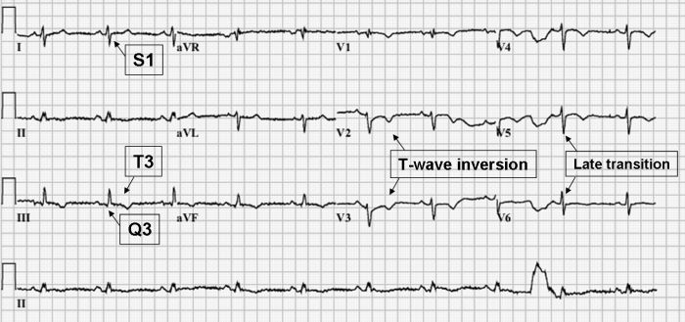
EKG

Slide 43
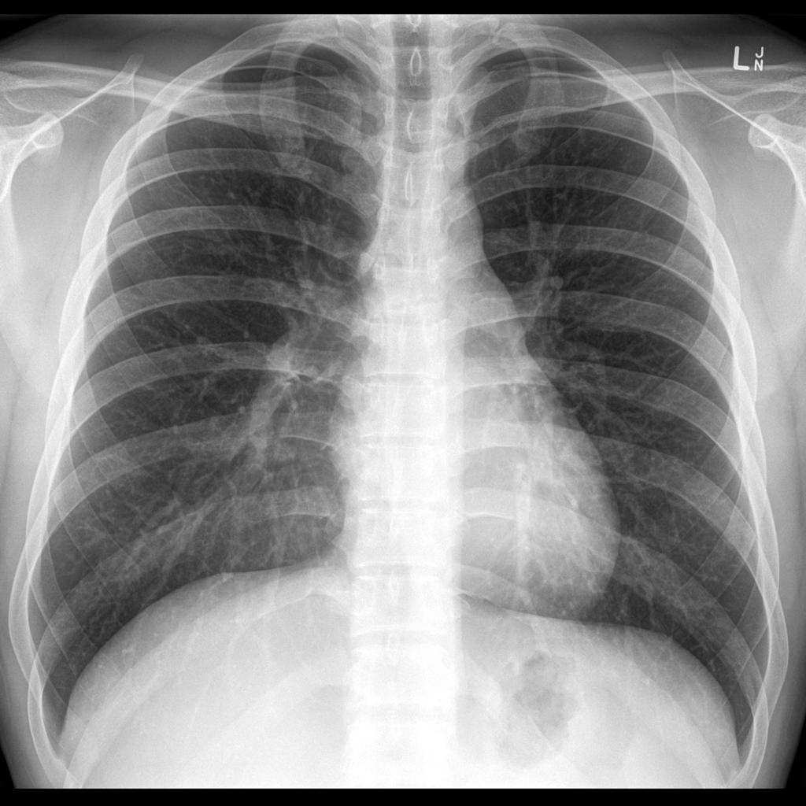
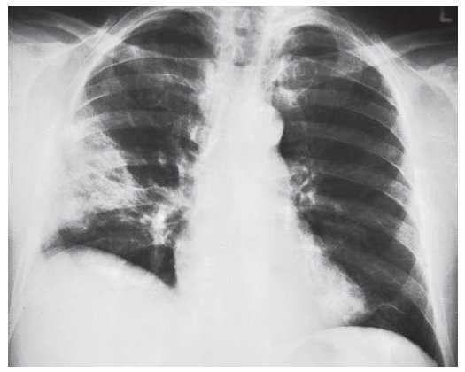
Chest X-ray
Excludes other reasons for dyspnea
Fleischman sign- atelectasis
Westerman sign – decreased pulmonary vascularization

Slide 44
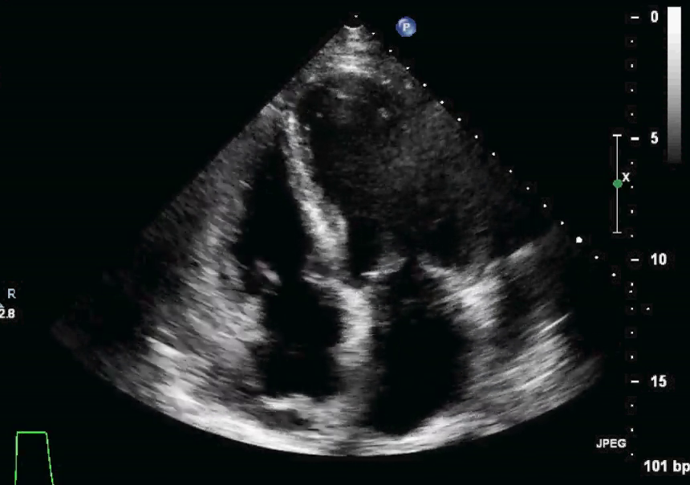
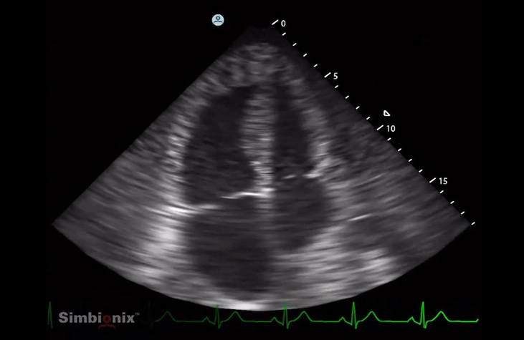
ECHO
RV dilatation, paradoxical septum movements, pulmonary hypertension, Tri regurgitation

Slide 45
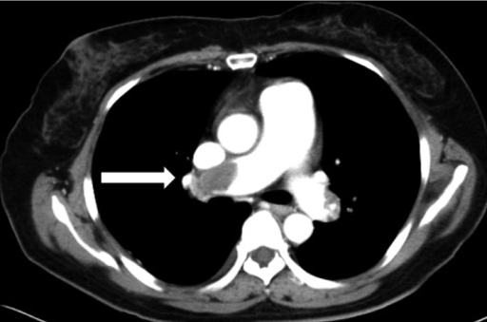
CT - AG

Slide 46
Other
Vein US – femoral, popliteal
TEE – thrombus in pulmonary artery
Swan-Ganz - precapillary PH, high CVP, high RV pressure, increase PAP,
Ventilation/perfusion scan – low specificity

Slide 47
Managment
Clinical probability, DD, echo and CT angio
Signs of DVT | 3 | Clinical probability: low 0-1 (3,4%) moderate 2-6 (20%) high 7 (63%) 0-4 PE less probable More than 4 - PE highly probable
Other dg improbable | 1,5
Tachycardia 100 | 1,5
Immobilization more than 3 days, surgery within 4 weeks | 1,5
DVT, PE in history | 1,5
hemoptysis | 1
malignancy | 1

Slide 48
1. High risk PE (shock, hypotension)
CT angio or ECHO, if CT unavailable/impermissible for the patient
CT/ECHO positive - trombolysis

Slide 49
2. Low risk PE (without shock/hypotension)
High clinical suspicion – CT angio
Low clinical suspicion – DD
Negative DD nearly completely exclude PE
TNT, NT pro BNP, RV dysfunction – thrombolysis/heparinization

Slide 50
Massive PE – unstable or RV dysfunction, TNT, NTproBNP
Thrombolysis – optimally within 48 hrs
alteplasis (0,9mg/kg)—10 mg bolus iv. + 90 mg cont. iv. for 2 hrs
+ heparin for min 72 hrs - UHF 80 IU/kg bolus + 18 IU/kg/hr

Slide 51
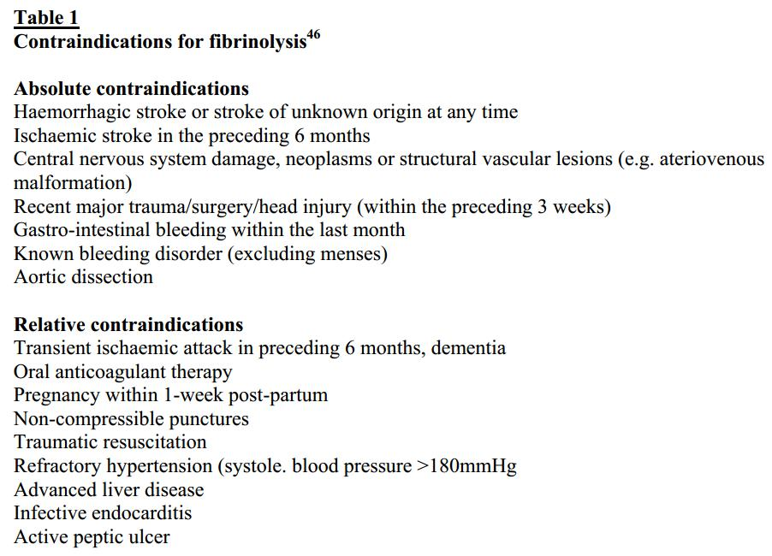
Thrombolysis contraindications

Slide 52
Small PE
UF heparin – bolus 80IU/kg + 18IU/kg/hr—aPTT 1,5-2,5 times norm
At least 6-10 days, than warfarin
LMWH- as effective as UHF, s.c. every 12 hrs
At least 6-10 days, than warfarin
Cave – renal dysfunction, antiXa (terap. 0,6-1,0 U/ml) 3 hrs after administration

