Slide 1

Sepsis and septic shock
Pavel Suk
Intensive Care Unit
St. Anne’s University Hospital

Slide 2
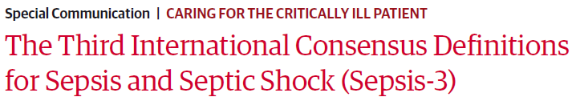
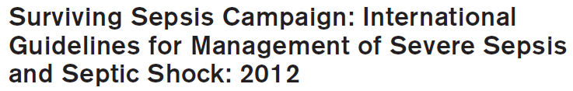
Mervyn Singer, JAMA 2016
R. Phillip Dellinger, Crit Care Med 2012

Slide 3
Definition I.
Sepsis = life-threatening organ dysfunction caused by a dysregulated host response to infection
organ dysfunction
  SOFA ≥ 2
  Quick SOFA (qSOFA) ≥ 2
    Respiratory rate > 22/min
    Altered mentation (GCS < 15)
    Systolic blood pressure < 100 mmHg
mortality > 10 %

Slide 4
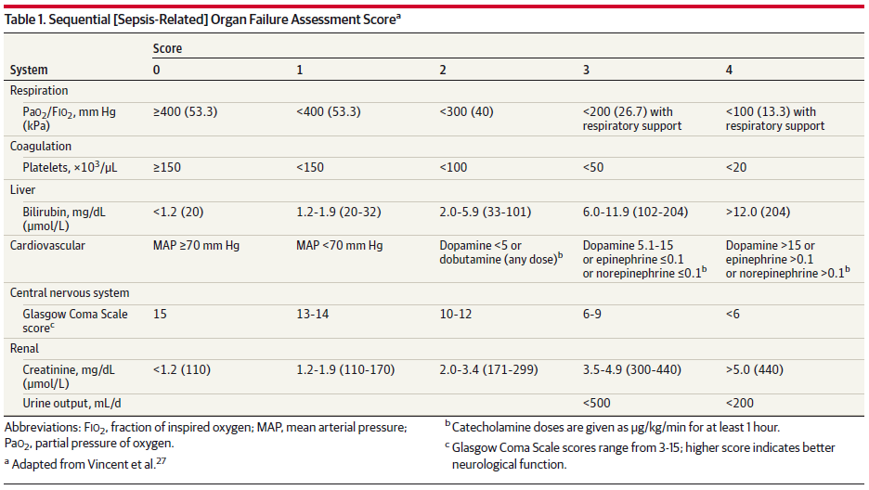
SOFA = Sequential [Sepsis-Related] Organ Failure Assessment Score

Slide 5
Definition II.
Septic shock
  hypotension despite adequate fluid resuscitation
  vasopressors to maintain MAP > 65mmHg
  serum lactate level > 2 mmol/L
  mortality > 40 %

Slide 6
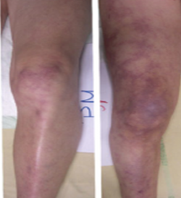
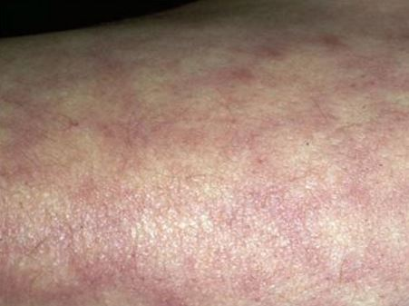
Initial Resuscitation
haemodynamics - signs
  tachycardia
  hypotension
  tissue hypoperfusion
    elevated lactate (> 2 mmol/l)
    low SvO₂ / ScvO₂
    skin mottling
    low urine output
    altered mental status

Slide 7
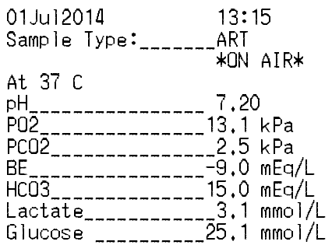
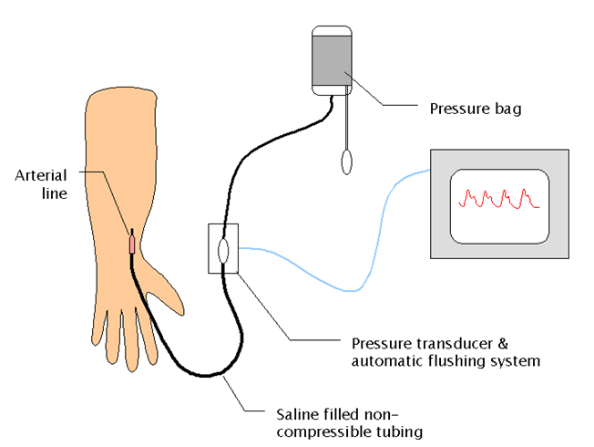
heamodynamics - monitoring
  clinical signs
  urine output
  lactate dynamics, SvO₂/ScvO₂
  echocardiography
  cardiac output measurement
  invasive blood pressure

Slide 8
haemodynamics – therapy
  correct hypovolaemia
    rapid crystalloid infusion (fluid challenge)
  maintain MAP > 65 mmHg
    vasopressors – titrate norepinephrine
  serial lactate levels / ScvO₂ trend monitoring
  iontropic support
  transfusion trigger as ussual

Slide 9
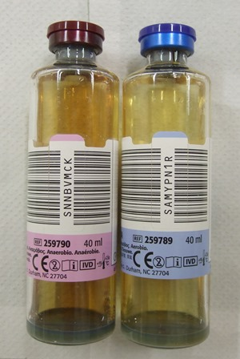
Microbial diagnostics
cultures from relevant sites (urine, throat, sputum, tracheal aspirate, wounds, abscess, bile,…)
at least 2 sets of blood cultures
(aerobic/anaerobic)
all before administration of AB

Slide 10
Antimicrobial therapy
intravenous antimicrobials within the 1st hour
activity against all likely pathogens (based on [likely] source of sepsis)
  usually broad-spectrum antibiotics
daily reassessment (change, de-escalation)
duration of therapy typically 7 to 10 days
  based on clinical course, PCT

Slide 11
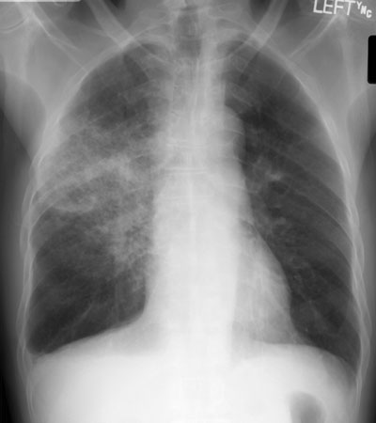
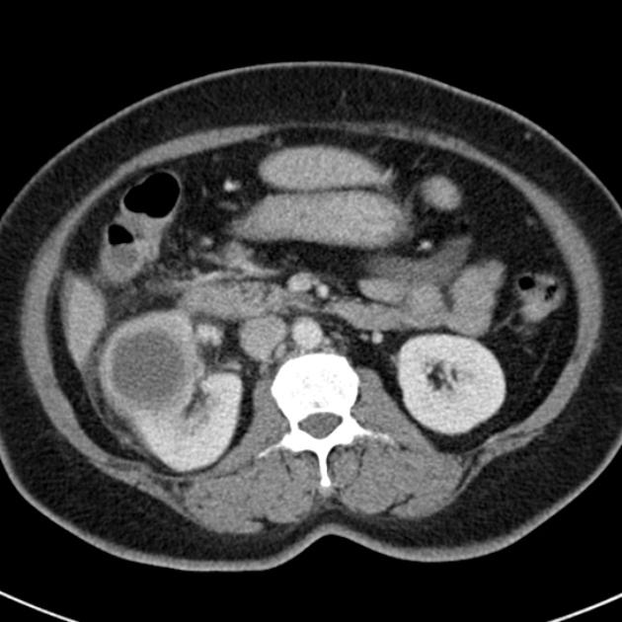
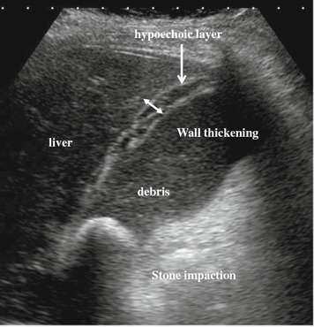
Source control
dignostics (imaging, puncture, surgery) to diagnose and control source of sepsis (ASAP, within 12 hrs)
mini-invasive approach preferred (CT guided drainage)
if catheters are possible source → remove/exchange

