Slide 1
Orbit
MUDr. Hana Došková, Ph.D.

Slide 2
Fractura orbitae
Anatomy
Canalis opticus
Fissura orbitalis superior
Fissura orbitalis inferior

Slide 3
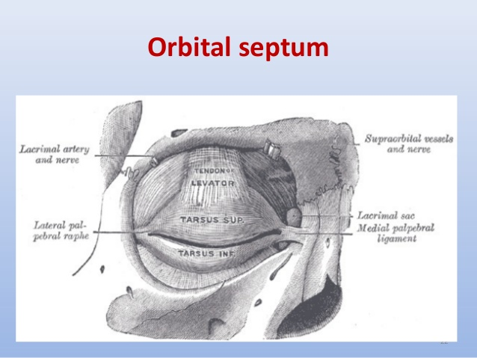

Slide 4
Fracturae of orbit
Roof - frontobasal, orbitofrontal
Lateral wall – orbitozygomatic
Medial wall – orbitoetmoideal
Floor – retromarginal, „blow out fracture“

Slide 5
Fracture of roof
Cause – failing on a sharp object, blow to the
Forehead
Signs: hematoma of the upper eyelid, disturbance of craniofacial bones
Small fractures require no treatment Fractures extending into the anterior cranial fossa - competence NCH Damage visual functions - ischemic neuropathy n. II
Therapy ischemic neuropathy: decompression optical channel or megadoses of methylprednisolone

Slide 6
Fracture of lateral wall
Cause - blunt trauma on cheekbones
Usually part of zygomatikomaxilárního complex (ZMK)
Symptoms: pain, hematoma of eyelids, conjunctiva chemosis, visual disturbances and eyeball displacement (diplopia, enophthalmos)
Dg. - CT, NMR
Treatment - Indications for surgery is persistent diplopia, limited mouth opening and flattening of the facial region

Slide 7
Orbit fracture
Fractura of ZMK
Isolated fracture of lateral wall

Slide 8
Medial wall fracture
Cause - blunt trauma
Symptoms - hematoma eyelid , subcutaneosu emphysema develops on blowing nose
Dg. - CT
Treatment – release of entrapped tissue

Slide 9
Blow out orbital floor fracture
Cause – sudden increase in the orbital pressure by a striking object ( larger than 5 cm)
The symptoms - swelling, hematoma of eyelids pseudoptóza, diplopia, inability to move the eyeball upwards (seriously elevation).
Paresthesia, hypoesthesia in n.infraorbitalis.

Slide 10
Blow out orbital floor fracture
Dg. - X-ray orbit, CT
Symptom - hammlock - wide breaking orbital floor. Significant enophthalmos, without incarceration of m.r. inf. Symptom - hanging drop - fisure fracture with soft tissue entrappment
Double diplopia Test passive duction Treatment - Surgery – in case of entrappemnt (in 3-5 days -resolved orbital hematoma).

Slide 11
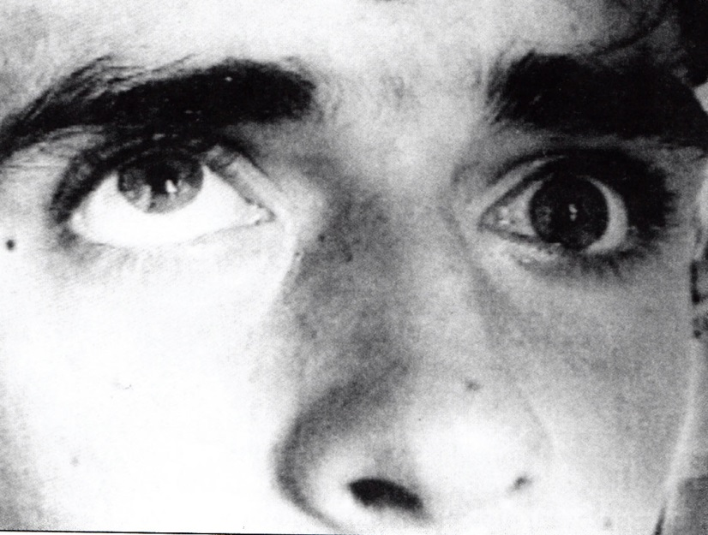
Blow out orbital floor fracture

Slide 12
Disease of lacrimal gland
Acute dacryadenitis – rare, in isolation
S: swelling of the lateral aspect of the eyelid – charakteristic „S“ shaped ptosis
T: usually is not required
Tumors: Lacrimal gland carcinoma - high mortality and morbidity
T: surgery and radiotherapy

Slide 13
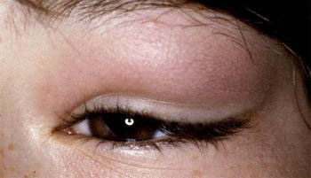
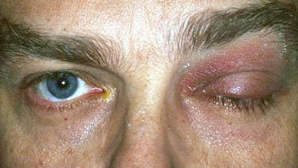
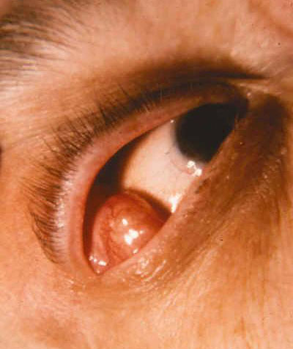
Disease of lacrimal gland
Dacryadenitis
Pleomorfic adenoma

Slide 14
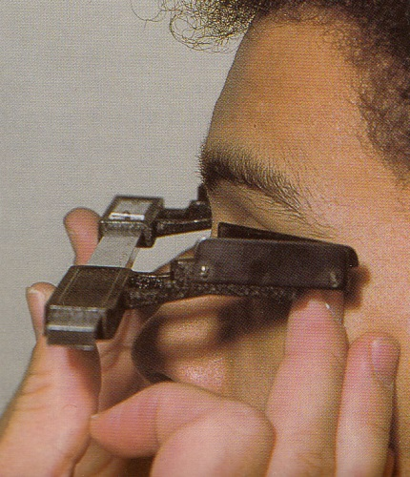
Helter exophtalmometr
Measurement of the position of the eye Hertel exoftalmometr measures the distance corneal apex - the external edge of the bony orbit (diameter 17 mm, above 20 - pathology)
Side difference to 2 mm - physiological
Always should be recorded the distance of the outer edges of the orbits

Slide 15
Disease of orbit
Pulsatile proptosis - the carotid cavernous fistula – abnormal communication btw vein and artery ( carotid artery and orbital cavernous sinus vein )
Intermittent proptosis - a symptom of vascular malformations in orbit (varix) - Valsalva maneuver
Pseudoproptosis - high axial myopia enophthalmos

Slide 16
Disease of orbit
Axial proptosis - only in the sagittal plane (Graves' disease, orbitocellulitis )
Paraaxial proptosis - lesions of peripheral lateral space (lacrimal gland tumors, frontoetmoidal mucocele, tumors of PN sinus)
Bilateral proptosis - thyreotoxicosis and EO

Slide 17
Examination of orbit
X ray
Ultrasound
CT
NMR

Slide 18
Inflammation of orbit
Etiopatogenesis:
Microbial infection Immune responses hyperergická-allergic-type Endocrine ophthalmopathy (Graves disease)
Microbial infections:
orbitocellulitis phlegmone orbit abscess of orbit Tenonitis myositis orbitalis Inflammatory pseudotumor of the orbit

Slide 19
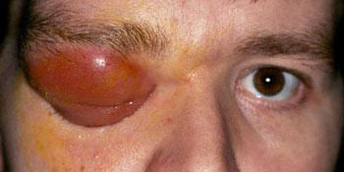
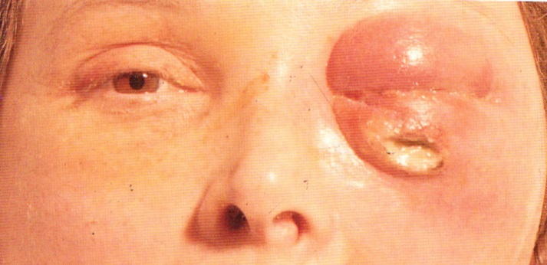
Inflammation of orbit
Orbitocelulitis
Abscess of orbit

Slide 20
Endocrine orbitopathy (EO)
Autoimmune disease with the formation of a binding antibodies on cells of thyroid gland Orbital fat Subcutaneous tissue front of the lower leg
Clinical picture: Eyelid symptoms Eye movement disorder Pseudoglaukom Exophtalmus Neuropathy n.II

Slide 21
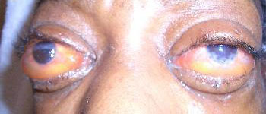
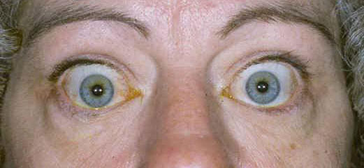
Endocrine orbitopathy (EO)

Slide 22
Endocrine orbitopathy (EO)
Diagnosis: laboratory findings Imaging (ultrasound B scan, NMR, CT) Test passive duction (muscle fibrosis)
Complications of EO - the cornea exposure, elevated intraocular pressure, changes in the orbit (neuropathy)
Treatment:
Endokrinologist
Ophthalmologist - serious ocular complications - megadoses of steroids, orbital decompression, the treatment of ocular disorders

Slide 23
Tumours of orbit
Primary vascular tumors dermoid cyst nerve tumors lacrimal gland tumors meningiomas orbit malignant lymphomas rhabdomyosarcoma
Benign and malignant primary secondary metastatic

Slide 24
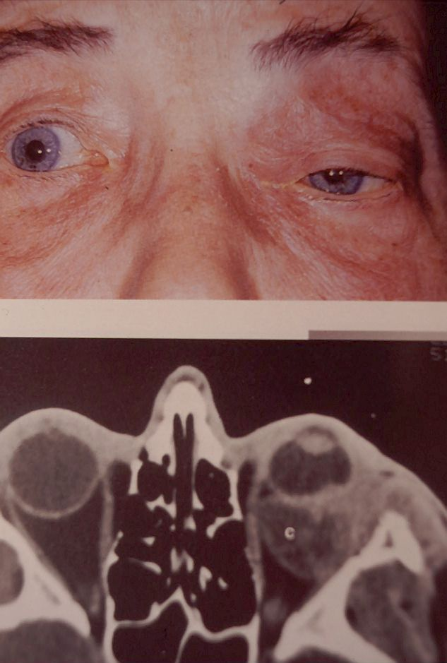
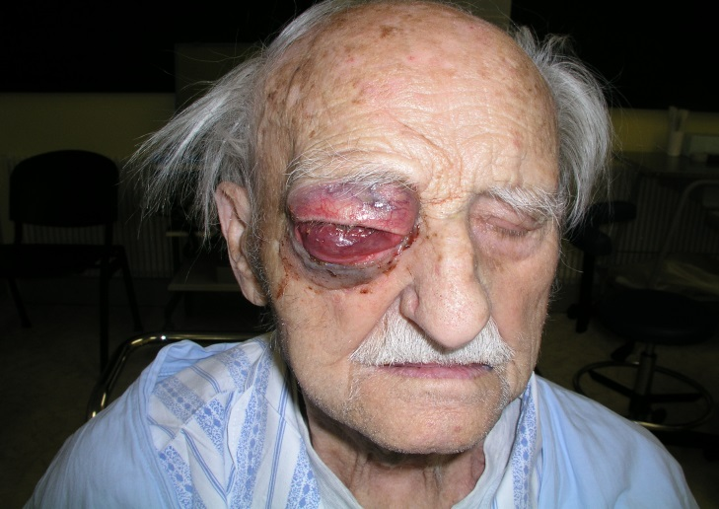
Tumours of orbit

Slide 25
Tumours of orbit
Secondary tumors of PN sinuses carcinomas of the eyelids Extrabulbar expansion of intraocular tumors metastatic - Adenocarcinomas (breast, lung, prostate, colon, pancreas, testis)
Treatment According to type, location and size of the tumor. Interdisciplinary cooperation
Anterior, lateral, and transcranial transetmoidální orbitotomy.
Orbital decompression, exenteration of the orbit.

Slide 26
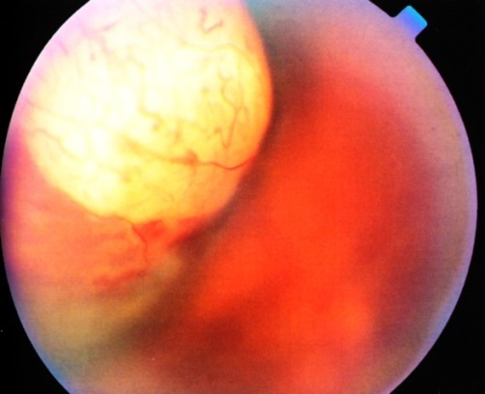
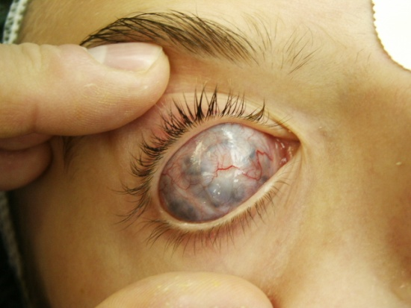
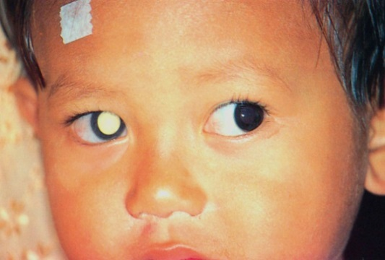
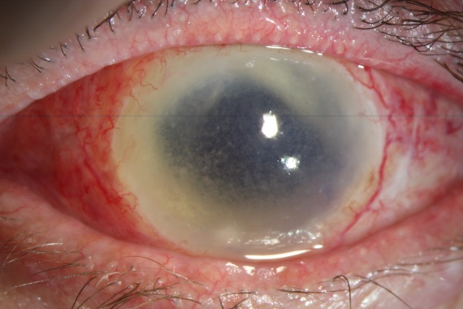
Enucleation and exenteration
Enucleation of the eyeball –
Removing the whole globe after
( transection of eye ocular muscles and optic nerve)
Indications: malignant intraocular tumors without extrabulbární promotion painful blind bulbus cosmetically unsightly blind bulbus devastating eye injury (primary enucleation) sympathetic ophthalmia

Slide 27
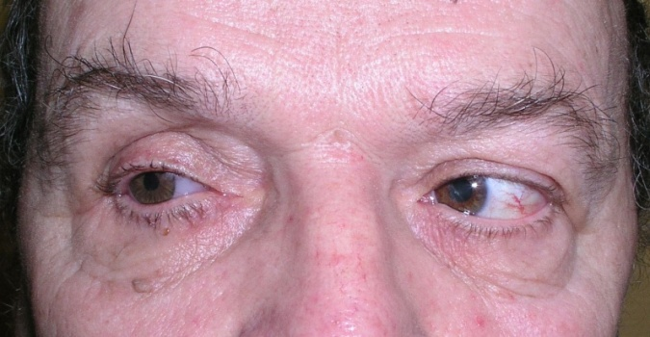
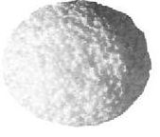
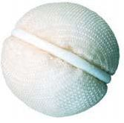
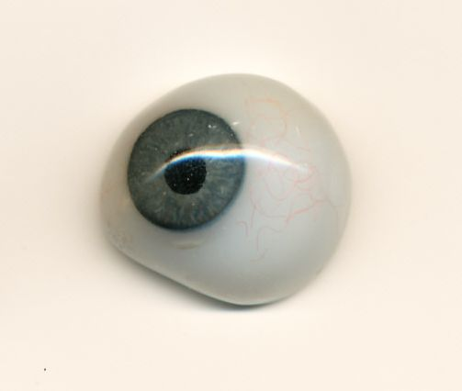
Enucleation and exenteration
Enucleation of the eyeball surgical procedure without orbital implant orbital implant

Slide 28
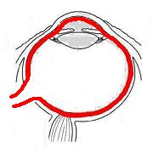
Exenteration of bulbi
Evacuating of the contents of the eyeball, leaving its packaging. Indications: Endophthalmitis (panoftalmitida) The devastating trauma of the globe with the evacuation of its contents

Slide 29
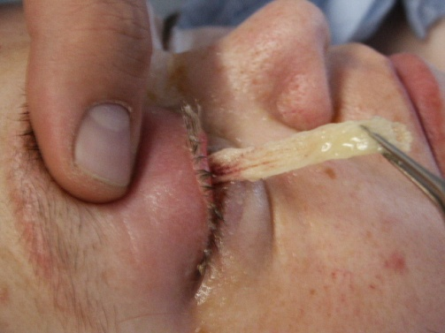
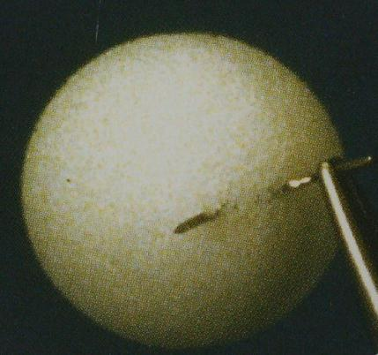
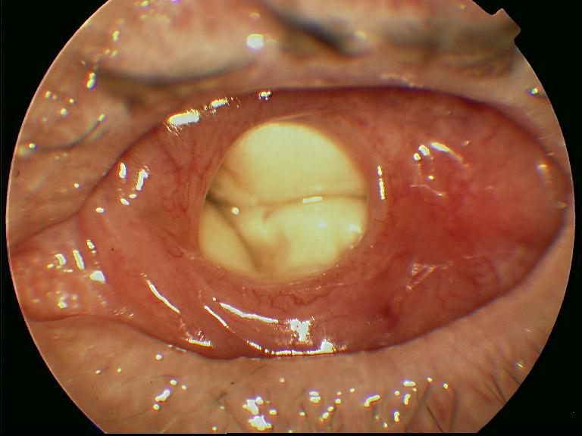
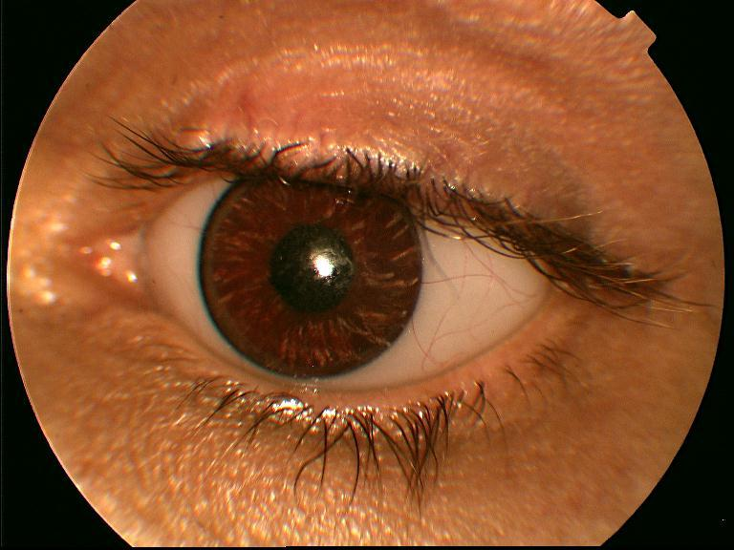
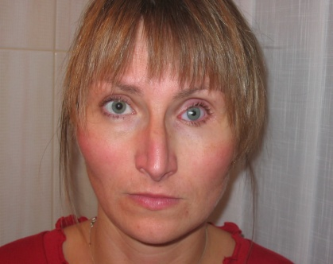
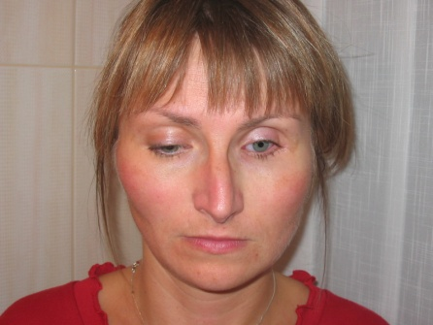
Enucleation and exenteration
Without implant
With implant

Slide 30
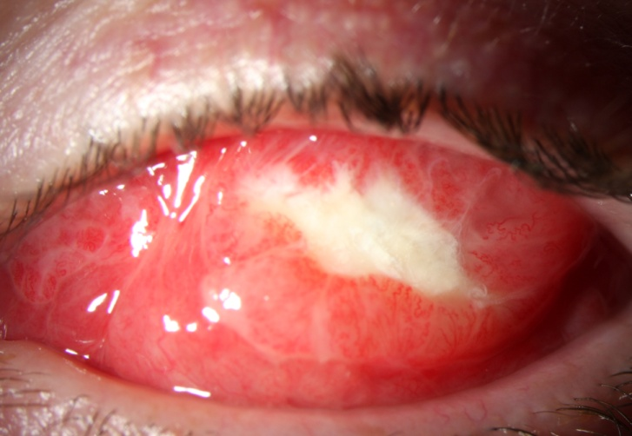
Enucleation and exenteration
Benefits of implant: good motility of the globe satisfactory cosmetic effect
Disadvantages of implant: elimination of implant the possibility of infection

Slide 31
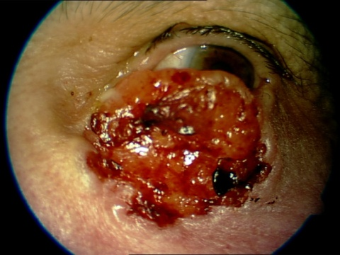
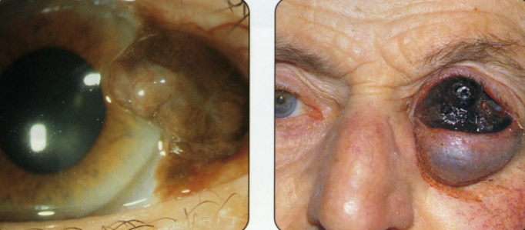
Exenteration of the orbit
Removing the entire contents of the orbit and the periosteum without retaining caps, preserving eyelid indications: tumors of the orbit tumors of the eyelids and eyeball with propagation into orbit intractable infectious processes trauma (devastating injuries with extensive tissue necrosis)

Slide 32
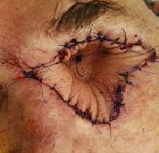
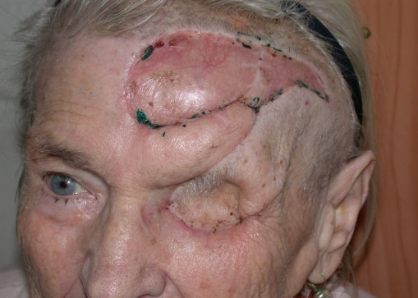
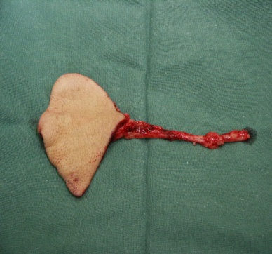
Exenteration of the orbit
Ways of dealing with the defect: healing granulation tissue free skin graft tissue flap with pedicle (muscle, fat, skin)

Slide 33
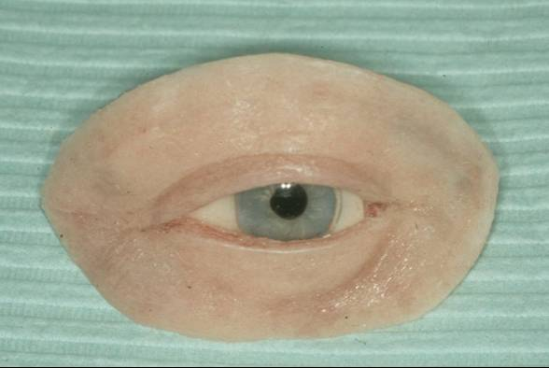
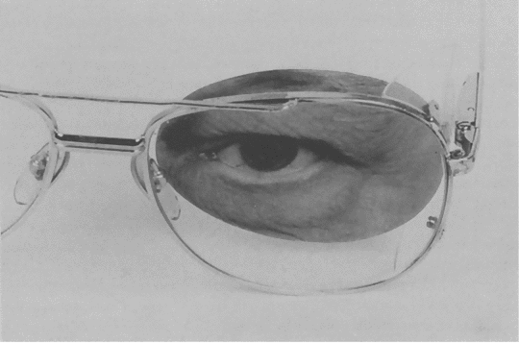
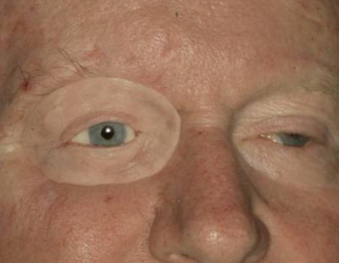
Exenteration of the orbit
Permanent Cosmetic Solutions: Spectacle ectoprotesis (prostheses)
Fixed implants

