Slide 1

Regulation
in cardiovascular system

Slide 2
Types of regulation
- general view
2 basic types:
Nervous regulation
Humoral regulation
    Feedback control - negative
    - positive
    autoregulation – local regulation – system regulation

Slide 3
REGULATION
IN CARDIOVASCULAR SYSTEM
Main function:
keep relatively constantaneous arterial blood pressure
Keep perfusion of tissues

Slide 4
Regulation of vessels tone
Tone of the vessels = basic tension of the smooth muscle inside of the wall
(vasoconstriction x vasodilatation)
Regulation - local autoregulation
- system regulation

Slide 5
Autoregulation
Autoregulation – the capacity of tissues to regulate their own blood flow
Myogenic theory – Bayliss phenomenon (as the pressure rises, the blood vessels are distended and the vascular smooth muscle fibres that surround the vessels contract; the wall tension is proportional to the distending pressure times the radius of the vessels – law of Laplace)

Slide 6
Autoregulation
Metabolic theory – vasodilator substances tend to accumulate in active tissue, and these metabolites also contribute to autoregulation
  ending products of energetic metabolism – CO₂, lactate acid, K⁺
  effect of hypoxia (circulation: vasodilatation x pulmonary circulation: vasoconstriction)
  Adenosin – coronary circulation: vasodilatation

Slide 7
Autoregulation
by substances which releasing from:
  endothelium
  tissues

Slide 8
Substances secreted by the ENDOTHELIUM
Vasodilatation:
Nitric oxide (NO) from endothelial cells
(originally called: EDRF)
Prostacyclin is produced by endothelial cells
Thromboxane A2 promotes platelet aggregation
(important prostacyclin – thromboxan balance)
Vazoconstriction:
Endothelins (polypeptids – 21peptides)
three isopeptides: ET 1, ET 2 , ET 3

Slide 9
Substances secreted by the tissues:
Histamine – primarily tissue hormones.
General affect: vasodilatation - decrease periphery resistence, blood pressure
KININS: 2 related vasodilated peptides
Bradykinin + lysylbradykinin (kallidin).
Sweat glands, salivary glands
10x strongers than histamine
Relaxation of smooth muscle, decrease blood pressure

Slide 10
Systemic regulation
By hormones
Catecholamines – epinephrine, norepinephrine - effect as activation of sympathetic system
RAAS - stress situation
ADH - general vasoconstriction
Natriuretic hormones - vasodilatation

Slide 11
Neural regulatory mechanism
Autonomic nervous system
Sympathetic: vasoconstriction
All blood vessels except capillaries and venules contain smooth muscle and receive motor nerve fibers from sympathetic division of ANS (noradrenergic fibers)
Regulation of tissue blood flow
Regulation of blood pressure
Parasympathetic part: vasodilatation
Only sacral parasympathetic cholinergic fibres (Ach) inervated arteriols from external sex organs

Slide 12
INTEGRATION of regulation in cardiovascular system
The regulation of the heart:
  Rami cardiaci n. vagi
Cardiac decelerator center - medula oblongata (ncl.dorsalis, ncl. ambiguus) – parasympathetic fibres of nervus vagus
: vagal tone (tonic vagal discharge)
Negative chronotropic effect (on heart rate)
Negative inotropic effect (on contractility)
Negative dromotropic effect (on conductive tissue)

Slide 13
INTEGRATION of regulation in cardiovascular system
The regulation of the heart:
  nn. cardiaci
Cardiac accelerator center – spinal cord, sympathetic ganglia – sympathetic NS
Positive chronotropic effect (on heart rate)
Positive inotropic effect (on contractility)
Positive dromotropic effect (on conductive tissue)

Slide 14
INTEGRATION of regulation in cardiovascular system
Vasomotor centre (regulation for function of vessels)
Medula oblongata
presoric area (rostral and lateral part –vasoconstriction – increase blood pressure
depresoric area (medio-caudalis part – vasodilatation, decrease of blood pressure)

Slide 15
INTEGRATION of regulation in cardiovascular system
Influence by central nervous system
  cerebral cortex
  limbic cortex
  hypothalamus

Slide 16
Blood pressure (BP) – pressure of the blood to the wall of the vessels
Systolic BP, diastolic BP, pulse pressure, mean arterial pressure (MAP)
BP = CO x R CO – cardiac output, R – resistance
CO = SV x HR SV – stroke volume, HR – heart rate

Slide 17
Classification BP values according to office BP
category | Systolic BP | Diastolic BP
 | (mmHg) | (mmHg)
optimal | < 120 | < 80
normal | 120 – 129 | 80 – 84
high normal pressure | 130 – 139 | 85 – 89
Hypertension – mild – grade 1 | 140 – 159 | 90 – 99
Hypertension – moderate-grade 2 | 160 – 179 | 100 – 109
Hypertension – severe – grade 3 | ≥ 180 | ≥ 110
Isolated systolic hypertension | ≥ 140 | < 90
According the Guidelines of ESC/ESH 2018

Slide 18
Definitions of hypertension according to
office, ambulatory, and home blood pressure levels
Category SBP(mmHg) DBP(mmHg)
Office BPa >_140 and/or >_90
Ambulatory BP
Daytime (or awake) mean >_135 and/or >_85
Night-time (or asleep) mean >_120 and/or >_70
24 h mean >_130 and/or >_80
Home BP mean >_135 and/or >_85
BP = blood pressure; DBP = diastolic blood pressure; SBP = systolic blood
pressure.
aRefers to conventional office BP rather than unattended office BP.

Slide 19
BLOOD PRESSURE MEASUREMENT
Direct invasive method
  1726 Stephan Hales – horse
  Today – during catetrisation
  Indirect non-invasive measurement
  palpation method
  Auscultation method
  Oscilometric method

Slide 20
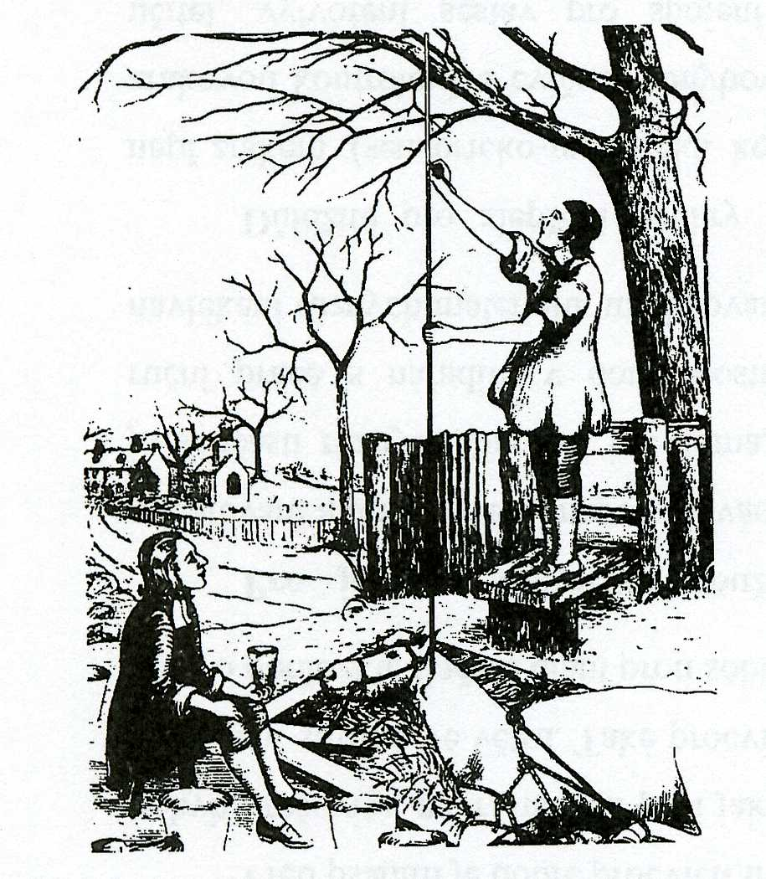

Slide 21
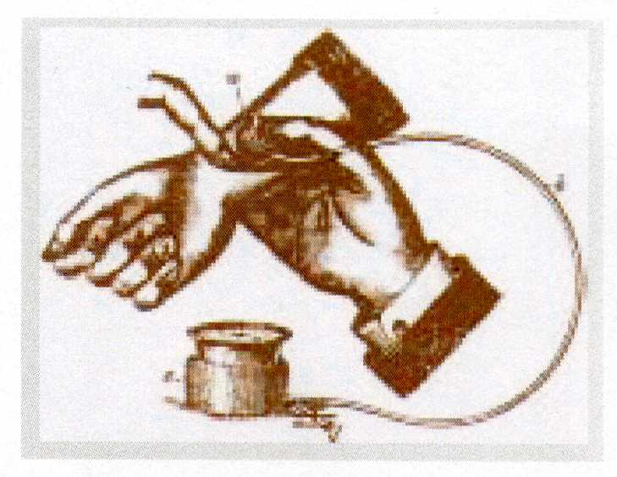
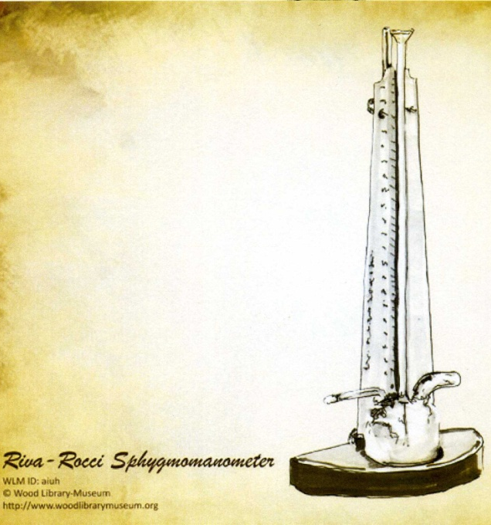
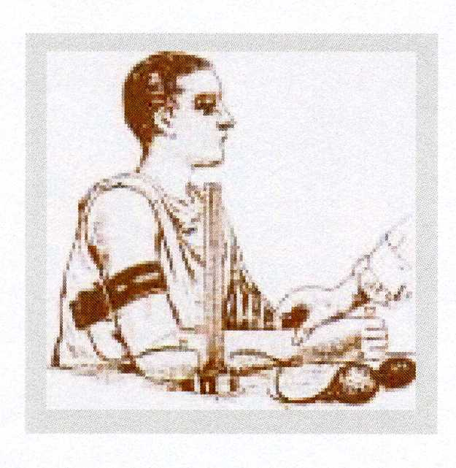
Palpatory methods
An Austrian physician
Von Basch
„aneroid sfygmomanometr“
Balloon in the wrist
1876
Italian physician
Riva Rocci
„mercury sfygmomanometr“
The cuff on the arm
1896

Slide 22
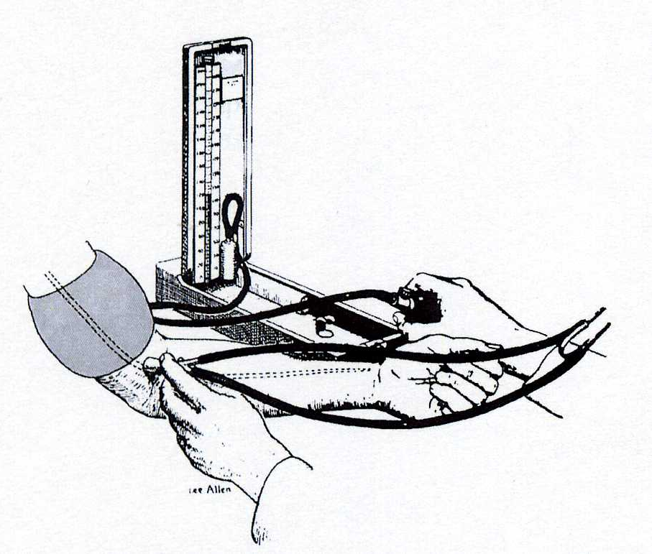
Auskultatory method
A Russian army surgeon
Nikolai Korotkoff
1904
„mercury sfygmomanometr“
The cuff on the arm
Stethoscope at the elbow

Slide 23
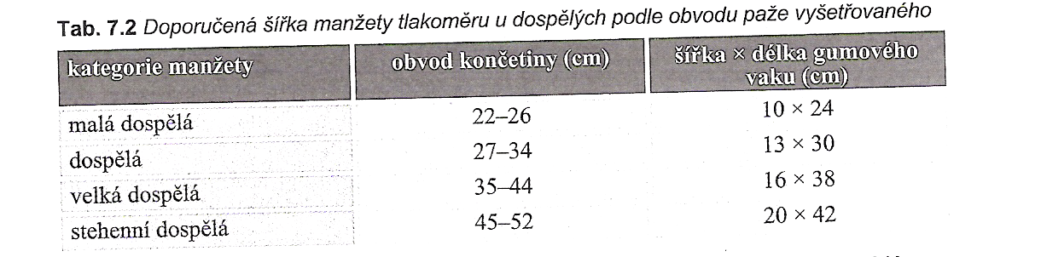
The size of the cuff in adults
Small adult
Adult
Large
Tight cuff
Špinar, J. a kol. Propedeutika a vyšetřovací metody vnitřních nemocí, 2008

Slide 24
Ambulatory blood pressure monitoring
Circadial rhythm – fluctuation during 24 h
The highest values – the morning, 6 –10 a.m. - the afternoon, 4 – 6 p.m.
The lowest values – 3 – 4 a.m.
Diurnal rhythm – differences between day – night
Dippers - nondippers

Slide 25
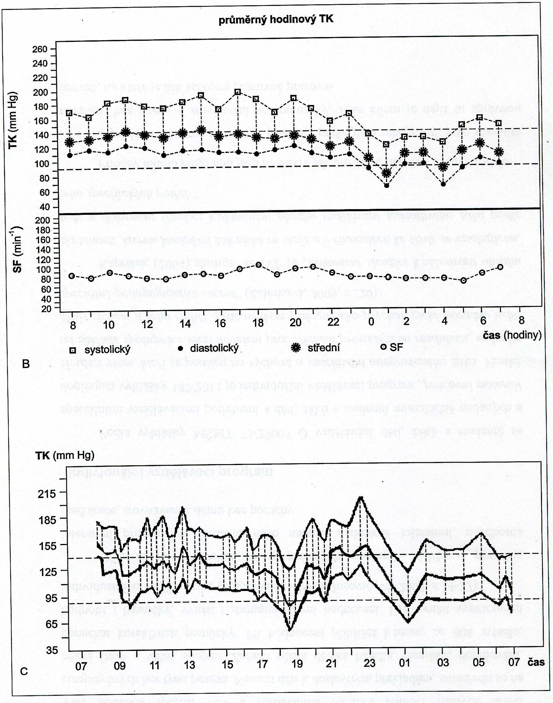

Slide 26
Record during 24 h or 48h or 7 days
Dif.dg. : white coat hypertension
Control of treatment of hypertension
Evaluation:
Mean values during 24 h: less than 125/80
Mean values during day period:less than 135/85
Mean values during night period:less than 120/70
Hypertension:
  More than 40% values above 140/90 at day, 120/80 at night

Slide 27
Regulation of blood pressure
Short - term regulation
- baroreflex
Middle - term regulation
- humorals regulation
sympathetic - catecholamines
RAAS
ADH
Long – term regulation
- kidney regulation

Slide 28
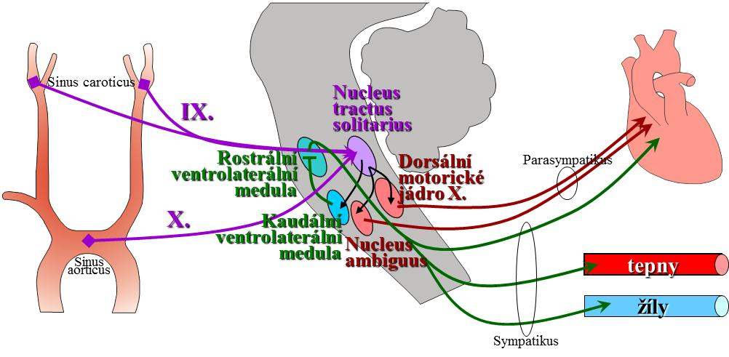
Short term regulation
BAROREFLEX

Slide 29
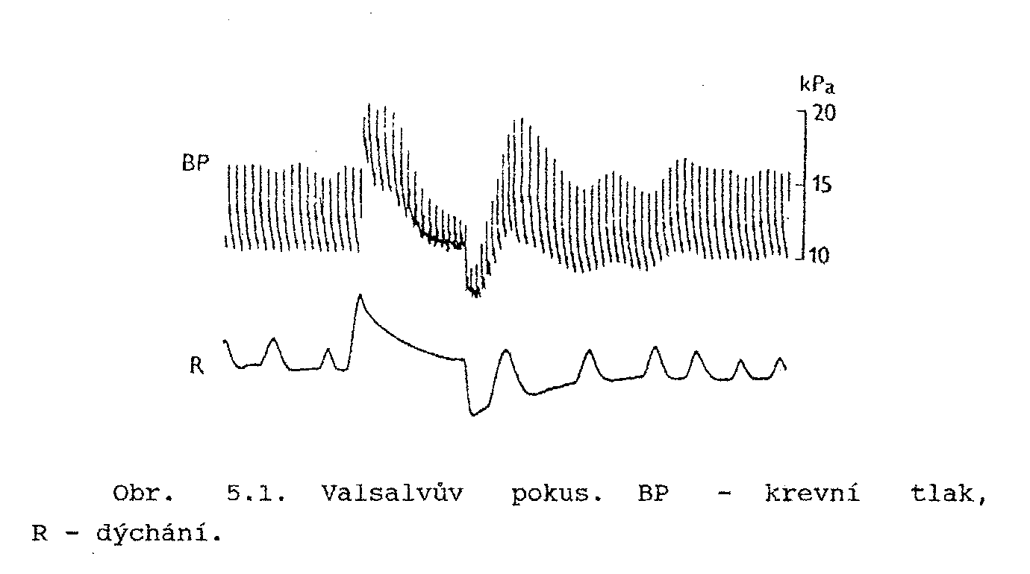
Stanovení citlivosti baroreflexu
Valsalvův manévr
Ganong WF, 2005

Slide 30
Noninvasive continuously beat-to-beat measurement of finger arterial pressure
Prof. Jan Peňáz, MD, PhD
Teacher and researcher on the Department of Physiology, Masaryk university, Brno
Patent 1969

Slide 32
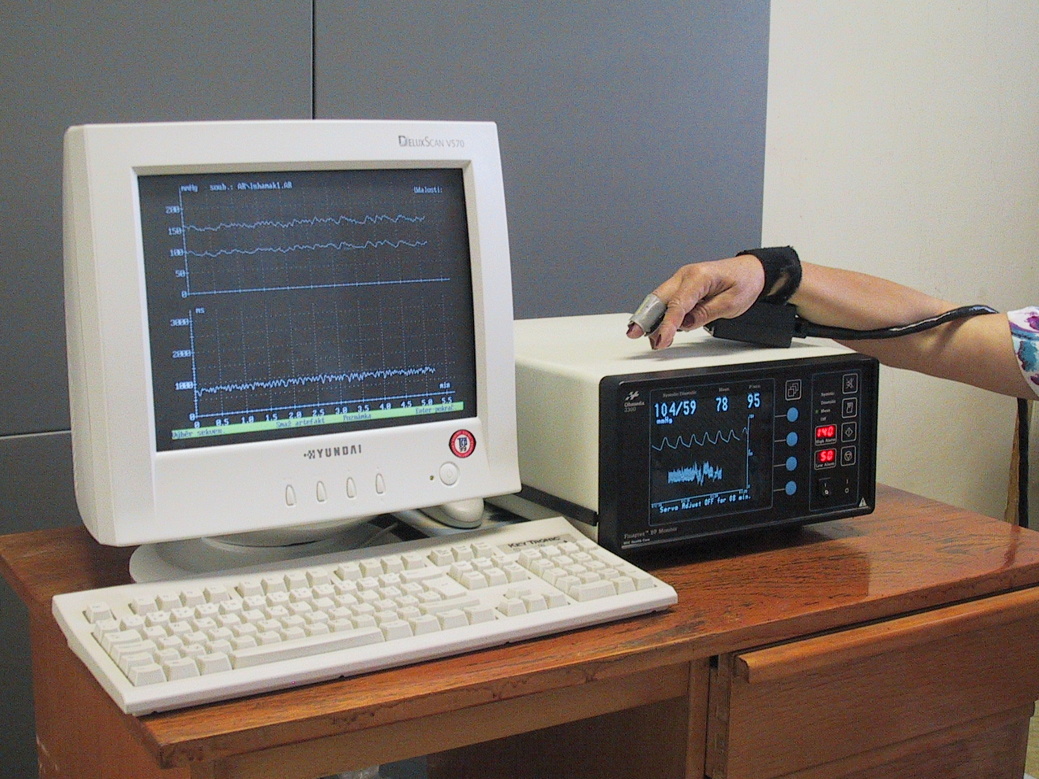
Finapres (Ohmeda, USA)

Slide 33
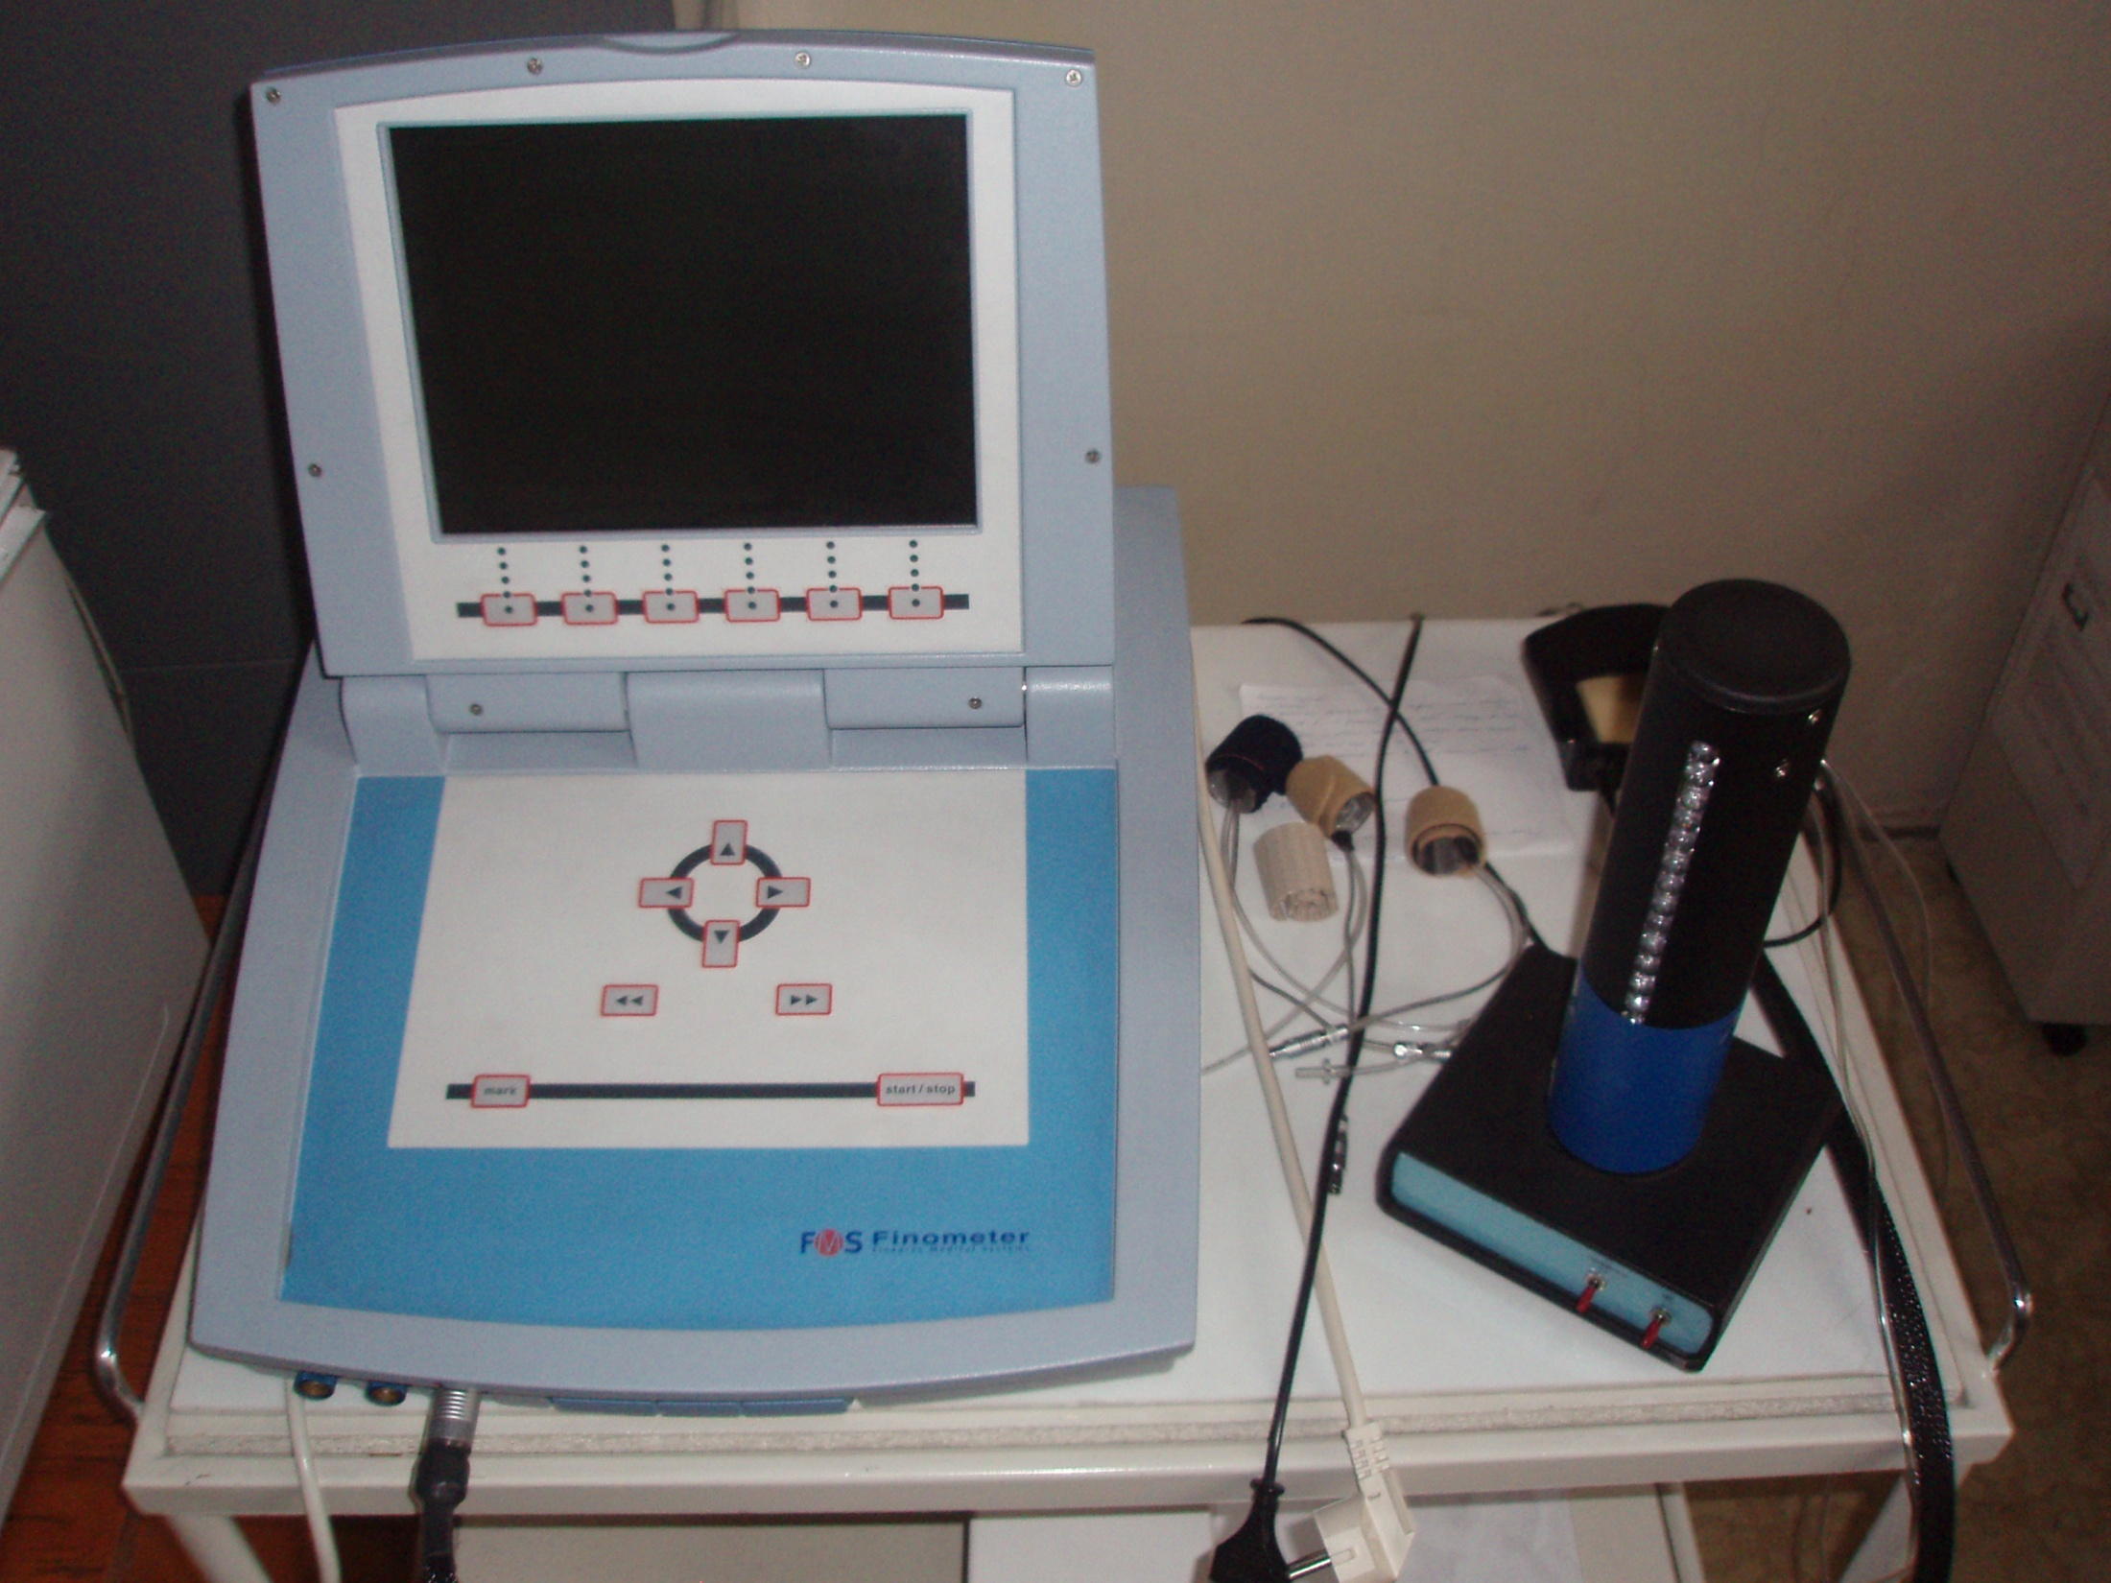
Finometr (FMS, Nizozemí)

Slide 34
We need than pressure in the cuff corresponded to the pressure of the digital artery
Method: photopletysmography
Recorded photoelectric plethysmogram
The new term: Transmural pressure – Pt (the pressure across the wall of the artery)
BP, Pc (pressure in cuff), Pt
We estimated: BP=Pc - - - Pt=0 - - - photoplethysmogram registered the highest amplitude of oscilation --- we measure the MAP
Step by step increase of Pc, in the moment of the highest amplitude – feed-back loop started for obtained(keeping) the constant volume of the finger

Slide 35
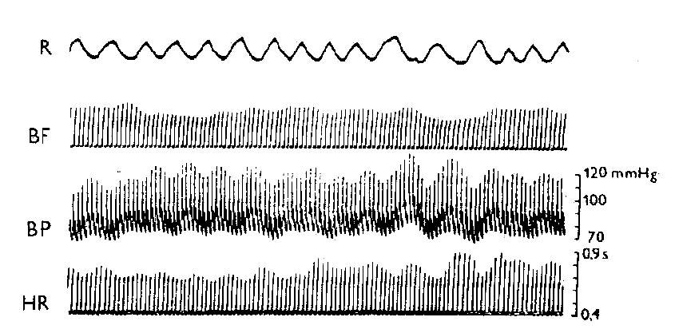
Records of circulatory parameters

Slide 36
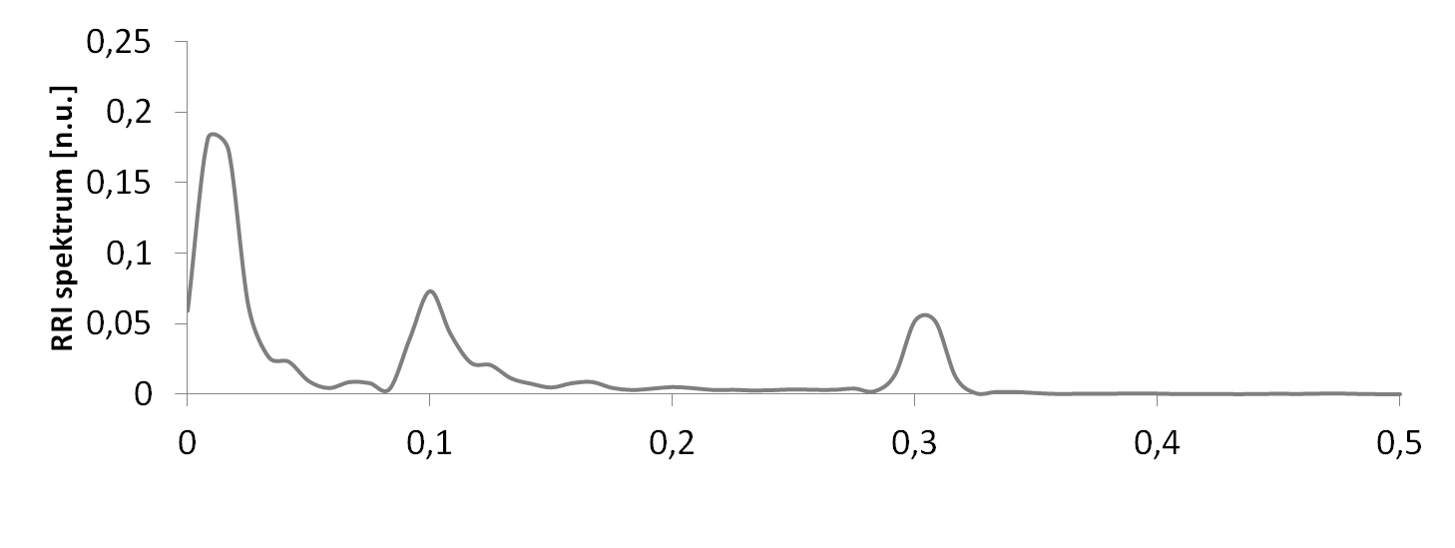
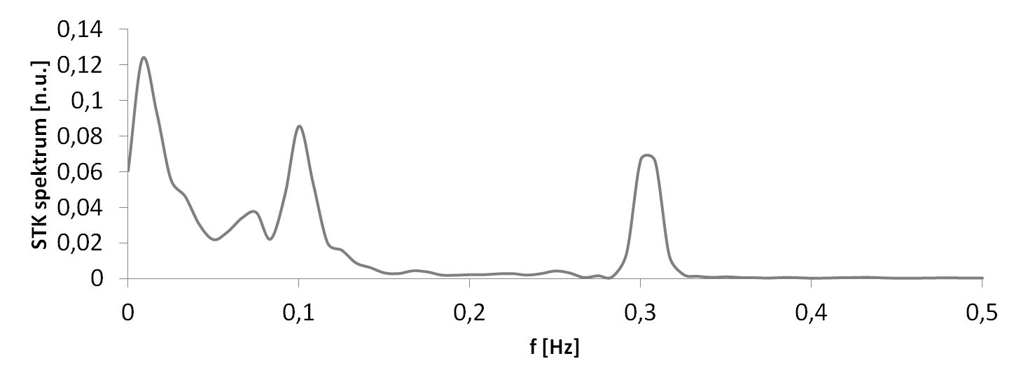
VARIABILITY of circulatory parameters
parasympathicus
sympathicus
Baroreflex
Baroreflex

Slide 39
Classification BP values according to office BP
category | Systolic BP | Diastolic BP
 | (mmHg) | (mmHg)
optimal | < 120 | < 80
normal | 120 – 129 | 80 – 84
high normal pressure | 130 – 139 | 85 – 89
Hypertension - mild | 140 – 159 | 90 – 99
Hypertension - moderate | 160 – 179 | 100 – 109
Hypertension - severe | ≥ 180 | ≥ 110
Isolated systolic hypertension | ≥ 140 | < 90
According the Guidelines of ESC/ESH 2018

Slide 40
Definitions of hypertension according to
office, ambulatory, and home blood pressure levels
Category SBP(mmHg) DBP(mmHg)
Office BPa >_140 and/or >_90
Ambulatory BP
Daytime (or awake) mean >_135 and/or >_85
Night-time (or asleep) mean >_120 and/or >_70
24 h mean >_130 and/or >_80
Home BP mean >_135 and/or >_85
BP = blood pressure; DBP = diastolic blood pressure; SBP = systolic blood
pressure.
aRefers to conventional office BP rather than unattended office BP.

Slide 41
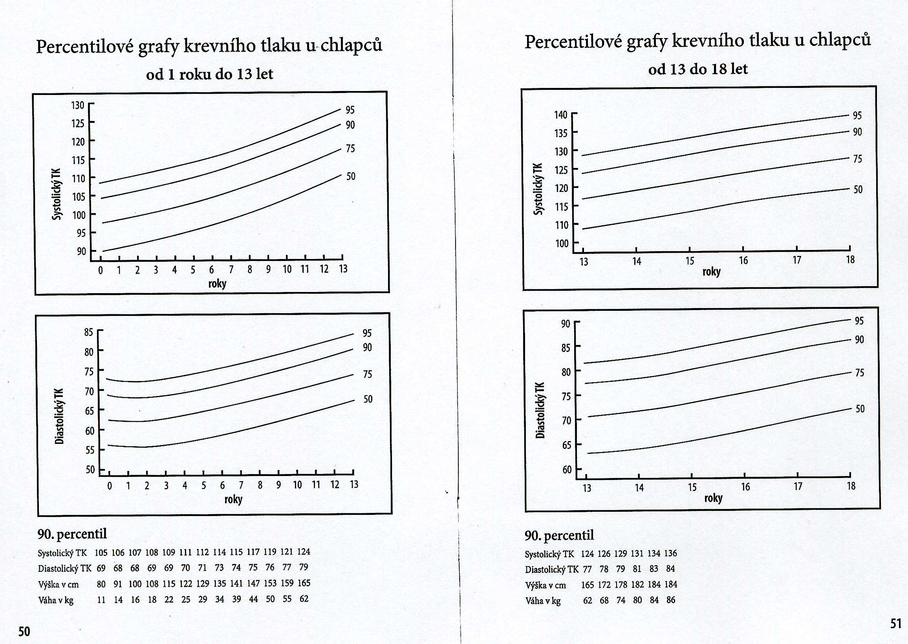
Zdravotní a očkovací průkaz dítěte a mladistvého, 2011

Slide 42
Krevní tlak
bezprostředně po narození je vysoký:
  poporodní stres – vyplavení katecholaminů a kortizolu
po 1.dnu se ustálí 70/50 mmHg:
  otevření pulmonálního a intestinálního řečiště
další mírný vzestup až k hodnotám pro dospělé
v období puberty:
  postupné dozrávání regulačních mechanismů
  stimulace z vnějšího prostředí

Slide 44
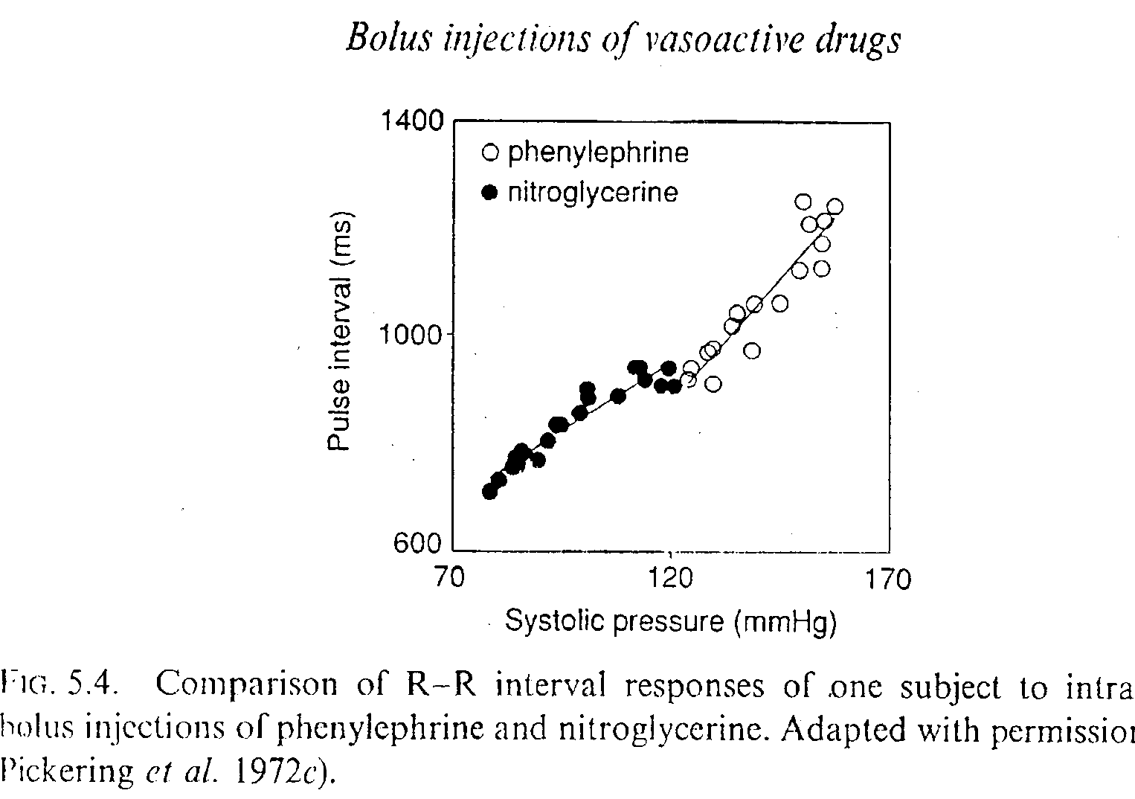
Estimation of baroreflex sensitivity
Invasive methods

Slide 45
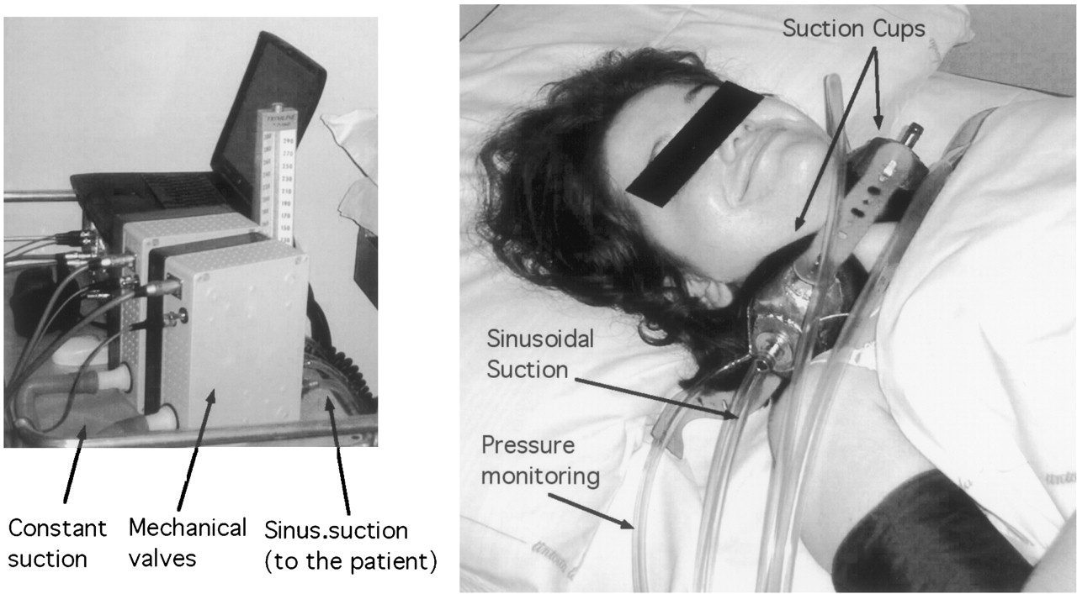

Estimation of baroreflex sensitivity
non – invasive technique – neck suction
Furlan R et al. Circulation 2003;108:717-723

Slide 46
Kontinuální neinvazivní měření
tep po tepu - Peňázova metoda
Profesor MUDr. Jan Peňáz, CSc.
Fyziologický ústav LF MU
Čs. patent z roku 1969

Slide 47
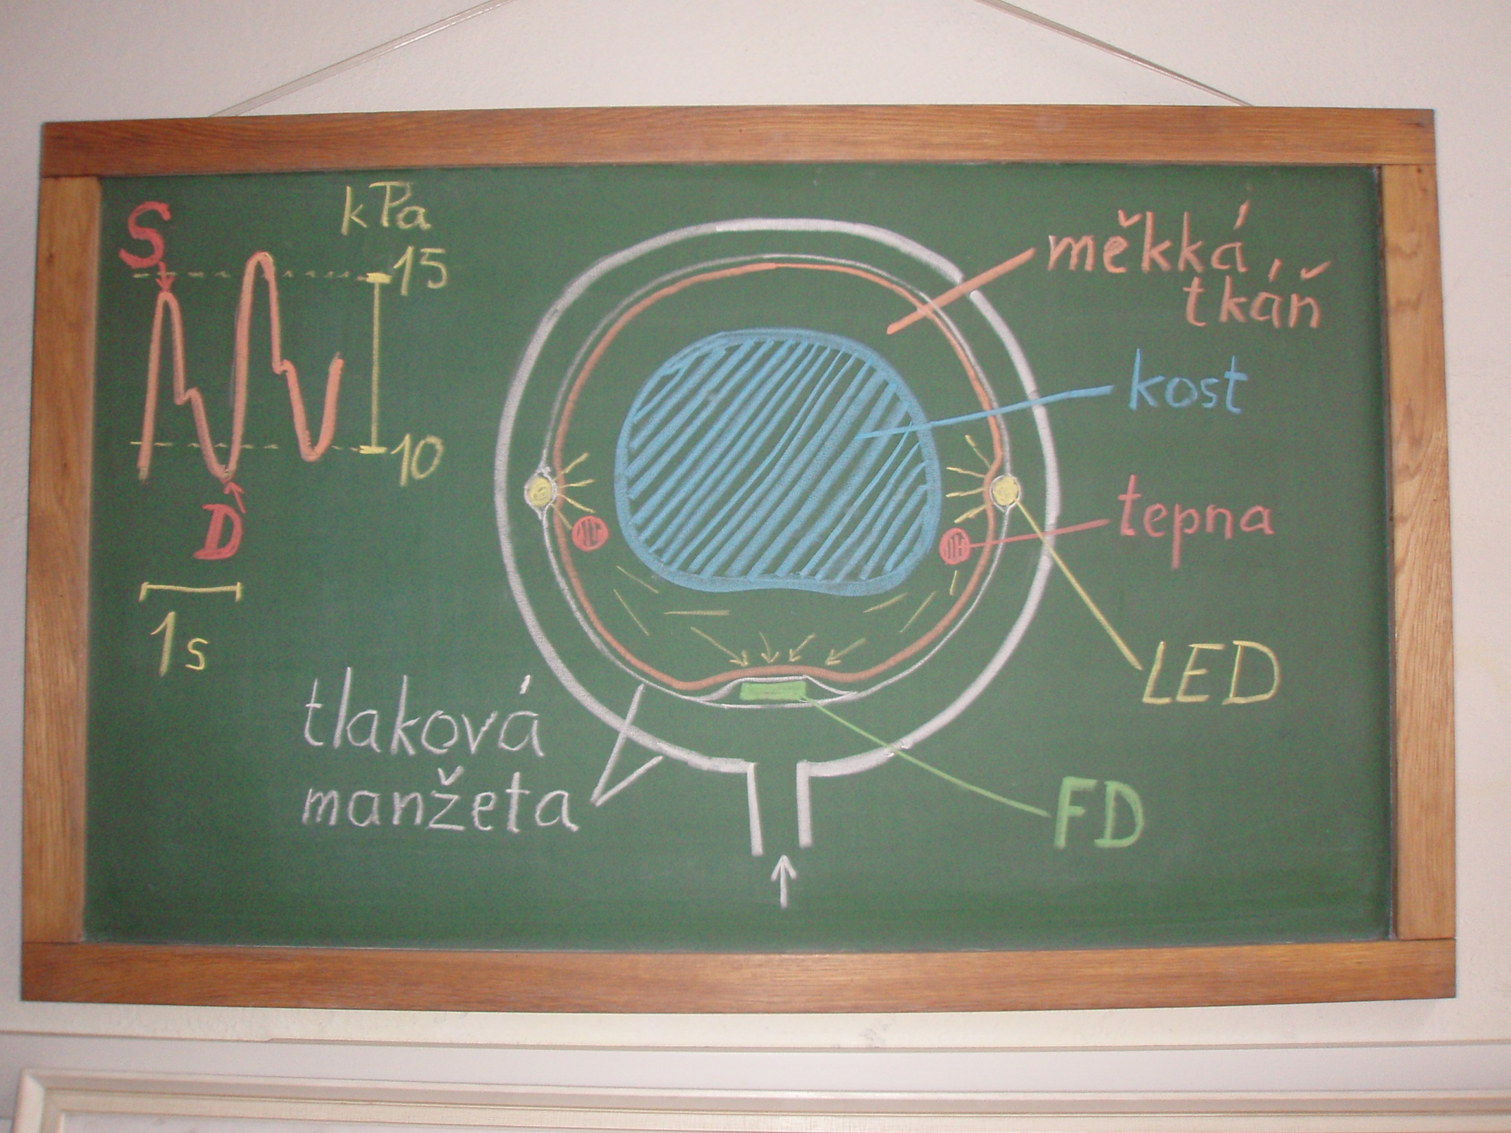

Slide 48
Stanovení citlivosti baroreflexu
Valsalvův manévr
Ganong WF, 2005

Slide 49
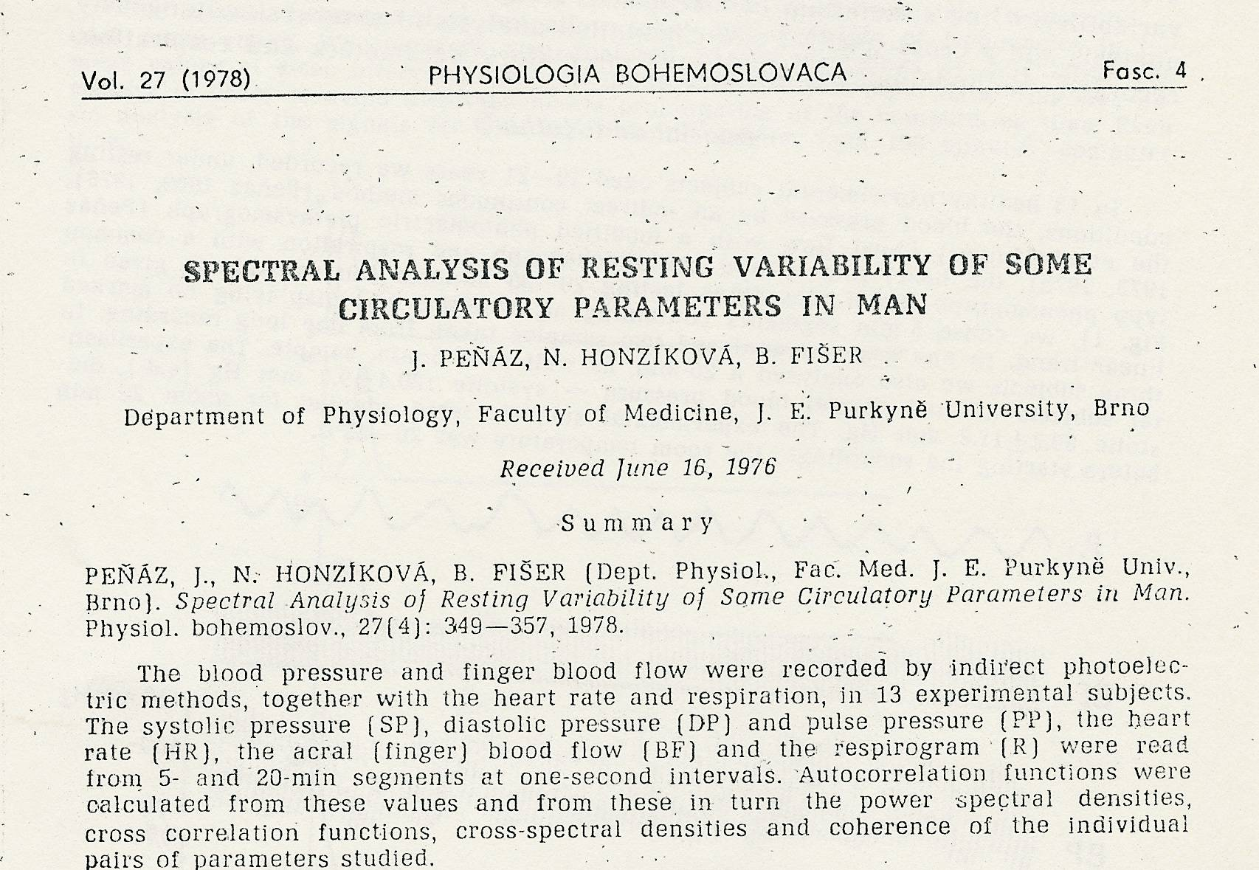

První spektrální analýza krevního tlaku u člověka

Slide 50
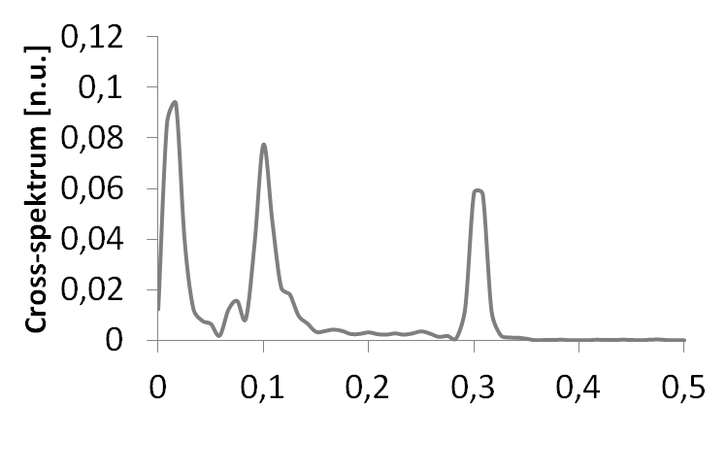
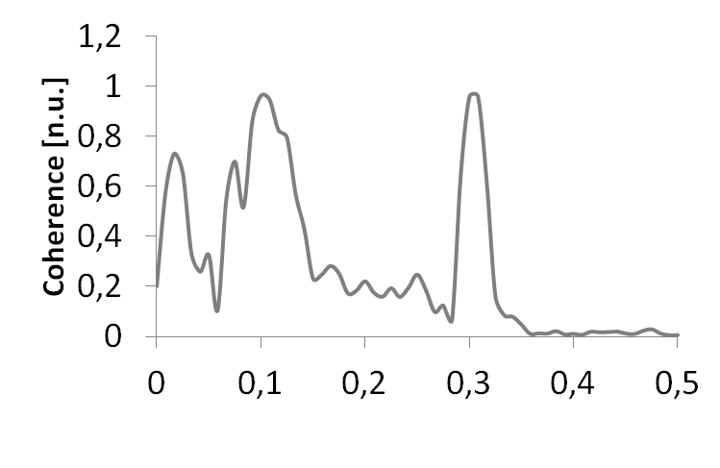
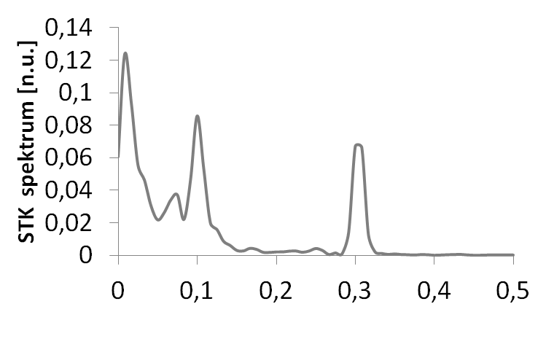
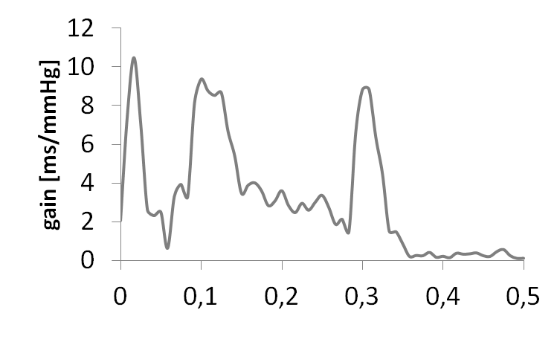
CITLIVOST BAROREFLEXU
- Vzájemná spektrální analýza

Slide 51
Sensitivity of baroreflex
Prolongation of RR intervals in ms due to changes of systolic blood pressure about 1 mmHg
Physiology values:
6 – 16 ms/mmHg

Slide 52
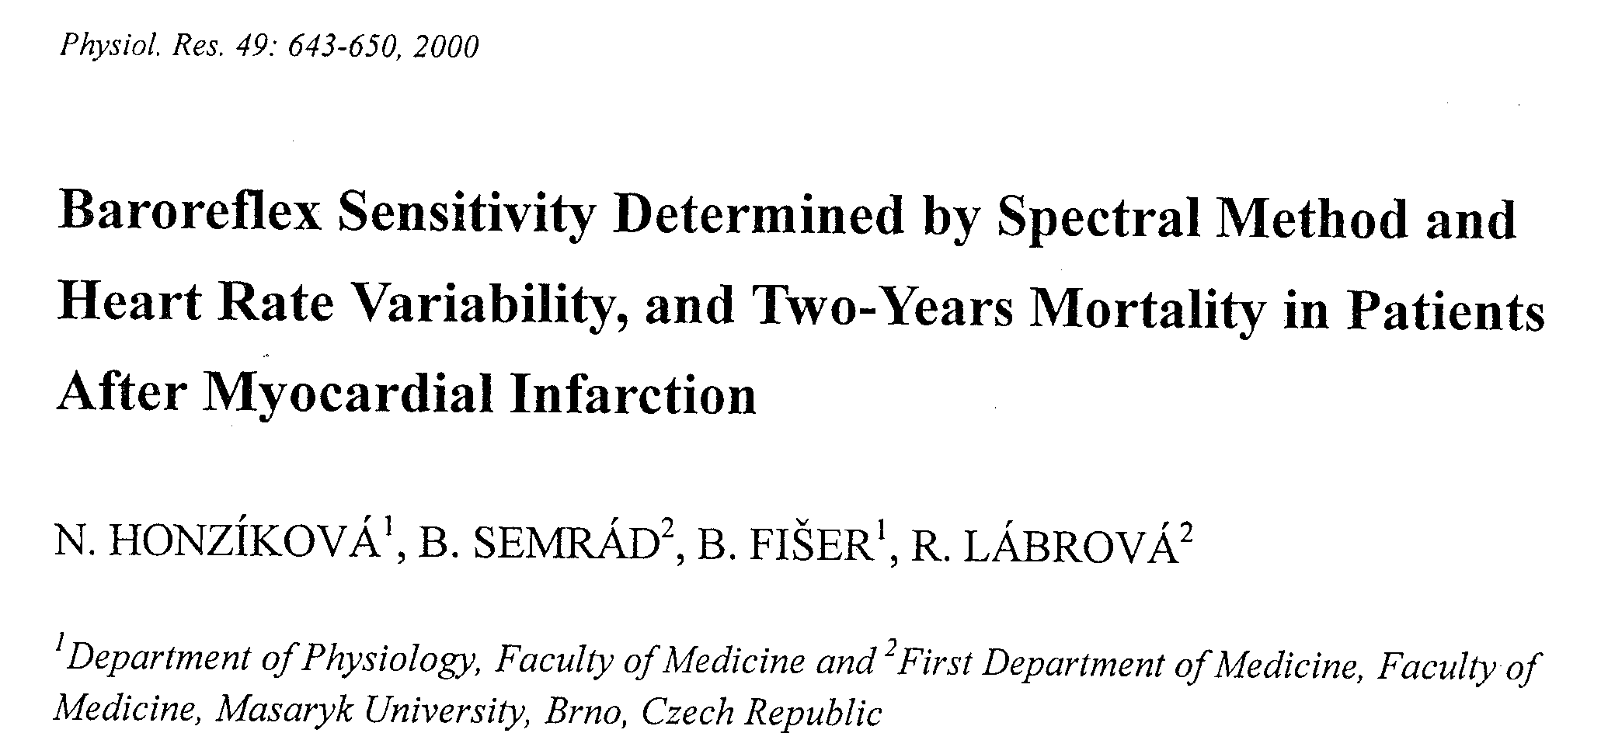

Variabilita v krevním oběhu a BRS – ukazatelé rizika srdeční smrti
po infarktu myokardu
Notes:
40
Zadání – u bodu 1 znamená odvozeného že vycházet nejen z analyzovaných dat, ale také z charakteristik jednotlivých veličin
…

Slide 53
zavedení stanovení BRS u hypertenzních pacientů (BRS nižší než 5 ms/mmHg)
využití pro studium časných či pozdních změn účinků léčby kardiotoxicky a neurotoxicky působícími antracykliny u onkologicky nemocných
předurčení rizika změn autonomního nervstva s dopadem na hladiny krevního tlaku u nemocných
s diabetes mellitus

Slide 54
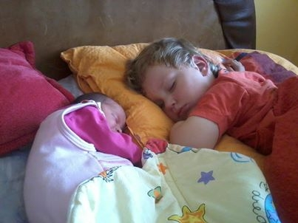

Slide 55


Děkujeme za pozornost

