Slide 1
Basic medical terminology 4

Slide 2
Questions
What case is the noun in the state of dependency in? And how is it usually translated into English?
  genitive case
  eg. fractura costae = fracture of a rib
What is called “prepositional phrase”?
  phrase following a preposition
  eg. post fracturam costae
Based on what should the adjective be connected to the noun?
  based on the gender of the noun

Slide 3
What is the correct adjective for the noun in the triangle?
dextra
dextrum
dexter
dextrum
radius
pollex
crus
dexter
dextrum
dextra
dextra
dexter

Slide 4
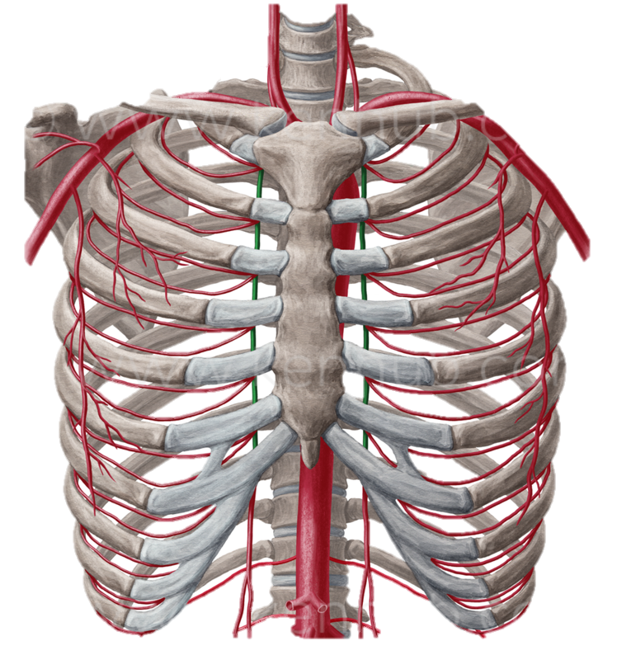
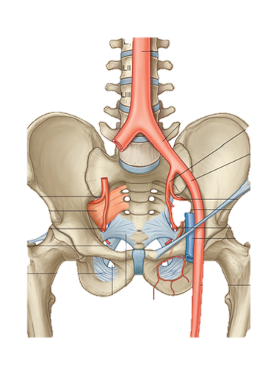
Arteriae
Notes:
Artheria thoracica interna, arteria iliaca externa

Slide 5
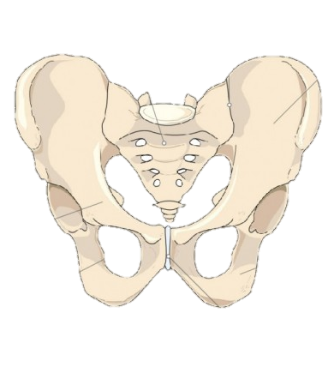
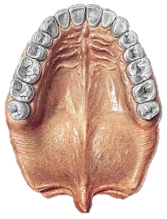
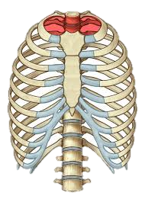
Apertura
Rhaphe
Notes:
Aprtura pelvis, apertura thoracis; raphe palatina

Slide 6
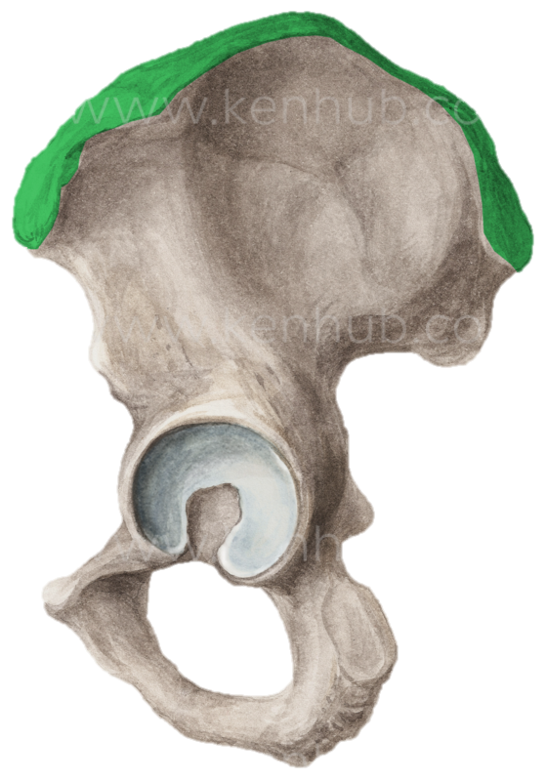
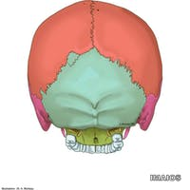
Cristae
Notes:
Crista iliaca, crista occipitalis externa

Slide 7
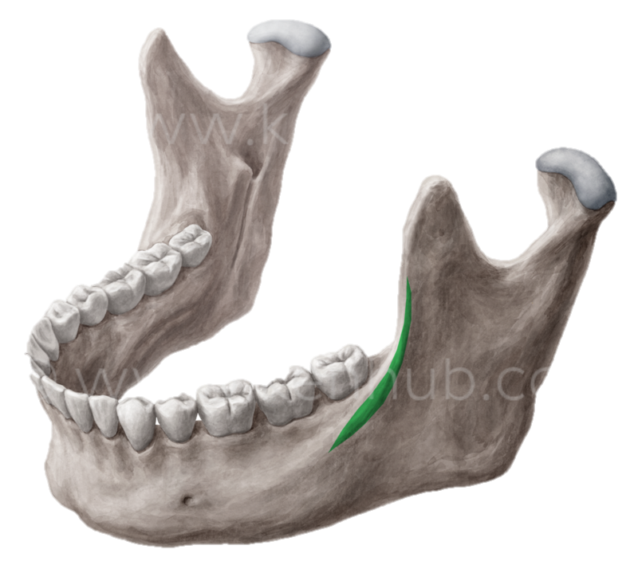
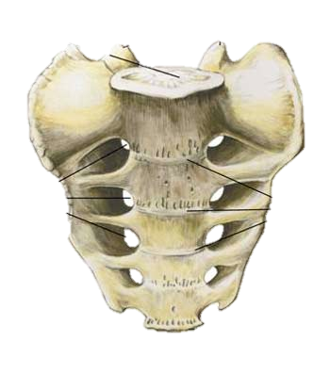
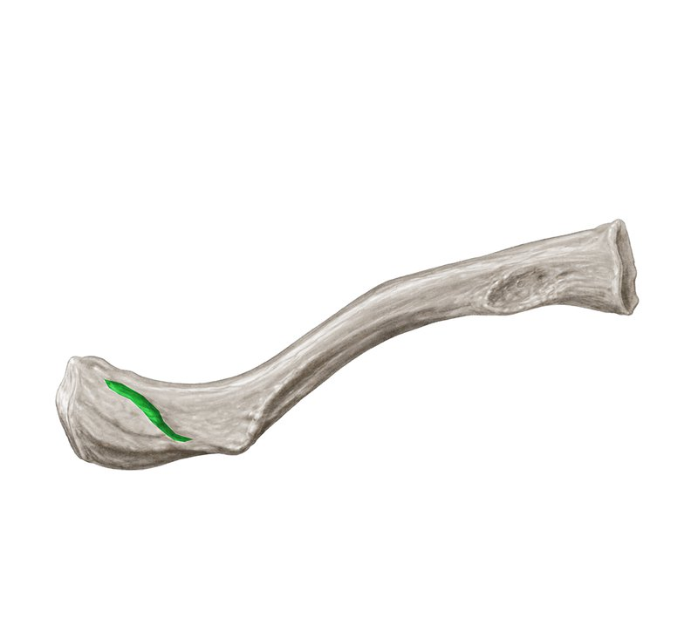
Lineae
Notes:
Linea obliqua mandibulae, linea trapezoidea (claviculae), lineae transversae ossis sacri

Slide 8
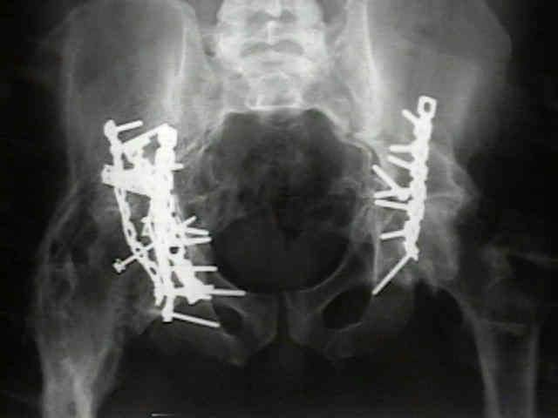
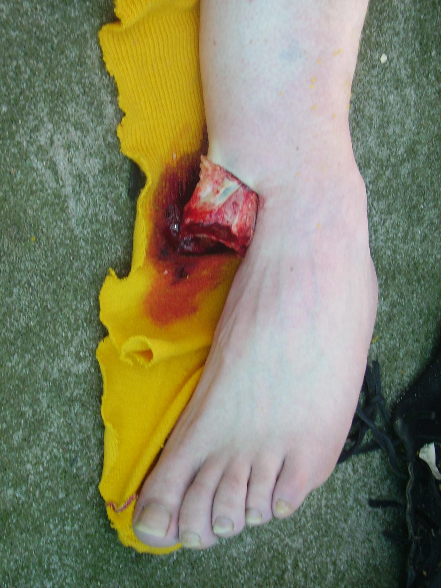
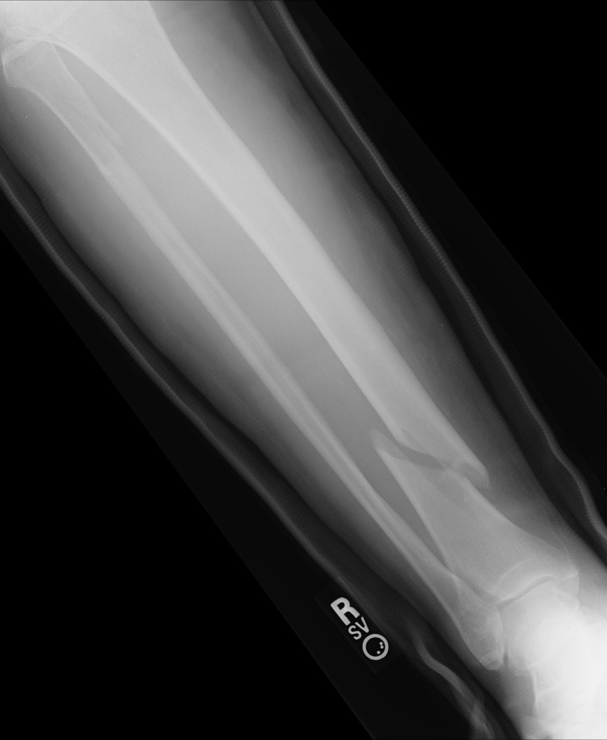
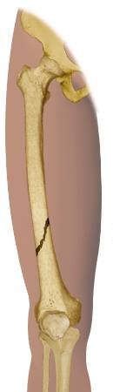
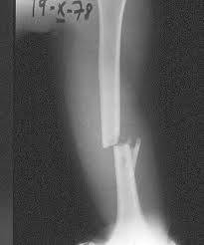
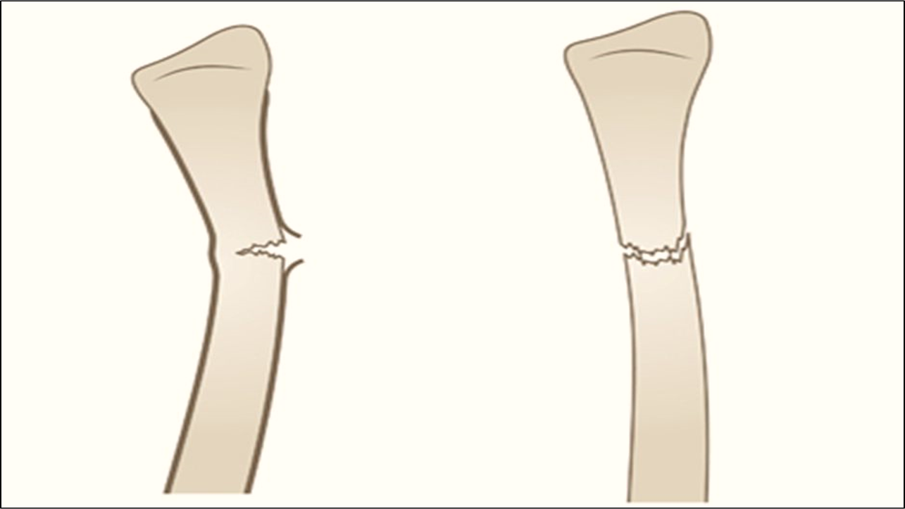
Fracturae
Notes:
Fractura completa/incompleta, aperta/clausa, obliqua/transversa

Slide 9
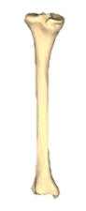
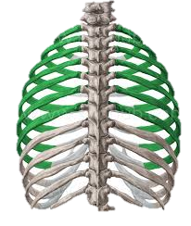
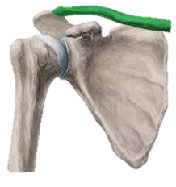
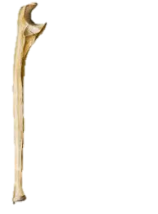
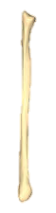
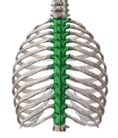
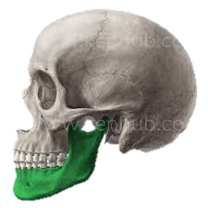
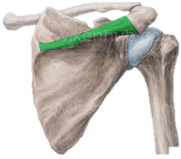
Say „fracture of …“ in Latin
1
2
3
4
5
6
7
8
Notes:
1. Tibia dextra, 2. Costae verae, 3. clavicula dextra, 4. ulna dextra, 5. mandibula sinistra, 6. fibula dextra, 7. spina scapulae dextrae, 8. vertebrae thoracicae

Slide 10
Ordinal numerals 1-12
Primus, a, um
Secundus, a, um
Tertius, a, um
Quartus, a, um
Quintus, a, um
Sextus, a, um
Septimus, a, um
Octavus, a, um
Nonus, a, um
Decimus, a, um
Undecimus, a, um
Duodecimus, a, um
costa spuria prima
vertebra thoracica secunda
costa vera tertia
vertebra coccygea quarta
costa vera quinta
vertebra thoracica sexta
costa vera septima
vertebra thoracica duodecima

Slide 11
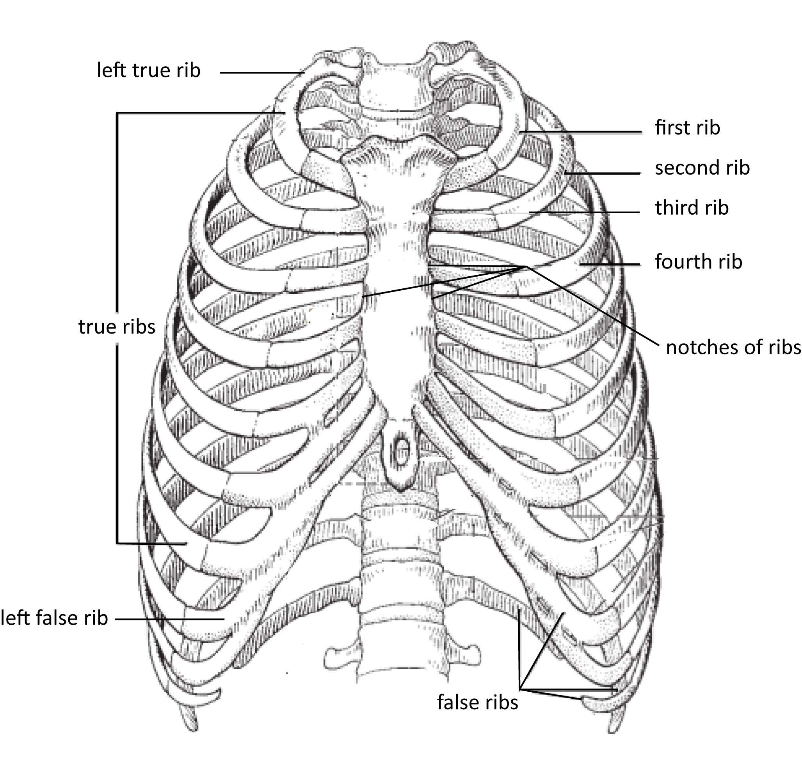
Costae
Costa vera sinistra
Costa prima
Costa secunda
Costa tertia
Costa quarta
Costae verae
Incisurae costarum
Costa spuria sinistra
Costae spuriae

Slide 12
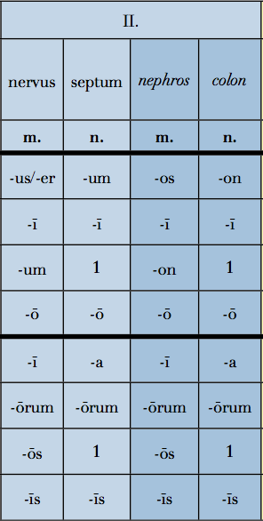
2nd declension - overview
Gen. sg. –I
Gender M (F)/N
Nouns of the female gender in this declension are exceptions
Nom. sg. –US/-ER/-OS
Gender M (F)
Nom. sg. –UM/-ON
Gender N

Slide 13
Nephros
The paradigm nephros is for masculine words of Greek origin.
The only difference is the ending -os in nom. sg. and -on in acc. sg.
-os
-on

Slide 14
Neuter gender nouns
There are some rules which apply for all Latin nouns of the neuter gender.
They have the same ending in the nominative and accusative cases.
In nom. pl. they end in –a
Since rule n. 1 can be applied, they end in -a even in acc. pl.
-um
-on
-um
-on
-a
-a
-a
-a

Slide 15
Connect
fractura + radius, ii, m; nasus, i, m.; sternum, i, n.
post + morbus, i, m. = disease
in (where) + oculus, i, m.; organum, i, n.

Slide 16
Homework
Finish handout 4 and bring it to the class
Learn the vocabulary in handout 4
Print handout five and bring it to the class
Bring the textbook

