Slide 1
Revision

Slide 2
Give the nom. sg. form
carie infarctu unguenti dentes
pulmonum pleuritidem gargarismate diei
temporibus labio morsum arcuum
ligamenta faciem thoracis laminarum
tractu neuroseos dyspnoes nephron
encephalo cornua

Slide 3
Identify the case; add the correct form of adjective
in genibus
dolor genus
in genua
dolor genuum
in genu
genua
sanatio decubitus
prope decubitus
sub decubitu
sanatio decubituum
sub decubitibus
prope decubitum
propter cariem
therapia carierum
sub carie
therapia cariei
sub cariebus
propter caries
valgus, a, um dolorosus, a, um profundus, a, um

Slide 4
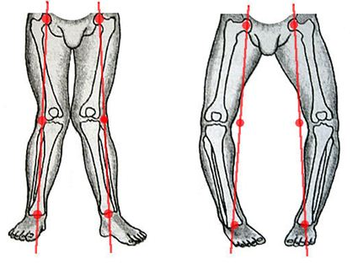
genua valga genua vara

Slide 5
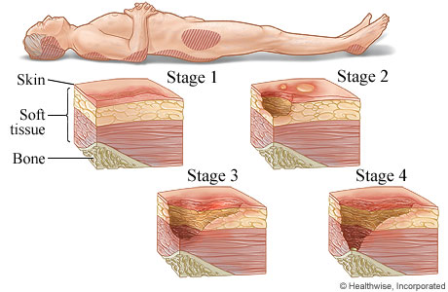
decubitus profundus

Slide 6
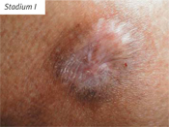
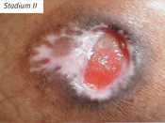
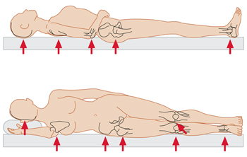
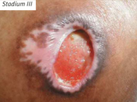
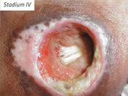
Decubitus
(decubitus ulcer, bedsore, pressure sore, pressure ulcer) is an area of unrelieved pressure over a defined area, usually over a bony prominence, resulting in ischemia, cell death, and tissue necrosis.

Slide 7
Form corresponding loose atributes
articulatio (genu dextrum)
  Articulatio genus dextri
arcus (vertebrae thoracicae)
  Arcus vertebrarum thoracicarum
causa (obstructio venae)
  Causa obstructionis venae
ligamenta (manus sinistra)
  Ligamenta manus sinistrae
effectus (gargarisma novum)
  Effectus gargarismatis novi
sanatio (decubitus profundus)
  Sanatio decubitus profundi
collapsus (systema circulatorium)
  Collapsus systematis circulatorii
status (canities praematura)
  Status canitiei praematurae
Unit 6, task 5

Slide 8
Connect the phrases with the preposition
post + infarctus acutus
  Post infarctum acutum
propter + partus praematurus
  propter partum praematurum
sub +plexus venosus uterinus
  Sub plexu venoso uterino / sub plexum venosum uterinum
in + decursus morbi
  In decursu morbi
ad + usus internus
  Ad usum internum
ante + processus spinosus
  Ante processum spinosum
sine + effectus malus
  Sine effectu malo
Unit 6, task 6

Slide 9
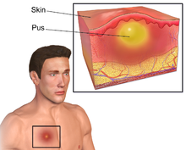
Abscessus
is a collection of pus that has built up within the tissue of the body, it may occur in any kind of solid tissue (lungs, brain, teeth, kidneys and tonsils), but most frequently appears on skin
abscessus (4x) abscessuum  abscessum abscessu  abscessibus
causae ________________
________________ ductus choledochi
excisio ________________ dolorosi ani
operatio meatus acustici sine ________________ secundario
________________ secundarii in vulneribus operativis
status post ________________ encephali
operation propter ________________ tubarum uterinarum
gravida cum ________________ dentium
Notes:
Identifikujte pád a číslo

Slide 10
Find a suitable group of adjectives for each of the listed nouns
genu decubitus partus facies usus status species pulsus
profundus, a, um dolorosus, a, um
tardus, a, um
durus, a, um
rarus, a, um
pallidus, a, um
Hippocraticus, a, um
gastricus, a, um
diaphragmaticus, a, um
aethylicus, a, um
epilepticus, a, um
asthmaticus, a, um
postoperativus, a, um
externus, a, um
internus, a, um
praematurus, a, um
complicatus, a, um
primus, a, um
dolorosus, a, um
maturus, a, um
aromaticus, a, um urologicus, a, um
antiasthmaticus, a, um
varus, a, um valgus, a, um
dexter, a, um
sinister, a, um

Slide 11
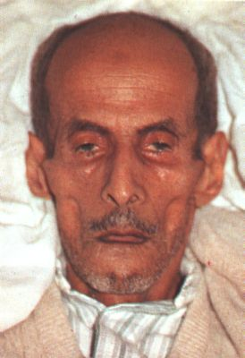
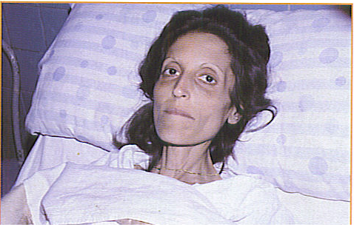
The facial expression produced in the by impending death or long illness (accompanied by pain), excessive evacuations, excessive hunger, and the like, e.g.by peritonitis (inflammation of peritoneum) or cholera. Its synonym is facies abdominalis.
The nose is sharp, the eyes sunken, the temples fallen in, the ears cold and drawn in and their lobes distorted, the skin of the face hard, stretched and dry, and the colour of the face pale or dusky.
facies Hippocratica / facies abdominalis

Slide 12
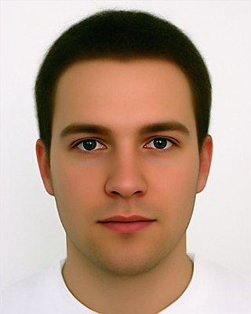
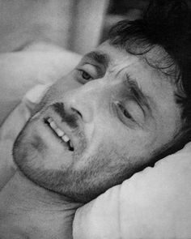
facies composita – normal, calm facial expression of healthy person
facies dolorosa – facial expression showing signs of pain

Slide 13
Form phrases from words in boxes and translate them into English
medicamentum (pl.) infectiosus, a, um morbus
contra
medicamenta contra morbum infectiosum
medicaments against infectious disease
acutus, a, um
pulmo
dolor
dextrer, tra trum
dolor acutus pulmonis dextri
acute pain of right lung
symptoma (pl.)
hepatitis
acutus, a, um
symptomata hepatitidis acutae
symptoms of acute inflammation of the liver
vulnus
pus in
lacer, a, um
pus in vulnere lacero
pus in a torn wound

Slide 14
Form phrases from words in boxes and translate them into English
decubitus dexter, tra, trum
regio in
scapula dolorosus, a, um
decubitus dolorusus in regione scapulae dextrae
painful bedsore in region of right shoulder blade
dens
profundus, a, um
caries
caninus, a, um
caries profunda dentis canini
deep dental decay of canine tooth
exisio lacteus, a, um
caries
dens propter
excisio dentis lactei propter cariem
excision of a milk tooth because of dental decay
operatio status
femur
fractura post
sinister, tra, trum
status post operationem fracturae femoris sinistri
state after operation of left femur
excisio, onis, f. - excision

Slide 15
Fill in correct endings
unguentum contra decubit...
dosis medicament... pro di...
exitus post infarct... myocardi... acut...
dolores chronic... dent... incisiv... propter cari... profund...
mors post part... praematur...
fractura apert... genus... sinistr...
vulner... punct... thorac...
abscessus meat... acustic... extern...
Unit 6, task 9

Slide 16
ADJECTIVES of 3RD DECLENSION
/ DICTIONARY ENTRY
ADJECTIVES OF 1st and 2nd DECLENSION
albus, a, um// niger, a, um
ADJECTIVES OF 3rd DECLENSION
acer, is, e// brevis, e// simplex, cis
3 : –ER (M), -IS (F), -E (N): very rare in med. terminology
2 : -IS (M+F), -E (N): extremely frequent
1 : -X, -NS (M+F+N): some types are frequent

Slide 17
ADJECTIVES of 3RD DECLENSION
3 terminations in nominative sg. which are always:
-ER (M), -IS (F), -E (N)
e. g.:
biventer, tris, tre having two bellies
acer, acris, acre sharp

Slide 18
ADJECTIVES of 3RD DECLENSION
2 terminations in nominative sg. which are always:
-IS (M+F), -E (N) :
Underived adjectives like:
  brevis, e short; gravis, e heavy, difficult
  levis, e light; tenuis, e thin, slender
Derived adjectives ending on -alis, e/-aris, e
  cranialis, e; muscularis, e
  (means relation, pertaining to or belonging to)
Derived adjectives ending on -bilis, e
  operabilis, e; mobilis, e
  (means capable or susceptible of a specified action)
Derived adjectives ending on -formis, e
  pisiformis, e; vermiformis, e
  (means shaped like, similar to, Latin equivalent to Greek
  ending -oideus, a, um)

Slide 19
ADJECTIVES of 3RD DECLENSION
1 termination in nominative sg. which usually is:
-X, -NS (M+F+N)
always accompanied with the genitive ending
Underived adjectives like:
  recens, recentis recent, new;
  latens, latentis latent, not manifested, hidden
Derived adjectives ending -plex, plicis (refers to number, multiplicity)
  simplex, cis; duplex, cis
Derived adjectives ending on -ceps, cipitis (refers to head-like strucutres)
  biceps, bicipitis
Originally participles having meaning of action ending on -ans, antis and -ens, entis
  migrans, antis; ascendes, entis

Slide 20
ENDINGS OF ADJECTIVES OF THE 3rd DECLENSION
 | SG |  | PL
 | M + F | N | M + F | N
1 | -x, -ns -is -er/-is | -x, -ns -e -e | -es | -ia
2 | -is |  | -ium
4 | -em | = 1. | -es | = 1.
6 | -i |  | -ibus
adjectives of 3rd declension are declined according to paradigms auris and rete

Slide 21
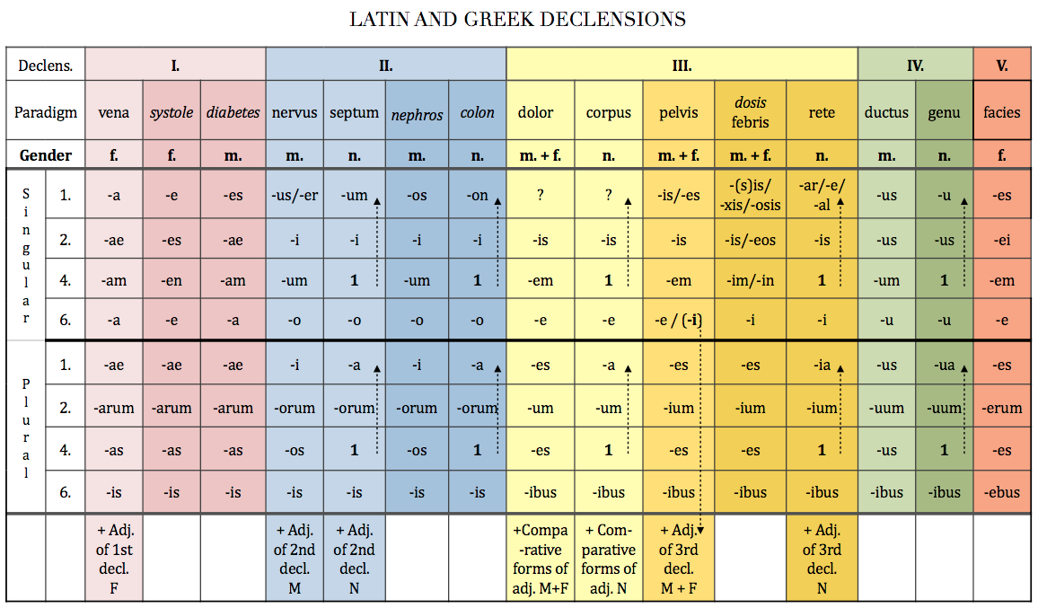

Slide 22
FORM CLOSE ATTRIBUTE
musculus+ biventer, is, e
!fossa + biventer, is, e
!ganglion + biventer, is, e
musculus + communis, e
arteria + communis, e
crus + communis, e
lobulus + simplex, cis
articulatio + simplex, cis
crus + simplex, cis
3-forms
2-forms
1-form
Number of forms in nom. sg.

Slide 23
Derive adjectives using endings
-alis, e or -aris, e
costa/ cost- + alis ⇢ costalis, e
femur / femor- + alis, e ⇢ femoralis, e
musculus/ muscul- + aris, e ⇢ muscularis, e
dorsum intestinum cervix labium
facies nasus pulmo viscera
apex digitus margo medulla
rectum orbita maxilla pectus
ren patella vagina tonsilla
sternum abdomen frons paries
superficies vestibulum spina bronchus
pars os, oris cranium dens

