Slide 1
1. Drug dosage forms and routes of administration 2. Information about drugs 3. Drug legislation in CZ

Slide 2
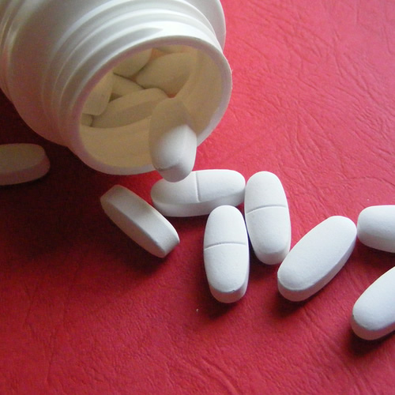
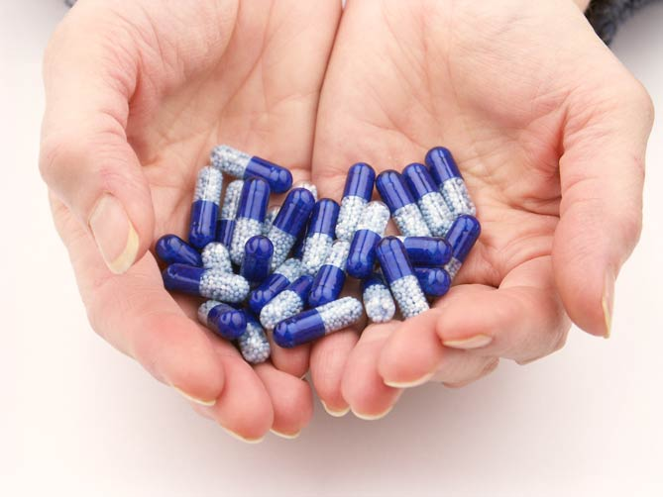
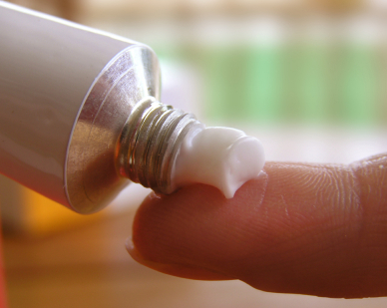
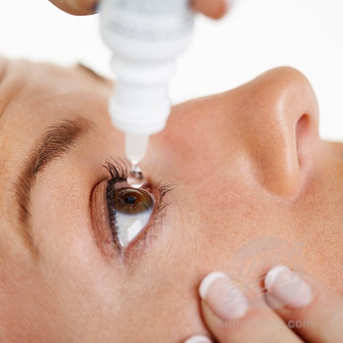
What is a dosage form?
It is a final form, in which
the drug is given to the patient.

Slide 3
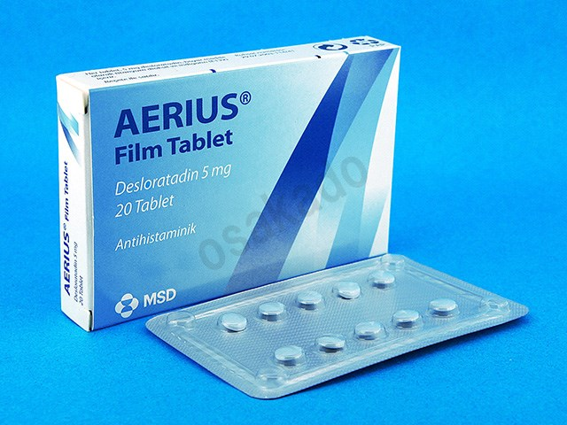
Dosage Form
Mixture of substances with therapeutical effect and excipients
Excipients: antioxidants, fillers, pigments (dyes), fragrances, ointment bases, solvents etc.
No pharmacological effect
Allergies (parabens), intolerance (lactose)
Shape and characteristics of a medical preparation
Adjusted to the route of administration
Influence pharmacokinetics of a medical substance
Generations of dosage forms:
1st = classic dosage forms
2nd = controlled release
3rd = controlled biodistribution
Excipients of AERIUS tablets:
Core: calcium hydrogen phosphate dihydrate, microcrystalline cellulose, maize starch, talc.
Coating: lactose monohydrate, hypromellose, titanium dioxide, macrogol 400, indigotin, carnauba wax, white wax.

Slide 4
Classification of Dosage Forms
According to the consistency:
solid
semi-solid
liquid
gaseous
According to the usage:
for internal use (Ad usum internum, e.g. Peroralia, Parenteralia)
for other use (Ad usum alium, e.g. Ocularia, Nasalia, Unguenta).

Slide 5
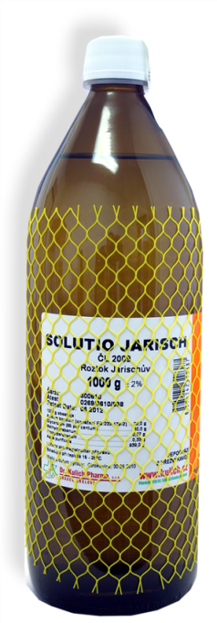
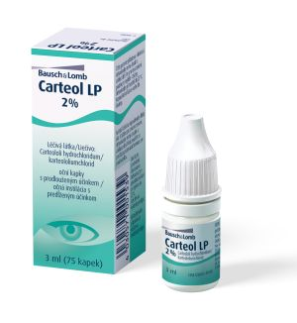
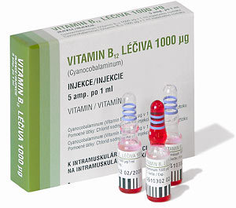
Liquid Dosage Forms
a) For internal use:
1. (Per)oral liquids
– solutions, suspension, emulsion for per os administration
– tinctures, drops, syrups
2. Parenteral liquids
– injections
– infusions
b) For external use:
– eye drops, ocular waters, ear drops, nasal drops
– liquids for cutaneous use, for compresses
– liquids applied to the mucosa (douche – irrigation, gargle)

Slide 6
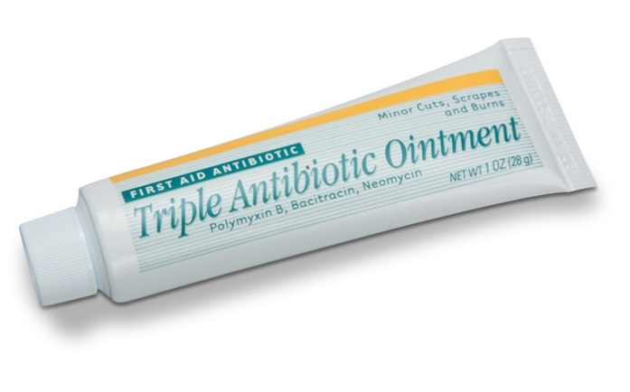
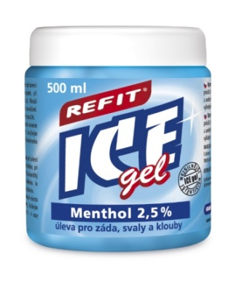
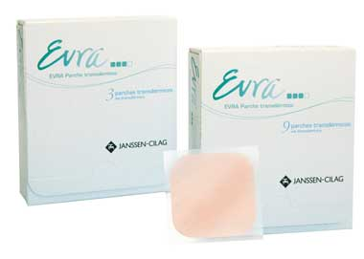
Semi-solid Dosage Forms
Applied on the skin or mucosa
Local effect (dermatology)
Systemic effect (TTS)
Ointment (unguent)
Creme
Gel (jelly)
Paste
Transdermal patch (TTS, Emplastra)

Slide 7
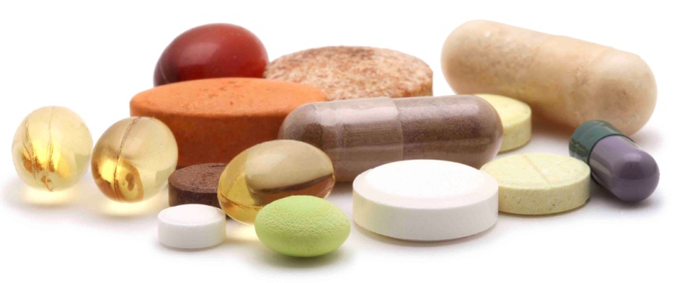
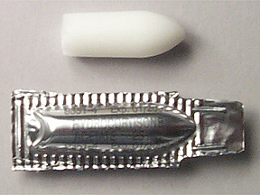
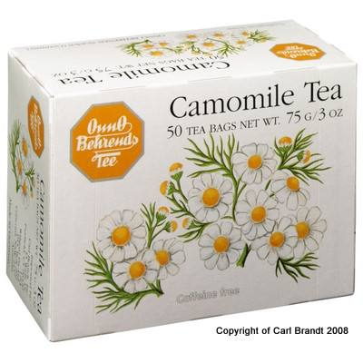
Solid Dosage Forms
Specific in shape:
Tablet
Suppository
Vaginal pessary (suppository)
Capsule
Lozenge (pastilles)
Non-specific in shape:
Dusting powder
Herbal mixture
Peroral powder:
Classic
Grained
Effervescent

Slide 8
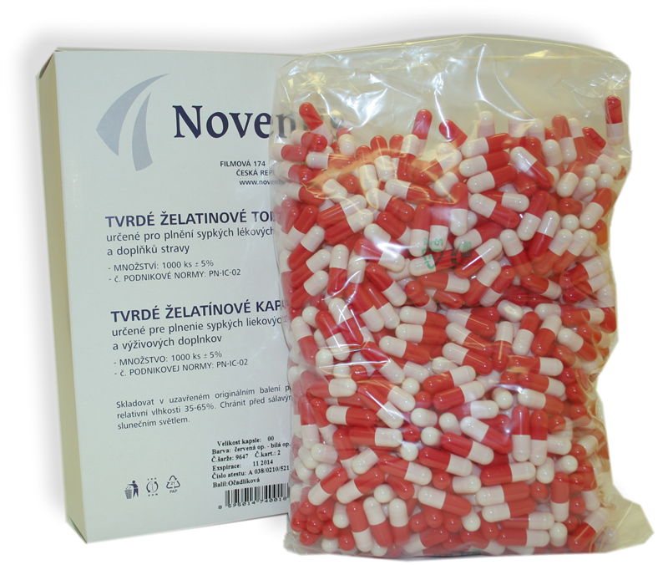
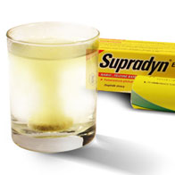
Tablets and Capsules
Tablets:
Uncoated
Coated
Gastro-resistant
Effervescent
Tablets disperged in the mouth
Chewable
Sublingual
etc.
Capsules:
Hard
Soft
Gastro-resistant
With modified release
etc.

Slide 9
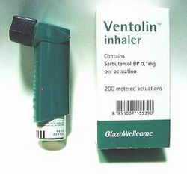
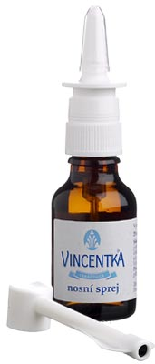
Gaseous Dosage Forms = Aerodispersions
Topical
ear, nasal, oral, sublingual and cutaneous spray
Preparations for inhalation
liquids (scattering of liquid drops)
powders (particle size determines the place of absorption)
Foams
cutaneous, rectal, vaginal foams
Making of an aerodispersion:
Mechanically by a nebulizer (spray)
By liquefied/compressed gas (pressure container)

Slide 10
https://www.youtube.com/watch?v=9VXdBprFIwc
https://www.youtube.com/watch?v=3FqBBQJsl2o

Slide 11
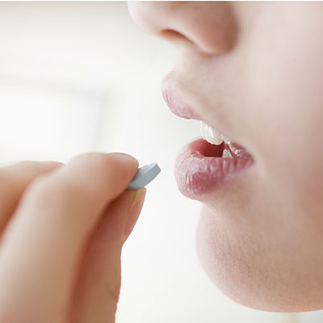
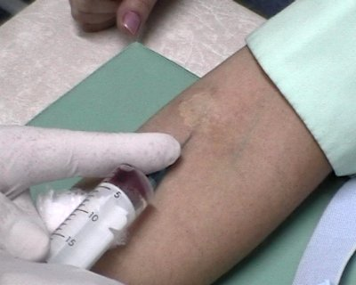
Routes of administration
How could a drug be administered?
Systemic administration
= drug is absorbed into the circulation → it influences all the body
Enterální aplikace:
enteral
parenteral
Local (topical) administration
= drug is NOT absorbed into the circulation → it affects only the place of application
:
skin, mucosa, e.g. conjunctiva:
GIT, but the drug in not absorbed from GIT

Slide 12
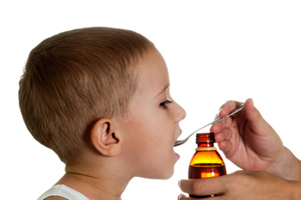
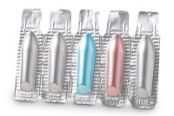
Systemic administration – enteral
(Per)oral (per os, p.o.) Enteron (ancient greek) = intestine
Onset of effect depends on phys-chem. properties of the medical substance and excipients
Possibility of lower bioavailability: first-pass effect (liver)
Rectal (per rectum)
Do not irritate stomach, do not cause nausea
Lower bioavailability – lesser surface of rectum walls
Sooner onset of effect – plexus venosus rectalis flows into vena cava inferior („bypass of the liver“)

Slide 13
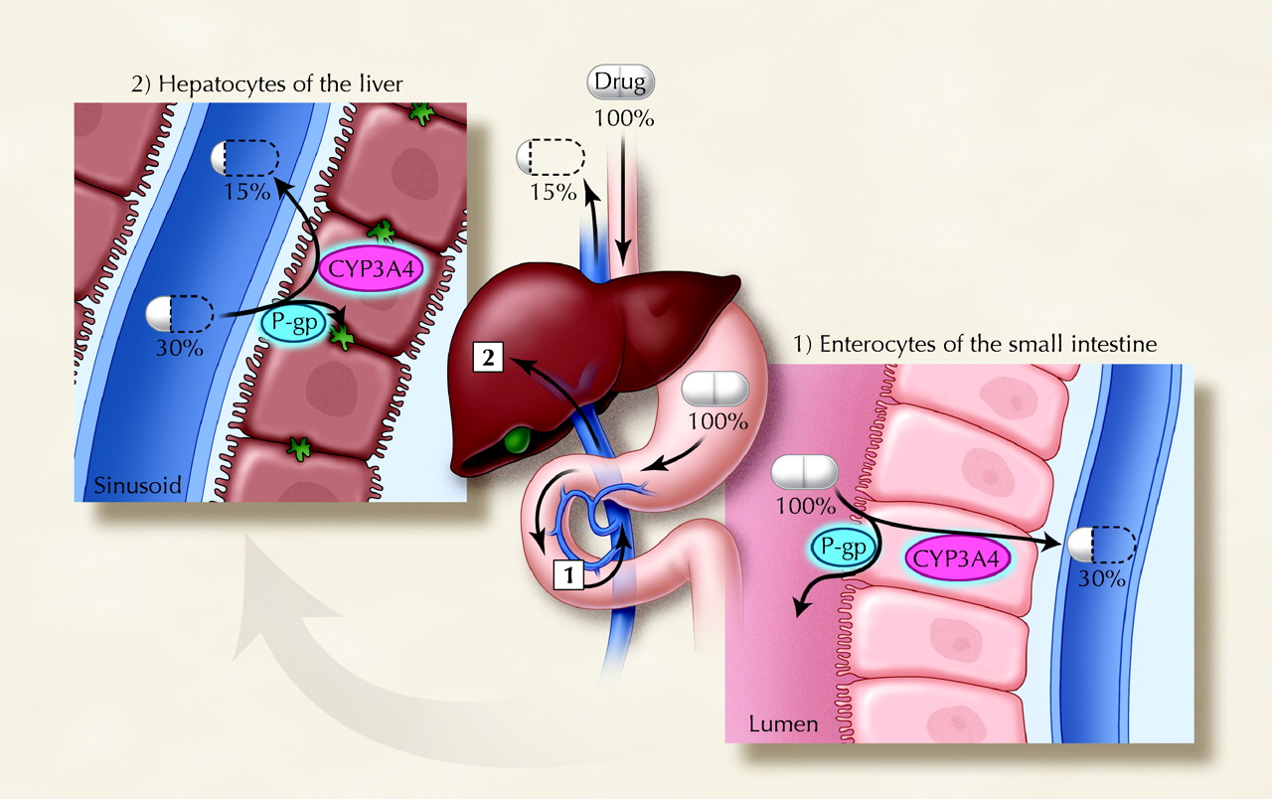
„First pass“ effect

Slide 14
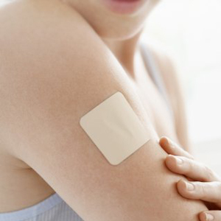
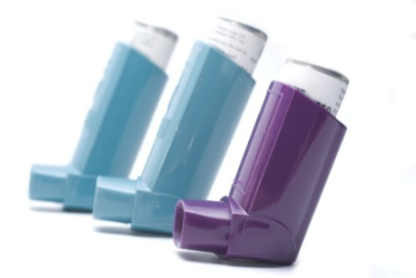
Systemic administration – parenteral
Para enteron (ancient greek) = out of the intestine
1. Non-injection (non-invasive)
a) oral
Absorption by oral mucosa (e.g. subligual)
Lipophilic substances – quick absorption (2 mins), e.g. nitroglycerin
b) inhalation
Gases, vapours nebo small particles
Respiratory diseases (asthma, COPD...)
c) transdermal
TTS = transdermal therapeutic system (controlled release)
E.g. hormonal contraception patch, nicotine patch, analgesic patch
d) transnasal
Good perfusion of nasal mucosa
Substances could irritate it, or impair cilia function
E.g. calcitonin, antimigraine drugs
e) vaginal – e.g. hormonal contraception ring

Slide 15
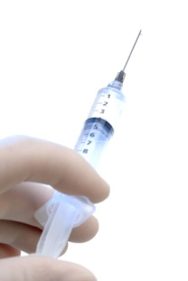
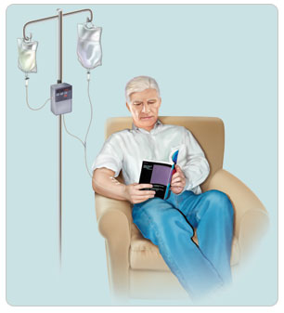
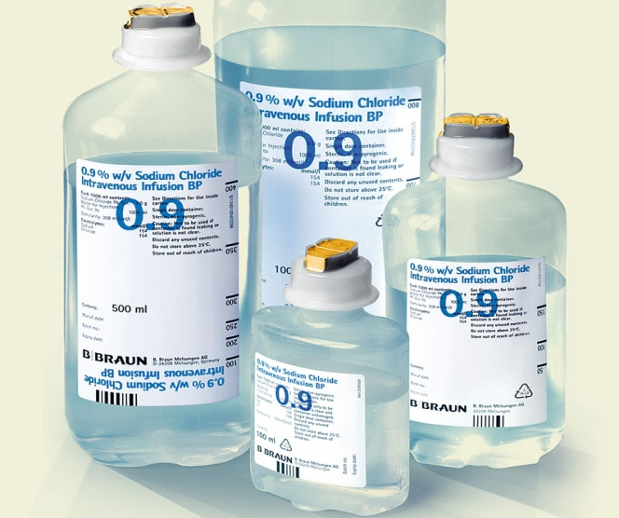
Systemic administration – parenteral
2. Injection (invasive)
- non-physiological
a) injection
small volume of liquid
i.v. administration – quick onset of effect
i.m., s.c. – gradual absorption into circulation
b) infusion
larger volume of liquid
parenteral nutrition, minerals, glucose, ATBs, cytostatics etc.

Slide 16
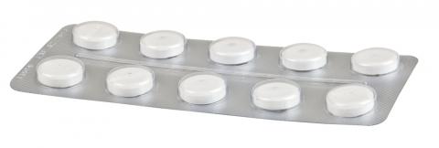
Could this drug influence the effect of other drugs?
?
What is this tablet?
How frequently should I use it?
What is this drug used for?
How to store it?
?
?
What are possible adverse effects?
What is an appropriate dose?
Does it influence vigility?
?
?
Who must not use it?

Slide 17
Information about Drugs
PIL & SPC
PIL = patient information leaflet = package leaflet for patients
SPC = summary of product characteristics = information for medical specialists (physicians, pharmacists, nurses etc.)
EMA – European Medicine Agency (ema.europa.eu)
Database of RMPs granted central authorisation by EC/EMA
Reports concerning drugs‘ safety – alerts
List of newly authorized drugs
SUKL – State Institute for Drug Control (sukl.eu)
Database of RMP authorized in CZ
Free access to all PILs and SPCs (in czech)
European Pharmacopoeia = european standard for the quality of drugs (Czech Pharmacopoeia = text from EP + czech specialities)
Computer databases of medical preparations
AISLP (czech↔english, in most pharmacies and doctor‘s offices)
Notes:
Jdi na web SÚKLu a ukaž vyhledávání
Jdi na web EMA a ukaž vyhledávání www.ema.europa.eu > Find medicine >Human >Product information
Ukaž AISLP

Slide 18
Pharmacopoeia
Purpose: to guarantee safe, effective and quality drugs
Information about medical substances, excipients, dosage forms
Instructions for production, preparation, control, storage of drugs
Used mostly in pharma industry
What could we found there?
Analytical and instrumental examination methods
Materials for drug containers and cases
Instructions to ensure sterility of medical preparations
Instructions concerning radiopharmaceuticals, vaccines etc.
Monographs of specific substances
Tables with usual dosage of drugs in adults, children, animals
etc.
NO: mechanism of actions, adverse effects, pharmacokinetics, contraindications, pregnancy safety etc.!
Notes:
Rozdej monografie

Slide 19
Basic Drug Legislation in CZ
Act No. 378/2007 Coll., on pharmaceuticals
Research
Authorization of new drugs („registration“)
Production, preparation and distribution
Prescribing and dispense of medical preparations
Destroying of unusable drugs
Pharmacy duties
Pharmacovigilance = drug safety service
Controls and sanctions

Slide 20
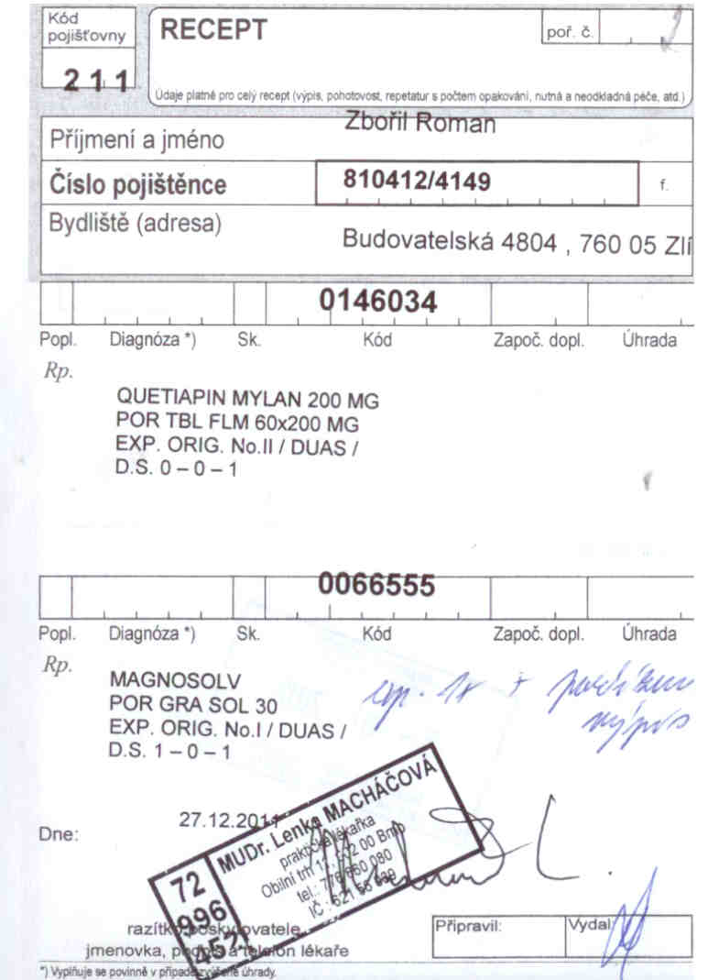
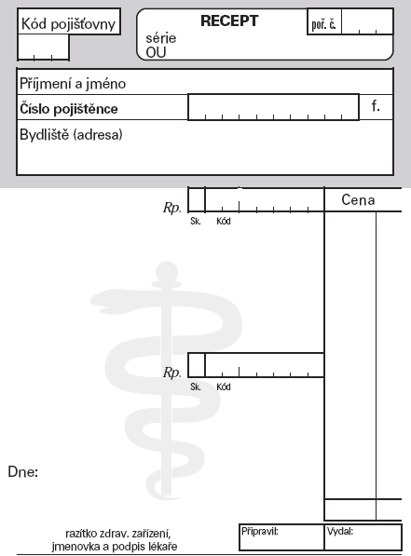
Medical Prescription (Rx) in CZ
Validity:
classic Rx: 14 days
Rx for ATBs: 5 days
Rx for local ATBs: 14 days
Drugs of abuse and psychotropic substances (special Rx form): 14 days
Rx for repeated use: 6 months, max. 1 year
Rx from ED: day after the day of making up (= max. 48 h)

Slide 21
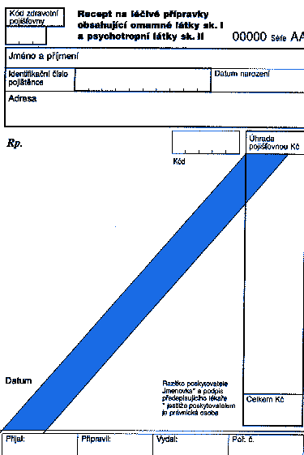
Legislation – Drugs of Abuse
Act No. 167/1998 Coll. on Dependency Producing Substances & Order of the Government 463/2013 Coll. regarding the lists of dependency producing substances
Specified narcotic and psychotropic drugs
should be strictly monitored:
Keeping files of accepting and dispensing
– „Opiates Book“
SUKL require this information
Special Rx form – with oblique blue strip
Medical preparations and Rx forms should be stored in a safe or vault!

Slide 22
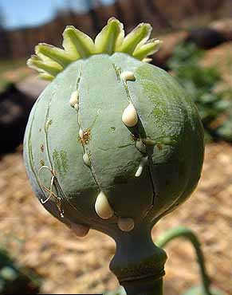
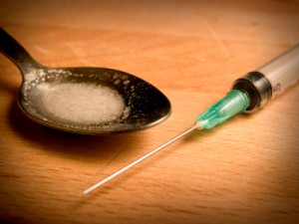
Classification of narcotics
Group 1 → Rx with blue strip
Highly addictive
E.g. strong opioid analgesics
morphine
oxycodone
fentanyl etc.
Group 2
Lower risk of addiction
Classic Rx form
E.g. codeine
Group 3 = „forbidden substances“
No therapeutic use
Misused
Sometimes used in the research
E.g. hashish, heroin etc..

Slide 23
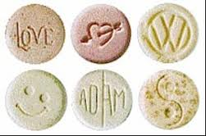
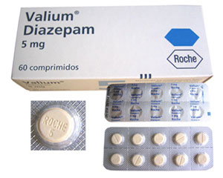
Classification of psychotropic drugs
Group 1 = „forbidden substances“
Hallucinogens, psychostimulants
E.g. MDMA (exstasy)
Group 2 → Rx with blue strip
Misused psychostimulants, addictive
E.g. methamphetamine and other amphetamins
Therapeutically used: e.g. methylphenidate, buprenorphine
Group 3
Barbiturates, risk of addiction, limited therapeutic use
E.g. pentobarbital
Group 4
Benzodiazepines, barbiturates and other potentially addictive drugs
Classic Rx. form
Hypnotics, sedatives, antiepileptics etc.
E.g. diazepam, oxazepam, phenobarbital…

Slide 24
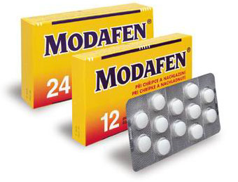
Precursors
= substances used in the production of addictive and psychotropic substances
classic Rx (except pseudoephedrine)
ephedrine – nasal drops in sinusitis
pseudoephedrine – medical preparation for cold treatment
→ OTC with restriction
ergotamine – antimigraine suppositories
ergometrine – obstetrics

