Slide 1
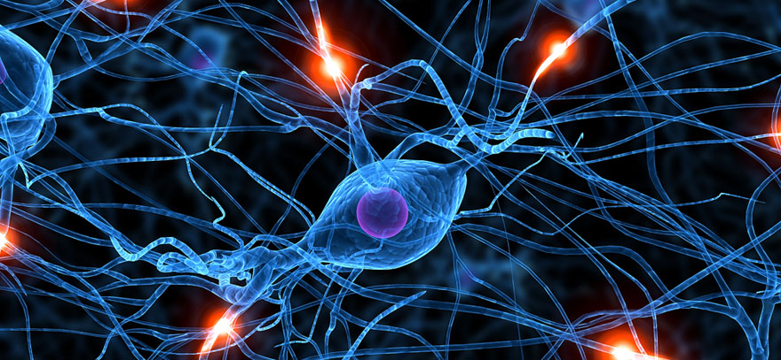
Special Chapters from Neurologic Pharmacotherapy

Slide 2
Overview of pharmacotherapy of:
Parkinson‘s disease and parkinsonism
choreatic dyskinesias
spastic disorders
myasthenia gravis
Ménière‘s disease

Slide 3
Parkinson‘s disease

Slide 4
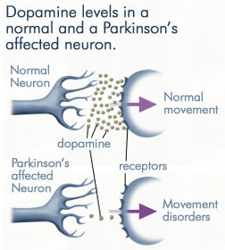
Parkinson‘s Disease
Degenerative disease of CNS: dying of dopaminergic neurons = dopamine deficit
Non-specific symptoms: fatigue, depression
Specific symptoms:
Resting tremor, stiffness (rigidity) and increased muscle tone, postural impairments
Extent of movements is limited, ability to move is slown down
Impairment of the movement initiation, akinesia (sudden inability to move)
Typical changes in walking, graphomotor skills and facial mimics
Psychiatric symptoms: cognitive impairment
Late-onset dyskinesia (night akinesia, morning stiffness, cramps)
https://www.youtube.com/watch?v=j86omOwx0Hk

Slide 5
Pharmacotherapy of PD
Dopamine (DA) deficit → DA precursor: LEVODOPA
Metabolised by DOPA decarboxylase to DA in CNS
Used orally several times a day
AE:
a) Metabolism to DA in periphery = vomiting, diarrhea, gastric ulcers, hypertension, tachycardia…
b) DA excess = hallucinations, agression, psychosis (rarely)
+ COMT inhibitors (catechol-O-methyl transferase)
entacapone, tolcapone
+ Peripheral DOPA decarboxylase inhibitors
carbidopa, benserazide
Wearing-off effect – quick subsiding of the effect

Slide 6
Pharmacotherapy of PD
Dopamine (DA) deficit → D receptors agonists
Used orally or by TTS
AE: drowsiness, irresistible falling asleep („sleep attacks“)
a) Ergoline derivatives – bromocriptine, pergolide, dihydroergocriptine
Ergot alkaloids derivatives
AE: fibrotic changes in lungs, heart valves + increased risk of psychiatric AE (psychotic symptoms)
b) Non-ergoline drugs – ropinirole, pramipexole, rotigotine
Lower risk of psychiatric AE, no fibrotic changes

Slide 7
Pharmacotherapy of PD
Adjuvant therapy of Parkinson‘s disease:
Selegiline – MAO B inhibitor (DA degradation enzyme)
Anticholinergics:
Relative excess of ACh → worsening of dyskinesia
Only for short-term use
Contraindication: elderly, patients with cognitive deficit
AE: anticholinergic effects – 3rd lecture
Amantadine – i.v. infusion in severe acute dyskinesia
Biperiden, procyclidine – used orally

Slide 8
Drug-induced extrapyramidal reactions

Slide 9
Drug-induced Extrapyramidal Reactions
Abnormal reaction of dopaminergic system
Imbalance between DA and ACh in CNS
Up-regulation of D receptors in basal ganglia
Dystonia, akathisia, facial choreatic movements
Tardive dyskinesia, parkinsonism
Typical (classical) antipsychotics – chlorpromazine, levopromazine, prochlorperazine, perfenazine, haloperidol…
Approx. 20% pacients !
H₁ antihistamines of 1st generation – thiethylperazine, prometazine
Prokinetic agents – metoklopramid
Older antihypertensive – reserpine, α-methyldopa
Antivertigo agents – cinnarizine, flunarizine
Antiepileptics – phenytoin, carbamazepine
Antidepressants – tricyclic AD, trazodone
Centrally active muscle relaxant baclofen

Slide 10
Drug-induced Extrapyramidal Reactions
Pharmacotherapy:
Switch to safer drug (safer antipsychotic etc.)
+
Dystonia, akathisia → i.v., p.o. anticholinergics
Tardive dyskinesia → sometimes i.m. botulinum toxin
Parkinsonism → antiparkinson agents
Benzodiazepines p.o., i.v. – sedation, muscle relaxation
Enhace GABAergic transmission

Slide 11
Choreatic dyskinesia

Slide 12
Choreatic Dyskinesia
= unintentional, involuntary, quick, irregular movements
Causes:
Huntington‘s chorea (hereditary neurodegenerative disease)
vascular chorea (ischemia in basal ganglia)
chorea minor (autoimmune disease)
Pharmacotherapy:
Antipsychotics – typical (haloperidol), or atypical (risperidone)
Risk of additional extrapyramidal reactions
Reserpine, tetrabenazine – ↓ levels of DA in CNS
Risk of additional extrapyramidal reactions, depression, hypotension
Benzodiazepines (clonazepam)
Amantadine

Slide 13
Spastic disorders

Slide 14
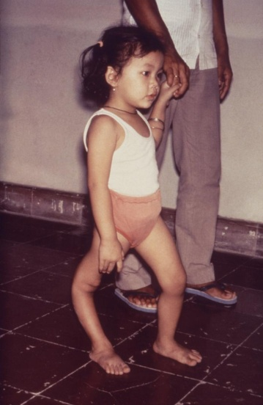
Spastic Disorders
Caused by damages of motor neurons:
a) peripheral motor neurons – ↓ muscle tone, strenght, progressive atrophy of skeletal muscles, long bones and skin
poliomyelitis anterior acuta
Charcot-Marie-Tooth disease
myasthenia gravis
b) central motor neurons – ↑ muscle tone, muscle contractures, limited ability of joints to move, joint dislocations, muscle hypertrophy → atrophy, deformities of long bones
Cerebral palsy (CP)
Pharmacotherapy is an adjuvant treatment – improves the results of physiotherapy, or enables it to be carried out!

Slide 15
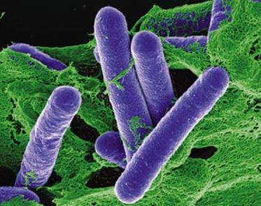
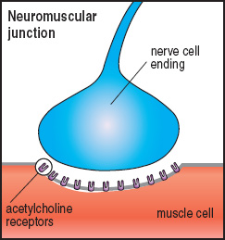
Local Therapy
Botulinum toxin A
Polypeptide from Clostridium botulinum
Injected i.m. into the spastic muscles
Causes irreversible inhibition of ACh release in NJs – peripherally active muscle relaxant (presynaptically acting)
Alleviate pain associated with spasms
Enables muscle growth – benefit for children with CP
Administered repeatedly, but sometimes 1 inj. can act even for 12 months
Reinnervation of muscles – new NJs are created in the muscle → spasms reoccur
Improves physiotherapy effects!

Slide 16
Systemic Therapy
Spasticity of larger areas → centrally acting muscle relaxants
BACLOFEN
GABA_{B} agonist – enhances GABAergic transmission = inhibits release of excitatory AA (glutamate, aspartate)
AE: drowsiness, confusion, hypotension, muscle weakness
Progressive tolerance – need for higher doses
Intrathecal administration – s.c. pump with catheter inserted into subarachnoideal space = lower doses
α₂ RECEPTOR AGONISTS
Activation lead to decrease of neurotransmitter levels in CNS – in spinal cord activation inhibits release of excitatory AA
AE: sedation, xerostomia, bradycardia, hypotension
tizanidine, clonidine
BENZODIAZEPINES – clonazepam, tetrazepam, diazepam

Slide 17
Systemic Therapy
Other drugs used in spastic disorders:
dantrolene
gabapentin, lamotrigine – antiepileptics (GABAergic MoA)
riluzole – amyotrophic lateral sclerosis
Cannabinoids
Mixture of THC and cannabidiol (oral spray)
Agonists of CB₁ and CB₂ receptors, decrease releasing of excitatory AA
Good therapeutical outcome in 30‒40% patients
AE: psychiatric (mood changes, depression, cognitive impairment, appetite changes etc.), GIT AE, off-balance, drowsiness etc.
Young patients – increased risk of schizophrenia or psychosis development !

Slide 18
Myasthenia gravis

Slide 19
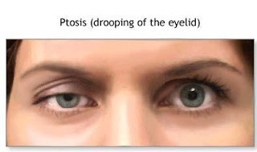
Myasthenia gravis
Autoimmune disease – autoantibodies aganist N_{M} receptors of NJs (women > men)
Fluctuating muscle weakness, patient get tired easily, worsening in afternoon and evening and after muscle strain
1st symptoms: ocular muscles, ptosis
Progression: facial muscles (facial weakness), head and neck muscles (difficulties with chewing, swallowing, speaking etc.)
Severe progression: myasthenic crisis – respiratory muscles
Drugs inducing MG: interferon α
Drugs worsening MG: aminoglycosides, quinidine, quinine, chloroquine, i.v. Mg²⁺

Slide 20
Symptomatic Therapy of MG
Cholinomimetics – acetylcholine esterase inhibitors = ↑ levels of ACh v synaptic clefts and NJs
pyridostigmine – p.o. several times a day
neostigmine – short-term acting, before muscle strain
ambedonium – N⁺, no central effect
AE: activation of ACh receptors = cholinergic effects:
a) muscarinic (salivation, sweating, streaming eyes, miosis, blurred vision, nausea, diarrhea, abdominal cramps, bronchospasmus, confusion, restlessness…)
b) nicotinic (fasciculations)
c) accumulation → cholinergic crisis = depolarization blockade of ANS ganglia and NJs
muscle weakness, potentially life-threatening
therapy: mechanical ventilation + i.v. atropine

Slide 21
Causal Therapy of MG
The cause is autoimmunity → immunosuppressives
Decrease number of B-cells, which produce antibodies
AE: non-specific effect = suppression of overall immune reactions – ↑ infections, risk of sepsis, risk of cancer
Glucocorticoids (prednisone, prednisolone, methylprednisolone)
Titration dose, the lowest efficient dose is used
Long-term oral therapy with typical AE (stomach, adipose tissue, diabetes, bone structure…)
Azathioprine – stops proliferation of lymphocytes
Combination with corticoids – enables lower doses
Other immunosupressives: cyclosporin, mycophenolate, methotrexate, tacrolimus

Slide 22
Ménière‘s disease

Slide 23
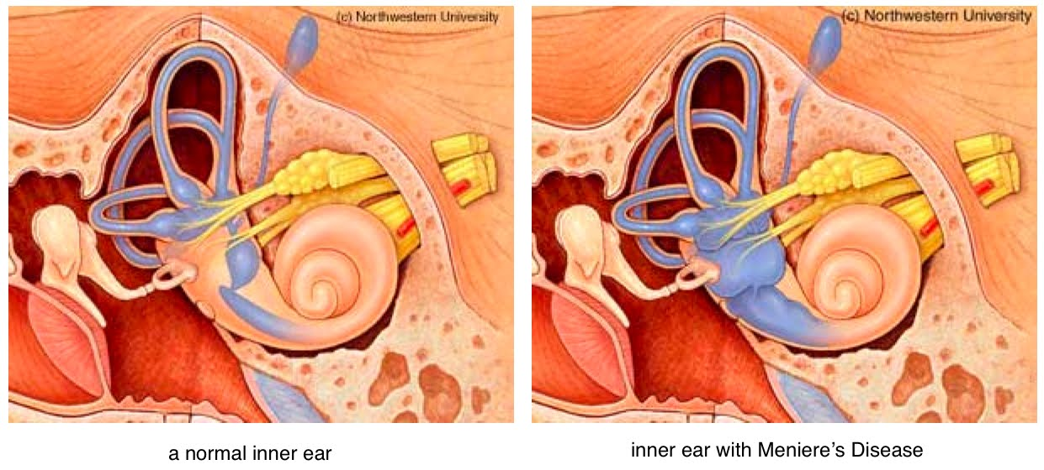
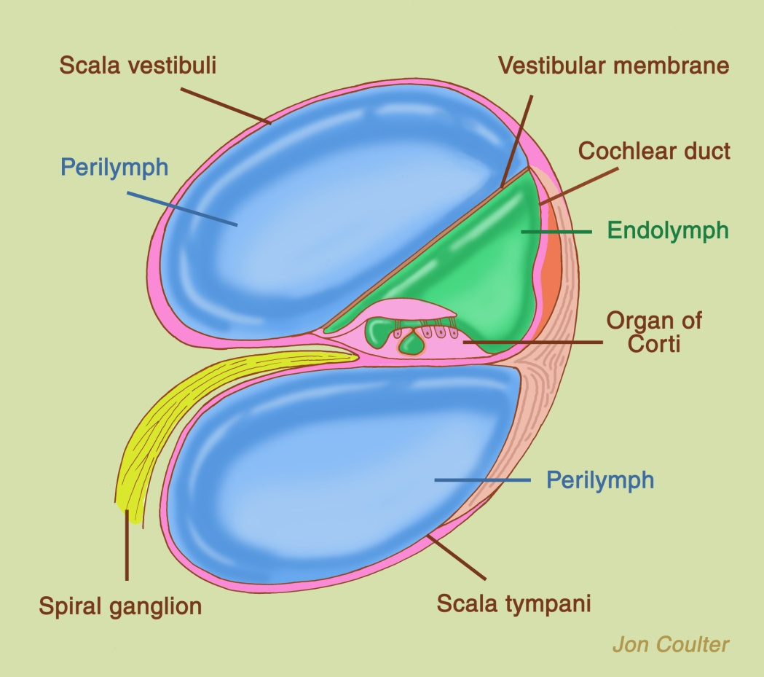
Ménière‘s Disease
Disease of the inner ear – endolymphatic hydrops
Accumulation of endolymph + distended endolymphatic space
Acute attack: microrupture of vestibular membrane between endolymphatic and perilymphatic space
Dizziness (vertigo), nystagmus, tinnitus, hearing loss…

Slide 24
Prophylactic Pharmacotherapy
BETAHISTINE
H₃ receptor antagonist
CNS, receptors of negative feedback
Regulate histaminergic transmission
Antagonism = ↑ release of histamine
Vasodilation in the inner ear – better microcirculation
Long-term use (lifelong), orally
CinnarizinE
H₁ receptor antagonist + T-type Ca²⁺ channel blockator
Antivertigo and prophylactic effect
Used orally

Slide 25
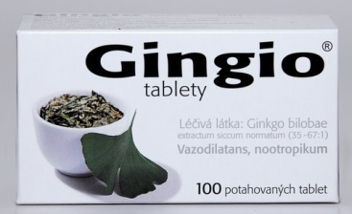
Prophylactic Pharmacotherapy
Cerebral vasodilators and hemorheologics
Improve circulation in CNS
Increase erythrocytes deformability, reduce blood viscosity
Mild antitrombotic, antiinflammatory and antioxidative effect
Used orally, i.v. in acute cases
Standardized extract from Ginkgo biloba
Vinpocetine
Pentoxifylline
Other drugs used for prophylaxis
Glucocorticoids, diuretics – antiedema effects

Slide 26
Antivertigo Drugs
Acute attack of Ménière‘s disease – nausea, vomiting, dizziness, hearing loss, tinnitus, feeling of the pressure in the ear…
Antiemetic/antivertigo drugs:
H₁ antihistamines of 1st generation
cross BBB, central effects
used also for the treatment of motion sickness
embramine, moxastine, dimenhydrinate…
AE: drowsiness, attention (vigilance) deficit
thiethylperazine – D₂ receptor antagonist (suppositories)
cinnarizine + H₁ antihistamines

