Slide 1
Exercise 2. – Week 1
Coordinate adjectives with nouns:
E.g.: linea, ae f (transversus, a, um) – linea transversa

Slide 2
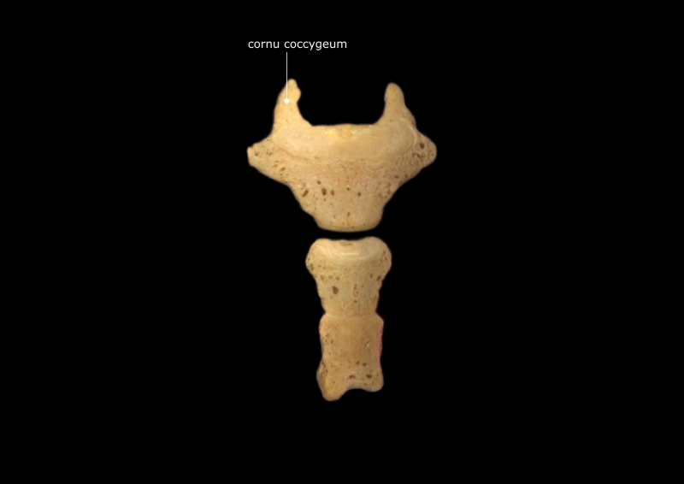
cornu, us n (coccygeus, a, um)
cornu coccygeum - coc·cyg·e·al cornu - two processes that project upward from the dorsum of the base of the coccyx to articulate with the sacral cornua. Synonym(s): cornu coccygeum, coccygeal horn, cornua coccygealia

Slide 3
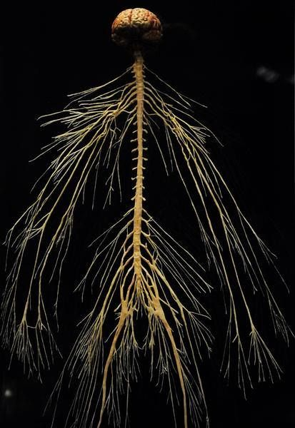
systema, atis n (nervosus,a, um)
Systema nervosum - nervous system - the organ system that, along with the endocrine system, correlates the adjustments and reactions of an organism to internal and environmental conditions.

Slide 4
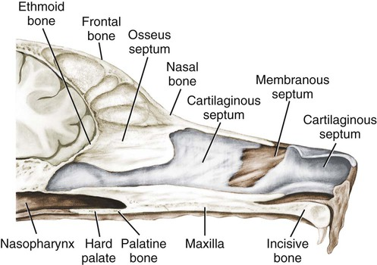
Septum nasi, i n (osseus, a, um)
Septum nasi osseum – bony nasal septum - the bones supporting the bony part of the nasal septum; these are the perpendicular plate of the ethmoid, the vomer, the sphenoidal rostrum, the crest of the nasal bones, the frontal spine, and the median crest formed by the apposition of the maxillary and palatine bones.

Slide 5
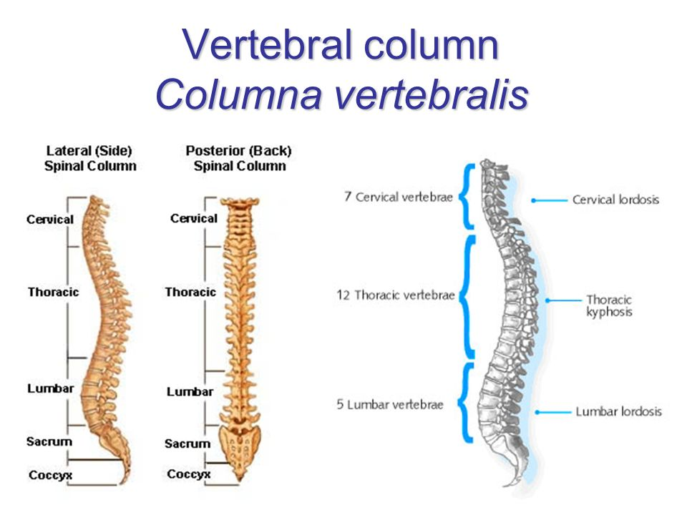
columna, ae f (vertebralis,e)
Columna vertebralis - vertebral column - the series of vertebrae that extend from the cranium to the coccyx, providing support and forming a flexible bony case for the spinal cord. Synonyms: columna vertebralis, spine, backbone, dorsal spine, rachis, spina dorsalis, spinal column, vertebrarium

Slide 6
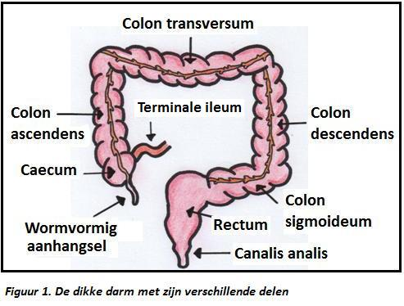
colon, i n (transversus, a, um)
Colon transversum - transverse colon - The part of the colon that lies across the upper part of the abdominal cavity.

Slide 7
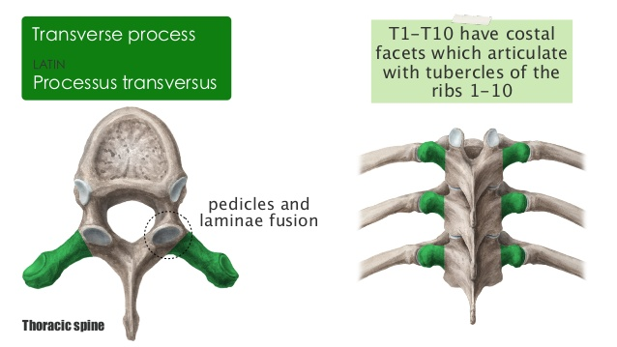
processus, us m (transversus, a, um) vertebrae
Processus transversus vertebrae - transverse process of vertebra - a bony protrusion on either side of the arch of a vertebra, from the junction of the lamina and pedicle, which functions as a lever for attached muscles.

Slide 8
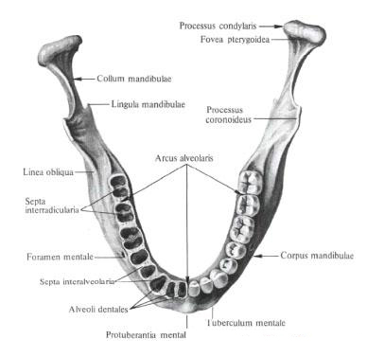
arcus, us m (alveolaris, e)
Arcus alveolaris – alveolar arch - the part of the upper or lower jawbones in which the teeth are set

Slide 9
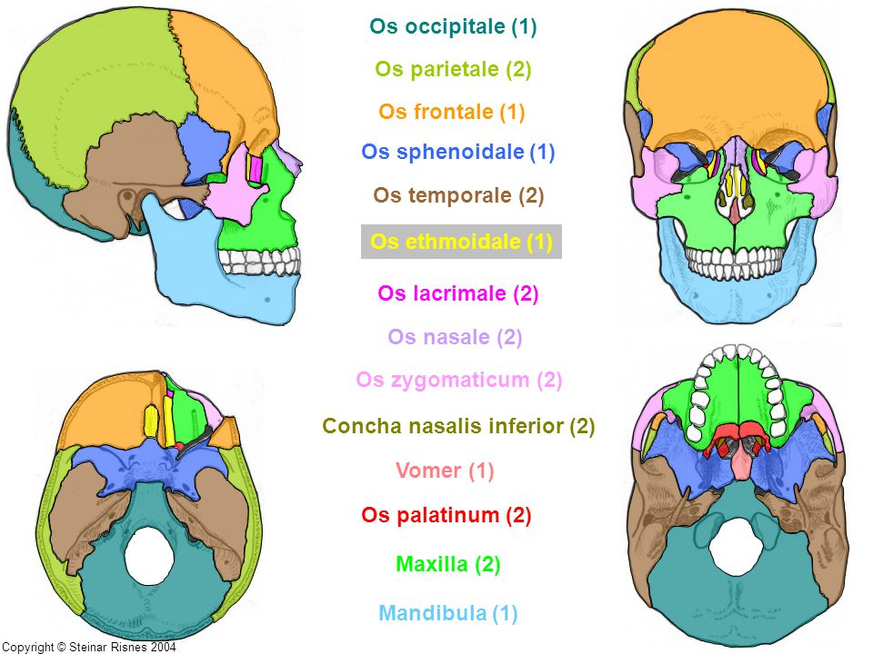
os, ossis n (ethmoidalis,e)
Os ethmoidale - ethmoid bone - an irregularly shaped bone lying between the orbital plates of the frontal bone and anterior to the sphenoid bone of the cranium

Slide 10
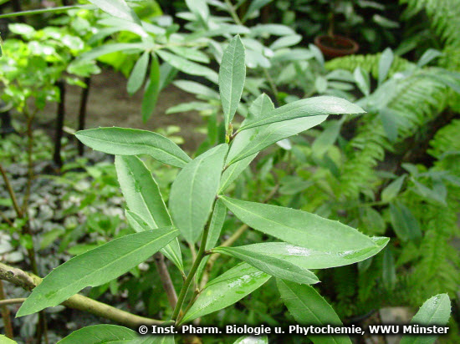
folium, i n (viridis, e)
Folium viride – green leaf

Slide 11
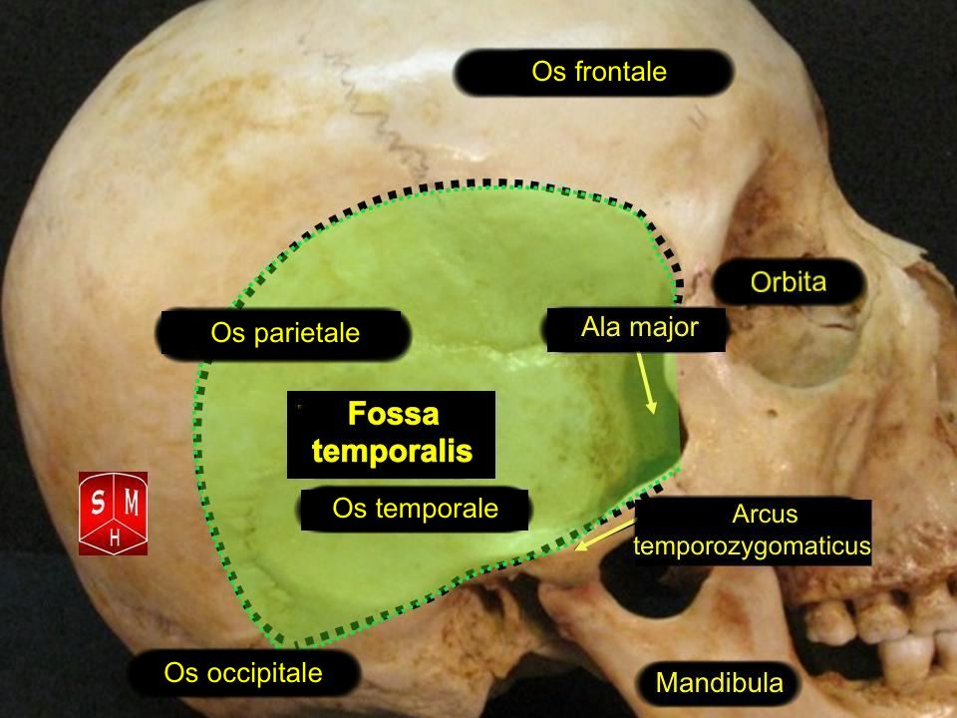
facies, ei f (temporalis, e)
Facies temporalis - temporal surface - the surface of a bone that contributes to the formation of the temporal fossa

Slide 12
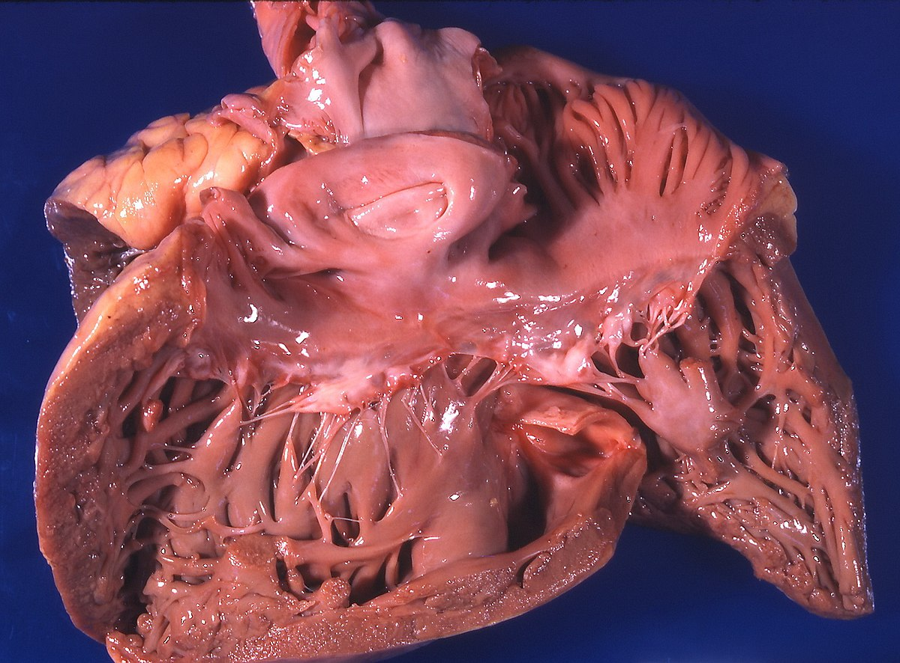
cor, cordis n (pulmonalis, e)
Cor pulmonale - pulmonary heart disease is an increase in bulk of the right ventricle of the heart, generally caused by chronic diseases or malfunction of the lungs. This condition can lead to heart failure.

Slide 13
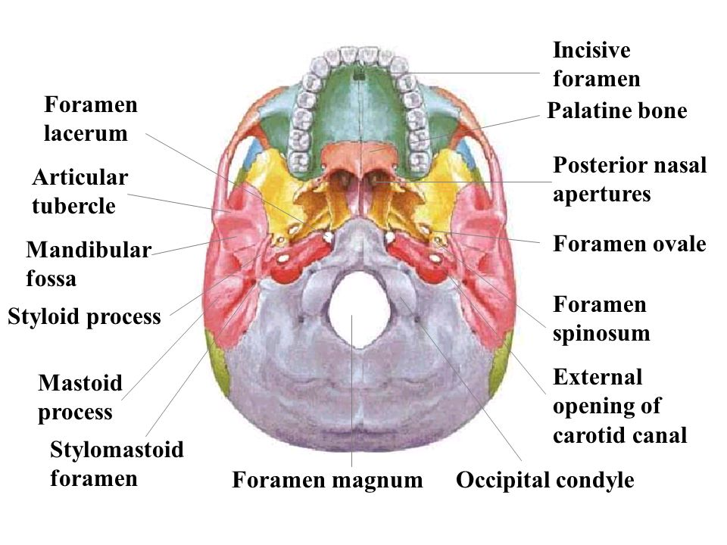
apertura, ae f (externus, a, um)
Apertura externa – external opening – e.g. apertura externa canalis carotici - external opening of carotid canal - a roughly circular opening on the inferior surface of the petrous portion of the temporal bone by which the internal carotid artery enters the carotid canal

Slide 14
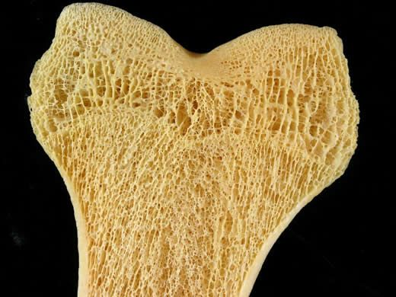
tela, ae f (spongiosus, a, um)
Tela spongiosa - the part of a bone (as much of the epiphyseal area of long bones) made up of spongy cancellous bone

Slide 15
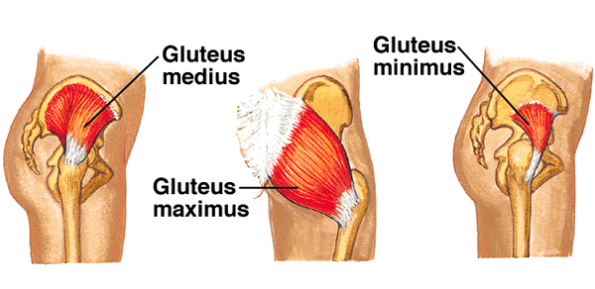
musculus, i m (glutaeus, a ,um)
Musculus glutaeus – gluteal muscle - any of the three muscles that form the buttocks: the gluteus maximus, gluteus medius, and gluteus minimus.

Slide 16
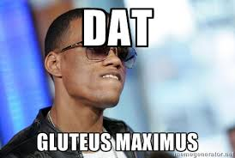

Slide 17
Exercise 3. – Week 1
Form the Genetive of the following anatomical terms:
E.g.: Nom.Sing. radix anterior – Gen.Sing. radicis anterioris

Slide 18
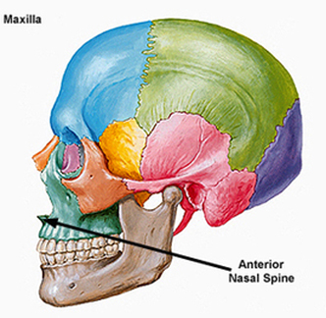
Spina nasalis anterior
Spinae nasalis anterioris – anterior nasal spine

Slide 19
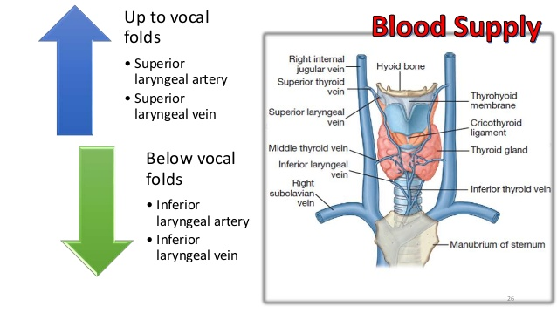
vena laryngea inferior
Venae laryngeae inferioris – inferior laryngeal vein

Slide 20
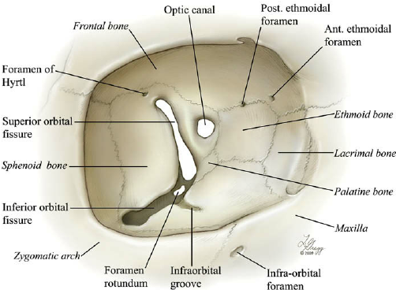
fissura orbitalis superior
Fissurae orbitalis superioris – superior orbital fissure

Slide 21
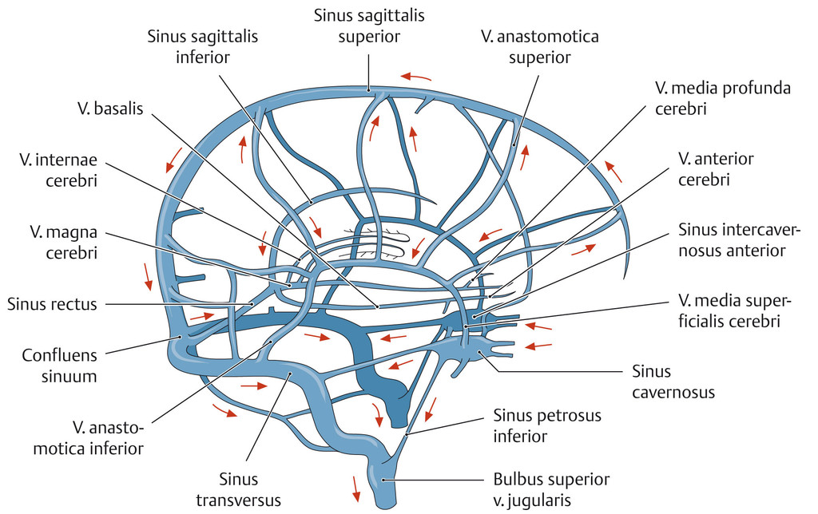
sinus sagittalis superior
Sinus sagittalis superioris – superior sagittal sinus

Slide 22
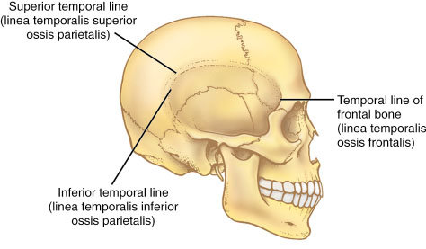
linea temporalis superior
Lineae temporalis superioris – superior temporal line

Slide 23
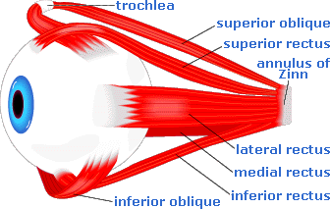
musculus rectus superior
Musculi recti superioris – superior rectus muscle

Slide 24
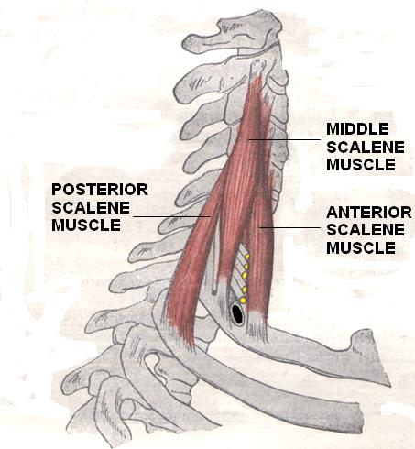
musculus scalenus anterior
Musculi scaleni anterioris – anterior scalene muscle

Slide 25
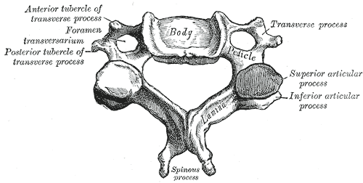
processus articularis superior
Processus articularis superioris – superior articular process

Slide 26
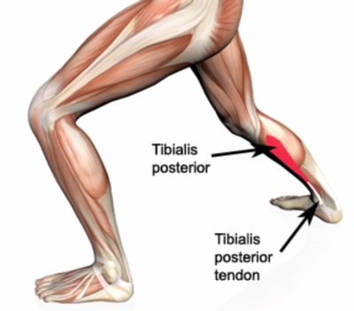
musculus tibialis posterior
Musculi tibialis posterioris – tibialis posterior muscle

Slide 27
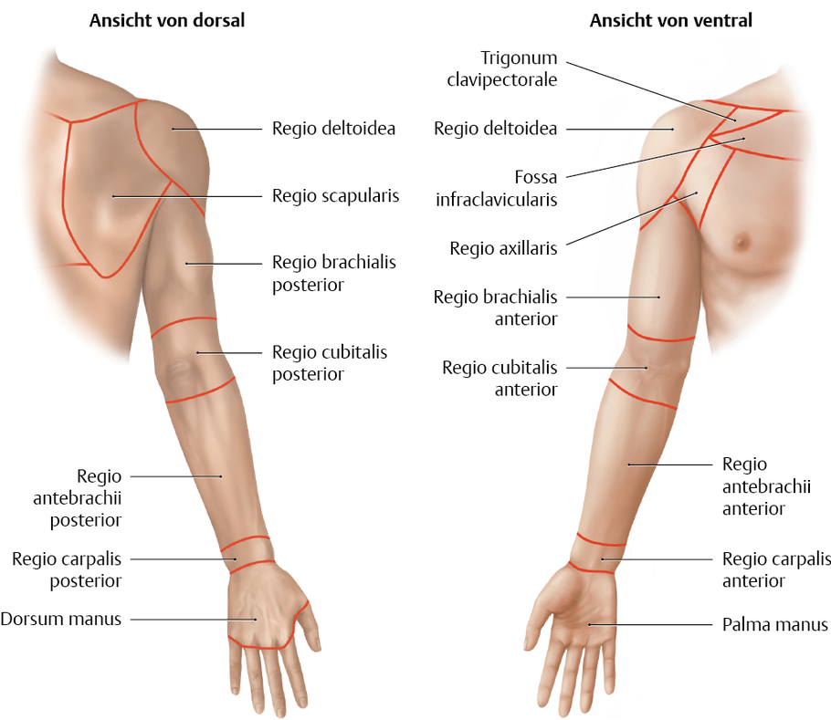
Regio cubitalis posterior
Regionis cubitalis posterioris – posterior cubital region

