Slide 1
Jitka Hüttlová
Treatment in Psychiatry
Department of Psychiatry, University Hospital Brno and Faculty of Medicine of Masaryk University

Slide 2
Treatment in Psychiatry
Treatment in Psychiatry
A. BIOLOGICAL treatment
  Psychopharmacotherapy
  Electroconvulsive Therapy (ECT)
  Repetitive Transcranial Magnetic Stimulation (rTMS)
  Deep Brain Stimulation (DBS)
  Vagus Nerve Stimulation
  Light Therapy
B. PSYCHOSOCIAL treatment
  Psychotherapy
  Psychiatric rehabilitation
  Other (music therapy, art therapy, ergotherapy…)

Slide 3
Main Psychopharmacological Drugs
Psychopharmacotherapy
1. Antidepressants
2. Mood stabilizers
3. Antipsychotics
4. Anxiolytics
5. Hypnotics
6. Cognition-Enhancing Drugs
7. Psychostimulants

Slide 4
General guidelines for antidepressant use
1.Antidepressants
Antidepressant efficacy is very similar so selection is based on past history of a response, side effect profile and coexisting medical conditions.
There is a delay typically of 2-4 weeks after a therapeutic dose is achieved before symptoms improve.
If no improvement is seen after a trial of adequate length and adequate dose, either switch to another antidepressant or augment with another agent.

Slide 5
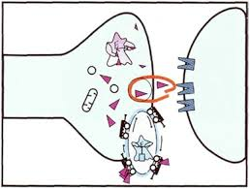
Neurobiology
1.Antidepressants
Lack of monoamine neurotransmitters → depression
Increase in monoamine neurotransmitters → treatment of depression
(Stahl 1997)

Slide 6
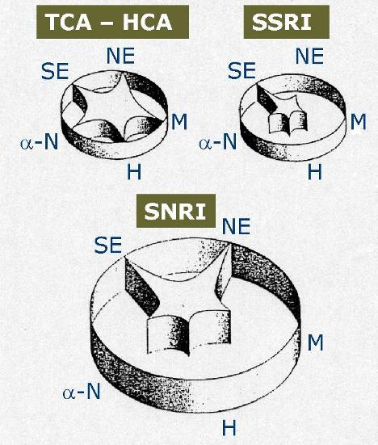
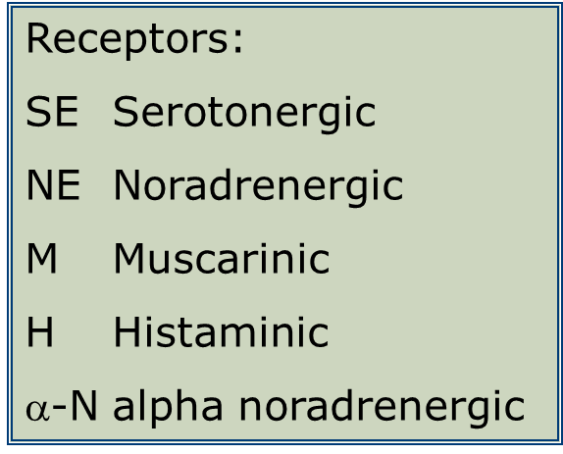
Neurotransmitter Reuptake Inhibition and Binding Affinity to Receptors
1.Antidepressants

Slide 7
Classification | Name | Example
st generation | Tricyclics (TCAs) and tetracyclics (TeCAs) | amitriptyline clomipramine
2nd generation |  | viloxazine
3rd generation | SSRI (Selective Serotonin Reuptake Inhibitors ) | citalopram escitalopram sertralin
 | SARI (Serotonin antagonist and reuptake inhibitor) | trazodon
 | NRI (Nor-Adrenaline Reuptake inhibitors) | reboxetin
4th generation | SNRI (Serotonin/Norepinephrine reuptake inhibitors) | venlafaxine milnacipran
 | DNRI (Dopamine/Norepinephrine reuptake inhibitors | bupropione
Other | Blockators of α2 -adrenoceptors | mirtazapin mianserin
 | (MAOIs) Monoamine Oxidase Inhibitors | moclobemide selegiline

Slide 8
Classification | Name | Mechanism of Therapeutic Efficacy | Specific character | Examples
1st generation | Tricyclics (TCAs) and tetracyclics (TeCAs) | •Inhibition of Serotonin and/or Norepinephrine reuptake followed by increase of their concentrations in synaptic cleft (react with other types of receptors → more side effects) | •Severe side effects - antihistaminic (sedation, weight gain), anticholinergic (dry mouth, constipation, potentially delirium), antiadrenergic (orthostatic hypotension, sexual dysfunction) •Can cause dangerous QT lengthening •Danger of Intoxication •Many Interactions | amitriptyline nortriptyline clomipramine dosulepin

Slide 9
Classification | Mechanism of Therapeutic Efficacy | Specific character | Examples
2nd generation | Norepinephrine Reuptake Inhibition | •Less anticholinergic side effects then 1st generation | viloxazine

Slide 10
Classification | Name | Mechanism of Therapeutic Efficacy | Specific character | Examples
3rd generation | SSRI (Selective Serotonin Reuptake Inhibitors ) | Block the presynaptic serotonin reuptake | •The most commonly used •Side effects: GI upset, sexual dysfunction, anxiety, restlessness, insomnia, fatigue or sedation, dizziness •Very little risk of cardiotoxicity in overdose | citalopram escitalopram sertralin fluoxetin fluvoxamin paroxetin

Slide 11
Classification | Name | Mechanism of Therapeutic Efficacy | Specific character | Examples
3rd generation | SARI (Serotonin antagonist and reuptake inhibitor) | Antidepressants with Doubled Serotonergic Efficacy | •A risk of serotonin syndrome | trazodon
 | NRI (Selective Nor-Adrenaline Reuptake inhibitors) | Increase norepinephrine |  | reboxetin

Slide 12
Classification | Name | Mechanism of Therapeutic Efficacy | Specific character | Examples
4th generation | SNRI (Serotonin/Norepinephrine reuptake inhibitors ) | Inhibit both serotonin and noradrenergic reuptake | •Side effects: nauzea, dizziness, blood preasure increase | venlafaxine milnacipran
 | DNRI (Dopamine/Norepinephrine reuptake inhibitors) | Inhibit Dopamine and Norepinephrine reuptake | •No weight gain, no sexual side effects, no sedation or cardiac interactions | bupropione

Slide 13
Classification | Name | Mechanism of Therapeutic Efficacy | Specific character | Examples
other | Blockators of α2-adrenoceptors | Increasing Synthesis and Releasing of Norepinephrine, Blockade Alpha-2 Adrenoceptors on Serotonergic Neurons and Increasing Production and Releasing of Serotonin | •Side effects: Weight gain, sedation, | mirtazapin mianserin

Slide 14
Classification | Name | Mechanism of Therapeutic Efficacy | Specific character | Examples
Other | (MAOIs) Monoamine Oxidase Inhibitors | Bind irreversibly to monoamine oxidase thereby preventing inactivation of biogenic amines such as norepinephrine, dopamine and serotonin leading to increased synaptic levels. | •Side effects: weight gain, dry mouth, sedation, sexual dysfunction and sleep disturbance •Hypertensive crisis can develop when MAOI’s are taken with tyramine-rich foods or sympathomimetics | moclobemide selegiline

Slide 15
Main Psychopharmacological Drugs
Psychopharmacotherapy
1. Antidepressants
2. Mood stabilizers
3. Antipsychotics
4. Anxiolytics
5. Hypnotics
6. Cognition-Enhancing Drugs
7. Psychostimulants

Slide 16
Mood stabilizers
2. Mood stabilizers
Indications: Bipolar, cyclothymia, schizoaffective, impulse control and intermittent explosive disorders.
Classes: Lithium, anticonvulsants, antipsychotics
Which you select depends on what you are treating and again the side effect profile.

Slide 17
Classification | Example | Characteristics
Lithium | Lithium | •Only medication to reduce suicide rate •I:Effective in long-term prophylaxis of both mania and depressive episodes •SE: Thyroid abnormalities, Polyuria/polydypsia , intention tremor •BS: examination of renal, cardiac and thyreoidal function, pregnancy
Antiepil. 2nd generation | carbamazepine | •I: acute mania and mania prophylaxis •SE: Rash, nauzea, vomiting, drug interactions!!! •BS: baseline liver function tests, CBC and an EKG
 | salts of valproic acid | •I: as effective as Lithium in mania prophylaxis but is not as effective in depression prophylaxis Effective in dysforic mania •SE: Thrombocytopenia and platelet dysfunction, transaminitis, sedation •BS: liver function, CBC, pregnancy
Antiepil. 3rd generation | lamotrigine | •I: Also used for neuropathic/chronic pain •SE: Nausea/vomiting, dizziness, toxic epidermal necrolysis and Stevens Johnson's Syndrome BS: liver function
 | gabapentine

Slide 18
Main Psychopharmacological Drugs
Psychopharmacotherapy
1. Antidepressants
2. Mood stabilizers
3. Antipsychotics
4. Anxiolytics
5. Hypnotics
6. Cognition-Enhancing Drugs
7. Psychostimulants

Slide 19
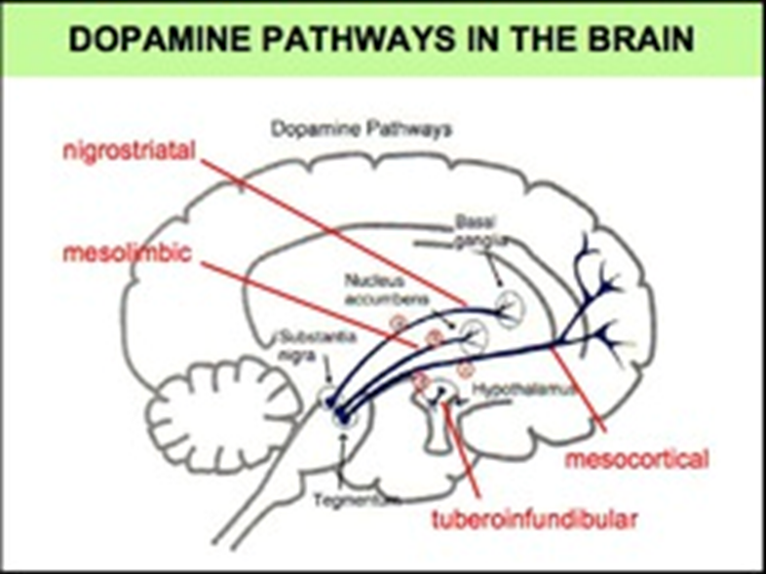
Neurobiology
3. Antipsychotics
Excess of DOPAMINE → schizophrenia
Decrease in Dopamine → treatment of schizophrenia

Slide 20
Neurobiology
3. Antipsychotics
MESOCORTICAL- associated with negative and cognitive symptoms
MESOLIMBIC- associated with positive symptoms (hallucinations, delusions, and thought disorders)
NIGROSTRIATAL- associated with movement regulation, Parkinsonian movements i.e. rigidity, bradykinesia, tremors), akathisia and dystonia
TUBEROINFUNDIBULAR - associated with hyperprolactinemia(gynecomastia/galactorrhea/decreased libido/menstrual dysfunction).

Slide 21
Classification
3. Antipsychotics
A. Typical antipsychotics (=1st generation antipsychotics, classical neuroleptics,)
B. Atypical antipsychotics (=2nd generation antipsychotics)

Slide 22
A.Typical antipsychotics
(1st generation)
3. Antipsychotics
previous generation
are D2 dopamine receptor antagonists
High potency typical antipsychotics bind to the D2 receptor with high affinity. As a result they have higher risk of extrapyramidal side effects.
Examples: fluphenazine, haloperidol, flupenthixol
Low potency typical antipsychotics have less affinity for the D2 receptors but tend to interact with nondopaminergic receptors resulting in more cardiotoxic and anticholinergic adverse effects including sedation, hypotension.
Examples: chlorpromazine, thioridazine

Slide 23
B.Atypical Antipsychotics
(2nd generation)
3. Antipsychotics
dopamine D2 receptor-blocking effect is lowered in affinity
combined with effects on other receptors
better influencing of negative and affective symptoms
significantly reduce or prevent the cognitive impairment
signifinantly less side effects
examples: risperidon, olanzapin, quetiapin

Slide 24
Adverse effects
3. Antipsychotics
Extrapyramidal side effects (EPS): Acute dystonia, Parkinson syndrome, Akathisia
Neuroleptic Malignant Syndrome (NMS): Characterized by severe muscle rigidity, fever, altered mental status, autonomic instability, elevated WBC, CPK Potentially fatal.
Weight gain, sedation, dyslipidemia, hyperprolactinemia, agranulocytosis, sexual dysfunctions…

Slide 25
Main Psychopharmacological Drugs
Psychopharmacotherapy
1. Antidepressants
2. Mood stabilizers
3. Antipsychotics
4. Anxiolytics
5. Hypnotics
6. Cognition-Enhancing Drugs
7. Psychostimulants

Slide 26
General information
4. Anxiolytics
Used to treat many diagnoses including panic disorder, generalized anxiety disorder, substance-related disorders and their withdrawal, insomnias and parasomnias.
In anxiety disorders often use anxiolytics in combination with SSRIS or SNRIs for treatment.
Main group – Benzodiazepines – cave – the risk of addiction !!!!

Slide 27
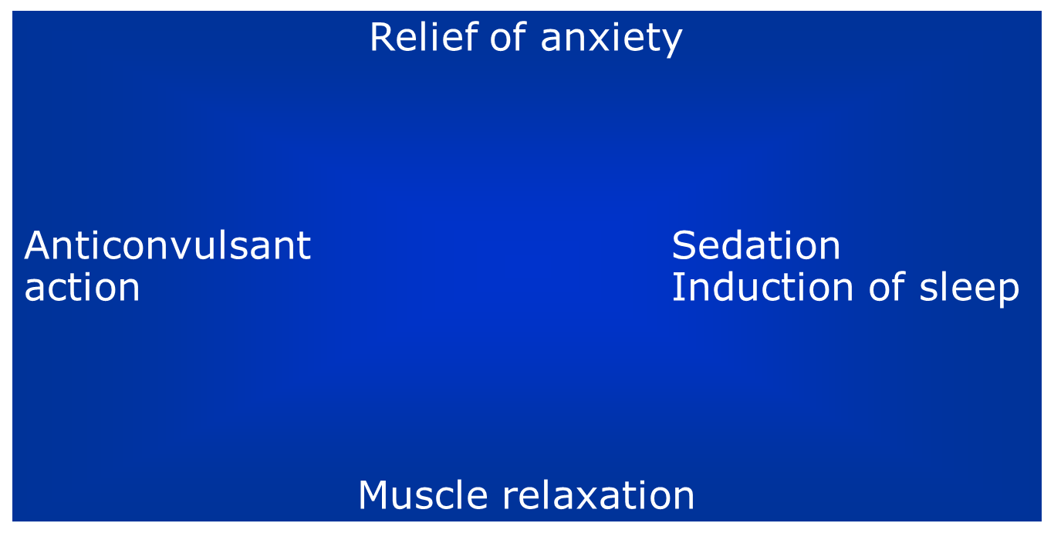
Action Profiles of Benzodiazepines
4. Anxiolytics

Slide 28
Examples
4. Anxiolytics
Short-term: oxazepam, lorazepam
Medium-term: alprazolam, bromazepam
Long-term: diazepam, clonazepam

Slide 29
Non-benzodiazepine anxiolytics
4. Anxiolytics
Non-addictive
Delayed onset of therapeutic effect
Examples: guaiphenesine, hydroxyzine, buspirone

Slide 30
Main Psychopharmacological Drugs
Psychopharmacotherapy
1. Antidepressants
2. Mood stabilizers
3. Antipsychotics
4. Anxiolytics
5. Hypnotics
6. Cognition-Enhancing Drugs
7. Psychostimulants

Slide 31
General information
5. Hypnotics
drugs with sedative effect
primary function is to induce sleep and to be used in the treatment of insomnia

Slide 32
Classification | Name | Example
1st Generation | barbiturates | phenobarbital
2nd Generation | benzodiazepines | midazolam, flunitrazepam, cinolazepam
3rd Generation | Z-drugs | zolpidem, zopiclone, zaleptone
Other Drugs with Hypnotic Efficacy | Antihistaminics | promethazine
 | antidepressants | mirtazapine, trazodone
 | melatonins
 | antipsychotics | quetiapin

Slide 33
Main Psychopharmacological Drugs
Psychopharmacotherapy
1. Antidepressants
2. Mood stabilizers
3. Antipsychotics
4. Anxiolytics
5. Hypnotics
6. Cognition-Enhancing Drugs
7. Psychostimulants

Slide 34
General information
6. Cognition-Enhancing Drugs
improve cognition
to treat Alzheimer's disease and other cognitive deficits
A. ACETYLCHOLINESTERASE INBITORS
-rivastigmine, donepezil
B. NMDA (N-methyl-D-aspartate) RECEPTOR ANTAGONISTS
-memantine

Slide 35
Main Psychopharmacological Drugs
Psychopharmacotherapy
1. Antidepressants
2. Mood stabilizers
3. Antipsychotics
4. Anxiolytics
5. Hypnotics
6. Cognition-Enhancing Drugs
7. Psychostimulants

Slide 36
General information
7. Psychostimulants
reduce fatigue, promote alertness and wakefulness and have possible mood enhancing properties
indicated for attention deficit hyperactivity disorder (ADHD), narcolepsy
Blocators of re-uptake dopamine and norephinephrine→ increase of dopamine and norephinephrine in synaptic cleft
Adverse effects: insomnia, agitation, anxiety and confusion
Methylphedinate, atomoxetine

Slide 37
Main Psychopharmacological Drugs
Psychopharmacotherapy
1. Antidepressants
2. Mood stabilizers
3. Antipsychotics
4. Anxiolytics
5. Hypnotics
6. Cognition-Enhancing Drugs
7. Psychostimulants

Slide 38
Treatment in Psychiatry
Treatment in Psychiatry
A. BIOLOGICAL treatment
  Psychopharmacotherapy
  Electroconvulsive Therapy (ECT)
  Repetitive Transcranial Magnetic Stimulation (rTMS)
  Deep Brain Stimulation (DBS)
  Vagus Nerve Stimulation
  Light Therapy
B. PSYCHOSOCIAL treatment
  Psychotherapy
  Psychiatric rehabilitation
  Other (music therapy, art therapy, ergotherapy…)

Slide 39
Electroconvulsive therapy
ECT
procedure, in which small electric currents are passed through the brain, intentionally triggering a brief seizure
ECT seems to cause changes in brain chemistry that can quickly reverse symptoms of certain mental illnesses
when other treatments are unsuccessful

Slide 40
Electroconvulsive therapy
ECT
informed consent must be signitured
ECT is administered under anesthetic with a muscle relaxant
ECT can differ in its application in three ways: electrode placement, frequency of treatments, and the electrical waveform of the stimulus.
side effects: confusion and memory lost
main indications: major depressive disorder, mania, and catatonia

Slide 41
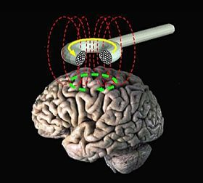
Repetitive transcranial magnetic stimulation (rTMS)
rTMS
a magnetic method used to stimulate small regions of the brain
a magnetic field generator, or "coil", is placed near the head
The coil produces small electric currents in the region of the brain just under the coil via electromagnetic induction. The coil is connected to a pulse generator, or stimulator, that delivers electric current to the coil.
Indication: major depressive disorder, negative symptoms of schizophrenia, auditory hallucinations,
Side effects: epileptiform paroxysm, mild headaches

Slide 42
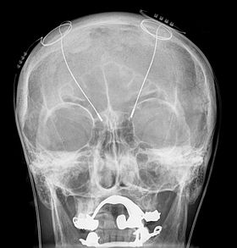
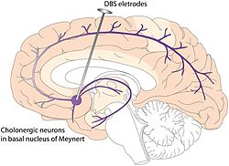
Deep brain stimulation (DBS)
DBS
a neurosurgical procedure
involving the implantation of a medical device called a neurostimulator (sometimes referred to as a 'brain pacemaker'), which sends electrical impulses, through implanted electrodes, to specific targets in the brain (brain nuclei) for the treatment of movement and neuropsychiatric disorders (major depression, OCD)
has been used in a small number of clinical trials

Slide 43
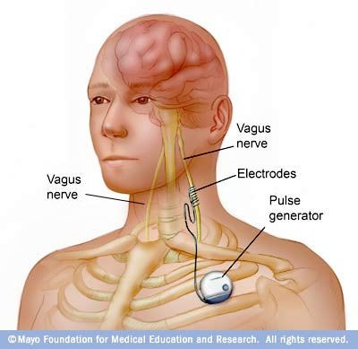
Vagus nerve stimulation
Vagus nerve stimulation
is a medical treatment that involves delivering electrical impulses to the vagus nerve. It is used as an adjunctive treatment for certain types of intractable epilepsy and treatment-resistant depression.
the device sends electrical signals along the vagus nerve to the brainstem, which then sends signals to certain areas in your brain.

Slide 44

Light Therapy
Light Therapy
involves daily scheduled exposure to bright artificial light
During light therapy, you sit or work near a device called a light therapy box. The box gives off bright light that mimics natural outdoor light.
Light therapy is thought to affect brain chemicals linked to mood and sleep
Biorhythm
Indication: treatment for SAD (Seasonal Affective Disorder), other types of depression, sleep disorders and other conditions
Side effects: eye strain, headache, nausea, irritability or agitation

Slide 45
Treatment in Psychiatry
Thank you very much for your attention

