Slide 1
(V.) Signal detection by PowerLab system - instruction
(VII.) Examination of pulse by palpation
Physiology I - practicals

Slide 2
Pulse (pulsus)
Aortal wall stretches in forward direction
Pressure (pulse) wave
Mechanical manifestation of heart activity
Mechanical wave (pulse wave) arises after each contraction of LV and propagates along the arterial wall
Aortal valve contracts behind the pressure wave
Ejection phase of systole
(open aortal valve)
Diastole (closed aortal valve)
STK
DTK

Slide 3
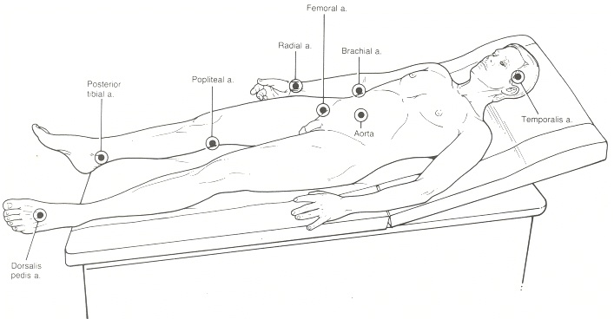
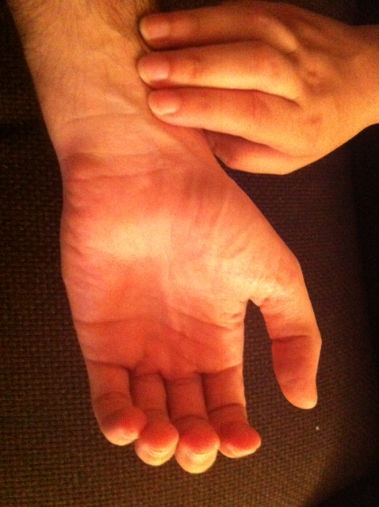
Palpation of pulse
Where:
  A. radialis
  A. carotis
  A. femoralis
  A. brachialis
  A. poplitea How:
  A. tibialis posterior
  A. dorsalis pedis

Slide 4
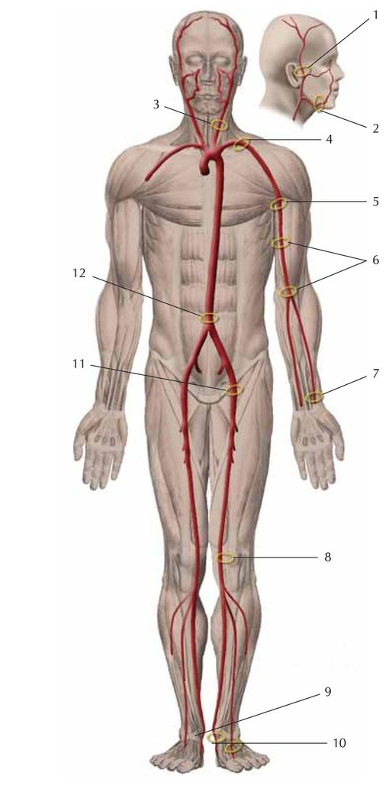
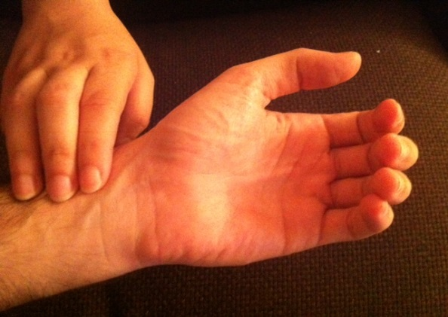
Palpation of pulse
a. carotis
a. subclavis
Where:
  A. radialis
  A. carotis
  A. femoralis
  A. brachialis
  A. poplitea
  A. tibialis posterior
  A. dorsalis pedis
a. axillaris
aorta abdominalis
a. brachialis
a. femotalis
a. radialis
a. poplitea
  How:
a. tibialis posterior
a. dorsalis pedis
http://docplayer.cz/docs-images/40/13777908/images/page_5.jpg

Slide 5
Examination of pulse
Frequency: number of pulses per one minute = pulse rate
Qualities: regularity, compressibility
According qualities, we can describe:
  Pulsus regularis
  Pulsus irregularis
  Pulsus celer (Corrigan´s pulse: P. celer, altus, frequens)
  Pulsus tardus
  Pulsus durus – hardly compressible pulse – hypertension
  Pulsus mollis – easily compressible pulse – hypotension
  Pulsus magnus – high amplitude of pulse
  Pulsus parvus – small amplitude of pulse
  Pulsus filiformis – threadlike pulse – circulatory failure

Slide 6
Heart rate
Physiological values: 60 – 100 beats per minute (BPM) at rest
Tachycardia: increased heart rate (> 100 at rest)
Bradycardia: decreased heart rate (< 60 at rest)
Arrhythmia: an abnormality in the heart's rhythm, or heartbeat pattern.
The heartbeat can be too slow, too fast, have extra beats, skip a beat, or otherwise beat irregularly

Slide 7
Heart rate vs. pulse frequency
Heart rate (HR) is a number of cardiac cycles per minute
  computed from ECG
Pulse frequency is a number of pulse cycles per minute
  Computed from sphygmography, blood pressure or by palpation of artery
Usually: heart rate = pulse frequency

Slide 8
Modulation of HR by autonomic nervous system (ANS)
ANS modulates heart automaticity by modulation of SA node activity
  Parasympathetic system – vagus nerve – „nervi retardantes“
    Via M2 receptors
    Negative chronotropic effect
    Decreased tonus of vagus nerve = increased HR
  Sympathetic system – sympathetic cardiac nerves – „nervi accelerantes“
    via β1 receptors
    Positive chronotropic effect
    Increased sympathetic activity = increased HR
  Sympathetic and parasympathetic systems are active simultaneously, but in different intensity…

Slide 9
Baroreflex
Short-time control of arterial pressure
Mean arterial pressure (MAP) is detected by baroreceptors in aortic arch and carotic sinus
  stretch-receptors (mechanoreceptors)
Afferent fibres: vagus nerve (n. X.) and n. glosopharingeus
Centre: rostral part of nucleus solitarius in medulla oblongata
Efferent pathways:
  Cardiac branch: n. vagus (+ SS) – heart rate changes
  Peripheral (vascular) branch: sympathetic vascular innervation – changes of total peripheral resistance (TPR)

Slide 10
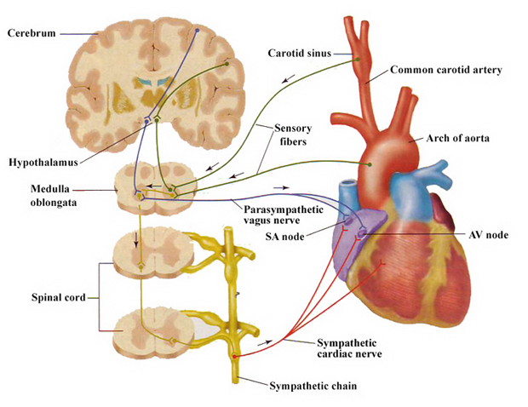
Baroreflex
Mechanism:
↓MAP
↓afferentation from baroreceptors processing
↓vagus activity and ↑sympathetic activity
↑HR and ↑TPR
(MAP = HR * SV * TPR)
↑MAP
… and conversely in case of MAP increase

Slide 11
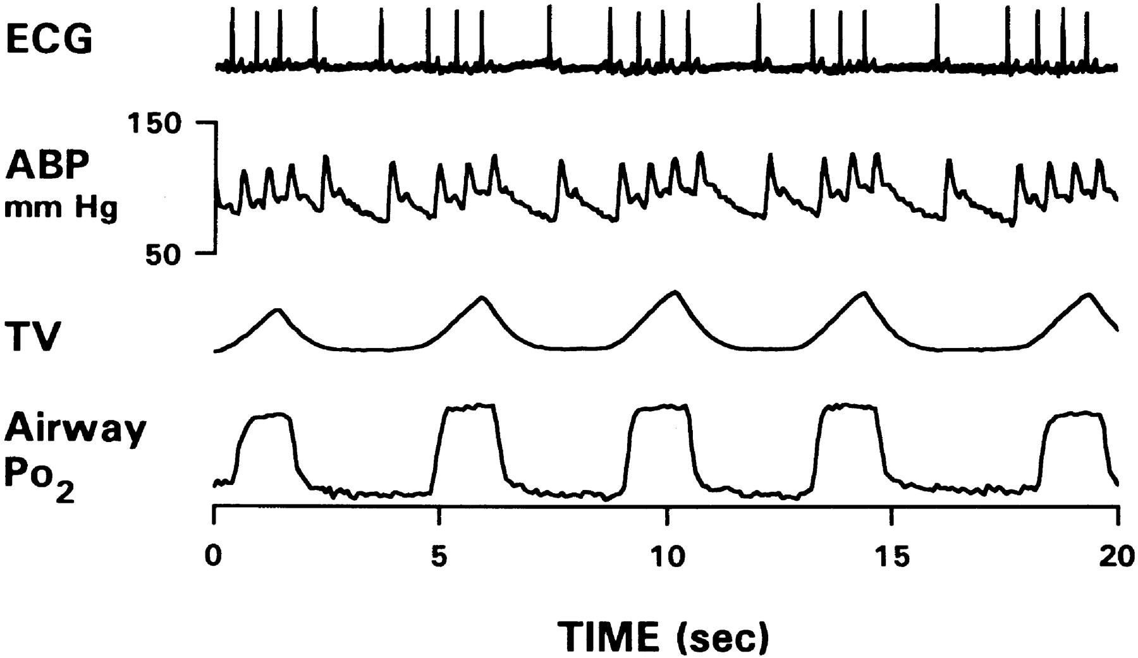
Respiratory sinus arrhythmia (RSA)
ECG
Changes of heart rate in accordance with breathing: increase of HR during inspirium, decrease of HR during expirium
The most evident in young people, associated with vagal activity
RSA disappears with HR increase (stress, exercise, high age)
BP
respiration
time [s]
Mechanisms of RSA formation:
Baroreflex: during inspiration – ↓ intrathoracic pressure → ↑venous return (due to ↑ pressure gradient) → ↑systolic volume → ↑MAP → baroreflex (2 s lag) → ↓HR → ↑ (balance of) MAP
Central origin: irradiation of respiratory centre to kardiomotoric centre in the medulla oblongata
Bainbridge reflex: ↑venous return during inspirium – stretch of atria – activation of stretch-receptors – stimulation of n. vagus – stimulation of SA node
Local source: mechanical stretch of SA node accelerates its depolarization (weak RSA is presented in transplanted heart)
Another reflexes influencing vagal activity, chemoreflex (oscillation of pCO₂, pO₂, pH)

Slide 12
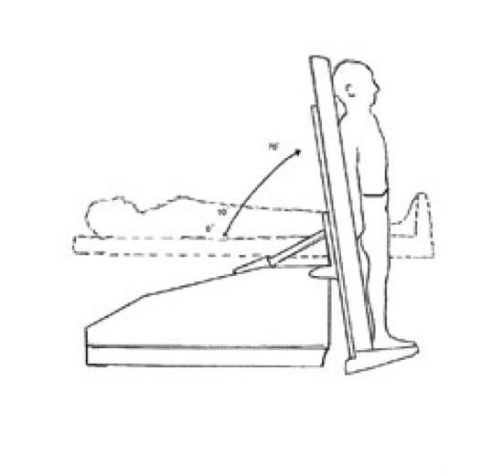
Heart rate during body posture changes
Body posture changes in gravity field cause blood pressure (BP) changes. These changes are minimized by short-term BP regulation (baroreflex).
Clinostatic reaction – change of position from standing (sitting) to lying:
↑venous return from lower part of body → ↑heart filling (preload) → ↑SV → ↑BP → baroreflex causes ↓HR and ↓ TPR
Orthostatic reaction – change of position from lying to standing (sitting):
↓ venous return from lower part of body → ↓ heart filling (preload) → ↓SV → ↓BP → baroreflex causes ↑HR and ↑TPR
  Cardiac branch of baroreflex is faster but less effective in BP maintenance - HR increases within 1 s after BP decrease, this prevents to brain perfusion decrease
  Peripheral branch of baroreflex is slower but more effective: TPR increases cca 6 s after BP decrease and stabilize BP → HR decreases during long lasting standing to resting value

Slide 13
Heart rate changes and physical exercise
Working muscle has higher metabolic demands – perfusion is increased (autoregulation of blood flow, metabolic vasodilatation)
Exercise increases tonus of sympaticus („ergotropic system“)
  Anticipation of exercise
There is compensatory vasoconstriction in those tissues which are not metabolically active (GIT, reproduction system, excretory system, skin) – s.c. redistribution of blood.
It affects heart function:
  Vasodilatation in muscles → ↓TPR → ↓BP → baroreflex → ↑HR
  Sympaticus: ↑HR
Athletes' heart

Slide 14
Zdroje obrázků
Slide 6 - https://www.pinterest.com/pin/144537469264742090/ [cited 31.8.2015]
Slide 6 - http://www.angiologist.com/general-medicine/pulse-palpation-and-pulse-location/ [cited 31.8.2015]
Slide 12 - http://corposcindosis.wikia.com/wiki/File:Baroreflex.jpg [cited 31.8.2015]
Slide 14 - http://www.cardiachealth.org/postural-orthostatic-tachycardia-syndrome-pots [cited 31.8.2015]

