Slide 1


Week 1 : Introduction; Algorithm Basics
Introduction to Bioinformatics (LF:DSIB01)
Panos Alexiou
panagiotis.alexiou@ceitec.muni.cz

Slide 2
Introduction to LF:DSIB01 - Course Goals
Introductory course for Bioinformatics
Students will:
  become familiar with fundamental concepts
  able to design, implement, and run basic analyses
  decipher domain specific language in publications
  understand the field and opportunities for development of skills
Not goals:
  solve specific research questions
  cover entirety of Bionformatics field
  teach programming skills

Slide 3
Introduction to LF:DSIB01 - Course Material
Lecture Notes
Useful Books
  An Introduction to Bioinformatics Algorithms, Jones and Pevzner
  Bioinformatics for Biologists, Pevzner and Shamir

Slide 4
Course Schedule
Introduction; Algorithm Basics
Sequence analysis introduction/common file formats
Sequence Alignment / Sequence pattern recognition 1/3
Sequence Alignment / Sequence pattern recognition 2/3
Sequence Alignment / Sequence pattern recognition 3/3
NGS / galaxy
--------------------------------------------------------------------------------------------
Introduction to Data Analysis
Principles of Data visualisation
Clustering / PCA
Basic Statistics
Bayesian Inference/Bayesian classifier
--------------------------------------------------------------------------------------------
Current Developments in Machine Learning
Colloquium Evaluation

Slide 5
Introduction to LF:DSIB01 - Student Responsibilities
Attend Classes and Practicals
Complete Practical Exercises
Demonstrate Understanding of Material

Slide 6


Slide 7
Basics of Algorithms
Definition of an algorithm
Pseudocode Notation
Exercise: The Coin Change Problem
Brute force, Iterative, Recursive
Big-O notation

Slide 8
What is an algorithm
A sequence of instructions one must perform to solve a well formulated problem
A step-by-step method of solving a problem
A set of instructions designed to perform a specific task
Sequence of instructions
Step-by-step method
Set of instructions
Solve
Perform
Well formulated problem
Specific task

Slide 9

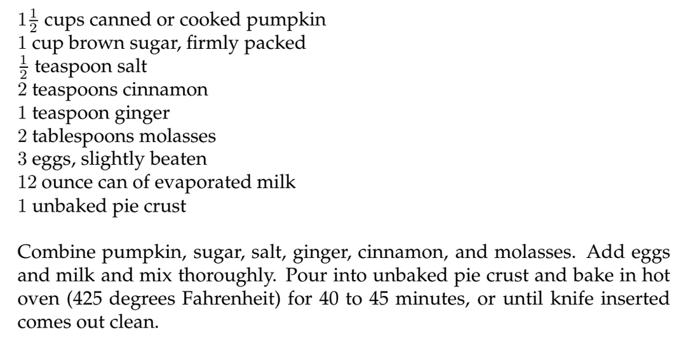
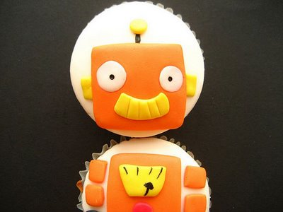
Sequence of instructions
Step-by-step method
Set of instructions
Solve
Perform
Well formulated problem
Specific task

Slide 10
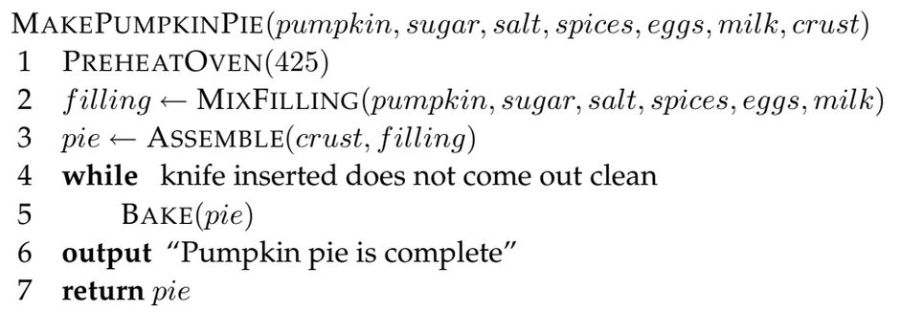
Pseudocode Notation

Slide 11
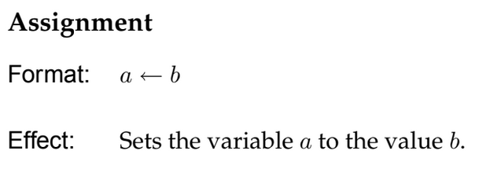
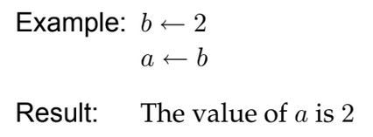
Pseudocode Notation

Slide 12
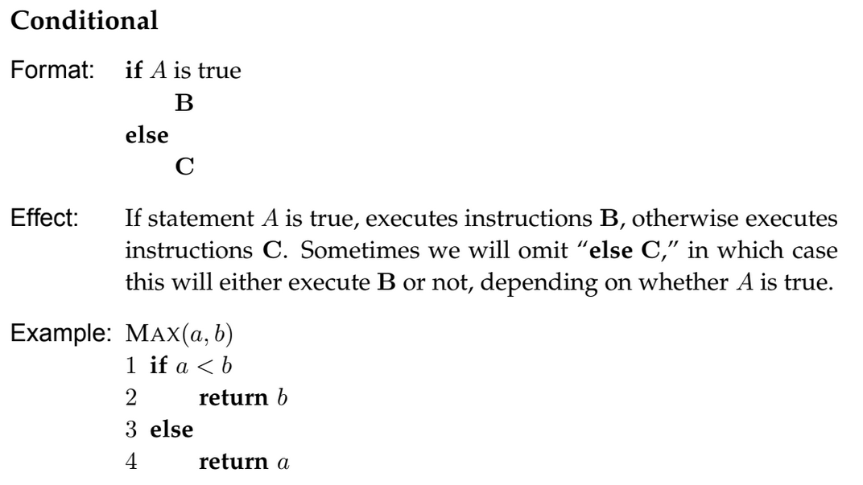
Pseudocode Notation

Slide 13
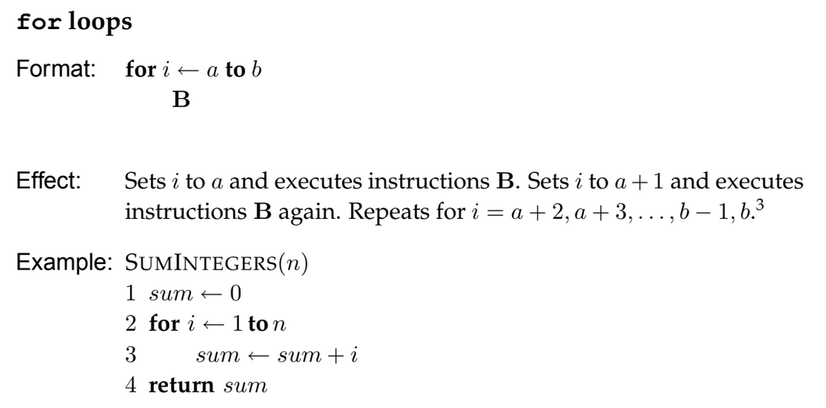
Pseudocode Notation

Slide 14
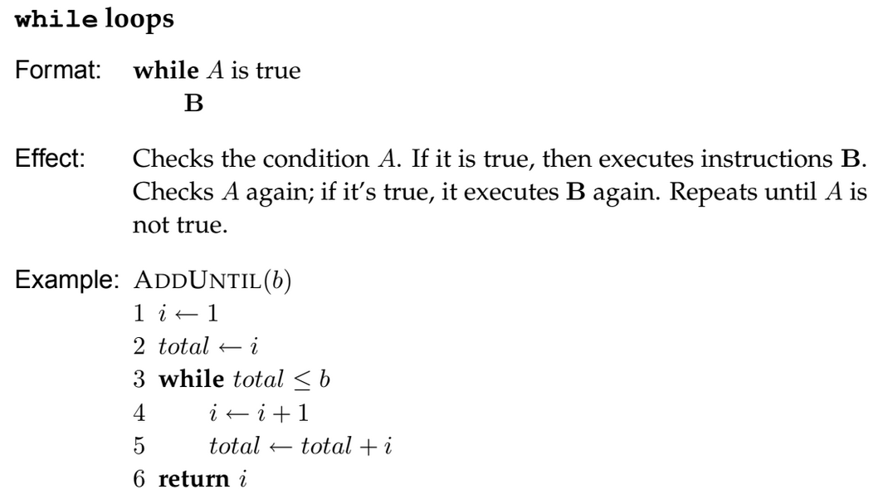
Pseudocode Notation

Slide 15
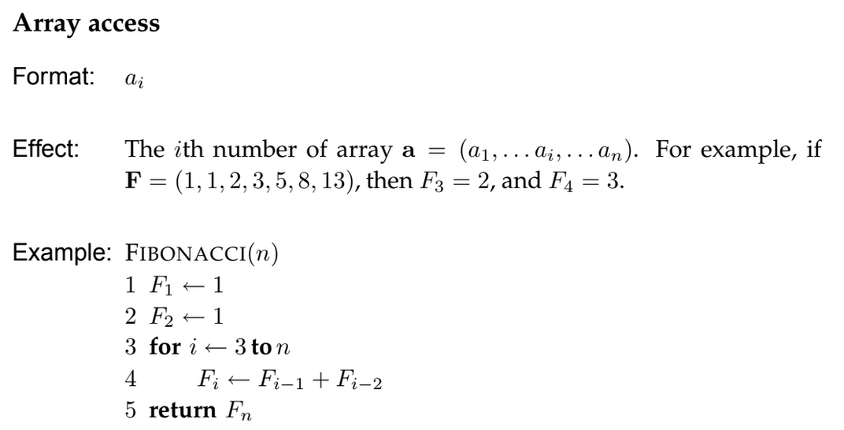
Pseudocode Notation

Slide 16
Pseudocode vs Computer Code
If you were to build a machine that follows these instructions, you would need to make it specific to a particular kitchen and be tirelessly explicit in all the steps (e.g., how many times and how hard to stir the filling, with what kind of spoon, in what kind of bowl, etc.)
This is exactly the difference between pseudocode (the abstract sequence of steps to solve a well-formulated computational problem) and computer code (a set of detailed instructions that one particular computer will be able to perform).

Slide 17
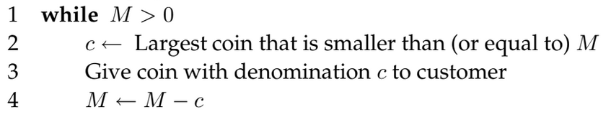
Pseudocode Exercise: Coin Change (Euro coins)
Convert an amount of money into the fewest number of coins
Input: Amount of money (M)
Output: the smallest number of 50c (a), 20c (b), 10c (c), 5c (d), 2c (e) and 1c (f)
such that 50a+20b+10c+5d+2e+1f = M
Try: M=60c; M=55c; M=40c

Slide 18
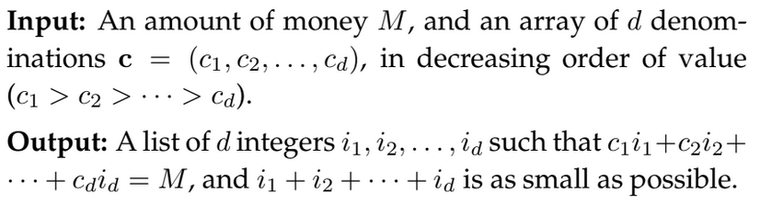
Pseudocode Exercise: Coin Change (Generalised)

Slide 19
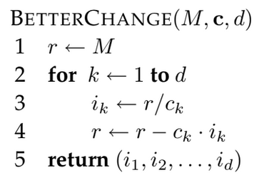
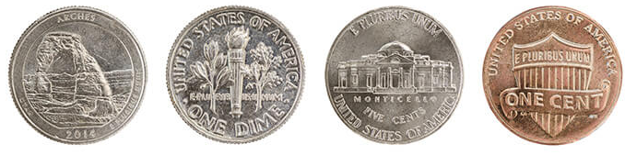
Pseudocode Exercise: Coin Change (US coins)
Try
M = 40; c1=25, c2=10, c3=5, c4=1
NB: Division = “floor”

Slide 20
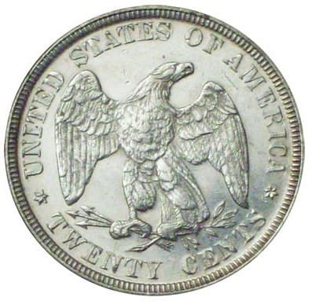
Pseudocode Exercise: Coin Change (US coins)
M = 40; c1=25, c2=20, c3=10, c4=5, c5=1
Discontinued
1875
for being too
confusing
NB: Division = “floor”

Slide 21
Pseudocode Exercise: Coin Change (US coins)
BetterChange
40=
1x25 + 1x10 + 1x5=
3 coins
Incorrect!
40 = 2x20=
2 coins
M = 40; c1=25, c2=20, c3=10, c4=5, c5=1
Discontinued
1875
for being too
confusing
NB: Division = “floor”

Slide 22
Pseudocode Exercise: Coin Change
Tries every combination
Guaranteed to find optimal
Slow

Slide 23
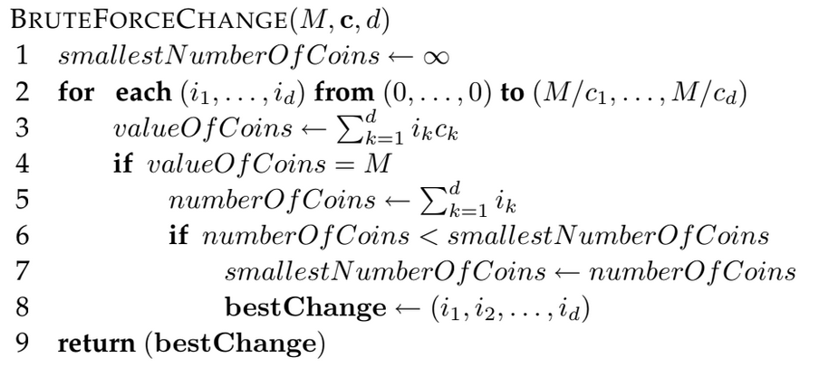
Brute Force
Algorithm
Tries every combination
Guaranteed to find optimal
Slow
Spoiler: (There is a better solution: Stay tuned for Week 4)

Slide 24
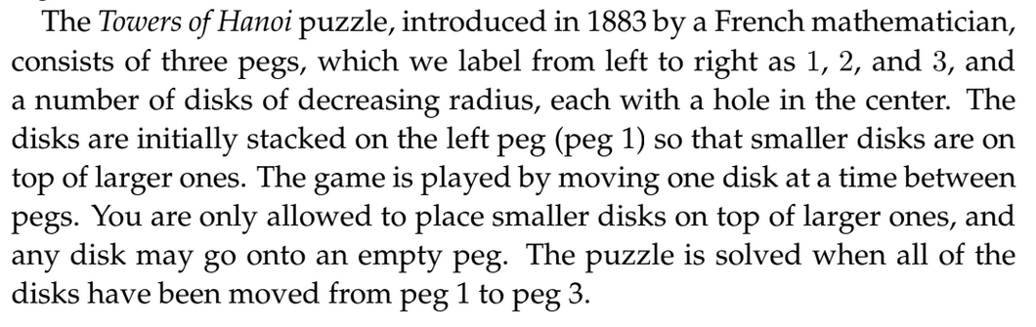
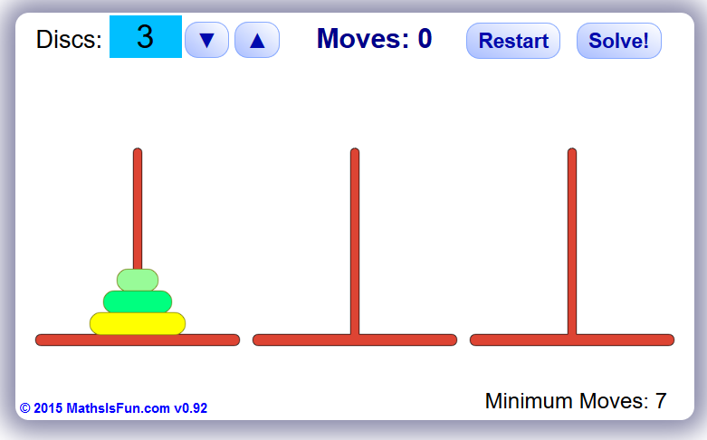
Recursive Algorithms
1 disc = 1 move
2 discs = 3 moves (1-2, 1-3, 2-3)
3 discs = 7 moves (1-3, 1-2, 3-2, 1-3, 2-1, 2-3,1-3)
…
https://www.mathsisfun.com/games/towerofhanoi.html

Slide 25
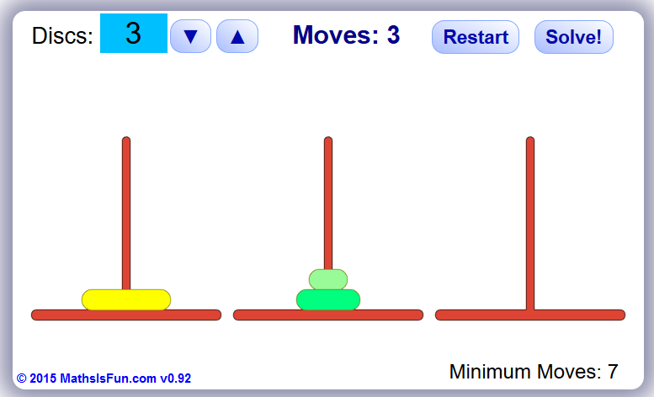
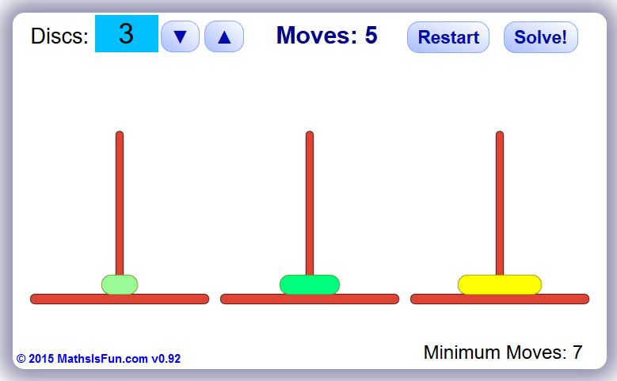
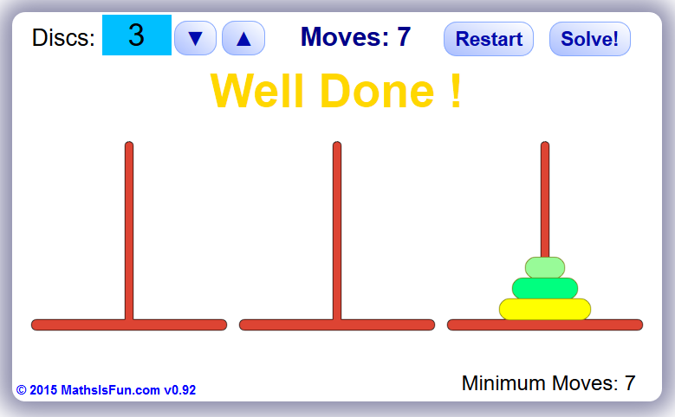
Towers of Hanoi (3 disks)
7 moves (1-3, 1-2, 3-2, 1-3, 2-1, 2-3,1-3)
More generally, to move a stack of size n from the left to the right peg, you first need to move a stack of size n − 1 from the left to the middle peg, and then from the middle peg to the right peg once you have moved the nth disk to the right peg.
To move a stack of size n − 1 from the middle to the right, you first need to move a stack of size n − 2 from the middle to the left, then move the (n − 1)th disk to the right, and then move the stack of n − 2 from the left to the right peg, and so
on.
https://www.mathsisfun.com/games/towerofhanoi.html

Slide 26
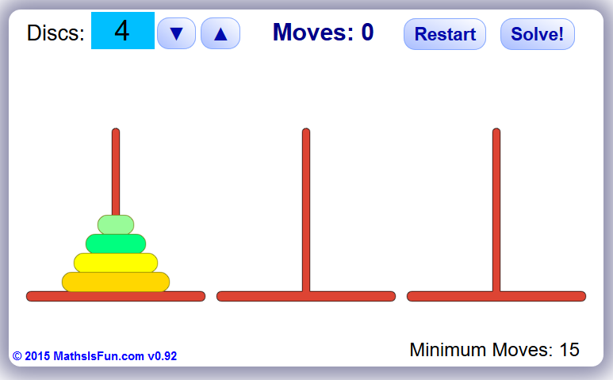
Towers of Hanoi: N disks
?
https://www.mathsisfun.com/games/towerofhanoi.html

Slide 27
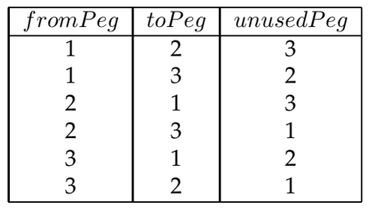
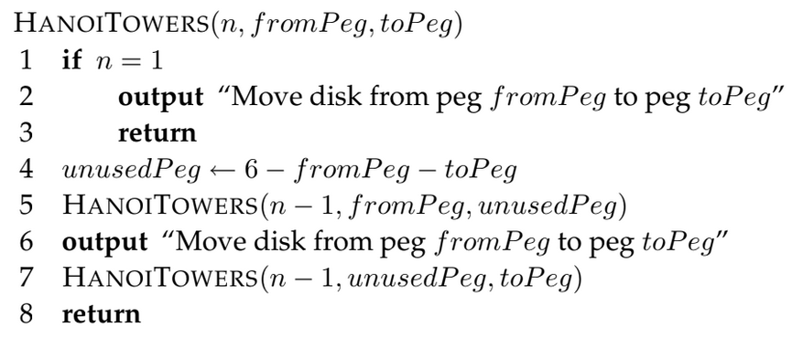
Towers of Hanoi: N disks
https://www.mathsisfun.com/games/towerofhanoi.html

Slide 28
Towers of Hanoi: N disks
https://www.mathsisfun.com/games/towerofhanoi.html

Slide 29
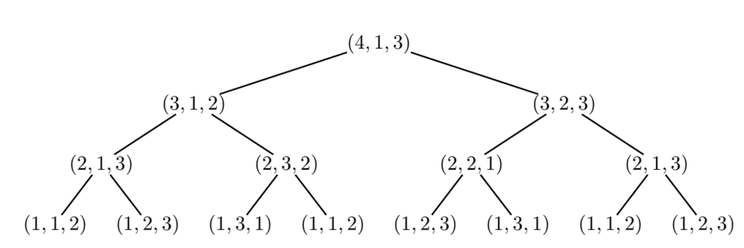
Towers of Hanoi: 4 disks
https://www.mathsisfun.com/games/towerofhanoi.html

Slide 30
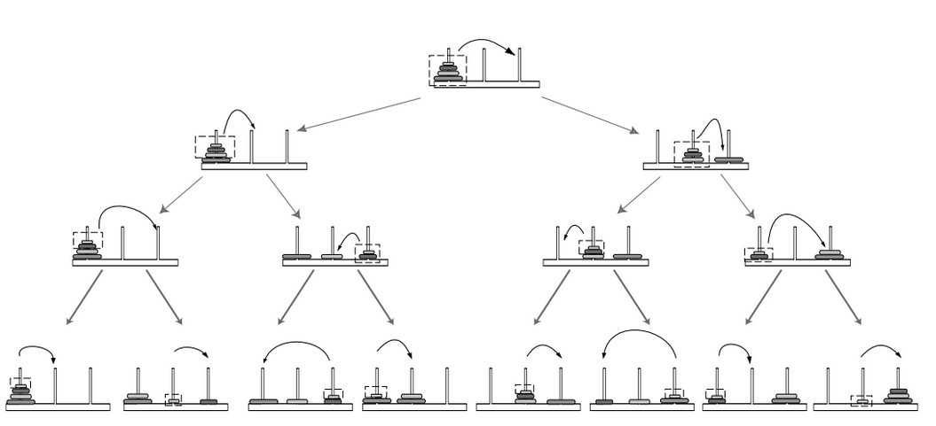
Towers of Hanoi: 4 disks
https://www.mathsisfun.com/games/towerofhanoi.html

Slide 31

Iterative Algorithms – Fibonacci Series

Slide 32
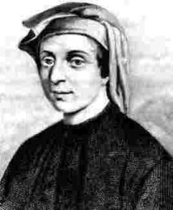
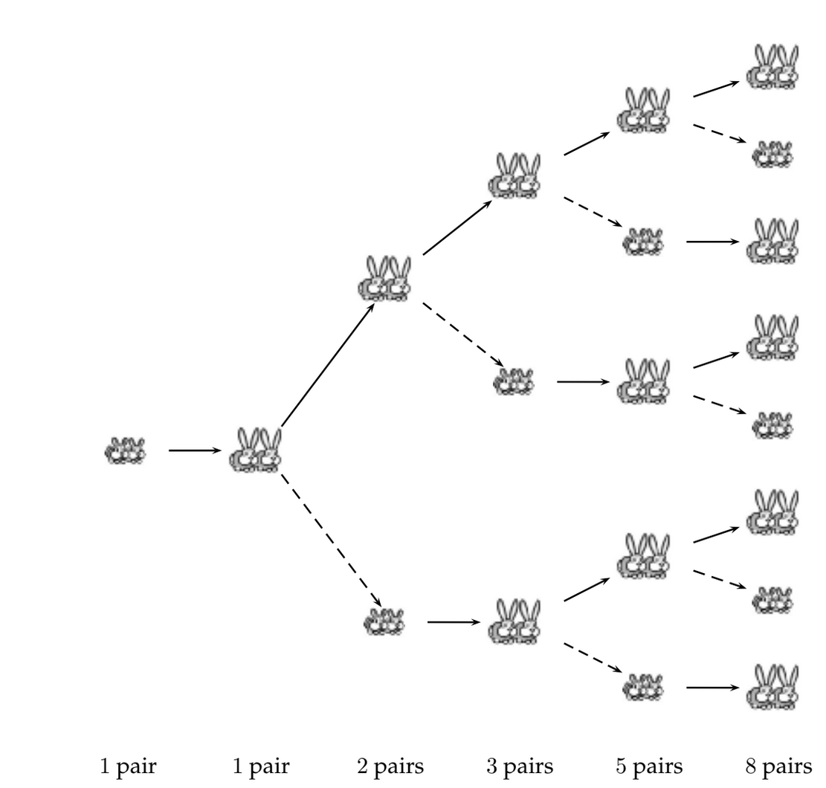

Iterative Algorithms – Immortal Rabbits
1,1,sum of previous two, …
A baby pair of rabbits takes the same time to mature
as a mature pair of rabbits takes to produce a new pair.
How many rabbits are there after N iterations?
PS: rabbits cannot die!

Slide 33
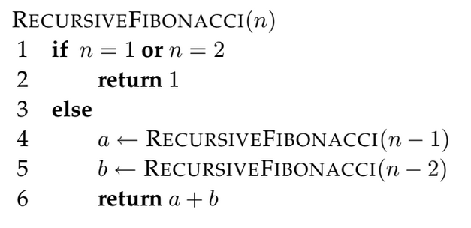
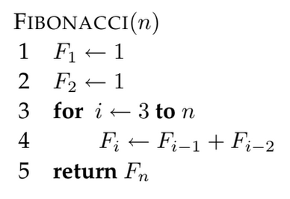
Iterative Algorithms vs Recursive Algorithms
Iterative: Fast (linear)
Recursive: Slow (exponential)

Slide 34
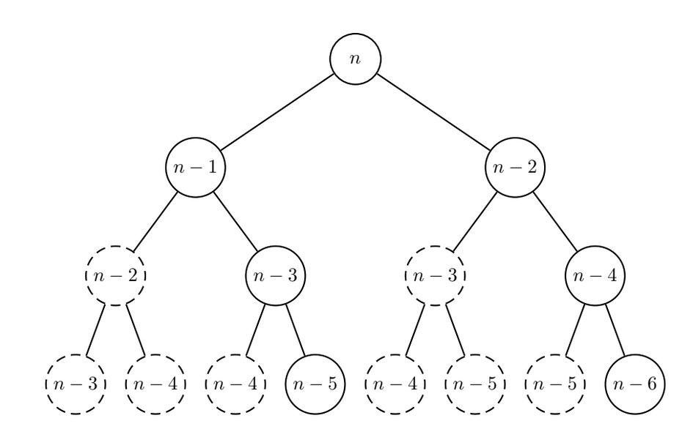
Recursive: Slow (exponential)

Slide 35
Algorithms
Brute force : Try Everything, slow but always correct
Recursive : To Solve for n, first solve for n-1
Iterative : Loop on something, can be faster

Slide 36
Fast vs Slow algorithms
How many operations does an algorithm take as N increases?
Is the relationship linear? Quadratic? Exponential?
What is the upper limit of the running time of an algorithm as N increases?

Slide 37
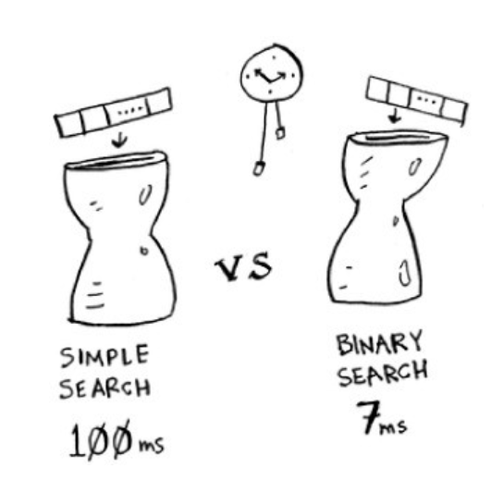
Guess random number (up/down)
1ms / check
N = 100
Simple search:
For i in 1 to N
If i == the number
return i
Binary search:
Range-min = 1
Range-max = N
While ()
i = middle number of range
if i == the number; return I
elsif i < number; Range-max=i;
elsif i > number; Range-min=i;

Slide 38
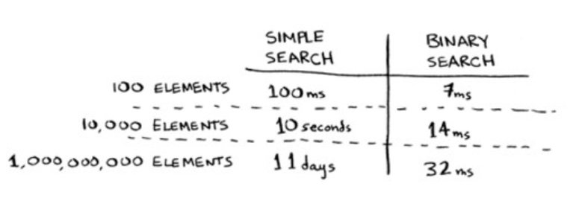
Guess random number (up/down)
~15 times faster
??? Guess ???

Slide 39
Guess random number (up/down)
~15 times faster
~450ms ?
~15 times faster ?

Slide 40
Guess random number (up/down)
~15 times faster
~15 times faster doesn’t make sense!

Slide 41
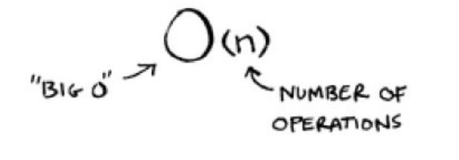
Guess random number (up/down)
Linear
1 ms/element
O(n)
Logarithmic
1 ms/log2(element)
O(log n)
(Worst case scenario)

Slide 42

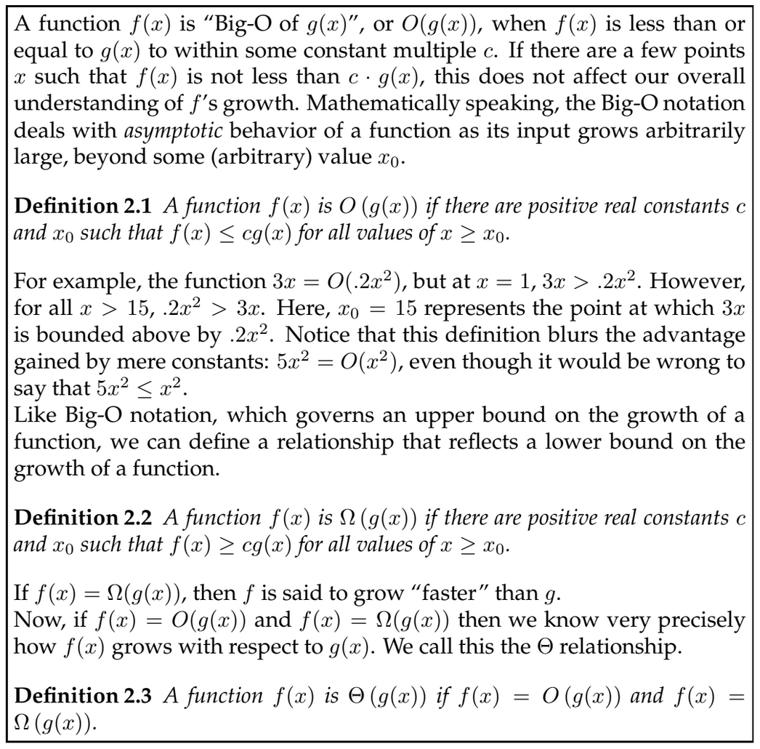

Slide 43
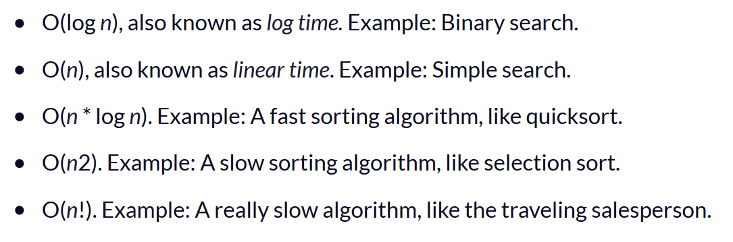
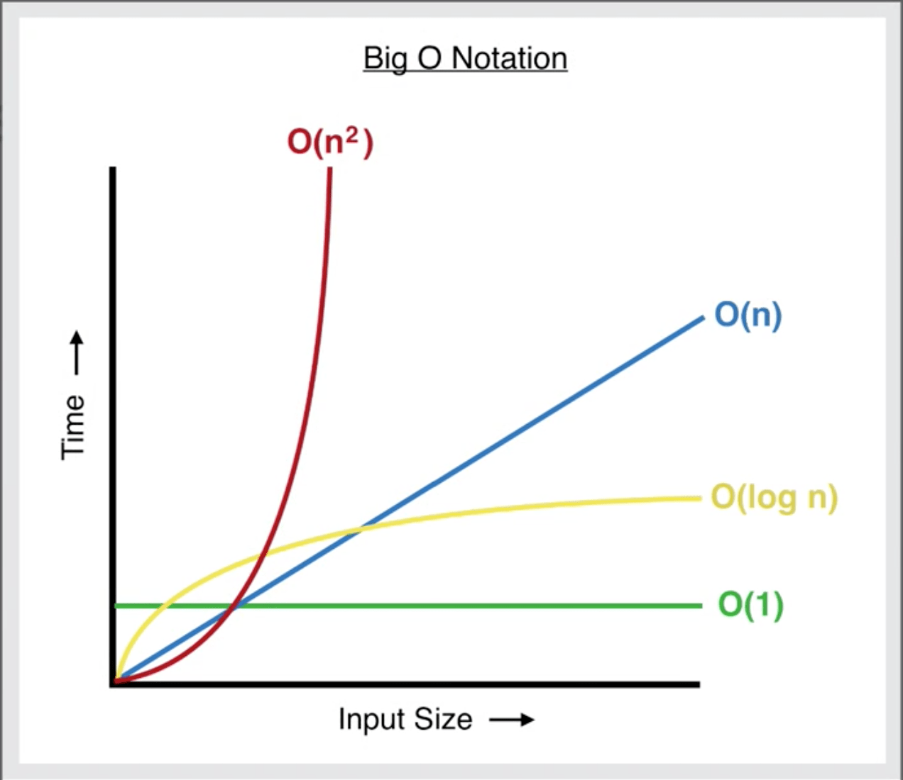
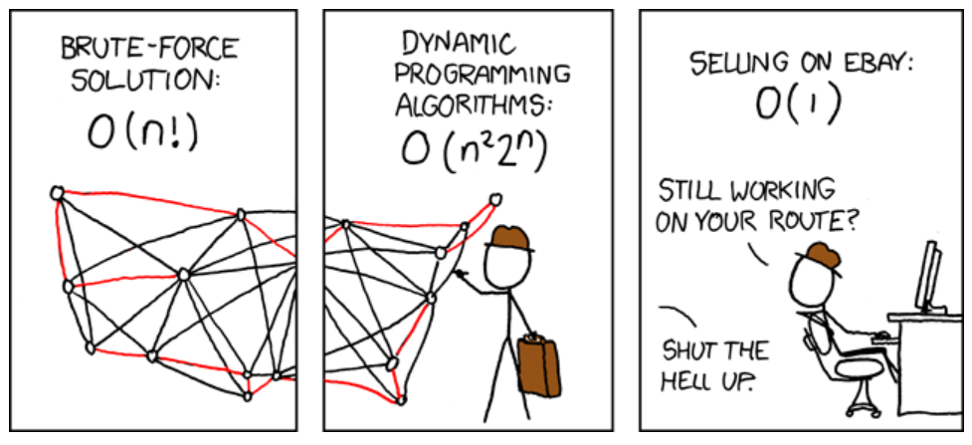
Common Big-Os
"Given a list of cities and the distances between each pair of cities,
what is the shortest possible route that visits each city and returns to the origin city?"
https://www.freecodecamp.org/news/big-o-notation-simply-explained-with-illustrations-and-video-87d5a71c0174/

Slide 44
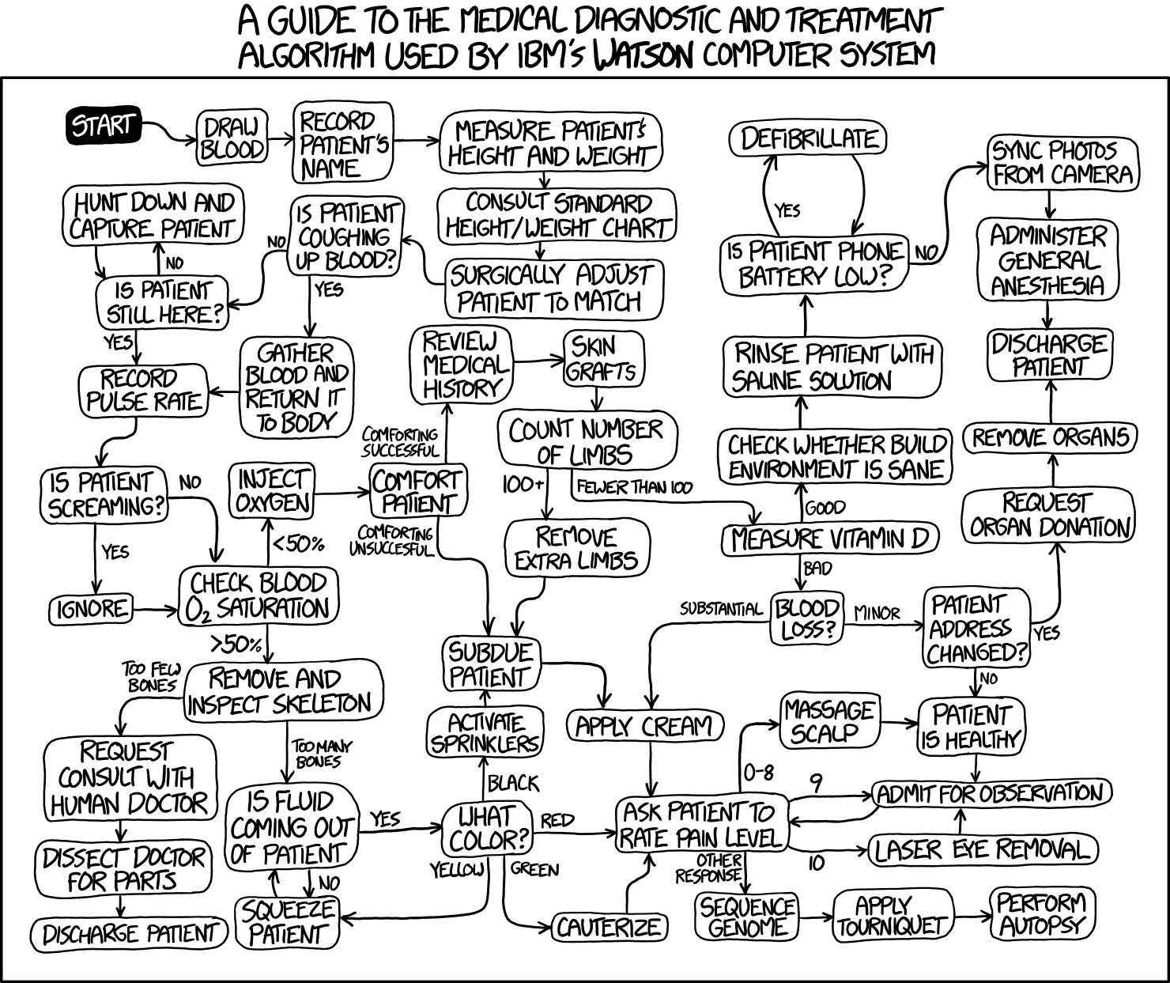
Week 1 Summary
I know what an algorithm is
I can write pseudocode
I understand
  Brute force
  Iterative
  Recursive
Big-O = how slow

Slide 45

CEITEC
@CEITEC_Brno
Thank you for your attention!
60 minutes lunch break.
Panos Alexiou
panagiotis.alexiou@ceitec.muni.cz
www.ceitec.eu

