Slide 1


Week 2 : Sequence analysis
Introduction to Bioinformatics (LF:DSIB01)

Slide 2
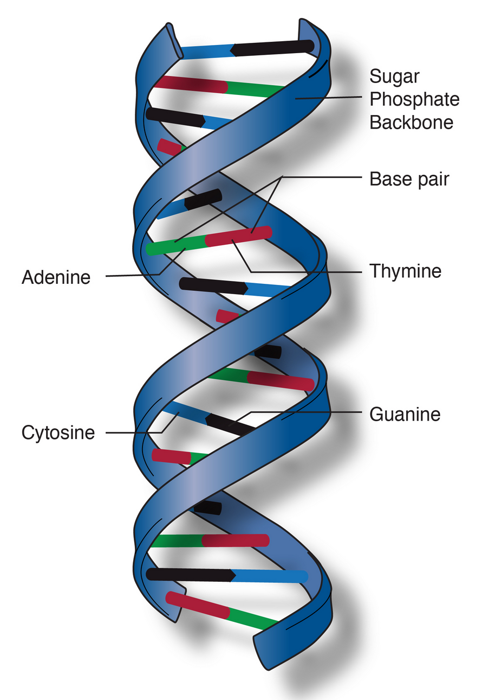
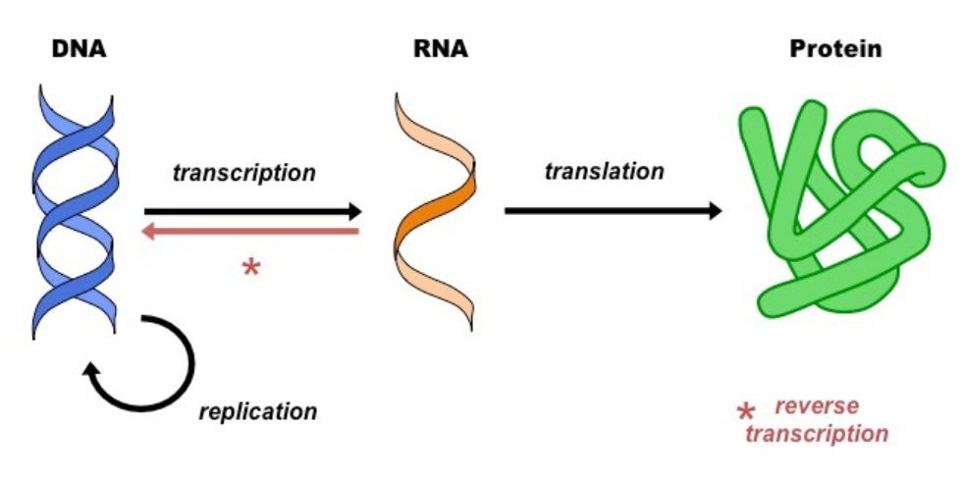
Genomics – Central Dogma of MolBio
Notes:
Central Dogma of Molecular Biology
Transcription / 70s reverse transcription
Translation
Genomics, Transcriptomics, Proteomics
---
DNA structure
4 Base Pairs
Complementarity

Slide 3
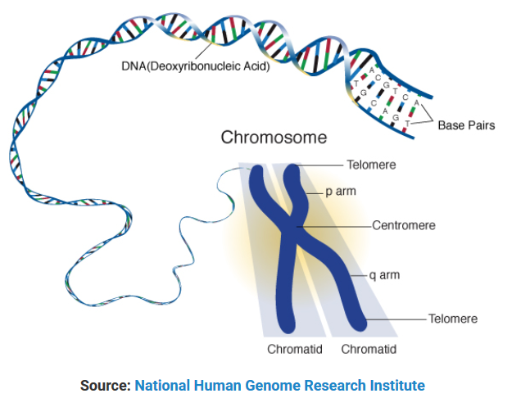
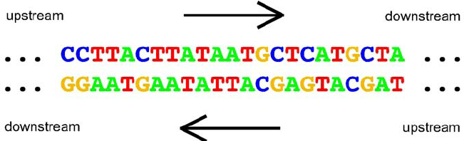
Chromosomes & Genomic Loci
A genomic locus is a POSITION on a chromosome or
other genomic reference.
We often denote a locus by genome assembly, chr,
start position, end position and strand.
A locus IS NOT A SEQUENCE even though a sequence
might be associated with a locus.
Notes:
Chromosomes
Numbers, X, Y
Telomere, Centromere
---
Strand
5 prime, 3 prime
Upstream, downstream
---
Definition of a genomic locus

Slide 4
Genes
What is a gene?
  Classical Period
    Mendel 1866 : Zellelemente (cell elements) : some factors that determine heredity
    Johannsen 1909: Coins the word Gene : some kind of calculating element
    1920s: Genes linked to chromosomes and grouped by heredity
    Muller 1926: Gene is the basis of evolution
  NeoClassical Period
    1940s: Genes have internal structure, can be dissected by recombination (1 dimension)
    1950s: Structure of DNA
    1960s: A gene is a discrete sequence that encodes a polypeptide (through RNA step)
    1960s-80s: cistrons; One cistron = one polypeptide
  Modern Period
    1986 : Alternative Splicing
    1987: Multiple transcription initiation sites (One gene = many transcripts)
    1990s: Gene Editing (the RNA can be changed)
    2000s: Gene Sharing (one genomic locus can produce several widely different products)
The evolving definition of the term Gene (Portin and Wilkins 2017)
Notes:
Evolving definition of the word Gene.
https://www.ncbi.nlm.nih.gov/pmc/articles/PMC5378099/pdf/1353.pdf

Slide 5
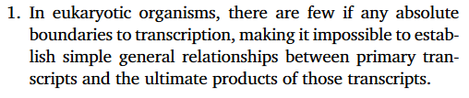
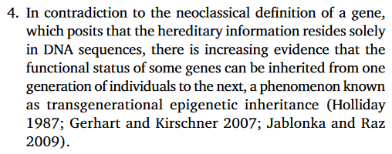

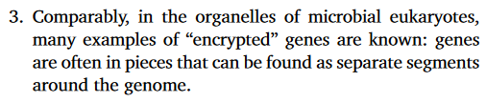
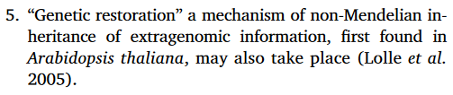

Genes
The evolving definition of the term Gene (Portin and Wilkins 2017)

Slide 6
Genes
The “Gene” cannot be simply defined
There is no clear cut hereditary unit that acts autonomously
A Gene is a DNA sequence (not necessarily contiguous) that specifies one or more sequence-related RNAs/proteins that are involved with some Gene Regulatory Network. (this definition pushes the ‘hard’ question to Network)
A Gene is a genomic locus that produces RNAs that have been annotated as connected to each other by function or heredity (this definition might fail to include genes split across loci and is based on external annotation thus subjective)
As a working definition of a Gene:
  A Genomic Locus that produces related* Transcripts
  *Related implies an Annotation

Slide 7
Transcripts -> Genes
5’
Intron
Exon
5’UTR
Exon
3’UTR
Intron
Intron
5’
5’UTR
Exon
Exon
3’UTR
Intron
5’
5’UTR
Exon
3’UTR
3’
RNA Transcripts
Gene
Gene is a locus that produces (related) Transcripts < Incomplete working definition

Slide 8
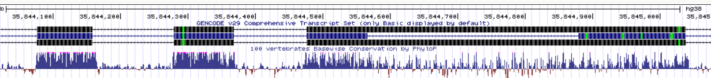
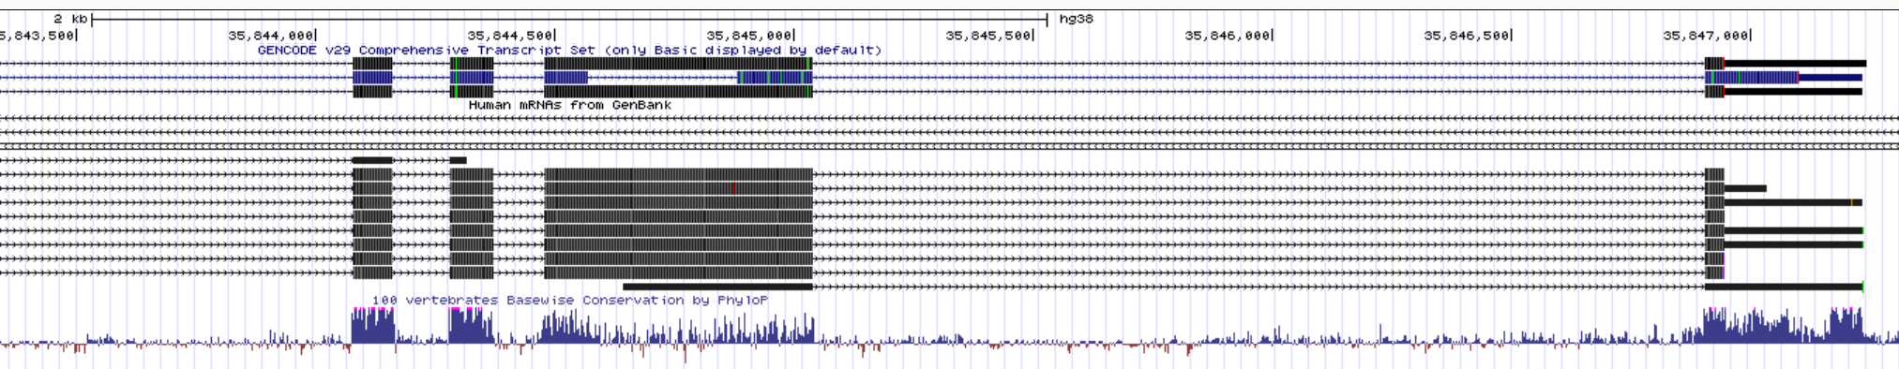

Slide 9
Genomics and Transcriptomics
Genomics is the scientific discipline that studies heredity, genes, and genomes
Transcriptomics is the scientific discipline that studies RNA
Both disciplines share techniques, analyses, and practical uses.
Genomic terms will be often used as a shortcut for talking about transcripts.

Slide 10
Encoding Genomic Information for Bioinformatics Use
Location Based Formats (.bed)
Count/Coverage Based Formats (.bedgraph .wig)
Feature Based Formats (.gtf)
Sequence Based Formats (.fasta .fastq)
Multiple Alignment Files
Alignment Based Formats (.sam)

Slide 11

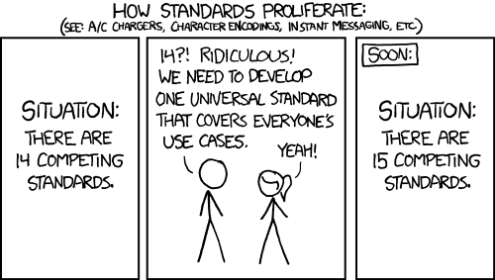

Slide 12
BED (Browser Extensible Data) file format
Tab Delimited Text File
Number of columns consistent per line
No Empty fields (some can have “.” as N/A)
BED 3 columns : chrom, chromStart, chromEnd
BED 6 columns : BED3 + name, score, strand
BED 12 columns : BED6 + thickStart, thickEnd, itemRGB, blockCount, blockSizes, blockStarts
https://genome.ucsc.edu/FAQ/FAQformat.html#format1

Slide 13
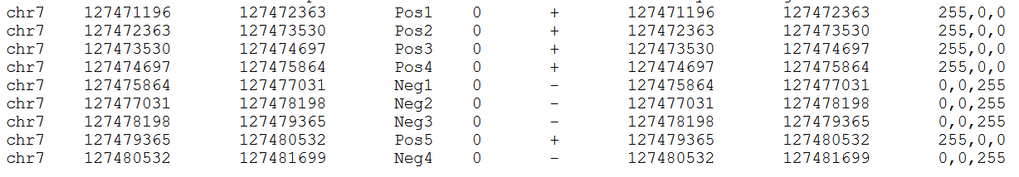
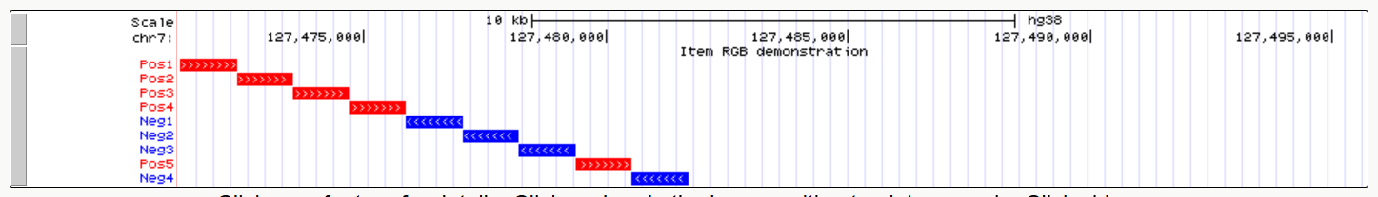
BED 3 columns : chrom, chromStart, chromEnd
BED 6 columns : BED3 + name, score, strand
BED 12 columns : BED6 + thickStart, thickEnd, itemRGB, blockCount, blockSizes, blockStarts

Slide 14
BED pros and cons
Generic
Human Readable
Useful for simple genomic loci
Awkward handling of splice events
Not useful for variable scores
Must repeat BED3 info every line

Slide 15
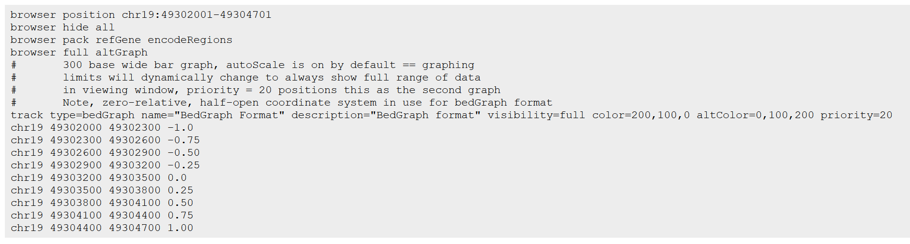
bedGraph
Used to display continuous data
Header “browser” + Header “track” + Sorted BED lines (chr, start, stop, score)

Slide 16
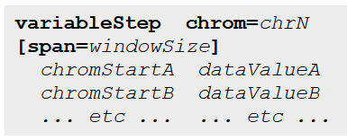
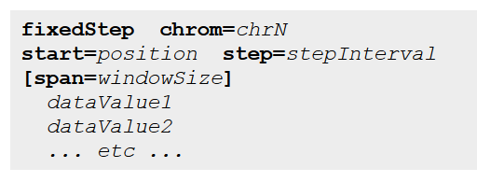
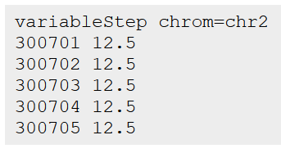
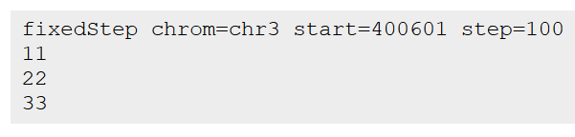
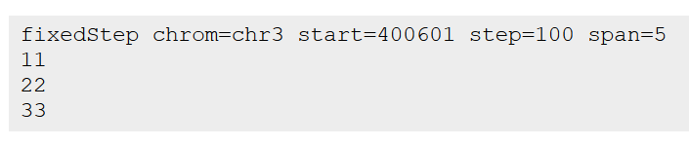

wiggle file (.wig)
Comes in two flavors: variablestep vs fixed step

Slide 17
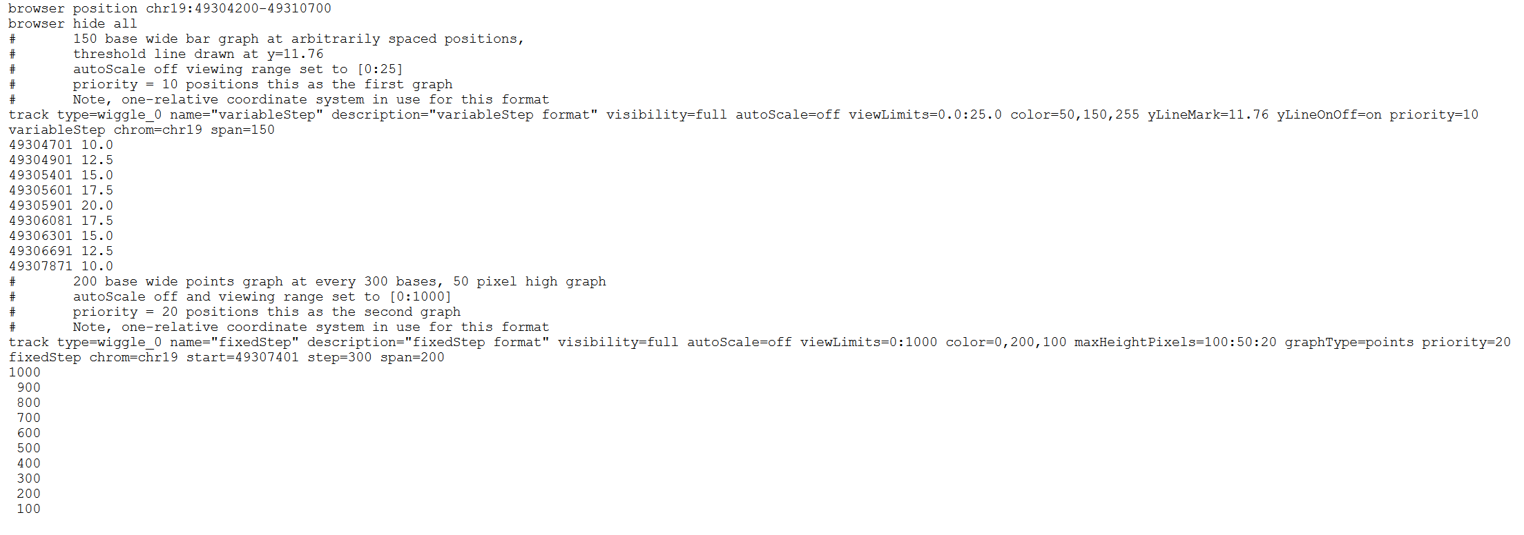
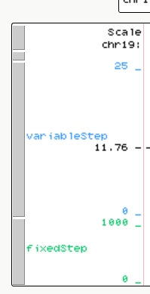
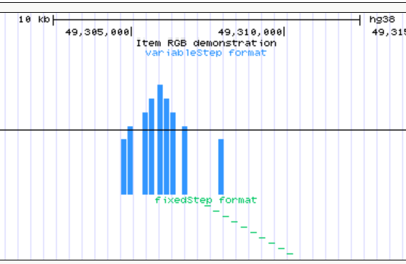

Slide 18
Wig pros and cons
Compact
Wide variety of values
Difficult for human readability
Difficult to add/subtract lines

Slide 19
General transfer format (.gtf)
Also commonly known as .gff (general feature format)
1. seqname (chr)
2. source (program generating seq)
3. feature (what is it? “CDS”, “exon”, “enhancer” etc)
4. start (position)
5. end (inclusive)
6. score (can be any float. Ideal: between 1-1000 for UCSC browser)
7. strand (“+”, “-”, “.”)
8. frame (for exons, frame is between 0-2 representing open reading frame, else “.”)
9. group; list of attributes (gene_id, transcript_id etc)

Slide 20
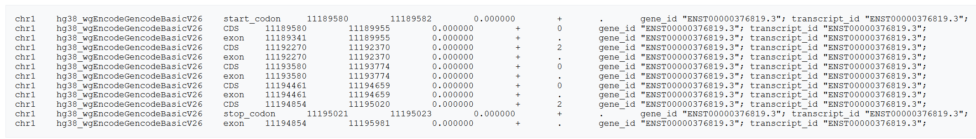

Slide 21
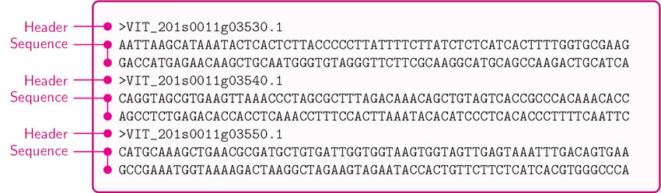
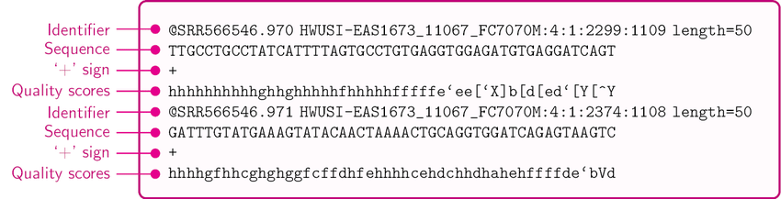
Fasta & Fastq

Slide 22
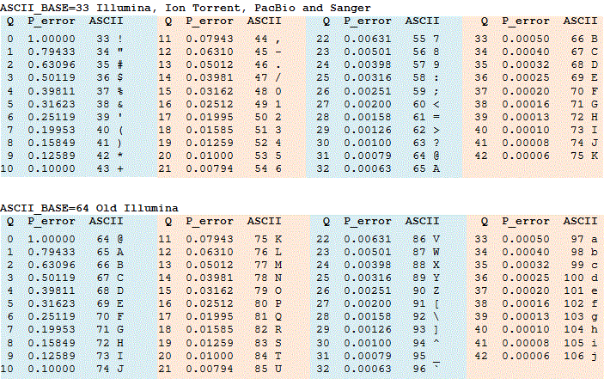
Fastq Quality Scores

Slide 23
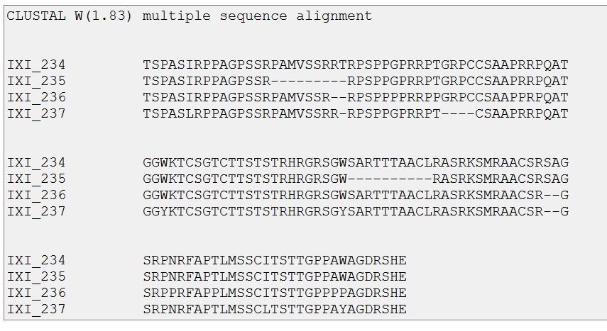
Multiple Alignment File

Slide 24
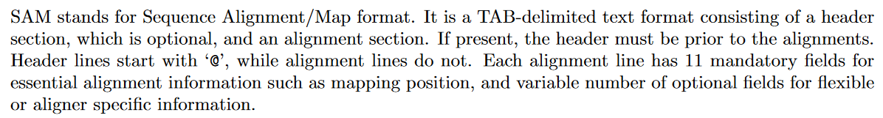
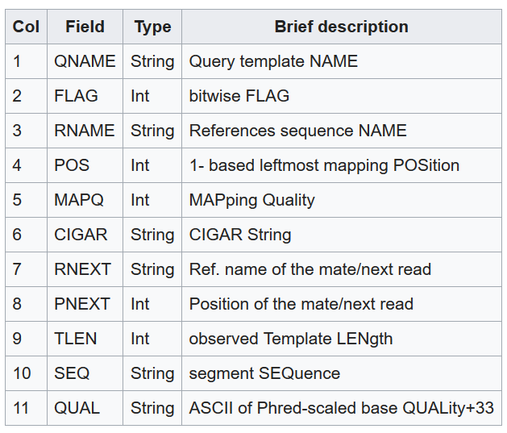
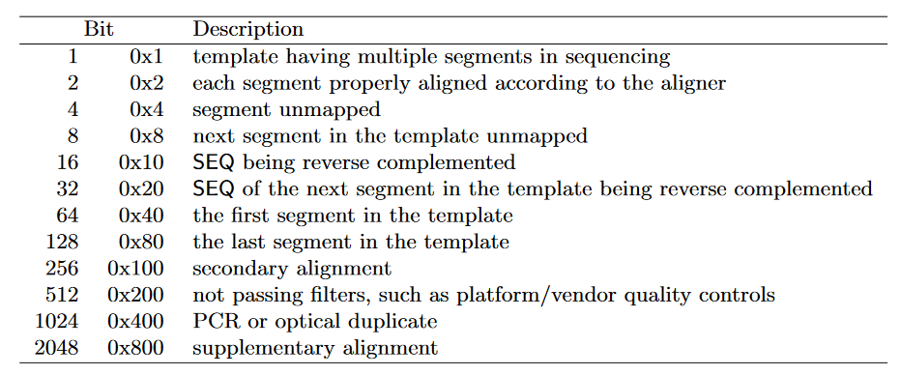
Sequence Alignment Map (.sam)
https://www.samformat.info/

Slide 25
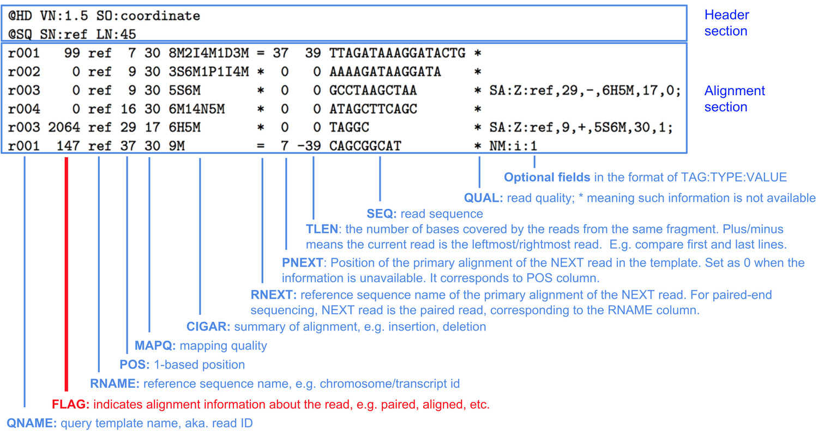
Sequence Alignment Map (.sam)
.bam format
(Binary SAM)

Slide 26
Encoding Genomic Information for Bioinformatics Use
Location Based Formats (.bed)
Count/Coverage Based Formats (.bedgraph .wig)
Feature Based Formats (.gtf)
Sequence Based Formats (.fasta .fastq)
Multiple Alignment Files
Alignment Based Formats (.sam)

Slide 27

CEITEC
@CEITEC_Brno
Thank you for your attention!
60 minutes lunch break.
Panos Alexiou
panagiotis.alexiou@ceitec.muni.cz
Office: ….
Hours: ….
www.ceitec.eu

