Slide 1


Week 3 : Pattern Recognition
Introduction to Bioinformatics (LF:DSIB01)

Slide 2
Sequence Patterns
We will learn:
1. How to define a pattern
2. How to identify the presence of a pattern in a sequence
3. How to count pattern occurrences
4. Calculation of overrepresentation
5. Creation of elaborate queries

Slide 3
Defining pattern
There are several ways to define a pattern
Deterministic Patterns
Patterns with mismatches
Position Weight Matrices
Stochastic Models

Slide 4
Deterministic Patterns
Defined Alphabet Σ=[A,T,G,C]
Simple Sequence: e.g. TATAAAA
Ambiguous character: e.g. TAT[AT]AAA : [AT] = either A or T
Wildcard: TAT . AAA : . = any character
Flexible gap: TAT. {1,3}AAA : .{1,3} = one to three times any character

Slide 5
Patterns with mismatches
Allow exact matching of Deterministic Pattern + a certain number of mistakes
This category will be covered in depth over the next 2 lectures (Week 4,5)

Slide 6
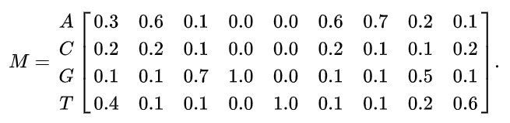

Position Probability Matrices (PPM)
Ambiguous symbol [AT] gives the same % on both symbols
PPM is a table Position x Alphabet containing probability (%) scores
Using this PPM one can score the probability that this pattern produces this sequence.
M

Slide 7
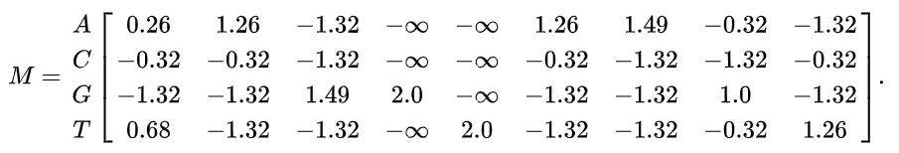

Position Weight Matrices (PWM)
More useful is the log-odds score (weight)
Odds Score = log2 (frequency / background frequency)
Sum: How different is the scored seq from a background random seq
0 => equal prob of being M or Background, + => M more prob, - => M less prob
M
M

Slide 8
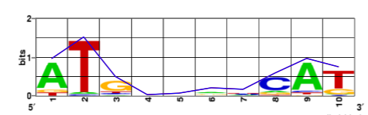
Information Content

Slide 9
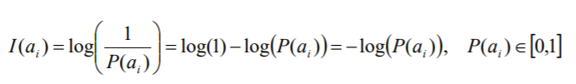
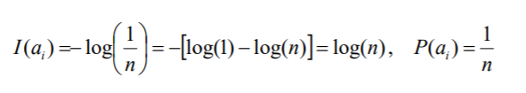
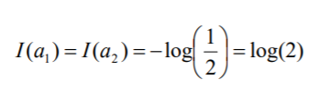
Information Content
Height = Information content (bits)
Information = degree of decrease in uncertainty
Hartley 1928: I(N) = log(N)
Shannon 1948:
< Definition of a bit
https://erilllab.umbc.edu/files/2016/04/Introduction_Information_Theory.pdf

Slide 10

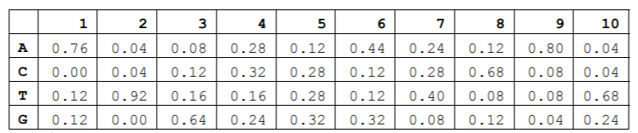


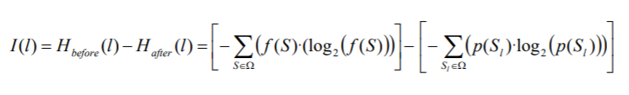

Entropy
Entropy is a measure of the unpredictability of a state (average information content)
https://erilllab.umbc.edu/files/2016/04/Introduction_Information_Theory.pdf

Slide 11
How to read a Seq Logo
Stack height indicates the Information Content per position (Rseq(I))
Letter height indicates the Base Frequency per position

Slide 12
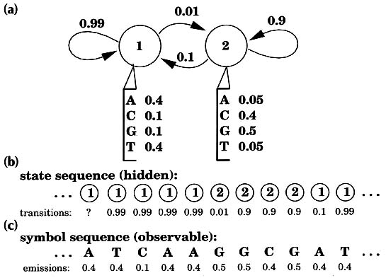
Stochastic models
A set of rules or a machine learning method
Must be able to discriminate / classify / score sequence
Commonly used: Hidden Markov Models
We will not talk about stochastic models in this course

Slide 13
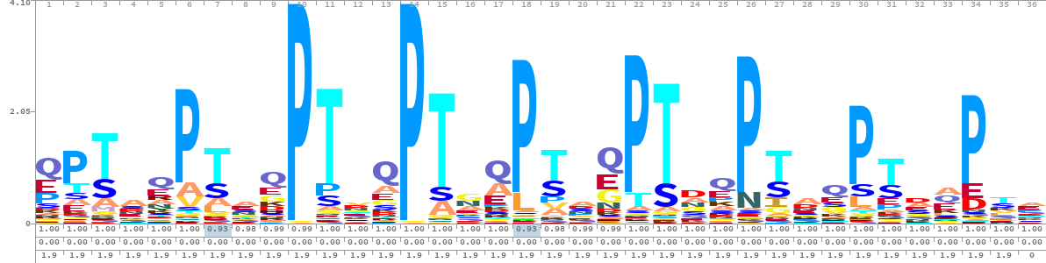
HMM Logo (PFAM)
https://bmcbioinformatics.biomedcentral.com/articles/10.1186/1471-2105-15-7

Slide 14

Hunting for Models

Slide 15
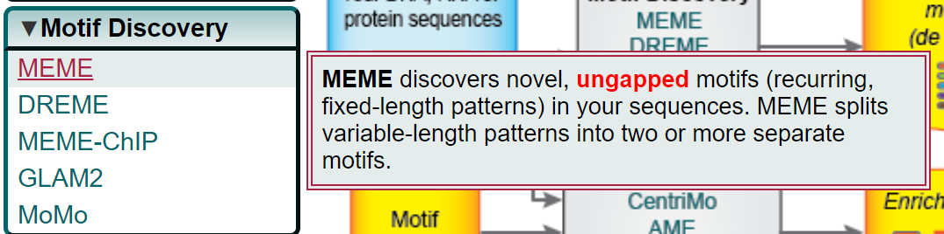
Motif Discovery with MEME
http://meme-suite.org/

Slide 16
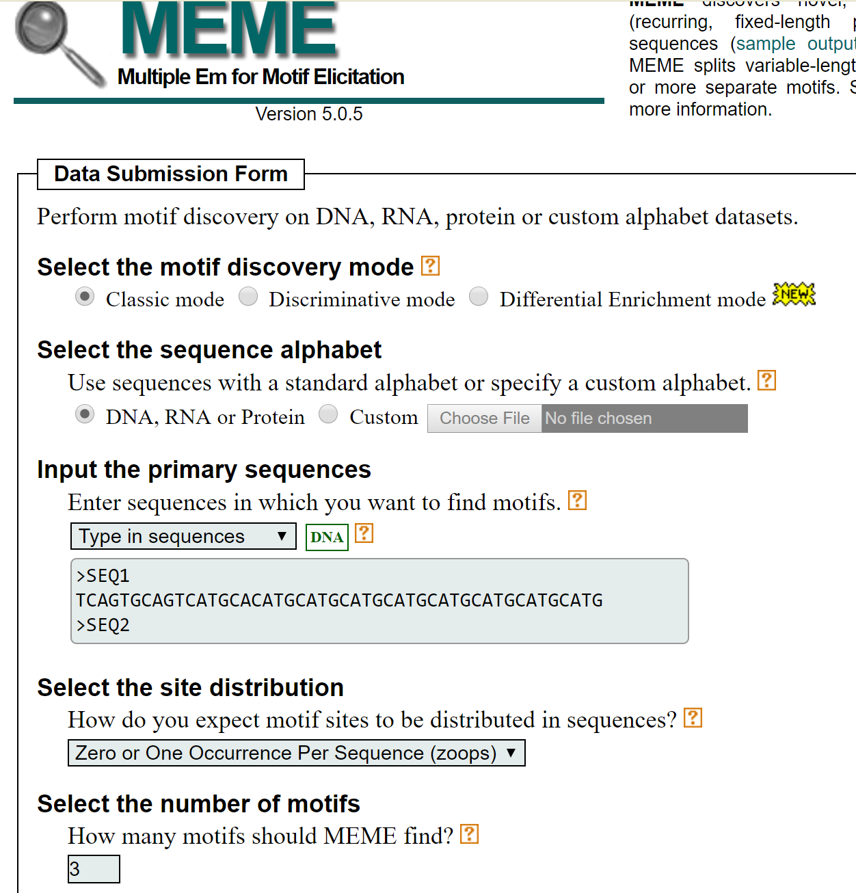
Motif Discovery with MEME
>SEQ1
TCAGTGCAGTCATGCACATGCATGCATGCATGCATGCATGCATGCATG
>SEQ2
TGTGCTGACTGCATGACTCTATCTGCATGACTGTTTCTGCGCGGC
>SEQ3
TGCATGCATGCACTGAAAAAAAAAATGCATGCATGCACTGACATGCTGACTGA
http://meme-suite.org/

Slide 17
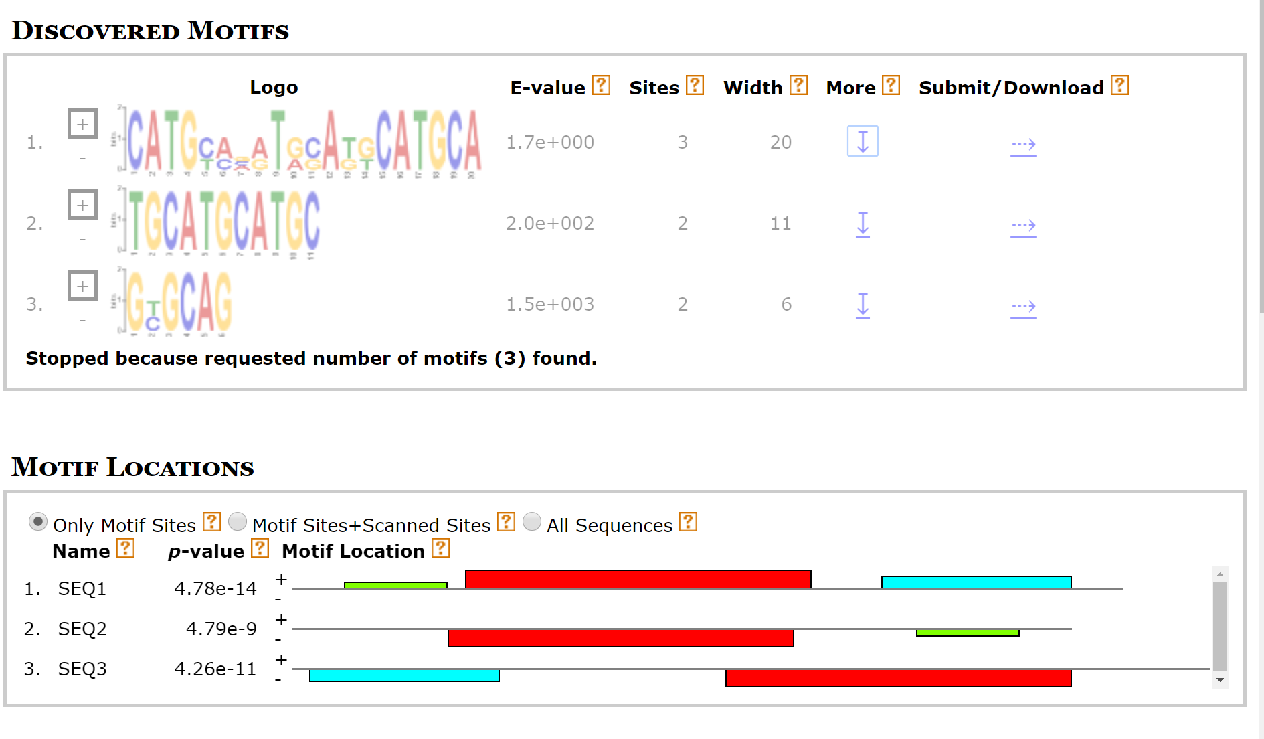
Motif Discovery with MEME
http://meme-suite.org/

Slide 18
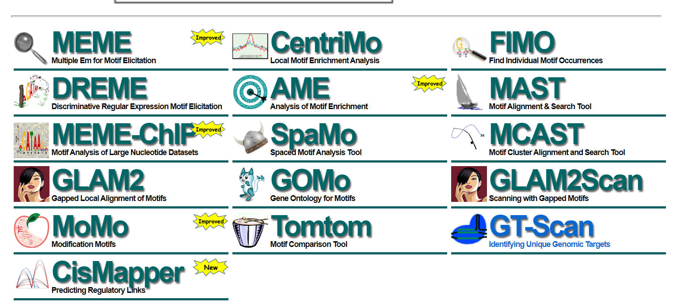
Motif Discovery with MEME
http://meme-suite.org/

Slide 19
Regular Expressions
For Deterministic Patterns
Regex is a commonly used language for definition of Deterministic Patterns
Extremely powerful syntax – but ATTENTION for unintended results
Meta-characters
Special Characters
Sets
https://www.w3schools.com/python/python_regex.asp

Slide 20
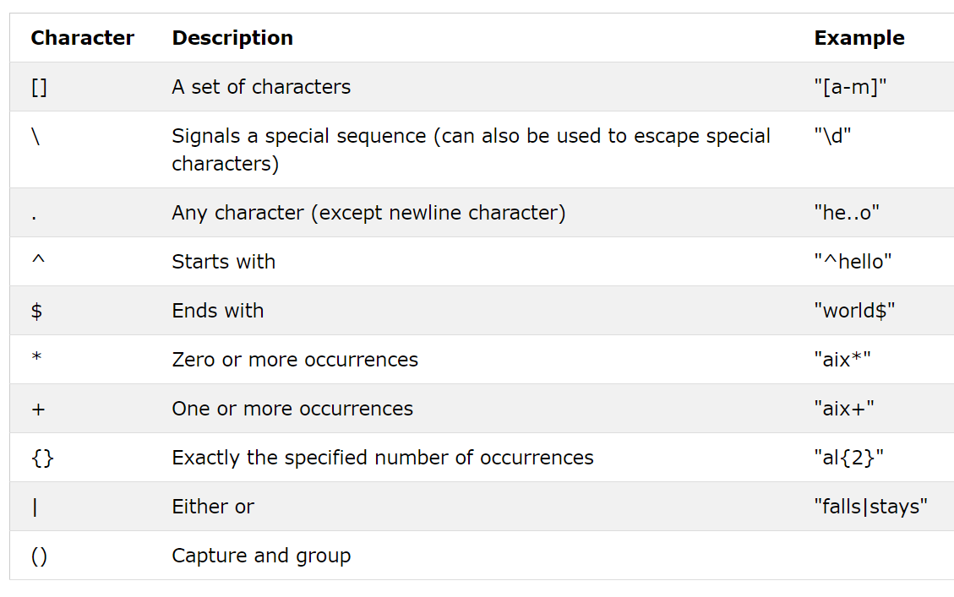
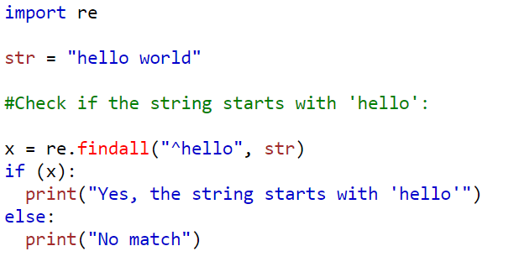
Meta-characters
https://www.w3schools.com/python/python_regex.asp

Slide 21
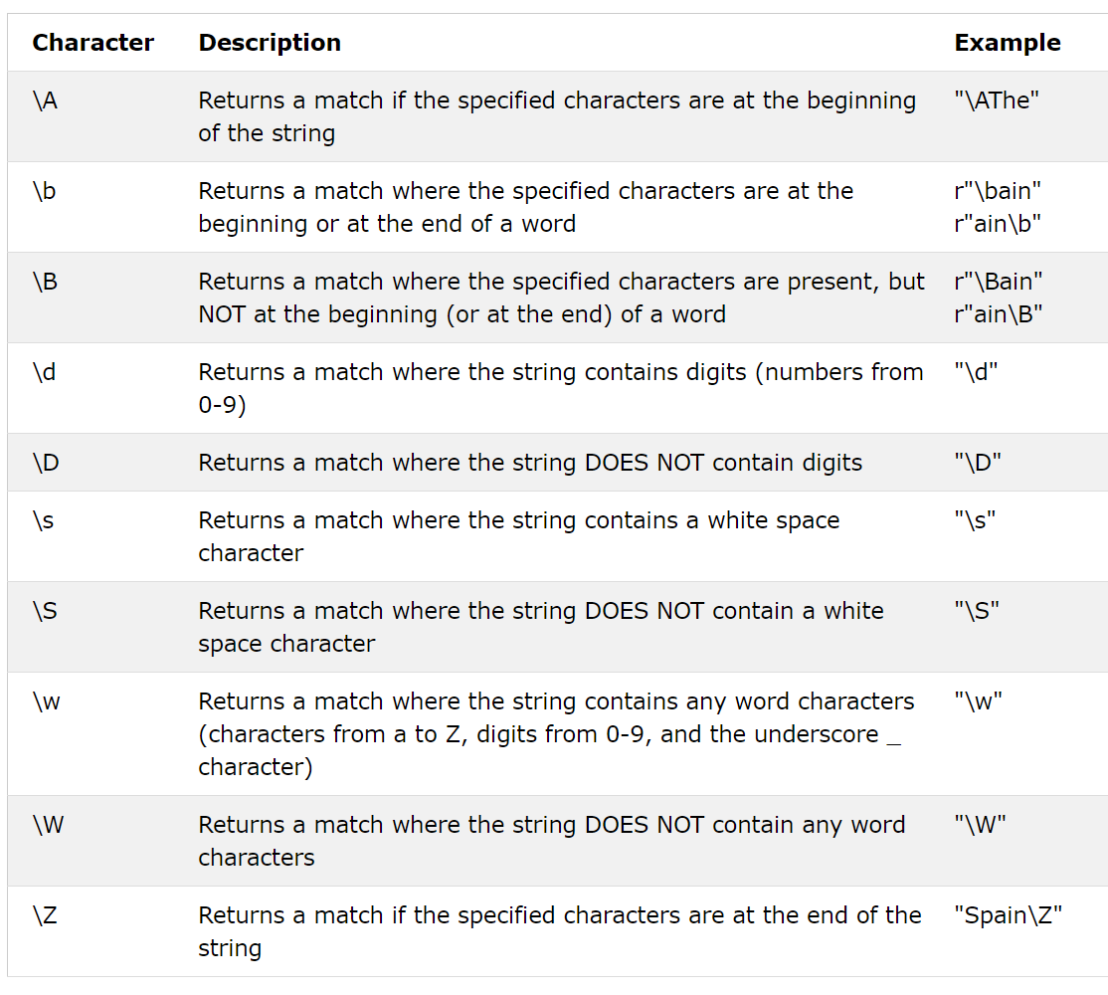
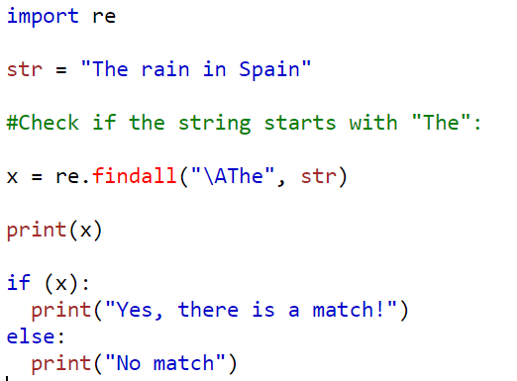
Special Characters
\A vs ^ : ^ matches start of LINE while \A start of string
https://www.w3schools.com/python/python_regex.asp

Slide 22
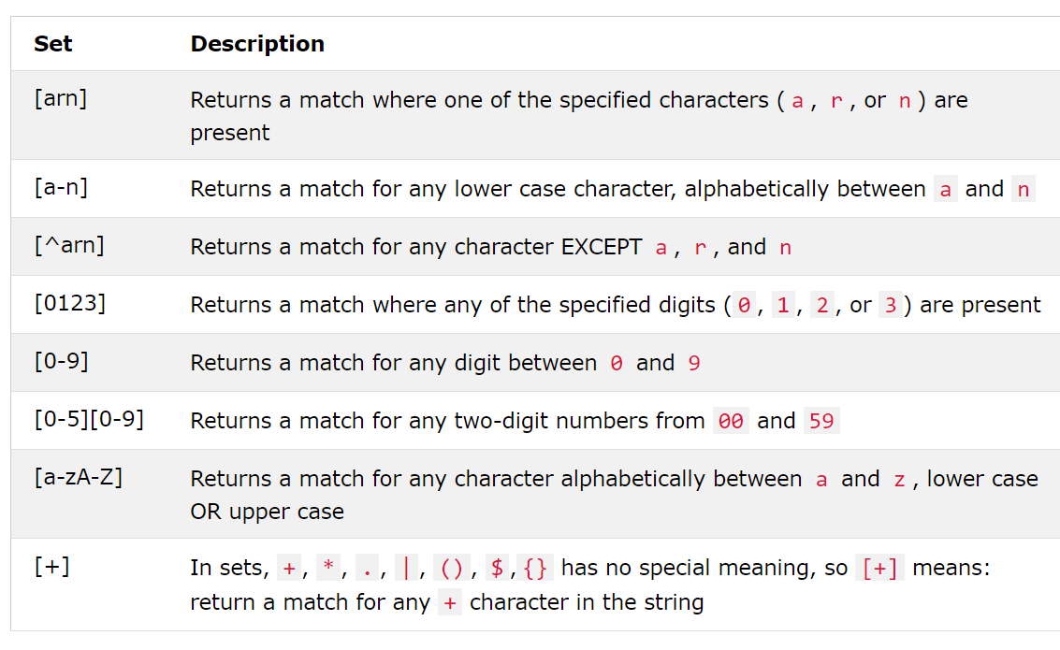
Sets
https://www.w3schools.com/python/python_regex.asp

Slide 23
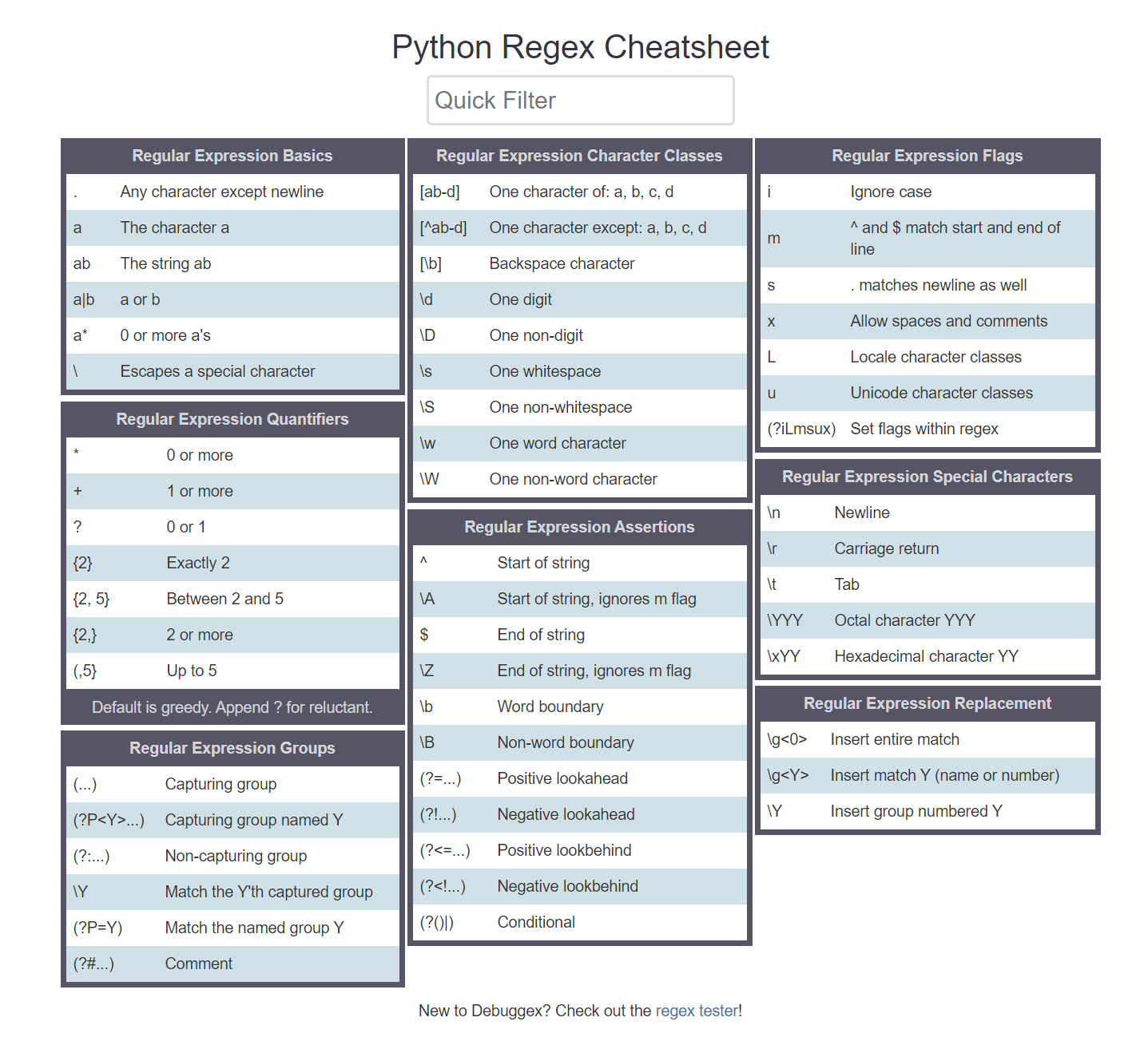
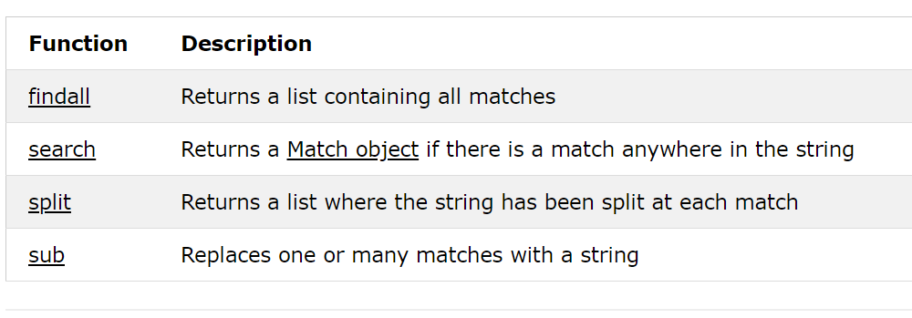
Python regex
https://www.debuggex.com/cheatsheet/regex/python

Slide 24

CEITEC
@CEITEC_Brno
Thank you for your attention!
60 minutes lunch break.
www.ceitec.eu

