Slide 1
Week 5 : Sequence Alignment
Introduction to Bioinformatics (LF:DSIB01)

Slide 2
BLAST - Basic Local Alignment Search Tool
BLAST is a method for performing Local Alignment
It uses a Seed query that must match perfectly to the reference, then builds around it
The alignment ends when a score threshold is passed
Step 1: Break Query into short words of specific length W
Step 2: Search for this sequence in a database of the reference
Step 3: Keep seeds that pass Threshold and extend
Step 4: Calculate E (Expected Value) – log10 chance that such alignment is found by luck
Published 1990
~80,000 citations

Slide 3
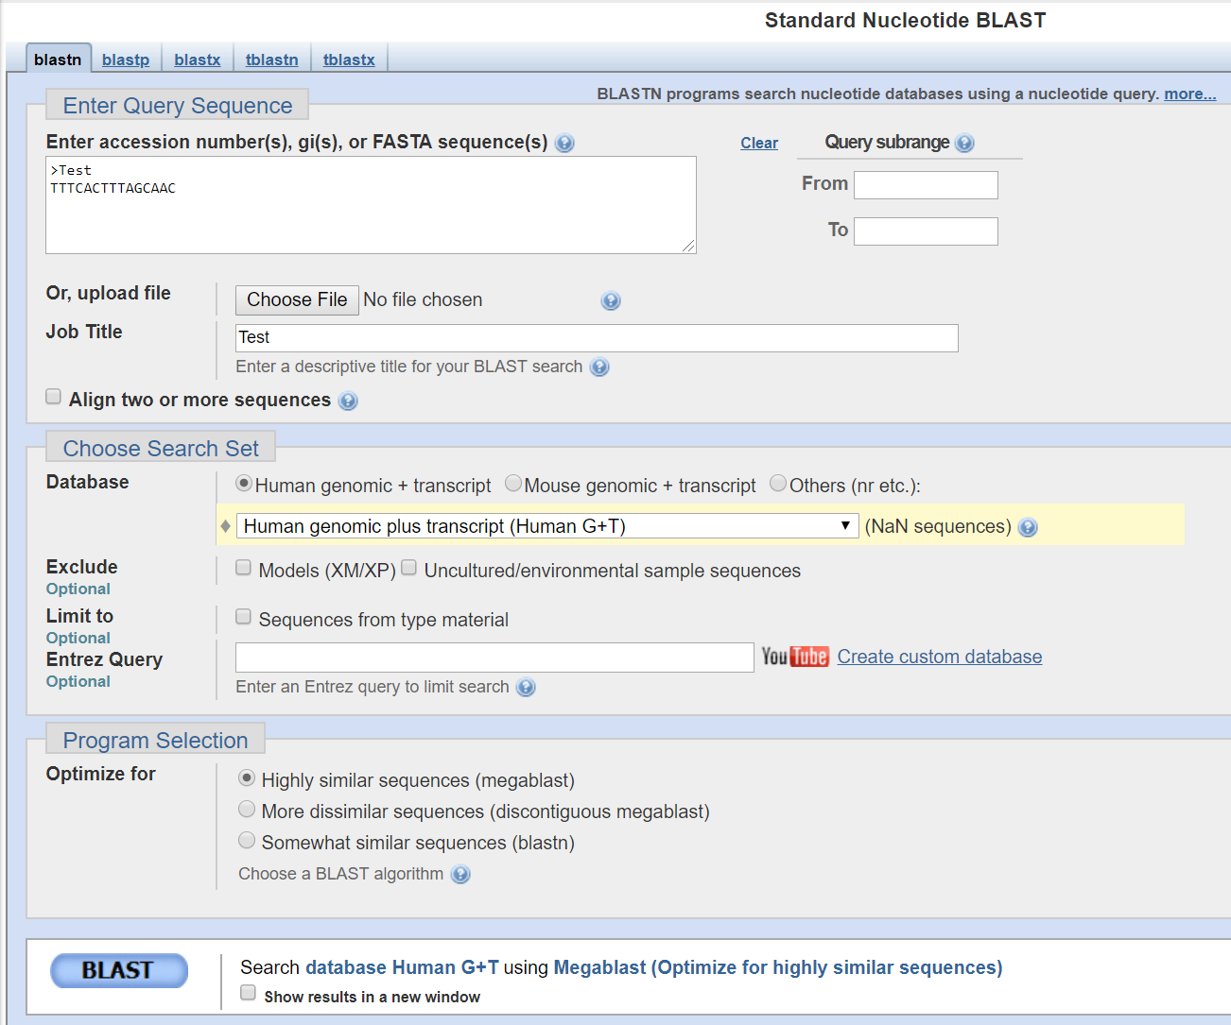
BLAST - Basic Local Alignment Search Tool
https://blast.ncbi.nlm.nih.gov/Blast.cgi

Slide 4
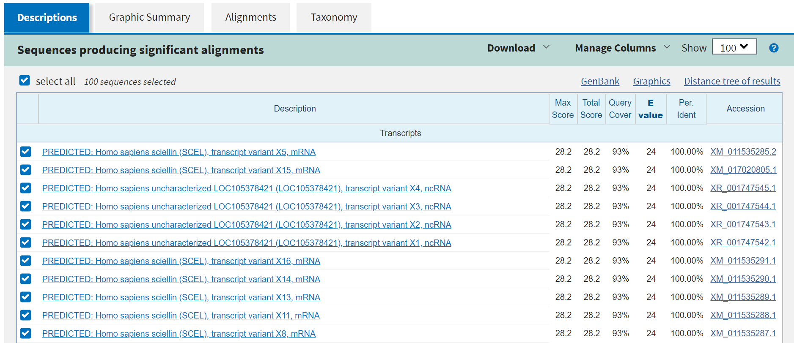
BLAST - Basic Local Alignment Search Tool

Slide 5
BLAST - Basic Local Alignment Search Tool
Useful information about alignment(s)
Works well for a single sequence

Slide 6
BLAST variations – old standalone programs
1999
BLASTN - Compares a DNA query to a DNA database. Searches both strands automatically. It is optimized for speed, rather than sensitivity.
BLASTP - Compares a protein query to a protein database.
BLASTX - Compares a DNA query to a protein database, by translating the query sequence in the 6 possible frames, and comparing each against the database (3 reading frames from each strand of the DNA) searching.
TBLASTN - Compares a protein query to a DNA database, in the 6 possible frames of the database.
TBLASTX - Compares the protein encoded in a DNA query to the protein encoded in a DNA database, in the 6*6 possible frames of both query and database sequences (Note that all the combinations of frames may have different scores).
BLAST2 - Also called advanced BLAST. It can perform gapped alignments.
PSI-BLAST - (Position Specific Iterated) Performs iterative database searches

Slide 7
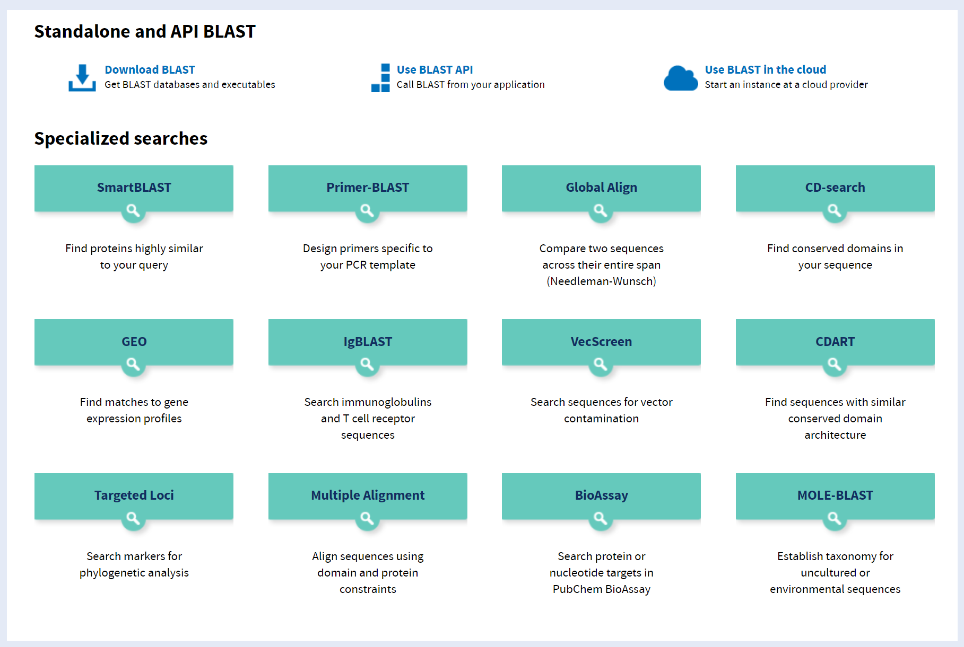
BLAST variations – web services and API
2019

Slide 8
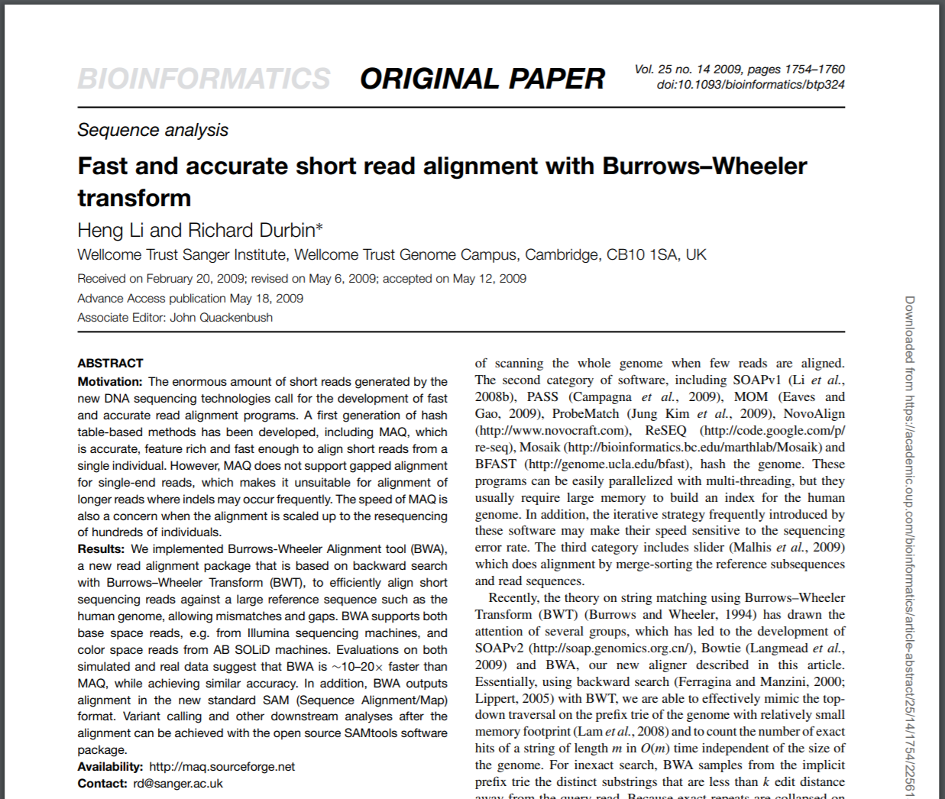
BWA - Burrows-Wheeler Aligner
BWA is a software package for mapping low-divergent sequences against a large reference genome, such as the human genome.
Variants: short seq (up to 100bp), longer seq (70-1,000,000bp)
Utilizes “Burrows Wheeler Transform” to make alignment faster
BWA, 2009

Slide 9
Burrows Wheeler Transform
Sort every permutation (sliding through) of the string and then take the last column = Transform
Essentially sorting by the character that comes AFTER this one (right-context)

Slide 10
Burrows Wheeler Transform
Important Property: LF (Last First) On the First and Last columns the order of same letters remains the same
Next Step:
Sort the table by order of letter AND index
$
A1
A2
A3
C1
C2
G1

Slide 11
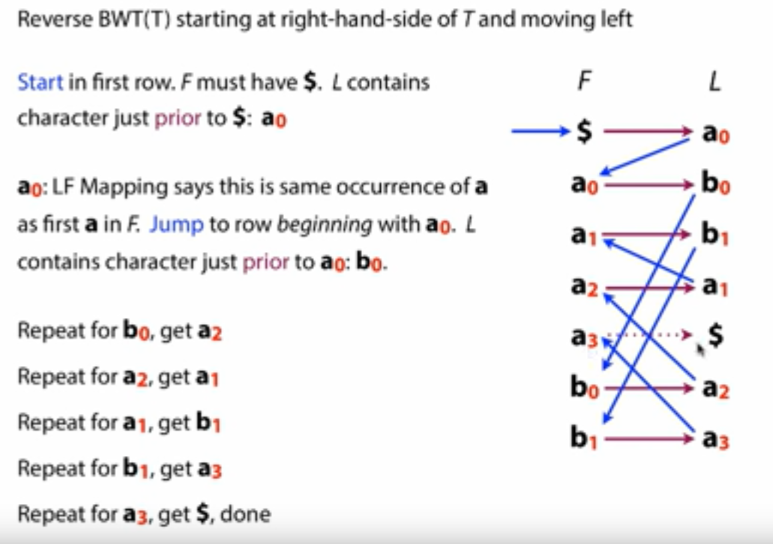
Burrows Wheeler Transform - Reversing
b) We can easily recreate the original sequence by working on a reverse order from any point in the Transform

Slide 12
Burrows Wheeler Transform
c) For every subsequence we can quickly find the location of all possible matches by working backwards in the transform
Using precalculation the complexity of the lookup can be reduced close to O(1)
Explanation of BWT for genomic indexing
by Ben Langmead (creator of bowtie)
https://www.youtube.com/watch?v=4n7NPk5lwbI
https://www.youtube.com/watch?v=kvVGj5V65io

Slide 13
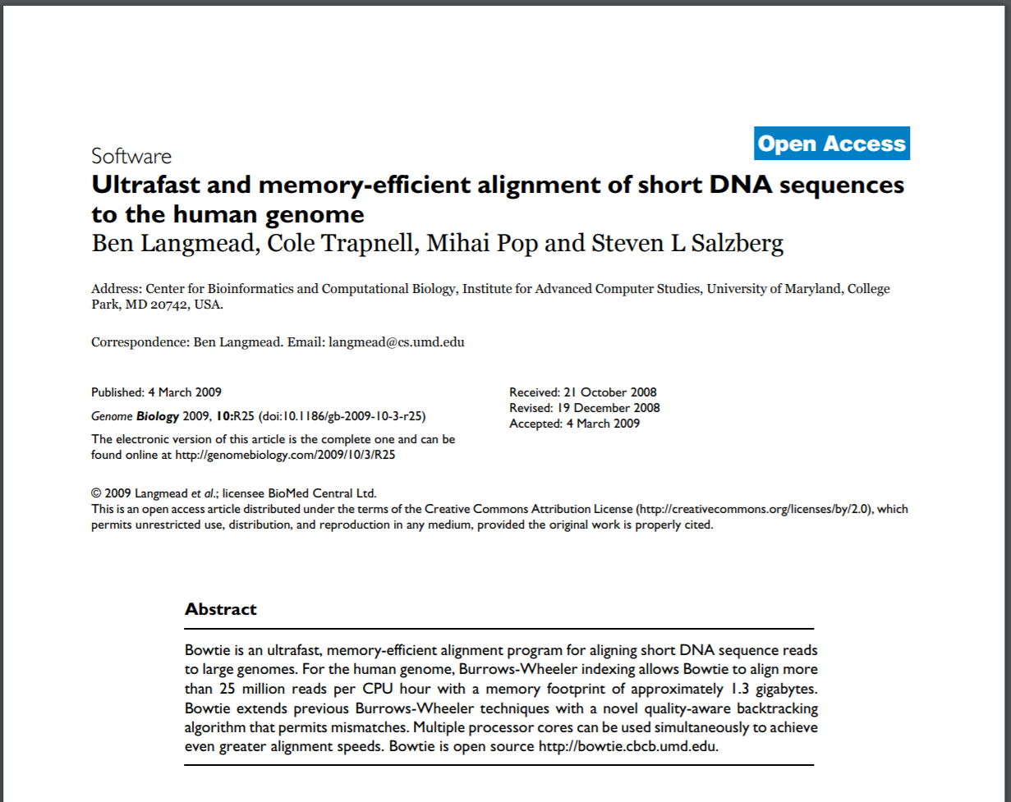
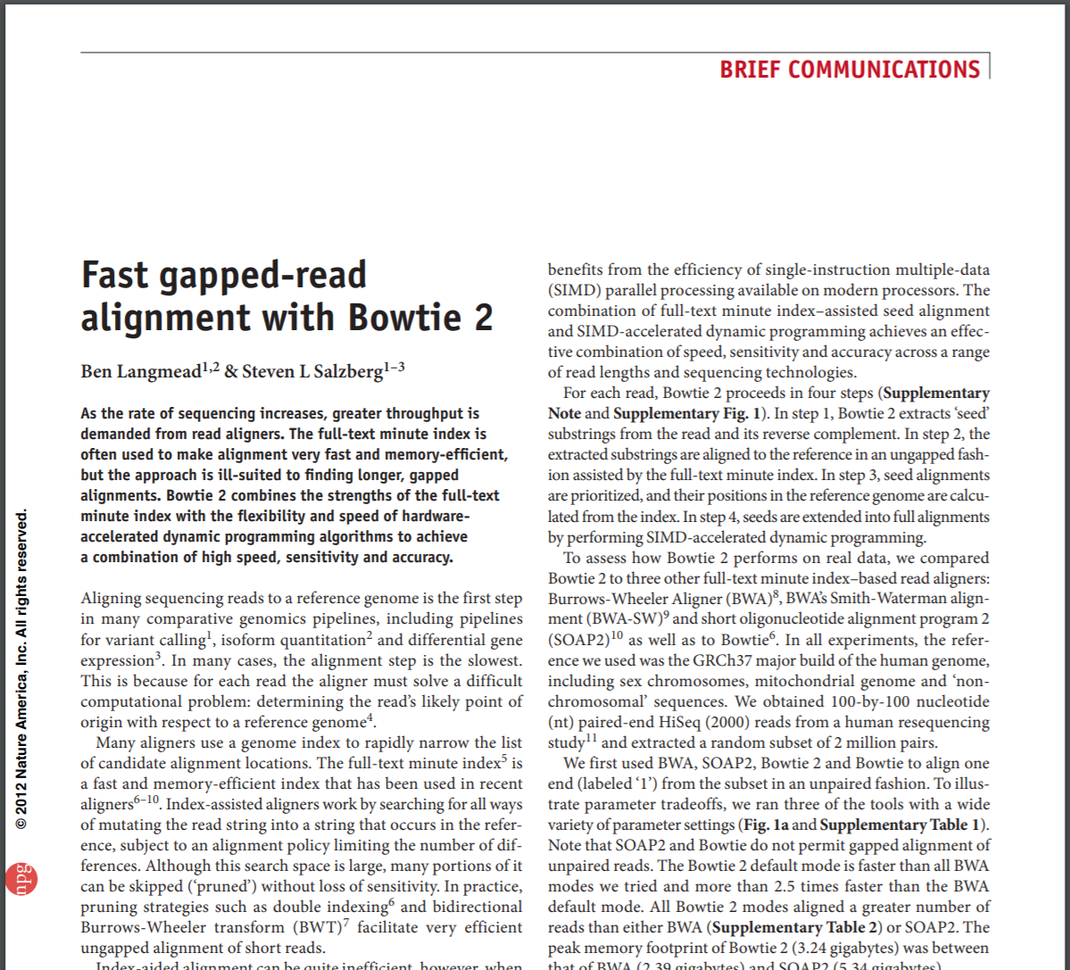
Bowtie
Bowtie, 2009
Bowtie 2, 2012

Slide 14
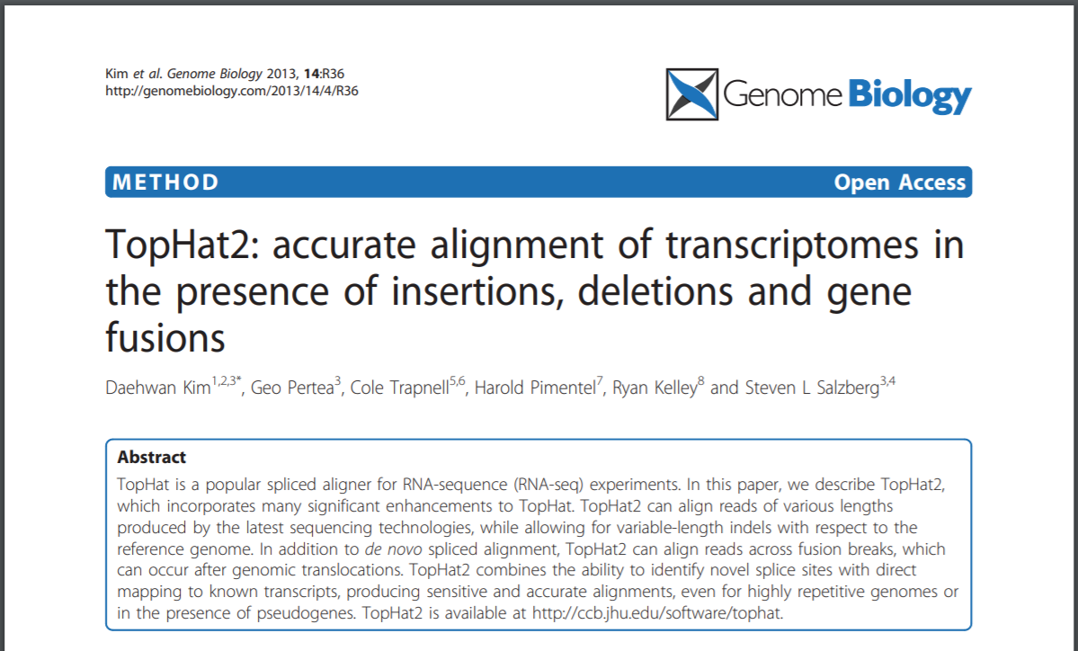
TopHat2
TopHat2 works well with gaps + introns
Bowtie 2, 2012
TopHat2, 2013

Slide 15
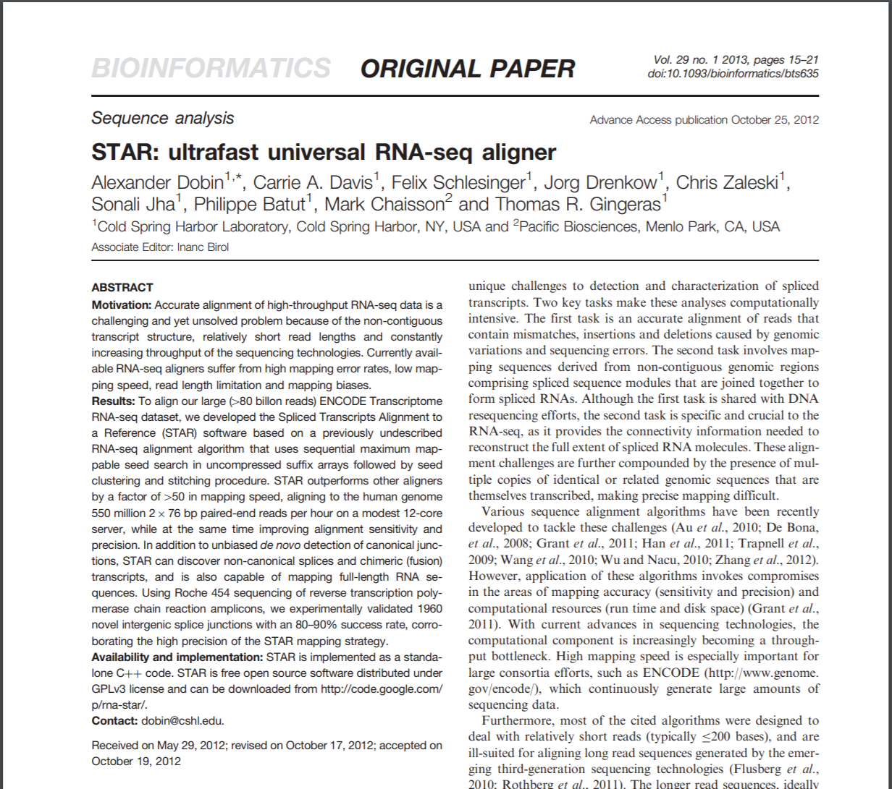
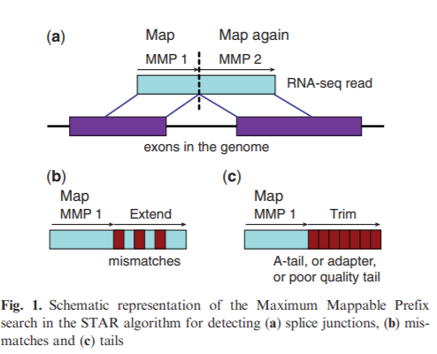
STAR
STAR works well with gaps + introns
Preferable for mapping on RNA
Faster than TopHat2
STAR, 2013

Slide 16
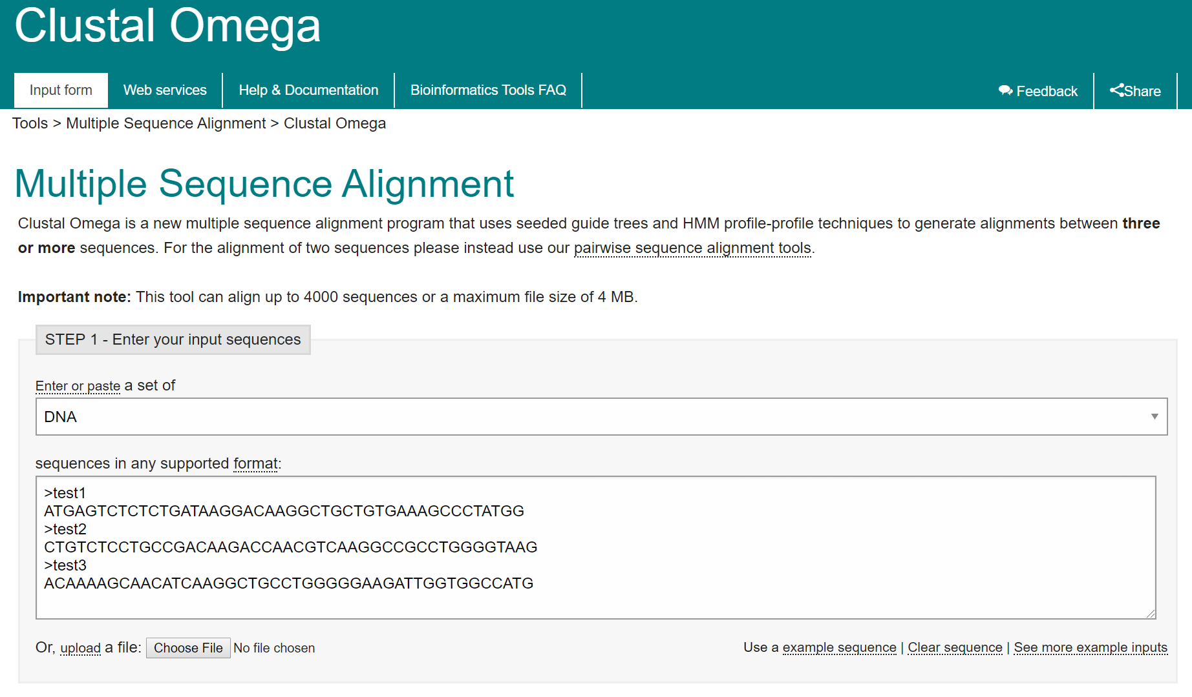
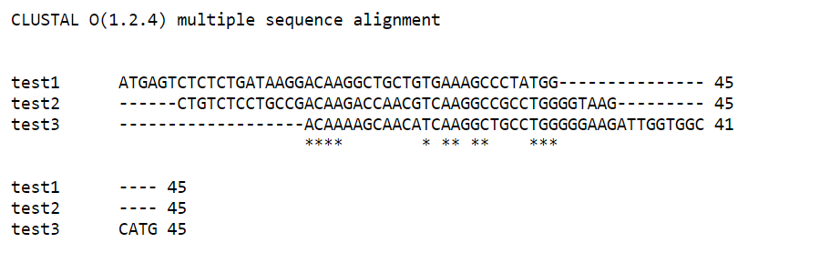
Clustal – Omega (Multiple Sequence Alignment)

Slide 17
Exercise
Global Alignment: Use Alignment Matrix
Global Alignment: Align Position Weight Matrices
https://bit.ly/3427HeE

Slide 18
CEITEC
@CEITEC_Brno
Thank you for your attention!
60 minutes lunch break.
www.ceitec.eu

