Slide 1
Galaxy
Galaxy is an open source, web-based platform for data intensive biomedical research. A universal GUI and workflow manager for lots of tools.
Official website: https://galaxyproject.org/main/
There are approximately 120 public servers, dozens of private academic servers and even several commercial servers. Lots of which are highly specialised or modified as Galaxy project is completely open access.
Anyone can use one of public servers, with or without an account, but Galaxy user accounts are simple to create (email, password and go!). Advantages are: increased data quotas, more resources available, parallel jobs and extended functionality across sessions (i.e., Histories), such as naming, saving, sharing, and publishing.

Slide 2
Usegalaxy.org
The main Galaxy server at http://usegalaxy.org
combines many common tools with data sources;
is available since 2007 for anyone to analyze their data free of charge;
provides substantial CPU and disk space, making it possible to analyze large datasets;
supports thousands of users and hundreds of thousands of jobs per month (see Statistics);
sustained by TACC hardware using allocation generously provided by the CyVerse project.
Notation: History, Dataset, Tool panel, Job, Workflow, Visualization, Library

Slide 3
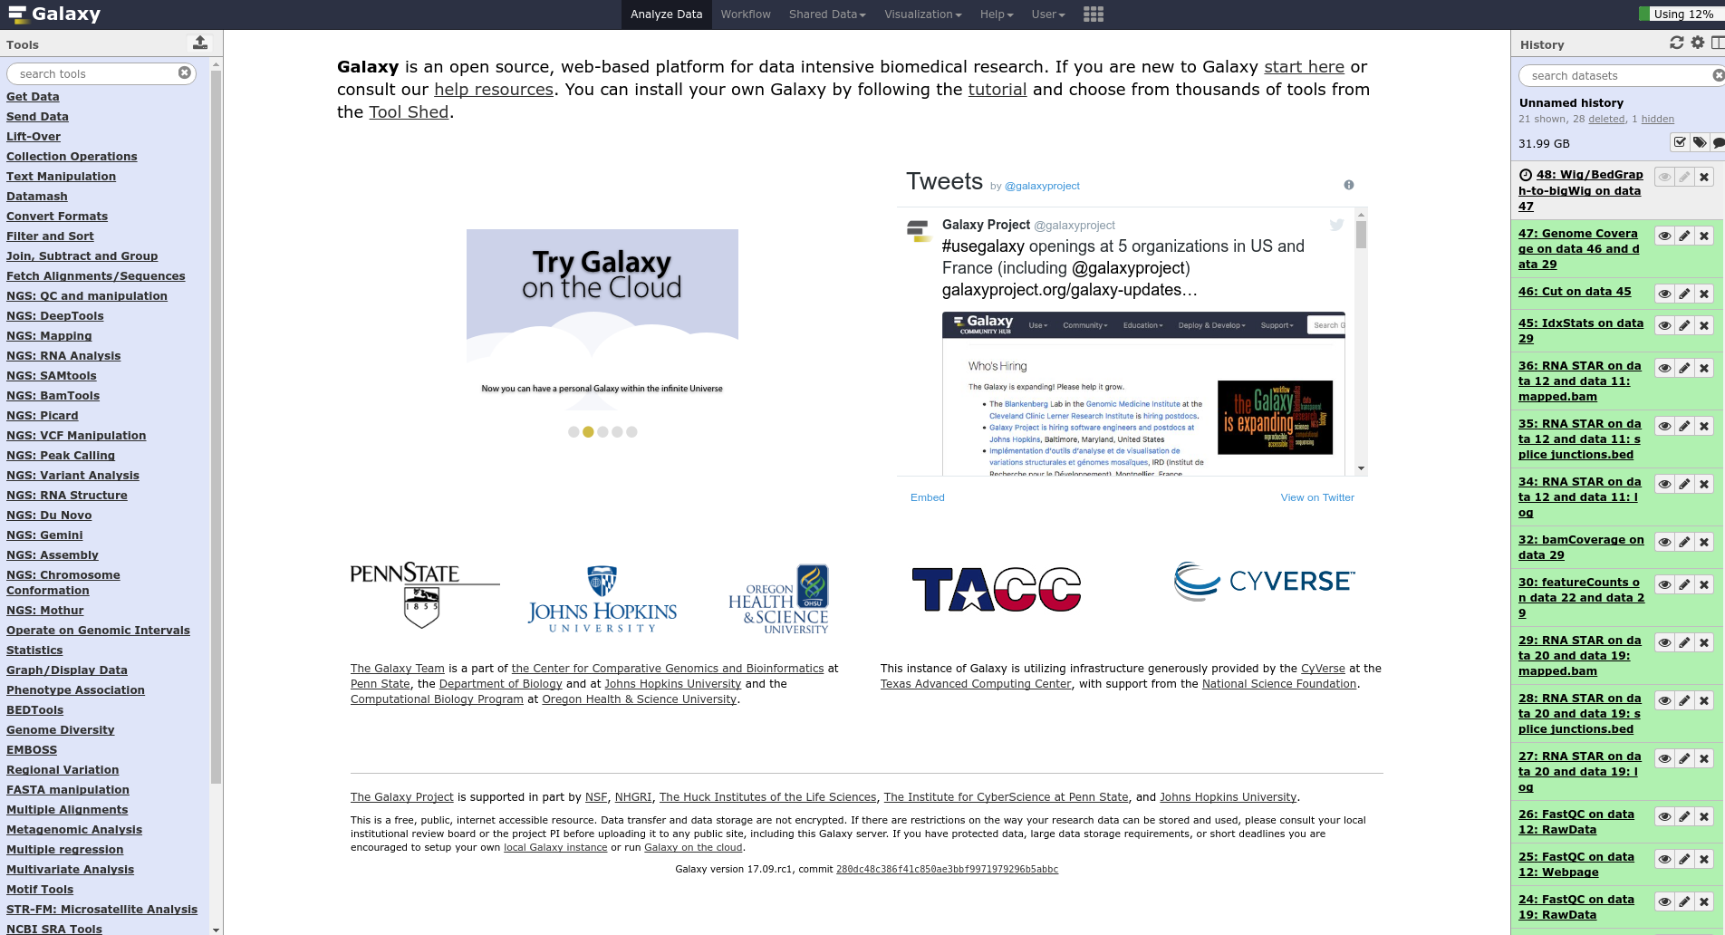

Slide 4
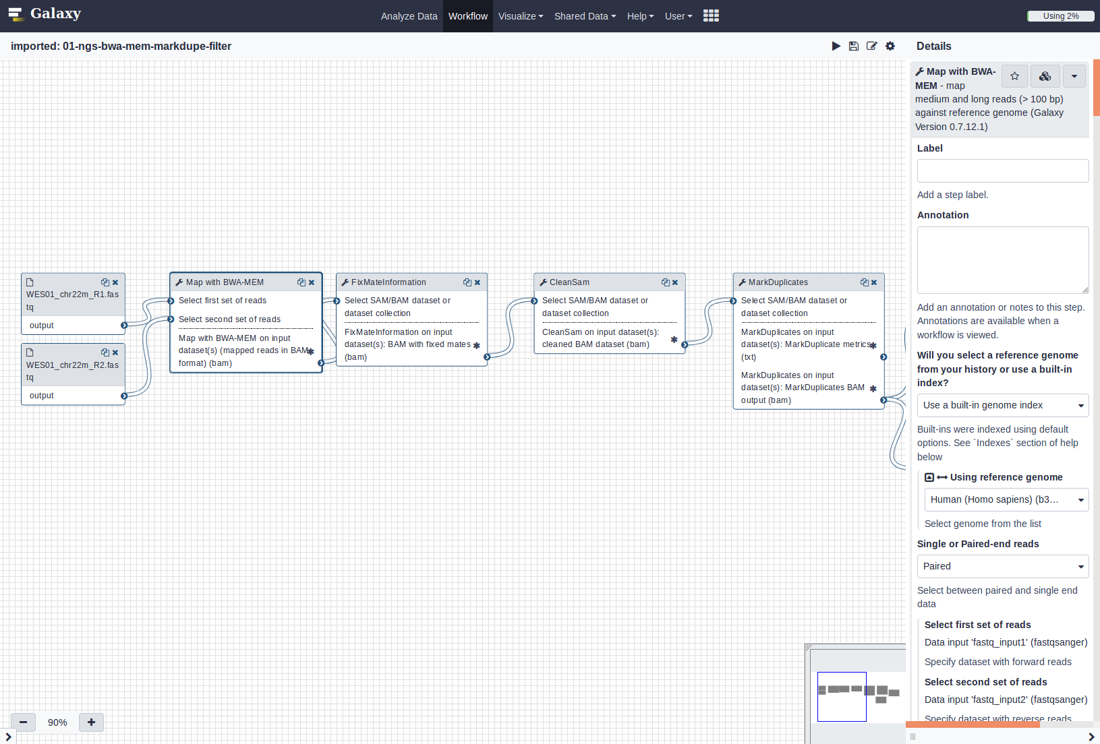

Slide 5
CEITEC Galaxy server
Public Galaxy is quite versatile and flexible (but not that much).
You can always install your own Galaxy instance. Advantages:
(simple) installation of additional tools, visualizations, etc.
own computational resources and personalised quotas in data storages
easy to share datasets, workflows, etc.
adjustable access security level (from no authentication to fully restricted access)
Our Galaxy server can be found here:
https://galaxy.ceitec.muni.cz/
To login please use your university UCO and secondary password
Notes:
Advantages and disadvantages of command line and Galaxy

Slide 6
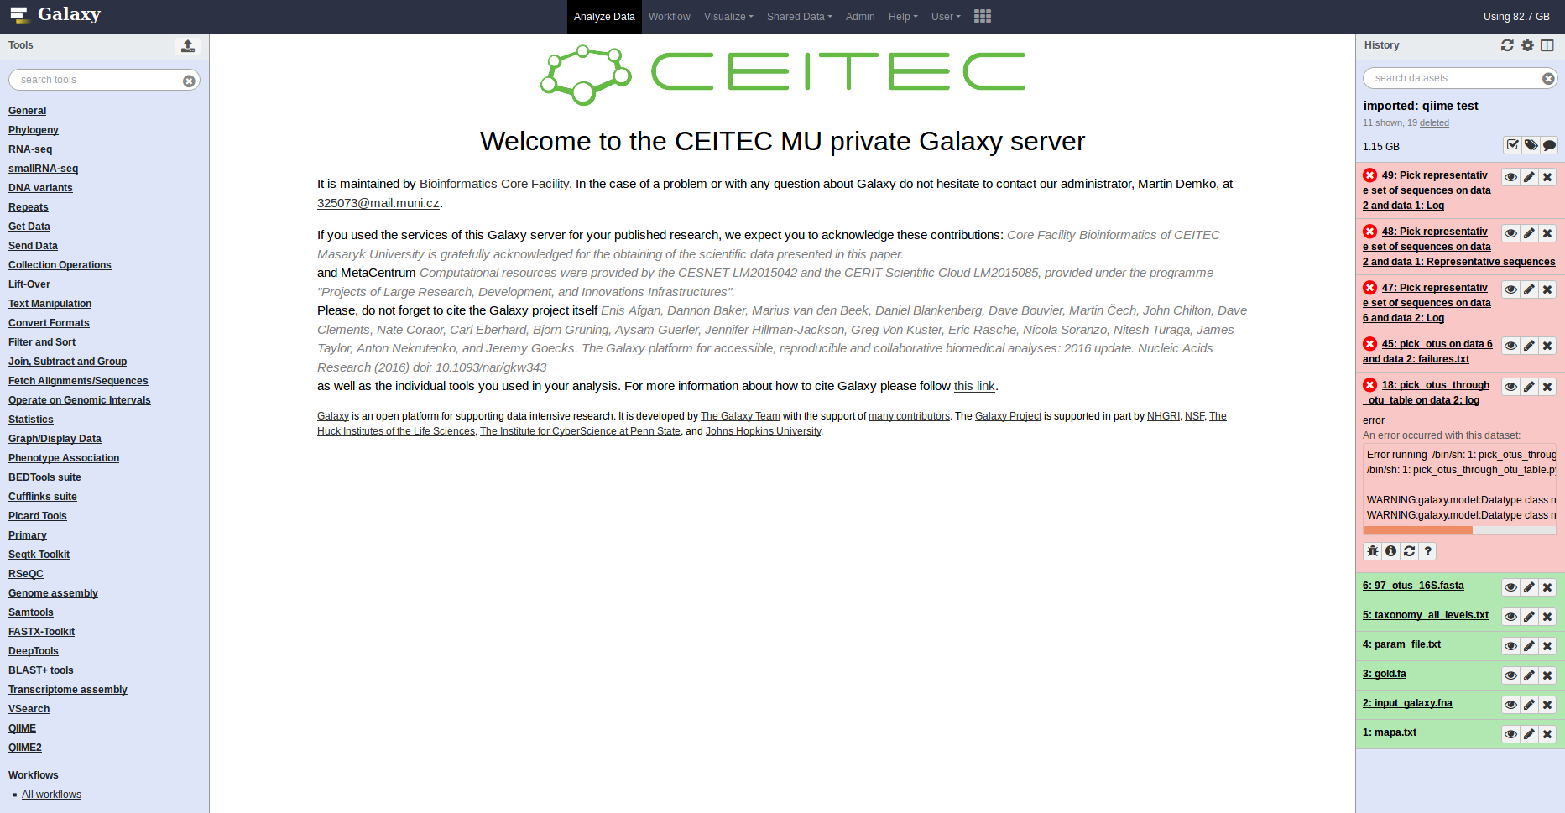
CEITEC Galaxy server
Notes:
Advantages and disadvantages of command line and Galaxy

Slide 7
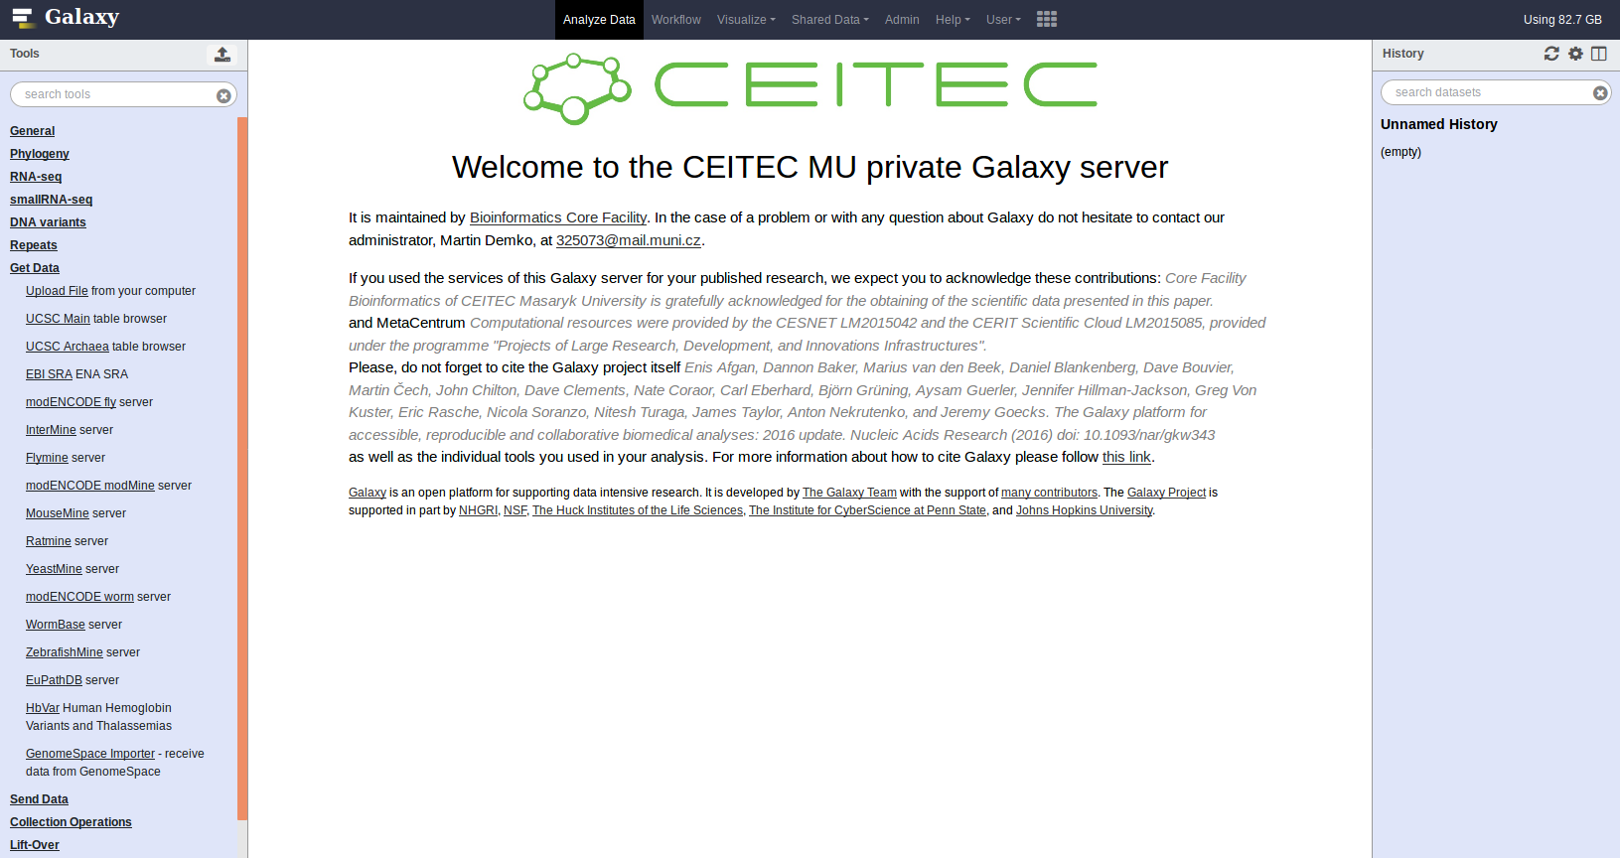
Upload data

Slide 8
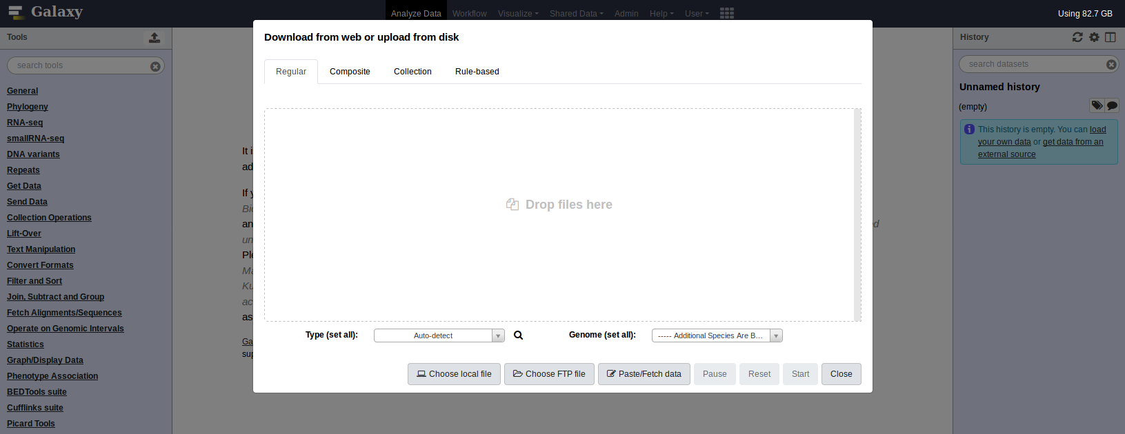
Upload data - sources

Slide 9
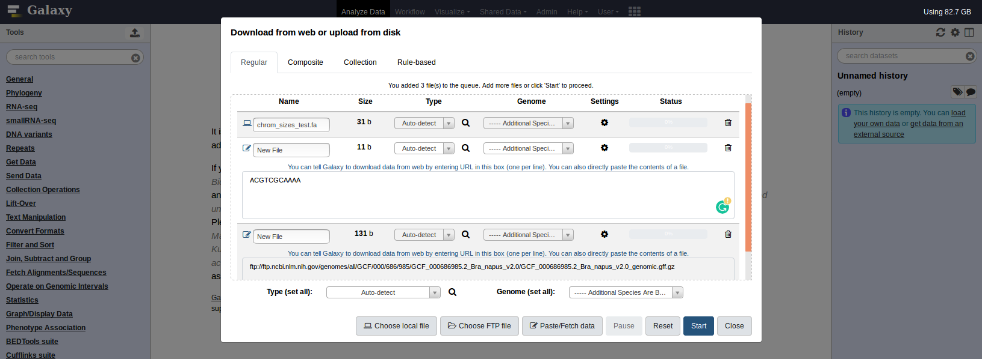
Upload data into History

Slide 10
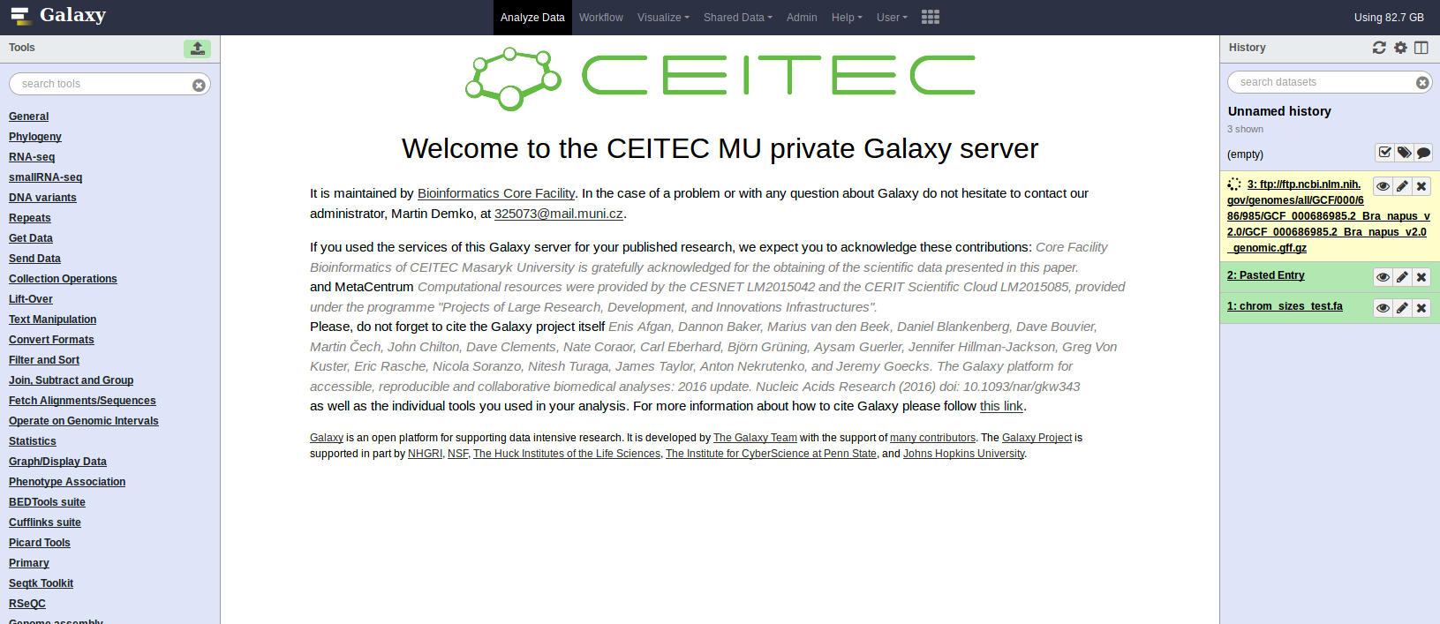
Upload data into History

Slide 11
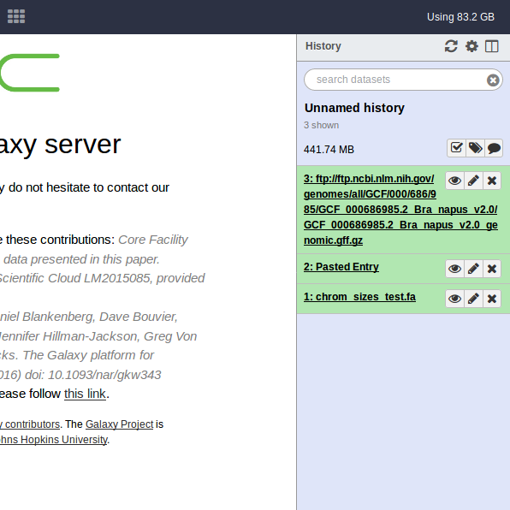
History
Total usage across the Histories
Reload, Advanced options, Multy-history panel
Size of History
Search field (looks in names, tags, comments, metadata)
History name (adjustable anytime, recommended to use)
Multi-dataset operations, History tags, History annotation
Dataset with ID and name

Slide 12
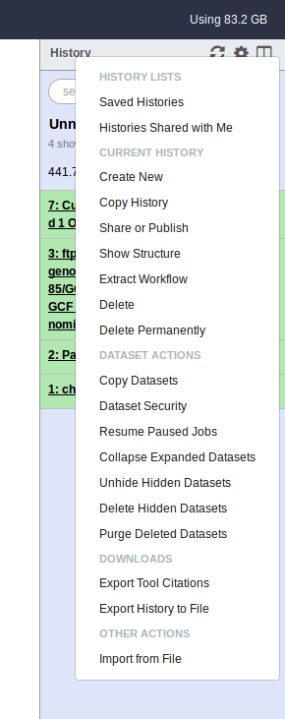
History - advanced options
Lot of useful features:
Copy whole History
Share or Publish History
Extract Workflow
Permanent delete of History or Datasets
Export citations from used Tools

Slide 13
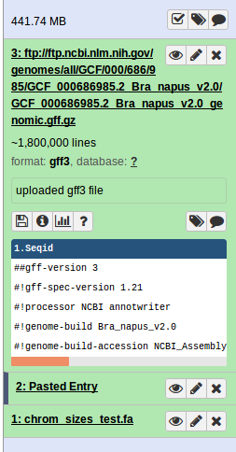
Dataset
HID - History ID of Dataset (increasing)
Name of Dataset (usually name of uploaded file or description of job result, strongly recommended to change)
View content of Dataset
Edit attributes (name, datatype, access)
Delete Dataset (not permanently)
Information about length, format and associated genome database
Adjustable Info panel
Download Dataset
Show Details of Dataset or Job
Show available Visualizations
Show Help page
Edit tags of Dataset (very usefull)
Edit attributes (name, datatype, access)
Delete Dataset (not permanently)
Peek into Dataset (first several lines)

Slide 14
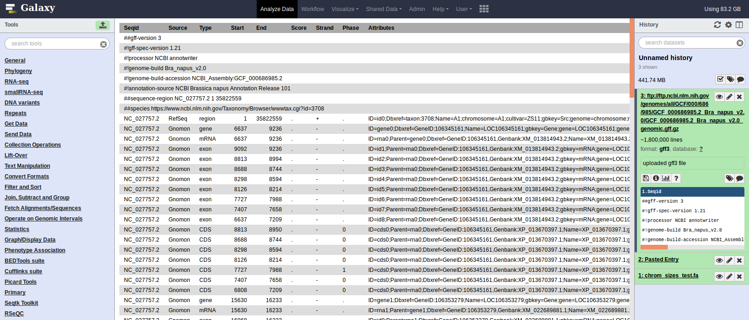
Dataset content

Slide 15
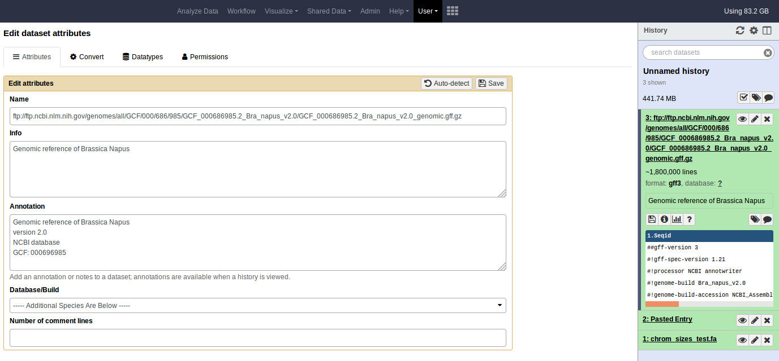
Dataset attributes

Slide 16
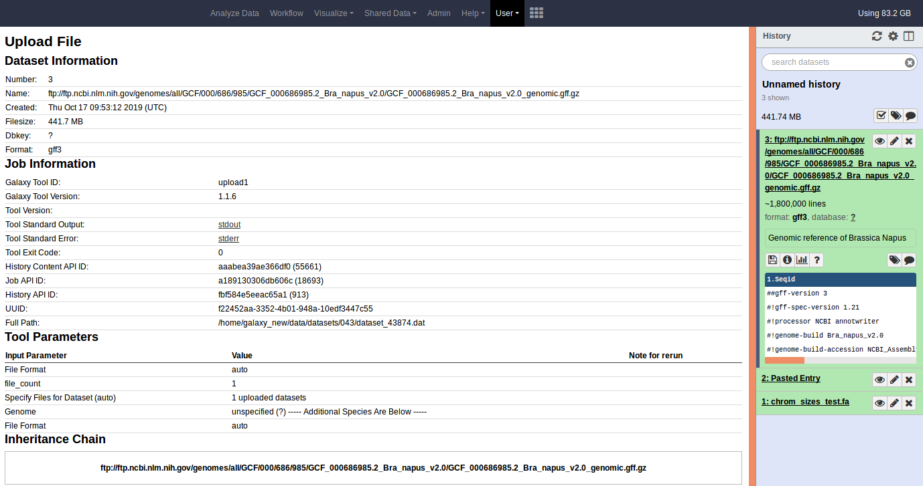
Dataset details
Each Dataset is a result of a Job using some Tool from Tool panel (here are useful information about performed Job)

Slide 17
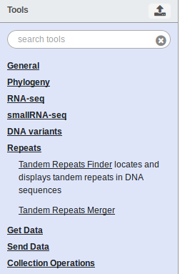
Tool panel
Search field of Tool panel (lloks into names, descriptions, metadata)
Tool panel with many (named) groups of tools.
Each group can be unrolled into a list of tools

Slide 18
Command-line Tool
Notes:
Example of STAR alignment in command line - very “nice” for non-bioinformaticians

Slide 19
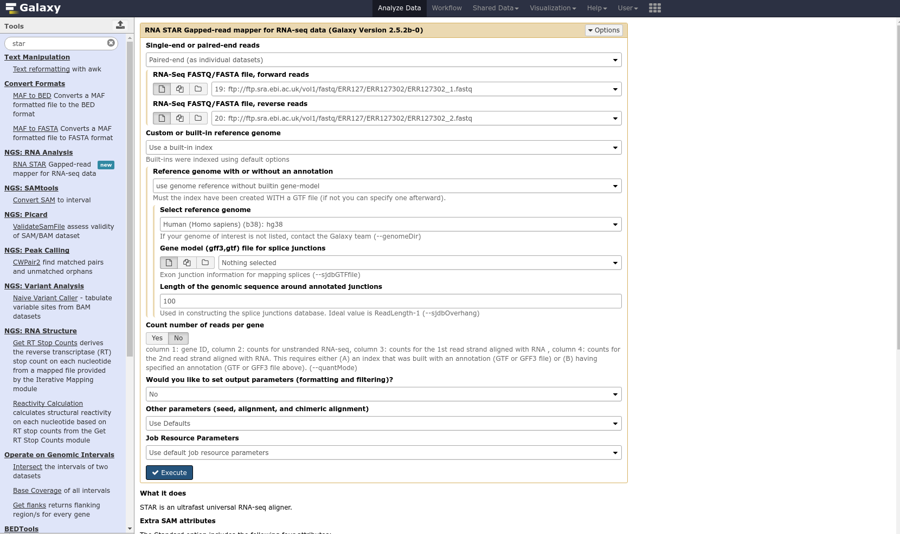
Galaxy - STAR alignment
Galaxy Tool
Notes:
EXAMPLE of STAR alignment in Galaxy - very NICE for non-bioinformaticians

Slide 20
Command-line vs Galaxy
Galaxy
is build on top of the bioinformatic (and not only) tools providing non-bioinformaticians an access to the tools
puts a graphic interface on the top of the command-line making it much more user-friendly
allows sharing of the data, workflows, results, visualizations, etc.
allows to repeat and edit Job settings easily
Is great for small-scale analyses
does not support all types of tools (e.g., online tools)
Command-line is more flexible
For large amount of data or unsupported tools it is still better to use command-line
Notes:
Advantages and disadvantages of command line and Galaxy

Slide 21
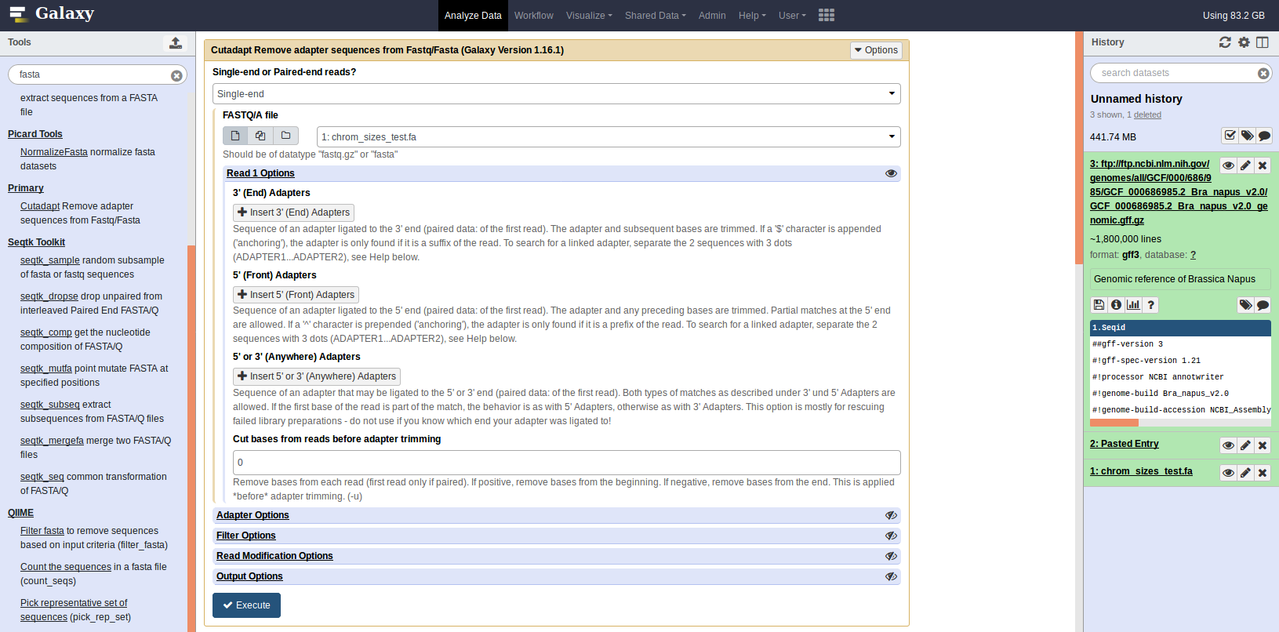
Job - setup

Slide 22
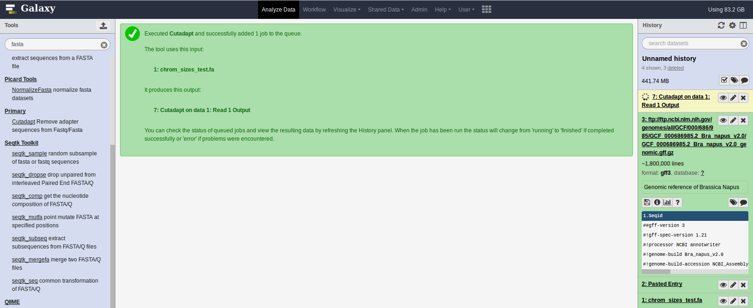
Job - execution

Slide 23
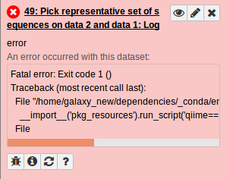
Job - error
Indicator of failed Job
Piece of Error message
Report failed Job (please, do!)
Rerun job (not only failed one)

Slide 24
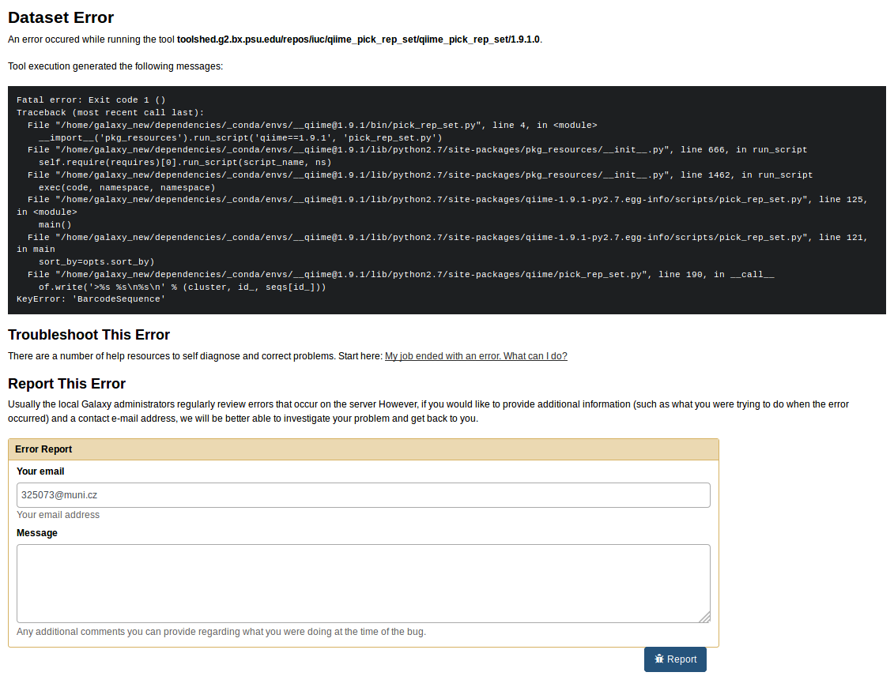
Report Job error

Slide 25
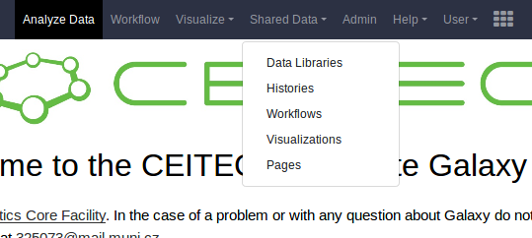
Data Libraries
Notes:
Copy the links which start with ftp:// and end with .fastq.gz
If the link doesn’t start with ftp:// Galaxy might have problem to upload it
If you are sure the link you copied is an ftp link you can just add the ftp:// in front of the link so it then looks like (most likely) as ftp://ftp.xxx.fastq.gz where xxx is the actual path to the file on the ftp server

Slide 26
Data Libraries

Slide 27
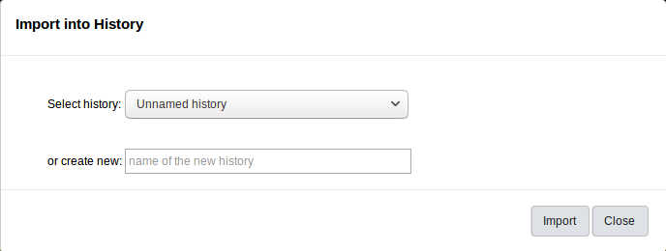
Data Libraries
2.
3.
1.

Slide 28
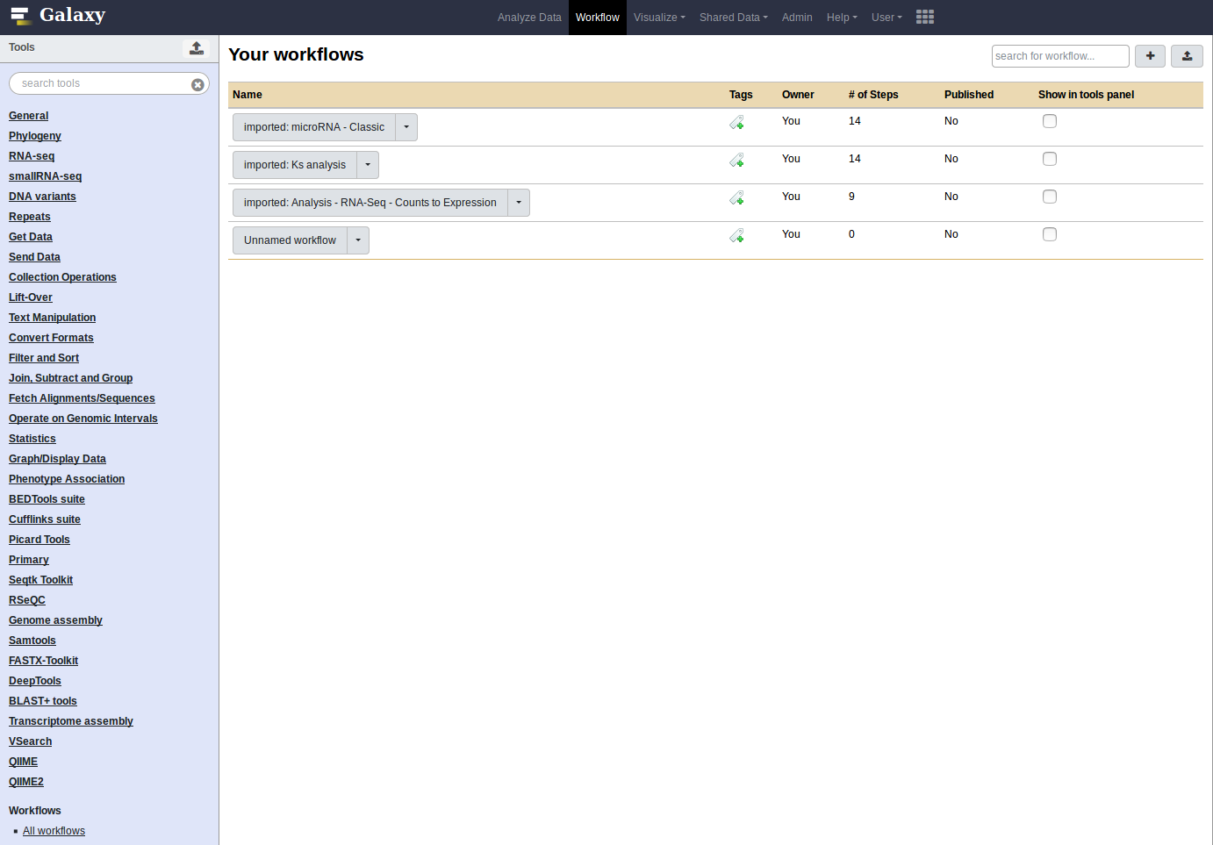
Workflow
Workflow or pipeline is an automatisation of multi-step analysis
Set (or tree) of tools taking the input from the output of another tool (except the very first)

Slide 29
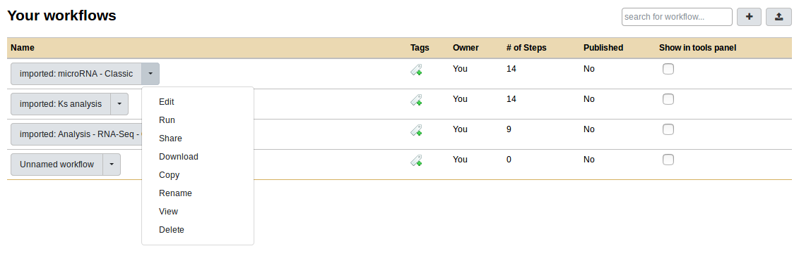
Workflow

Slide 30
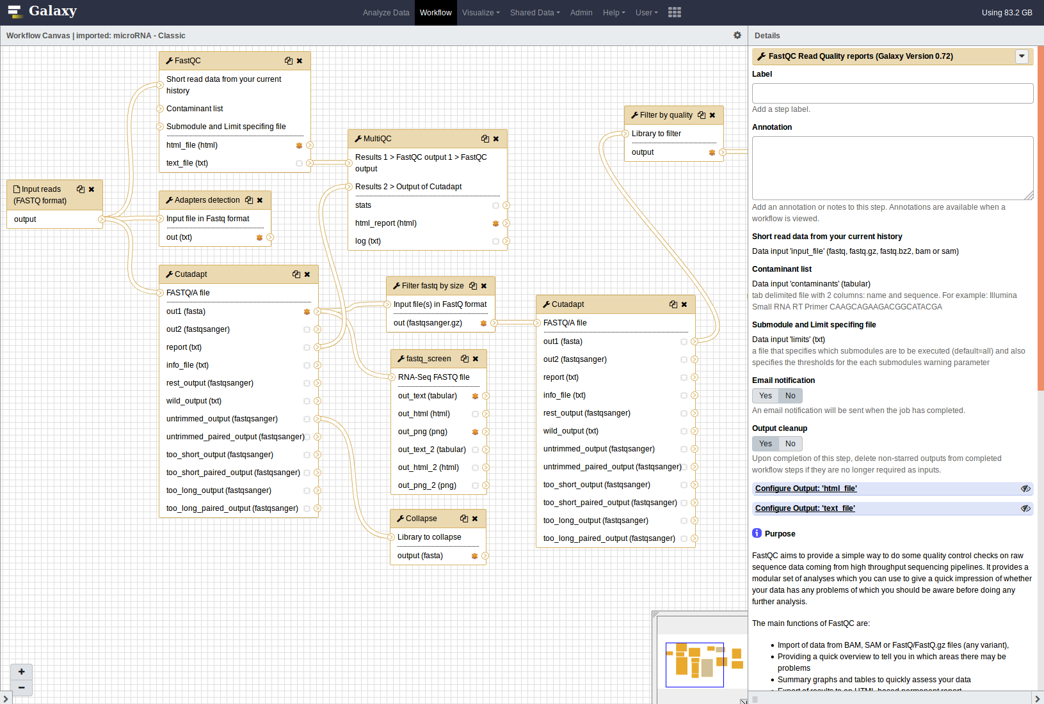
Workflow - build
Tools can be drag&dropped from Tool panel and connected together only if output and input Dataset format matches
Parameters,
Annotation,
etc.

Slide 31
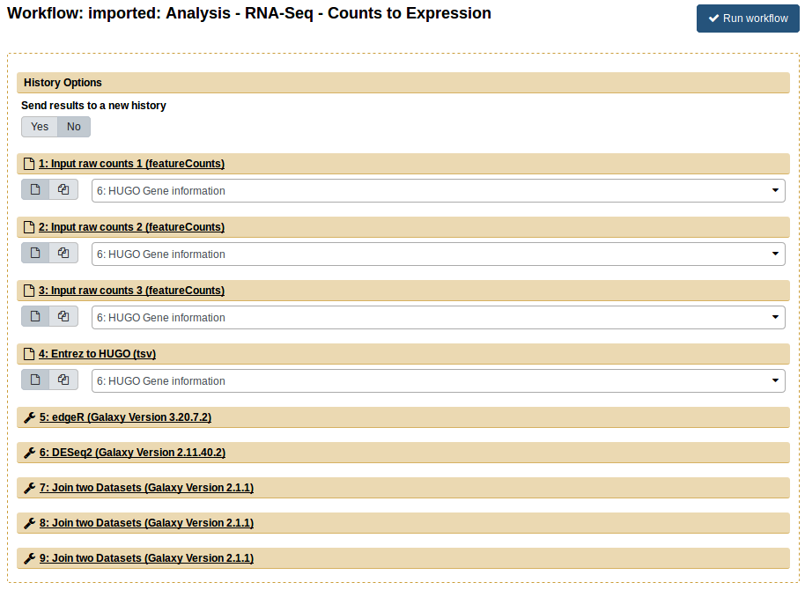
Workflow
- execution

Slide 32
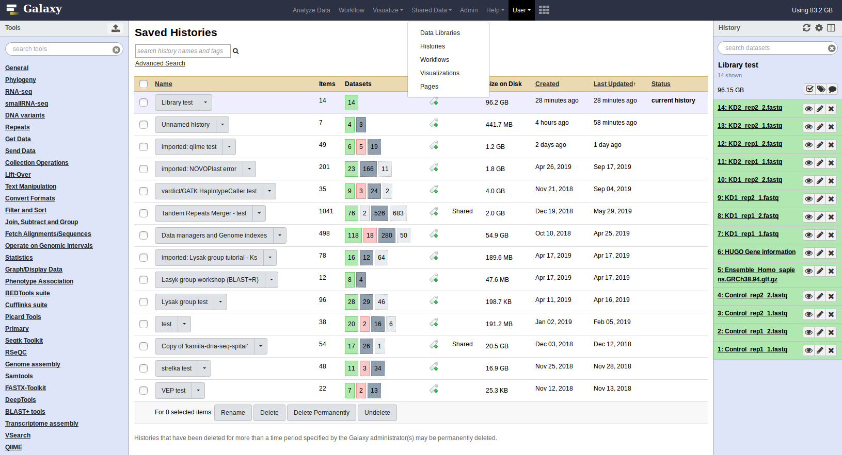
Saved Histories
Special panel
(next slide)

Slide 33
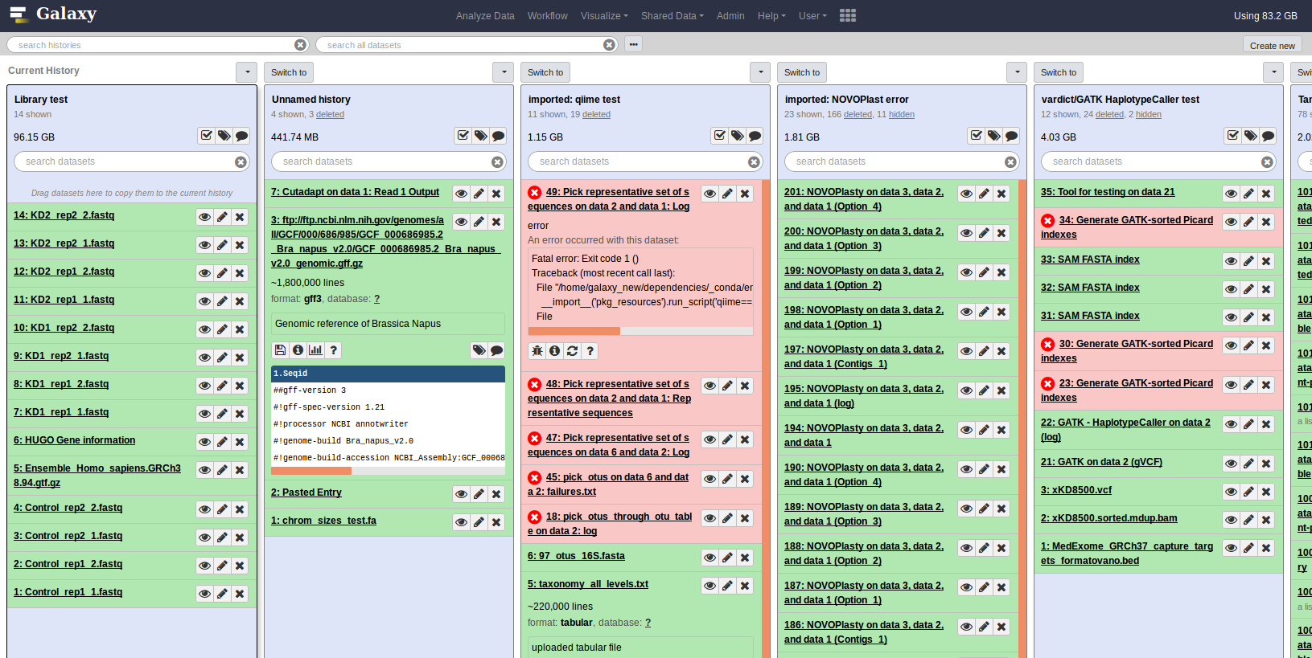
Multi-history panel

Slide 34
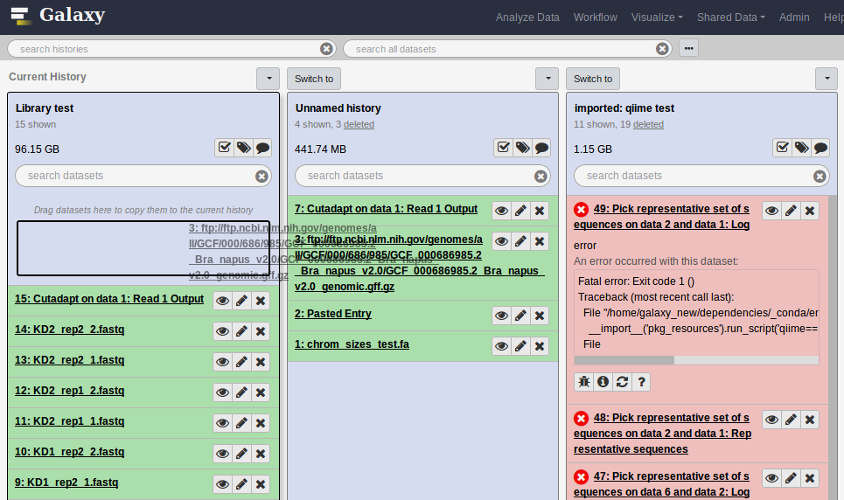
Multi-history panel - drag&drop copy Datasets

Slide 35
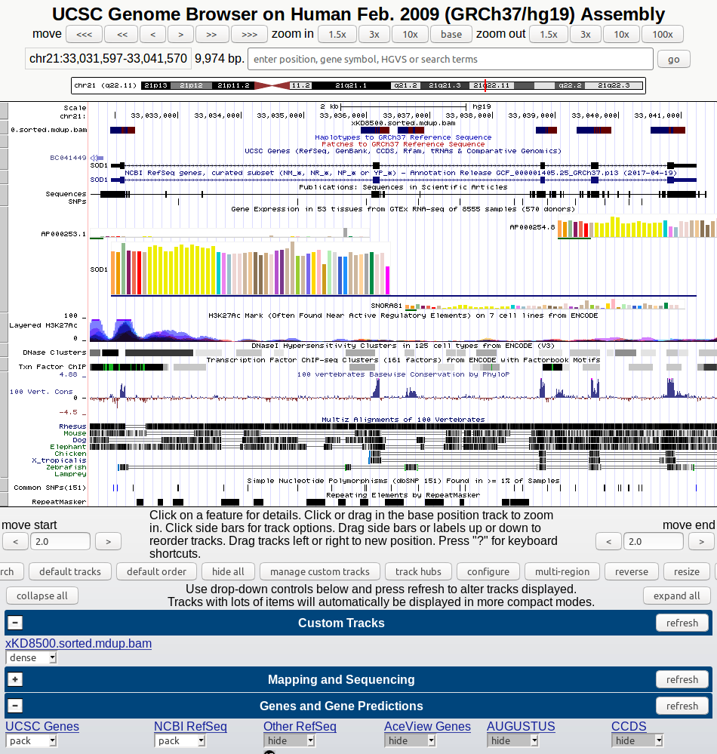
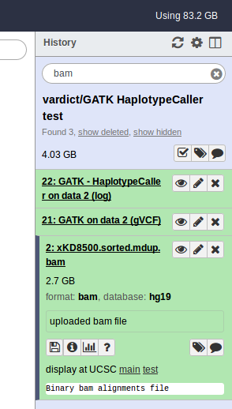
Visualization
Depends entirely on Dataset format

