Slide 1
Outline
Sequencing (NGS) in general
Sequencing data analysis in general
Kathi Zarnack and Julian König data
Results (selected)
Galaxy
RNA-Seq data analysis

Slide 2
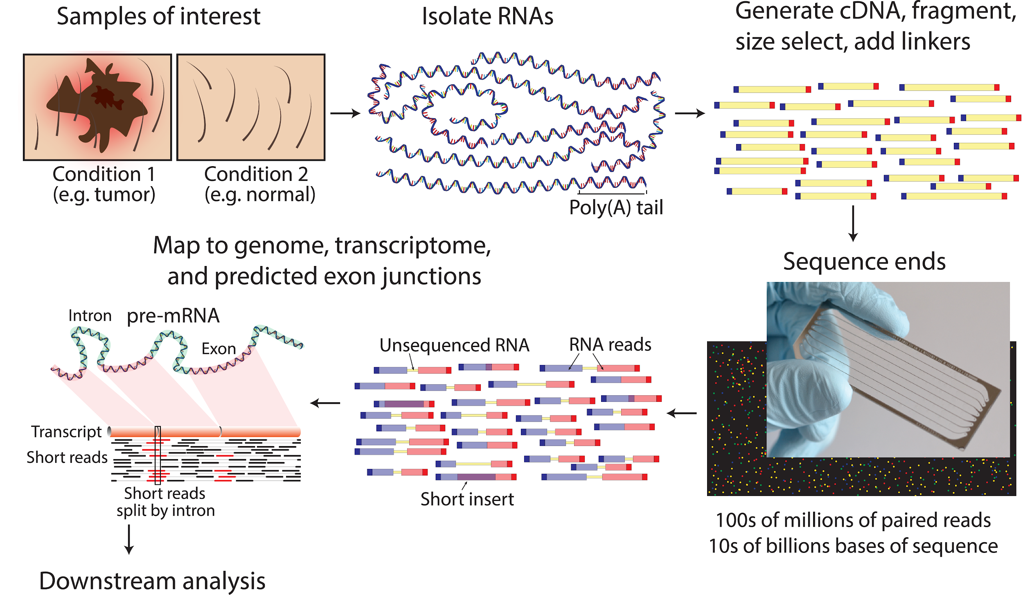
Sequencing (NGS) in general
PLoS Comput Biol. 2015
Informatics for RNA Sequencing: A Web Resource for Analysis on the Cloud.
Griffith M, Walker JR, Spies NC, Ainscough BJ, Griffith OL.
Notes:
How do we get the data - process of sequencing, isolation of RNA, iCLIP/RNA-Seq principle (very brief) and all the way to .fastq

Slide 3
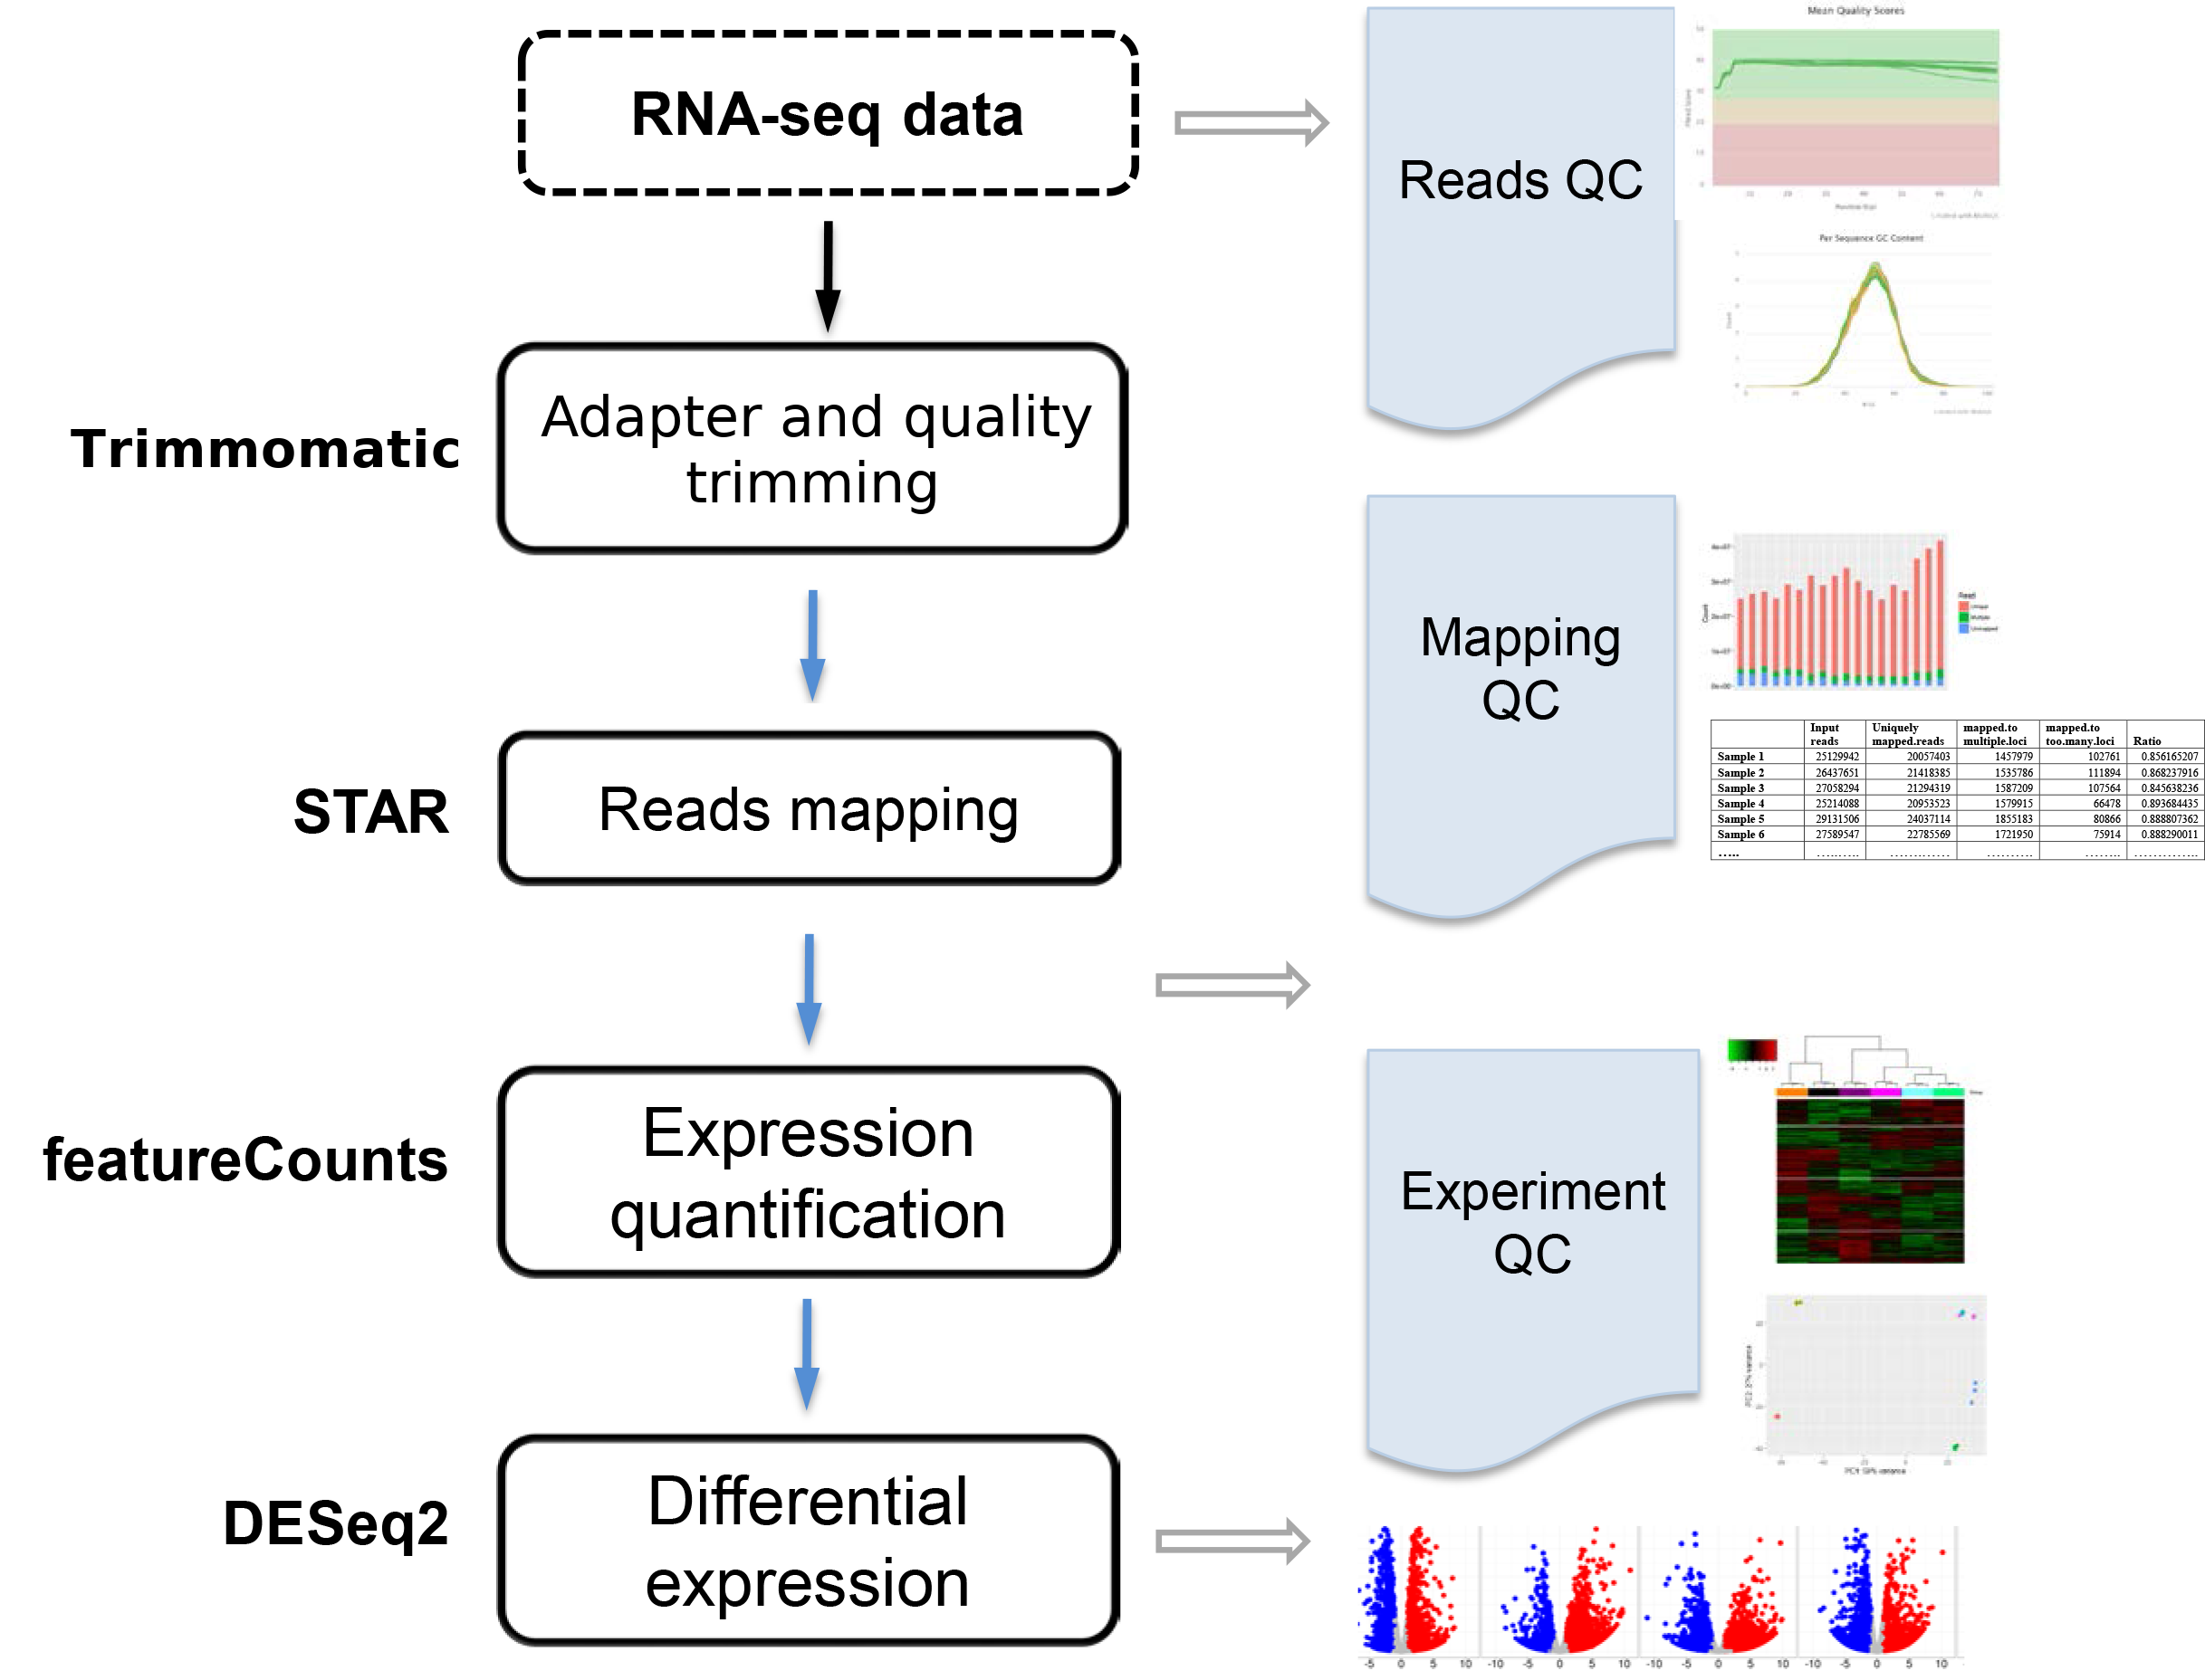
Sequencing data analysis in general
PLoS Comput Biol. 2015
Informatics for RNA Sequencing: A Web Resource for Analysis on the Cloud.
Griffith M, Walker JR, Spies NC, Ainscough BJ, Griffith OL.
Notes:
Now we have the fastq files so what do we do with it.
This is just an example, not the workflow we will use.
We need raw reads, annotation and reference genome.
Then we can align and/or assemble transcriptome, quantify or find peak and further process the data.

Slide 4
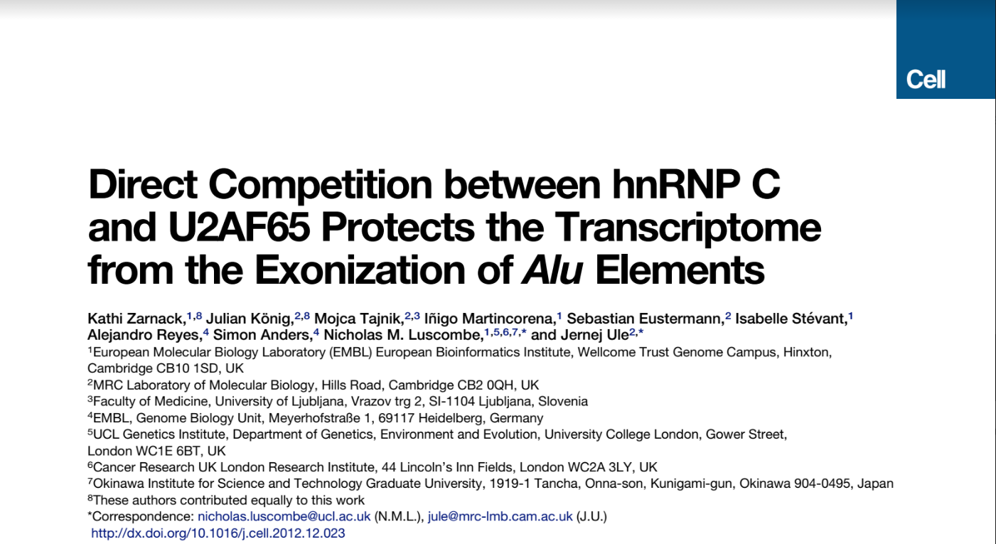
Kathi Zarnack data
Cell. 2013
Direct competition between hnRNP C and U2AF65 protects the transcriptome from the exonization of Alu elements.
Zarnack K, König J, Tajnik M, Martincorena I, Eustermann S, Stévant I, Reyes A, Anders S, Luscombe NM, Ule J.

Slide 5
Summary of the results
Cell. 2013
Direct competition between hnRNP C and U2AF65 protects the transcriptome from the exonization of Alu elements.
Zarnack K, König J, Tajnik M, Martincorena I, Eustermann S, Stévant I, Reyes A, Anders S, Luscombe NM, Ule J.
There are ~650,000 Alu elements in transcribed regions of the human genome. These elements contain cryptic splice sites, so they are in constant danger of aberrant incorporation into mature transcripts. Despite posing a major threat to transcriptome integrity, little is known about the molecular mechanisms preventing their inclusion. Here, we present a mechanism for protecting the human transcriptome from the aberrant exonization of transposable elements. Quantitative iCLIP data show that the RNA-binding protein hnRNP C competes with the splicing factor U2AF65 at many genuine and cryptic splice sites. Loss of hnRNP C leads to formation of previously suppressed Alu exons, which severely disrupt transcript function. Minigene experiments explain disease-associated mutations in Alu elements that hamper hnRNP C binding. Thus, by preventing U2AF65 binding to Alu elements, hnRNP C plays a critical role as a genome-wide sentinel protecting the transcriptome. The findings have important implications for human evolution and disease.
Notes:
Summary of the paper
Highlight - the cryptic exons protection and competition between hnRNP C and U2AF65

Slide 6
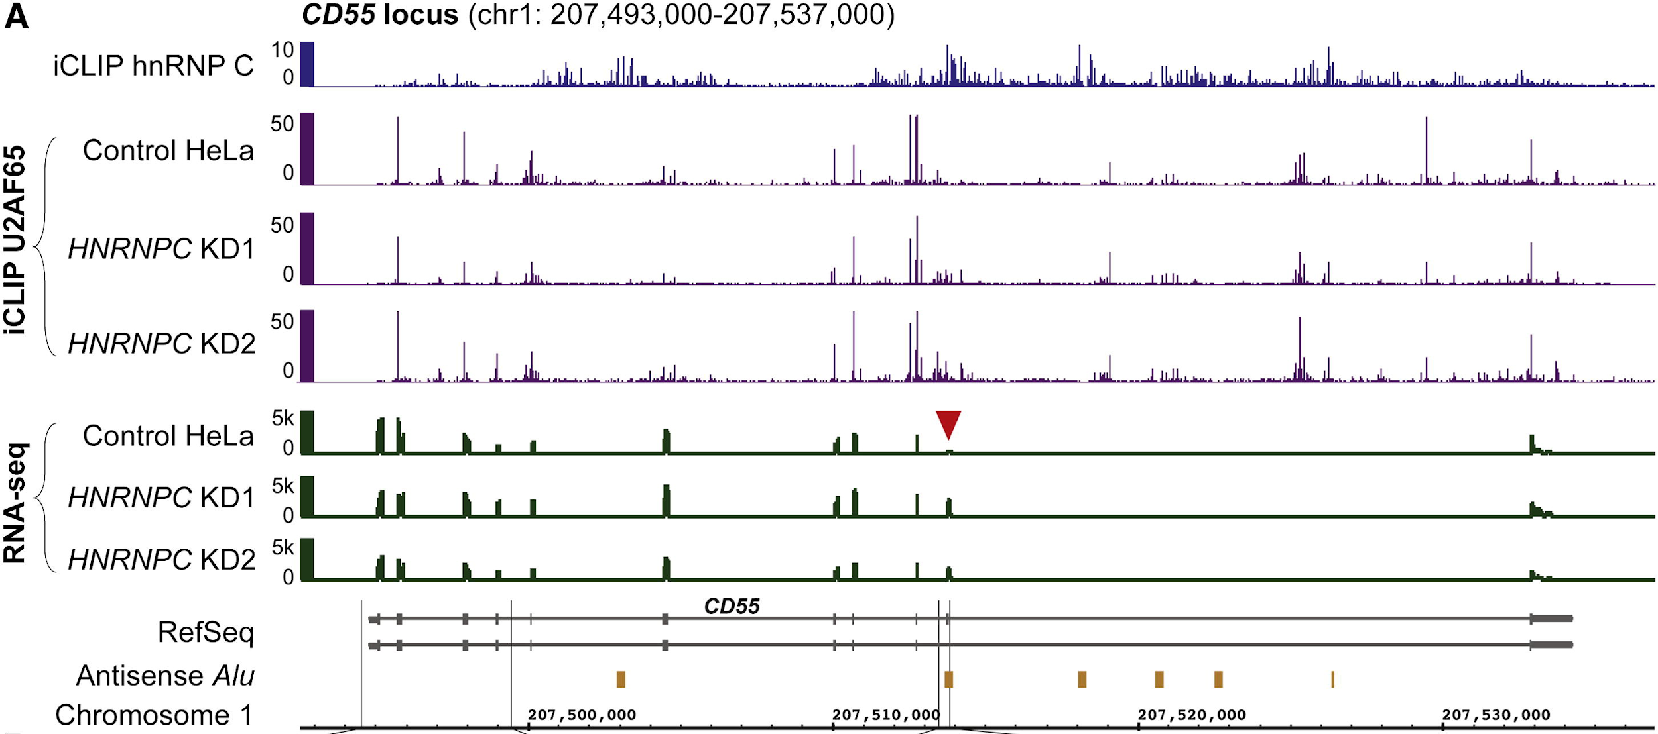
Results (selected)
Cell. 2013
Direct competition between hnRNP C and U2AF65 protects the transcriptome from the exonization of Alu elements.
Zarnack K, König J, Tajnik M, Martincorena I, Eustermann S, Stévant I, Reyes A, Anders S, Luscombe NM, Ule J.
RNA-Seq coverage over exons
In control, cryptic exons are not expressed
In hnRNP C knockdown, cryptic exons are expressed
Notes:
Highlight coverage of Alu exons
Here, at PTS gene but we will show CD55

Slide 7
Goal of the practical
Get from the raw sequencing data to the gene expression (RNA-Seq)
Analyze RNA-Seq data and get differential gene expression and expression of individual exons (example at gene CD55 gene)
Show coverage cryptic exon(s) (example at gene CD55)
Do everything in less that half a day

Slide 8
Galaxy practical
Get the data
Or you just load the preloaded data
Shared Data -> Data Libraries -> Bi5444 -> RNA-Seq

Slide 9

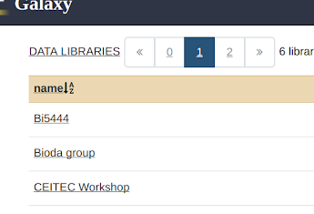
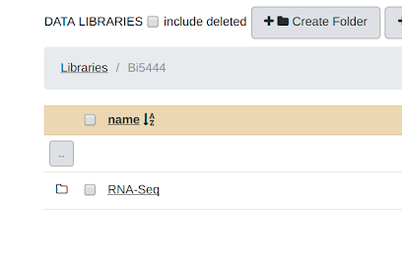
Galaxy practical
1.
2.
3.

Slide 10
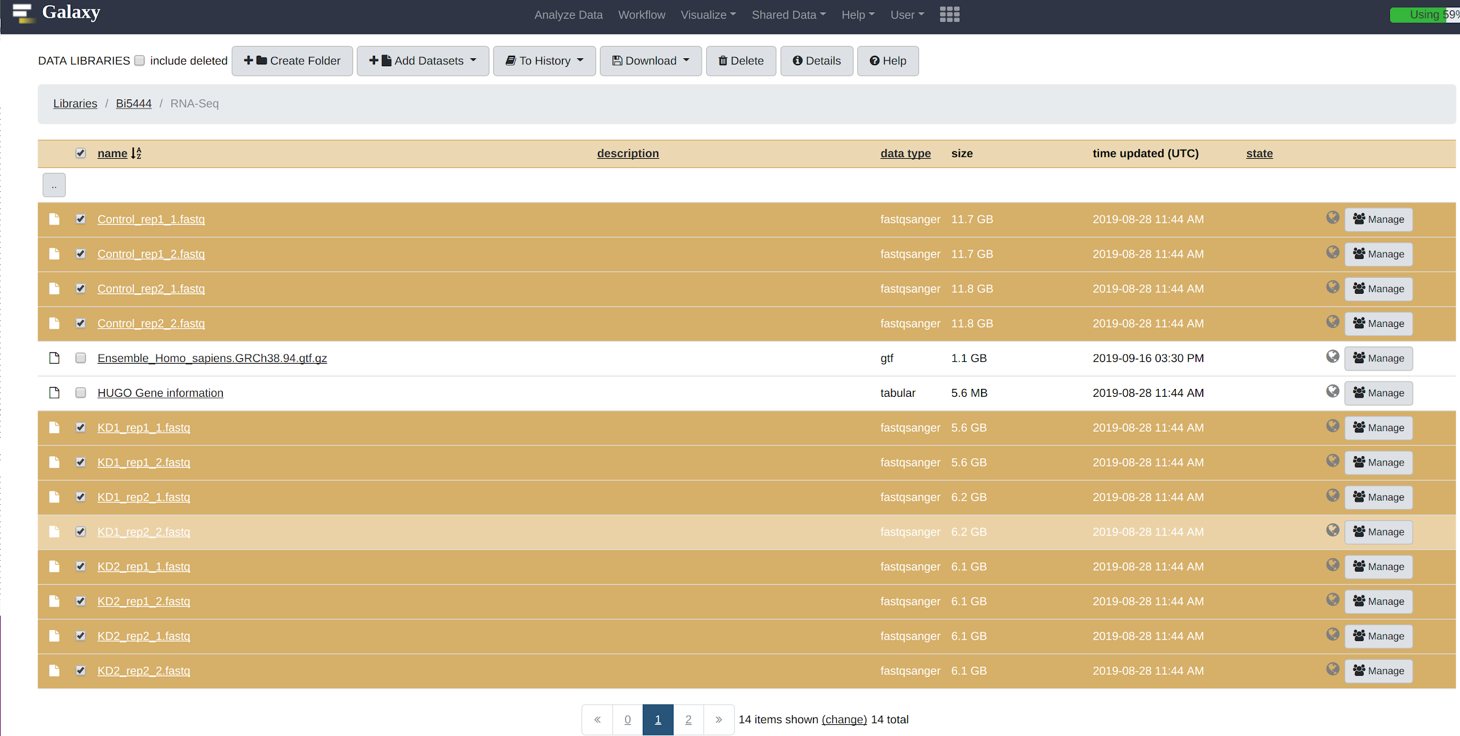
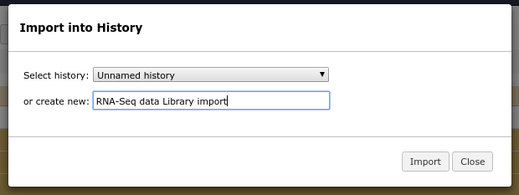
Galaxy practical

Slide 11
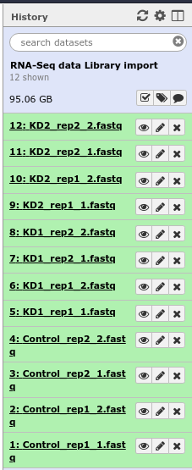
Galaxy practical
Get the data

Slide 12
Galaxy practical
Initial quality check
Check the raw reads quality
Using FastQC tool
Input FASTQ, output HTML

Slide 13
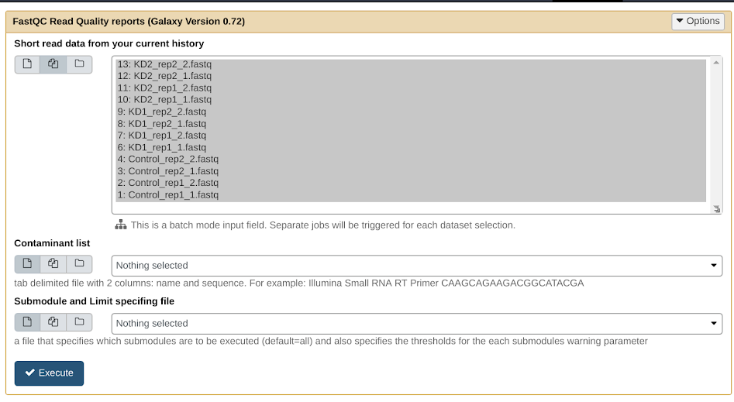
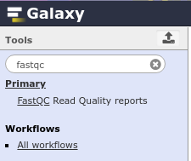
Galaxy practical
Initial quality check

Slide 14
Galaxy practical
Initial quality check
It is still running, right?
But without that, we cannot proceed 😞
We have a solution! :)
Import Galaxy history
Notes:
Most likely the alignment will take quite some time. Guide them to the sharing of the history in Galaxy.

Slide 15
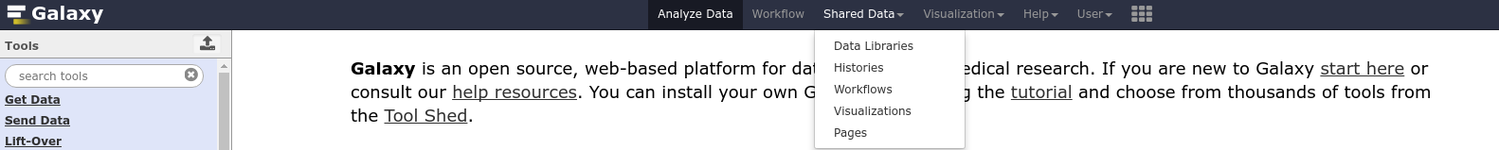
Galaxy practical
Initial quality check
Import Galaxy history

Slide 16
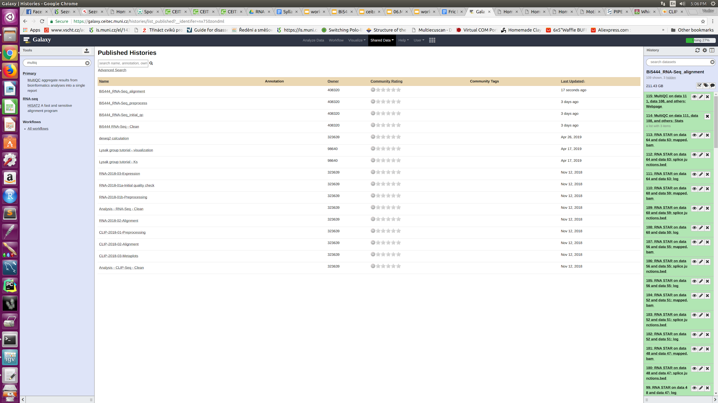
Galaxy practical
Initial quality check
Import Galaxy history
Notes:
Type CEITEC in the search box.

Slide 17
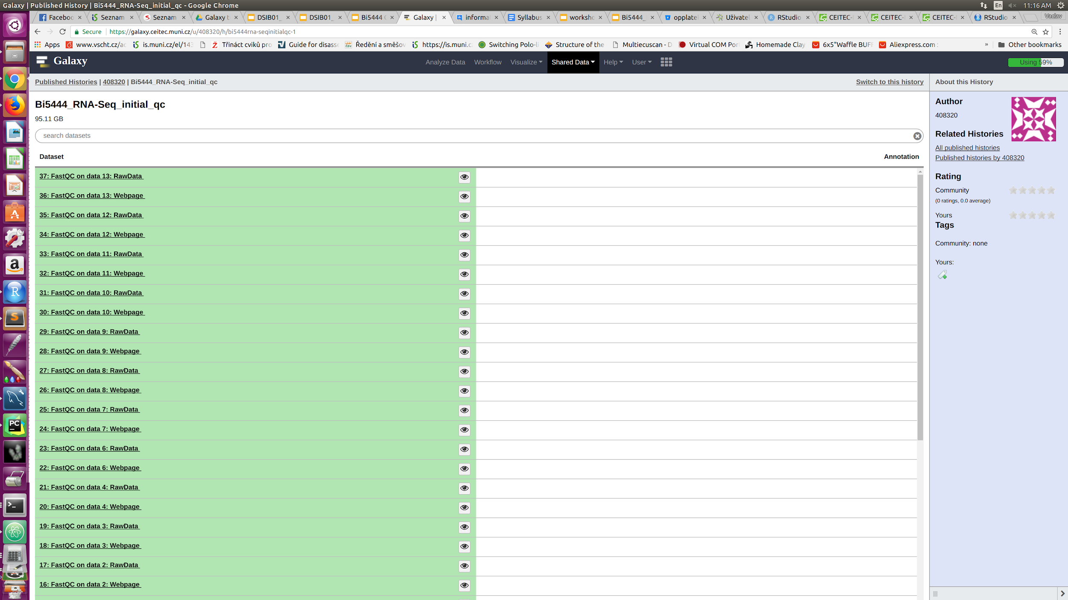
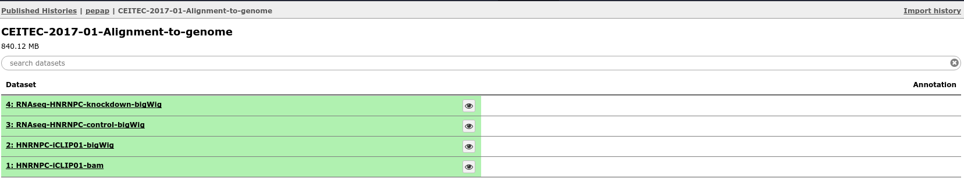
Galaxy practical
Initial quality check
Import Galaxy history

Slide 18
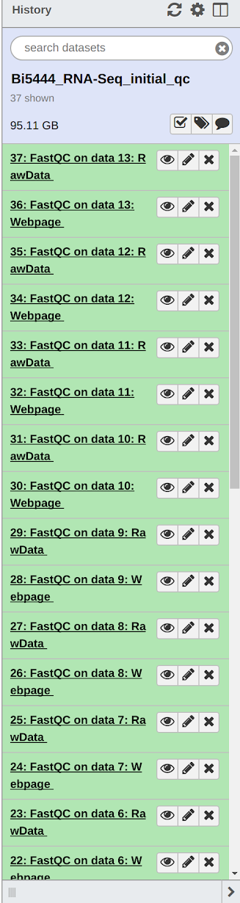
Galaxy practical
Initial quality check
HTML report(s)
Notes:
You can see we will show you the analysis only on one file but you can do it easily for the rest of them

Slide 19
Galaxy practical
Initial quality check
HTML report(s)
But there is too many of them
MultiQC - makes you life simpler
This time, you can try it on your own!
Notes:
You can see we will show you the analysis only on one file but you can do it easily for the rest of them at home.

Slide 20
Galaxy practical
Summary of the logs
Summarize the output logs
Using MultiQC tool
Input LOG(s), output HTML

Slide 21
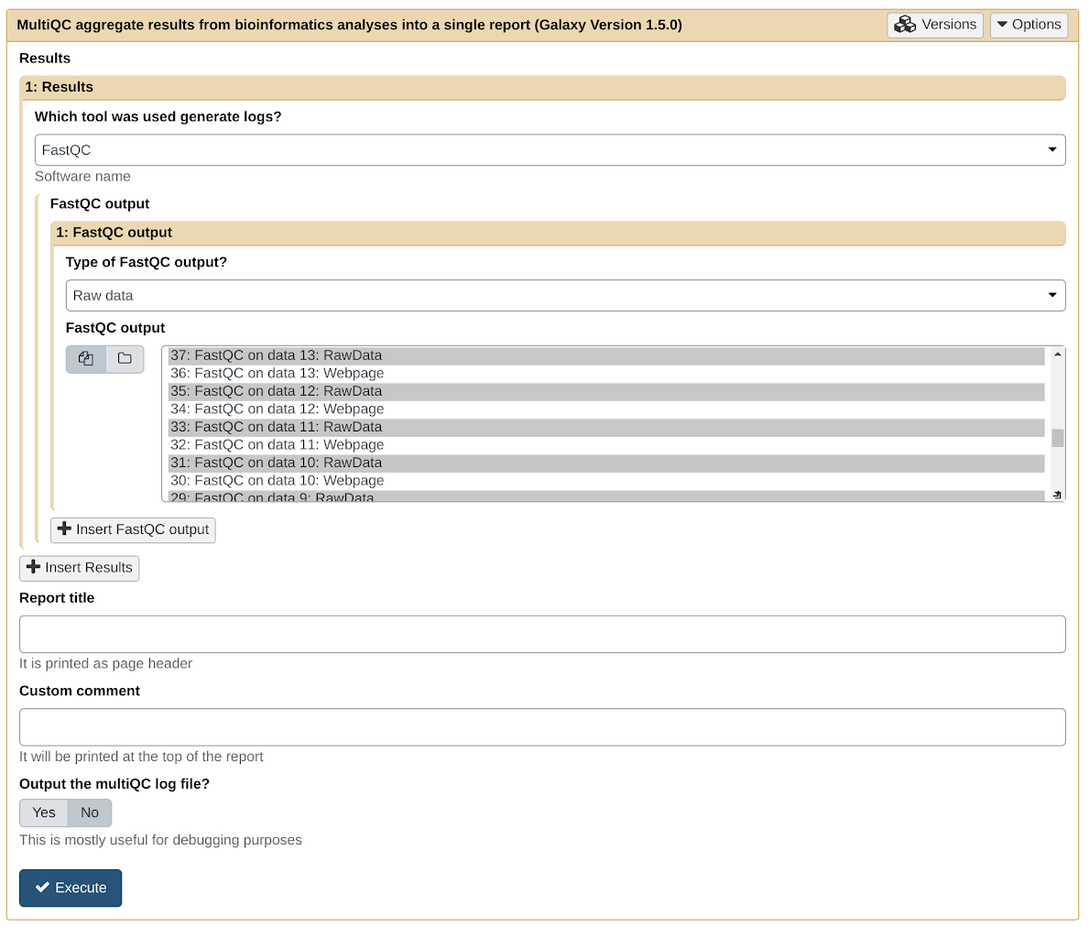
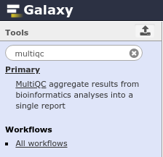
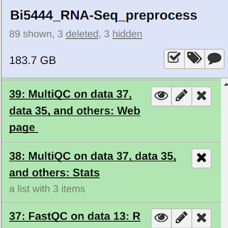
Galaxy practical
Summary of the logs

Slide 22
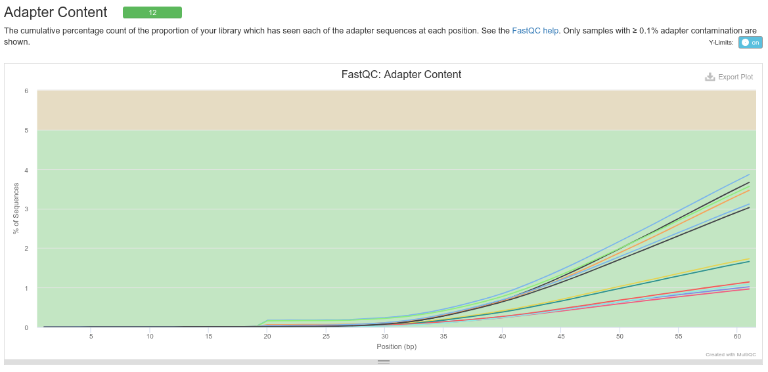
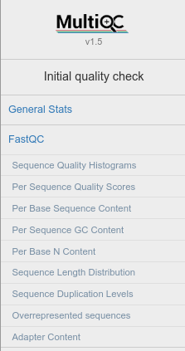
Galaxy practical
Initial quality check - Adapter content
Notes:
If you scroll at the way down you can see some residual adapter content
But if you hover over the lines you would see the percentages are very low (you can also see it on y-axis scale)

Slide 23
Galaxy practical
Read preprocessing
Remove adapters and/or trim low-quality ends
Using Trimmomatic trimmer
Input FASTQ, output FASTQ

Slide 24
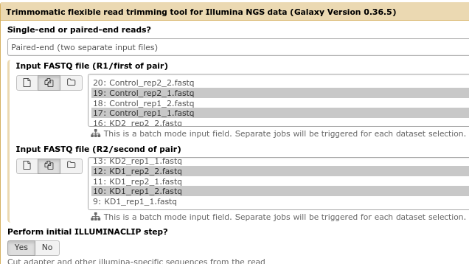
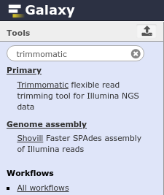
Galaxy practical
Read preprocessing

Slide 25
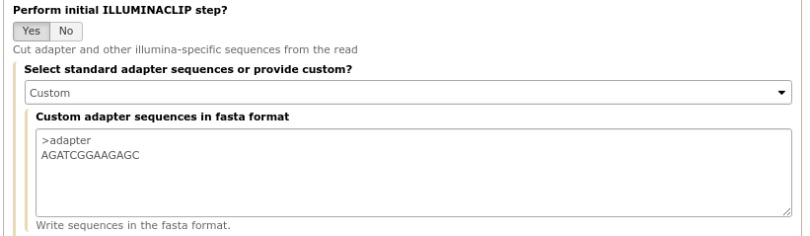
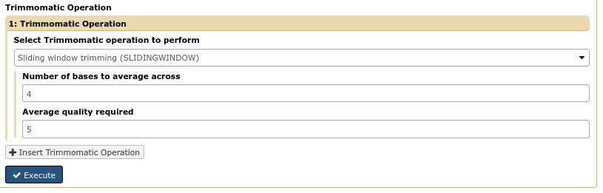
Galaxy practical
Read preprocessing
Adapter sequence (partial):
>adapter
AGATCGGAAGAGC

Slide 26
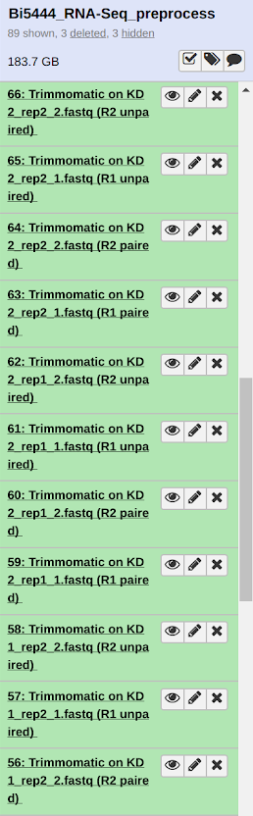
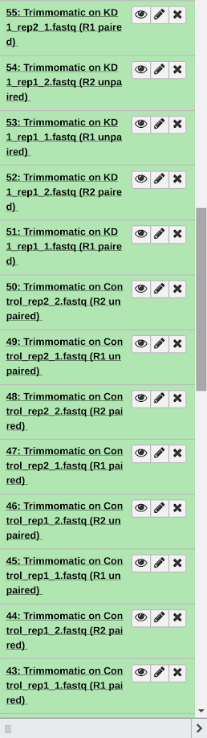
Galaxy practical
Read preprocessing

Slide 27
Galaxy practical
Preprocessing quality check
Check the preprocessed reads quality and summarize
Using FastQC & MultiQC tools
Input FASTQ/LOG, output HTML

Slide 28
Galaxy practical
Preprocessing quality check
Please, run the FastQC and MultiQC on the preprocessed files and check the adapter content

Slide 29
Galaxy practical
Preprocessing quality check
Share Data -> Histories -> Bi5444_RNA-Seq_preprocess

Slide 30
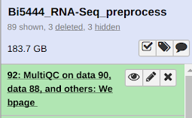
Galaxy practical
Preprocessing quality check
Check the preprocessed reads quality & summarize
Are all the bad things gone?

Slide 31
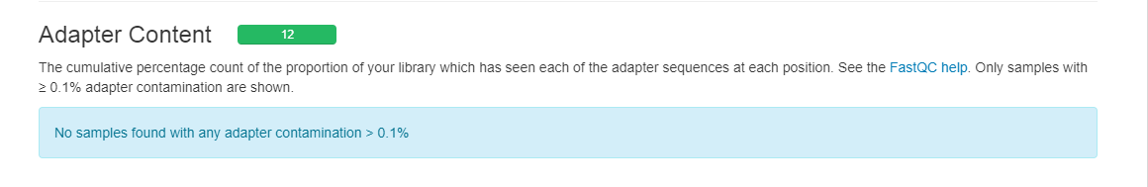
Galaxy practical
Preprocessing quality check
Notes:
Yep, we are nice and clean!

Slide 32
Galaxy practical
Preprocessing quality check
Check the preprocessed reads quality & summarize
Are all the bad things gone?
Actually, for modern aligners such as STAR, it doesn’t matter that much
They can perform soft-clipping

Slide 33
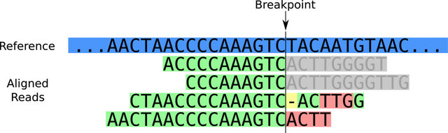
Galaxy practical
Soft-clipping in alignment
Hiding of non-matching parts of the reads
Can overcome remaining adapter or low-quality sequences
Only to specified limits (in STAR the default is max. 33% of the read length)
BMC genomics. 2014
SHEAR: sample heterogeneity estimation and assembly by reference.
Landman SR, Hwang TH, Silverstein KA, Li Y, Dehm SM, Steinbach M, Kumar V.
Soft-clipped part
Notes:
But allowing to much soft-clipping results in ambiguous mapping and possible cross-mapping events
For example default minimal aligned length after soft-clipping in BWA-MEM (popular aligner for DNA reads) is only 19 nt! This alignment length is very unspecific and you can easily map bacterial sequences to the human reference genome

Slide 34
Galaxy practical
Alignment to genome
Align RNA-Seq data to a genome
Using STAR aligner
Input FASTQ, output BAM

Slide 35
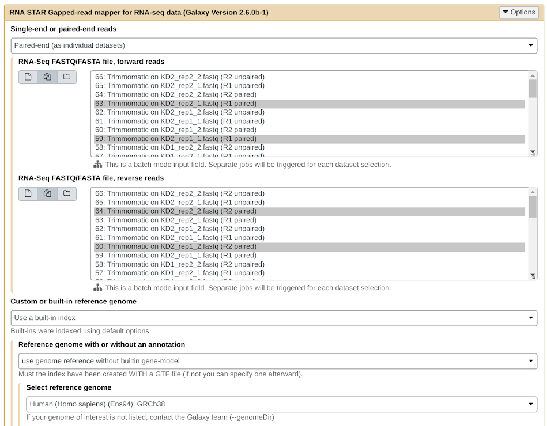
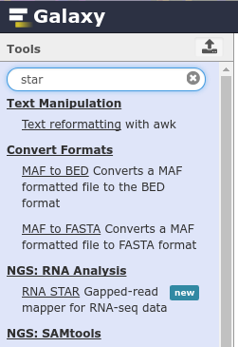

Galaxy practical
Alignment to genome
Notes:
The name of the input file might be different.

Slide 36
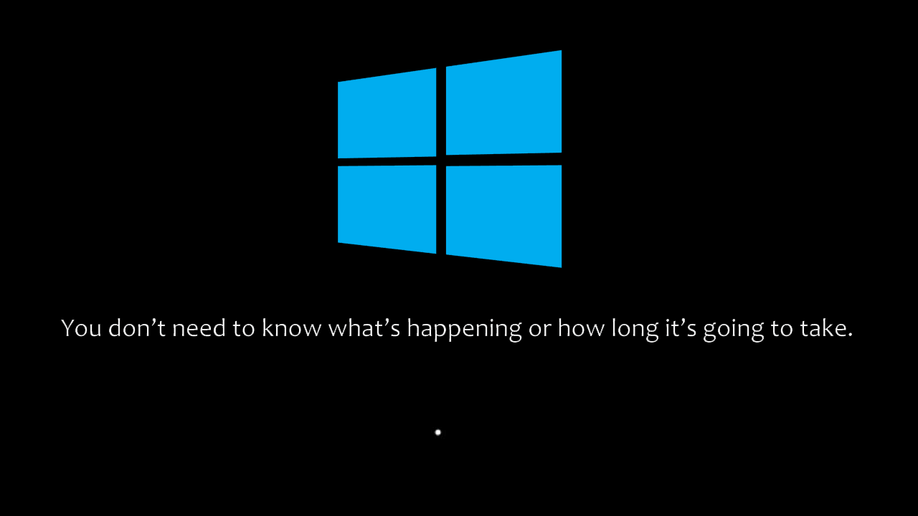
Sit back, wait and relax
Notes:
The USA is most likely to be waking up right now so the servers are very busy.

Slide 37
Galaxy practical
Alignment to genome
Share Data -> Histories -> Bi5444_RNA-Seq_alignment
Notes:
The name of the input file might be different.

Slide 38
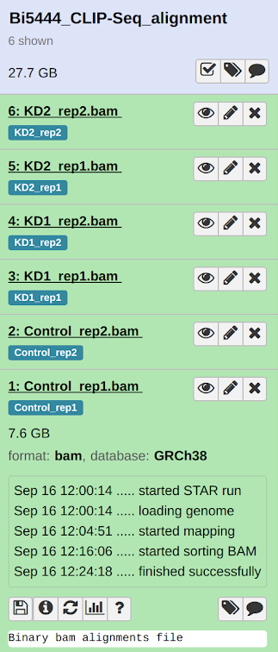
Galaxy practical
Alignment to genome
STAR performs well even with defaults
Main output is the BAM file
This is one of the few files worth to keep and save
Notes:
The name of the input file might be different.

Slide 39
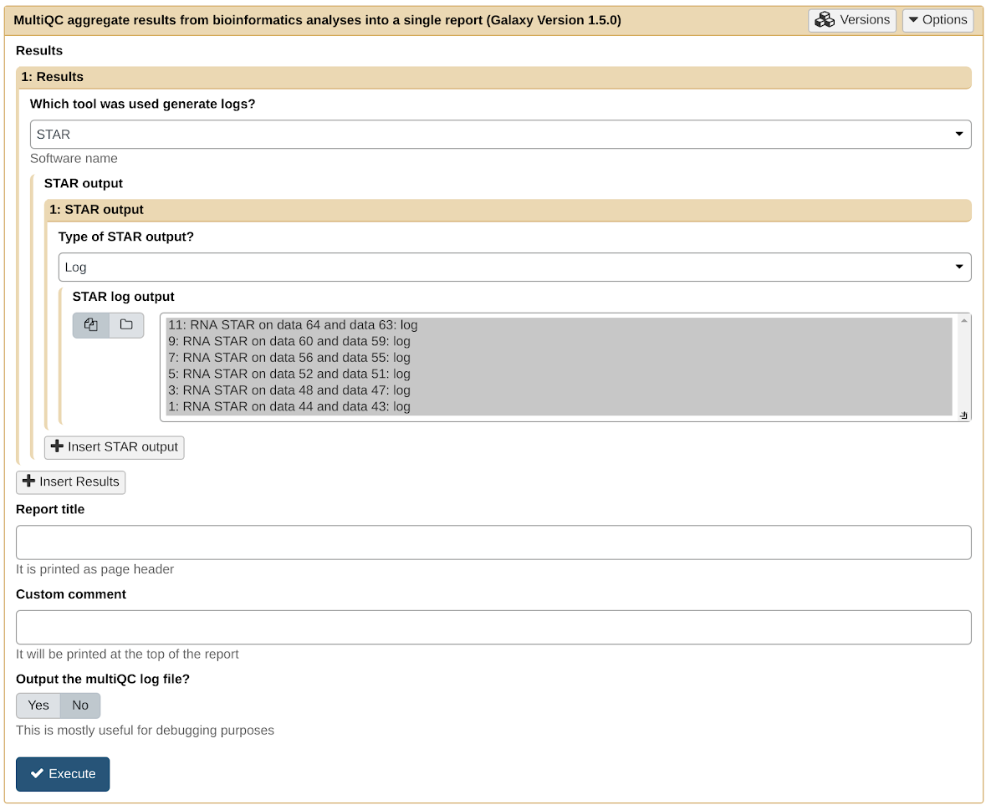
Galaxy practical
Quality control of alignment
Run MultiQC to assess the alignment

Slide 40
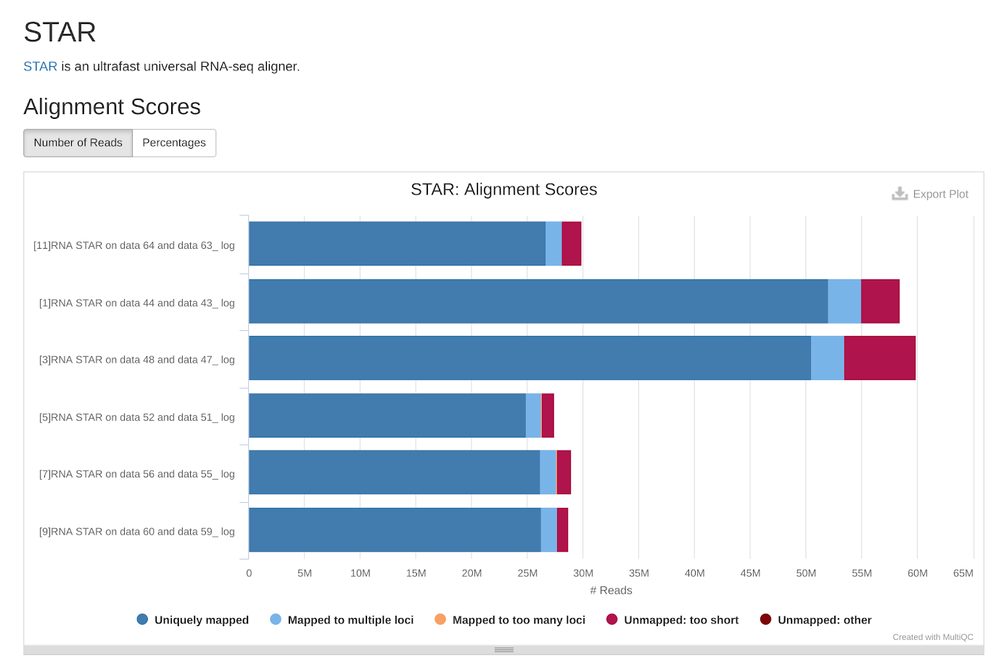
Galaxy practical
Quality control of alignment

Slide 41
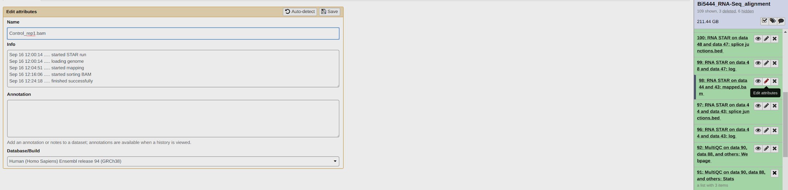
Galaxy practical
Rename and tags
Better names comprehensibility

Slide 42
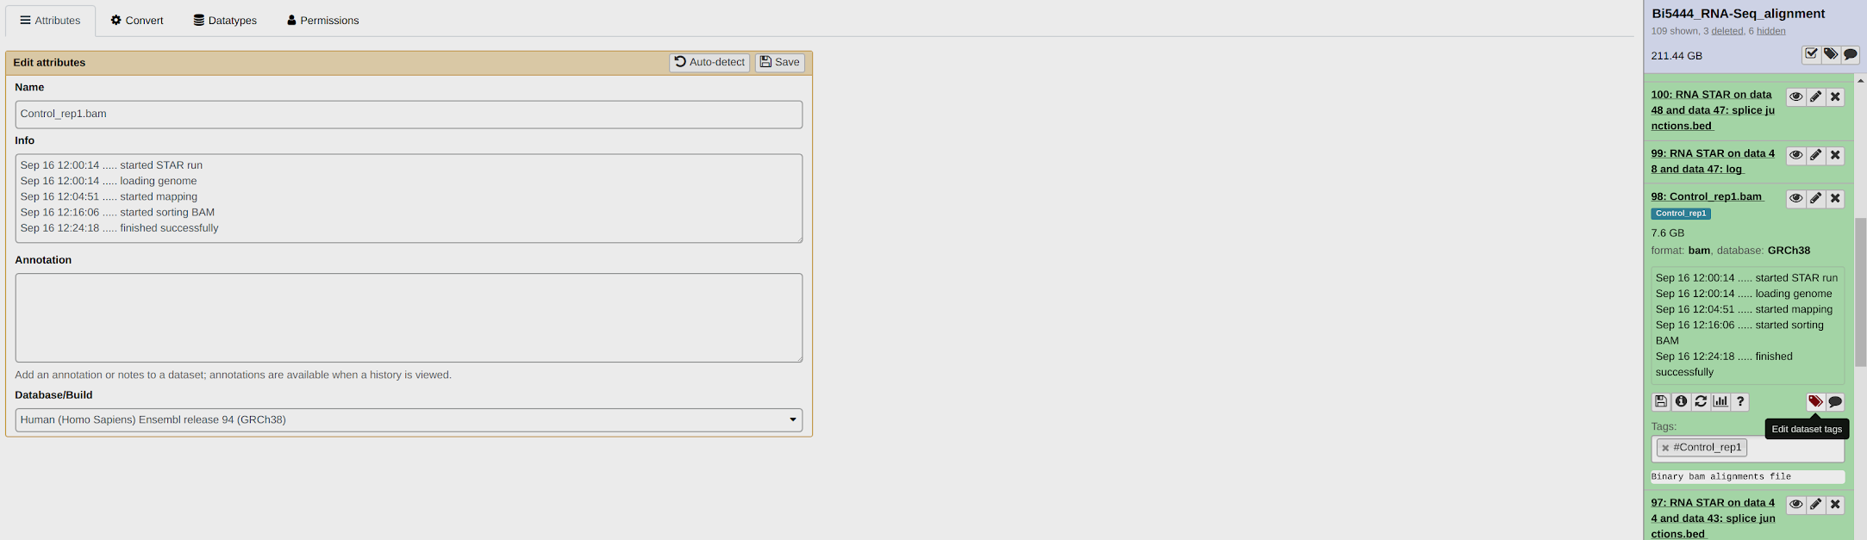
Galaxy practical
Rename and tags
Better names comprehensibility

Slide 43
Galaxy practical
Gene counts
For the raw gene counts (expression) you need to have a list of genes and their positions in the genome - gene annotation
Using UCSC Main table browser
Input nothing, output GTF

Slide 44
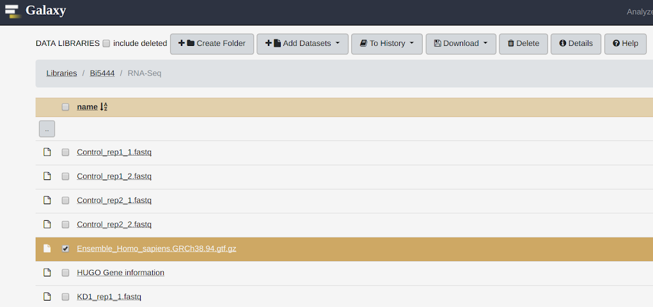
Galaxy practical
Gene counts
Share Data -> Data Libraries -> Bi5444
-> RNA-Seq -> Ensemble_Homo_sapiens.GRCh38.94.gtf.gz

Slide 45
Galaxy practical
Gene counts
Get the raw gene counts
Using featureCounts tool
Input BAM and annotation GTF, output TXT (raw gene counts)

Slide 46
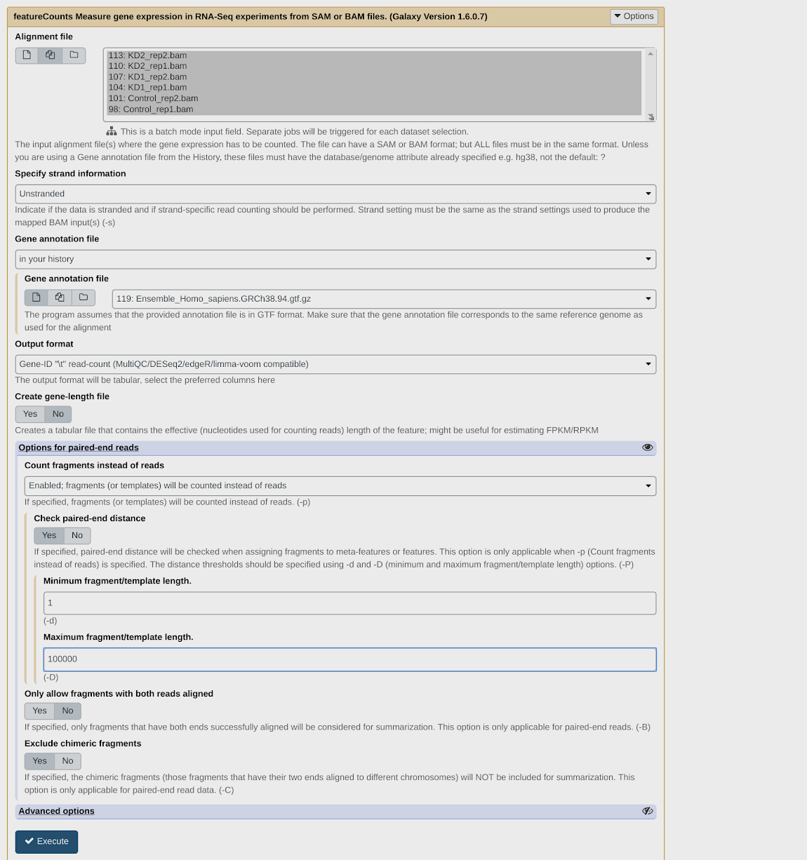
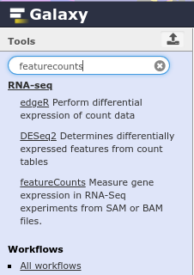
Galaxy practical
Gene counts

Slide 47
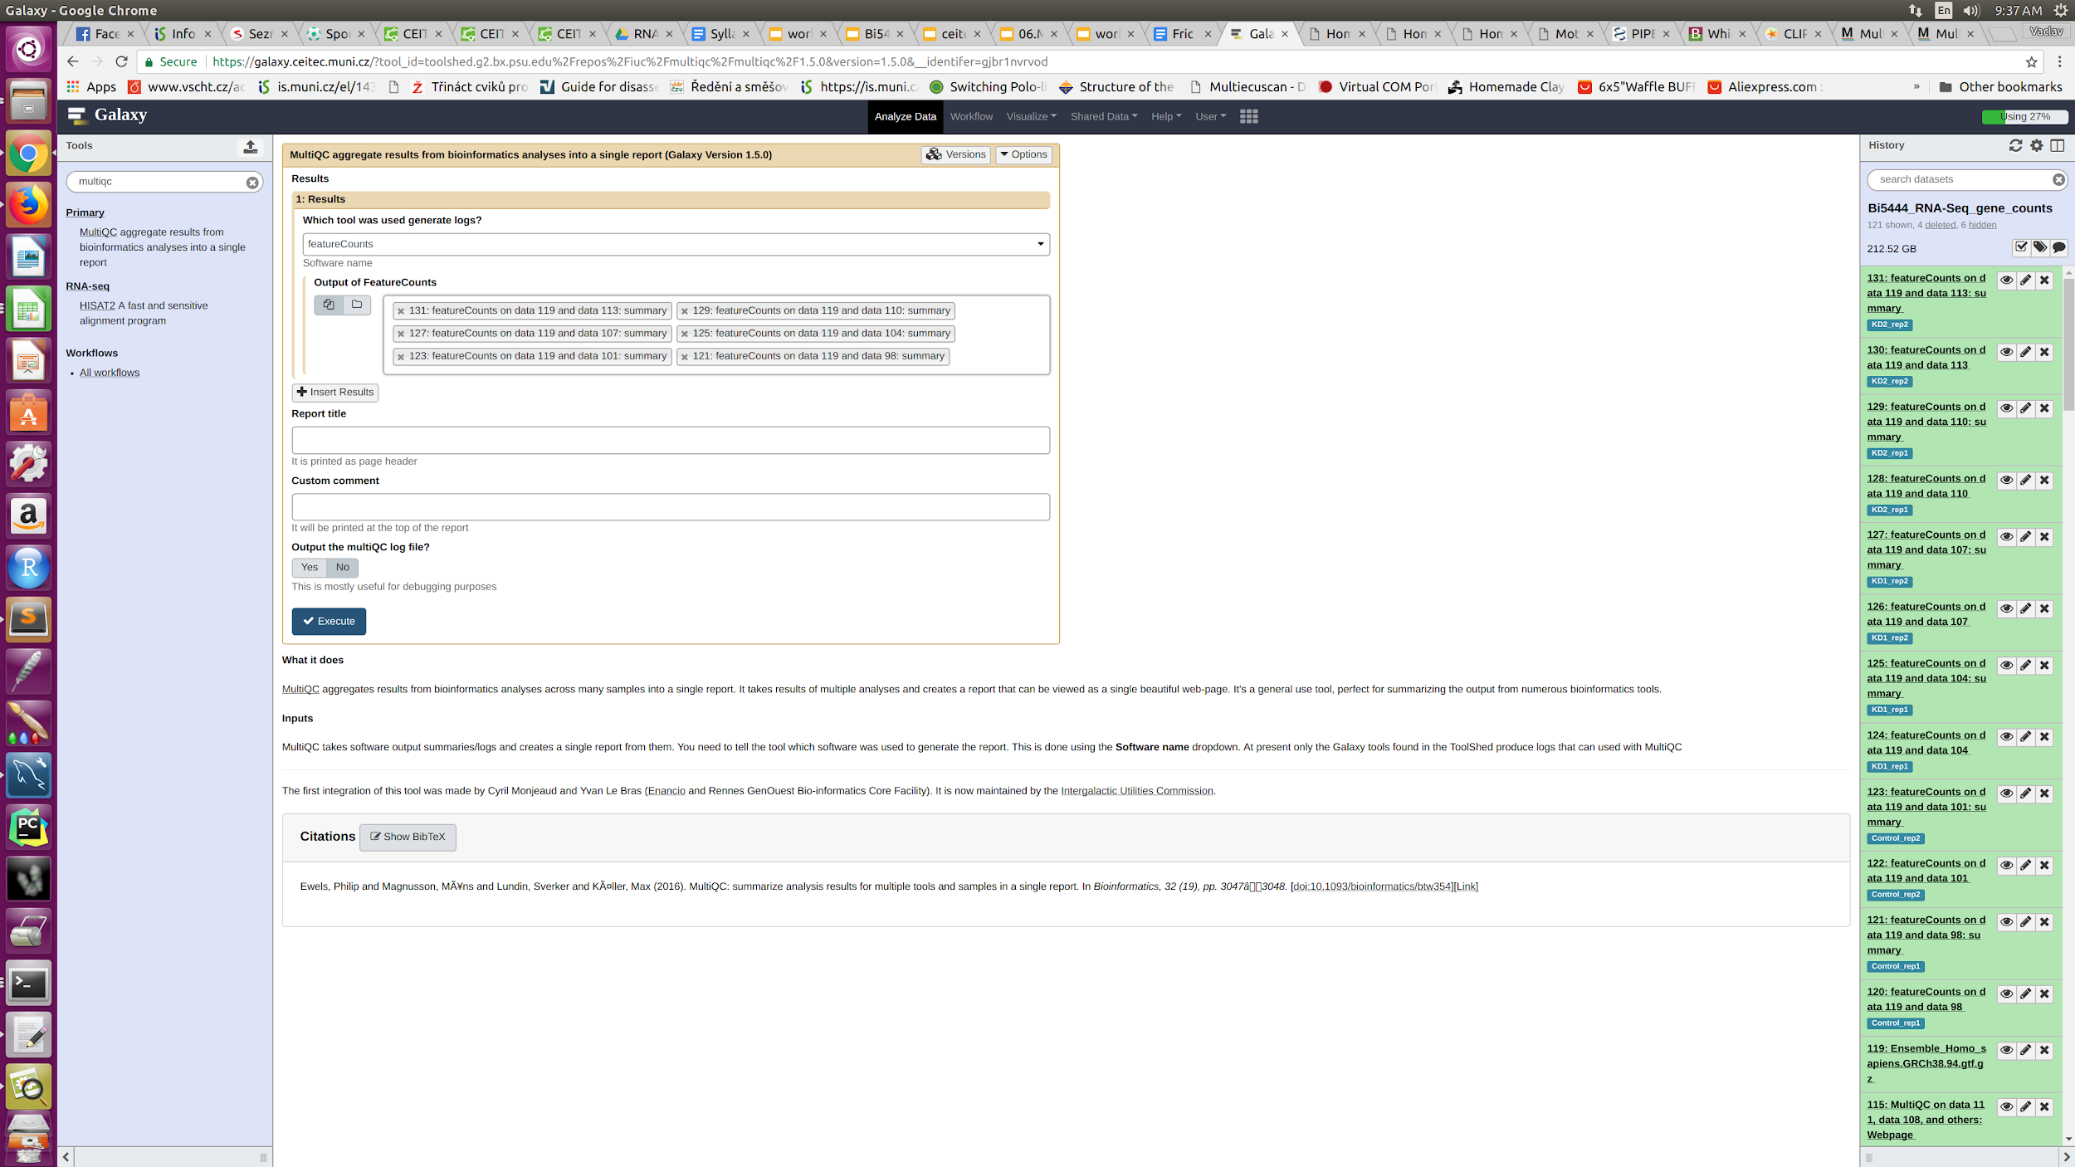
Galaxy practical
Gene counts
Quality control of gene counts
Again MultiQC

Slide 48
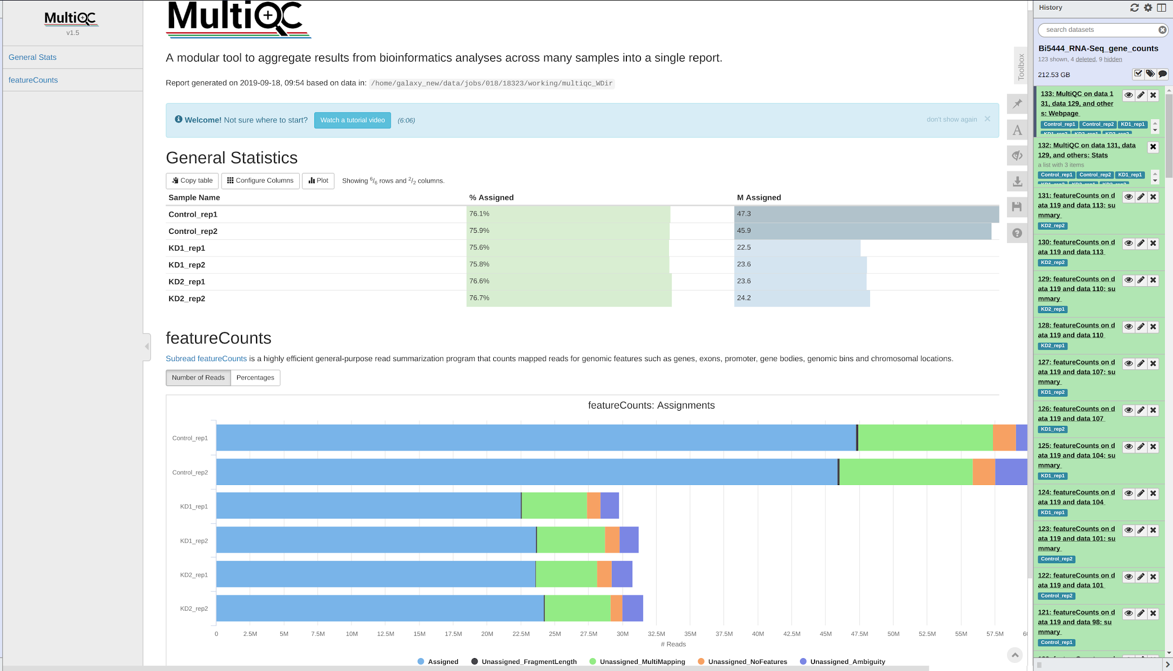
Galaxy practical

Slide 49
Galaxy practical
Differential gene expression
Get differential gene expression from the raw counts
Using edgeR and DESeq2 tools

Slide 50
Galaxy practical
Differential gene expression - note
Optimally, the experiment should be designed with at least three biological replicates
However, if the data are only “supportive” two replicates is enough
Bioinformatics. 2013
Liu Y, Zhou J, White KP. RNA-seq differential expression studies: more sequence or more replication?
Rna. 2016
Schurch NJ, Schofield P, Gierliński M, Cole C, Sherstnev A, Singh V, Wrobel N, Gharbi K, Simpson GG, Owen-Hughes T, Blaxter M. How many biological replicates are needed in an RNA-seq experiment and which differential expression tool should you use?.

Slide 51
Galaxy practical
Differential gene expression
Shared Data -> Histories -> Bi5444_RNA-Seq_DE_start

Slide 52
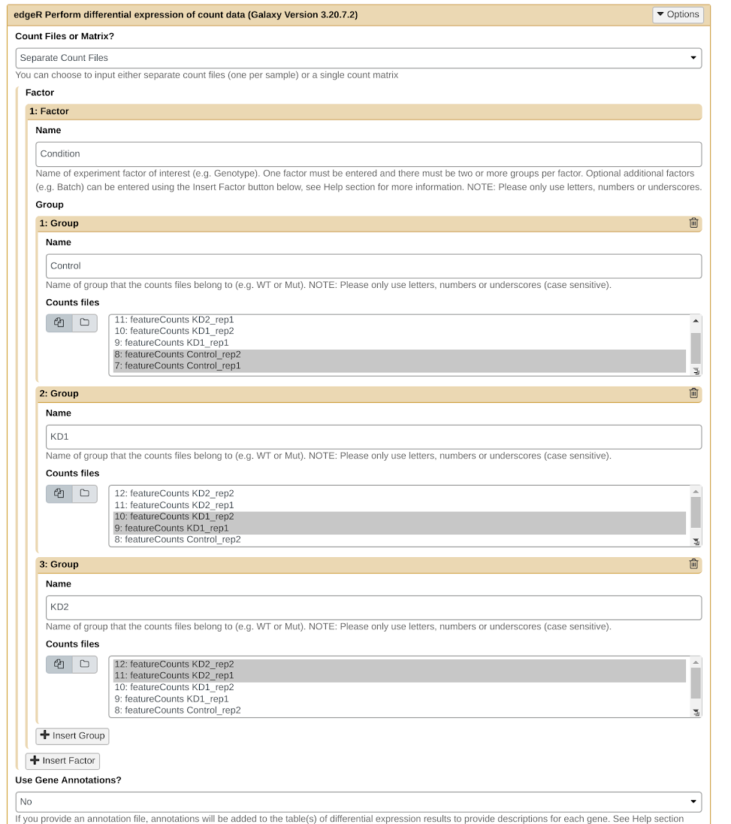
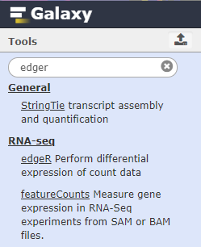
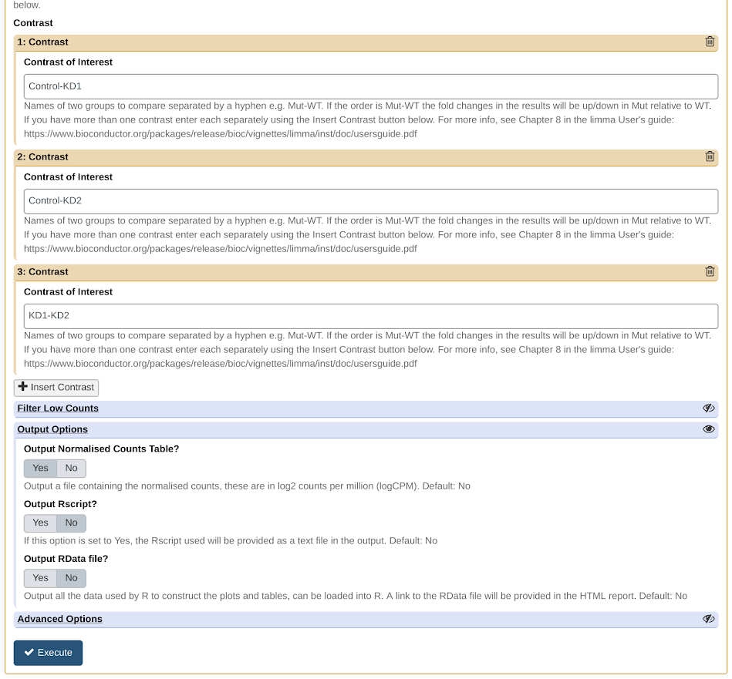
Galaxy practical
Differential gene expression

Slide 53
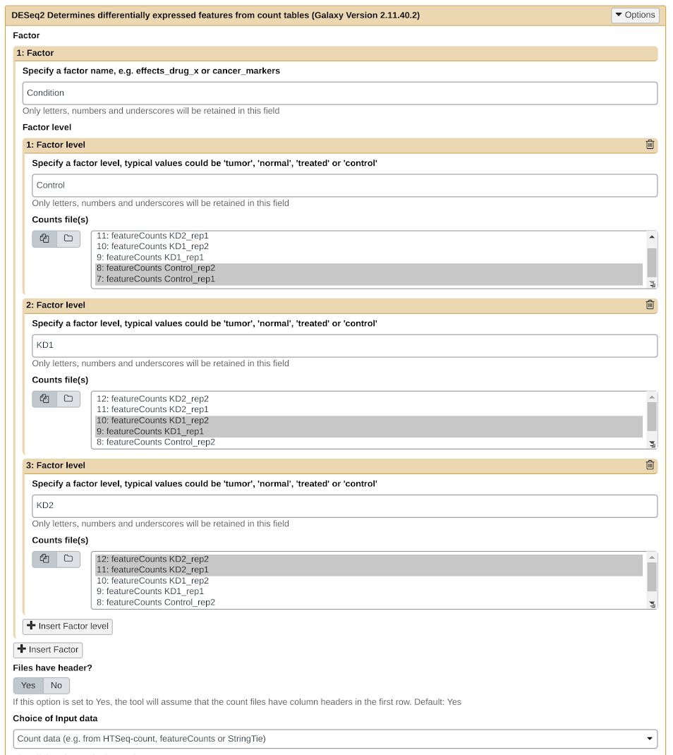
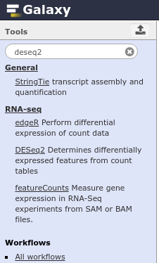
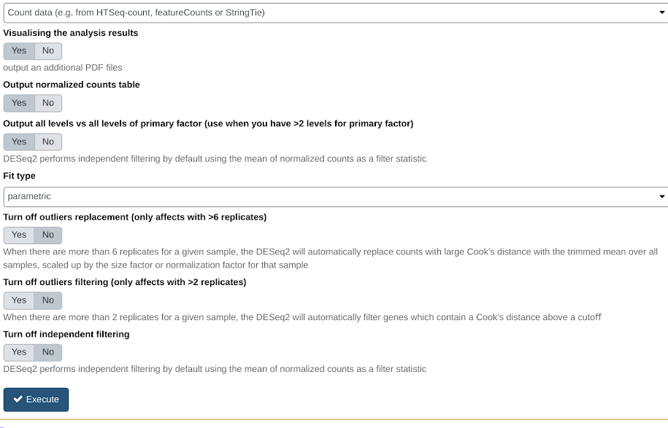
Galaxy practical
Differential gene expression

Slide 54
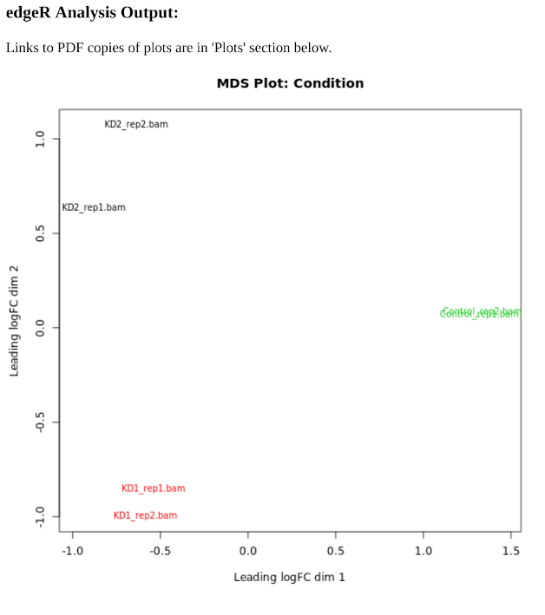

Galaxy practical
Differential gene expression
Notes:
We can see that the samples ale nicely clustering together

Slide 55



Galaxy practical
Differential gene expression

Slide 56
Galaxy practical
Gene symbol annotation
But we do not see any gene symbol/names which we all like
Merge with HUGO information (https://www.genenames.org/)
Share Data -> Data Libraries -> Bi5444
-> RNA-Seq -> HUGO Gene information

Slide 57

Galaxy practical
Gene symbol annotation
Merge with HUGO information

Slide 58


Galaxy practical
Gene symbol annotation

Slide 59

Galaxy practical
Gene symbol annotation

Slide 60


Galaxy practical
Differential gene expression

Slide 61

Galaxy practical
Differential gene expression

Slide 62
Galaxy practical
Alignment coverage
Visualization of coverage of aligned data (and expressed exons)
Using deepTools -> bamCoverage
Input BAM, output BIGWIG

Slide 63


Galaxy practical
Effective genome size (hg38): 2913022398
https://deeptools.readthedocs.io/en/develop/content/feature/effectiveGenomeSize.html
Alignment coverage
Notes:
Note: The versions of the tools changed from 2017 and it might look slightly different.

Slide 64

Galaxy practical
Alignment coverage
BIGWIG coverage

Slide 65

Galaxy practical
Alignment coverage
BIGWIG visualization

Slide 66

Galaxy practical
Alignment coverage
CD55 region

Slide 67

Galaxy practical
Alignment coverage
BIGWIG size

Slide 68
Galaxy practical
Alignment coverage
Now you do it for the other two BIGWIG files

Slide 69

Notes:
There is an antisense Alu present at “exon10”
You can actually see there is one more antisense Alu and it is also slightly expressed after hnRNP C knockdown
And if you look further the exon is annotated in RefSeq as well (both of them)

Slide 70
Galaxy practical
Alignment coverage
If something went wrong, history of DE and coverage visualization
Shared Data -> Histories -> Bi5444_RNA-Seq_DE_full_history

Slide 71
RNA-Seq data analysis - pipeline in Galaxy
Initial quality check - FastQC
  Check for overall quality of the data, number of reads, read length distribution, ...
Preprocessing - Trimmomatic
  Remove adapters, low quality ends, unwanted sequences, …
Alignment - STAR
  Map reads to the reference genome
Alignment quality check - STAR log, featureCounts
  Check overall alignment statistics
Genome coverage (peaks) - bamCoverage
  Get overview of mapped positions in the genome
Gene annotation - UCSC Main table browser
  Get gene annotations for reference genome
Quantification - featureCounts
  Get gene read counts
Differential gene expression - edgeR,DESeq2 (genes)
  Differences between conditions

Slide 72
RNA-Seq data analysis - other possibilities
Initial quality check - FastQC
  Check for overall quality of the data, number of reads, read length distribution, ...
Preprocessing - Cutadapt, BBTools, seqtk
  Remove adapters, low quality ends, unwanted sequences, …
Alignment - GSNAP, Bowtie2
  Map reads to the reference genome
Alignment quality check - Picard tools, RSeQC, Qualimap
  Check overall alignment statistics
Genome coverage (peaks) - STAR + bedGraphToBigWig, Bedtools
  Get overview of mapped positions in the genome
Gene annotation - UCSC, Ensembl, NCBI
  Get gene annotations for reference genome
Quantification - RSEM, HTSeq, Salmon, Kallisto
  Get gene read counts
Differential gene expression - DEXSeq (exons), baySeq (genes)
  Differences between conditions
Gene ontology and pathways - g:Profiler, KEGG
  Check ontologies and pathways for selected genes

