Slide 1


Week 8 : Statistics
Introduction to Bioinformatics (LF:DSIB01)

Slide 2
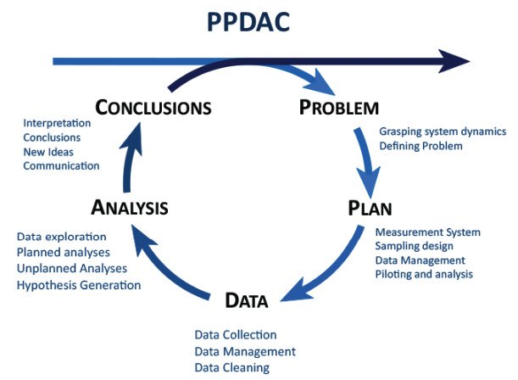
What is statistics?
Statistics is the science of learning from data, and of measuring, controlling and communicating uncertainty. - American Statistical Association (ASA)

Slide 3
What is statistics?
Statistics is the science of learning from data, and of measuring, controlling and communicating uncertainty. - American Statistical Association (ASA)

Slide 4
Sampling Design
Randomization
  Sampling designs should be as random as possible
Overrepresentation
  Preferentially select units where the dispersion is larger
  Sample is not necessarily a “scale copy” of population
  It makes sense to increase depth in categories that are more variable
Restriction
  Should restrict or exclude problematic samples such as samples with empty categories
  Stratification: fixing the sample size in categories of the population
  Is not in contrast with Randomization as long as there are enough possible samples
Review: Probability Sampling Designs: Principles for Choice of Design and Balancing, Tille and Wilhelm, 2016

Slide 5
Statistical Hypothesis Testing
To ask questions on data
we use statistical methods that provide
a confidence or likelihood about the answers.
Null Hypothesis: H0: The default position that there is nothing new happening
How can we test our confidence in the Null Hypothesis?

Slide 6
Statistical Hypothesis Testing
Usual goal:
Reject Null Hypothesis with some confidence (0.05)
Confirm statistically significant effect.
Example
You can’t confirm null Null Hypothesis!

Slide 7
Frequentist (classical) vs. Bayesian statistics
A Probability value can be thought of in several ways:
Long-term frequency
Degree of belief
Degree of logical support
Frequentist Statistics works with (1) while Bayesian Statistics with (2 and 3)

Slide 8
Example:
Doctor knows that 20% of the population has Disease
Test that shows + for 90% of Disease individual
but also shows + for 30% of Healthy individual
A patient comes in the Doctor’s office and takes the test.
What is the probability that the patient has Disease?
The patient takes Test and the test comes back +
What is the probability that the patient has Disease?
(given that the Test showed +)
Frequentist Statistics
Only repeatable random events (like the result of flipping a coin) have probabilities.
These probabilities are equal to the long-term frequency of occurrence of the events in question.
Cannot apply probabilities to hypotheses or to any fixed but unknown values in general
Bayesian Statistics
Probabilities can represent the uncertainty in any event or hypothesis
Newly collected data narrows down the probability distribution over the parameter.

Slide 9
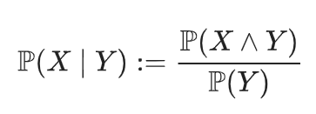
Example:
Doctor knows that 20% of the population has Disease
Test that shows + for 90% of Disease individual
but also shows + for 30% of Healthy individual
A patient comes in the Doctor’s office and takes the test.
What is the probability that the patient has Disease?
20% (1:4)
The patient takes Test and the test comes back +
What is the probability that the patient has Disease?
(given that the Test showed +)
43% (3:7)
How?
Answered in Lecture 10: Bayesian Inference
Frequentist Statistics
Only repeatable random events (like the result of flipping a coin) have probabilities.
These probabilities are equal to the long-term frequency of occurrence of the events in question.
Cannot apply probabilities to hypotheses or to any fixed but unknown values in general
Bayesian Statistics
Probabilities can represent the uncertainty in any event or hypothesis
Newly collected data narrows down the probability distribution over the parameter.

Slide 10
Response vs. explanatory variable
Dependent vs. measured variable
Example
What if variables are independent.
  Correlation
What if it is a chicken egg scenario.
  select it to fit your model/test
Why do we care?
  Formula in R

Slide 11
Response vs. explanatory variable
Response variable type | Explenatory variable type | Example tst type
Categorical | Categorical | Fisher test
Categorical (two groups) | Continuous | t-test
Categorical (multiple groups) | Continuous | ANOVA
Continuous | Continuous | Linear regression
Continuous | Categorical (two groups) | Logistic regression

Slide 12
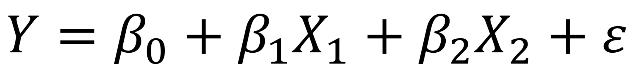
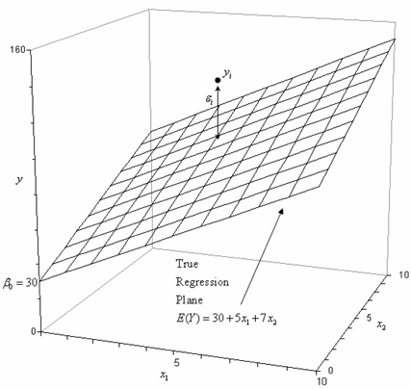
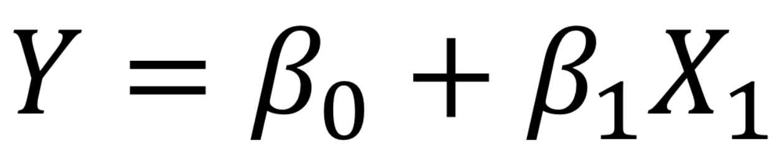
Linear regression
Simple linear regression is used to model the relationship between two continuous variables.
Multiple linear regression is used when we we have multiple explanatory variables.
Beware - overfitting!

Slide 13
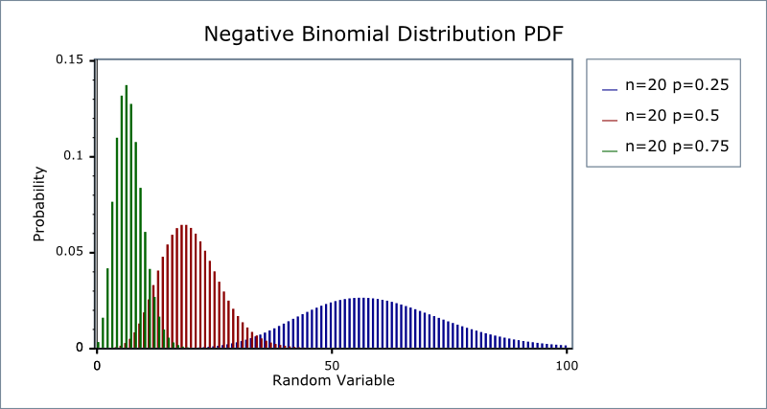
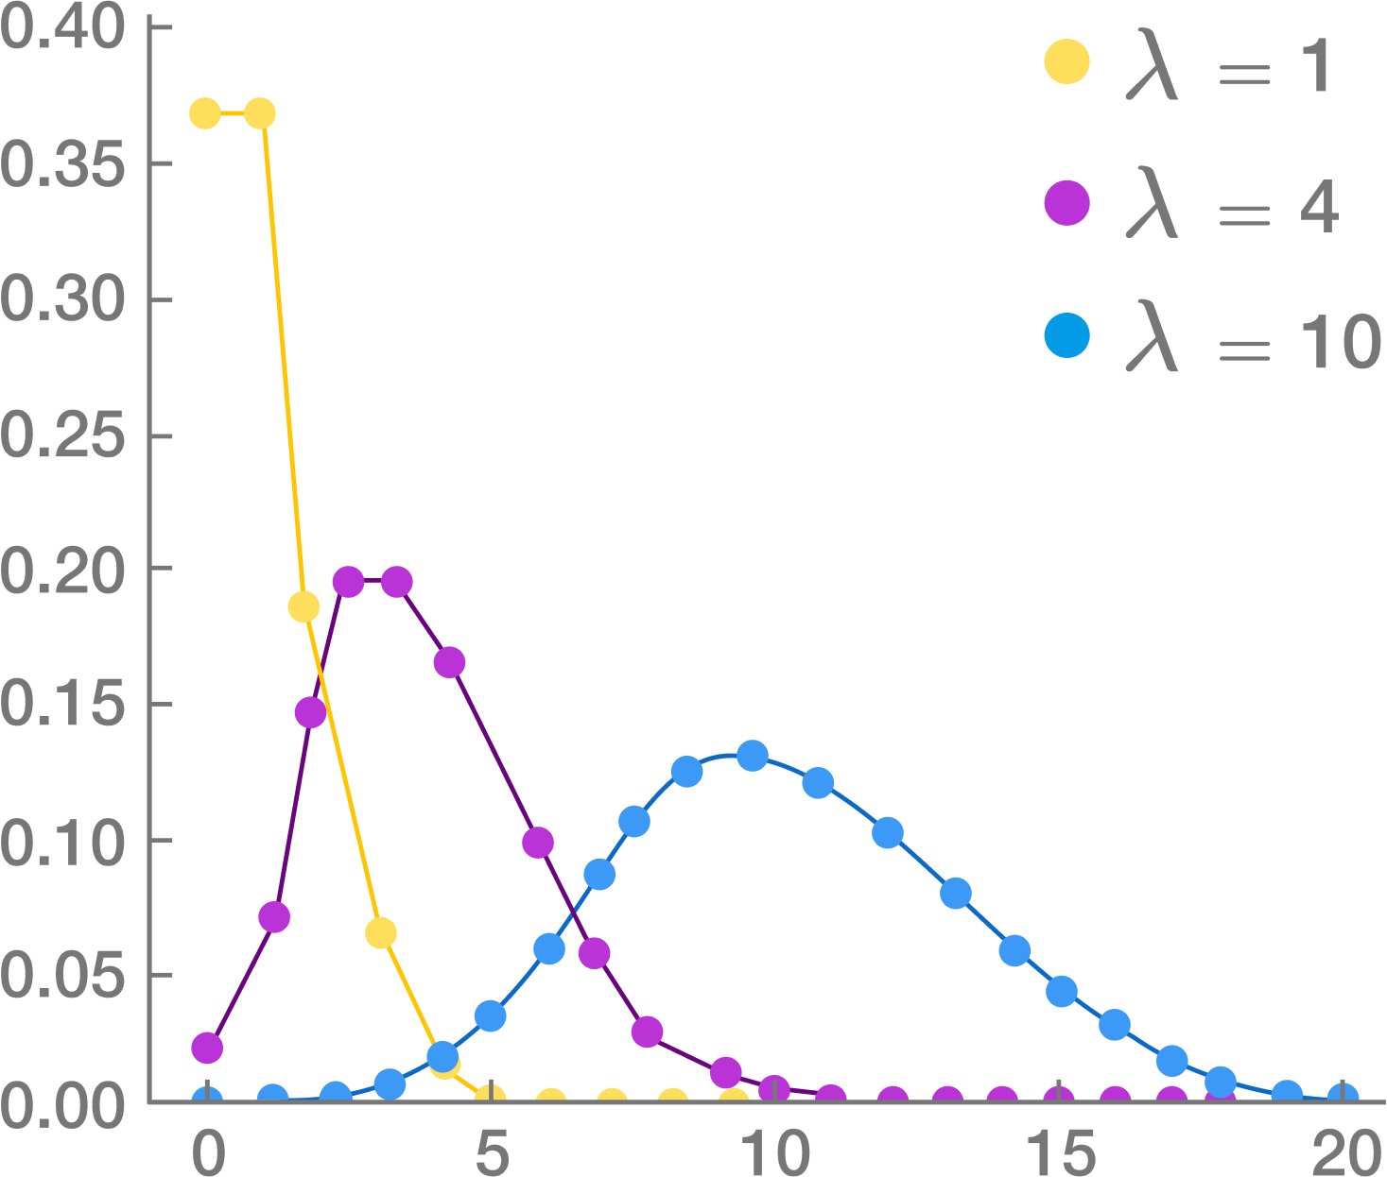
Nonlinear regression
Nonlinear regression is a form of regression analysis in which observational data are modeled by a function which is a nonlinear. ;-)
Polynomial regression
Poisson distribution

Slide 14
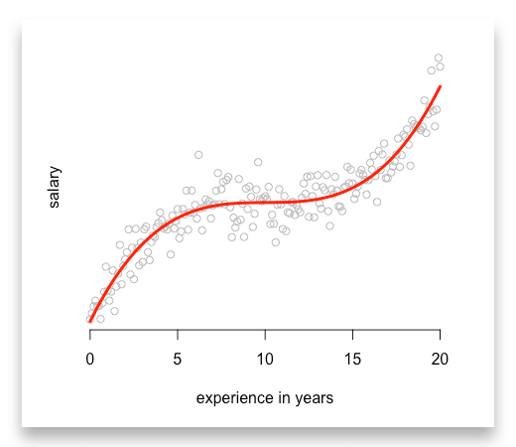
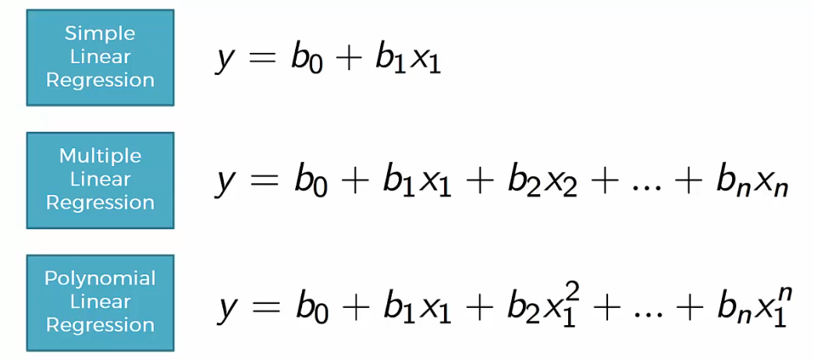
Nonlinear regression
Nonlinear regression is a form of regression analysis in which observational data are modeled by a function which is a nonlinear. ;-)
Polynomial regression

Slide 15
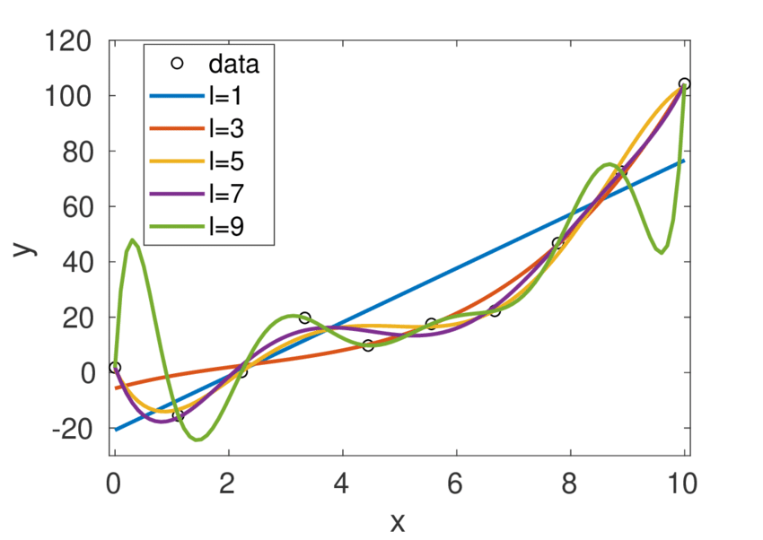
Polynomial regression
Overfitting

Slide 16
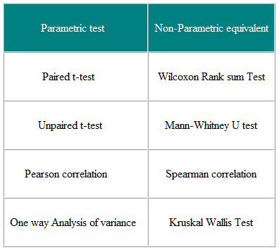
Parametric vs. non-parametric tests
Parametric tests assume underlying statistical distributions in the data. Therefore, several conditions of validity must be met so that the result of a parametric test is reliable. For example, Student’s t-test for two independent samples is reliable only if each sample follows a normal distribution and if sample variances are homogeneous.
Nonparametric tests do not rely on any distribution. They can thus be applied even if parametric conditions of validity are not met. They are generally weaker.

Slide 17
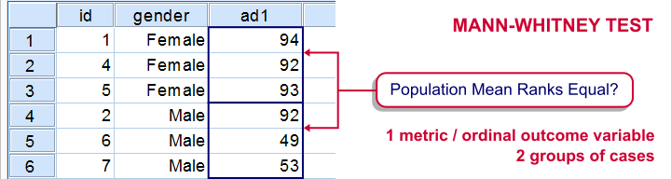
Wilcoxon rank-sum test (Mann–Whitney U test)
Comparing medians of two population
No assumptions about the populations – but data must be ordinal
  Beware of ties
One population can be sub-sample of the other
  Does selected genes have a higher expression?

Slide 18
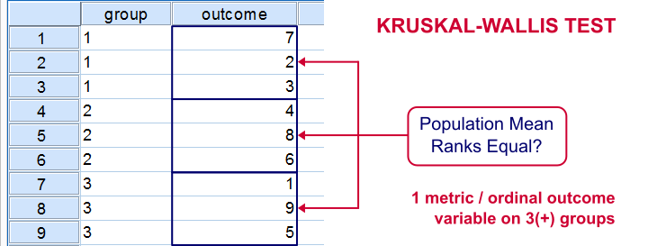
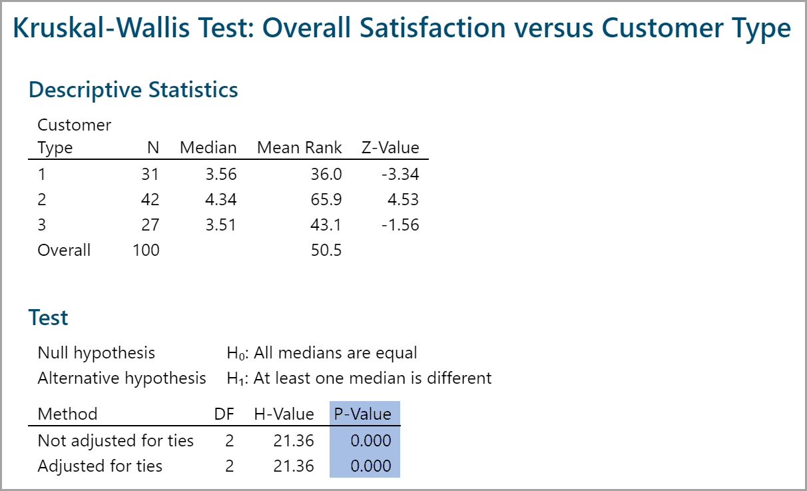
Kruskal–Wallis test

Slide 19
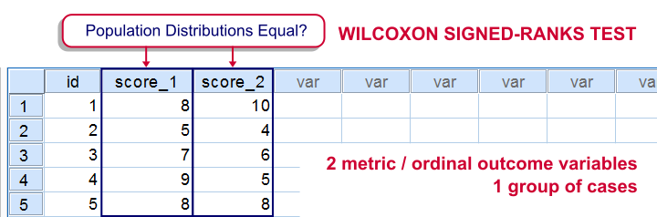
Wilcoxon signed-rank test
Paired data points

Slide 20
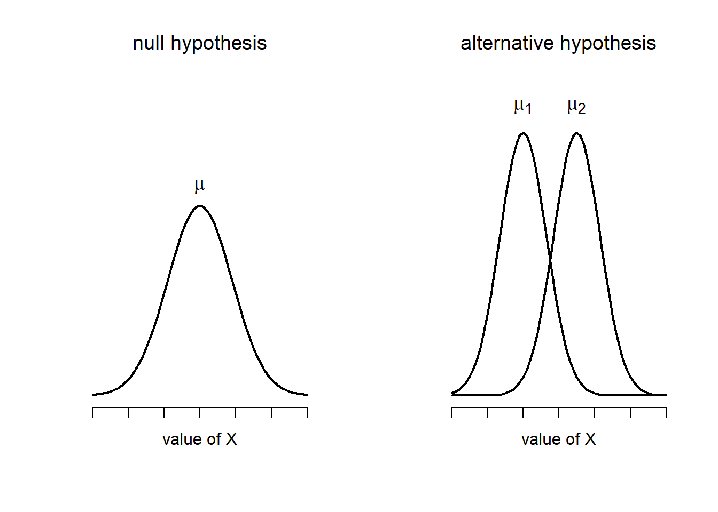
Student's t-test

Slide 21
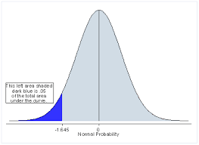
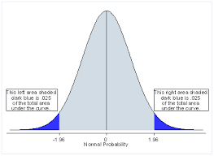
Student's t-test
One sided vs. two sided
Also paired version

Slide 22
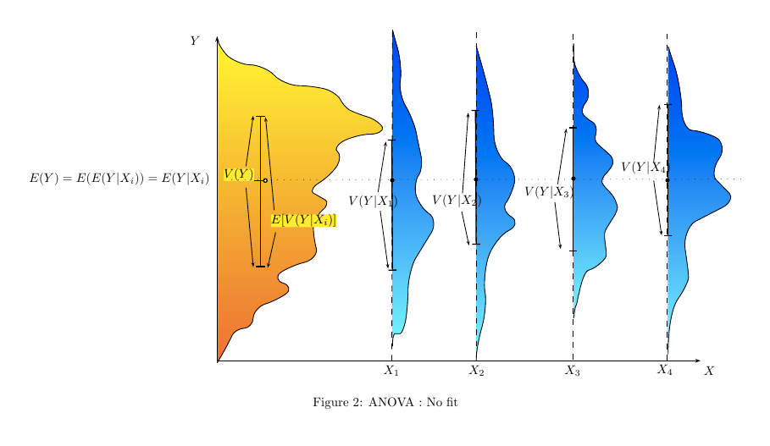
ANOVA

Slide 23
p-value
Many researchers in various areas use standard routines in statistical software in the expectation that the software can condense their research into a single summary (most often a p-value) that ‘objectifies’ their results. This idea of objectivity is in stark contrast with the realization by many of these researchers at some point that depending on individual inventiveness there are many ways to arrive at such a number.”

Slide 24
p-value adjustment
Multiple testing problem
  Minimize false positive error rate

Slide 25

CEITEC
@CEITEC_Brno
Thank you for your attention!
60 minutes lunch break.
www.ceitec.eu

