Slide 1


Week 8 : Clustering and dimension reduction
Introduction to Bioinformatics (LF:DSIB01)

Slide 2
Clustering (cluster analysis)
Very broad definition – group of data objects
Unsupervised classification
Data mining
What data you need for clustering?
  Data points with features where you can measure distance
    Some methods need Triangular inequality
  Distance matrix
  Important for sequence comparison!

Slide 3
Clustering types
Centroid models
  K-mean clustering
  Mean-Shift Clustering
Distribution models
  Expectation–Maximization (EM) Clustering
Density models
  DBSPAN
Connectivity models
  Hierarchical clustering
Graph-based models
  Clique, Spanning tree, Markov Cluster Algorithm (MCL)
…

Slide 4
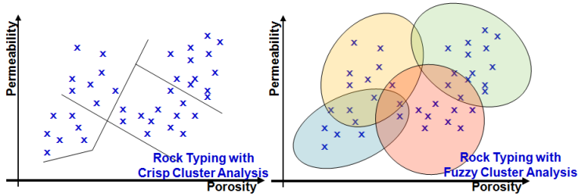
Clustering
Hard vs. Fuzzy clustering
  Fuzzy = each object belong to each cluster to some degree (probability)
  Overlapping clustering =~ discreet Fuzzy clustering
  More detailed analysis, but hard to interpret – good not as a final step

Slide 5
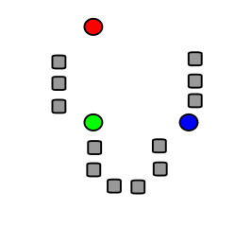
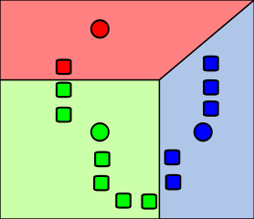
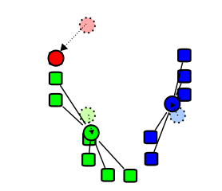
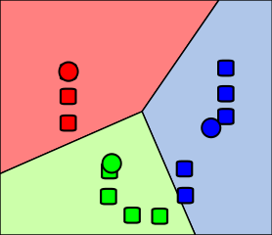
K-mean clustering
most well-known clustering algorithm
  Select a number of clusters to use and randomly initialize centers
  k clusters are created by associating every observation with the nearest mean
  Centroid of each of the k clusters becomes the new mean
  Repeat steps 2 and 3 until stopping rule

Slide 6
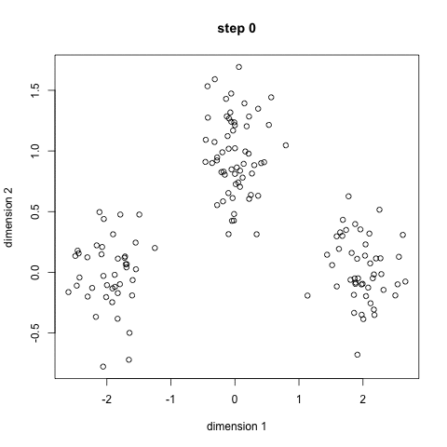
K-mean clustering

Slide 7
K-mean clustering
Advantage
  simple to implement
  very fast
    linear complexity O(n)
Disadvantage
  Must select number of clases
  Random start point
  Identify ‘spherical clusters’

Slide 8
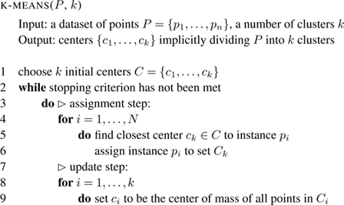
K-mean clustering pseudocode

Slide 9
Mean-Shift Clustering
Steps
  circular sliding window centered at a point C (randomly selected)
  every iteration, the sliding window is shifted towards regions of higher density by shifting the center point to the mean of the points within the window
  until there is no direction at which a shift
  process of steps 1 to 3 is done with many sliding windows until all points lie within a window

Slide 10
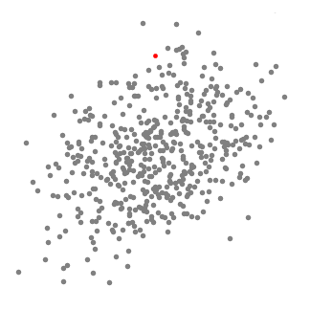
Mean-Shift Clustering

Slide 11
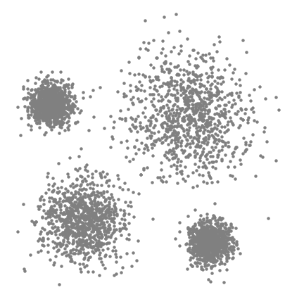
Mean-Shift Clustering

Slide 12
Mean-Shift Clustering
Advantage
  Not-necessary to select number of clusters
  Fast computation
Disadvantage
  Must select kernel range r
  Identify ‘spherical clusters’

Slide 13
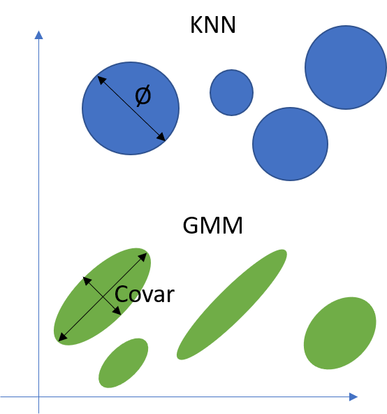
Expectation–Maximization (EM) Clustering using Gaussian Mixture Models (GMM)
Similar to K-means clustering
  each cluster is not defined only by its mean but also variance
  Gaussian normal curve in each dimension

Slide 14
Expectation–Maximization (EM) Clustering using Gaussian Mixture Models (GMM)
KM
  select a number of clusters to use and randomly initialize centers
  k clusters are created by associating every observation with the nearest mean
  centroid of each of the k clusters becomes the new mean
  repeat steps 2 and 3 until stop rule
EM with GMM
  select a number of clusters to use and randomly initialize Gaussian distribution parameters
  Using Gaussian distributions for each cluster, compute the probability that each data point belongs to a particular cluster
  compute a new set of parameters of Gaussian distributions to maximize the probabilities of data points within the clusters
    Weighted sum of individual
  repeat steps 2 and 3 until convergence

Slide 15
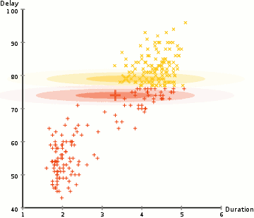
Expectation–Maximization (EM) Clustering using Gaussian Mixture Models (GMM)

Slide 16
Density-Based Spatial Clustering of Applications with Noise
  DBSCAN begins with an arbitrary starting data point that has not been visited. The neighborhood of this point is extracted using a distance epsilon ε (All points which are within the ε distance are neighborhood points).
  If there are a sufficient number of points (according to minPoints) within this neighborhood then the clustering process starts and the current data point becomes the first point in the new cluster. Otherwise, the point will be labeled as noise (later this noisy point might become the part of the cluster). In both cases that point is marked as “visited”.
  For this first point in the new cluster, the points within its ε distance neighborhood also become part of the same cluster. This procedure of making all points in the ε neighborhood belong to the same cluster is then repeated for all of the new points that have been just added to the cluster group.
  This process of steps 2 and 3 is repeated until all points in the cluster are determined i.e all points within the ε neighborhood of the cluster have been visited and labeled.
  Once we’re done with the current cluster, a new unvisited point is retrieved and processed, leading to the discovery of a further cluster or noise. This process repeats until all points are marked as visited. Since at the end of this all points have been visited, each point will have been marked as either belonging to a cluster or being noise.

Slide 17
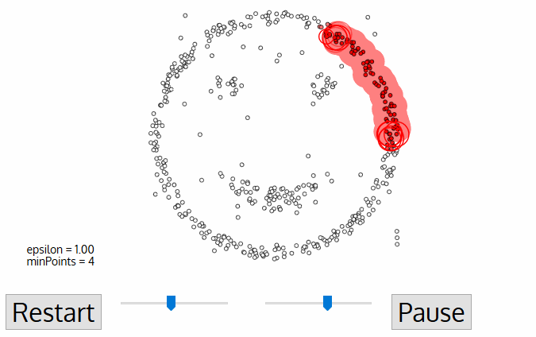
Density-Based Spatial Clustering of Applications with Noise

Slide 18
Density-Based Spatial Clustering of Applications with Noise
Advantage
  Not-necessary to select number of clusters
  Identifies outliers as noise
  Work on distance matrix
Disadvantage
  Doesn’t perform as well as others when the clusters are of varying density
  Drawback also occurs with very high-dimensional data

Slide 19
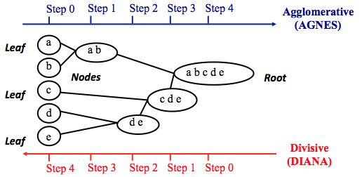
Hierarchical Clustering
top-down or bottom-up
  Agglomerative or divisive

Slide 20
Agglomerative Hierarchical Clustering
Steps
  Select smallest distance from distance matrix (selects two data points)
  Combine selected two clusters into one new data point. Recompute distances to all other data points.
  Repeated 1 and 2 until we end up with one cluster or decide to stop.

Slide 21
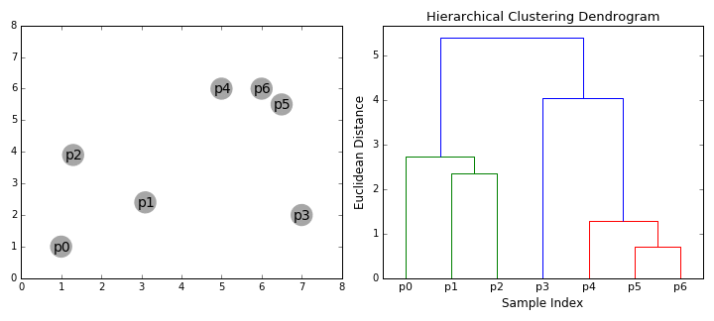
Agglomerative Hierarchical Clustering

Slide 22
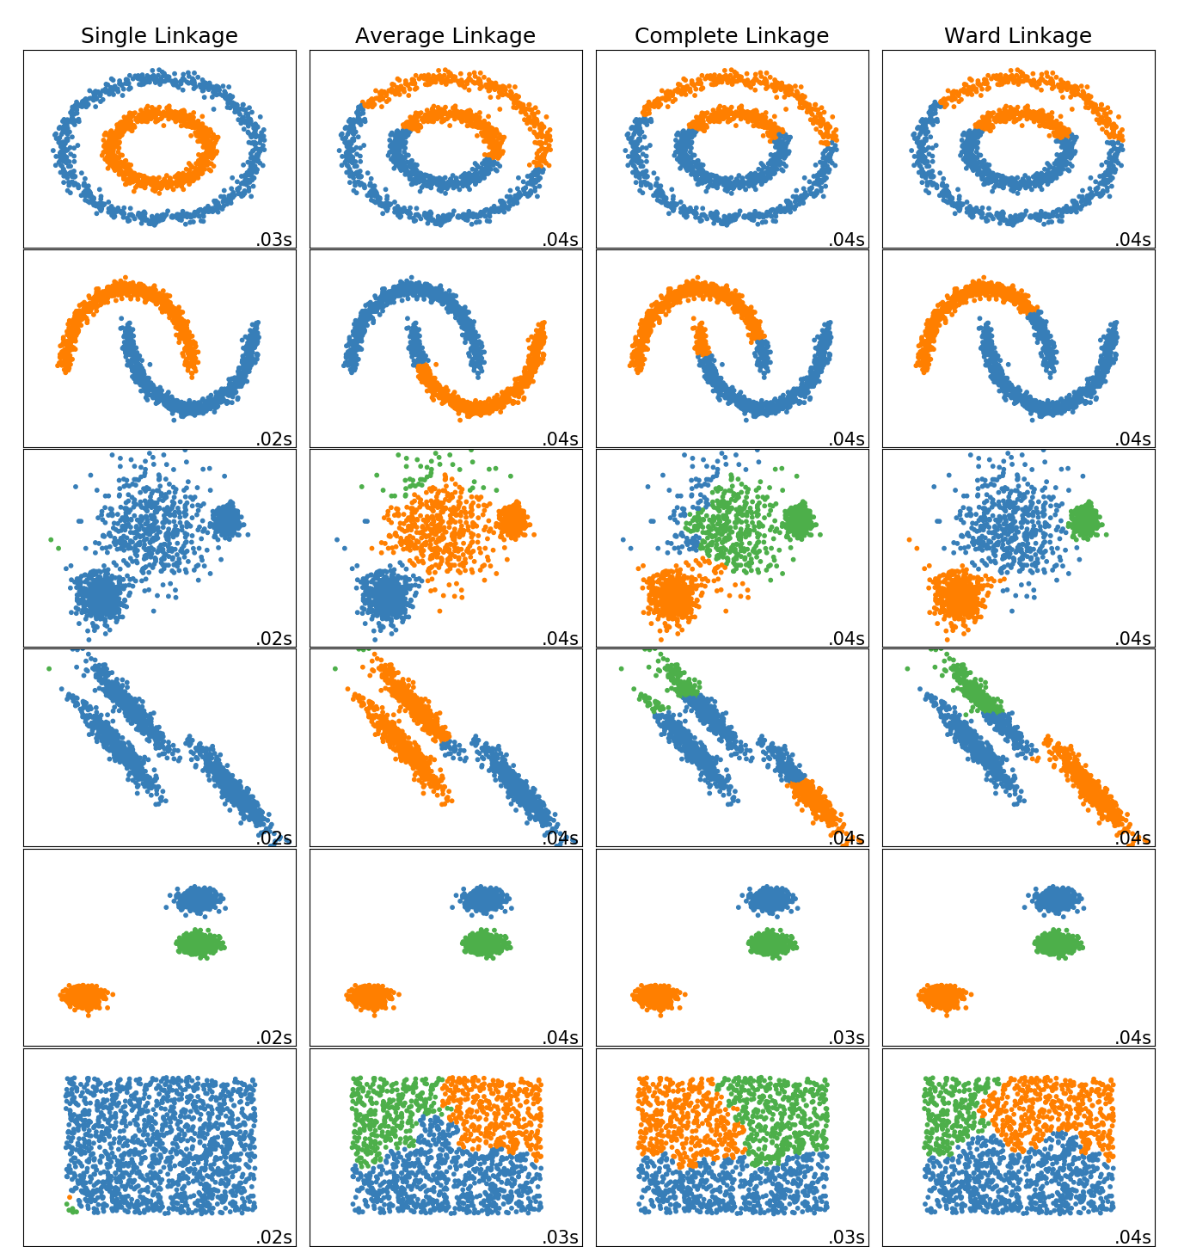
Agglomerative Hierarchical Clustering
Different agglomeration function:
  Max = Complete linkage
  Min = Single linkage
  Mean = Average linkage
  Ward linkage
    Ward's minimum variance criterion minimizes the total within-cluster variance.

Slide 23
Agglomerative Hierarchical Clustering
Advantage
  Get all ‘number of clusters’
  Uncover underlying hierarchy
  Work on distance matrix
  Agglomeration method can modulate results
Disadvantage
  High computational complexity
    complexity O(n³)
  Still simple cluster shapes

Slide 24
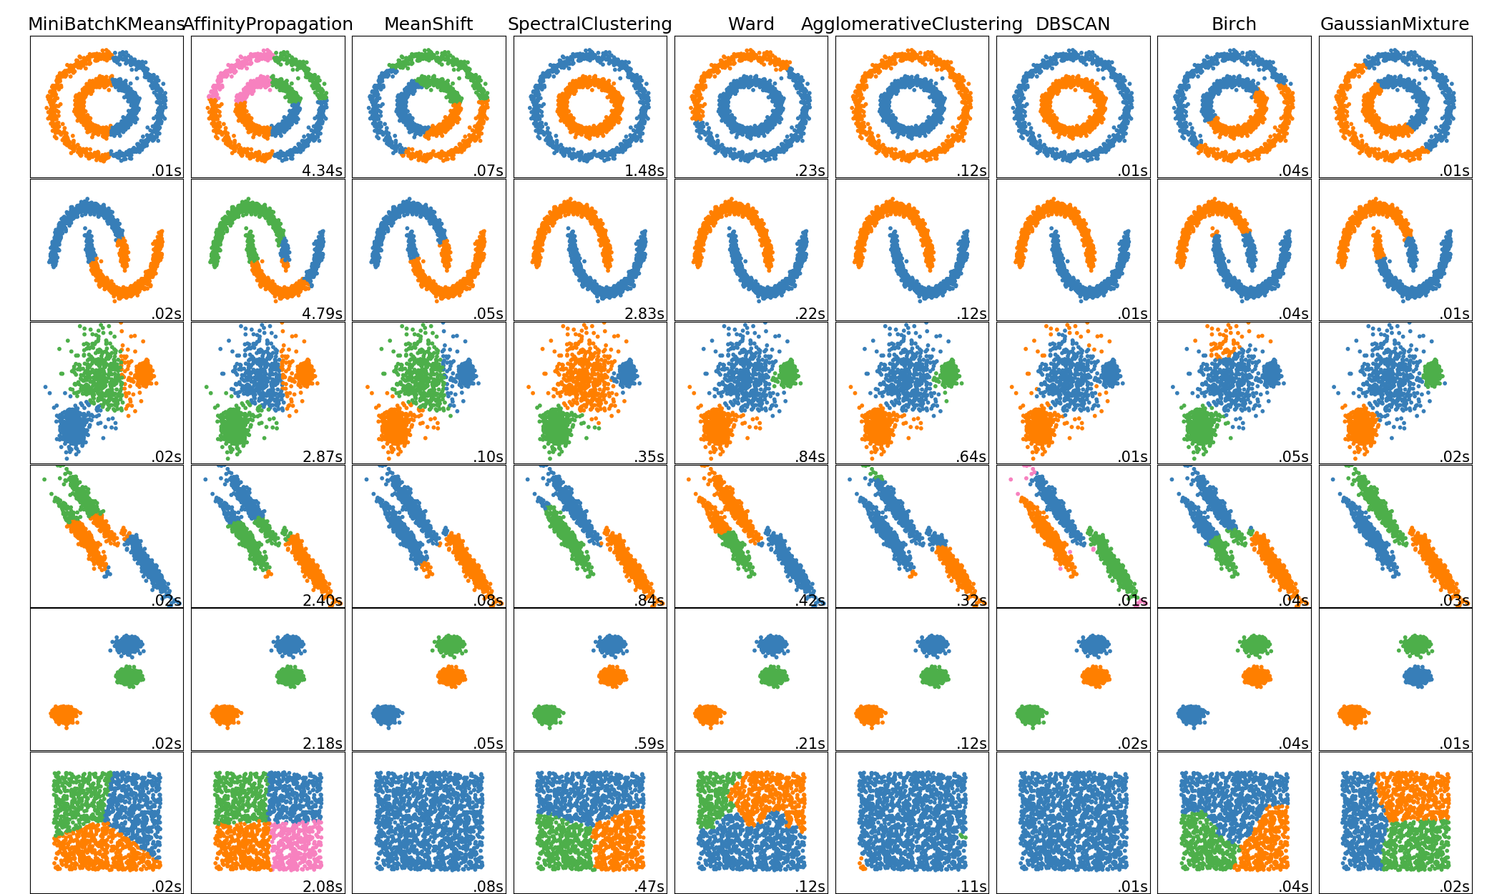
Clustering overview

Slide 25
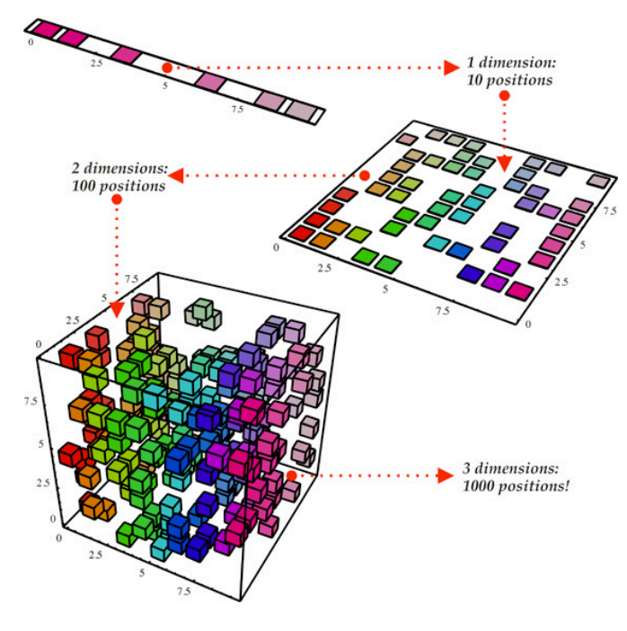
Dimension reduction
Why?

Slide 26
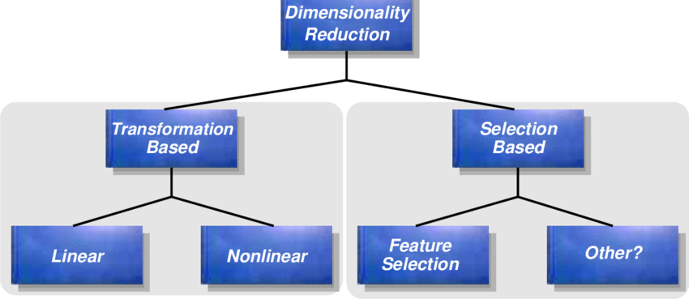
Dimension reduction
Feature selection
Feature projection

Slide 27
Feature selection
Subset selection method
  Exhaustive
  Greedy forward selection
  Genetic algorithm
Evaluation metric type
  Wrapper methods
    Build full model and test
  Filter methods
    mutual information
    Pearson product-moment correlation coefficient
  Embedded methods

Slide 28
Feature projection
Principal Component Analysis (PCA)
Non-negative matrix factorization
Independent Component Analysis (ICA)
t-SNE

Slide 29
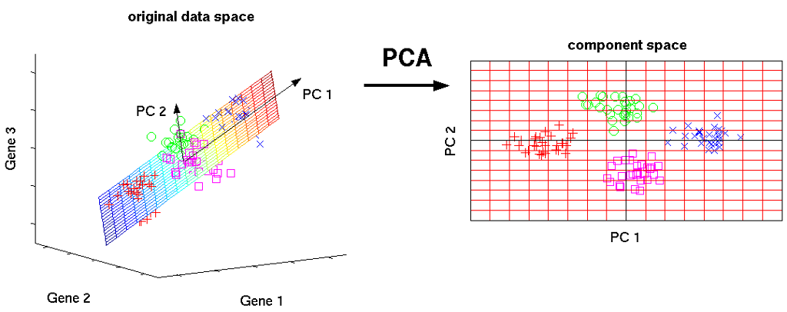
PCA
Highlight variance
Mainly used to visualize data better

Slide 30
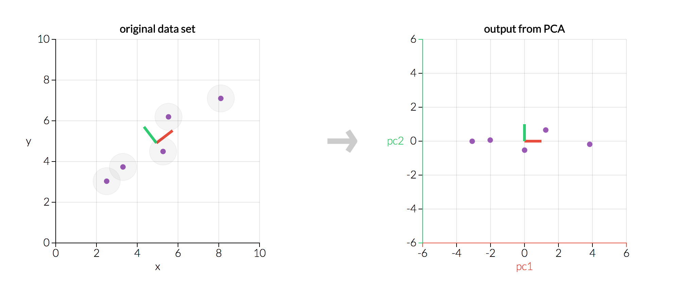
PCA

Slide 31
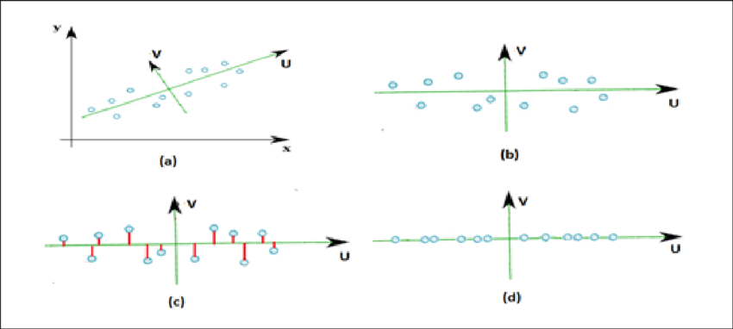
PCA

Slide 32
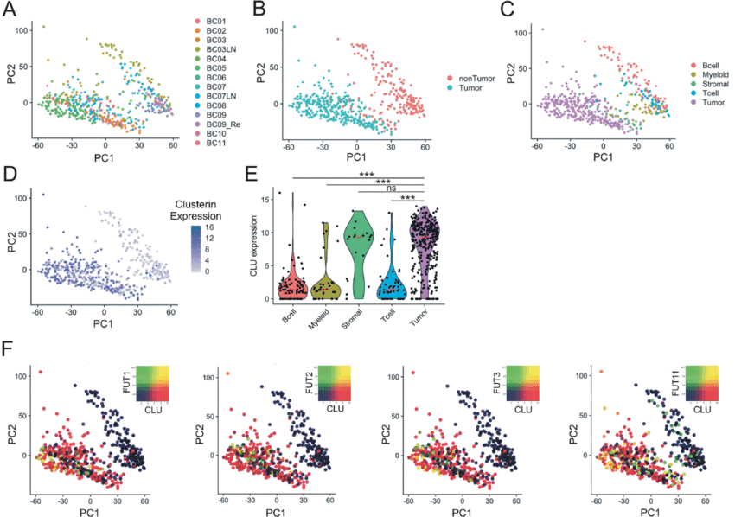
PCA

Slide 33
PCA
Warnings:
  Check variance explained
  Check normality of your data-points
    Relatively higher values can ‘capture’ the whole PCA

Slide 34

CEITEC
@CEITEC_Brno
Thank you for your attention!
60 minutes lunch break.
www.ceitec.eu

