Slide 1


Week 8 : Bayesian modeling
Introduction to Bioinformatics (LF:DSIB01)

Slide 2
Bayes’ theorem

Slide 3
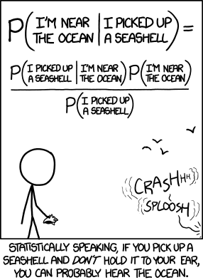
Bayes’ theorem

Slide 4
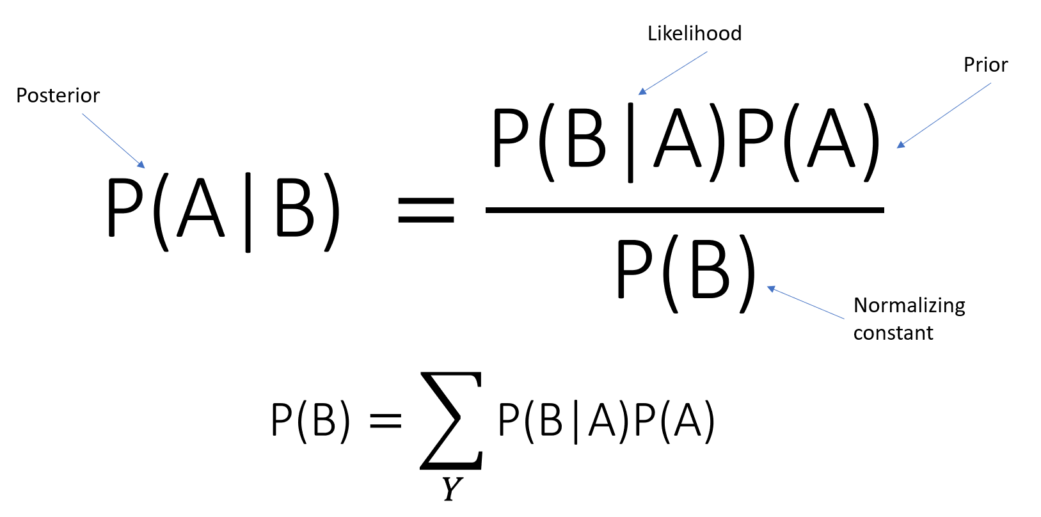
Bayes’ theorem

Slide 5
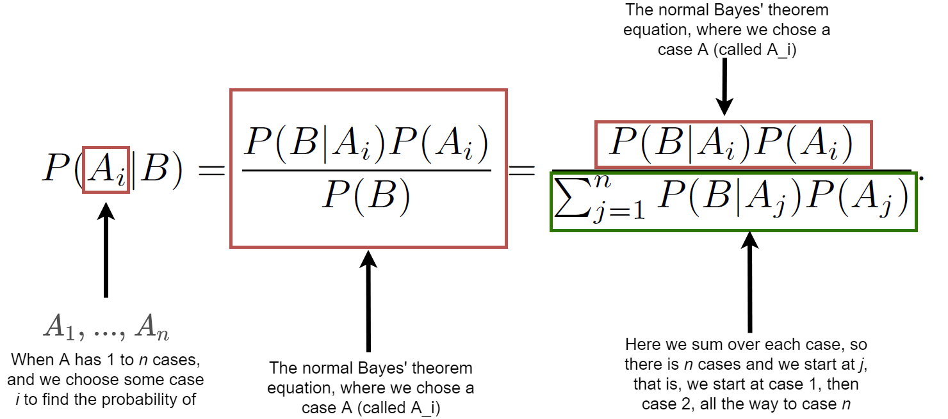
Bayes’ theorem

Slide 6
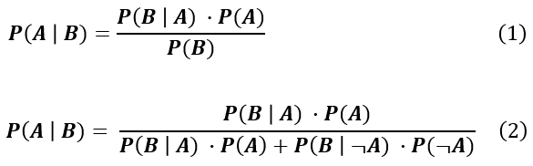
Bayes’ theorem - example
You might be interested in finding out a patient’s probability of having liver disease if they are an alcoholic.
  Past data tells you that 10% of patients entering your clinic have liver disease. P(A) = 0.10.
  Five percent of the clinic’s patients are alcoholics.
  Among those patients diagnosed with liver disease, 7% are alcoholics.

Slide 7
Bayes’ theorem - example
You might be interested in finding out a patient’s probability of having liver disease if they are an alcoholic.
  Past data tells you that 10% of patients entering your clinic have liver disease. P(A) = 0.10.
  Five percent of the clinic’s patients are alcoholics.
  Among those patients diagnosed with liver disease, 7% are alcoholics.
P(A|B) = (0.07 * 0.1) / 0.05 = 0.14
If the patient is an alcoholic, their chances of having liver disease is 0.14 (14%). This is a large increase from the 10% suggested by past data.

Slide 8
Bayes’ theorem - example
What is the probability that a woman has cancer if she has a positive mammogram result?
  One in 1000 of women have breast cancer.
  98 percent of women who have breast cancer test positive on mammograms.
  1 percent of women without breast cancer have a positive mammogram.

Slide 9
Bayes’ theorem - example
What is the probability that a woman has cancer if she has a positive mammogram result?
  One in 1000 of women have breast cancer.
  98 percent of women who have breast cancer test positive on mammograms.
  1 percent of women without breast cancer have a positive mammogram.
P(A)=0.001, P(-A)=0.999, P(B|A)=0.98,P(B|-A)=0.01
(0.98 * 0.001) / ((0.98 * 0.001) + (0.01 * 0.999)) = 0.0893
The probability of a woman having cancer, given a positive test result, is ~9%.

Slide 10
Bayes’ theorem - applications
Bayesian statistics
  Data modeling
  Parameter estimation
Bayesian networks
  Naïve Bayesian classifier
  Dynamic Bayesian networks
    Hidden markov models
Can be used in many different context
  Neural networks

Slide 11
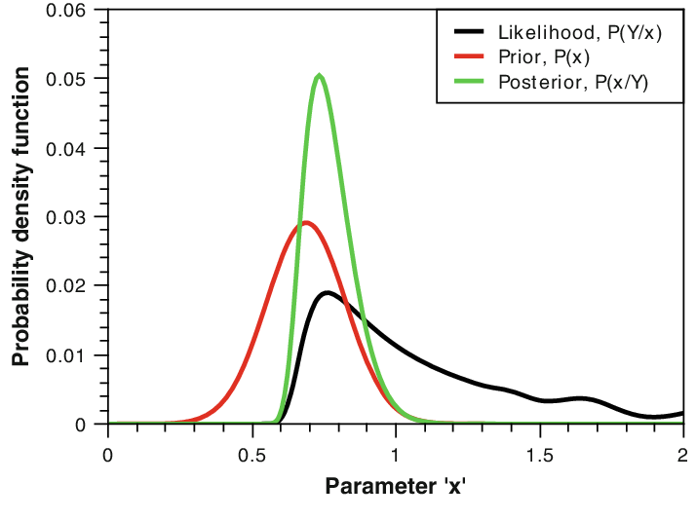
Bayesian statistics
Bayesian statistical methods use Bayes' theorem to compute and update probabilities after obtaining new data.

Slide 12
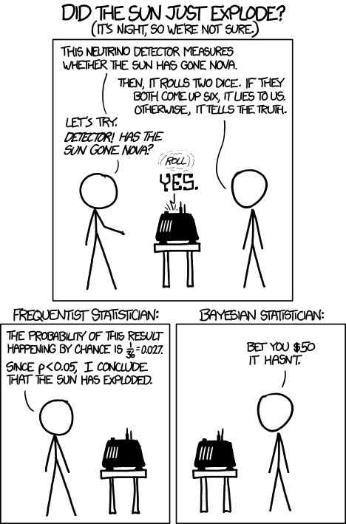
Bayesian vs. frequentists statistics
Bayesian interpretation of probability where probability expresses a degree of belief in an event
In the Bayesian view, a probability is assigned to a hypothesis, whereas under frequentist inference, a hypothesis is typically tested without being assigned a probability.
The frequentist interpretation that views probability as the limit of the relative frequency of an event after many trials

Slide 13
Bayesian vs. frequentists statistics
Two main sticking points
  Prior believe
  Small amount of data situations

Slide 14
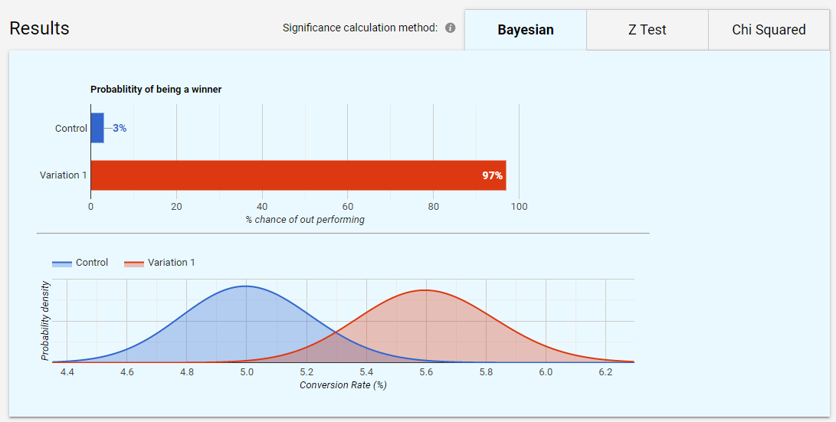
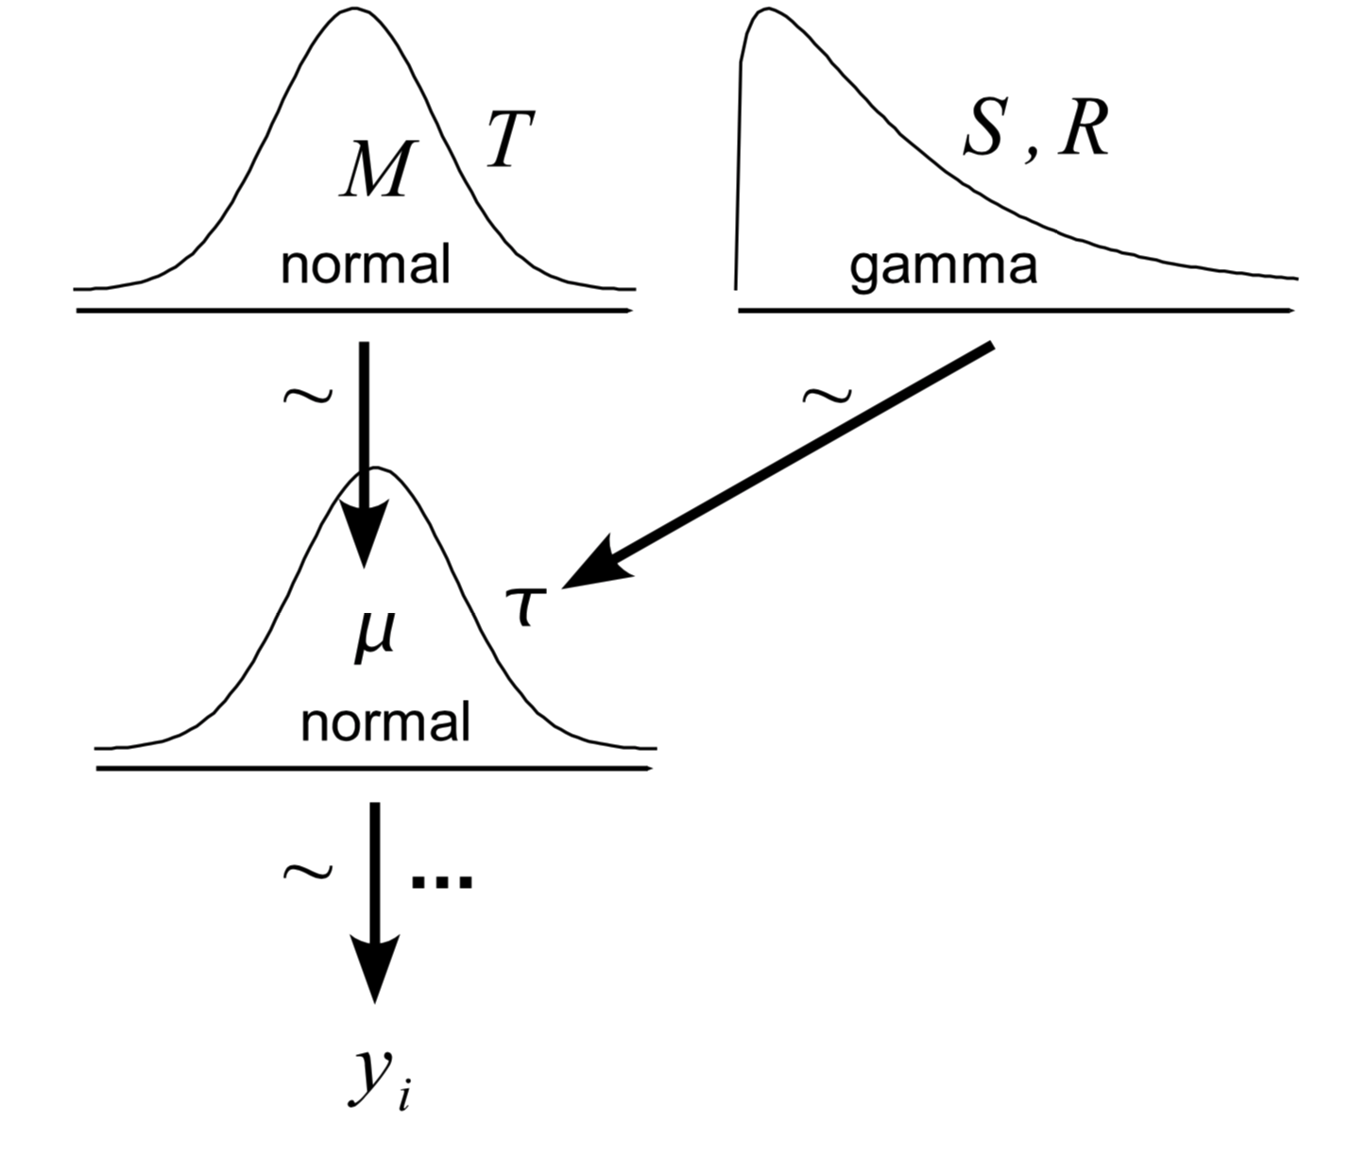
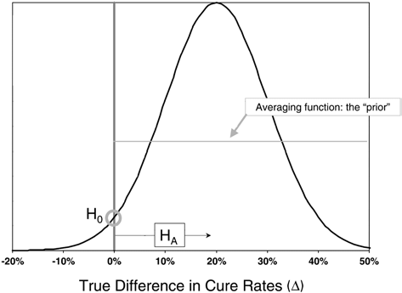
Bayesian statistics – parameter estimation
Data from some probability distribution function (PDF)
The goal is to get PDF of the parameter of this function

Slide 15
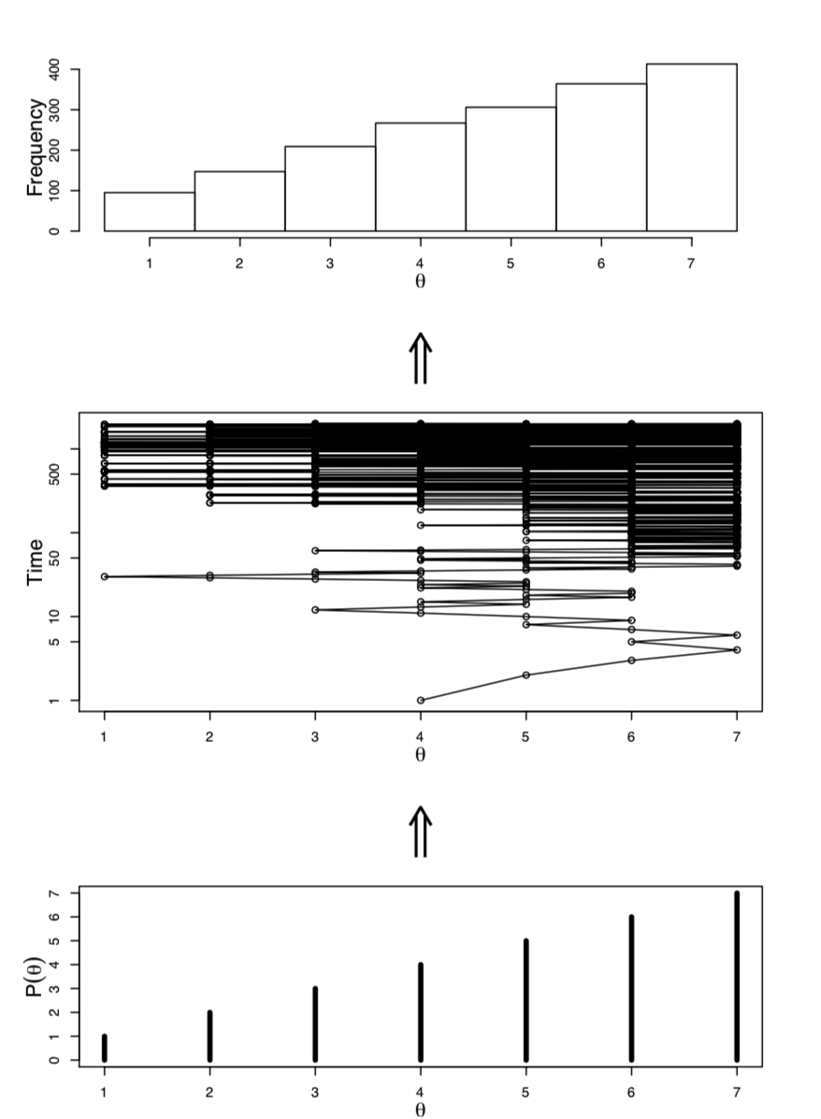
PDF estimation with sampling
Impossible (very hard) to compute analytically
Markov chain Monte Carlo (MCMC)
  This allowed usage of Bayesian statistics

Slide 16
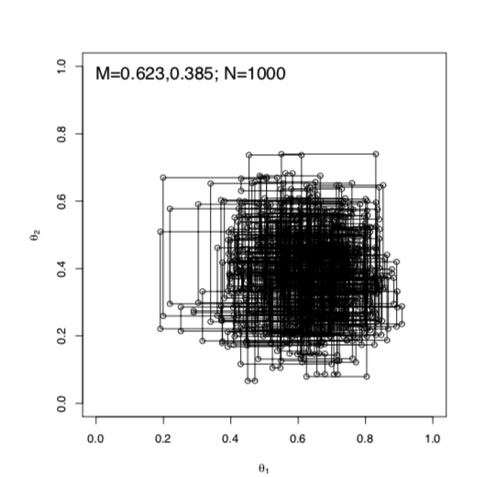
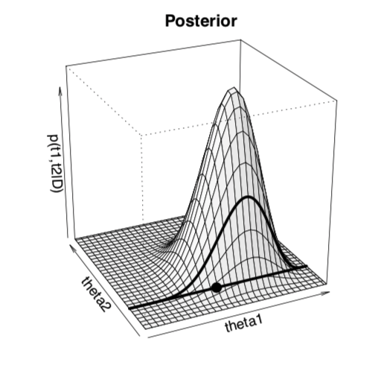
PDF estimation with sampling
Impossible (very hard) to compute analytically
Markov chain Monte Carlo (MCMC)
  This allowed usage of Bayesian statistics

Slide 17
Bayesian statistics - example
Student t-test

Slide 18
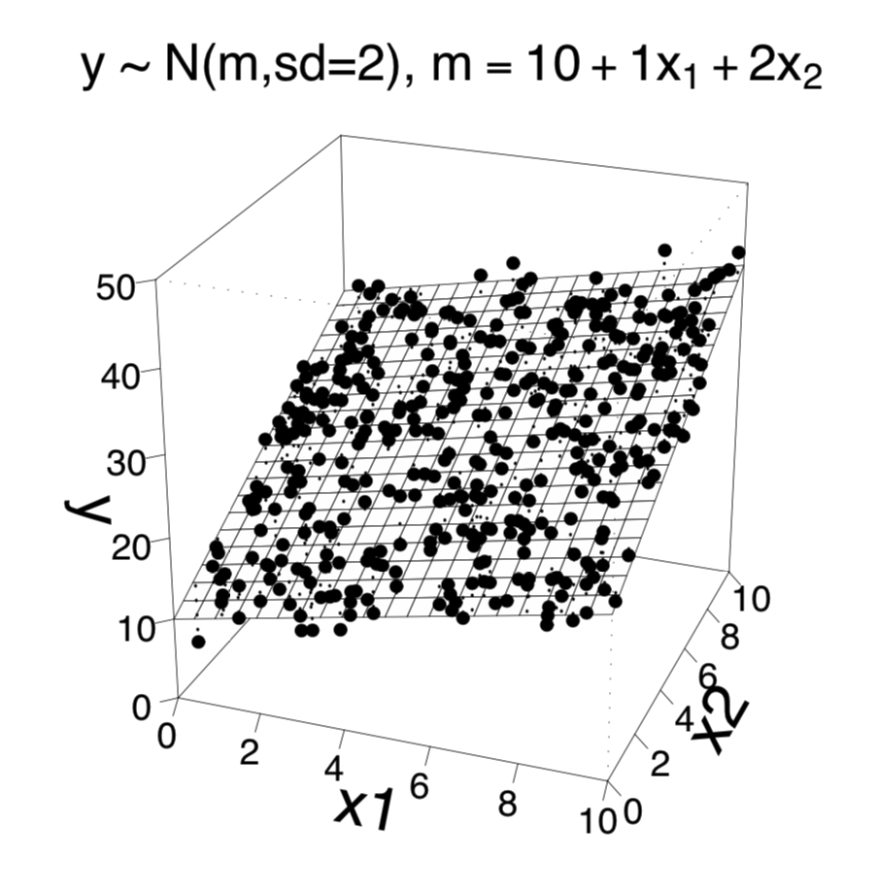
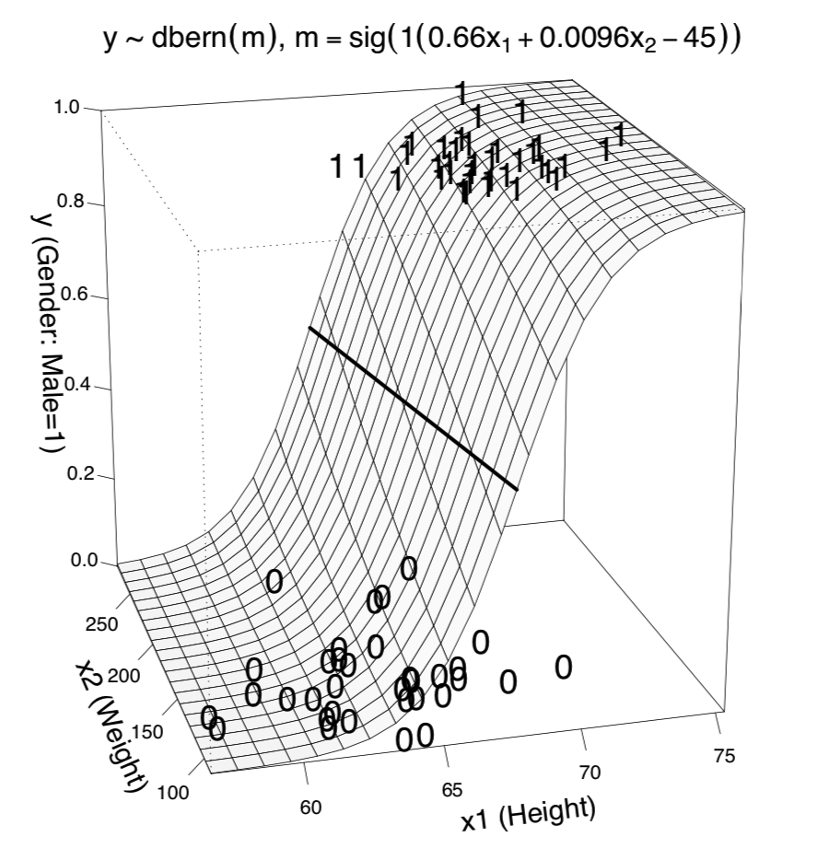
Bayesian statistics – Generalized linear model
y = β₀ + β₁x₁ + β₂x₂
y = sig(β₀ + β₁x₁ + β₂x₂ )

Slide 19
Bayesian statistics – Generalized linear model
y Scale Type | Link Function | pdf
metric | identity | normal
dichotomous | logistic | Bernoulli
ordinal | thresholded cumulative normal | categorical
count | exponential | Poisson

Slide 20
Bayesian statistics – Generalized linear model
Response variable type | Explenatory variable type | Example test type
Categorical | Categorical | Fisher test
Categorical (two groups) | Continuous | t-test
Categorical (multiple groups) | Continuous | ANOVA
Continuous | Continuous | Linear regression
Continuous | Categorical (two groups) | Logistic regression

Slide 21
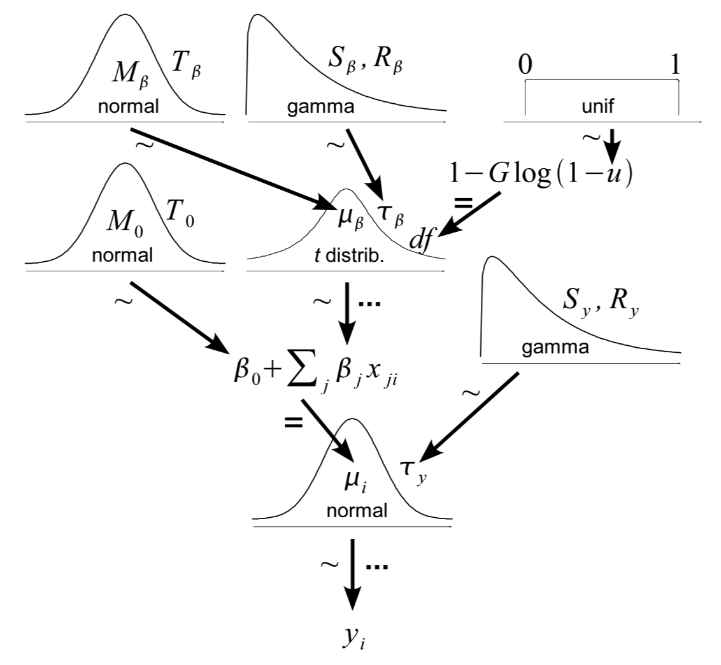
Bayesian statistics – hierarchical models

Slide 22
Bayesian networks
Diracted acyclic probabilistic graph
Represents a set of variables and their conditional dependencies

Slide 23
Bayesian networks - example
E5:
Family genentics
P(E5)
CPT(E4|C,E5,E7)
E4:
lab result2
P(E6)
P(E7)
E7:
Hot weather
E6:
Smoker
CPT(E3|C,E7)
C:
diagnosis
E3:
symptom2
CPT(C|E5,E6)
CPT(E2|C)
E2:
lab result
E1:
symptom1
CPT(E1|C,E6)

Slide 24
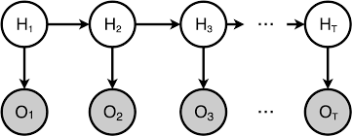
Dynamic Bayesian networks
Hidden markov models (hmm) are a (simple) special case of DBN

Slide 25
Naive Bayesian Classifier

Slide 26
Naive Bayesian Classifier – simple example
E4:
lab result2
CPT(E4|C)
C:
diagnosis
CPT(E3|C)
E3:
symptom2
CPT(E2|C)
CPT(E1|C)
E2:
lab result
E1:
symptom1

Slide 27
Naive Bayes classifiers - properties
highly scalable, requiring number of parameters linear in the number of variables
  curse of dimensionality
training can be done by evaluating a closed-form expression which takes linear time
Assumption of independence
  Simple model
Successfully being used
Best if you have poor understanding of the problem.

Slide 28
Naive Bayesian Classifier - example
Pancreatic tumor classification based on miRNA levels
miRNA sequencing from plasma samples
  ~300 miRNAs
Select ~20 miRNAs to classify tumor types
Bayesian model - 24 miRNAs -> 85% success rate
Log expression ratio
(miRNA12,miRNA9)
tumor classification
Log expression ratio
(miRNA25,miRNA60)
Log expression ratio
(miRNA24,miRNA51)
…

Slide 29

CEITEC
@CEITEC_Brno
Thank you for your attention!
60 minutes lunch break.
www.ceitec.eu

