Slide 1
Surface Phenomena Mgr. V. Bernard, Ph.D.
Foundation course - Physics

Slide 2
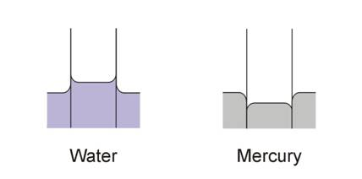
Cohesive forces, surface tension, capillarity
Cohesive forces – are the forces of attraction that like particles exert on one another. Cohesive forces lead to surface tension – the tendency of the surface of a liquid to contract to the smallest possible area.
Adhesive forces (similar to cohesive forces) – are attractive forces that act between particles of different substances.
Adhesive
forces are
dominant,
capillary elevation
Cohesive
forces are
dominant,
capillary depression
Manifestations of surface tension are relatively weak phenomena but cohesive forces in the bulk of the liquid are much stronger!
http://media.showme.com/files/423984/pictures/thumbs/839622/last_thumb1365254064.jpg
http://www.chm.bris.ac.uk/~chdms/Teaching/Chemical_Interactions/images/pic041.jpg

Slide 3
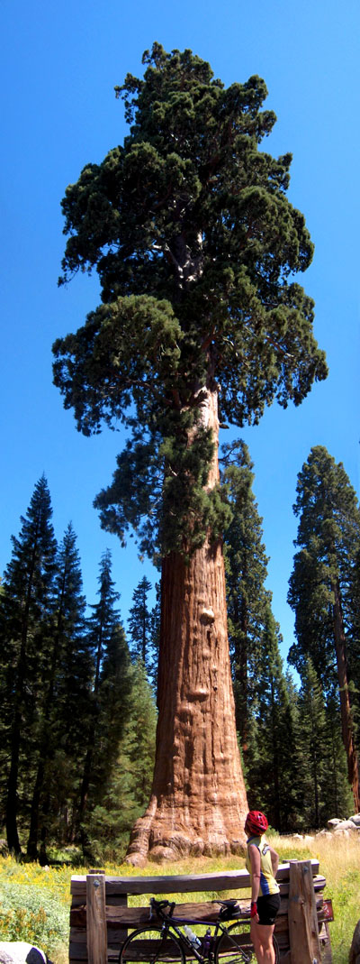
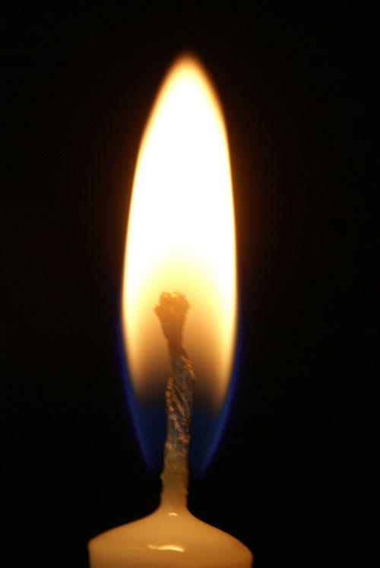
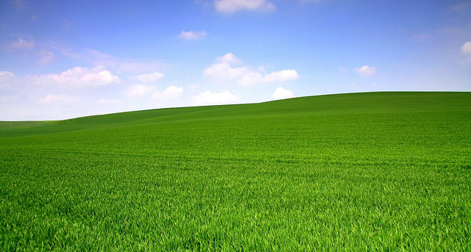
Capillary Elevation
Without the capillary elevation or cohesion forces in general it would not be possible to transport water from roots to the highest branches of trees. The water could not move up in soil. The candle wick could not be saturated by wax etc.

Slide 4
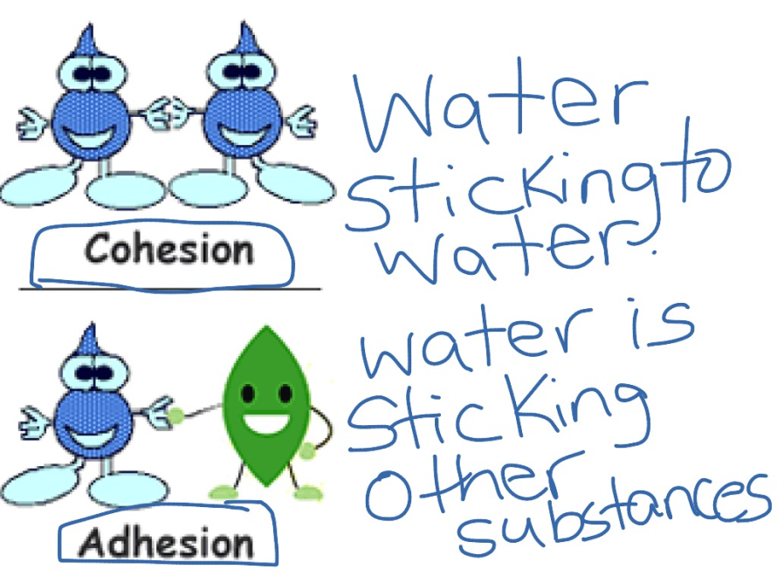
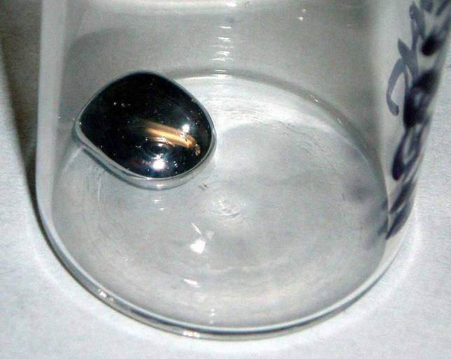
Cohesion and Adhesion
Cohesion ( cohesive attraction or cohesive force) is the action of like molecules (not just water) sticking together, being mutually attractive.
Adhesion (adhesive attraction or adhesive force) is the tendency of certain dissimilar molecules to cling together.
Mercury exhibits more cohesion than adhesion with glass.

Slide 5
https://slideplayer.com/slide/9157487/

Slide 6
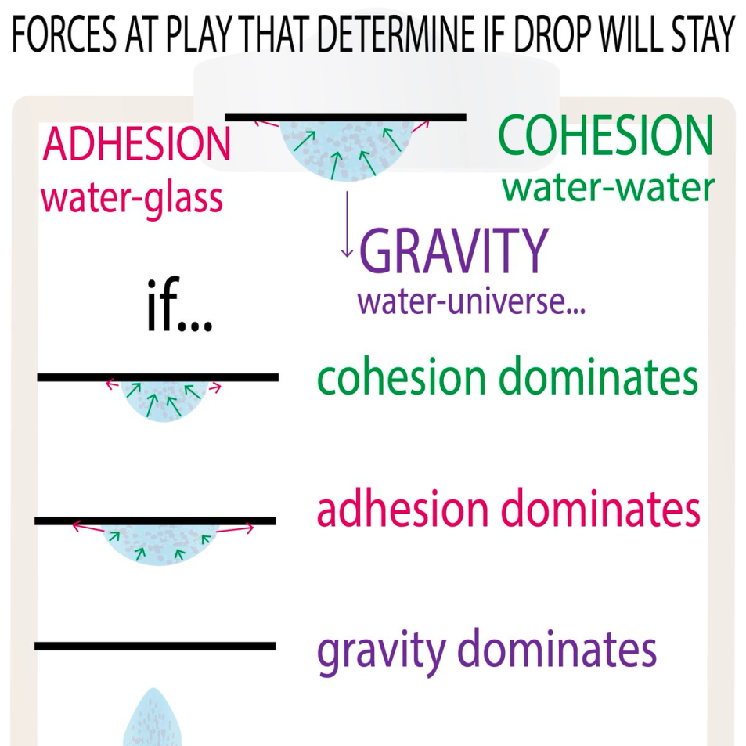
Adhesion x Cohesion x Gravity
https://i.stack.imgur.com/Dgw1K.jpg

Slide 7
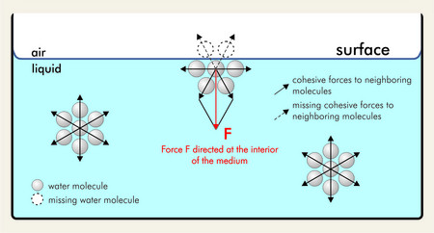
Surface Layer and Tension
Surface tension is the elastic-like property of a fluid surface which forces it to acquire the least surface area possible. Surface tension allows insects (e.g. water striders), usually denser than water, to stride on a water surface.
At liquid-air interfaces, surface tension results from the greater attraction of liquid molecules to each other (due to cohesion) than to the molecules in the air (due to adhesion).
http://www.sita-process.com/uploads/RTEmagicC_Groesse_Oberflaechenspannung1-E_10.jpg.jpg

Slide 8
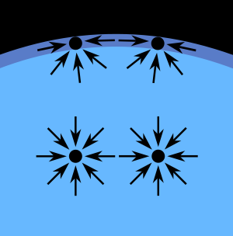
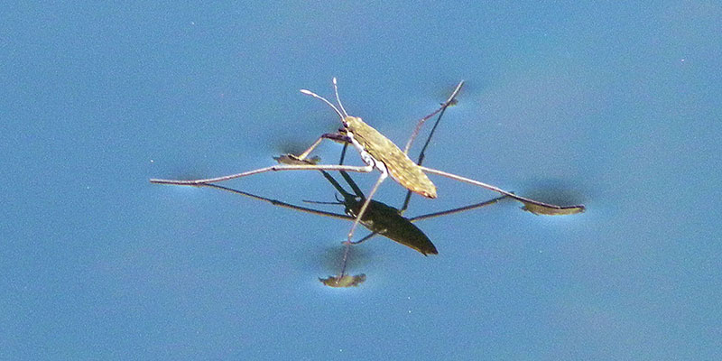
Surface Layer and Tension
The net effect is an inward force at its surface that causes the liquid to behave as if its surface were covered with a stretched elastic membrane - surface layer.
Water strider can walk on water
http://historiadelavida.editorialaces.com/wp-content/uploads/2016/05/sobre-el-agua-mosquito.jpg
https://en.wikipedia.org/wiki/Surface_tension#/media/File:Wassermolek%C3%BCleInTr%C3%B6pfchen.svg

Slide 9
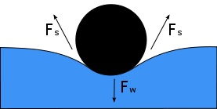
Surface Tension
Surface tension σ has the dimension of force per unit length, or of energy per unit area. The two are equivalent, but when referring to energy per unit of area, it is common to use the term surface energy, which is a more general term in the sense that it applies also to solids.
$σ=\frac{F}{l}$ or σ = $\frac{E}{A} (Nm−1)$
Fv
A object (needle) floating on the surface of water. Its weight, Fw, depresses the surface, and is balanced by the surface tension forces on either side, Fs, which are each parallel to the water's surface at the points where it contacts the needle. Notice that the horizontal components of the two Fs arrows point in opposite directions, so they cancel each other, but the vertical components Fv point in the same direction and therefore add up to balance Fw.
See next slide!!!
https://simple.wikipedia.org/wiki/Surface_tension

Slide 10
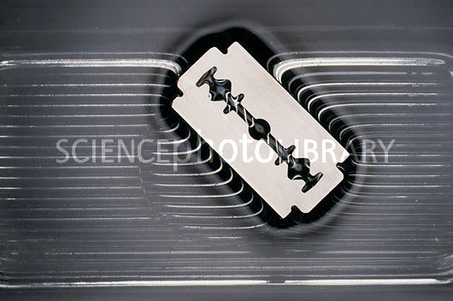
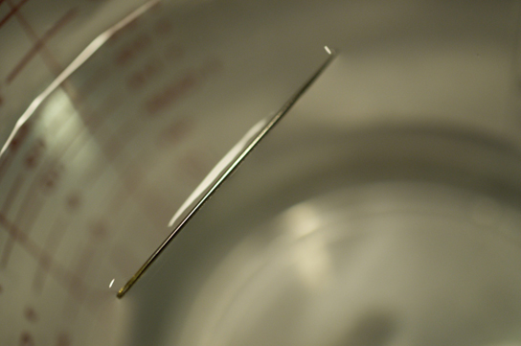
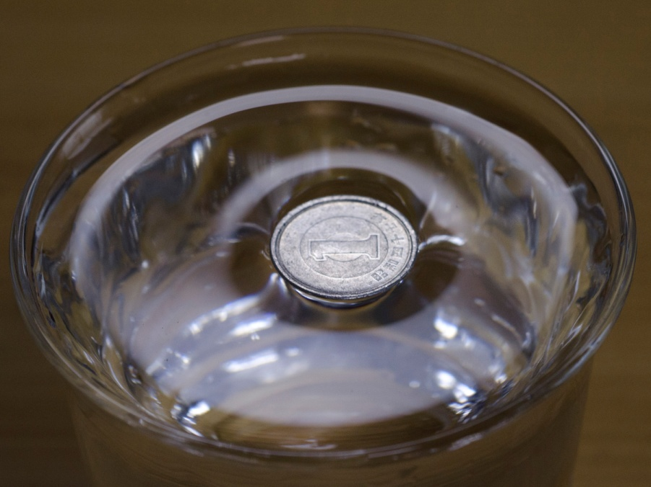
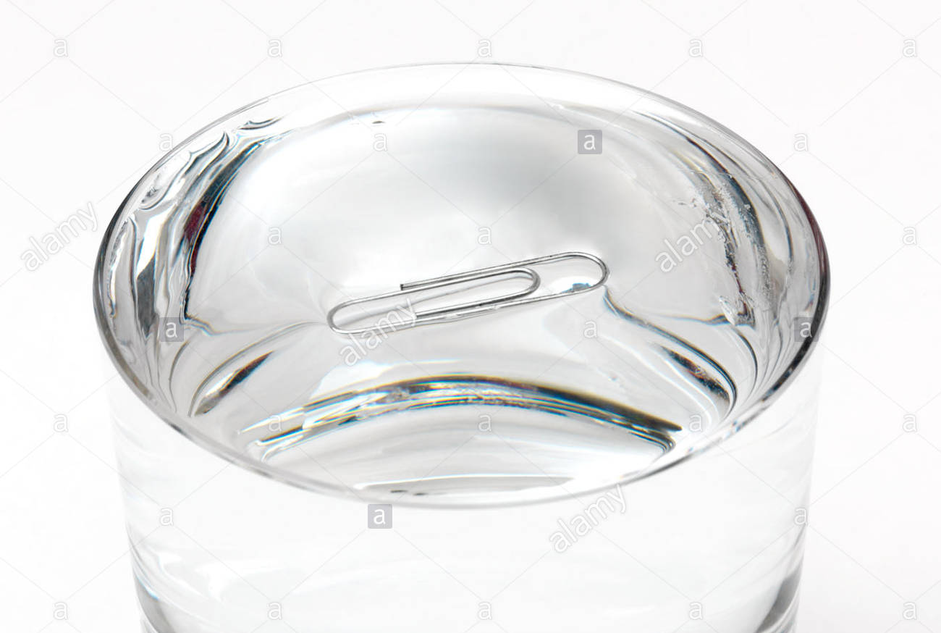
Surface tension
Not only water strider can be kept afloat by surface tension. It can be also the Japanese ¥ which is made of aluminium, a razor blade, steel needle or a paper clip!

Slide 11
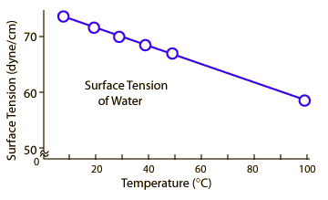
Water
Hot water is a better cleaning agent because the lower surface tension makes it a better "wetting agent" to get into pores and fissures rather than bridging them with surface tension. Soaps and detergents further lower the surface tension.
(1 dyn = 10⁻⁵ N)

Slide 12
Example – soap bubble
A soap bubble is on the frame with a 10 cm long stick. What work should be done to push the stick 2 cm?
10 cm
2 cm
F
F

Slide 13
10 cm
result:
2 cm
F
F
W= F.s

Slide 14
Example – water drop
What is the weight of water drop (σ = 73.10-3N.m-1), which eaves from a pipe with a radius of 0.5 mm?
F surface tension
F gravity

Slide 15
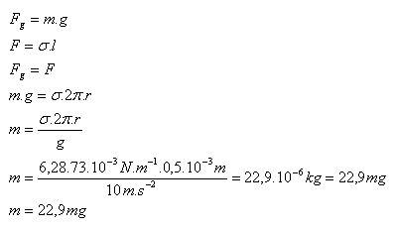
What is the weight of water drop (σ = 73.10-3N.m-1), which eaves from a pipe with a radius of 0.5 mm?
R = 0,5.10-3m, g = 10 m.s-2, σ = 73.10-3N.m-1
gravity
surface
2πr=l

Slide 16
Surface x Volume
Sphere:
Minimal surface in case of identical volumes
of different bodies.
In ideal drop is spherical.

Slide 17
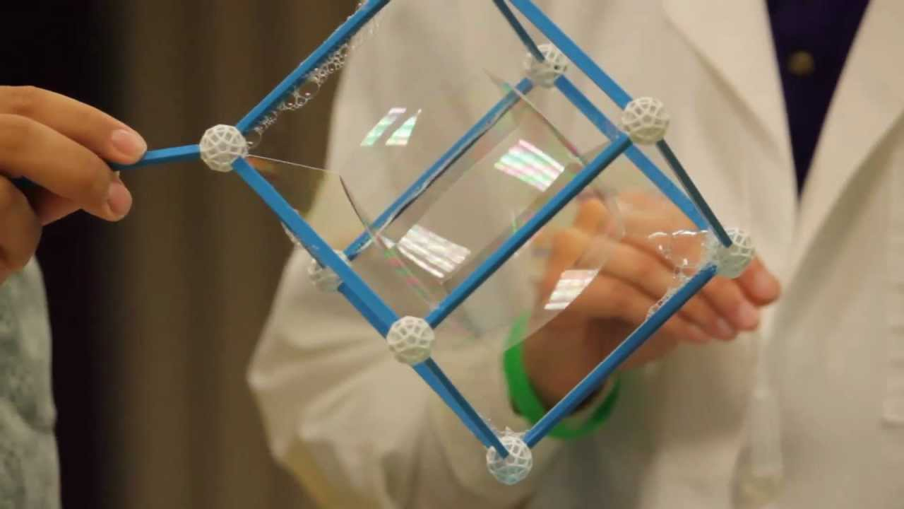
Cubic Bubble? ☺

Slide 18
Meniscus
A: The bottom of a concave meniscus. B: The top of a convex meniscus.
The meniscus is the curve in the upper surface of a liquid close to the surface of the container or another object, caused by surface tension. It can be either concave or convex, depending on the liquid and the surface.
A concave meniscus occurs when the particles of the liquid are more strongly attracted to the container (adhesion) than to each other (cohesion), causing the liquid to climb the walls of the container. This occurs between water and glass. Water-based fluids like sap, honey, and milk also have a concave meniscus in glass or other wet table containers.
A convex meniscus occurs when the particles in the liquid have a stronger attraction to each other than to the material of the container. Convex menisci occur, for example, between mercury and glass in barometers and thermometers.

Slide 19
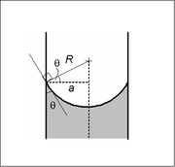
Capillary Pressure
Because of tension force, the special Laplace pressure exists – capillary pressure.
The Young–Laplace equation states that this pressure is proportional to the surface tension (σ), and inversely proportional to the effective radius (r), of the interface, it also depends on the wetting angle θ, of the liquid on the surface of the capillary.
P=$\frac{2σ}{r}cos{θ}$

Slide 20
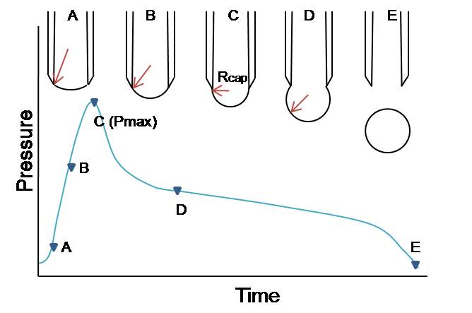
Capillary Pressure – in Bubbles or Drops – Laplace Pressure
Drops - P=$\frac{2σ}{r}$
Bubble - P=$\frac{4σ}{r}$
Why such a difference?
The gas-filled air bubbles levitating in the air have TWO surfaces – external and internal.
https://upload.wikimedia.org/wikipedia/commons/2/2c/Bubble2.jpg

Slide 21
???
Calculate the capillary presure inside of the water drop d=1 cm, δ H₂O = 72 [10⁻³ N/m] and compare it with the same drop of mercury (Hg) δ Hg = 476 [10-3 N/m].

Slide 22
???
Calculate the capillary presure inside of the water drop d=1 cm, δ H₂O = 72 [10⁻³ N/m] and compare it with the same drop of mercury (Hg) δ Hg = 476 [10-3 N/m].
Drops - P=$\frac{2σ}{r}$
H₂O
Hg
p = 2 * 0.072/0.005 = 28.5 Pa
p = 2 * 0.476/0.005 = 190 Pa

Slide 23
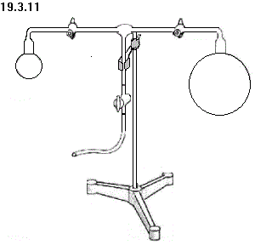
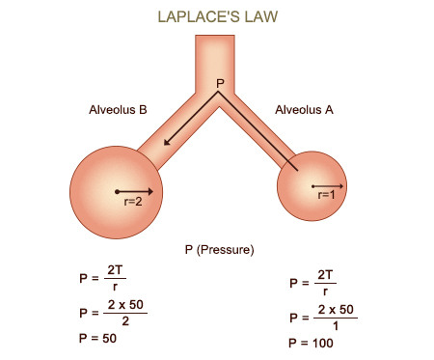
Capillary Pressure – in Bubbles or Drops – Laplace Pressure
What will happen with the bubbles in case of free communication between them? Consider higher pressure inside the smaller bubble! What could be the problem with alveoli?
xxxx

Slide 24
Example
What is the air pressure in a soap bubble with a radius of 2 mm when the atmospheric pressure is 101325 Pa?
P atm
r
P surf

Slide 25
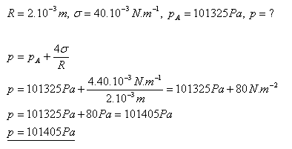
What is the air pressure in a soap bubble with a radius of 2 mm when the atmospheric pressure is 101325 Pa?

Slide 26
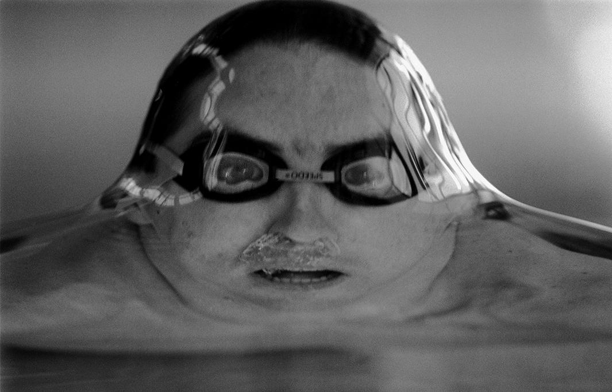
In case we would be tiny water animals it would be difficult for us to break through the water surface. Why?

Slide 27
Example
Calculate the surface energy of mercury drop, which has a volume of 1 cm³.

Slide 28
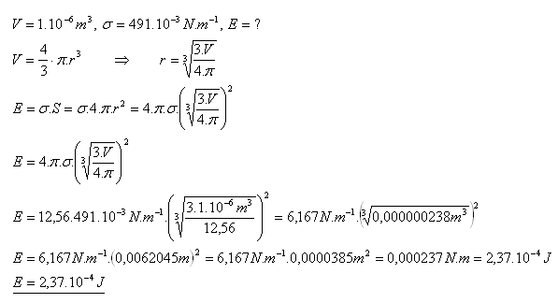
Example
Calculate the surface energy of mercury drop, which has a volume of 1 cm³.

Slide 29
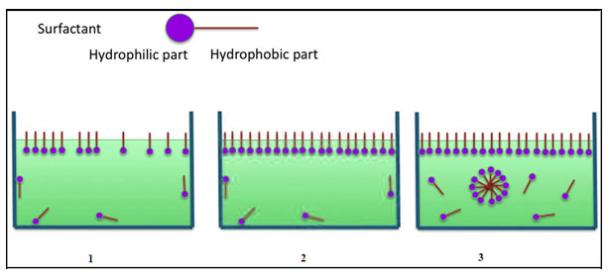
Surfactants
Surfactants or tensides are substances of general importance (detergents), including medicine (alveolar surfactant, bile acids). They decrease the surface tension on the air/water or fat/water interface.
The alveolar surfactant lowers surface tension of alveoli.
Detergents are used for washing.
Bile acids cover droplets of fat in our intestine, decrease their surface tension, help to break them into smaller ones, help to enter into blood through the intestinal wall.

Slide 30
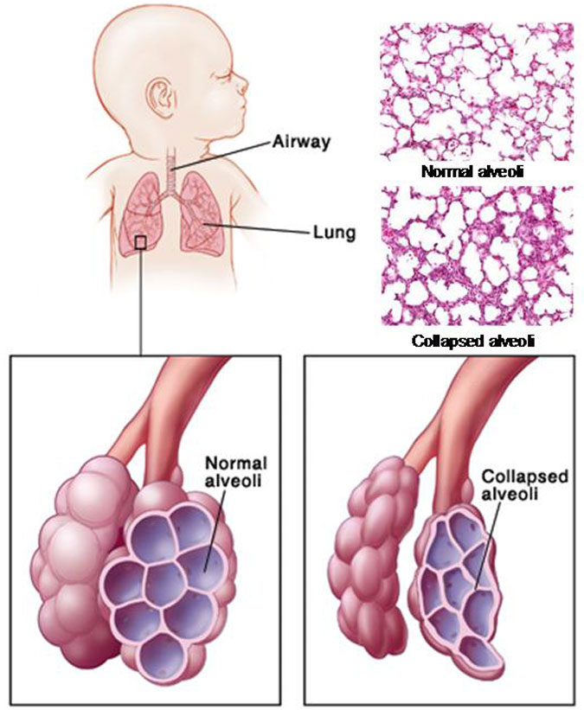
Lung Surfactants
Due to the lack of surfactant, premature infants suffering from RDS (respiratory distress syndrome) exhibit alveolar collapse and decreased lung compliance

Slide 31
Adsorption
Not aBsorption!
Adsorption is the adhesion of atoms, ions, or molecules from a gas, liquid, or dissolved solid to a surface. This process creates a film of the adsorbate on the surface of the adsorbent. This process differs from absorption, in which a fluid (the absorbate) is dissolved by or permeates a liquid or solid (the absorbent), respectively.
adsorption – on surface X absorption – inside matter

Slide 32
Adsorption
Activated carbon, also called activated charcoal, is a form of carbon processed to have small, low-volume pores that increase the surface area available for adsorption or chemical reactions. Due to its high degree of microporosity, just one gram of activated carbon has a surface area in excess of 3,000 m², as determined by gas adsorption.
Activated carbon is used to treat poisonings and overdoses following oral ingestion. Tablets or capsules of activated carbon are used in many countries as an over-the-counter drug to treat diarrhea, indigestion, and flatulence.

Slide 33
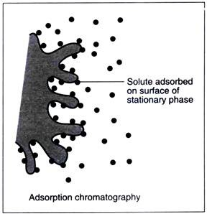
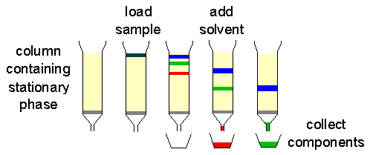
Adsorption
Adsorption chromatography utilizes a mobile liquid or gaseous phase that is absorbed onto the surface of a stationary solid phase. The equilibration between the mobile and stationary phase accounts for the separation of different solutes.

Slide 34
Study materials
Book – Glencoe,Physics: Chapter 13, section 2

