Slide 1
BASIC MEDICAL TERMINOLOGY
4th and 5th declension

Slide 2
4th decl.:
-US, US, M. or -U, US/N. (only genu and cornu)
TYPICAL ENDING -tus, -xus, -sus
artus, us, m. Abl. Pl. artubus
arcus, us, m. arcubus
manus, us, f.
acus, us, f.
5th decl.:
-ES, EI, F.
species, erum, f.

Slide 3
How can you decline nouns ending in –us?
Decide the declension of the following nouns:
longus
ulcus
fetus
uterus
morbus
infarctus
nasus
sinus
vulnus
crus

Slide 4
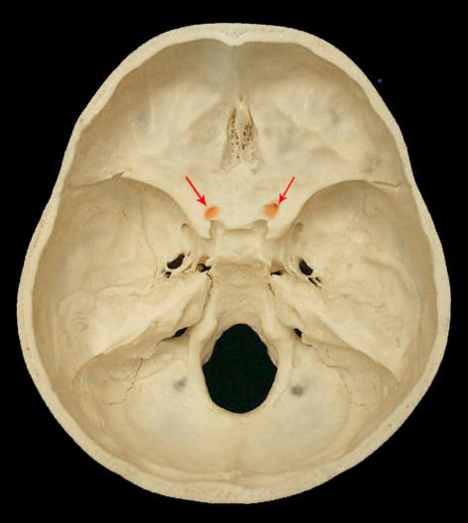
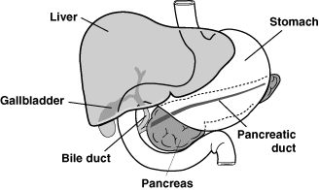
canalis = a narrow tubular passage or channel, e.g. optic canal
ductus = a passage with well-defined walls, esp. for the passage of excretion or secretion
common bile duct ?
optic canal ?

Slide 5
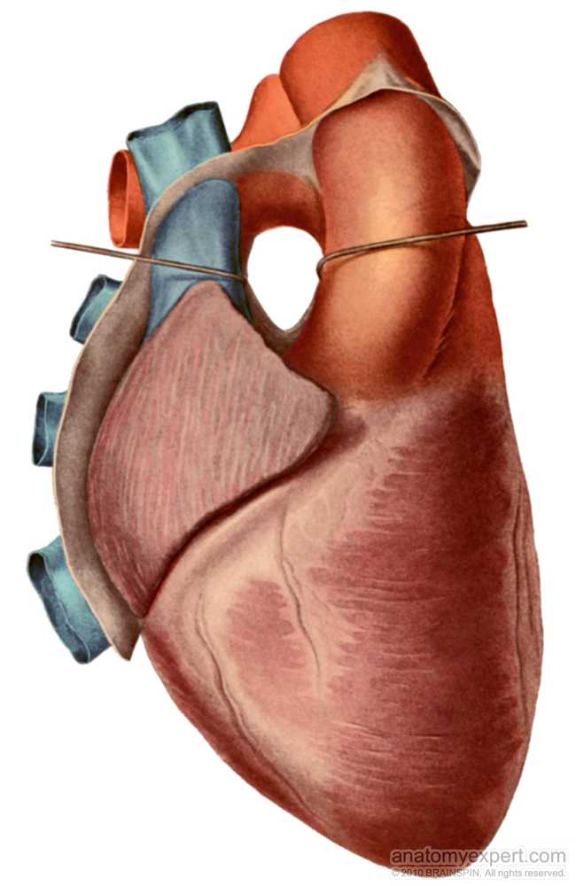
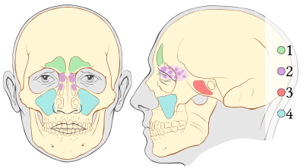
sinus = a cavity in bone, esp. the pair cavities in the facial part of skull
transverse sinus of pericardium?
1 frontal sinuses
2 ethmoid sinuses
3 sphenoid sinus
4 maxillary sinuses

Slide 6
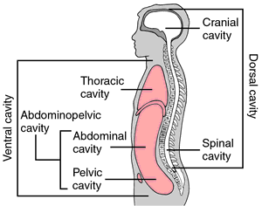
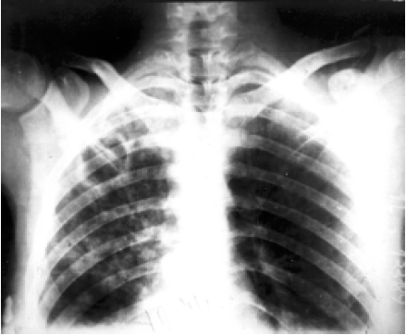
cavitas = a cavity of organs or the regions of body
caverna = a cavity with many interconnected chambers; a pathological cavity caused by the decay of tissues, e.g. cavernae tuberculosae

Slide 7
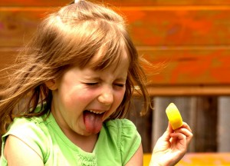
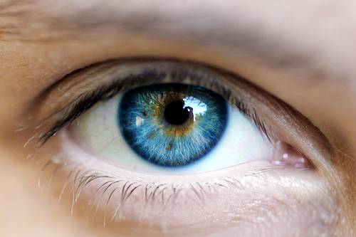
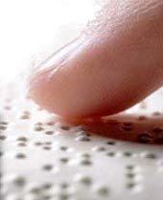

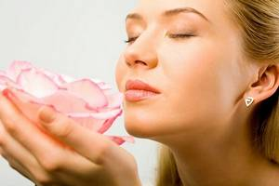
Sensus humani:
visus ~ auditus ~ olfactus ~ tactus ~ gustus
1
2
3
4
5

Slide 8

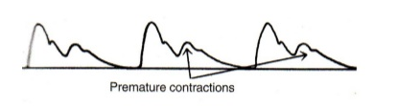
Pulsus…
parvus tardus celer bigeminus

Slide 9
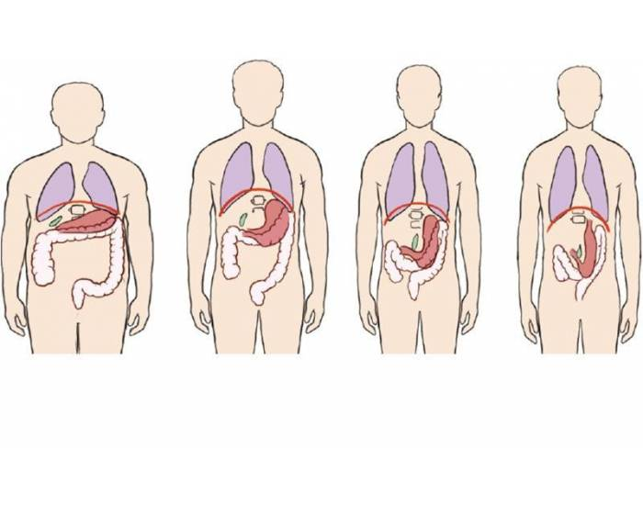
Habitus…
= a general body type or constitution of a person; posture or position of the body
A hypersthenicus
B sthenicus
C hyposthenicus
D asthenicus
a) b) c) d)
*Gr. sthenos = strength
Which of these is the average/normal?

Slide 10
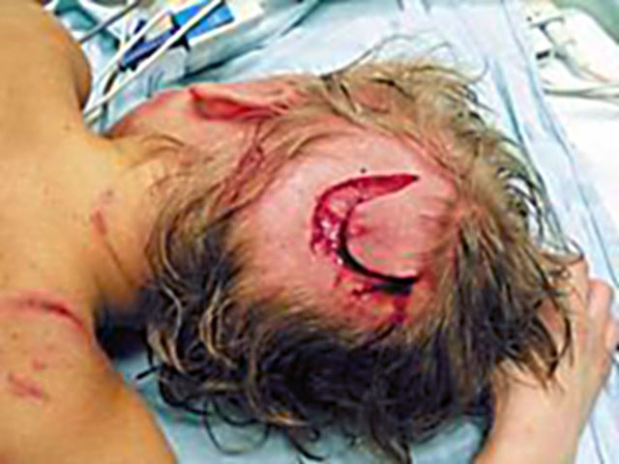
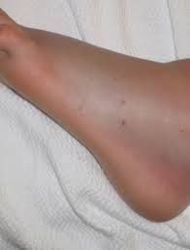
Morsus…
m. serpentis
→ Create diagnoses according to the pictures!
m. canis

Slide 11
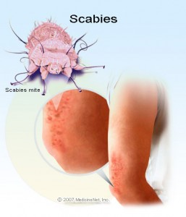
Scabies
(Lat. scabere = to scratch)
= a contagious skin disease caused by a tiny mite (Sarcoptes scabiei) laying eggs under the skin, the characteristic itching is caused by the reaction to the feces of the mite
grey ointment against scabies?

Slide 12
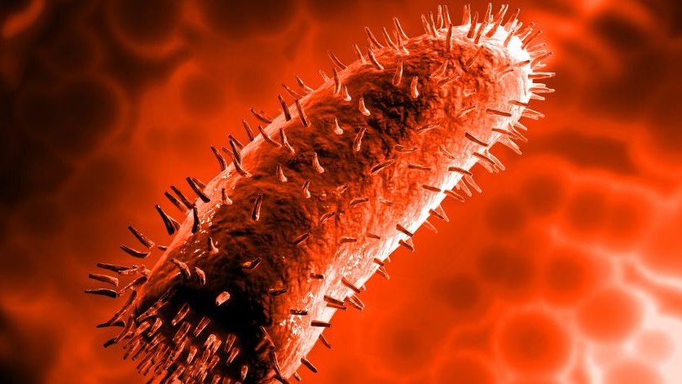
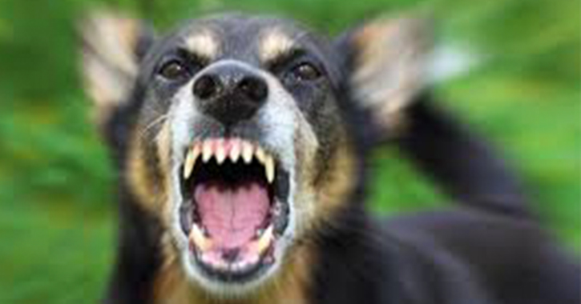
Rabies
= an acute viral disease (a virus of the family Rhabdoviridae) of the central nervous system transmitted through saliva from the bite of an infected animal, it is also called hydrophobia because of the typical symptom of the disease; the symptoms include extreme thirst, fever, depression, confusion, hard swallowing, muscle spasms, sensitivity to touch, light or loud noise; if not prevented, it is almost always fatal
r. silvatica
r. domestica
death due to rabies after the bite of an animal?

Slide 13
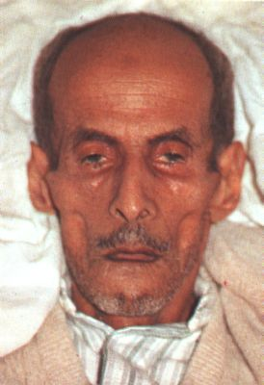
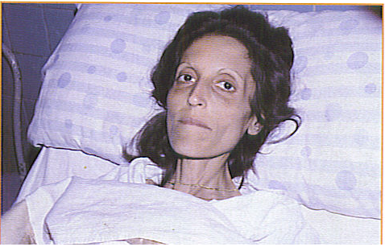
The facial expression produced in the by impending death or long illness (accompanied by pain), excessive evacuations, excessive hunger, and the like, e.g.by peritonitis (inflammation of peritoneum) or cholera. Its synonym is facies abdominalis.
The nose is sharp, the eyes sunken, the temples fallen in, the ears cold and drawn in and their lobes distorted, the skin of the face hard, stretched and dry, and the colour of the face pale or dusky.
facies Hippocratica / facies abdominalis

Slide 14
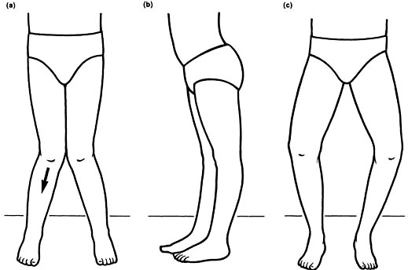
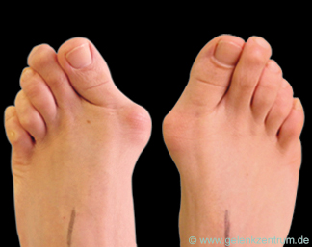
valgus
x
varus
?? ??
state after the operation of a toe twisted inwards of the left foot?
Notes:
Genu valgum, genu varum

Slide 15
in situ…
morbus ischemicus cordis, cardiostimulator in situ
tumor mammae l. sin., implantatus in situ
tear wound of the head, a foreign body in the place (of the wound)?
cancer of the large intestine, carcinoma in its (original) place?
x
metastases of the tumor towards the liver?

Slide 16
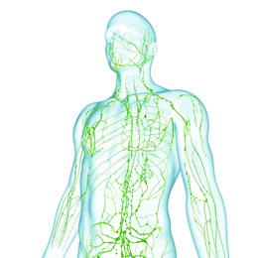
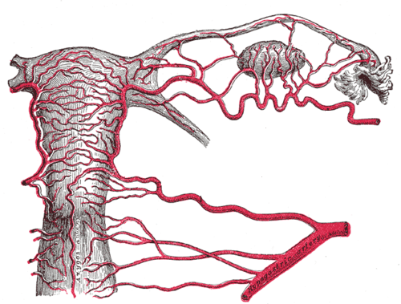
Plexus…
uterine venous network?
deep lymphatic network?
state after the excision of a lymphatic node due to carcinoma?

Slide 17
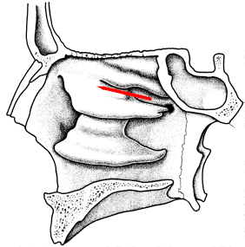
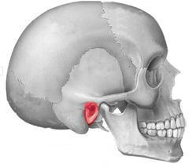
Meatus…
= an opening or passage, esp. one leading to the body surface, external opening of a canal
medial meatus of the nose?
nasopharyngeal meatus?
external acoustic meatus?
Notes:
Meatus acusticus externus

Slide 18
Status…
post operationem --->
propter asthma --->
propter epilepsiam --->
-ivus -icus

Slide 19
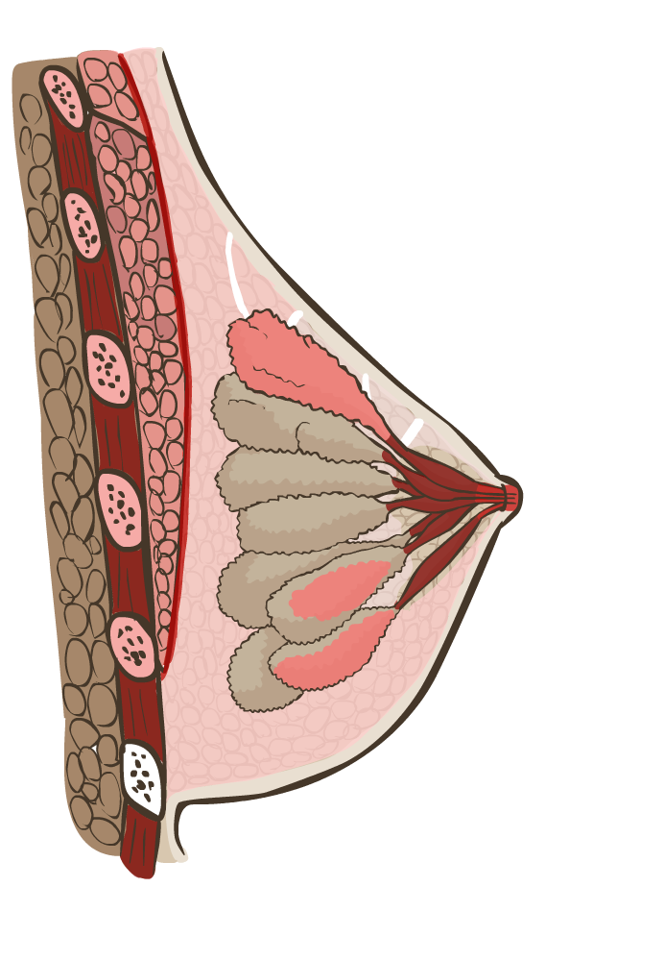
fasci _ _ _ pectoralis
ligament_ _ _ suspensori_ _ _ mamm_ _ _
lob_ _ _ glandul_ _ _ mammari_ _ _
sin_ _ _ lactifer_ _ _
duct_ _ _ lactifer_ _ _
lobul_ _ _ glandul_ _ _ mammari_ _ _
corpus adipos_ _ _ mamm_ _ _
cost_ _ _ ver_ _ _ septim_ _ _

Slide 20
The breast is the tissue overlying muscles of chest. Women's breasts are made of specialized tissue producing milk (a few days after the delivery) as well as of fatty tissue.
The milk-producing part of the breast is organized into 15 to 20 lobes. Within each are smaller structures, called lobules, where milk is produced. The milk travels through a network of tiny tubes called ducts. The ducts connect and come together into larger ducts, which eventually exit the skin in the nipple. The dark area of skin surrounding the nipple and covered with small tubercles is called the areola.
Connective tissue and ligaments provide support to the breast and give it its shape (but it also depends on other factors, e.g. number of pregnancies); nerves provide sensation. The breast also contains blood vessels, lymphatic vessels, and lymphatic nodes.
Common breasts diseases: breast cancer, ductal carcinoma in situ, breast cyst, fat necrosis and mastitis.
Notes:
Handout, na zapisovanie slov do tabuľky// na druhej strane obrázok z nasledujúceho slajdu

Slide 21
Give the nom. sg. form
carie infarctu unguenti dentes
pulmonum pleuritidem gargarismate specierum
temporibus labio morsum arcuum
ligamenta scabiem thoracis
laminarum scatulis tractu neuroseos
dyspnoes encephalo cornua

Slide 22
Identify the case; add the correct form of adjective
in genibus
dolor genus
in genua
dolor genuum
in genu
genua
sanatio decubitus
prope decubitus
sub decubitu
sanatio decubituum
sub decubitibus
prope decubitum
propter cariem
therapia carierum
sub carie
therapia cariei
sub cariebus
propter caries
valgus, a, um dolorosus, a, um profundus, a, um

Slide 23
Put the phrase in brackets in a correct form after the 1st word
Patiens cum + (genua valga)
Arcus + (vertebrae thoracicae)
Causa + (obstructio venae)
Effectus + (gargarisma novum)
Sanatio + (decubitus profundus)
Collapsus + (systema circulatorium)
Status post+ (canities praematura)
-ibus, -is
-arum, -arum
-is, -ae
-is, -i
-us, -i
-is, -i
-em, -am

Slide 24
Connect with preposition UN6/T6
ex + dies
post + infarctus acutus
propter + partus praematurus
sub + plexus venosus uterinus
in + decursus morbi
ad + usus internus
ante + processus spinosus
pro + decubitus dolorosi
sine + effectus malus
ex die
post infarctum acutum
propter partum praematurum
sub plexu venoso uterino
in decursu morbi
ad usum internum
ante processum spinosum
pro decubitibus dolorosis
sine effectu malo

Slide 25
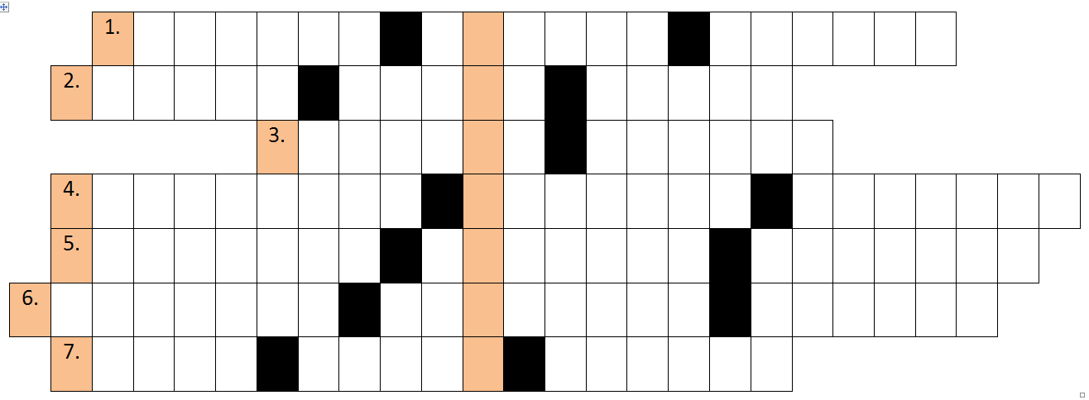
Solve the crossword
C
Y
S
T
I
S
O
V
A
R
I
I
D
E
X
T
R
I
F
O
S
S
A
V
E
N
A
E
C
A
V
A
E
L
O
B
U
L
I
T
E
S
T
I
S
S
T
E
N
O
S
I
S
V
E
S
I
C
A
E
F
E
L
L
E
A
E
E
X
C
I
S
I
O
T
U
M
O
R
I
S
B
E
N
I
G
N
I
S
A
N
A
T
I
O
V
U
L
N
E
R
I
S
L
A
C
E
R
I
M
O
R
S
I
N
T
R
A
P
A
R
T
U
M
The cyst of the right ovary
Fossa of the hollow vein
Small lobes of the testis
Narrowing of the gallbladder
5. Removal of the benign tumor
6. Healing of the torn wound
7. Death during the delivery

Slide 26
Select terms that belong to certain sense, translate
tactus  gustus  auditus  visus  olfactus
cartilago meatus acustici
labyrinthus osseus
caliculus gustatorius
nervus opticus
calcar sclerae
glandulae cutis
papilla foliata
musculus sphincter pupillae
terminationes nervorum
auris interna
pars olfactoria tunicae mucosae nasi
musculus tensor tympani
pili et capilli
pars caeca retinae
cortex et epithelium lentis
Notes:
Priradiť k jednotl. Zmyslovým orgánom, možno obmebiť pomocou slovička structura +

Slide 27
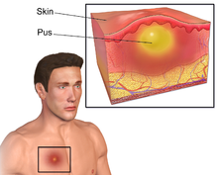
Abscessus
is a collection of pus that has built up within the tissue of the body, it may occur in any kind of solid tissue (lungs, brain, teeth, kidneys and tonsils), but most frequently appears on skin
abscessus (4x) abscessuum  abscessum abscessu  abscessibus
causae ________________
________________ ductus choledochi
excisio ________________ dolorosi ani
operatio meatus acustici sine ________________ secundario
________________ secundarii in vulneribus operativis
status post ________________ encephali
operatio propter ________________ tubarum uterinarum
gravida cum ________________ dentium
Notes:
Identifikujte pád a číslo

Slide 28
Find a suitable group of adjectives for each of the listed nouns
genu decubitus partus facies
usus status species pulsus
profundus, a, um dolorosus, a, um
tardus, a, um
durus, a, um
rarus, a, um
pallidus, a, um
Hippocraticus, a, um
gastricus, a, um
diaphragmaticus, a, um
aethylicus, a, um
epilepticus, a, um
asthmaticus, a, um
postoperativus, a, um
externus, a, um
internus, a, um
praematurus, a, um
complicatus, a, um
primus, a, um
dolorosus, a, um
maturus, a, um
aromaticus, a, um urologicus, a, um
antiasthmaticus, a, um
varus, a, um valgus, a, um
dexter, a, um
sinister, a, um

Slide 29
PUERPERIUM
PARTUS PRAEMATURUS
PARTUS MATURUS
PARTUS SEROTINUS
ABORTUS
Before the end of 28th week of pregnancy | Before the end of 38th week of pregnancy | Before the end of 42nd week of pregnancy | After the end of 42nd week of the pregnancy | During the 6-8 weeks after the delivery
Graviditas tubaria extrauterina l. dx., Interruptio★ graviditatis.
Haematoma vaginae post partum spontaneum★.
Funiculus umbilicalis★ circum abdomen fetus.
Ruptura parietis vaginae l. sin. intra partum, Sutura parietis.
Abortus propter defectum★ congenitum fetus.
Prolapsus pedum fetus in vaginam. Sectio caesarea acuta.
Metastases ovarii l. utr., Status post CA mammae l. sin., Prognosis mala
Psychosis puerperalis★ matris

Slide 30
Form phrases from words in boxes and translate them into English
cum et partus
anaesthesia
praematura
caesarea sectione
acutae cavitatem
haemorrhagiae
abdominis ad causa
sanatio lacteorum
cariebus
dentium cum
operationem status
propter femoris
lateris fracturam post cervicis dextri

Slide 31
Derive adjectives using endings
-alis, e or -aris, e
costa/ cost- + alis ⇢ costalis, e
femur / femor- + alis, e ⇢ femoralis, e
musculus/ muscul- + aris, e ⇢ muscularis, e
dorsum intestinum cervix labium
facies nasus pulmo viscera
apex digitus margo medulla
rectum orbita maxilla pectus
ren patella vagina tonsilla
sternum abdomen frons paries
superficies vestibulum spina bronchus

