Slide 1
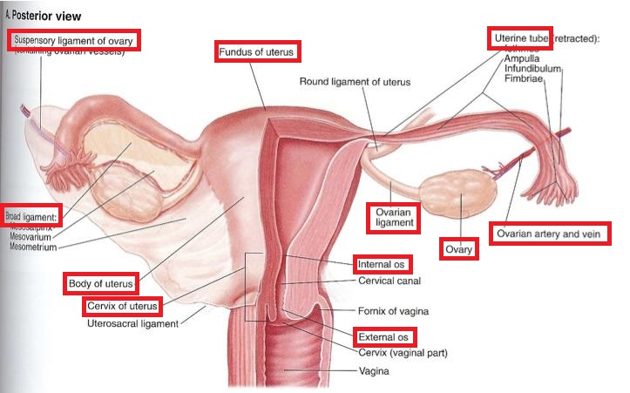
Translate the parts of female reproductive system marked in red

Slide 2
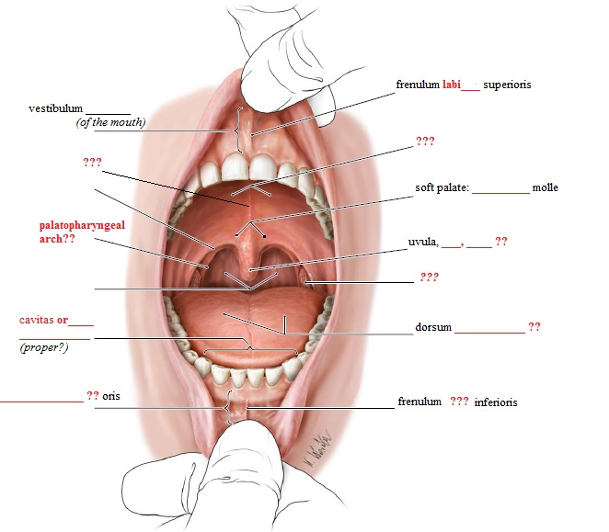
Fill in the missing medical terms

Slide 3
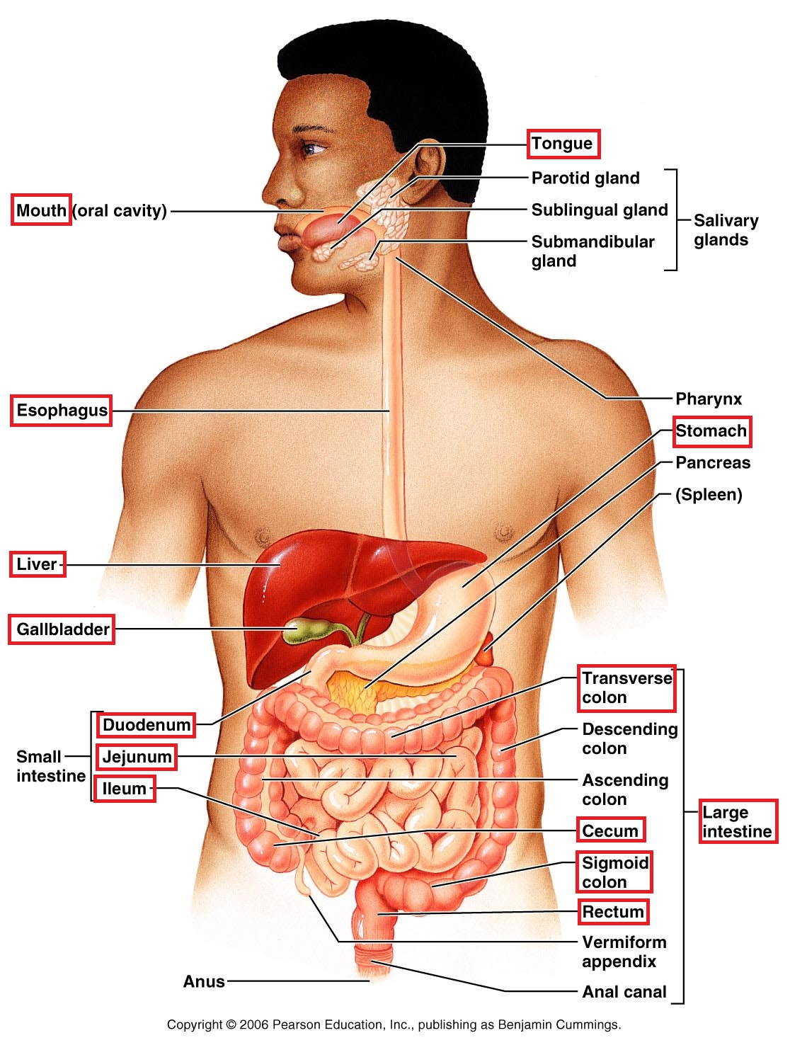
cancer of….?? treatment of the cancer of… state after treatment of the cancer of…

Slide 4
Revision
What are the examples of the 1st declension? What about their genders and genitive endings?
How many paradigms do we have in the 2nd declension? What are the differencies between them?
Can you see any regularities in the paradigms of neuters? Are there any endings which are the same for all words of 1st and 2nd declension?
What is the difference between adjectives liber and ruber?
How do we decline Latin adjectives?

Slide 5
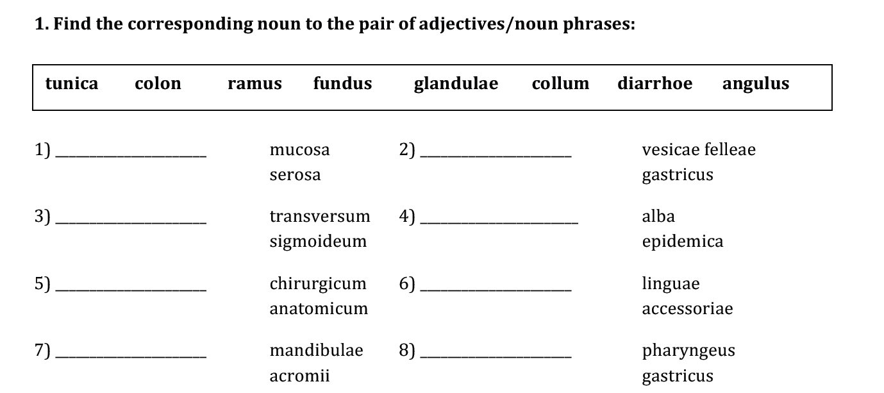
Choose fitting terms from the box

Slide 6
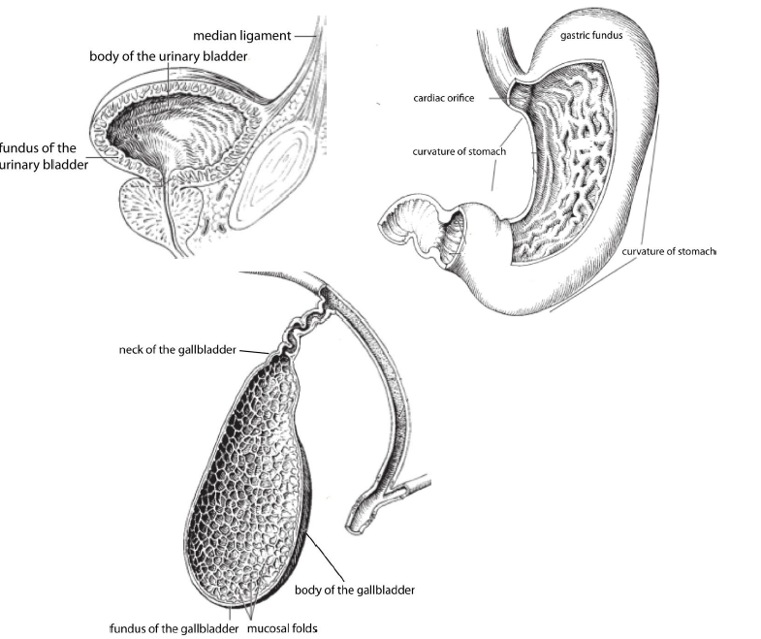
Name the structures in Latin

Slide 7
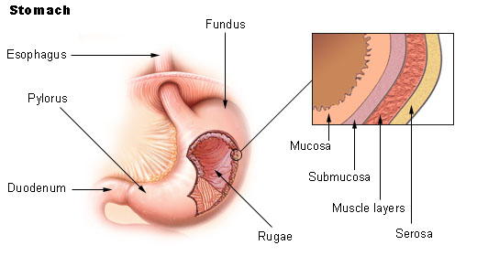
TUNICA MUCOSA ET SEROSA
MUCOSA: a membrane that lines various cavities in the body and surrounds internal organs; some mucous membranes secrete mucus, a thick protective fluid
SEROSA: a smooth tissue membrane consisting of two layers of mesothelium, which secrete lubricating serous fluid which reduces friction from muscle movement

Slide 8
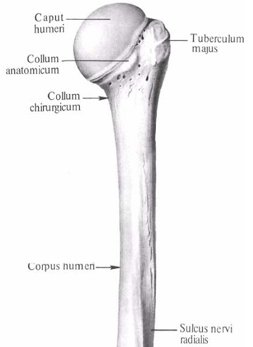
collum anatomicum
= site of epiphyseal fusion of a long bone, just below the head of bone
collum chirurgicum
= the part of bone which has a landmark near it important in surgeries (artery, vein, or a nerve), also a common site of injuries requiring surgery

Slide 9
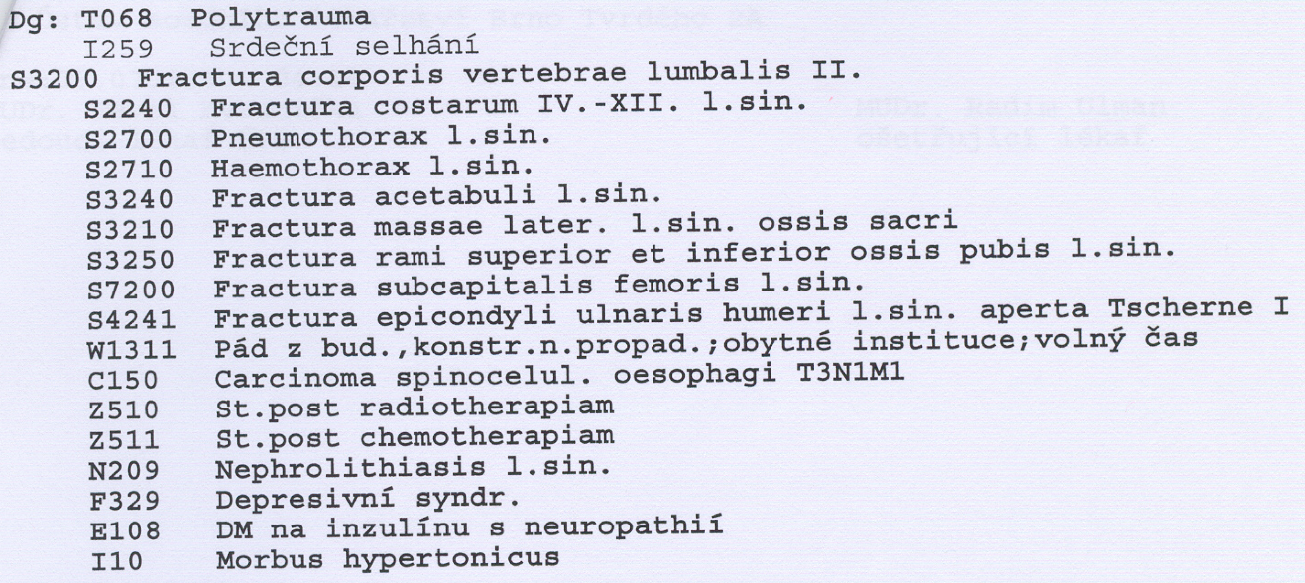
Structure of a medical diagnose
*TSCHERNE – systém of classification of soft tissue injuries: Tscherne I = skin lacerated by bone fragment. No or minimal contusion to the skin.

Slide 10
EXPRESSING THE SIDE IN CLINICAL DIAGNOSES
lateris dextri l.dx.
lateris sinistri l. sin.
lateris utriusque l. utr.
when speaking about pair organs/bones, we do not translate „lateris“
  fractura scapulae l.dx. fracture of the right shoulder blade
  If both sides are injured, we put the organ/bone in SINGULAR!
    vulnera contusa femoris l.utr. bruised injuries of both thighs
When speaking about regions of body, we translate „lateris“
vulnera lacera colli l. utr. torn wounds on both sides of neck
dolores abdominis l.dx. pains on the right side of abdomen

Slide 11
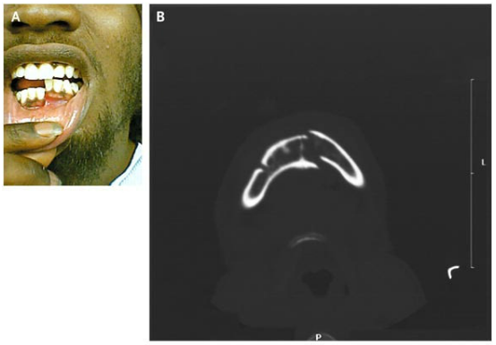
A 21-year-old man
presented after being
struck with a gun on
his right lower jaw.
Examination revealed
displacement of the
left half of his mandible with malocclusion on biting (Panel A). Computed tomography showed a fracture of the left mandible and a fracture of the right mandibular body and angle (Panel B). Given the U shape of the mandible, it is common for contralateral fractures to result from major injury. Intravenous analgesics and antibiotics were given; the patient underwent open reduction with internal fixation of his fractures.

