Slide 1
Motivational interviewing in
health care
Mgr. Tereza Knejzlíková

Slide 2
Contempt of presentation
part 8:00 - 8:50 Introduction and a Transtheoretical model of change
part 9- 9:50 Motivational interviewing - principles
part 10:00 - 11:00 Practice and conversations
lunch :D

Slide 3
Introduction
I really should…
I need to change it.
I think that I have a problem.
I need to do something with it.
Motivational interviewing (MI) is a therapeutic conversation about change that is non-confrontational and goal directed. Is uses a number a different strategies to arrange conversation such as way that patients vocalize their own motivational statements thus talk themselves into making change.
MI began to be tested with many different health problems, particularly chronic diseases, in which behavior change is key and patient motivational is common challenges. There have a positive trials of MI in the management of cardiovascular disease, diabetes, diet, hypertension, psychosis (treatment adherence), and pathological gambling, exercise and lifestyle changes.

Slide 4
Introduction
Adherence is obviously a major worry for a patient and family. In order to help, you have to build up a relationship of trust. If you have not got this, then someone is unlikely to be honest your if they are struggling. Instead, it is likely that they will tell you what they think you want to hear.
Good way to think about this is that you develop good contact and collaboration with your patient.

Slide 5
Introduction
Conversation about behavior change arise within a consultation whenever you or your patients are considering their doing something different in the interest of health. That “doing” might be taking a medication regularly, using a walker, flossing teeth, changing diet, exercising, and so on. It might also involve cutting down or quitting behaviors that are harmful to health: smoking, heavy drinking, drug abuse, overworking, or eating junk food.

Slide 6
Introduction
We know some myths about unmotivated patients:
We could think that - When a patient seems unmotivated to change or to take the advice of practitioners, it is often assumed that there is something to matter with the patient and that there is not much one can do about it. These assumptions are usually false. No person is completely unmotivated.
In opposite is attitude that - The way in which you talk with patients about their health can substantially influence their personal motivation for behavior change.

Slide 7
Introduction
Could you give me some examples where we can use a MI in medicine?
cardiovascular disease
blood pressure
obesity
decision making about treatment of cancer
adherence of treatment
decision making about gravidity interruption
diabetes
allergy
...

Slide 8
The Transtheoretical model of change
The transtheoretical model (TTM) of change in health psychology explains or predicts a person's success or failure in achieving a proposed behavior change, such as developing different habits. It attempts to answer why the change "stuck" or alternatively why the change was not made.

Slide 9
The Transtheoretical model of change
The transtheoretical model (TTM) has proven successful with a wide variety of simple and complex health behaviors, including smoking cessation, weight control, sunscreen use, reduction of dietary fat, exercise acquisition, quitting cocaine, mammography screening, and condom use (Prochaska, et al., 1994).

Slide 10
The Transtheoretical model of change
Based on more than two decades of research, the TTM has found that individuals move through a series of stages:
precontemplation (PC)
contemplation (C)
preparation (PR)
action (A)
maintenance (M)

Slide 11
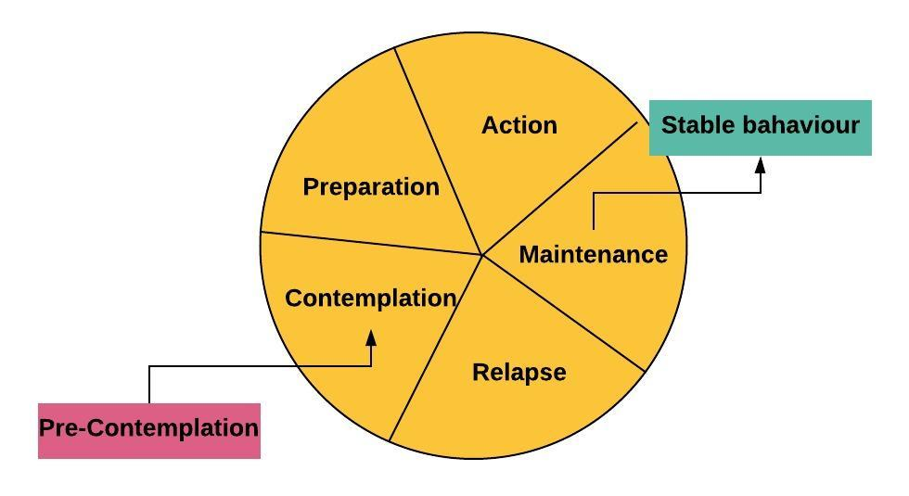

Slide 12
Precontemplation
Pre-Contemplation is the stage in which an individual has no intent to change behavior in the near future, usually measured as the next 6 months. Precontemplators are often characterized as resistant or unmotivated and tend to avoid information, discussion, or thought with regard to the targeted health behavior.
Benzodiazepines user:
“I have problem with my memory and attention. It is getting worse since the last year and I do not know why. Could you give me medication on this problem, please?”

Slide 13
Contemplation
Contemplation stage. Individuals in this stage openly state their intent to change within the next 6 months. They are more aware of the benefits of changing, but remain keenly aware of the costs. Contemplators are often seen as ambivalent to change or as procrastinators.
Ambivalent: Having two opposing feelings at the same time, or being uncertain about how you feel. Having mixed feelings or contradictory ideas about something or someone.

Slide 14
Preparation
Preparation is the stage in which individuals intend to take steps to change, usually within the next month (DiClemente et al., 1991). PR is viewed as a transition rather than stable stage, with individuals intending progress to A in the next 30 days.
How do we recognize that patient is going to a preparation stage?
he has more questions about his future
he is trying a new behavior or experimenting with old behavior
he is finding solutions in his problematic situation

Slide 15
Action
Action stage is one in which an individual has made overt, perceptible lifestyle modifications for fewer than 6 months.
for example:
Obese man started training with private fitness trainer and is regularly visiting his nutritional therapist.
Woman with diabetes II. type is successfully on a diet and regularly measures sugar level.

Slide 16
Maintenance
Maintenance: these are working to prevent relapse and consolidate gains secured during A (Prochaska et al., 1992). Maintainers are distinguishable from those in the A stage in that they report the highest levels of self-efficacy and are less frequently tempted to relapse.
Relapse we understand like predictable stage and not like pathological phenomen. We must be support for patient and we try to revitalis their internal resources.

Slide 17
After the patient's thyroid gland has been removed due to malignant carcinoma, she comes to the endocrinologist for follow-up examination. Blood test results indicate, that there is a problem with the patient's adherence of medication treatment. The patient downplays the presence of symptoms of deep hypothyroidism. At which stage of the transtheoretical model is the patient located now?
Pre-contemplation
Contemplation
Preparation
Action
Maintenance
Relapse

Slide 18
A patient with whom the doctor has met at regular intervals due to progressive diabetes comes exceptionally late, and does not make eye contact with the doctor. Initially, he does not answer questions, although the previous cooperation was excellent. During the care, the client managed to change his eating habits and started to measure sugar levels regularly. Today, however, it has a ragged impression, his results are poor. It looks like that he is ashamed, uncomfortable, repeatedly apologizes for his failure. At which stage of the transtheoretical model the patient is located now?
Pre-contemplation
Contemplation
Preparation
Action
Maintenance
Relapse

Slide 19
“On one hand, you are very worried that drinking affects your family and that it also affects your work. You were very surprised that two different friends told you in the same week that they were worried about you. But at the same time, you don't think you are an alcoholic, and you know that you can easily stop drinking for a whole week and it does not cause you any problems. It must be confusing...” doctor reacts on patients speech. At which stage of the transtheoretical model the patient is located now?
Pre-contemplation
Contemplation
Preparation
Action
Maintenance
Relapse

Slide 20
Motivational interviewing (MI)
MI is not a technique for tricking people into doing what they do not want to do. Rather, it is a skillful clinical style for eliciting from patients their own good motivations for making behavior changes in the interest of their health. It involves guiding more than directing, dancing rather than wrestling, listening at least as much as telling. The overall “spirit” has been described as:
Collaborative
Evocative
Honoring patient autonomy

Slide 21
Collaborating
A Cooperative and collaborative partnership between patient and doctor. Instead of an uneven power relationship in which the expert clinician directs the passive patient in what to do.
Evocative
Often health care seems to involve giving patients what they lack, be it medication, knowledge, insight, or skills. MI instead seeks to evoke from patients that which they already have.

Slide 22
Honoring patient autonomy
Clinicians may inform, advise, even warn, but ultimately it is the patient who decides what to do. To recognize and honor this autonomy is also a key element in facilitating health behavior change.

Slide 23
Which sentence is evocating?
I think that you need to eat more vegetables and to limit sugar.
My experience is that people who started with exercise have better results of their blood pressure. It would be very good if you start with exercise too.
What do you think about exercise? You should start with it.
Tell me something about solutions of your problem, which you tried. Was something effective? Do you have any idea, how you could help yourself? We can talk together about some solutions if you want.

Slide 24
A good guide will:
ASK where the person wants to do and get to know him of her a bit.
INFORM the person about options and see what makes sense to them.
LISTEN to and respect what the person wants to do and offer help accordingly.
A key to understanding process of change of behavior is knowing the phenomenon of ambivalence.

Slide 25
Ambivalence
“I need to lose some weight, but I hate exercising.”
“I want to get up, but it hurts.”
“I should quit smoking, but I just can’t seem to do it.” “I mean to take my medicine, but I keep forgetting.”
A telltale sign of ambivalence is the but in the middle.

Slide 26
Ambivalence
Perhaps your consultations sometimes seem to leave patients to- tally unmoved: “I’ve told him and told him, but he just won’t change.” How common this frustration is in health care! You explain over and over to patients what they need to do, how they could, why they should, and yet nothing happens. It is “righting reflex”.

Slide 27
Righting reflex
When you take a directing style with an ambivalent person, you are taking up one side of their own ambivalence— the pro-change side.
“Exercising and losing weight would decrease your risk of a heart attack.”
“It’s important for you to get out of bed and move around.” “I want you to stop smoking.”
“This medicine won’t help you if you don’t take it faithfully.”
How will be patients answer probably?

Slide 28
Righting reflex
Example:
PRACTITIONER: Well, if you did decide to exercise more, that would not only help your knee but also help you lose weight and improve your mood, you know. Exercise makes people slimmer, fitter, and feel better.
PATIENT: Yes, I know all that. But I can’t help thinking that if I exercise while my knee hurts, even with gentle things like swimming, that I am doing more damage to it, despite what you say about those studies you read. . . .

Slide 29
Listening for CHANGE TALK
Change talk:
When you are speaking with patient about behavior change, there are six themes you may hear, six different type of change talk.
When you hear change talk, you are doing it right. When you find yourself arguing for change and the patient defending status quo, you know you are off course.
Themes are: DESIRE, ABILITY, REASONS, NEED, COMMITMENT, TAKING STEPS

Slide 30
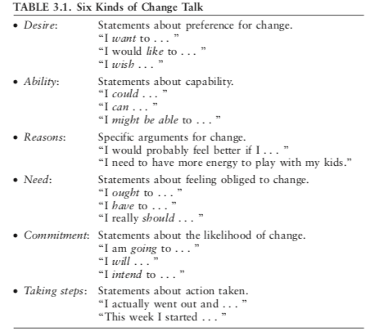
Ambivalence often involves conflict among these four motivational themes: desire, ability, reasons, and need.
“I really should (need) but I can't (ability)”
“I want to (desire) but it hurts (reasons).”
DARN - desire, ability, reasons, need

Slide 31
Reactions, which are counterproductive:
Statements such as these can trigger some skepticism:
“Yes, but did you read it?” [the book on aerobics]
“Well, are you using them?” [the condoms]
“February—the shortest month!” [not eating meat]

Slide 32
How we can ask for DARN?
“Why would you want to quit smoking [desire]?”
“How would you do it, if you decided to [ability]?”
“What for you are the three best reasons for quitting [reasons]?”
“How important is it for you to quit [need]?”

Slide 33
Asking
Closed and Open questions
Which type of questions is it?
“Where does it hurt?”
“Has your daughter had a fever?”
“Have you been taking your medication?”
“When you do drink, how many drinks do you normally have?”
“Does it seem worse in the morning or in the evening?”

Slide 34
Asking
When you ask open questions, you give your patient more active involvement in and influence over the course of the consultation. Open questions also allow patients to tell you things that you have not asked about but that are potentially important. In addition, asking open questions can give you a chance to catch your breath, to stop, look, and listen.
Open questions are those to which there is not an obvious short answer. They invite the person to offer their own experiences and perceptions.

Slide 35
Asking
“In what ways has this interfered with your life?”
“Tell me about a typical day when you drink.”
“Tell me about your headache.”
“Before we begin the exam, what are the things that concern you most today?”
“How are things going in your family?”
“What are you most worried about?”

Slide 36
Example:
There were more closed questions than open ones in the first example.
Patient was more passive in the first example.
Some closed questions are redundant in first example.
Practitioner are evoking change talk in second example.

Slide 37
Few examples of useful questions
1. “What’s worrying you most today about this illness?”
2. “What concerns you most about these medicines?”
3. “What exactly happens when you get that pain?”
4. “What did you first notice about your child’s condition?”
5. “Tell me more about. . . .”
An open question is an invitation. “May I ask you . . . ?”

Slide 38
Good questions for work with ambivalence
Asking about the pros and cons provides you with a set of key guiding questions that are particularly useful if someone seems uncertain about change. This gives you the opportunity to explore ambivalence. It gives the patient time to come face-to-face with uncertainty in an accepting atmosphere in which his or her inner motivations are free to surface.
“What do you like about smoking? And what’s the downside for you? What are the not-so-good things about smoking?”
Could you tell me something about pros and cons your eating habits, please?

Slide 39
After these phases it is important to ask about NEXT STEP in reality, or only hypothetical, if i feel that patient is not ready to change.

Slide 40
“WHAT NEXT” (in reality)
“So what do you make of all of this now?”
“So what are you thinking about smoking at this point?” “What do you think you’ll do?”
“What would be a first step for you?”
“What, if anything, do you plan to do?”
“What do you intend to do?”
…..When, What, How...

Slide 41
“WHAT NEXT”
“What might it take for you to make a decision to ______?”
“If you did make a change in __________, what might be some of the benefits?”
“Suppose that you did decide to _____________. How would you go about it in order to succeed?”
“Let’s imagine for a moment that you did ____________. How would your life be different?”
“How would you like things to be different?”
“Suppose you continue on without making any change in ___________. What do you think might happen in 5 years?”

Slide 42
3. Useful skill is REFLECTING
Reflecting is specific type of listening and reaction on patients words.
Each reflection is a short summary of what is happening at that moment.
The practitioner forms a hypothesis about what the patient means so as to be able to say it back in somewhat different word. The patient either confirms or discomfirms the hypothesis.

Slide 43
Examples:

Slide 44
Practice part:
Listening listening and encouragement
Change talk Emphasizing choice and autonomy
Empathic statement Reflective listening
Informing Asking for commitment
Open question Information exchange: Provide/Elicit
Defensive Offering a short summary
Question gives permission inform Agenda setting

