Slide 1
PARASYMPATHETIC
NERVOUS SYSTEM

Slide 2
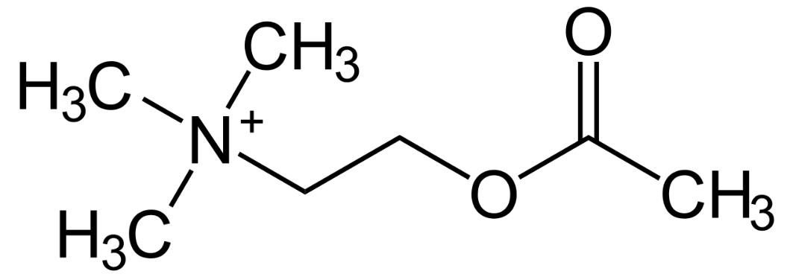
Cholinergic drugs elicit their effect:
via the parasympathetic synapses of effector organs
via synapses of the autonomic nerve ganglia
3) via synapses of neuromuscular junctions
4) via synapses in CNS
- influence synapses, where acetylcholine (ACh) acts
as their neurotransmitter

Slide 3
Cholinergic nervous system
- pharmacological interventions
acetylcholine analog.
⊝Θ
cholinotropics
Θ
cholinomimetics
ACHE inhibitors
cholinolytics
direct
indirect
indirect
direct
N_{N}
M
N_{N}
M
ganglioplegics
parasympatholytics
parasympathomimetics
gangliomimetics
muscle relaxants
N_{M}

Slide 4
Terminology:
Cholinomimetics - ↑ activity at cholinergic synapses
  direct – ACh and its analogues
  they imitate ACh effects on M and N receptors
  indirect - ACHE inhibitors
  always non-selective
        short-term effect - edrophonium
        intermediate and long-term effect - carbamates („stigmins“)
        very long effect - organophosphates
Parasympathomimetics - they imitate ACh effect on M rc.
  direct (mostly non-selective effect)
  stimulatory agents selective to M receptors for ACh

Slide 5
Terminology:
Cholinolytics
- direct:
- agents blocking acetylcholine receptors
  Parasympatholytics - M receptor blockers
  - without any effect on nicotinic receptors
  Ganglioplegics - N_{N}-receptor blockers
  Peripheral muscle relaxants (non-depolarizing) –
  - N_{M}-receptor blockers
- indirect: e.g. presynaptic inhibition of ACh release

Slide 6
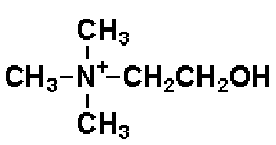
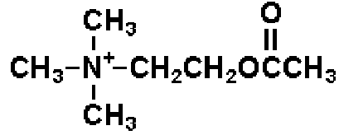
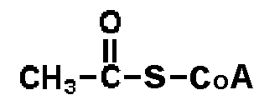
Acetylcholine synthesis
choline in a lecithin form is a dietary supplement
lecithin acts as a precursor to ACh
+
acetyl CoA
choline
choline acetyltransferase (CHAT)
acetylcholine (ACh)

Slide 7
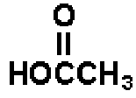
Acetylcholine degradation
hydrolysis
acetylcholinesterase
(ACHE)
acetylcholine
+
choline
acetate

Slide 8
Cholinotropic agents
- according to the chemical structure we distinguish:
  agents with quaternary ammonium cation
  quaternary amines, e.g. muscarine
  with low GIT absorption (they do not cross BBB)
  tertiary amines, e.g. natural alkaloids
  (nicotine, physostigmine)

Slide 9
Cholinomimetics - cholinergic agonists
- pharmacological effects:
CVS - negative chronotropic effect
- heart depression
- generalized vasodilation
GIT - increased motility of smooth muscles
respiratory tract - bronchoconstriction
↑ bronchial secretion
eye - miosis, ↓ intraocular pressure
↑ lacrimation
↑ sweating, ↑ salivation
CNS - tremor, increased locomotion

Slide 10
Acetylcholine and its analogues
acetylcholine
rapid biodegradation by ACHE → not used in clinics
5-20 s effect after i.v. administration
limited absorption after oral / s.c. administration
does not penetrate BBB
- other choline esters:
carbachol
poor absorption from GIT
agonist of M and N Rc
not hydrolyzed by cholinesterase → long duration of action
I: ophthalmology - miosis
cevimeline
selective M agonist - parasympathomimetic
I: xerostomia (dry mouth), Sjögren’s syndrome

Slide 11
Acetylcholine and its analogues
↑ postganglionic neuronal activity
↑ neuromuscular signal transduction
↑ activity of parasympathetic effectors
↑ sympathetic stimulation of sweat glands
- pharmacological effects:
  ↓ BP, bradycardia, danger of heart arrest
  nauzea, cough, dyspnoe
  vascular dilation: NO release
  salivation, lacrimation, ↑ mucosal gland secretion
  excessive sweating

Slide 12
Cholinomimetics - natural alkaloids
pilocarpine (Pilocarpus)
non-selective M receptor agonist
good absorption from GIT
BBB crossing (→CNS excitation)
stimulates gland secretion
stimulates m. sphincter pupilae (eyedrops)
I: miotic agent used in ophthalmology 2-4%, Sjögren's syndrome
muscarine (Inocybe, Clitocybe, Amanita muscaria/phalloides)
M receptor agonist, quaternary amine
arecoline (Areca catechu)
CNS stimulant, tertiary amine
M and N receptor agonist

Slide 13
Indirect cholinomimetics
ACHE inhibitors
short-term
(REVERSIBLE)
long-term
(IRREVERSIBLE)
competitive
enzyme inhibition
complex
inhibitor + enzyme
COVALENT INHIBITION
medicinal use
toxicology

Slide 14
Indirect cholinomimetic agents
Reversible ACHE inhibitors
General indications:
      glaucoma
      GIT atony
      urinary retention
      antidotes of non-depolarizing muscle relaxants
      myasthenia gravis (use quaternary amines)
      Alzheimer‘s disease (use tertiary amines)
      intoxication with organophosphates
      poisoning associated with the central anticholinergic syndrome (atropine)

Slide 15
Indirect cholinomimetic agents
Reversible ACHE inhibitors
Side effects:
  miosis
  increased glandular secretion
  nausea, diarrhea
  heart depressants (negative chronotropic effect)
  CNS – stimulation followed by depression
  neuromuscular junction - fasciculation and twitching (overdose - depolarization blockade)
  overdosing = cholinergic crisis – depolarization blockade - muscle paralysis

Slide 16
Indirect cholinomimetics
Reversible ACHE inhibitors
neostigmine, (edrophonium)
short-term effect
I: diagnosis of myasthenia gravis
„decurarization“, antidotes of competitive muscle relaxants
pyridostigmine, ambenonium
longer effect than neostigmine, slower onset of action
weaker muscarinic effect - less GIT side effects
I: myasthenia gravis
distigmine
long-acting reversible ACHE inhibitor
I: myasthenia gravis, atonic the urinary bladder, uterine atony, postoperative GIT atony, paralytic ileus

Slide 17
Indirect cholinomimetics
Reversible ACHE inhibitors
- CNS effects of drugs, that can cross the blood-brain barrier
physostigmine
I: antidote in acute intoxications with central anticholinergic syndrome
galantamine, rivastigmine, donepezil
I: dementias of the Alzheimer´s type
galantamine has a positive allosteric effect
on ACh binding on N rec.

Slide 18
Indirect cholinomimetics
Irreversible ACHE inhibitors
- effects: nausea, vomitus, sweating, CVS collapse,
breath depression, fasciculation and twitching → muscle paralysis, CNS convulsions
- agents: organophosphates
insecticides (malathion, parathion)
chemical weapons such as nerve gas sarin or VX, soman, tabun
- their antidotes: obidoxime, trimedoxime, pralidoxime

Slide 19
Indirect cholinomimetics
Irreversible ACHE inhibitors
Therapy of organophosphate itoxication:
1. reduce further neurotoxine absorption
2. mechanical ventilation
3. atropine i.v. in high doses 2 mg every 5 min until a slight overdose (in mass-casualty settings s.c.)
4. ACHE reactivators : obidoxime, (pralidoxime)
      5. therapy of muscle convulsions i.v. benzodiazepines
      6. high doses of reversible ACHE inhibitors
      7. bioscavengers

Slide 20
Parasympatholytics
tertiary amines
quaternary amines
blockade of M >N receptors
blockade of M receptors
atropine
scopolamine
tropicamide, cyklopentolate
oxybutynine
tolterodine, fesoterodine
solifenacin, darifenacin
procyklidine, biperiden
(pirenzepine, telenzepine) (homatropine)
butylscopolamine
phenpiverine, propiverine
otilonium, glycopyrrolate
ipratropium, tiotropium
aclidinium, umeclidinium
trospium
(oxyfenonium),(poldin)

Slide 21
Parasympatholytics
direct antimuscarinic agents
General indications:
spasmolytics
bronchodilating agents
antiarrhythmics
mydriatics
premedication prior to GA
antiemetics
antiparkinson agents
antidotes of pilocarpine, ACHEI poisoning (physostigmine)

Slide 22
Parasympatholytics
direct antimuscarinic agents
Side effects:
dry mouth (xerostomia)
dry eyes (xerophthalmia)
loss of accommodation (cycloplegia)
heart palpitations
constipation
urinary retention
CNS: seizures, severe dyskinesias, hallucinations, agitated delirium, respiratory depression, coma

Slide 23
PL with tertiary N
atropine, tropicamide, cyclopentolate, homatropine
mydriasis (stimulation of m. sphincter pupilae)
cycloplegia (paralysis of the ciliary muscle of the eye)
I: for diagnostic and therapeutic mydriasis
scopolamine (hyoscine) TTS, supp.
I: therapy of kinetosis, CNS depression
oxybutinine
orally, TTS
pharmacokinetics: high 1st pass effect
I: antispasmodic agent used for overactive urine bladder

Slide 24
PL with tertiary N
Selective parasympatholytics:
darinefacin, solifenacin
M₃ uroselective antagonists
I: symptomatic therapy of overactive urinary bladder
(pirenzepine)
gastric M1 receptor selective antagonist
former indication: gastroduodenal ulcers

Slide 25
PL with quaternary N
- do not cross BBB (blood-brain barrier)
spasmolytics for functional bowel disorders: otilonium
N-butylscopolamine
phenpiverine (oxyphenonium),(poldin)
urinary antispasmodic for hyperactive urinary bladder: trospium
bronchodilator agents: ipratropium (SAMA) tiotropium, aclidinium
                glycopyrrolate, umeclidinium
(LAMA)
* long acting muscarinic antagonists (LAMA)
short acting muscarinic antagonists (SAMA)

Slide 26
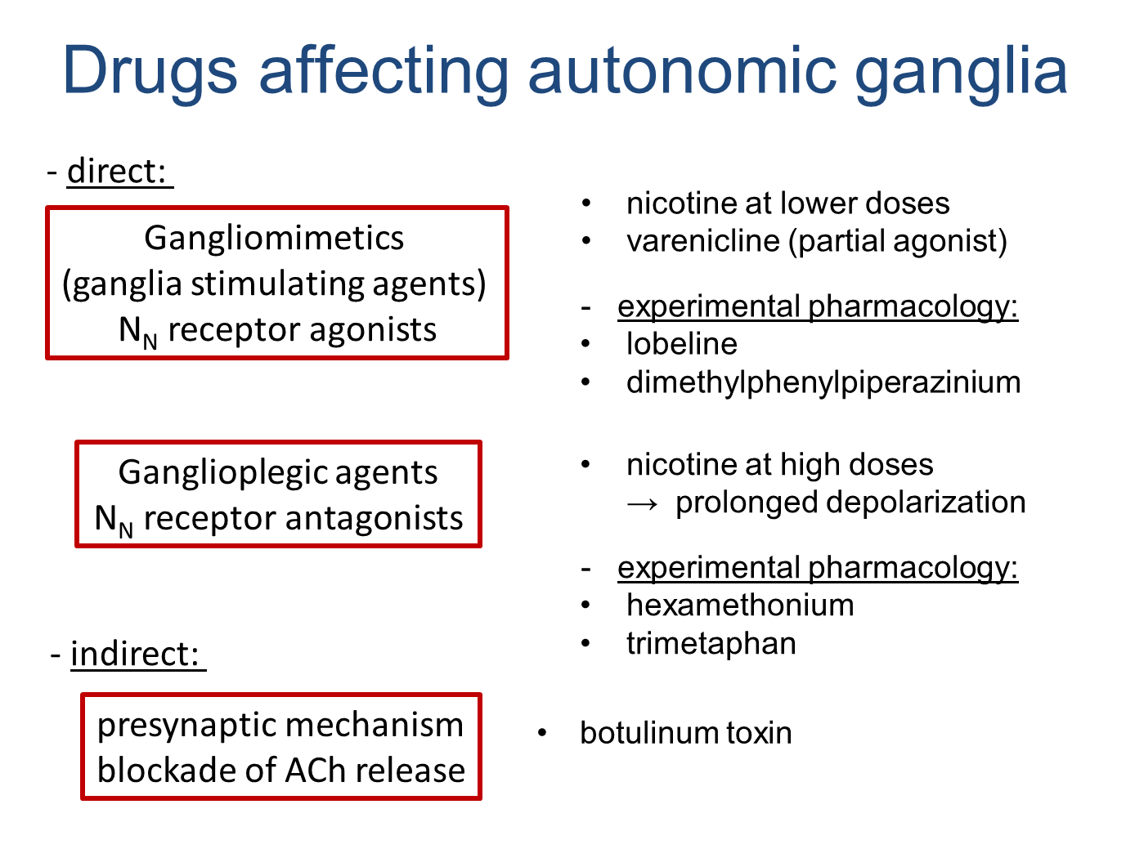

Slide 27
Skeletal muscle relaxants
1. Centraly acting
2. Peripheral effect on neuromuscular junctions
nondepolarizing depolarizing
- N_{M} antagonists - N_{M} agonists
- antag. by ACHEI - decamethonium
- tubocurarine - suxamethonium
- mivacurium
- atracurium, cisatracurium
- rocuronium, pipecuronium
- (pancuronium, vecuronium)
indirect muscle relaxants: dantrolene, botulinum toxin
Notes:
decamethonium - not registered

